Slide 1

EDA REAL ESTATE IN METROPOLITAN CITIES
by
S.Dhipesh Kumar,
M.Bhavana

Slide 2
About us
S.Dhipesh Kumar
Batch no: 213
Educational background: b.Tech (cse)
I'm very passionate about M.L and I would like start my career in Data Science filed to achieve my goals.
M.Bhavana
Batch no: 213
Educational background: m.arch
I would like to upgrade my career. A.I is ruling the world I'm interested to restart my career as Data Scientist.
Work Experience - 3 yrs

Slide 3
Problem statement:
Analyzing the prices in real estate according to the location, transactions and status.
Objective of the project : Market values of flats, villas and independent houses in metropolitan cities.
Limitation : Project is limited to particular metropolitan cities
i.e. Hyderabad, Mumbai, Bangalore, Chennai, Pune, Kolkata
Web Scraping – magicbricks.com
Processor used – Beautiful Soup is used to extract Data from magicbricks.com

Slide 4
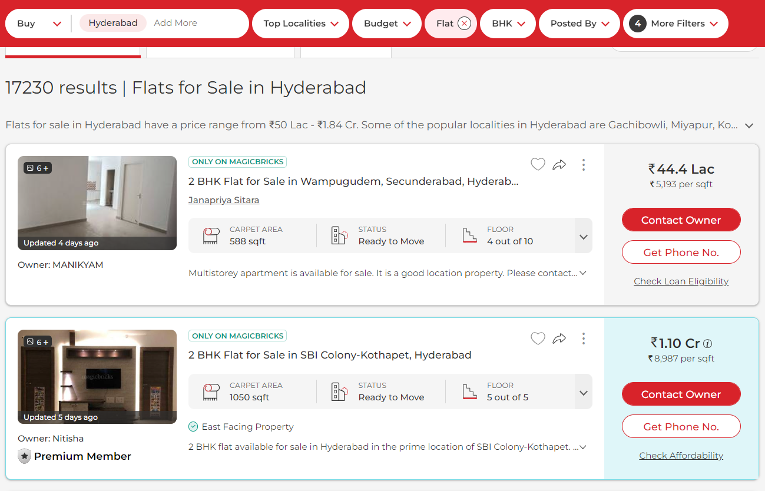
Website of magic bricks
It is a scroll down
website and gets
updated for
every 24hrs

Slide 5
Process of Web Scrapping
Source of the data is from magicbricks.com
As the status code is 200 we used processor such as Beautiful Soup to extract data from magicbricks.com
To complete this analysis we used Libraries/Technologies such as python, pandas, requests, Re, Beautiful Soup
Extracted data stored in a structured format as a spreadsheet for further analysis.
Process of Data Cleaning
Identifying the missing values in raw data and removing it is more required for data collection
Identifying the duplicates and result is zero
Data Manuplating
Identifying the special characters and removing it
Converting the data types from object to integer and float
Creating Dataframe:
Converting the scrapped data into data frame using pandas
Exporting the dataframe into .CSV format

Slide 6
Summary of the Data
Data collected -1800 rows & 10 columns for 6 cities,
- - Missing values : 281 & duplicates : 3
- - After data cleaning 1516 rows & 10 columns,
The dataset contains real estate properties for 6 cities considering
Type of building,
Type of BHK,
Area,
Location,
Price per sqft,
Status,
Transaction,
Furnishing
Price.
Dataset consists of 4 numerical data & 6 categorical data
Uni- variate Analysis : 9
Bi- variate Analysis : 11

Slide 7
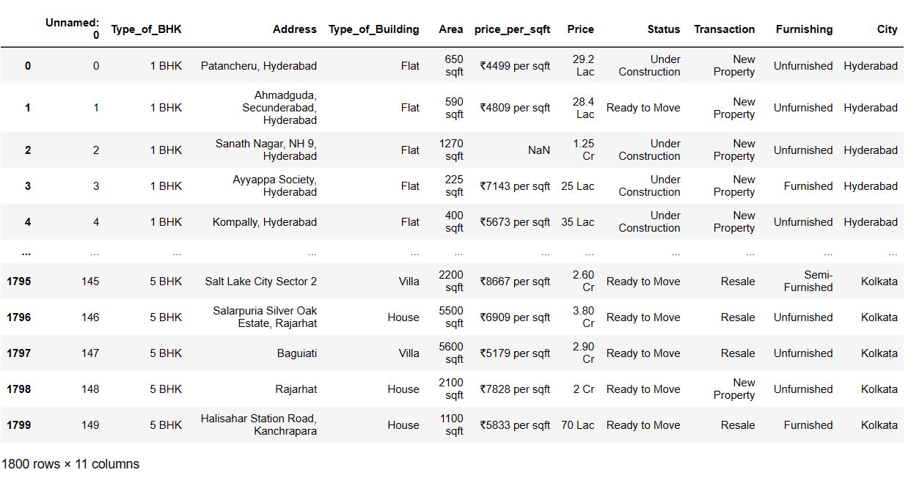
Data frame of Raw Data

Slide 8
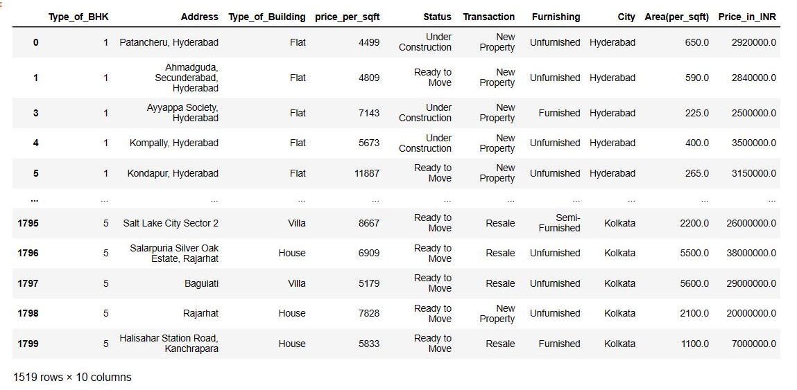
Data frame after cleaning

Slide 9
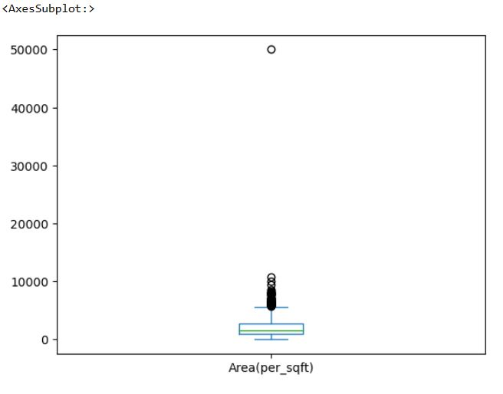
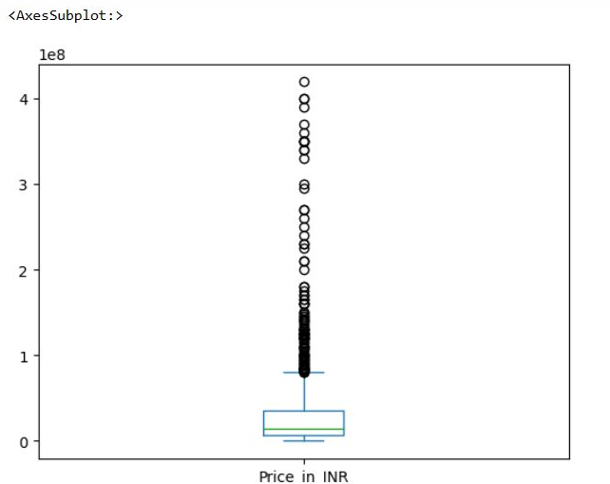
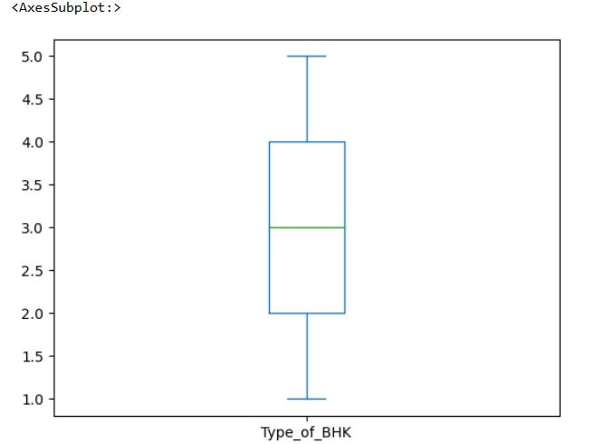
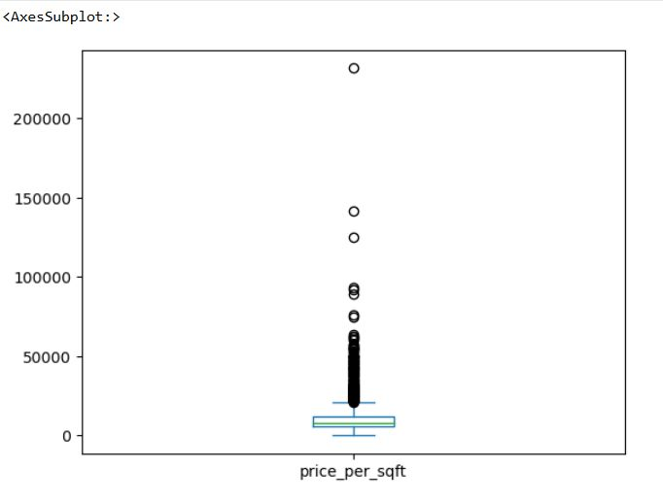
Data Manuplating
Identifying the Outliers
It is irrelevant to remove outliers to this project as market price varies according to the area and location

Slide 10
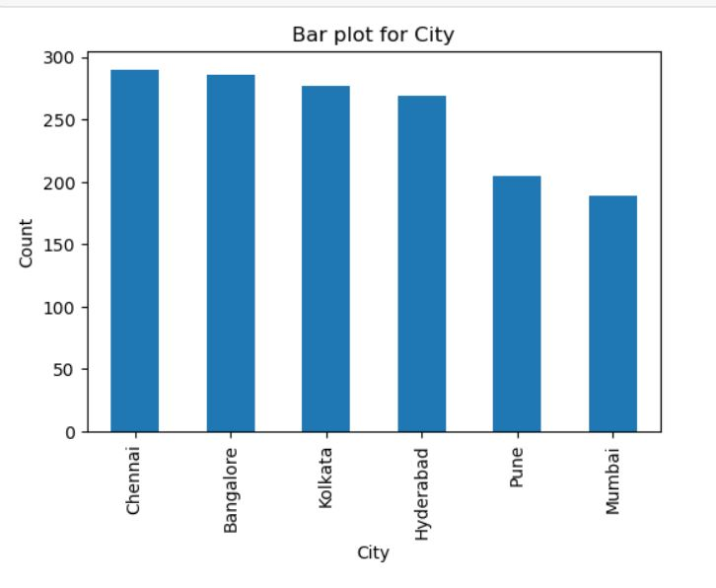
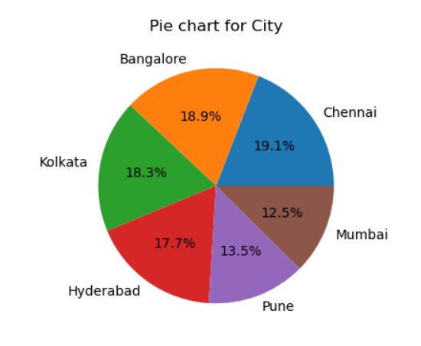
City vs count
Uni-variate Analysis:
As it is Categorical data, used bar plot & pie chart
Data availability of each city

Slide 11
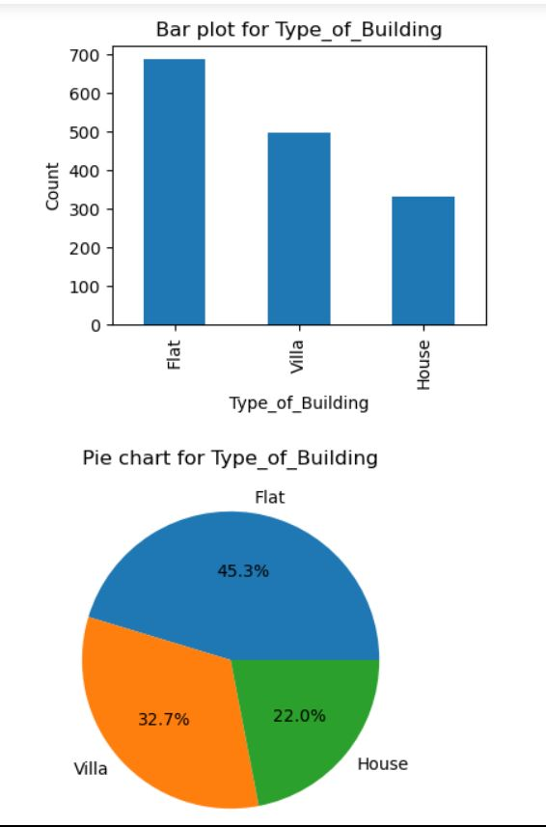
Type of building vs count
Uni-variate Analysis:
As it is Categorical data, used bar plot & pie chart
Insights : flats occupy more space in real estate, then comes villa and houses

Slide 12
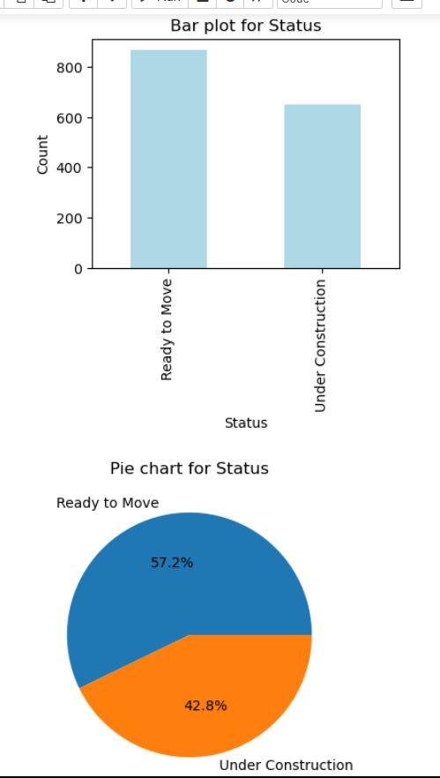
City vs count
Uni-variate Analysis:
As it is Categorical data, used bar plot & pie chart
Insights : Ready to move are more in ratio than under construction in all cities

Slide 13
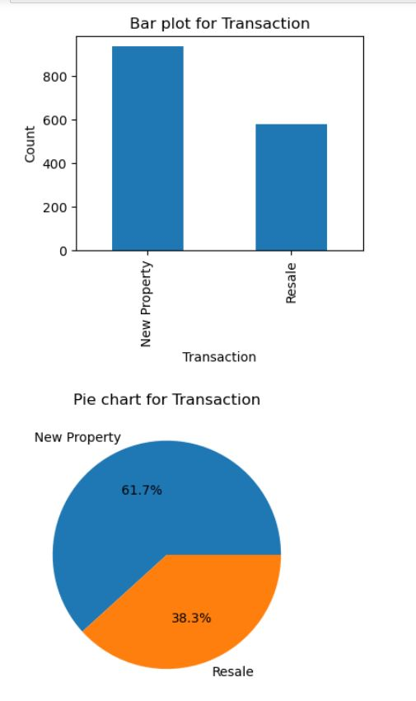
City vs count
Uni-variate Analysis:
As it is Categorical data, used bar plot & pie chart
Insights : New property are more in ratio than resale in all cities

Slide 14
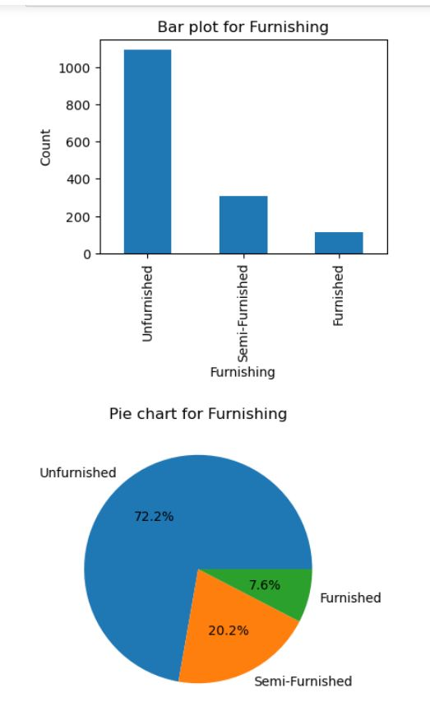
Uni-variate Analysis:
As it is Categorical data, used bar plot & pie chart
Insights : Real estate is good in unfurnished followed by semi furnished and furnished

Slide 15
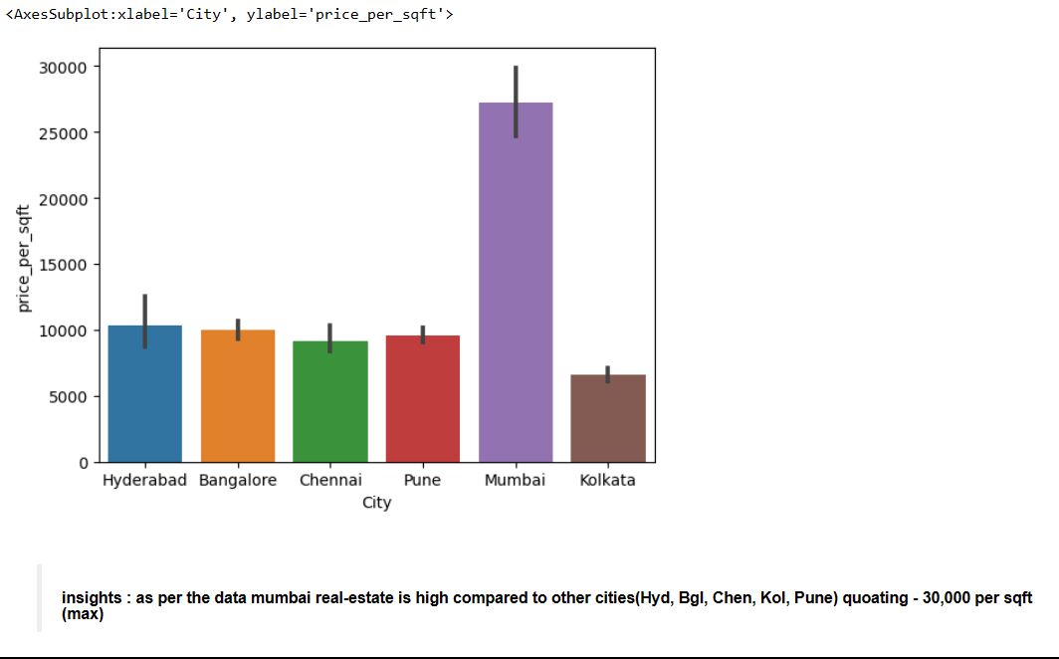
Bi-variate Analysis:
As it is Categorical data & numerical data used bar plot
Insights : Real estate is high in Mumbai followed by Hyderabad, Bangalore, Pune, Chennai and Kolkata
Quotation of price is 30,000 per sft at maximum

Slide 16
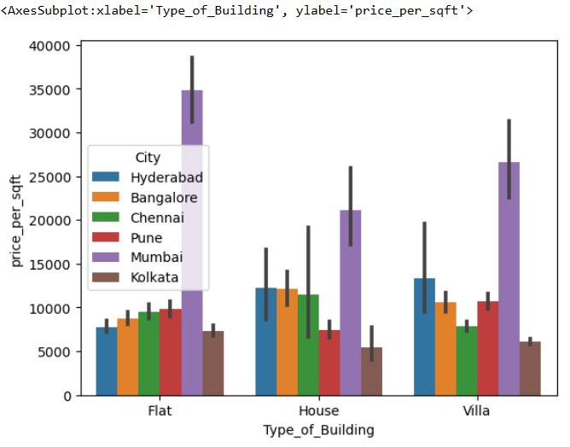
Bi-variate Analysis:
As it is Categorical data & numerical data used bar plot
Insights : city vise distribution of types of building comparing with price per sft.
Mumbai goes first in all types of building followed by hyd, Bangalore, Chennai, Pune and Kolkata

Slide 17
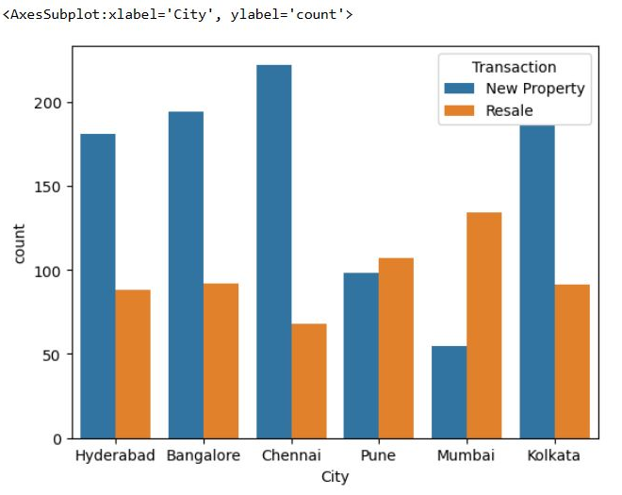
Bi-variate Analysis:
As it is Categorical data & Categorical data used Count plot
Insights : city vise distribution of new property and resale list, where Chennai goes first in new property
Followed by Bangalore, hyd, Kolkata, Pune and Mumbai is least in new property
Mumbai stands first in resale property then followed by Pune, bang lore, Kolkata, hyd, Chennai

Slide 18
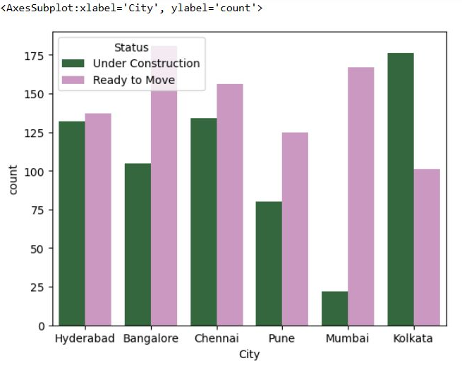
Bi-variate Analysis:
As it is Categorical data & Categorical data used Count plot
Insights : city vise distribution of status (ready to move n under construction)
Ready to Move:- Bangalore has more no.of ready to move properties, followed by Mumbai, Chennai, hyd, pune, Kolkata
Under Constructions:- Kolkata has more no.of under construction properties, followed by hyd, Chennai, pune.

Slide 19
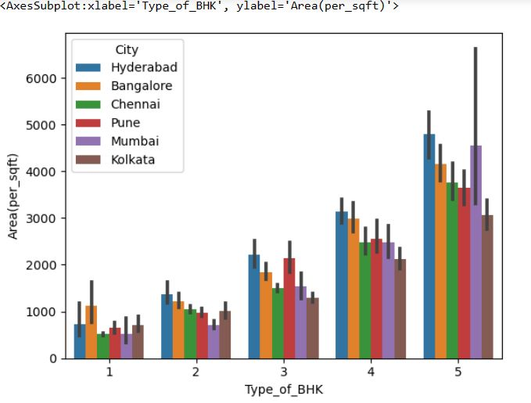
Bi-variate Analysis:
As it is Categorical data & numerical data used bar plot
Insights : Comparision of Average area distribution of each type of BHK’s i.e 1bhk, 2bhk, 3bhk, 4bhk, 5bhk with cities
1bhk :- Bangalore occupies more area followed by hyd, Kolkata, pune, Chennai, Mumbai
2bhk:- hyd occupies more area followed by Bangalore, Chennai, pune, Kolkata, Mumbai
3bhk:- hyd & pune occupies more area followed by Bangalore, Chennai & Mumbai, Kolkata
4bhk:- hyd occupies more area followed by Bangalore, pune, Chennai & Mumbai, Kolkata.
5bhk:- hyd occupies more area followed by Mumbai, Bangalore, Chennai, pune, Kolkata.

Slide 20
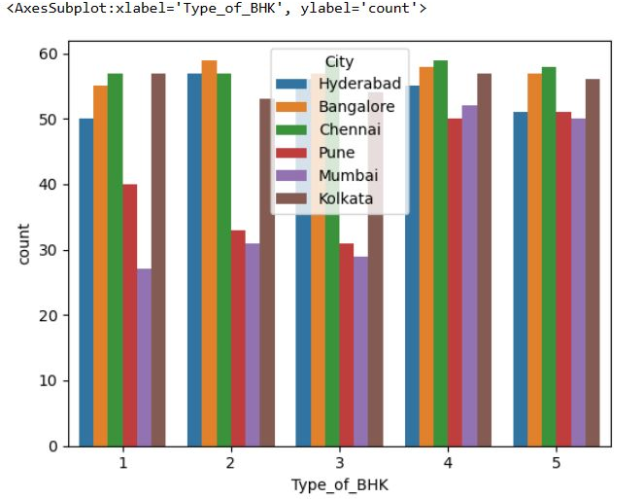
Bi-variate Analysis:
As it is Categorical data & numerical data used Count plot.
Count of Type_of_BHK in city i.e 1bhk, 2bhk, 3bhk, 4bhk, 5bhk with cities Mumbai, Chennai, Hyd, Pune, Kolkata, Bangalore.

Slide 21
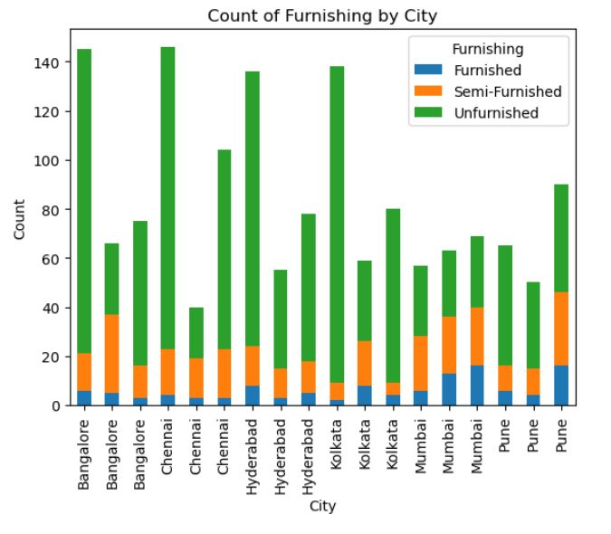
Bi-variate Analysis:
As it is Categorical data & Categorical data used Stacked Bar plot
Insights: Furnishing detail's for each city's flats, villas, houses.
Real estate for Unfurnished flats, villa, houses are higher than semi furnished and furnished

Slide 22
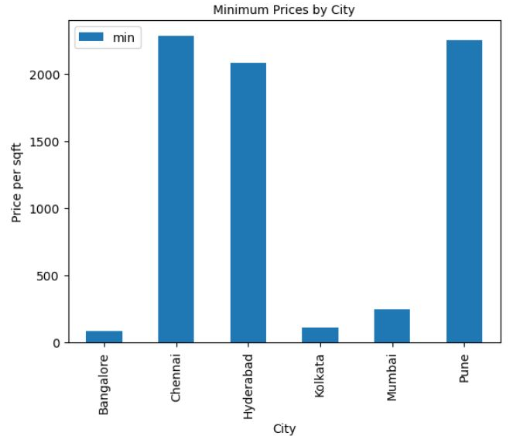
Bi-variate Analysis:
As it is Categorical data & numerical data used bar plot
Insights: Minimum price per sqft is in Bangalore, Kolkata, Mumbai, hyd, pune, Chennai.

Slide 23
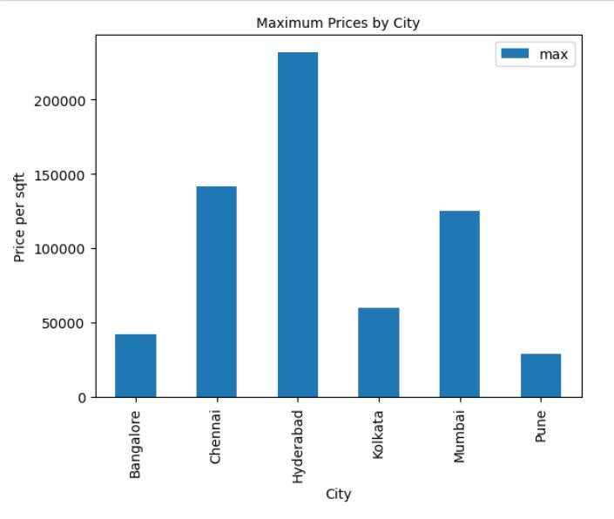
Bi-variate Analysis:
As it is Categorical data & numerical data used bar plot
Insights: Maximum price per sft is in Hyderabad, Chennai, Mumbai, Kolkata, Bangalore, pune.

Slide 24
Conclusion:
Real estate is high in Mumbai followed by Hyderabad, Bangalore, Pune, Chennai and Kolkata
- Quotation of price is 30,000 per sft at maximum in Mumbai
City vise distribution of types of building comparing with price per sft.
-Mumbai goes first in all types of building followed by hyderabad, Bangalore, Chennai,
Pune and Kolkata
City vise distribution of new property and resale list
- Chennai goes first in new property followed by Bangalore, hyd, Kolkata, Pune and Mumbai is least in new property
- Mumbai stands first in resale property then followed by Pune, bang lore, Kolkata, hyd, Chennai
City vise distribution of status (ready to move and under construction)
- Ready to Move:- Bangalore has more no.of ready to move properties, followed by Mumbai, Chennai, hyd, pune, Kolkata
- Under Constructions:- Kolkata has more no.of under construction properties, followed by hyd, Chennai, pune.
Real estate for Unfurnished flats, villa, houses are higher than semi furnished and furnished

Slide 25

THANK YOU

