Slide 1
MUDABlue: An Automatic Categorization System for Open Source Repositories
Shinji Kawaguchi†, Pankaj K. Garg††,
Makoto Matsushita†, Katsuro Inoue†
† Osaka University, Japan
†† Zee Source, USA

Slide 2
Software Repository
“Software repository” archives many software systems with their source codes
It is very common in these years
  In open source community
    Provide platforms for many open source projects
    E.g. SourceForge (http://sourceforge.net/)
  In industrial context
    Archive software systems created in a company
    To share information about projects that exist (or existed) in the company
    Useful especially for large and distributed organization
    E.g. Corporate Source*, Progressive Open Source**
*J. Dinkelacker and P. Garg. Corporate Source: “Applying Open Source Concepts to a Corporate Environment (Position Paper)“.
In Proceedings of the 1st ICSE International Workshop on Open Source Software Engineering, May 15, 2001, Toronto, Canada.
**J. Dinkelacker, P. Garg, D. Nelson, and R. Miller. “Progressive Open Source”.
In Proceedings of the International Conference on Software Engineering, Orlando, Florida, 2002.

Slide 3
Background
Software repository is also used for...
  finding a software system which fills a demand
  finding source codes related to currently developing products.
Generally, there are many software systems in a repository.
  SourceForge hosted nearly 100,000 projects
Categorization is essential for software finding
At present, software systems are categorized manually.
  A manager of a repository makes a hierarchical category structure.
  A software developer choose an adequate category for a software.
Notes:
There are many software systems in a software repository, so
...
Because of its massiveness,
(Categorization is essential for software finding.)

Slide 4
Problem
Inflexible and exclusive classification
  Generally, software systems are categorized by uses of a software system.
  Classification by depending library or architecture also valuable for users.
A software system has various aspects
Making a hierarchical category structure requires a huge amount of work.
  To make it better, comprehensive knowledge about various libraries and architectures is needed.
A repository manager’s load becomes high
Notes:
単一のビューのみを提供
断定的すぎる
ソフトウェアの持つ多様性を無視している
ソフトウェアの特性を歪めている

Slide 5
Nonexclusive categorization
regexp
Software 1
Software 3
Editor
Spreadsheet
GUI (MFC)
GUI (MFC)
support for
regular expression
support for
regular expression
If you do not have knowledge
about these libraries and
architectures, you can not
prepare such categories.
MFC
Software 2
Software 4
Editor
Spreadsheet
GUI (GTK)
GUI (GTK)
support for
regular expression
GTK
Editor
Spreadsheet
Notes:
I explain about various aspect of software systems by this figure.
In this figure, there are 4 software systems.
Software 1 and 2 are editors, and the others are spreadsheet software.
Typical, exclusive categorization categorize them into two groups from the view point of their uses.
But, categorization by depending architecture and using libraary is also useful.

Slide 6
Research Aim
MUDABlue: Automatic categorization system for software repository
  Nonexclusive categorization counting various aspects of a software system.
  Identify depending libraries and architecture and classify software systems automatically
  Uses only source code.
MUDABlue is not require comprehensive
knowledge about software systems

Slide 7
Classification by identifiers
Identifiers imply behavior of source codes
  Some statements which have an identifier “window” are related to some kind of GUI operations
Group some identifiers which are highly related and consider them as one category.
Software 1
Software 3
Editor
Spreadsheet
GUI (MFC)
GUI (MFC)
window
menuBar
cmdButton
window
MFC
Notes:
（ここの入りが問題。過去研究について軽く言及？
・IRメソッドを転用した分類手法について？
・昔やったNaiveLSAアプリケーション？->LSAまだ出てきてない）
IRの応用する研究もあることはある。
ただ、単純にそれらを応用してソフトウェアの類似度をはかっても nonexclusive classification は実現できない。
そこで、
Some researches were trying to classify software systems using categorization method for natural language.
But to realize non-exclusive classification, just calculating similarities between software systems is not adequate.
So we focused on identifiers.

Slide 8
Latent Semantic Analysis (LSA)
We employ Latent Semantic Analysis (LSA) to define calcurate simirality between identifiers.
The LSA is:
  proposed for calculating a similarity about documents or terms in natural language.
  based on Vector Space Model.
  able to detect similarity with documents sharing only highly related (but not same) words.
    Original vector space model can not detect such relation ship.

Slide 9
Example of LSA
WordVector
Doc1
Doc4
1 | 1 | 2 | 0 | 0 | 0 | 1 | 0 | 0
2 | 1 | 1 | 1 | 1 | 1 | 0 | 0 | 0
3 | 0 | 1 | 3 | 1 | 0 | 0 | 0 | 0
4 | 0 | 0 | 0 | 0 | 0 | 0 | 2 | 0
5 | 0 | 0 | 0 | 0 | 0 | 1 | 1 | 2
6 | 0 | 0 | 0 | 0 | 1 | 0 | 1 | 1
A
B
C
D
E
F
G
H
A
B
B
F
DocumentVector
G
G
Doc2
Doc5
A
B
C
D
E
F
G
H
H
Similarities between
words (documents) are
represented by the
cosine of two vectors.
Make a word-by-document
matrix.
Doc3
Doc6
B
C
C
C
D
E
G
H
LSA
1 | 0.3 | 0.7 | 0.9 | 0.4 | 0.3 | 0.2 | 0.3 | 0.3
2 | 0.4 | 1.0 | 1.4 | 0.6 | 0.3 | 0.2 | 0.1 | 0.1
3 | 0.6 | 1.5 | 2.3 | 1.0 | 0.4 | 0.2 | -0.2 | -0.2
4 | 0.1 | 0.1 | -0.2 | 0.0 | 0.2 | 0.4 | 0.9 | 0.9
5 | 0.1 | 0.2 | -0.2 | 0.0 | 0.4 | 0.6 | 1.5 | 1.4
6 | 0.1 | 0.2 | -0.1 | 0.0 | 0.3 | 0.4 | 1.0 | 0.9
A
B
C
D
E
F
G
H
Notes:
I present brief of LSA and Vector Space Model.
In Vector Space Model, we make a word-by-document matrix like this.
The word-by-document matrix shows the number of appearance of the words in documents.
Similarities between words are defined by cosine of two word vectors.
Furthermore, in LSA, we apply mathematical transformation called Single Value Decomposition on the matrix.

Slide 10
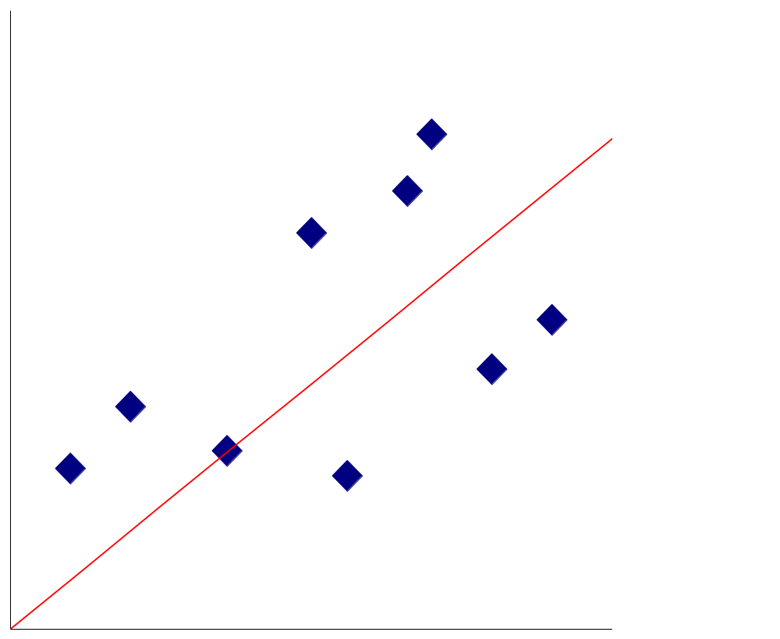
Singular Value Decomposition
SVD reduces the dimensions of the matrix with minimum mean square error
Reducing dimensions of high dimensioned data brings
  reducing data size
  merging similar data into one dimension
b
l
a
Reduce 2-dimention data (a, b)
to 1-dimention (l)

Slide 11
Effect of LSA
Documents which have indirect relationship show high similarities.
LSA make clear about trends of documents.
Similarities about all pair of documents.
 | 1 | 2 | 3 | 4 | 5 | 6
1 | 1.0 | 0.2 | -0.1 | -0.3 | -0.3 | -0.5
2 | 0.2 | 1.0 | 0.5 | -0.5 | -0.9 | -0.5
3 | -0.1 | 0.5 | 1.0 | -0.2 | -0.4 | -0.5
4 | -0.3 | -0.5 | -0.2 | 1.0 | 0.3 | 0.5
5 | -0.3 | -0.9 | -0.4 | 0.3 | 1.0 | 0.5
6 | -0.5 | -0.5 | -0.5 | 0.5 | 0.5 | 1.0
 | 1 | 2 | 3 | 4 | 5 | 6
1 | 1.0 | 1.0 | 0.9 | -0.6 | -0.6 | -0.5
2 | 1.0 | 1.0 | 1.0 | -0.8 | -0.8 | -0.7
3 | 0.9 | 1.0 | 1.0 | -0.8 | -0.8 | -0.8
4 | -0.6 | -0.8 | -0.8 | 1.0 | 1.0 | 1.0
5 | -0.6 | -0.8 | -0.8 | 1.0 | 1.0 | 1.0
6 | -0.5 | -0.7 | -0.8 | 1.0 | 1.0 | 1.0
before LSA
after LSA
Notes:
Applying Singular Value Decomposition, we can get indirect relation ship among documents.
These tables are similarities about all pair of documents.
Left table is about original word-by-document matrix, and right one is about the matrix applied Singular Value Decomposition.
In Vector Space Model, highly similar documents must have some exactly same words.
In contrast, Latent Semantic Analysis capture indirect relationship and clear about trends of documents.

Slide 12
Proposed Method(1/2)
Preparing the Matrix
Sof1
Soft4
Soft1
Soft4
A
B
B
F
J
G
G
I
J
Soft2
Soft5
Soft2
Soft5
1.Extract
Identifier
A
B
C
D
E
F
G
H
H
J
Soft3
Soft6
Soft3
Soft6
B
C
C
C
D
E
G
H
J
2.Make Identifier-by-Software Matrix
1 | 1 | 2 | 0 | 0 | 0 | 1 | 0 | 0 | 0 | 1
2 | 1 | 1 | 1 | 1 | 1 | 0 | 0 | 0 | 0 | 0
3 | 0 | 1 | 3 | 1 | 0 | 0 | 0 | 0 | 0 | 0
4 | 0 | 0 | 0 | 0 | 0 | 0 | 2 | 0 | 1 | 1
5 | 0 | 0 | 0 | 0 | 0 | 1 | 1 | 2 | 0 | 1
6 | 0 | 0 | 0 | 0 | 1 | 0 | 1 | 1 | 0 | 1
1 | 1 | 2 | 0 | 0 | 0 | 1 | 0 | 0
2 | 1 | 1 | 1 | 1 | 1 | 0 | 0 | 0
3 | 0 | 1 | 3 | 1 | 0 | 0 | 0 | 0
4 | 0 | 0 | 0 | 0 | 0 | 0 | 2 | 0
5 | 0 | 0 | 0 | 0 | 0 | 1 | 1 | 2
6 | 0 | 0 | 0 | 0 | 1 | 0 | 1 | 1
A
B
C
D
E
F
G
H
I
J
A
B
C
D
E
F
G
H
3.Remove
Stand-off Identifiers
and
Common Identifiers
Notes:
This figure shows the first half of MUDABlue categorization procedure.
In this step, we make identifier-by-software matrix, like word-by-document matrix.
Before applying LSA, we remove stand-off identifiers and common identifiers. Because they are useless for LSA.

Slide 13
Proposed Method(2/2)
Making Clusters
1 | 1 | 2 | 0 | 0 | 0 | 1 | 0 | 0
2 | 1 | 1 | 1 | 1 | 1 | 0 | 0 | 0
3 | 0 | 1 | 3 | 1 | 0 | 0 | 0 | 0
4 | 0 | 0 | 0 | 0 | 0 | 0 | 2 | 0
5 | 0 | 0 | 0 | 0 | 0 | 1 | 1 | 2
6 | 0 | 0 | 0 | 0 | 1 | 0 | 1 | 1
1 | 0.3 | 0.7 | 0.9 | 0.4 | 0.3 | 0.2 | 0.3 | 0.3
2 | 0.4 | 1.0 | 1.4 | 0.6 | 0.3 | 0.2 | 0.1 | 0.1
3 | 0.6 | 1.5 | 2.3 | 1.0 | 0.4 | 0.2 | -0.2 | -0.2
4 | 0.1 | 0.1 | -0.2 | 0.0 | 0.2 | 0.4 | 0.9 | 0.9
5 | 0.1 | 0.2 | -0.2 | 0.0 | 0.4 | 0.6 | 1.5 | 1.4
6 | 0.1 | 0.2 | -0.1 | 0.0 | 0.3 | 0.4 | 1.0 | 0.9
A
B
C
D
E
F
G
H
A
B
C
D
E
F
G
H
4.LSA
5.Calcurate Identifier Similarity and
Cluster Analysis
1
2
3
1
2
3
A
B
C
D
ClusterTitle1
F
G
H
6.Make
Software
Clusters
7.Make
Cluster’s
Titles
1
4
5
6
1
4
5
6
ClusterTitle2
Notes:
Then we apply LSA to the matrix.
In 5th step, we calculate similarities between all pairs of identifiers and apply cluster analysis.
Using cluster analysis, we group similar identifiers into one group.
And we consider each group as one category.
In 6th step, we define what software systems belong to each category.
If a software has any identifiers contained in a identifier cluster,
the software belong to the category
At this point, we got categories and belonging software systems.
Finally, we make cluster’s title.
Titles are best 10 identifiers in sum of software vector.

Slide 14

MUDABlue System
MUDABlue
Categorization System
Soft1
Soft4
Parser
Matrix
generator
Ourlier
remover
LSA
program
Soft2
Soft5
DBMS
(PostgreSQL)
Soft3
Soft6
Cluster
analysis
program
Software
cluster
generator
Category
title
generator
RDB
converter
Soft1
Soft2
Soft3
CategoryTitle1
Supporting for C programs.
Written in Perl, C and shell script.
Soft1
Soft4
Soft5
Soft6
CategoryTitle2
User Interface System
Web Browser
Keyword
searche
Category
hierarchy
view
UCM
view
Detailed
information
display
Web-based application.
Written in PHP, JavaScript and JavaApplet
Notes:
We impremented the method as MUDABlue system.
Categorization part, UI part
A user can access MUDABlue by web browser.

Slide 15
Case study
Through the case study, we show
How MUDABlue shows the categories
Evaluation about retrieved categories
  Summary of retrieved categories
  Precision and Recall comparison of automatic exclusive categorization methods
Test data
  We choose 6 genres from SourceForge at random
  boardgames, compilers, database, editor, videoconversion, xterm
  We retrieve all C programs from above 6 genres.
    41 software systems.
    164,102 identifiers
    We remove stand-off and common identifiers. 22,048 identifiers are remained.

Slide 16
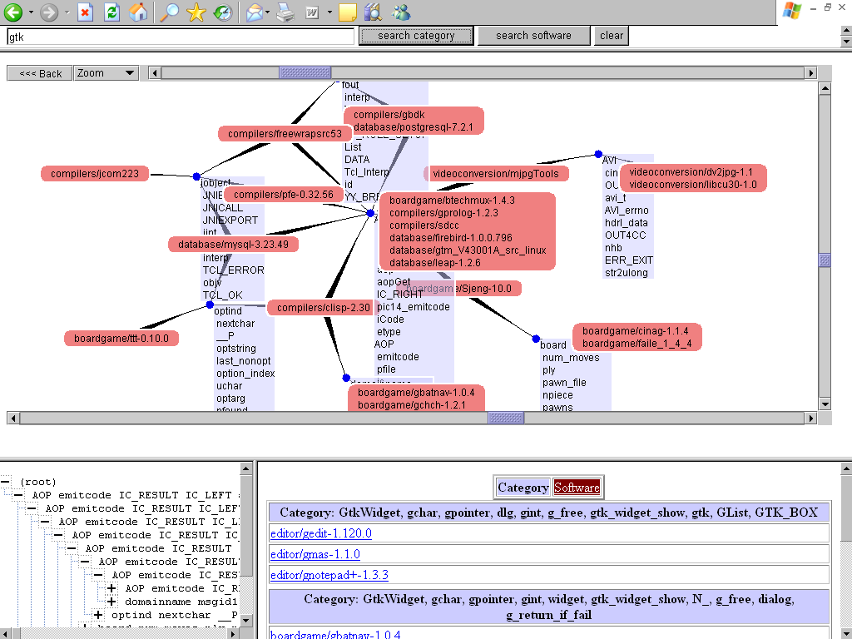
Demonstration (1/4)

Slide 17
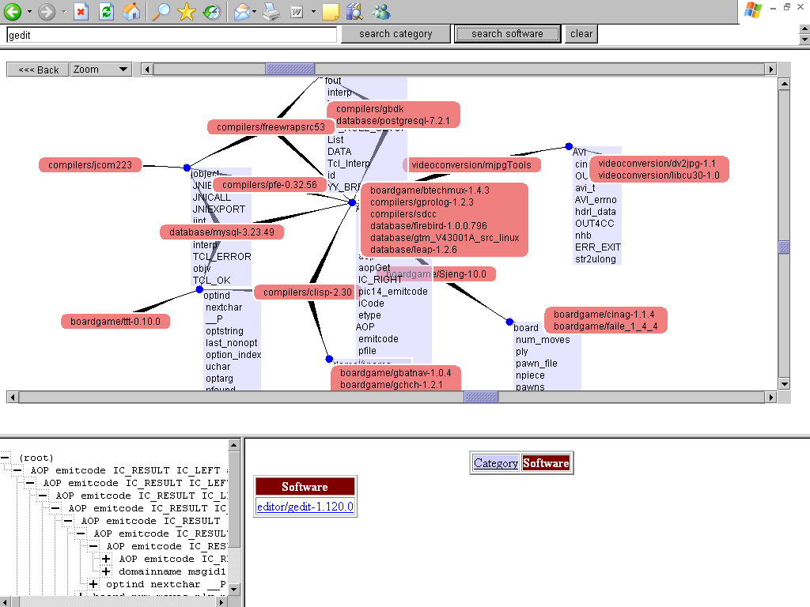
Demonstration (2/4)

Slide 18
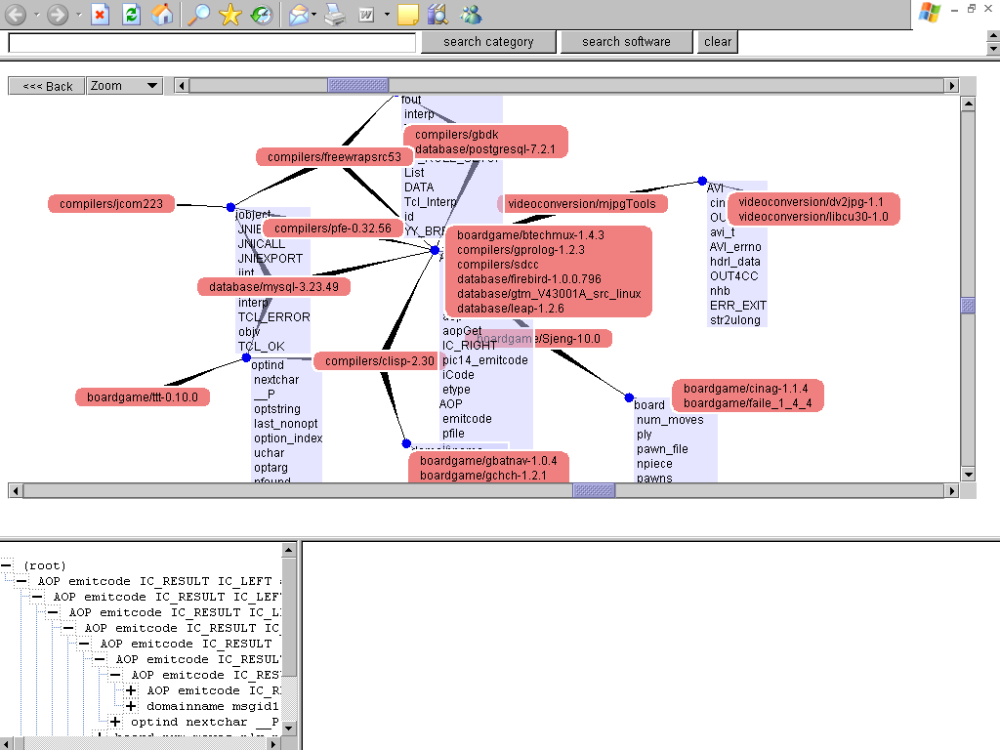
Demonstration (3/4)

Slide 19
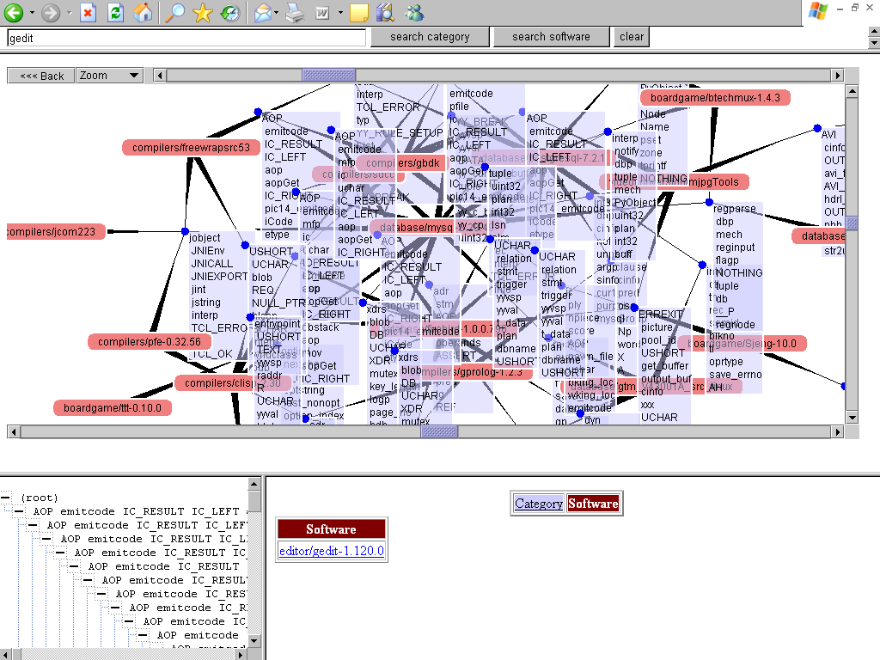
Demonstration (4/4)

Slide 20
The result of case study
Our system returned 40 categories
Details of new categories
  GTK(2 clusters) GUI library
  win32(3 clusters) Windows32 API
  yacc Library for Syntactic analysis
  SSL Library for SSL communication
  regexp Library for regular expression
  getopt Library for parsing arguments
  JNI Java Native Interface
  Python/C Architecture for extending Python interpreter
Clusters same as existed categories | 18
New categories | 11
The Other categories | 11

Slide 21
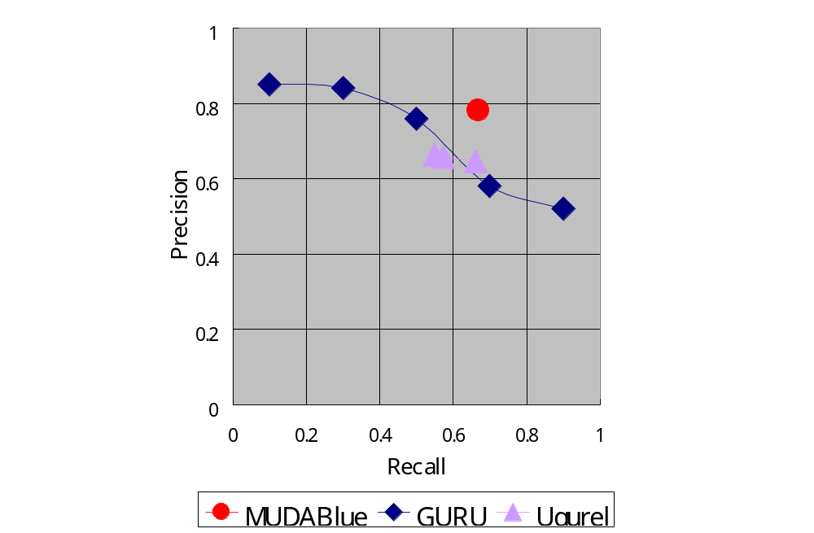
Precision and Recall
GURU
  Using IR methods
  Applied to Unix man pages.
Ugurel et.al’s method
  Using support vector machine (SVM) method
  Applied to documents of software system.
This figure indicates that MUDABlue has same accuracy with these researches.
Notes:
We evaluated retrieved categories by precision and recall.
For comparison, the result of GURU and Ugurel’s method are also plotted.
These researches categorize exclusive way and uses given category set.
So MUDABlue and these researches are different and this comparison is not GENNMITU,
but we can say that MUDABlue has same accuracy with these researches.

Slide 22
Discussion
Accuracy of MUDABlue’s categories compares favorably with other researches
Our method found categorization by a library and an architecture without any knowledge
  Categorization by many aspects of software systems without human knowledge
    (existing research needs predefined category set)
  Categorization without detailed, consistent documentation
  Categorization in non exclusive way

Slide 23
Conclusion and Future Work
We proposed MUDABlue, automatic categorization system for a software repository
We showed that MUDABlue method could found new categorization without any knowledge about software systems
Future works
  Reducing the other categories
    Improving identifier deletion process would reduce the other categories
  Improve understandability of categories’s title
    Some titles are easy to understand, and some are not.
    Category of same library are tend to have understandable titles.
  Granularity of category
    Generated categories tend to be too fine-graind granularity.

Slide 25
1.Extract Identifier
Extract all identifiers
  variable name
  constant name
  function name
  type name
Sof1
Soft4
Soft1
Soft4
A
B
B
F
J
G
G
I
J
Soft2
Soft5
Soft2
Soft5
1.Extract
Identifier
A
B
C
D
E
F
G
H
H
J
Soft3
Soft6
Soft3
Soft6
B
C
C
C
D
E
G
H
J

Slide 26
2.Make Identifier-by-Software Matrix
Identifier-by-Software Matrix
  A row represents a software
  A column represents an identifier
  A cell has the number of identifiers appeared in a software
Sof1
Soft4
1 | 1 | 2 | 0 | 0 | 0 | 1 | 0 | 0 | 0 | 1
2 | 1 | 1 | 1 | 1 | 1 | 0 | 0 | 0 | 0 | 0
3 | 0 | 1 | 3 | 1 | 0 | 0 | 0 | 0 | 0 | 0
4 | 0 | 0 | 0 | 0 | 0 | 0 | 2 | 0 | 1 | 1
5 | 0 | 0 | 0 | 0 | 0 | 1 | 1 | 2 | 0 | 1
6 | 0 | 0 | 0 | 0 | 1 | 0 | 1 | 1 | 0 | 1
A
B
C
D
E
F
G
H
I
J
A
B
B
F
J
G
G
I
J
Soft2
Soft5
A
B
C
D
E
F
G
H
H
J
2.Make
Identifier-by-
Software
Matrix
Soft3
Soft6
B
C
C
C
D
E
G
H
J

Slide 27
3.Remove Stand-off Identifiers and Common Identifiers
We remove stand-off Identifier and common identifiers because they are useless for categorization
  Stand-off Identifier
  An identifier appears only one software.
  Common Identifier
  An identifier appears more than half of software
1 | 1 | 2 | 0 | 0 | 0 | 1 | 0 | 0 | 0 | 1
2 | 1 | 1 | 1 | 1 | 1 | 0 | 0 | 0 | 0 | 0
3 | 0 | 1 | 3 | 1 | 0 | 0 | 0 | 0 | 0 | 0
4 | 0 | 0 | 0 | 0 | 0 | 0 | 2 | 0 | 1 | 1
5 | 0 | 0 | 0 | 0 | 0 | 1 | 1 | 2 | 0 | 1
6 | 0 | 0 | 0 | 0 | 1 | 0 | 1 | 1 | 0 | 1
1 | 1 | 2 | 0 | 0 | 0 | 1 | 0 | 0
2 | 1 | 1 | 1 | 1 | 1 | 0 | 0 | 0
3 | 0 | 1 | 3 | 1 | 0 | 0 | 0 | 0
4 | 0 | 0 | 0 | 0 | 0 | 0 | 2 | 0
5 | 0 | 0 | 0 | 0 | 0 | 1 | 1 | 2
6 | 0 | 0 | 0 | 0 | 1 | 0 | 1 | 1
A
B
C
D
E
F
G
H
I
J
A
B
C
D
E
F
G
H
3.Remove
Stand-off
Identifiers
and
Common
Identifiers

Slide 28
4.LSA
We apply LSA for the matrix removed stand-off identifiers and common identifiers
We can retrieve indirect relationship by applying LSA
1 | 1 | 2 | 0 | 0 | 0 | 1 | 0 | 0
2 | 1 | 1 | 1 | 1 | 1 | 0 | 0 | 0
3 | 0 | 1 | 3 | 1 | 0 | 0 | 0 | 0
4 | 0 | 0 | 0 | 0 | 0 | 0 | 2 | 0
5 | 0 | 0 | 0 | 0 | 0 | 1 | 1 | 2
6 | 0 | 0 | 0 | 0 | 1 | 0 | 1 | 1
1 | 0.3 | 0.7 | 0.9 | 0.4 | 0.3 | 0.2 | 0.3 | 0.3
2 | 0.4 | 1.0 | 1.4 | 0.6 | 0.3 | 0.2 | 0.1 | 0.1
3 | 0.6 | 1.5 | 2.3 | 1.0 | 0.4 | 0.2 | -0.2 | -0.2
4 | 0.1 | 0.1 | -0.2 | 0.0 | 0.2 | 0.4 | 0.9 | 0.9
5 | 0.1 | 0.2 | -0.2 | 0.0 | 0.4 | 0.6 | 1.5 | 1.4
6 | 0.1 | 0.2 | -0.1 | 0.0 | 0.3 | 0.4 | 1.0 | 0.9
A
B
C
D
E
F
G
H
A
B
C
D
E
F
G
H
4.LSA

Slide 29
5.Cluster Identifiers
Calculate similarities between all pairs of identifiers using the result of LSA
Apply cluster analysis based on the similarities
We call the result cluster as “identifier cluster”
1 | 0.3 | 0.7 | 0.9 | 0.4 | 0.3 | 0.2 | 0.3 | 0.3
2 | 0.4 | 1.0 | 1.4 | 0.6 | 0.3 | 0.2 | 0.1 | 0.1
3 | 0.6 | 1.5 | 2.3 | 1.0 | 0.4 | 0.2 | -0.2 | -0.2
4 | 0.1 | 0.1 | -0.2 | 0.0 | 0.2 | 0.4 | 0.9 | 0.9
5 | 0.1 | 0.2 | -0.2 | 0.0 | 0.4 | 0.6 | 1.5 | 1.4
6 | 0.1 | 0.2 | -0.1 | 0.0 | 0.3 | 0.4 | 1.0 | 0.9
A
B
C
D
E
F
G
H
5.Cluster
Identifiers
A
B
C
D
F
G
H

Slide 30
6.Make Software Cluster
From each identifier cluster, we make a software cluster.
A software cluster is an union of software systems which have a token included in an identifier cluster.
Sof1
Soft4
A
B
B
F
J
G
G
I
J
A
B
C
D
F
G
H
Soft2
Soft5
6.Make software
cluster
A
B
C
D
E
F
G
H
H
J
Soft3
Soft6
1
2
3
1
4
5
6
B
C
C
C
D
E
G
H
J

Slide 31
7.Make Cluster’s Titles
For each software cluster, we make a title which represents what software systems are categorized.
Get all software vector included in a software cluster.
Sum up them.
From the summation vector, chose some tokens which have high value, and we make them as title of a cluster.
7.Make Cluster’s Titles
1
2
3
1
4
5
6
1
2
3
1
4
5
6
ClusterTitle1
ClusterTitle2

Slide 32
The result of case study (subset)
Title | Software | NoI
AOP, emitcode, IC_RESULT, IC_LEFT, aop, aopGet, IC_RIGHT, pic14_emitcode, iCode, etype | compilers/gbdk, compilers/sdcc | 8597
CASE_IGNORE, CASE_GROUND_STATE, screen, CASE_PRINT, CASE_BYP_STATE, Widget, TScreen, CASE_IGNORE_STATE, CASE_PLT_VEC, CASE_PT_POINT | xterm/R6.3, xterm/R6.4 | 2160
YY_BREAK, yyvsp, yyval, DATA, yy_current_buffer, tuple, yy_current_state, yy_c_buf_p, yy_cp, uint32 | compilers/gbdk, database/mysql-3.23.49, database/postgresql-7.2.1 | 223
AVI, cinfo, OUTLONG, avi_t, AVI_errno, hdrl_data, OUT4CC, nhb, ERR_EXIT, str2ulong | videoconversion/dv2jpg-1.1, videoconversion/libcu30-1.0, videoconversion/mjpgTools | 177
board, num_moves, ply, pawn_file, npiece, pawns, moves, white_to_move, move_s, promoted | boardgame/Sjeng-10.0, boardgame/cinag-1.1.4, boardgame/faile_1_4_4 | 154
GtkWidget, gchar, gpointer, gint, widget, gtk_widget_show, N_, g_free, dialog, g_return_if_fail | boardgame/gbatnav-1.0.4, editor/gedit-1.120.0, editor/gmas-1.1.0, editor/gnotepad+-1.3.3, editor/peacock-0.4 | 104
New Category
Software systems using YACC
Software systems using GTK library
Same category as SourceForge

Slide 33
Naive LSA approach for categorization
Apply LSA for software similarity
  Software Document
  Identifier (variable, function, type) Word
Calculate similarities by result of LSA
We apply cluster analysis using similarities of software systems calculated above
  Cluster analysis divides a set into some groups using similarities of each item

Slide 34
Problem of naive approach
Each high relationship has each reason
Cluster analysis based on simple software similarity is not adequate
Software 1
Software 3
Editor
Spreadsheet
GUI (MFC)
GUI (MFC)
support for
regular expression
support for
regular expression
Software 2
Software 4
Editor
Spreadsheet
GUI (GTK)
GUI (GTK)
support for
regular expression

Slide 35
(demonstration)
Notes:
This is the MUDABlue interface.
Keyword search part, category hierarchy view, Unifiable Cluster Map view and detailed information view
Keyword search part enables to search categories or software systems by keyword.
Detailed information display part shows the result of keyword searching.
To provides a holistic view of a software repository, we implemented Unifiable Cluster Map.
In UCM view, a red square contains software systems and a blue point is category.
A line between software systems and a category represents that the software systems belong to the category.
Here shows 2 xterm software systems belong to one category and this software belongs to X categories.
In this way, we represent non-exclusive categorization.
But if there are many categories, it is hard to browsing whole software repository.
To improve scalability, we allow unifying categories.
Unifying categories reduces the number of nodes displayed and prevents nodes from cluttering the screen.
For instance, most of the categories are unified in MUDABlue’s initial state.
So a user can explore what he or she interested in by expanding categories.

Slide 36
Case study
We applied our proposed method for real software systems using implemented prototype
  We choose 6 genres from SourceForge at random
  boardgames, compilers, database, editor, videoconversion, xterm
  We retrieve all C programs from above 6 genres.
    41 software systems.
    164,102 identifiers
    We remove stand-off and common identifiers. 22,048 identifiers are remained.
Notes:
In this case study, we show the retrieved categories and how MUDABlue present them.

