Slide 1
Automatic Categorization Algorithm for Evolvable Software Archive
Shinji Kawaguchi†, Pankaj K. Garg††
Makoto Matsushita† and Katsuro Inoue†
† Graduate School of Information Science and Technology,
Osaka University
†† Zee Source

Slide 2
Background
Recently, software archive systems become very common.
  (SourceForge, ibiblio, etc...)
  They are used for ...
    finding software which fill a demand
    finding source codes related to currently developing products.
  These archives are very large and evolving.
Need categorizing archived software

Slide 3
Research Aim
Present: manual categorization
  hard work – a software archive is large and evolving
  less flexibility – categorization is strongly depend on pre-defined category set
Automatic categorization is important
  less cost
  adaptable – automatic categorization method generate category set
We are researching automatic categorization methods

Slide 4
Related Works on Software Clustering
Divide one software into some clusters for software understanding
Calculate “similarity” between all pairs of units and categorize them based on the similarities.
  grouping files using similarity of their names*
  grouping functions using call relationships among functions**
  grouping functions using their identifiers***
Similarity:
  They retrieve information from source code.
Difference:
  Their works focused on intra-software relationship.
  Our research focused on inter-software relationship.
*N. Anquetil and T. Lethbridge. Extracting concepts from file names; a new file clustering criterion.
In Proc. 20th Intl. Conf. Software Engineering, May 1998.
**G. A. Di Lucca, A. R. Fasolino, F. Pace, P. Tramontana, U. De Carlini, Comprehending Web Applications by a Clustering Based Approach
10th International Workshop on Program Comprehension (IWPC'02)
***Jonathan I. Maletic and Andrian Marcus, Supporting Program Comprehension Using Semantic and Structural Information
in Proceedings of the 23rd IEEE International Conference on Software Engineering (ICSE 2001)

Slide 5
Three Approaches
We experimented with following three approaches for automatic categorization.
  SMAT, similarity measurement tool based on code-clone detection.
  Decision tree approach
  Latent Semantic Analysis (LSA) approach

Slide 6
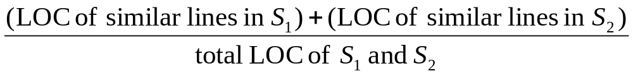
1st Approach - SMAT
SMAT: Software similarity measurement tool
  SMAT calculate software similarity by ratio of “similar lines”
  Similar lines are determined by code-clone detection tool “CCFinder” and line-based comparison tool “diff”
  The similarity of two software S₁ and S₂ is defined as follows

Slide 7
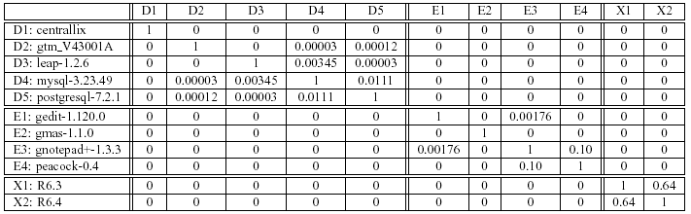
Result of SMAT
The result is table form.
  Each row and column represents one software
  Each cell has similarity value between two software systems.

Slide 8
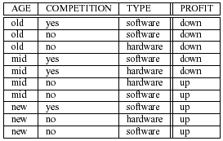
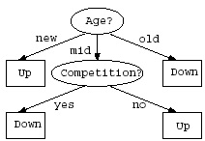
2nd Approach - Decision Tree
One of a machine learning approach for automatic classification.
Decision tree is generated from example data set.
Example data set contains some data and one answer.
C4.5 is a common decision tree generator
Data
Answer
C4.5
Output: Decision Tree
Input: Example Dataset

Slide 9
Result of Decision Tree Approach
Application for software categorization
  Enumerate all 3-gram of *.c and *.h filenames in sample data, and use them as data.
  Each cell is “T” or “F” depend on the software has its 3-gram in its filenames or not.
  Each sample software, the category information is given.
tyx
xterm
_fu
database
mpe
videoconversion
alo
editor
ops
database
win
compilers
tin
compilers
Lib
compilers
boardgame
True
False

Slide 10
3rd Approach - LSA
Originally, LSA (Latent Semantic Analysis)* is proposed for similarity calculation of documents written in natural language.
This method makes a word-by-document matrix and each document is represented by a vector
Similarity is represented by cosine of two document vectors.
LSA can detect similarity with software sharing only highly related (but not exactly same) words.
  This method extract cooccurrence between words by applying SVD (Singular Value Decomposition) to the matrix
* Landauer, T. K., Foltz, P. W., & Laham, D. (1998). Introduction to Latent Semantic Analysis.
Discourse Processes, 25, 259-284.

Slide 11
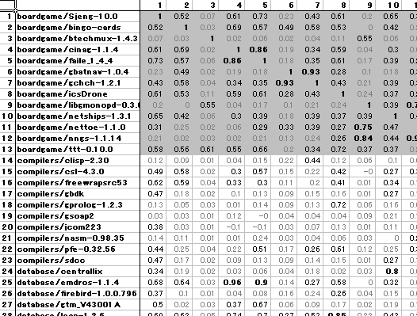
Result of LSA method
Application for software categorization
  Extracting identifiers (variable name, function name, etc…) from source code and consider them as words.
We calculate similarities between all pairs of software systems.
A part of Figure 4. Similarity of Software System by LSA

Slide 12
Comparison of three methods
 |  | SMAT | Decision Tree | LSA
How to decide |  | Similarity (ratio of lines with code-clone) | Decision tree | Similarity (cosine of vectors)
Input |  | Source code only | Source code and category set | Source code only
Result | in different category | similarities are all 0 | no miss if example input is small | high value if software using same library
 | in same category | very low value or 0 | no miss if example input is small | some category shows very high relationship
Scalability |  | Yes | No (Generated decision tree has many errors if example is large) | Yes

Slide 13
Conclusion
We have reported some preliminary work on automatic categorization of a evolvable software archive.
In each of the cases, we have limited success with the parameters that we chose.
  Software functionality is high abstract concept.
  Software has several aspects.
We are actively pursuing this research direction.
  Non-exclusive categorization is much better for software categorization

Slide 15
Application for software categorization
Software | fil | cmd | … | mpe | Category
Soft1 | T | T |  | F | Printing
Soft2 | F | T |  | F | Editor
…
SoftM | T | F |  | T | Database
Enumerate all *.c *.h files in sample data, and use their 3-gram.
Each cell is “T” or “F” depend on the software has its 3-gram in its filenames or not.
Each input software, the category information is given.

Slide 16
Result of Decision Tree Approach
tyx = t: xterm (2.0)
tyx = f:
| _fu = t: database (6.0)
| _fu = f:
| | mpe = t: videoconversion (3.0)
| | mpe = f:
| | | alo = t: editor (4.0)
| | | alo = f:
| | | | ops = t: database (2.0/1.0)
| | | | ops = f:
| | | | | win = t: compilers (6.0)
| | | | | win = f:
| | | | | | tin = t: compilers (2.0)
| | | | | | tin = f:
| | | | | | | Lib = t: compilers (2.0)
| | | | | | | Lib = f: boardgame (14.0/1.0)
High ratio of error with large input (57.6%)
This approach require a set of category.

Slide 17
Result of Decision Tree Approach
Application for software categorization
  Enumerate all *.c *.h files in sample data, and use their 3-gram.
  Each cell is “T” or “F” depend on the software has its 3-gram in its filenames or not.
  Each input software, the category information is given.
Three Problem
  Over fitting for test data
  High ratio of error with large input (57.6%)
  This approach require a set of category.
tyx
xterm
_fu
database
mpe
videoconversion
alo
editor
ops
database
win
compilers
tin
compilers
Lib
compilers
boardgame
True
False

Slide 18
Experimentation
Test data: 41 software from sourceforge
  these software is classified in 6 genre at sourceforge
Extracting identifiers (variable name, function name, etc…) from source code.
  164102 identifiers are extracted
Omitting unnecessary identifiers
  identifiers appear at only one software
  identifiers appear in many (more than half) software
  22178 identifiers are remained
Apply LSA for 41 x 22178 matrix

Slide 19
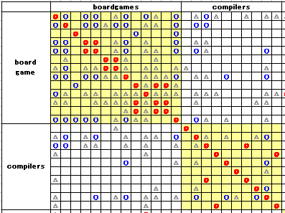
Result of LSA method (1/3)
This table shows similarities of each software
boardgame
  few common concepts in boardgame
    (board, player)
compilers
  includes many kind of software
    compiler of new programming language
    code generator(compiler-compiler)
    etc...

Slide 20

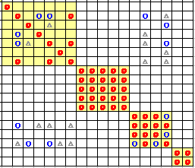
Result of LSA method (2/3)
database
  different implementation
    Full functional DB
    Simple text-based DB
editor, videoconversion, xterm
  very high similarity

Slide 21
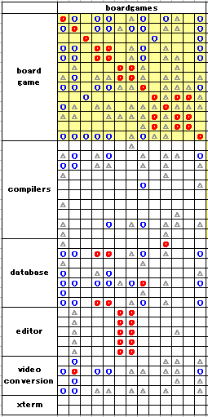
Result of LSA method (3/3)
Some software has high similarity tough they are in different categories.
They use same libraries
  GTK – one of a GUI library

Slide 22
Comparison of three methods
SMAT
  Generally, very low similarity values
Decision Tree
  Need pre-defined category set
  Overfitting test data
  Not applicable for large data
Latent Semantic Analysis
  High similarity values in some category
  Software in different category, but using same library sometimes show high similarity

Slide 23
LSA – sample document
  c1: Human machine interface for ABC computer applications
  c2: A survey of user opinion of computer system response time
  c3: The EPS user interface management system
  c4: System and human system engineering testing of EPS
  c5: Relation of user perceived response time to error measurement
  m1: The generation of random, binary, orderd trees
  m2: The intersection graph of paths in trees
  m3: Graph minors IV: Widths of trees and well-quasi-ordering
  m4: Graph minors: A survey

Slide 24
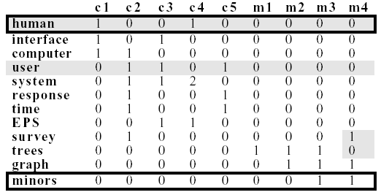
LSA – word by document matrix
document
word

