Slide 1




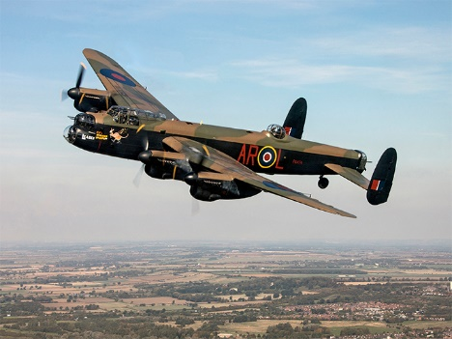


LiveContent user data: Bookmarks, Notes and Attachments
Battle of Britain Memorial Flight: Maintenance Portal

Slide 2
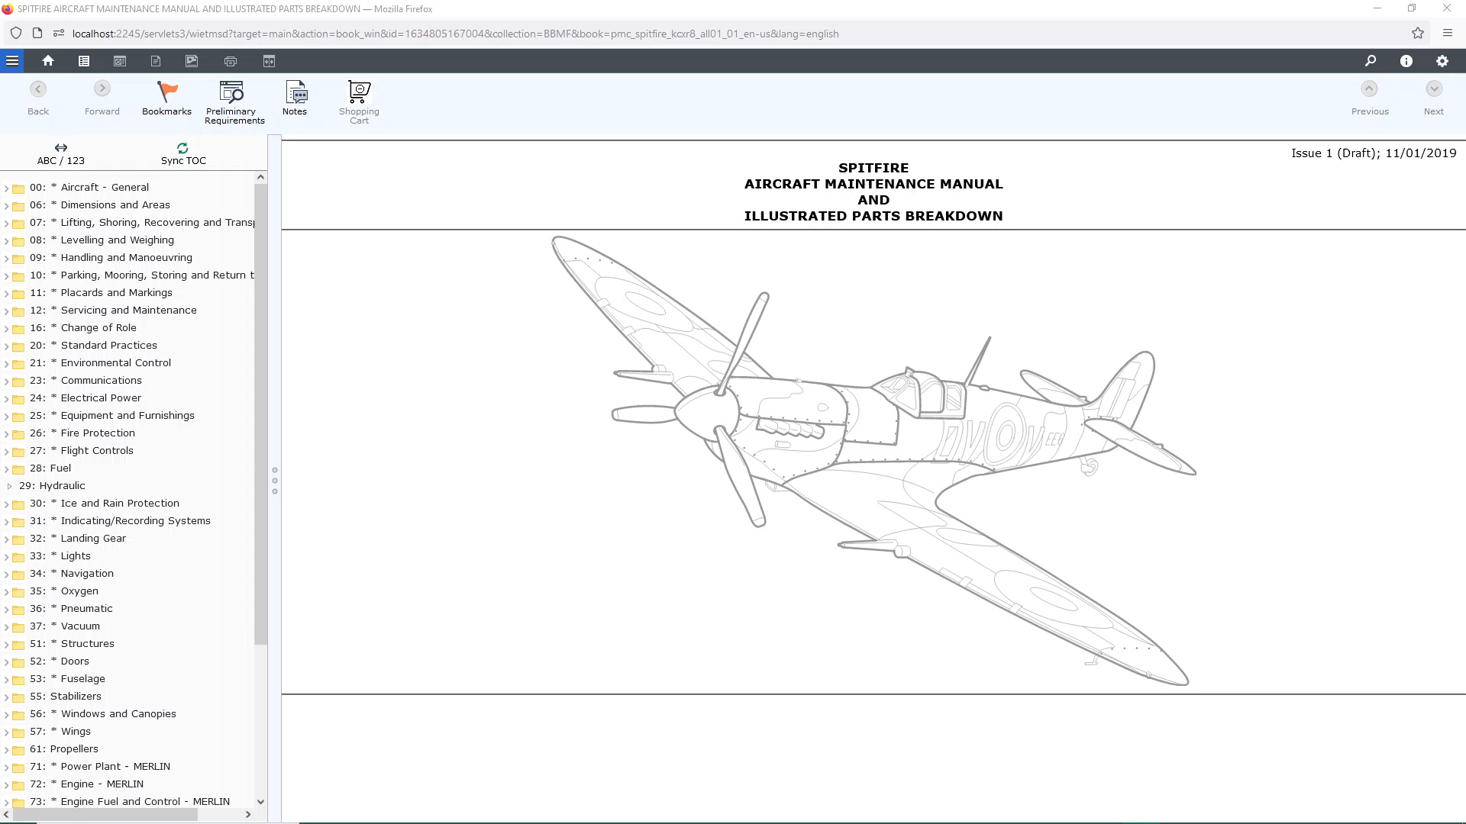
Only the creator of the Bookmark can edit or delete

Slide 3

Only the creator of the Note can edit or delete

Slide 4
