Slide 1







LiveContent user data
Battle of Britain Memorial Flight: Maintenance Portal

Slide 2
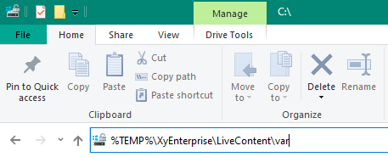

About LiveContent user data
LiveContent creates a user folder in the following server location:
%TEMP%\XyEnterprise\LiveContent\var
%TEMP% is a Windows environmental variable.
Paste %TEMP%\XyEnterprise\LiveContent\var into Explorer
Notes:
When a user logs into LiveContent a user folder will be created on the server machine in the following location:
%TEMP%\XyEnterprise\LiveContent\var
Where %TEMP% is a Windows environmental variable, common to all users.
To locate this folder on the hosting machine paste the exact text into Windows Explorer and hit enter

Slide 3
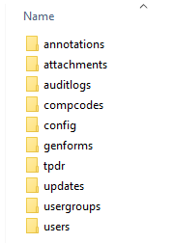
About LiveContent user data (cont’d)
This folder contains user data ordered by Collection.
The ‘working’ folder contains folders for ‘annotations’ and ‘attachments’.
This allows users to maintain their bookmarks and attachments over time.
Notes:
The ‘var’ folder will contain the user data ordered by Collection, this is called “BBMF”.
Each Collection will contain sub-folders ‘log’ and ‘working’
The ‘working’ folder contains subfolder for all user activity, such as ‘annotations’ and ‘attachments’.
The contents of these folder will be called when a publication is updated or replaced with a new build.
The collection and publication name must remain constant throughout the life of the publication; this will allow users to maintain their bookmarks and attachments over time.

