Slide 1







User management
Battle of Britain Memorial Flight: Maintenance Portal

Slide 2

BBMF IETP user access
Battle of Britain Memorial Flight: Maintenance Portal
User Feature | Administrator | SuperUser Online | User Online | SuperUser Offline | User Offline
LiveContent features | ✓ | ✓ | ✓ | ✓ | ✓
Incremental update | ✓ |  |  | ✓ | ✓
Legacy documents | ✓ | ✓ |  | ✓
User management | ✓
Password policy
Password must be at least 12 characters in length
Passwords must contain:
At least one capital letter: (A–Z); plus
At least one number: (0–9); plus
At least one special character: ! " # $ % & ( ) * + , - : ; < > ? @ [ \ ] ^ _ { | } ~ £; plus
Lower-case alpha characters: (a–z).
Notes:
There are five User types for the BBMF:
Administrator
SuperUser
User
Offline SuperUser
Offline User
This table shows access to LiveContent features and legacy, or non-S1000D, documents
The BBMF Viewer has a password policy that has been amended the match the MOD password policy.
The password must be at least 12 characters in length
The password must contain:
At least one capital letter
At least one number
At least one special character, as shown here
All other characters must lower-case alpha characters “a–z”

Slide 3
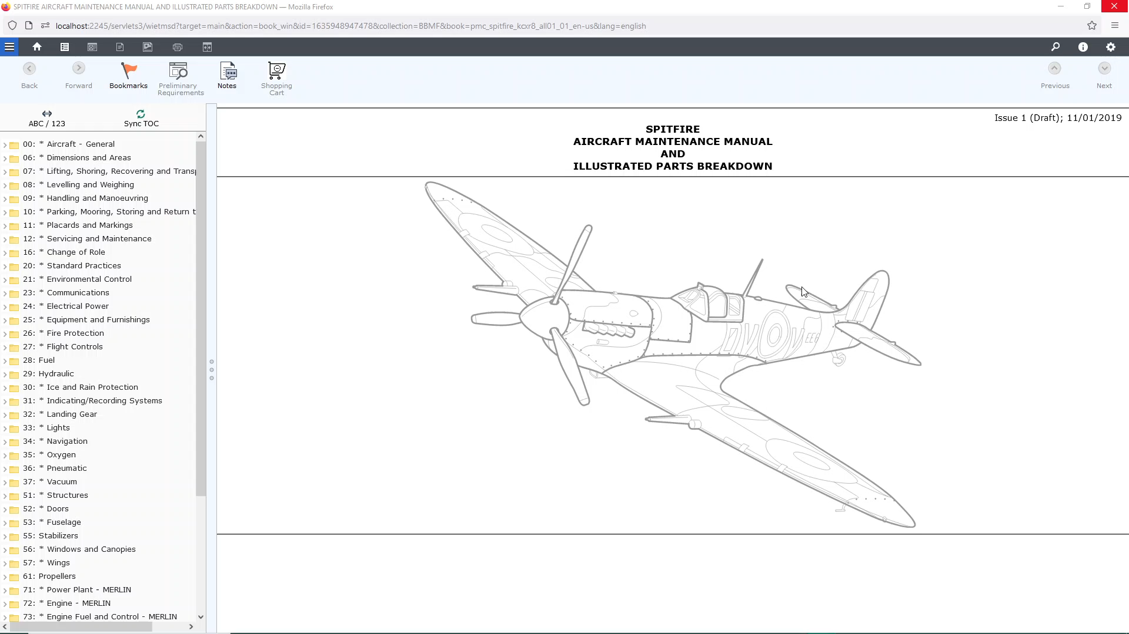
Notes:
Only users with Administrative rights can create and amend user settings.
This includes setting passwords: non-admin users can not re-set their own passwords.
To change an existing user an administrator can select: Settings > User Management
They can now select an existing user and press “Edit” to change their settings.
You can change all fields. Please note the rule about the password policy that has been changed to meet the MOD security policy.
When you change the settings you will have to re-set or re-apply the password
To add a new user press the “Add” button
You must fill in all the required fields.
When complete press “Save”
If you need to delete a user first select the user then press “Delete”
Finally, A note about adding a new User Group.
You can add new user groups by adding a new XML configuration file in the correct format.
You cannot add a new group from this screen.
You should be mindful that user groups are linked to access to features in LiveContent so you should only do so in consultation with RWS so the correct application changes are made to match the new profile

Slide 4

Notes:
Only users with Administrative rights can create and amend user settings.
This includes setting passwords: non-admin users can not re-set their own passwords.
To change an existing user an administrator can select: Settings > User Management
They can now select an existing user and press “Edit” to change their settings.
You can change all fields. Please note the rule about the password policy that has been changed to meet the MOD security policy.
When you change the settings you will have to re-set or re-apply the password
To add a new user press the “Add” button
You must fill in all the required fields.
When complete press “Save”
If you need to delete a user first select the user then press “Delete”
Finally, A note about adding a new User Group.
You can add new user groups by adding a new XML configuration file in the correct format.
You cannot add a new group from this screen.
You should be mindful that user groups are linked to access to features in LiveContent so you should only do so in consultation with RWS so the correct application changes are made to match the new profile

Slide 5
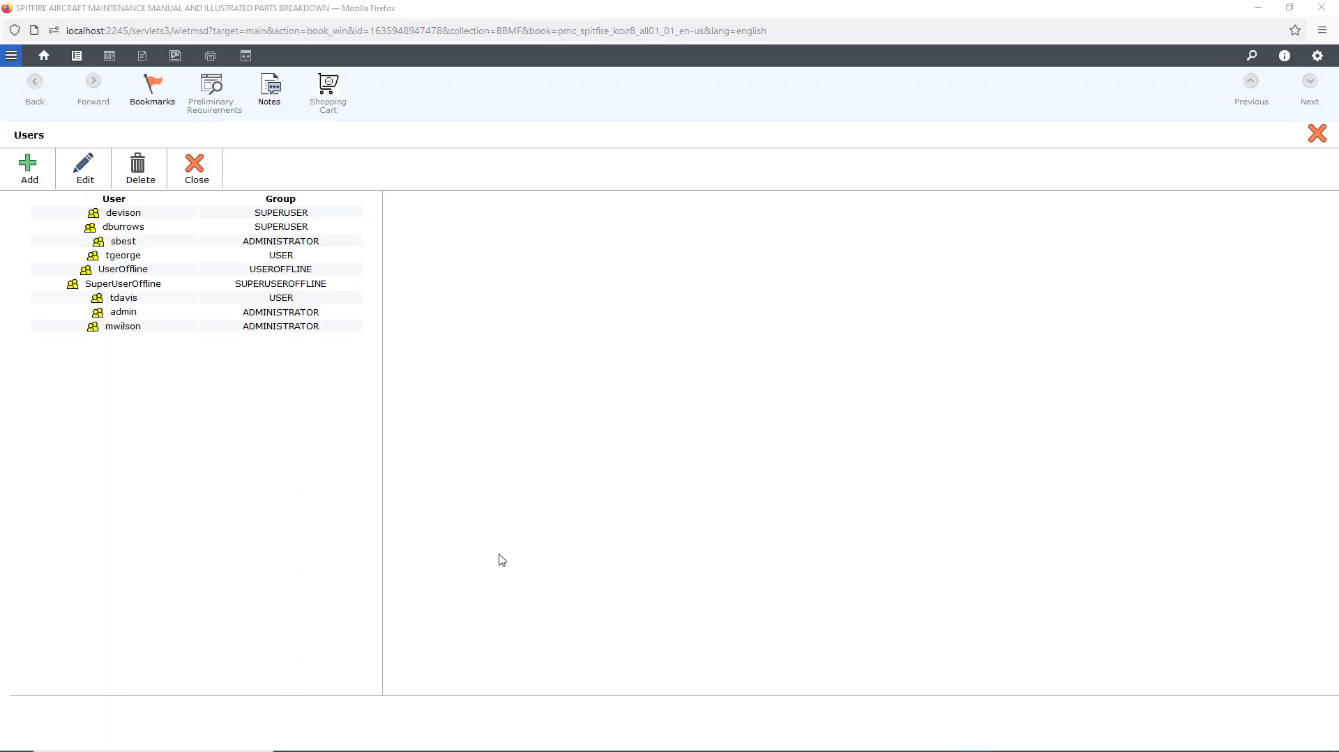
Notes:
Only users with Administrative rights can create and amend user settings.
This includes setting passwords: non-admin users can not re-set their own passwords.
To change an existing user an administrator can select: Settings > User Management
They can now select an existing user and press “Edit” to change their settings.
You can change all fields. Please note the rule about the password policy that has been changed to meet the MOD security policy.
When you change the settings you will have to re-set or re-apply the password
To add a new user press the “Add” button
You must fill in all the required fields.
When complete press “Save”
If you need to delete a user first select the user then press “Delete”
Finally, A note about adding a new User Group.
You can add new user groups by adding a new XML configuration file in the correct format.
You cannot add a new group from this screen.
You should be mindful that user groups are linked to access to features in LiveContent so you should only do so in consultation with RWS so the correct application changes are made to match the new profile

Slide 6

Notes:
Only users with Administrative rights can create and amend user settings.
This includes setting passwords: non-admin users can not re-set their own passwords.
To change an existing user an administrator can select: Settings > User Management
They can now select an existing user and press “Edit” to change their settings.
You can change all fields. Please note the rule about the password policy that has been changed to meet the MOD security policy.
When you change the settings you will have to re-set or re-apply the password
To add a new user press the “Add” button
You must fill in all the required fields.
When complete press “Save”
If you need to delete a user first select the user then press “Delete”
Finally, A note about adding a new User Group.
You can add new user groups by adding a new XML configuration file in the correct format.
You cannot add a new group from this screen.
You should be mindful that user groups are linked to access to features in LiveContent so you should only do so in consultation with RWS so the correct application changes are made to match the new profile

Slide 7
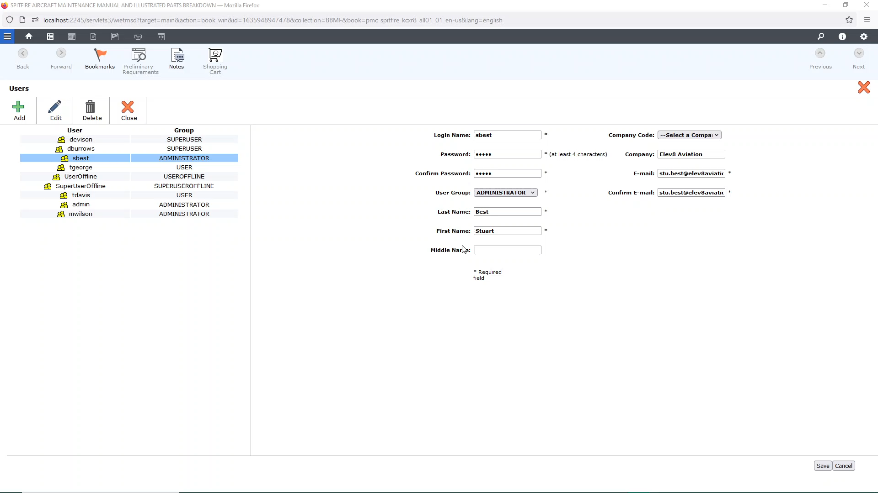
Notes:
Only users with Administrative rights can create and amend user settings.
This includes setting passwords: non-admin users can not re-set their own passwords.
To change an existing user an administrator can select: Settings > User Management
They can now select an existing user and press “Edit” to change their settings.
You can change all fields. Please note the rule about the password policy that has been changed to meet the MOD security policy.
When you change the settings you will have to re-set or re-apply the password
To add a new user press the “Add” button
You must fill in all the required fields.
When complete press “Save”
If you need to delete a user first select the user then press “Delete”
Finally, A note about adding a new User Group.
You can add new user groups by adding a new XML configuration file in the correct format.
You cannot add a new group from this screen.
You should be mindful that user groups are linked to access to features in LiveContent so you should only do so in consultation with RWS so the correct application changes are made to match the new profile

Slide 8
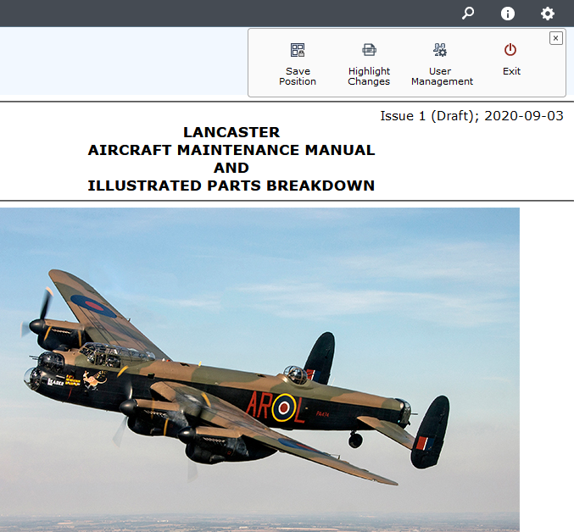
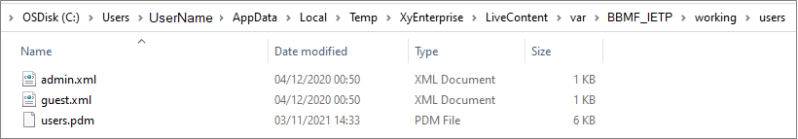
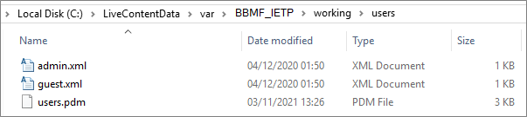
Managing BBMF IETP user access
Battle of Britain Memorial Flight: Maintenance Portal
Notes:
User credentials are set when an administrator calls the User Management function in any of the Publications in a LiveContent collection.
That is, an administrator can login to LiveContent and select any of the Aircraft Publications to set the users.
LiveContent creates a LiveContent user folder where LiveContent is hosted: that is, only:
On the Delivery Server on the hosted Cloud Virtual Machine; or
Each standalone LiveContent instance
NOT on the connected LiveContent user machine

Slide 9
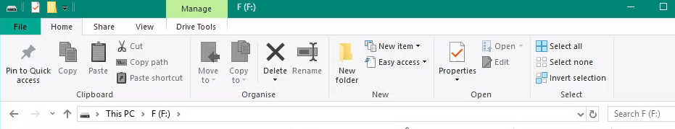
Managing BBMF IETP user access (cont’d)
Battle of Britain Memorial Flight: Maintenance Portal
%TEMP%\XyEnterprise\LiveContent\var\[IETP-FOLDER-NAME]
[LiveContentData]\var\[COLLECTION-NAME]
Notes:
The location of the user folder will resolve to one of two place:
%TEMP%\XyEnterprise\LiveContent\var\[IETP-FOLDER-NAME]
Where %TEMP% is a Windows system variable based on the user account; such as C:\Users\[USER-NAME]\AppData\Local\Temp
You can resolve this yourself by raising a Windows Explorer windows and typing in %TEMP% then hitting enter.
You can do the same with the full path to find where LiveContent stores its user data: %TEMP%\XyEnterprise\LiveContent\var
[LiveContentData]\var\[COLLECTION-NAME]
[LiveContentData] will be used if the IETP is hosted on the LiveContent Publisher machine.
This is stored in a Windows Registry entry: HKEY_LOCAL_MACHINE\SOFTWARE\XyEnterprise\LiveContent "DataDir" ("C:\LiveContentData")

Slide 10
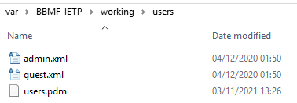
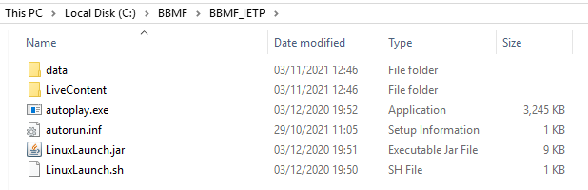
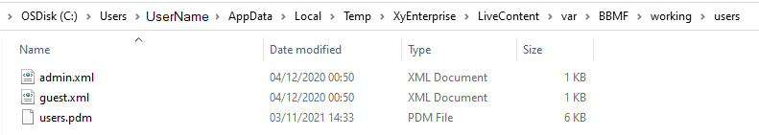
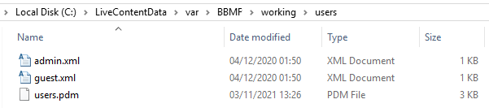
Managing BBMF IETP user access (cont’d)
Battle of Britain Memorial Flight: Maintenance Portal
Notes:
For example if the LiveContent IETP is located at C:\BBMF\BBMF_IETP for user “Administrator” with a Collection “BBMF_IETP”, this will create a user folder in either:
C:\Users\Administrator\AppData\Local\Temp\XyEnterprise\LiveContent\var\BBMF_IETP;
or
C:\LiveContentData\var\BBMF_IETP
This BBMF_IETP working folder will have subfolders: “working\users”.
When the IETP is running and changes are made to users with “User Management” by administrator a file called users.pdm (an encrypted XML file) will be either created or updated.

Slide 11
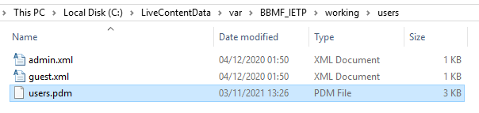
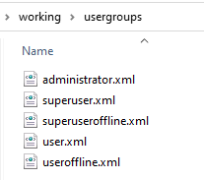
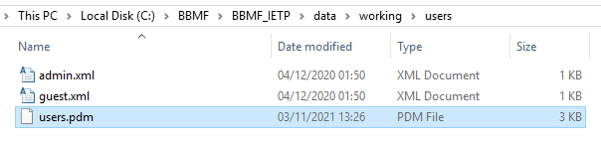
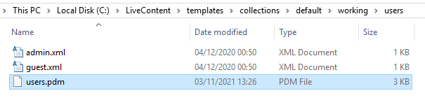
Managing BBMF IETP user access (cont’d)
Battle of Britain Memorial Flight: Maintenance Portal

