Slide 1





The S1000D Data Module

Slide 2

The Data Module
What is a Data Module?
  A DM is self-contained topic or procedure
  Contains text and references to graphics and other DMs
How is a Data Module used?
  DMs are designed for reuse
Notes:
A data module is the basic information unit for an S1000D document.
Each one contains a particular topic or procedure related to the equipment.
Data modules contain text as well as references to illustrations, multimedia objects, or links to other data that is related to that text.
The illustrations and multimedia objects are not stored directly in the data module, but rather referenced to further facilitate reuse.
Each data module in a CSDB project is unique.
Where data is common to multiple programmes or publications a data module can be created to be reused as many times as necessary.
This reusable data module must be a completely self-contained set of information, for example, a complete repair procedure.
A goal of S1000D is to permit data modules to be used by other projects and even other services since a data module may be appropriate for more than one programme.

Slide 3
The Data Module Code
Each Data Module has a unique identifier: a DMC.
The Raytheon Eagle CSDB manages the DMCs.
DMCs can be seen in the LiveContent IETP in the TOC or as links.
The DMC enables chunks of information to be managed or reused.
The illustrations or multimedia objects have a similar code, the ICN.
The DMC’s structure is standardised.
Notes:
Each Data Module has a unique identifier, known as the Data Module Code, or DMC for short.
The Raytheon Eagle Common Source DataBase, or CSDB, manages the DMCs.
The DMC can be seen in the LiveContent IETP in the table of contents or as links from one Data module to another
The DMC, together with other metadata, allows Data Modules to be independently managed and reused.
The illustrations or multimedia objects associated with the data modules have a similar code known as the Illustration Control Number, or ICN.
The DMC’s structure is standardised, even though the lengths of its individual components may vary. The DMC can range from 17 to 41 alphanumeric characters.

Slide 4
Data Module Code (cont’d)
 | DMC | SPITFIRE-AAAA-29-10-04-00AA-520A-A
 | Model Identification | SPITFIRE-AAAA-29-10-04-00AA-520A-A
 | System Difference Code | SPITFIRE-AAAA-29-10-04-00AA-520A-A
SNS | System | SPITFIRE-AAAA-29-10-04-00AA-520A-A
 | Subsystem | SPITFIRE-AAAA-29-10-04-00AA-520A-A
 | Sub Subsystem | SPITFIRE-AAAA-29-10-04-00AA-520A-A
 | Unit or Assembly | SPITFIRE-AAAA-29-10-04-00AA-520A-A
 | Dissassembly Code | SPITFIRE-AAAA-29-10-04-00AA-520A-A
 | Dissassembly Code Variant | SPITFIRE-AAAA-29-10-04-00AA-520A-A
 | Information Code | SPITFIRE-AAAA-29-10-04-00AA-520A-A
 | Information Code Variant | SPITFIRE-AAAA-29-10-04-00AA-520A-A
 | Item Location Code | SPITFIRE-AAAA-29-10-04-00AA-520A-A
Notes:
This is an example of a Data Module Code.
You can see the breakdown of the code starting with the Model identification which for this project is SPITFIRE.
The system difference code will always be the same for these projects.
The DMC then continues with breakdown information from the aircraft-specific standard numbering system, or SNS, through to disassembly information and then the information code which defines the type of information contained within the Data Module. In this example it is Procedural information.
Finally the item location details where the information is relevant to, for example, on aircraft, or on a bench in a bay.
In this example the ‘A’ signifies it is ‘On Aircraft information.

Slide 5
Data Module structure
<dmodule S1000D version "S1000D_4-2/descript.xsd"...>
<identAndStatusSection>
<dmAddress>
<dmIdent>
<dmCode DMC-SPITFIRE-AAAA-29-00-00-00AA-040A-A />
<language EN-US /><issueInfo 000.01 />
</dmIdent>
<dmAddressItems>
<issueDate 2019-11-07 />
<dmTitle>Hydraulic power - General - Description</dmTitle>
</dmAddressItems>
</dmAddress>
<dmStatus new Data Module>
<Security: Unrestricted >
<Distribution: This work is Crown copyright and... >
<RPC: QinetiQ / KCXR8 > | <Originator: QinetiQ / KCXR8 >
<Applicability: ALL >
<BREX Rules: dmCode DMC-SPITFIRE-AAAA-00-00-00-00AA-022A-A >
<QA: tabtop >
<Remarks: Source document: Excel spread sheet 29-00 HYDS.xls, >
</dmStatus>
</identAndStatusSection>
<content>
Tasks, spares parts, tools and consumables... or;
Description... or;
Illustrated spare parts listing...
</content>
</dmodule>
A Data Module consists of two parts:
IDSTATUS (meta data)
  DMC, language, date, issue, title
  Security, data owner, applic, BR rules
Contents (instructions)
  Tasks; or
  Equipment descriptions; or
  Spares parts listings
Notes:
A Data Module consists of two parts: Identification and Status section, or IDSTATUS, and the Content section
This shows a very simplified view of the XML inside the Data Module
The IDSTATUS section contains “metadata” about the document.
This is mainly used by the CSDB and the IETP to process the document.
Some of this information will be visible in the IETP, and some of it will be hidden as it does not help with maintenance procedures.
Here we can see the Data Module code…. The language of the DM…. The issue date and the title.
We also see the security classification…. The data owner …. The applicability of the data module and the business rules that the authors work to when creating the content
Here we see the top-level Contents section.
This contains the information displayed in the tasks, descriptions and the spare parts listings

Slide 6
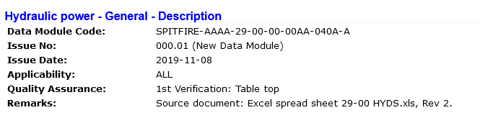
Data Module structure (cont’d)
The Identification and Status section provides information for:
Managing the Data Module within the Raytheon Eagle CSDB.
Managing Data Module applicability.
Managing the quality assurance process.
Controlling the retrieval processes.
Notes:
The identification and status section of the data module contains all the information needed to manage a data module and the data contained within it.
The identification section contains identification and address information. The identification portion is unique and includes the data module code, the language, and the issue date and the data module title.
The status segment contains such data as the security classification, the responsible partner company and originator, any applicability (effectivity), quality assurance status, data restrictions, and the reason for any update that was performed.
Together, the two sections make it possible to control a data module’s retrieval, to manage quality control and to provide applicability and other information to users.
The information within the identification and status section governs the whole data module, so its applicability, classification, and other requirements must always be appropriate for all of the data module content.
This shows how the IDSTATUS appears in the IETP.

Slide 7
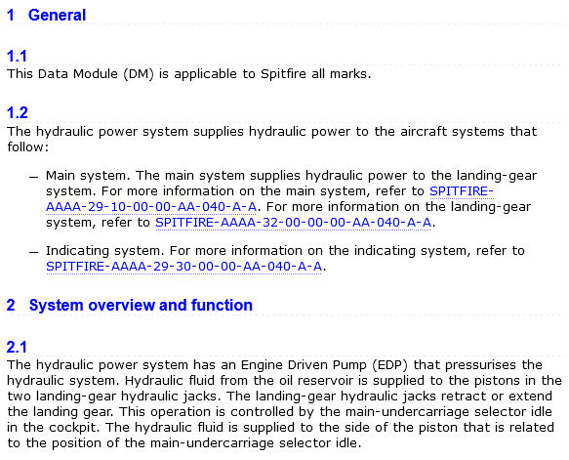
Data Module structure (cont’d)
The Contents section provides the user with the actual information required to conduct the task or describe the system.
Notes:
The Contents section of a data module contains the text and any links to the illustrations or multimedia objects that is presented to the user. The structure and elements of this segment of a data module are dictated by the type of data module selected and its schema.
The Contents section provides the user with the actual information required to conduct the task or describe the system. The BBMF maintenance documents use the following types:
Description
Procedural
Illustrated Parts Data

