Slide 1





S1000D Data Module types

Slide 2

Data Module types
Some current S1000D Data Module types | Illustrated parts data Descriptive information Procedural information Container information Crew/operator information Fault information Maintenance checklists and inspections Maintenance planning information Process information Training information Wiring data information Wiring data description information
Notes:
S1000D has many different document types that have specific uses.
Programmes, such as the BBMF, uses only those document types necessary for the supported equipment, or platform.
The BBMF uses three document types:
Illustrated parts data or IPD;
Descriptive information; and
Procedural, or task, information

Slide 3
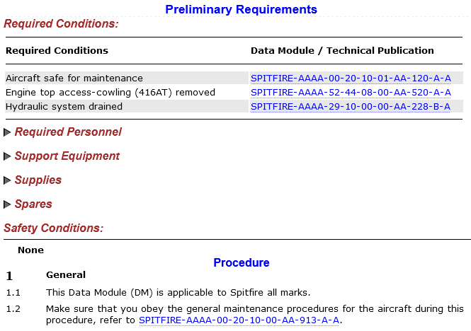
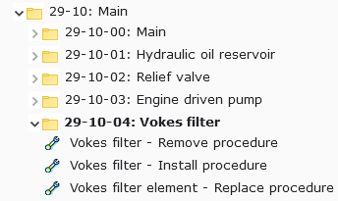

Procedural Information Type
SPITFIRE-AAAA-29-10-04-00AA-520A-A | Remove Procedure
SPITFIRE-AAAA-29-10-04-00AA-720A-A | Install Procedure
SPITFIRE-AAAA-29-10-04-01AA-920A-A | Remove and Install Procedure
Notes:
This shows the three main types of procedures used in the BBMF.
You can see the DMC, with the different information codes, and the corresponding DM title.
This shows how these procedural DM types appear in the Table of Contents of Chapter 29 of the Spitfire AMM.
The navigation can also show the DMC, instead of the title.
Here is an example of how a procedural Data Module appears in the LiveContent IETP.
A procedural Data Module consists of:
Information to check before the task….
Any associated spare parts or tools, and
Any relevant safety information about the task
This is followed by the numbered sequence of steps to carry out
NOTE: a link to another relevant data module will appear as a DMC. When you hover over you will see the title popup so you can check if this is relevant before you click it.

Slide 4
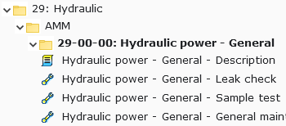
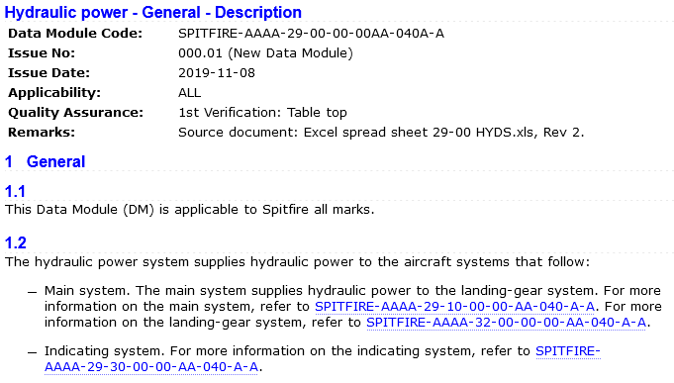
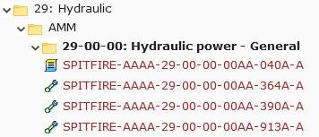
Description Information Type
SPITFIRE-AAAA-29-00-00-00AA-040A-A | General Description
Notes:
This shows the main type of descriptive Data Module used in the BBMF.
As with procedural you can see the DMC, with the information code, and the corresponding DM title.
This shows how this descriptive Data Module type appears in the Table of Contents of Chapter 29 of the Spitfire AMM.
This shows the navigation showing the DMC, instead of the title.
This shows the how a descriptive Data Module is displayed in the IETP.

Slide 5
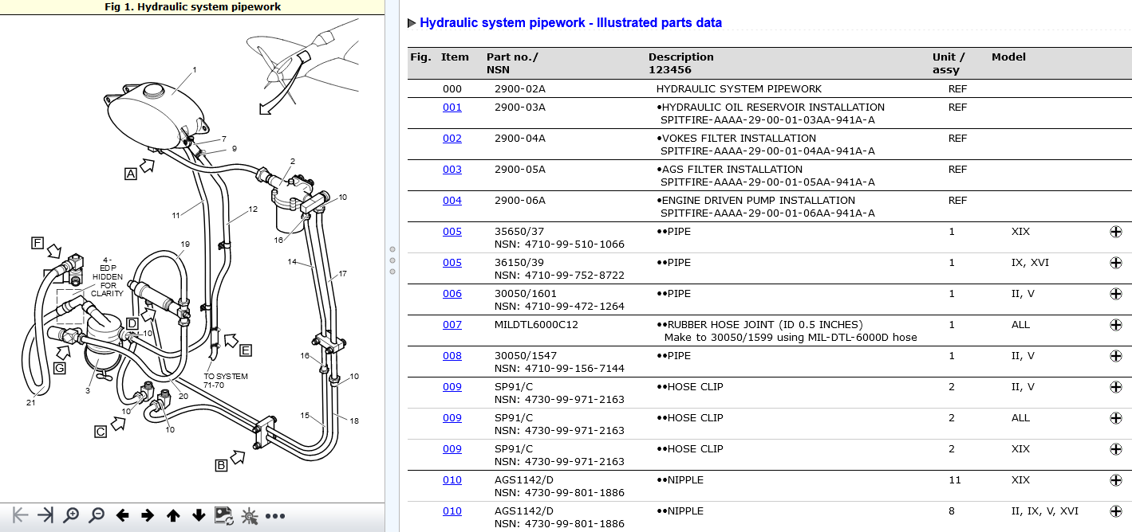
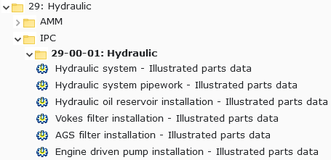
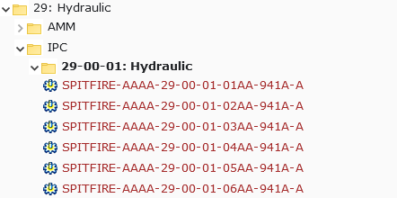
Illustrated Parts Information Type
SPITFIRE-AAAA-29-00-00-00AA-941A-A | Illustrated Parts Data
Notes:
This shows an Illustrated Parts Data Module Code.
As with procedural and descriptive you can see the DMC, with the information code, and the corresponding DM title.
This shows how Illustrated Parts Data Modules appear in the Table of Contents of Chapter 29 of the Spitfire IPC.
This shows the navigation showing the DMC, instead of the title.
This shows the how an Illustrated Parts Data Module is displayed in the IETP.
Each IPD will have one or more illustrations which will appear in the left-hand pane
IPD illustrations are hotspotted, that is, areas of the graphics are linked to areas in the text.
For example, for each numbered callout on the illustration there is a line item in the IPD table.
The numbered callouts are linked so they can be clicked to highlight the corresponding part information on the right.
The item number is also linked back to the graphic.
The IPD table has a shopping cart icon next to any orderable part. This will be discussed in the more detail in the LiveContent tutorial

