Slide 1





The S1000D Publication Module

Slide 2

The Publication Module
      What is a Publication Module?
      How is a Publication Module used?
      How will a Publication Module appear?
Notes:
In this presentation we will discover the S1000D Publication Module, or “PM”.
A PM defines the sequence and hierarchy of a publication.

Slide 3
The Publication Module
A Publication Module defines an S1000D publication.
The PM acts like a table of contents to build the publication and IETP navigation.
The Publication Module defines the combined AMM and IPC publication for each aircraft.
Notes:
A Publication Module is another S1000D document that is used at the programme level to define the publication.
As Data Modules are small, self-contained pieces of information, the PM acts like a table of contents to link Data Modules into chapters and sub-chapters to build the publication and top-level navigation in the IETP.
The Publication Module is created by the BBMF S1000D authors sent to LiveContent as a definition of the combined AMM and IPC publication for each aircraft.

Slide 4
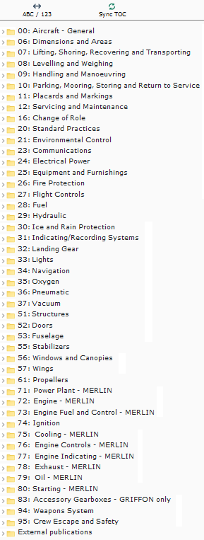
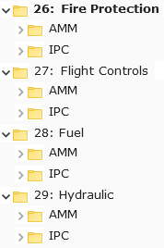
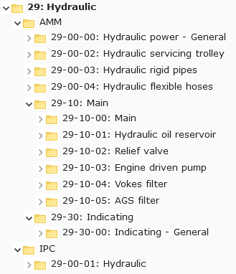
A publication structure
A BBMF publication is hierarchical.
The top level is the Chapter, or system.
Systems are divided into AMM and IPC.
AMM and IPC have further breakdown.
The breakdown is shown in the IETP.
Notes:
A BBMF publication is hierarchical.
The top level of hierarchy is the Chapter and is represented by a two-digit number followed by the description of the aircraft system.
Each system is divided into AMM and IPC.
The AMM and IPC both have further breakdown.
The sub-chapters represent the sub-system and assembly level breakdown of the aircraft and are represented as folder icons in the IETP

Slide 5
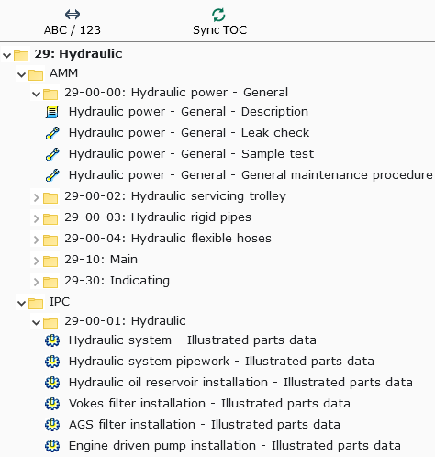
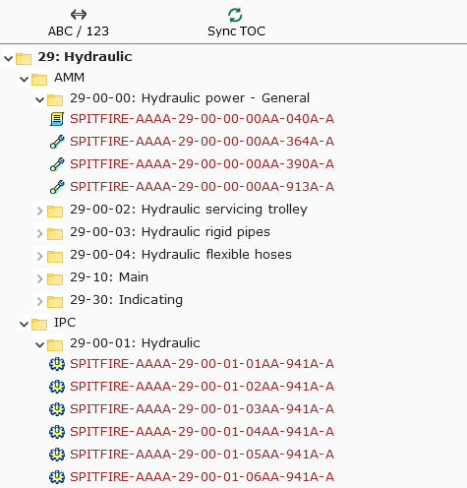



Data Modules in the BBMF Viewer
  Descriptive information
  Procedural information
  Illustrated parts data
Notes:
Inside the chapter breakdown you will see the tasks, descriptions and spares parts breakdowns generated from the Data Modules.
Each data module type has a different icon next to it
Each Data Module is represented by either its title or its DMC. You can choose which way to identify these by toggling the navigation

