Slide 1
Can an actor effect the ratings of a movie?

Slide 2
Have Any of you guys picked a movie based on the main actors in it?
With the data I collected, you will be able to pick an actor and make an educated guess on if the movie could be GREAT movie or Not.

Slide 3
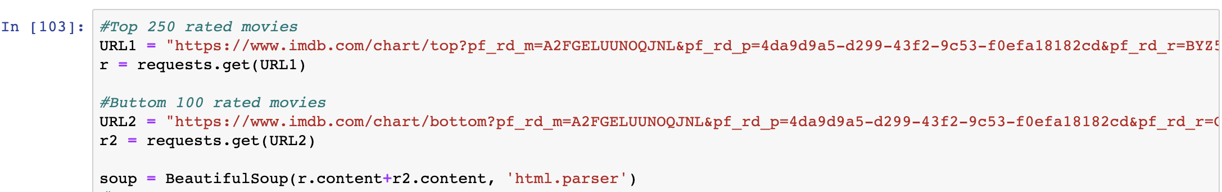
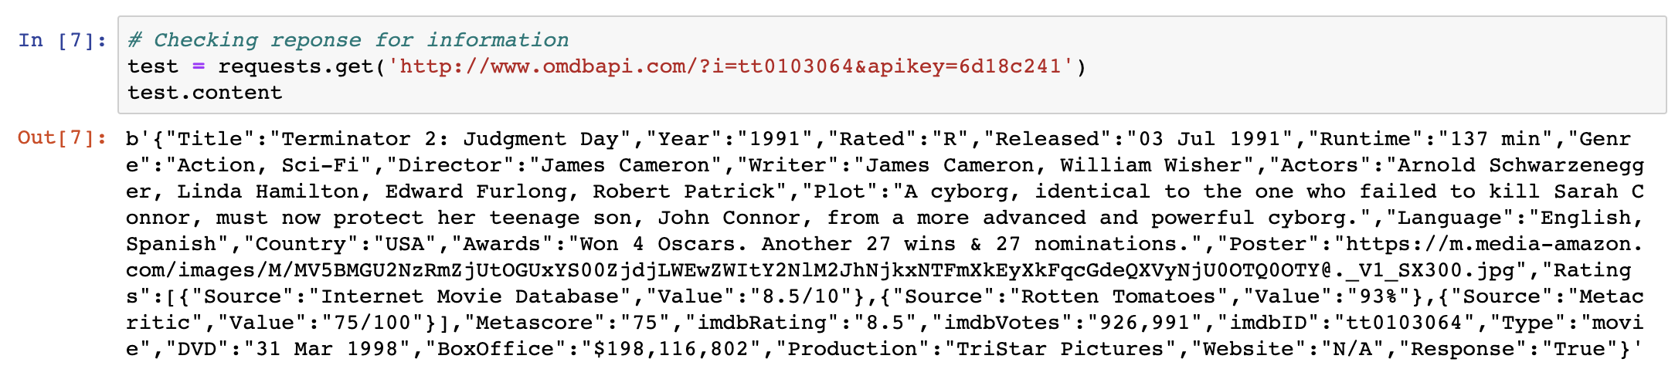
Data collected
I started by getting the data from the top 250 most popular and the lowest 100 movies from www.imdb.com
I used web-scrapping to get the movie ID’s and the api www.omdbapi.com because IMDb.com does not have a native api calling system. With that information we used a for loop to iterate each of the movie_id’s with a customer url call. OMDBapi
I pulled the information I needed from an api. And cleaned it.
I did have to cut some data out of the final database only because of time constraints from cleaning the data.

Slide 5
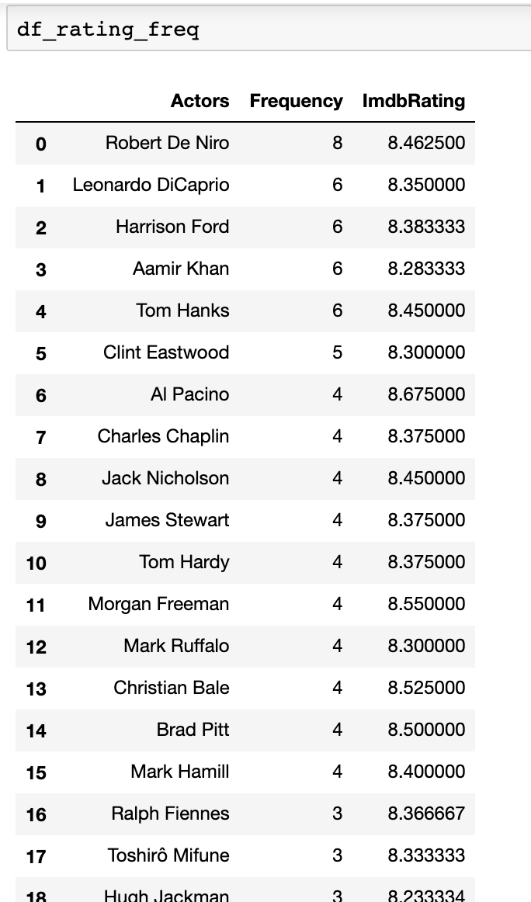
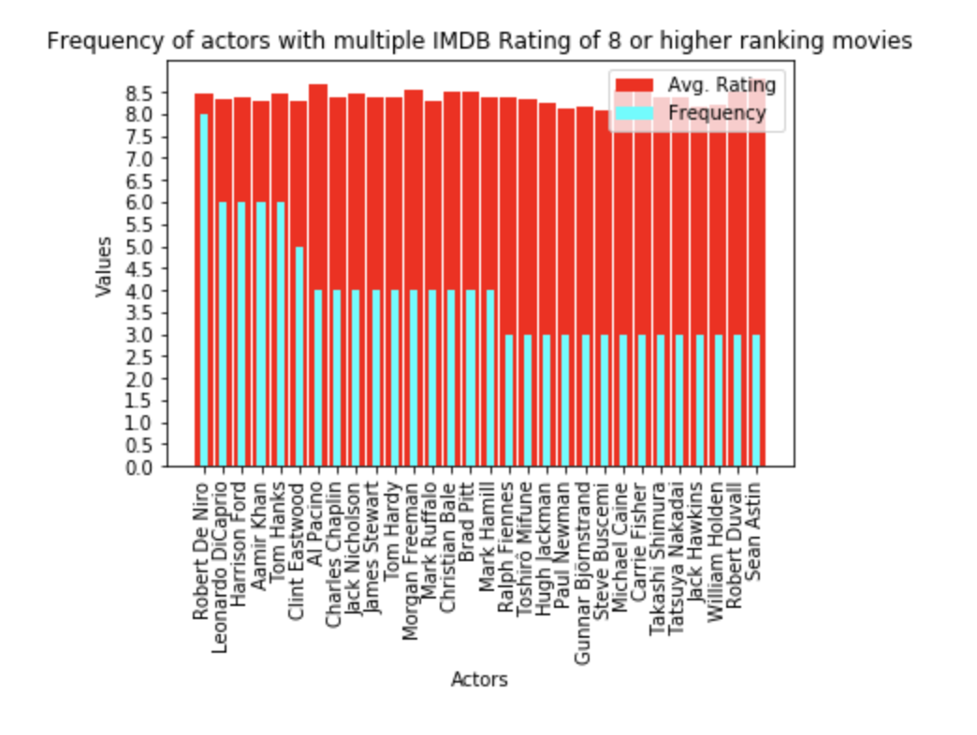
Actors in movies with a IMDb Rating of 8 or higher

Slide 6
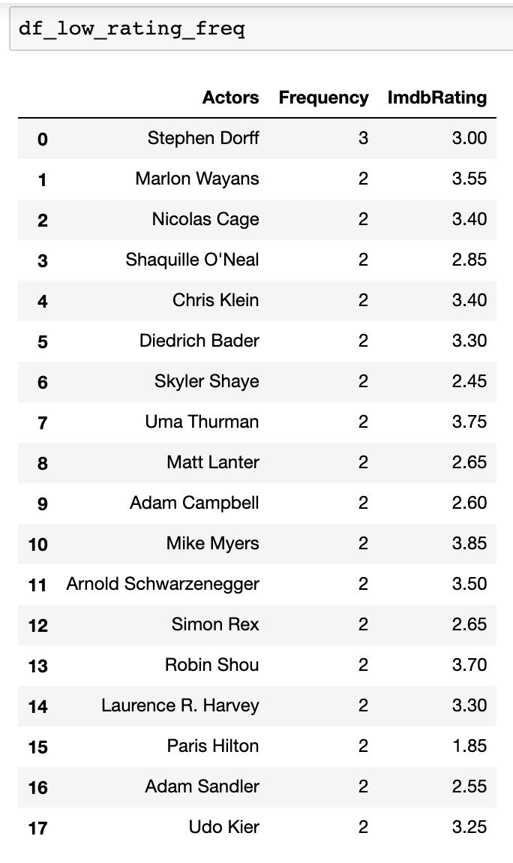
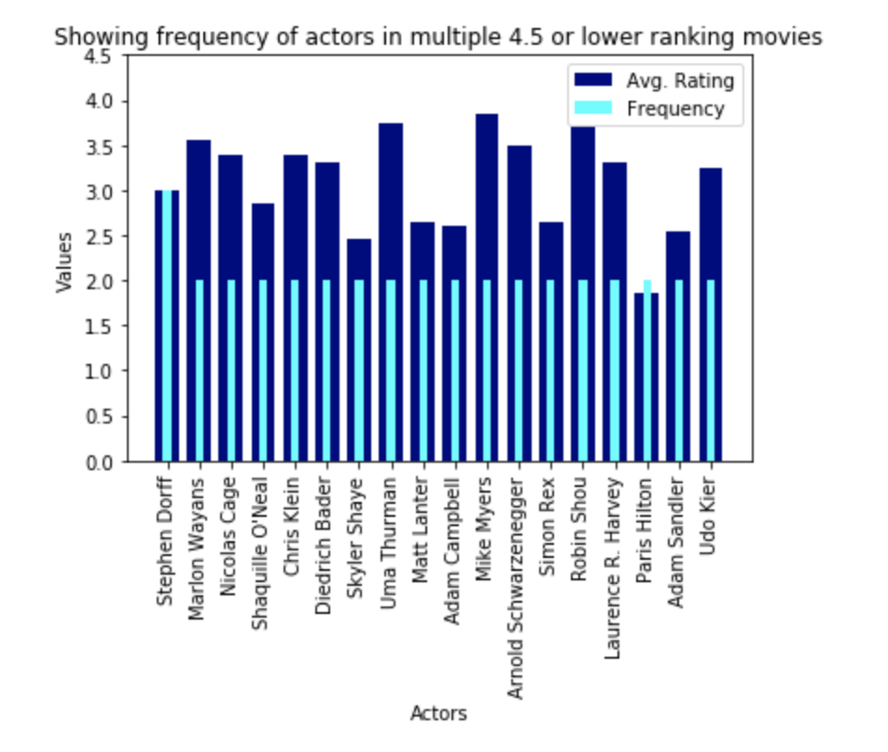
Actors in movies with a IMDb Rating of 4.5 or lower

