Slide 1
Installing MOPSMAP* and running the UI package with in-situ aerosol size distributions
Joseph Schlosser
*Modelled optical properties of ensembles of aerosol particles (MOPSMAP)

Slide 2
Summary
Slides 3-6………………………………………………....Install Ubuntu (Windows 10)
Slide 7…………………………………...............................Install python packages
Slides 8-10…………………………………………………………………Install MOPSMAP
Slides 11-12……………………………….…….Run MOPSMAP user interface (UI)

Slide 3
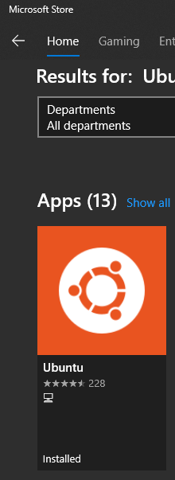
Install Ubuntu (Windows 10)
1) Search for “Ubuntu” and install the Ubuntu application from the Microsoft Store.

Slide 4
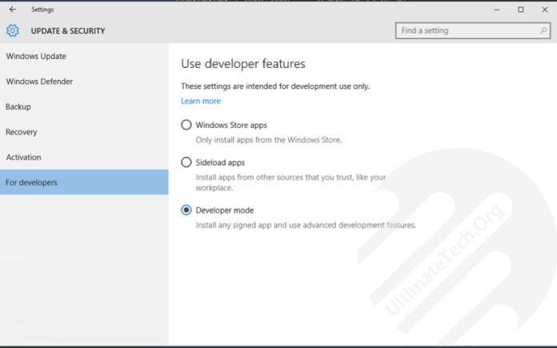
Install Ubuntu (Windows 10)
2) Turn on Developer mode
a) Open Settings > Update and Security > For developers
b) Select the Developer Mode radio button
c) Click Yes in popup

Slide 5
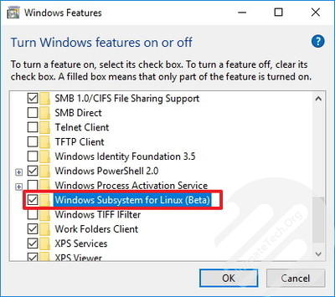
Install Ubuntu (Windows 10)
3) Install the Windows Subsystem for Linux
->Via “Turn Windows features on or off”
a) Open Control Panel and Click on Programs
b) Click on Turn Windows features on or off
c) Check the Windows Subsystem for Linux (beta) option.
d) Click OK and Restart system to complete the task.
->Via PowerShell
a) Open PowerShell as Administrator and run command:
Enable-WindowsOptionalFeature -Online -FeatureName Microsoft-Windows-Subsystem-Linux
b) Restart your computer when prompted

Slide 6
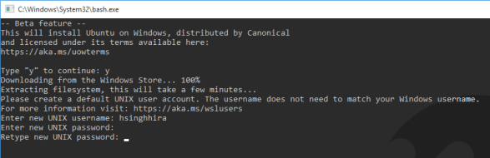
Install Ubuntu (Windows 10)
4) Download components for Linux
a) Open Command Prompt and run bash or Simply search for bash.exe
b) Enter Y to download components
c) Create an UNIX user

Slide 7
Install python packages
These tasks will need to be done from the ubuntu terminal environment after it is installed.
1) Ensure python 3 is updated.
a) $ sudo apt update
b) $ sudo apt -y upgrade
c) $ python3 -V
2) Install python package installer (pip)
a) $ sudo apt install -y python3-pip
3) Install basic set of packages and development tools for our programming environment:
a) $ sudo apt install -y build-essential libssl-dev libffi-dev python3-dev
4) Install python packages required to run the MOPSMAP UI
$ pip3 install numpy
$ pip3 install csv
$ pip3 install matplotlib

Slide 8
Install MOPSMAP
The following information was modified from https://mopsmap.net/download.html
1) Download MOPSMAP v1.0 (https://doi.org/10.5281/zenodo.1284217)
a) Download Fortran source code (mopsmap_program_v1.0.tar.gz): https://zenodo.org/record/1284217/files/mopsmap_program_v1.0.tar.gz
b) Download Single particle data set (~30GB download, ~43GB on disk):
bi) Download the 'main part' (mopsmap_dataset_v1.0_main.tar.xz), which is ~9 GB, to run the basic Fortran program with m_{r} from 1.28 to 1.64:
https://zenodo.org/record/1284217/files/mopsmap_dataset_v1.0_main.tar.xz
bii) Download the 'extended part' (mopsmap_dataset_v1.0_extended.tar.xz), which is ~21GB, in addition to the 'main part' if you want to cover the complete refractive index range as given in Table 1 of the GMD paper [1]:
https://zenodo.org/record/1284217/files/mopsmap_dataset_v1.0_extended.tar.xz
c) Download read_input.f90: PROVIDED FOR NOW.

Slide 9
Install MOPSMAP
The program uses features up to Fortran 2008. It was tested with the GNU Fortran compiler version 6.3 and requires in addition the netcdf developer library for Fortran. Under Debian or Ubuntu, 'sudo apt-get install gfortran libnetcdff-dev make' should be sufficient to meet these requirements.
The following steps are required to compile and run the program:
1) Extract the downloaded source code archive, e.g. with 'tar -xzf mopsmap_program_v1.0.tar.gz'.
2) Place the read_input.f90 in the 'mopsmap' directory command.
3) Change to directory 'mopsmap'.
4) Use the 'make' command to compile the code.
5) Extract the downloaded data set while inside the mopsmap directory, e.g., with 'tar -xJf ../mopsmap_dataset_v1.0_*.tar.xz'.

Slide 10
Install MOPSMAP
Now you should be able to start MOPSMAP with an input file by typing the command 'PATH/mopsmap input_file.txt' where PATH needs to be replaced by the path to the 'mopsmap' directory, where the executable 'mopsmap' is located.
In the input file you may need to add a line 'scatlib 'PATH/optical_dataset'' so that the program knows where the data set is located.
There are several examples provided in the directory 'misc' of the program, including examples from the MOPSMAP paper published at GMD [1]. Consult the MOPSMAP user guide (mopsmap_userguide.pdf) for details about the input and the output of the Fortran program.
Publications or other works using MOPSMAP results are requested to include the following citation:
[1] Gasteiger, J. and Wiegner, M.: MOPSMAP v1.0: a versatile tool for the modeling of aerosol optical properties, Geosci. Model Dev., 11, 2739-2762, https://doi.org/10.5194/gmd-11-2739-2018, 2018.
Furthermore, it should be taken into consideration whether publications cited in the MOPSMAP paper need to be cited as well.

Slide 11
Run MOPSMAP user interface (UI)
1) Unzip the MOPSMAP_UI_Package in the desired directory (e.g., B:/)
2) Use the following commands in the ubuntu terminal to acquire the forward modeled data (NOTES: replace the directory name with the one you unzipped the package in and replace the filename with the .ict fileneame containing the laser aerosol spectrometer (LAS) size distribution data):
a) cd /mnt/b/MOPSMAP_UI_Package
b) cp mopsmap_SD_run.py ~/mopsmap/misc
c) cp mopsmap_UI.py ~/mopsmap/misc
d) cp importICT.py ~/mopsmap/misc
e) cp LAS_bin_sizes.csv ~/mopsmap/misc
f) cp filename.ict
g) cd ~/mopsmap/misc
3) Run the UI by entering “python3 mopsmap_UI.py” in the ubuntu terminal and follow the commands, which start with entering the filename of the .ict file containing the LAS data.

Slide 12
Run MOPSMAP user interface (UI)
4) Use the following commands in the ubuntu terminal to generate a timeseries of calculated extinction coefficient (NOTES: replace the directory name with the one you unzipped the package in and replace the filename with the .ict file containing the LAS size distribution data):
a) $ cd /mnt/b/OptClosurePackage
b) $ cp PlottingCode.py ~/mopsmap/misc
c) $ cd ~/mopsmap/misc
d) $ python3 PlottingCode.py
-> as part of step (d), the user will need to enter the filename
5) Use the following commands in the ubuntu terminal to retrieve the time series generated in the previous step
a) $ cp filename_extinction_timeseries.png /mnt/OptClosurePackage
b) $ cd /mnt/b/OptClosurePackage

