Slide 1

Laptop Price Estimation
Presented By
Usaid Chaudhary
Abdullah Azmat
Saad Nasir

Slide 2
01
Problem Statement
02
Dataset Information
TODAY’S AGENDA
Presented By
Usaid Chaudhary
Abdullah Azmat
Saad Nasir
03
Data Preprocessing and Transformation
04
EDA & ML Modelling

Slide 3
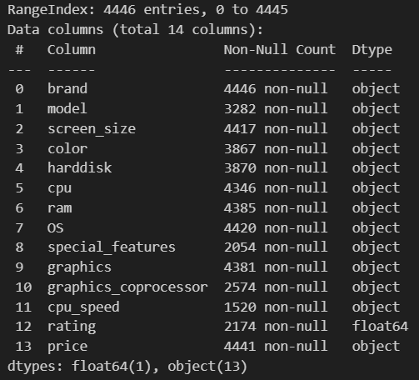
Dataset Information
Problem Statement
(i): Variety Of Choices
(ii): Complex Decision Making
(iii): Lack Of Personalized Guidance
Selecting the right laptop is challenging due to the wide variety of models, specifications, and prices. Consumers often lack the tools to make informed decisions, leading to confusion and suboptimal choices. There is a need for an efficient, data-driven approach to help consumers navigate this complexity and make decisions that fit their needs and budget.

Slide 4
Project Title
Dataset Information
Problem Statement
(i) Source:
(ii): Dimensions
The Dataset is taken from Kaggle:
https://www.kaggle.com/datasets/talhabarkaatahmad/laptop-prices-dataset-october-2023
(iii): Dataframe Summary:
1. Brand: Manufacturer or brand (e.g., HP, Apple, Dell).
Significance: Important for assessing brand reputation and reliability in decision-
making.
2. Model: Specific model name or identifier for each laptop.
Significance: Helps in comparing specific models within a brand.
3. Screen size: Size of the laptop screen (e.g., 14", 15.6").
Significance: Affects portability and user experience.

Slide 5
Data Preprocessing & Transformation
Dataset Information
(iii): Dataframe Summary:
9. Special features: Unique features (e.g., Backlit Keyboard).
Significance: Adds value and differentiates products.
10. Graphics: Type of GPU (e.g., Integrated, Dedicated).
Significance: Important for graphic-intensive applications.
11. Graphics coprocessor: Details about graphics coprocessor.
Significance: Adds information on graphics performance.
12. CPU speed: CPU speed (e.g., 1.8 GHz).
Significance: Influences processing speed and performance.
13. Rating: Customer rating on a scale of 1 to 5.
Significance: Reflects consumer satisfaction.
14. Price: Price of the laptop (e.g., $999.99).
Significance: Central variable for budget optimization in the project.
4. Color: Color of the laptop.
Significance: May influence aesthetic preferences.
5. Hard disk: Storage capacity (e.g., 256 GB, 1 TB).
Significance: Key for assessing storage needs.
6. CPU: Type of CPU (e.g., Intel Core i5).
Significance: Crucial for evaluating performance.
7. RAM: Amount of RAM (e.g., 8 GB, 16 GB).
Significance: Impacts multitasking and performance.
8. OS: Operating system (e.g., Windows 11, macOS).
Significance: Influences user experience and software compatibility.

Slide 6
Data Preprocessing & Transformation
Dataset Information
Pre-Processing
Transformation
Handling Missing Values
Assigning Weights to Processors types
Calculating Value For Money Score
Dimensionality Reduction
Removing Duplicates
Unit Standardisation
Handling Outliers
Feature Normalisation

Slide 7
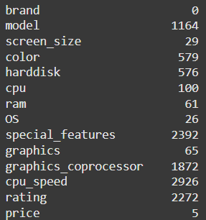
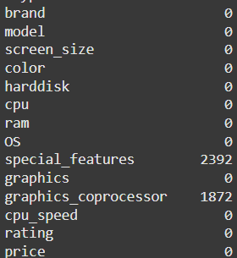
Pre-Processing
Data Preprocessing & Transformation
Handling Missing Values
Transformation
Before
After
Filled with Mode
Filled with Mean
Filled with Place-Holder
Assigning Weights to Processor types
Calculating Value For Money Score
Dimensionality Reduction
screen_size
color
harddisk
ram
os
Cpu_speed
rating
price
model (“unknown”)
cpu (“unknown”)
graphics (“integrated”)

Slide 8
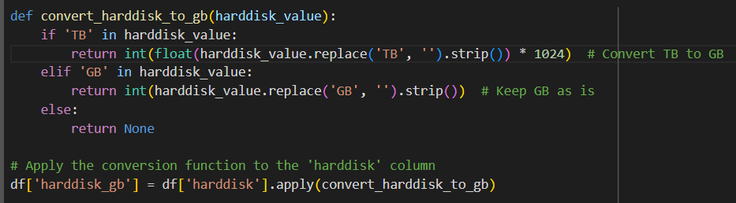
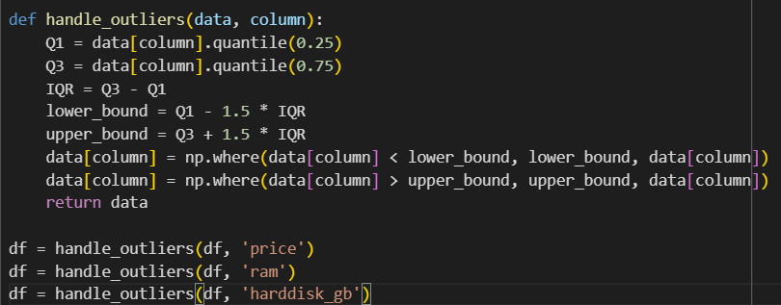
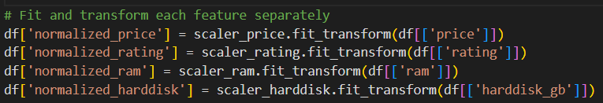
Pre-Processing
Data Preprocessing & Transformation
Transformation
Unit Standardizing of Harddisk Column
Handling Outliers
Transformation
Handling Missing Values
Before
After
Assigning Weights to Processor types
Calculating Value For Money Score
Dimensionality Reduction
Feature Normalization
Filled with Mode
Filled with Mean
Filled with Place-Holder
screen_size
color
harddisk
ram
os
Cpu_speed
rating
model (“unknown”)
cpu (“unknown”)
graphics (“integrated”)
price

Slide 9
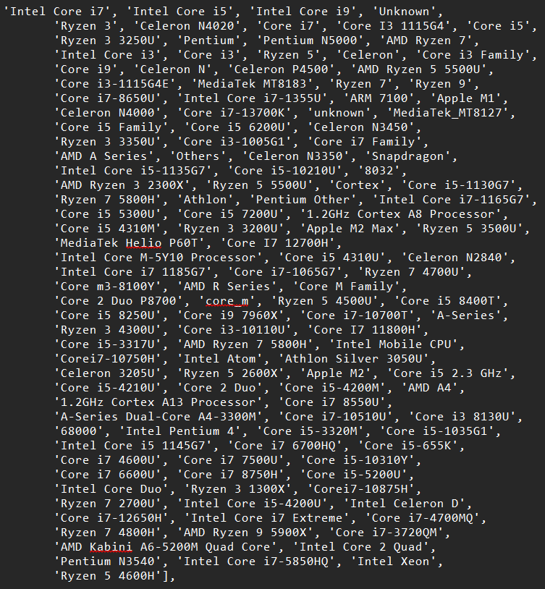
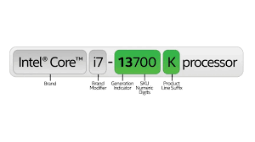
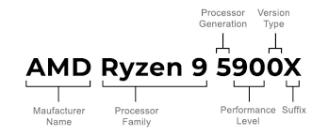
Transformation
Pre-Processing
Data Preprocessing & Transformation
Unique Values in CPU Before Transformation
CPU Chip Naming Format
Handling Missing Values
Transformation
Before
After
Assigning Weights to Processor types
Calculating Value For Money Score
Dimensionality Reduction
Interested
Filled with Mode
Code For Handling The Problem Here
Filled with Mean
Filled with Place-Holder
screen_size
color
harddisk
ram
os
Cpu_speed
rating
model (“unknown”)
cpu (“unknown”)
graphics (“integrated”)
price

Slide 10
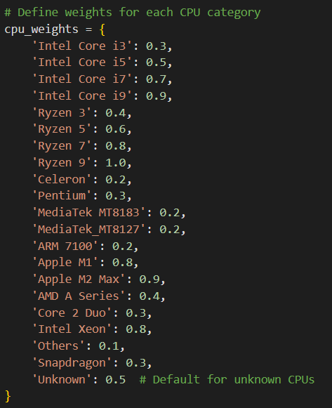
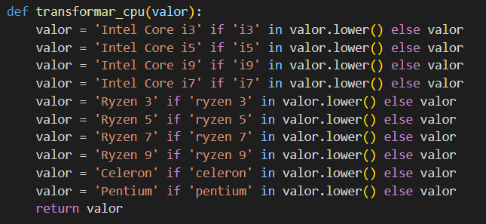
Transformation
Pre-Processing
Data Preprocessing & Transformation
Assigning Weights to CPU
Handling Missing Values
Transformation
Code For Handling The Problem Here
Before
After
Assigning Weights to Processor types
Calculating Value For Money Score
Dimensionality Reduction
Filled with Mode
Weights Assigning
Filled with Mean
Filled with Place-Holder
screen_size
color
harddisk
ram
os
Cpu_speed
rating
model (“unknown”)
cpu (“unknown”)
graphics (“integrated”)
price
VFM Score Calculation

Slide 11
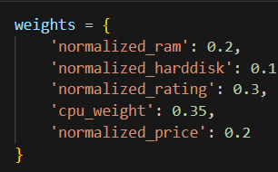
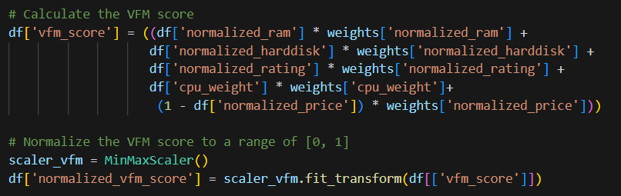
Transformation
Pre-Processing
Data Preprocessing & Transformation
VFM Score Calculation
Assigning Weights to CPU
Handling Missing Values
Weights Assigning
Transformation
Code For Handling The Problem Here
Before
After
Assigning Weights to Processor types
Calculating Value For Money Score
Dimensionality Reduction
Filled with Mode
Filled with Mean
Filled with Place-Holder
screen_size
color
harddisk
ram
os
Cpu_speed
rating
model (“unknown”)
cpu (“unknown”)
graphics (“integrated”)
price

Slide 12
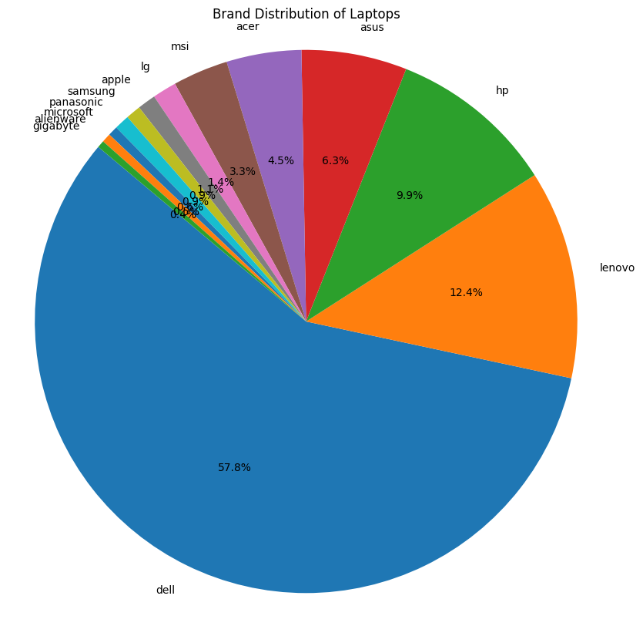
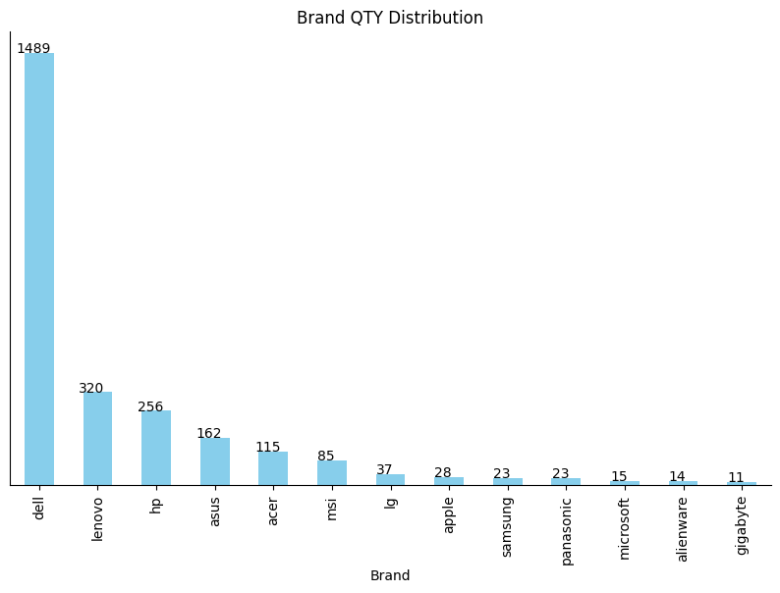
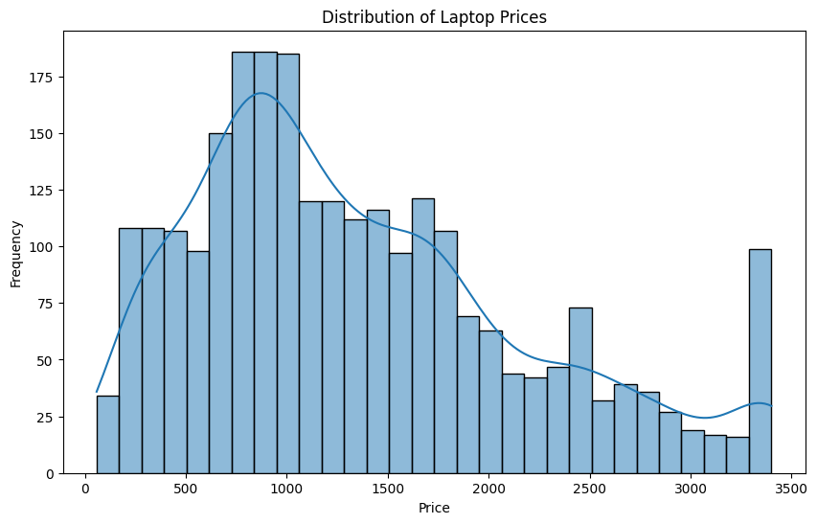
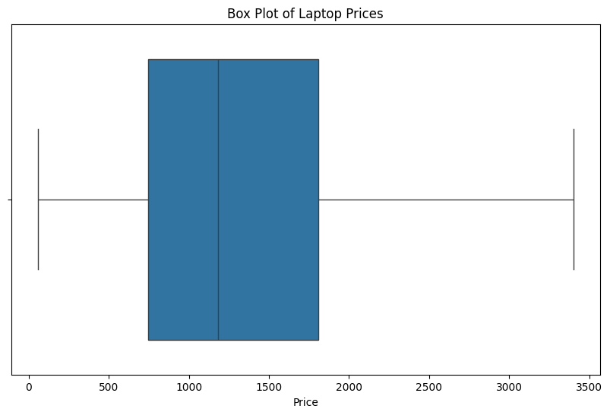
EDA
Pre-Processing
Data Preprocessing & Transformation
Uni-Variate Analysis
Handling Missing Values
Code For Handling The Problem Here
After
Assigning Weights to Processor types
Calculating Value For Money Score
Dimensionality Reduction
Brand Distribution in Dataset
Filled with Mode
Filled with Mean
Filled with Place-Holder
screen_size
color
harddisk
ram
os
Cpu_speed
rating
model (“unknown”)
cpu (“unknown”)
graphics (“integrated”)
price

Slide 13
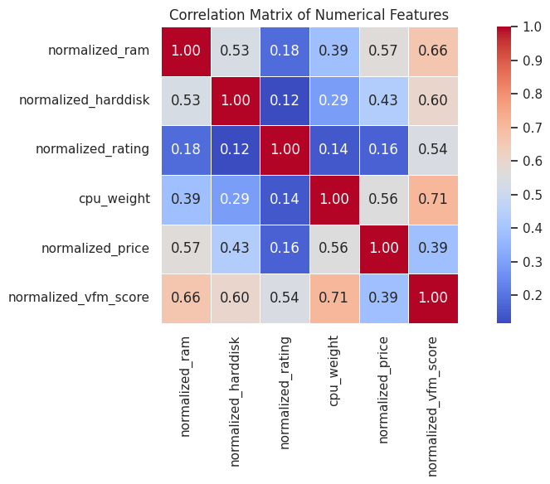
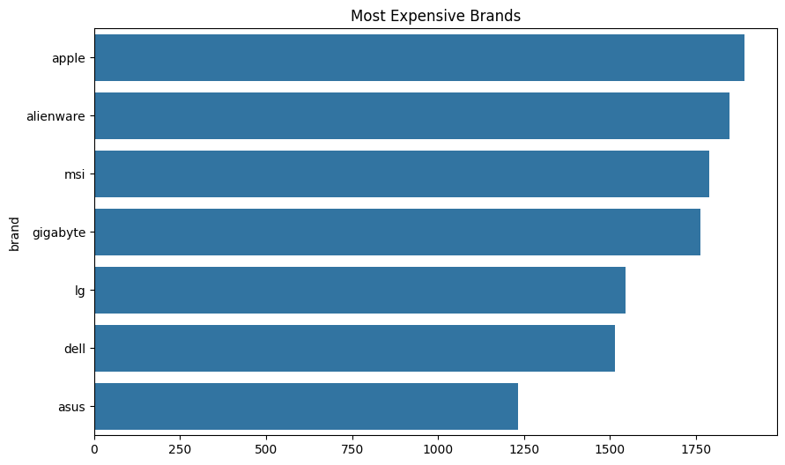
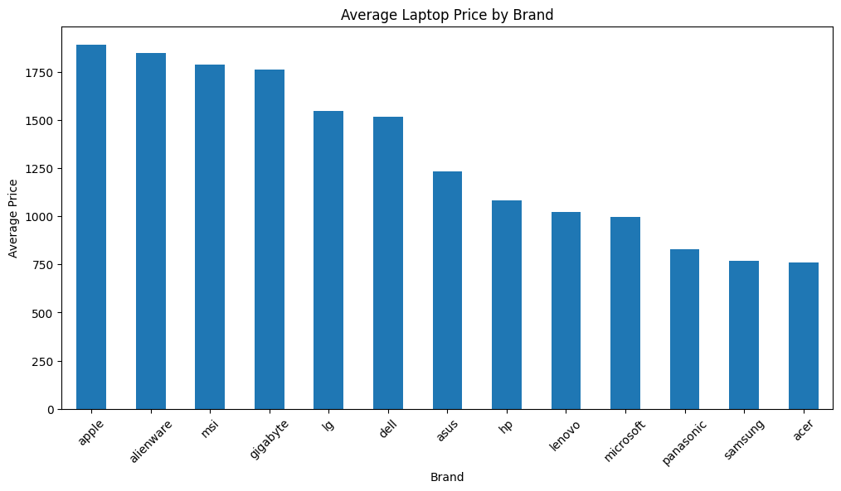
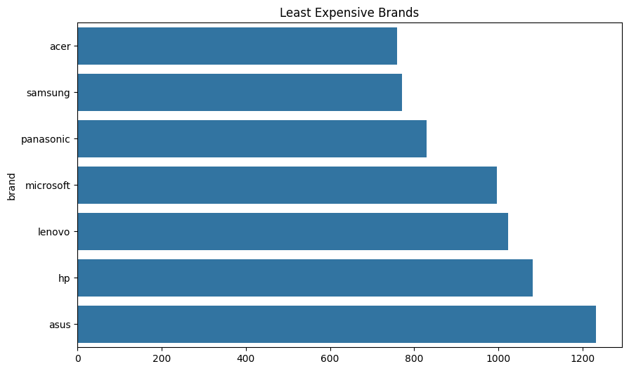
EDA
Pre-Processing
Data Preprocessing & Transformation
Uni-Variate Analysis
Handling Missing Values
Code For Handling The Problem Here
After
Assigning Weights to Processor types
Calculating Value For Money Score
Dimensionality Reduction
Price Distribution in Dataset
Filled with Mode
Filled with Mean
Filled with Place-Holder
screen_size
color
harddisk
ram
os
Cpu_speed
rating
model (“unknown”)
cpu (“unknown”)
graphics (“integrated”)
price

Slide 14
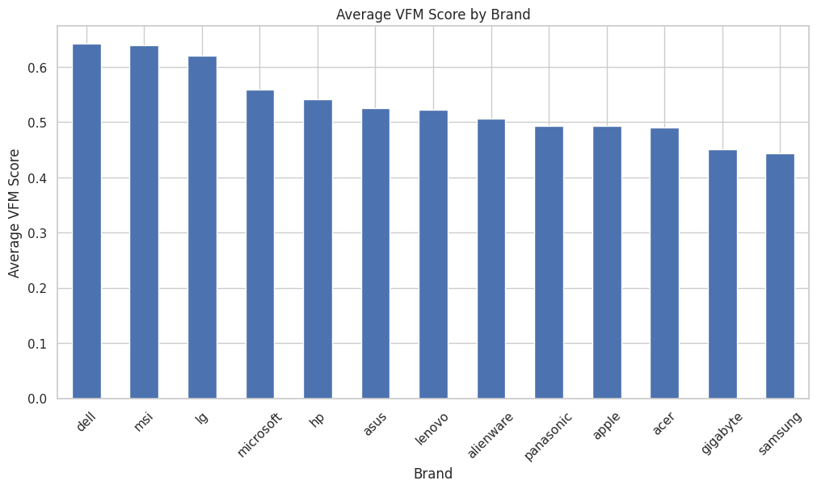
EDA
Pre-Processing
Data Preprocessing & Transformation
Handling Missing Values
Code For Handling The Problem Here
After
Assigning Weights to Processor types
Calculating Value For Money Score
Dimensionality Reduction
Brands Comparison
Filled with Mode
Filled with Mean
Filled with Place-Holder
screen_size
color
harddisk
ram
os
Cpu_speed
rating
model (“unknown”)
cpu (“unknown”)
graphics (“integrated”)
price

Slide 15
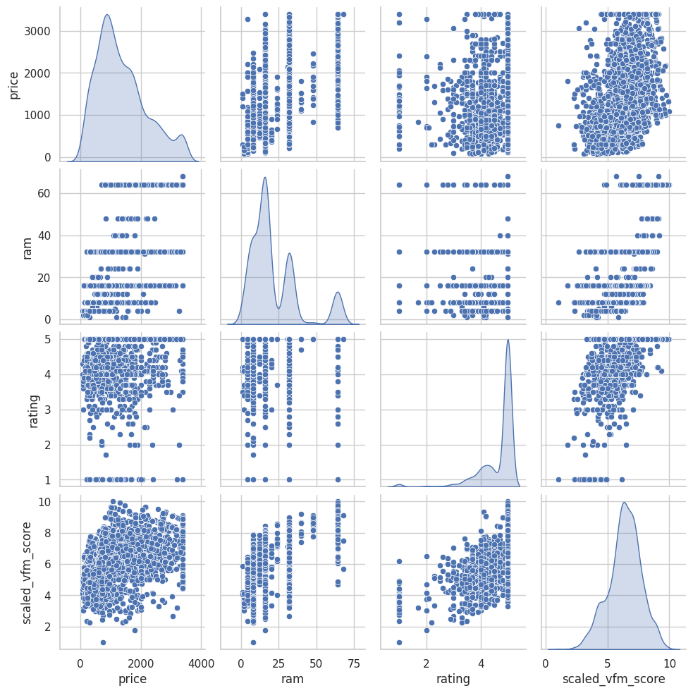
EDA
Pre-Processing
Data Preprocessing & Transformation
Correlation Matrix
Pair Plot
Handling Missing Values
Code For Handling The Problem Here
After
Assigning Weights to Processor types
Calculating Value For Money Score
Dimensionality Reduction
Filled with Mode
screen_size
color
harddisk
ram
os
Cpu_speed
rating

Slide 16
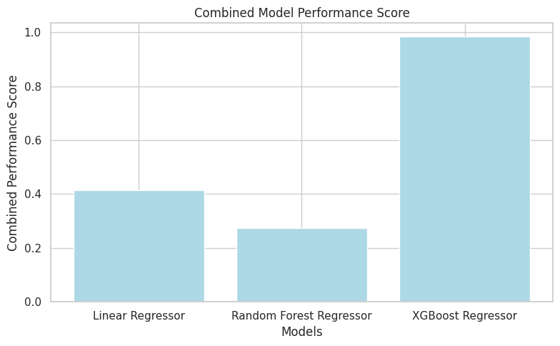
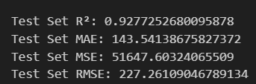
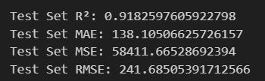
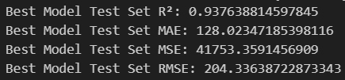
Results
Machine Learning Modelling
Pre-Processing
Data Preprocessing & Transformation
Linear Regressor
Handling Missing Values
Code For Handling The Problem Here
After
Random Forest Regressor
Assigning Weights to Processor types
Calculating Value For Money Score
Dimensionality Reduction
XGBoost Regressor
Filled with Mode
screen_size
color
harddisk
ram
os
Cpu_speed
rating

Slide 17
Results
Machine Learning Modelling
Pre-Processing
Data Preprocessing & Transformation
Linear Regressor
Actual Price: $589.99
After
Random Forest Regressor
Linear Regressor
Random Forest Regressor
XGBoost Regressor
Assigning Weights to Processor types
Calculating Value For Money Score
Dimensionality Reduction
$806.41
$688.86
$575.75
Excels at handling non-linear relationships and iterative error correction.
Benefits from hyperparameter tuning (e.g., learning rate, max depth, number of estimators).
Despite longer training times, it provides higher accuracy and precision.
XGBoost is the optimal choice for this dataset due to its superior handling of complex data relationships and iterative error correction.
XGBoost Regressor
Filled with Mode
screen_size
color
harddisk
ram
os
Cpu_speed
rating

