Slide 1

Programming Fundamentals
First Mini Project : Image Processing
Presented By Algorithm Aficionados
Saad Nasir
(23L-2625)
Emad Rafique
(23L-2604)

Slide 2

Image Enhancement
01
02
Image Transformation
TODAY'S AGENDA
03
Image Filtering
04
Geometric Transformation

Slide 3
Image Enhancement
Brightness
Simple Linear Contrast Stretching Method
Sharpness

Slide 4
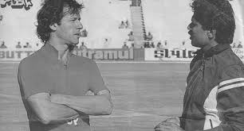
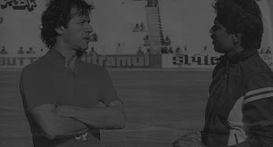
Brightness
Original Image
Function Definition
void changeBrightness(double factor) {
for (int r = 0; r < rows; r++)
for (int c = 0; c < cols; c++) {
ImageData[r][c] *= factor;
if (ImageData[r][c] > maxGray)
ImageData[r][c] = maxGray;
}
}
After Processing
factor = 0.4

Slide 5
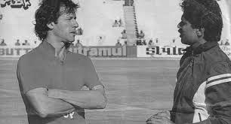
Simple Linear Contrast Stretching
Original Image
Function Definition
void linearContrastStretching() {
vector<int> flattenedData;
for (const auto& row : ImageData) {
flattenedData.insert(flattenedData.end(), row.begin(), row.end());
}
int minIntensity = *min_element(flattenedData.begin(), flattenedData.end());
int maxIntensity = *max_element(flattenedData.begin(), flattenedData.end());
for (int r = 0; r < rows; r++) {
for (int c = 0; c < cols; c++) {
ImageData[r][c] = static_cast<int>(255.0 *
(ImageData[r][c] - minIntensity) / (maxIntensity - minIntensity));
}
}
}
After Processing

Slide 6
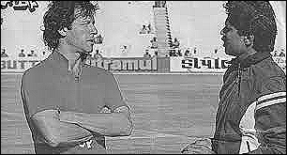
Sharpness
Original Image
Function Definition
void adjustSharpness(double factor) {
vector<vector<int>> sharpenedImage(rows, vector<int>(cols, 0));
for (int r = 1; r < rows - 1; r++) {
for (int c = 1; c < cols - 1; c++) {
int sharpPixel = static_cast<int>(5 * ImageData[r][c] -
ImageData[r - 1][c] -
ImageData[r + 1][c] -
ImageData[r][c - 1] -
ImageData[r][c + 1]);
sharpenedImage[r][c] = max(0, min(255, sharpPixel));
}
}
ImageData = sharpenedImage;
}
After Processing
factor = 15.0

Slide 7
Image Transformation
Covert Image to Binary
Image Resizing
Image Rotation
Image Flipping
Image Cropping
Handling Multiple Images

Slide 8
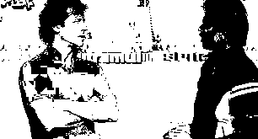
Image to Binary
Original Image
Function Definition
void toBinary() {
for (int r = 0; r < rows; r++) {
for (int c = 0; c < cols; c++) {
if (ImageData[r][c] > 127) {
ImageData[r][c] = maxGray;
}
else {
ImageData[r][c] = 0;
}
}
}
}
After Processing

Slide 9

Image Resizing
Original Image
Function Definition
void reSize(float factX, float factY) {
int new_r = rows * factY;
int new_c = cols * factX;
vector<vector<int>> ImageResize(new_r, vector<int>(new_c));
for (int r = 0; r < new_r; r++) {
for (int c = 0; c < new_c; c++) {
ImageResize[r][c] = ImageData[int(r / factY)][int(c / factX)];
}
}
rows = new_r;
cols = new_c;
ImageData = ImageResize;
}
After Processing
factX = 1.0
factY = 2.0

Slide 10
Image Rotation
Function Definition
void imageRotation(double angleDegrees) {
const double M_PI = acos(-1.0);
double angleRadians = angleDegrees * M_PI / 180.0;
vector<vector<int>> rotatedImage(rows, vector<int>(cols, 0));
int centerX = cols / 2;
int centerY = rows / 2;
for (int r = 0; r < rows; r++) {
for (int c = 0; c < cols; c++) {
int rotatedX = static_cast<int>(cos(angleRadians) * (c - centerX) - sin(angleRadians) * (r - centerY) + centerX);
int rotatedY = static_cast<int>(sin(angleRadians) * (c - centerX) + cos(angleRadians) * (r - centerY) + centerY);
if (rotatedX >= 0 && rotatedX < cols && rotatedY >= 0 && rotatedY < rows) {
rotatedImage[r][c] = ImageData[rotatedY][rotatedX];
}
else {
rotatedImage[r][c] = 255;
}
}
}
ImageData = rotatedImage;
}

Slide 11
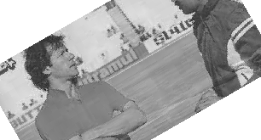
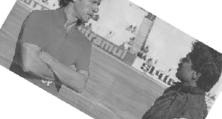
Image Rotation
Original Image
After Processing
angleDegrees = 30
angleDegrees = -30

Slide 12
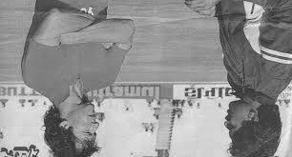
Flipping an Image (Horizontal)
Original Image
Function Definition
void horizontalFlipImage() {
for (int r = 0; r < rows / 2; r++){
for (int c = 0; c < cols; c++) {
int T = ImageData[r][c];
ImageData[r][c] = ImageData[rows-1 - r][c];
ImageData[rows-1 - r][c] = T;
}
}
}
After Processing

Slide 13
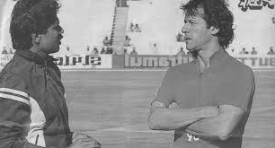
Flipping an Image (Vertical)
Original Image
Function Definition
void verticalFlipImage() {
for (int r = 0; r < rows; r++) {
for (int c = 0; c < cols / 2; c++) {
int T = ImageData[r][c];
ImageData[r][c] = ImageData[r][cols - 1 - c];
ImageData[r][cols - 1 - c] = T;
}
}
}
After Processing

Slide 14
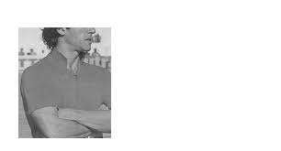
Image Cropping
Original Image
Function Definition
void imageCropping(int st_x, int st_y, int cw, int ch) {
for (int r = 0; r < rows; r++) {
for (int c = 0; c < cols; c++) {
if (r > ch || r < st_y || c < st_x || c > cw) {
ImageData[r][c] = 255;
}
}
}
}
After Processing
Here:
st_x = 20
cw = 120
st_y = 30
ch = 150

Slide 15
Combining Images
Function Definition
void combineImages(const Image& otherImage, bool sideBySide = true) {
if (sideBySide && rows == otherImage.rows) {
int newCols = cols + otherImage.cols;
vector<vector<int>> combinedImage(rows, vector<int>(newCols, 0));
for (int r = 0; r < rows; r++) {
for (int c = 0; c < cols; c++) {
combinedImage[r][c] = ImageData[r][c];
}
}
for (int r = 0; r < otherImage.rows; r++) {
for (int c = 0; c < otherImage.cols; c++) {
combinedImage[r][cols + c] = otherImage.ImageData[r][c];
}
}
cols = newCols;
ImageData = combinedImage;
}
else if (!sideBySide && cols == otherImage.cols) {
int newRows = rows + otherImage.rows;
vector<vector<int>> combinedImage(newRows, vector<int>(cols, 0));
for (int r = 0; r < rows; r++) {
for (int c = 0; c < cols; c++) {
combinedImage[r][c] = ImageData[r][c];
}
}
for (int r = 0; r < otherImage.rows; r++) {
for (int c = 0; c < otherImage.cols; c++) {
combinedImage[rows + r][c] = otherImage.ImageData[r][c];
}
}
rows = newRows;
ImageData = combinedImage;
}
else {
cout << "Invalid combination. Dimensions do not match." << endl;
}
}

Slide 16
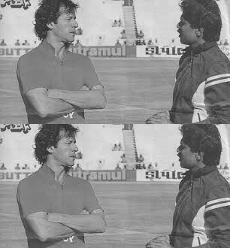
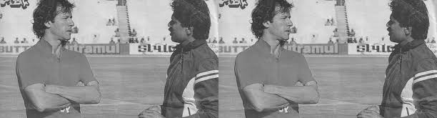
Combining Images
Original Image
side-to-side
top-to-bottom

Slide 17
Image Filtering
Mean Filter
Median Filter
General Linear Filter
Enhancing Image by Applying Filter
Derivative of Image by Derivative Masks Filters
Find Edges Using Derivatives

Slide 18
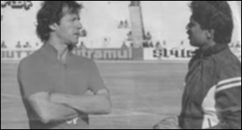
Mean Filter (3x3)
Original Image
Function Definition
void applyMeanFilter() {
vector<vector<int>> filteredImage(rows, vector<int>(cols, 0));
for (int r = 1; r < rows - 1; r++) {
for (int c = 1; c < cols - 1; c++) {
int sum = 0;
for (int i = -1; i <= 1; i++) {
for (int j = -1; j <= 1; j++) {
sum += ImageData[r + i][c + j];
}
}
filteredImage[r][c] = sum / 9; // 3x3 mean filter
}
}
ImageData = filteredImage;
}
After Processing

Slide 19

Median Filter (3x3)
Original Image
Function Definition
void applyMedianFilter() {
vector<vector<int>> filteredImage(rows, vector<int>(cols, 0));
for (int r = 1; r < rows - 1; r++) {
for (int c = 1; c < cols - 1; c++) {
vector<int> neighborhood;
for (int i = -1; i <= 1; i++) {
for (int j = -1; j <= 1; j++) {
neighborhood.push_back(ImageData[r + i][c + j]);
}
}
sort(neighborhood.begin(), neighborhood.end());
filteredImage[r][c] = neighborhood[4]; // 3x3 median filter
}
}
ImageData = filteredImage;
}
After Processing

Slide 20
General Linear Filter Loaded From File
Function Definition
void applyLinearFilter(const char filterFileName[]) {
ifstream filterFile(filterFileName);
if (!filterFile.is_open()) {
cout << "Error: Could not open filter file." << endl;
return;
}
int filterSize;
filterFile >> filterSize;
vector<vector<int>> filterMatrix(filterSize, vector<int>(filterSize, 0));
for (int i = 0; i < filterSize; i++) {
for (int j = 0; j < filterSize; j++) {
filterFile >> filterMatrix[i][j];
}
}
filterFile.close();
int filterRadius = filterSize / 2;
vector<vector<int>> filteredImage(rows, vector<int>(cols, 0));
for (int r = filterRadius; r < rows - filterRadius; r++) {
for (int c = filterRadius; c < cols - filterRadius; c++) {
int sum = 0;
for (int i = -filterRadius; i <= filterRadius; i++) {
for (int j = -filterRadius; j <= filterRadius; j++) {
sum += filterMatrix[i + filterRadius][j +
filterRadius] * ImageData[r + i][c + j];
}
}
filteredImage[r][c] = sum;
}
}
ImageData = filteredImage;
}
filterFileName[ ] = “filterlinearz.txt”

Slide 21
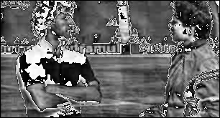
General Linear Filter Loaded From File
Original Image
Size
filterlinearz.txt
3
0 1 0
0 1
0 1 0
After Processing
Filter Values

Slide 22
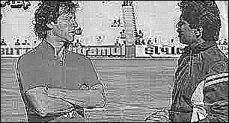
Enhance Image by Applying Filter
Function Definition
Original Image
void applyFilter(const vector<vector<int>>& filter) {
int filterSize = filter.size();
int filterRadius = filterSize / 2;
vector<vector<int>> enhancedImage(rows, vector<int>(cols, 0));
for (int r = filterRadius; r < rows - filterRadius; r++) {
for (int c = filterRadius; c < cols - filterRadius; c++) {
int sum = 0;
for (int i = -filterRadius; i <= filterRadius; i++) {
for (int j = -filterRadius; j <= filterRadius; j++) {
sum += filter[i + filterRadius][j + filterRadius] * ImageData[r + i][c + j];
}
}
enhancedImage[r][c] = max(0, min(255, sum));
}
}
ImageData = enhancedImage;
void enhanceImageWithFilter() {
vector<vector<int>> enhancementFilter = { {-1, -1, -1},
{-1, 9, -1},
{-1, -1, -1} };
applyFilter(enhancementFilter);
}
After Processing

Slide 23
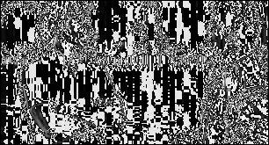
Derivative Using Derivative Masks
Function Definition
Original Image
void computeImageDerivative(const vector<vector<int>>& derivativeMask) {
int maskSize = derivativeMask.size();
int maskRadius = maskSize / 2;
vector<vector<int>> derivativeImage(rows, vector<int>(cols, 0));
for (int r = maskRadius; r < rows - maskRadius; r++) {
for (int c = maskRadius; c < cols - maskRadius; c++) {
int sum = 0;
for (int i = -maskRadius; i <= maskRadius; i++) {
for (int j = -maskRadius; j <= maskRadius; j++) {
sum += derivativeMask[i + maskRadius][j +
maskRadius] * ImageData[r + i][c + j];
}
}
derivativeImage[r][c] = sum;
}
}
ImageData = derivativeImage;
}
After Processing
vector<vector<int>> derivativeMask = { {-1, 0, 1}, {-2, 0, 2}, {-1, 0, 1} };
images[activeImage].computeImageDerivative(derivativeMask);

Slide 24
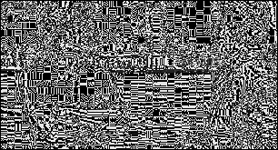
Find Edges
Original Image
Function Definition
void computeImageDerivative(const vector<vector<int>>& derivativeMask) {
int maskSize = derivativeMask.size();
int maskRadius = maskSize / 2;
vector<vector<int>> derivativeImage(rows, vector<int>(cols, 0));
for (int r = maskRadius; r < rows - maskRadius; r++) {
for (int c = maskRadius; c < cols - maskRadius; c++) {
int sum = 0;
for (int i = -maskRadius; i <= maskRadius; i++) {
for (int j = -maskRadius; j <= maskRadius; j++) {
sum += derivativeMask[i + maskRadius][j +
maskRadius] * ImageData[r + i][c + j];
}
}
derivativeImage[r][c] = sum;
}
}
ImageData = derivativeImage;
}
After Processing
vector<vector<int>> derivativeMask = { {0, 1, 0}, {1, -4, 1}, {0, 1, 0} };
images[activeImage].computeImageDerivative(derivativeMask);

Slide 25
Geometric Transformation
Translating an Image
Scale an Image

Slide 26
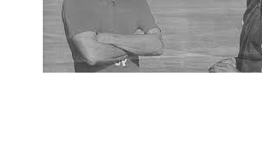
Translate Image
Original Image
Function Definition
void translateImage(int offsetX, int offsetY) {
vector<vector<int>> translatedImage(rows, vector<int>(cols, 0));
for (int r = 0; r < rows; r++) {
for (int c = 0; c < cols; c++) {
int newR = r + offsetY;
int newC = c - offsetX;
if (newR >= 0 && newR < rows && newC >= 0 && newC < cols) {
translatedImage[r][c] = ImageData[newR][newC];
}
else {
translatedImage[r][c] = 255;
}
}
}
ImageData = translatedImage;
}
After Processing
offsetX = 50
offsetY = 80

Slide 27

Scale Image
Original Image
Function Definition
void scaleImage(double scaleFactor) {
int newRows = static_cast<int>(rows * scaleFactor);
int newCols = static_cast<int>(cols * scaleFactor);
vector<vector<int>> scaledImage(newRows, vector<int>(newCols, 0));
for (int r = 0; r < newRows; r++) {
for (int c = 0; c < newCols; c++) {
int originalR = static_cast<int>(r / scaleFactor);
int originalC = static_cast<int>(c / scaleFactor);
scaledImage[r][c] = ImageData[originalR][originalC];
}
}
rows = newRows;
cols = newCols;
ImageData = scaledImage;
}
After Processing
scaleFactor = 2

Slide 28

USING VFX
FIN

