Slide 1



Healthcare Analytics Project

Slide 2
INDEX
KPI 1 Number of Patients across various summaries
KPI 1 OBSERVATION
KPI 2 Profit Vs Non-Profit Stats And It’s Observation
KPI 3 Chain Organizations w.r.t. Total Performance Score as No Score and It’s Observation
KPI 4 Dialysis Stations Stats and It’s Observation
KPI 5 Total Category Text - As Expected and It’s Observation
KPI 6 Average Payment Reduction Rate and It’s Observation
Conclusion
Excel dashboard
Tableau Dashboard
Power Bi Dashboard
Mysql
Challenges Faced and How We Overcame.

Slide 3
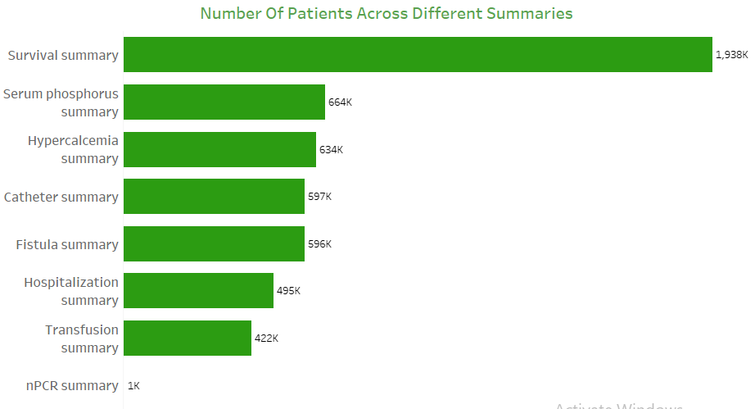
KPI 1 Number of Patients across various summaries

Slide 4
KPI 1 OBSERVATION
1. Dominance of Survival Summary:
The "Survival summary" has the highest number of patients, with nearly 1.938 million, which is significantly higher than any other category.
This suggests that survival rates or outcomes are a primary focus in this dataset, potentially due to the critical importance of tracking patient survival.
2. High Patient Counts in Key Summaries:
"Serum phosphorus summary" and "Hypercalcemia summary" both have over 600,000 patients. These summaries likely relate to important metabolic parameters in patient care.
This indicates a strong emphasis on monitoring and managing serum phosphorus and calcium levels, which are critical in managing chronic conditions like kidney disease.
3. Moderate Attention to Catheter and Fistula Summaries:
Both "Catheter summary" and "Fistula summary" have nearly 600,000 patients each. These summaries might be tracking vascular access types for dialysis patients, which are essential for treatment planning and patient outcomes.
4. Lower Focus on Hospitalization and Transfusion Summaries:
The "Hospitalization summary" and "Transfusion summary" have fewer patients, around 495K and 422K respectively. These summaries could be tracking acute events or interventions, suggesting they are less frequent but still critical.
5. Minimal Focus on nPCR Summary:
The "nPCR summary" has only 1,000 patients, indicating that this is either a niche metric, a recently introduced summary, or one that only applies to a small subset of the patient population.

Slide 5
KPI 2 Profit Vs Non-Profit Stats And It’s Observation
1. Dominance of Profit Organizations:
The chart shows that 89% of the organizations are profit-oriented. This significant majority indicates that the primary focus of Dialysis Centre is on generating revenue and making profits.
2. Minority of Non-Profit Organizations:
Only 11% of the organizations are non-profit. This smaller proportion suggests that a limited number of hospitals focus on patient’s health without the primary intent of generating profit.

Slide 6
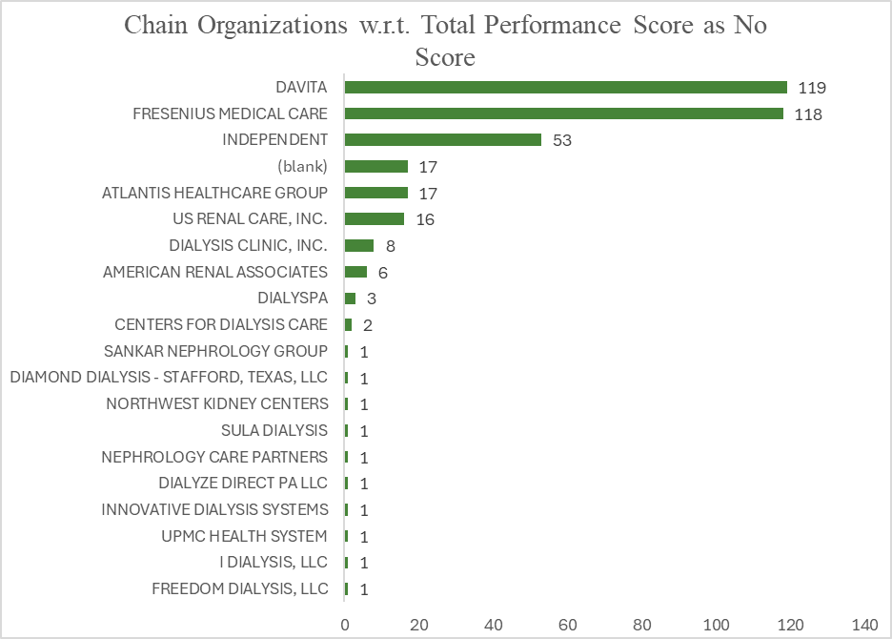
KPI 3 Chain Organizations w.r.t. Total Performance Score as No Score and It’s Observation
DaVita and Fresenius Medical Care lead with the highest performance scores, at 119 and 118, showing their dominant role in the dialysis industry.
There is a significant gap in performance scores, with most smaller organizations scoring only 1, emphasizing the concentration of high scores among a few major providers.
The concentration of high scores suggests that top providers like DaVita and Fresenius have a substantial influence on overall dialysis care quality.
Many smaller organizations have minimal scores, indicating they may have less impact or visibility in the industry compared to the major players.

Slide 7
KPI 4 Dialysis Stations Stats and It’s Observation
About 99% of Dialysis Stations offering In-center Hemodialysis only 1% is not offering. That’s the good sign.
"An equal or nearly equal number of dialysis stations are not offering peritoneal dialysis. Steps need to be taken to increase the availability of peritoneal dialysis in more dialysis stations."

Slide 8
KPI 4 Dialysis Stations Stats
Most dialysis stations about 91%, are owned by chains, while only 9% are individual dialysis centres.
A significant number of dialysis stations 71% do not offer home haemodialysis training, with only 29% providing this service.

Slide 9
KPI 5 Total Category Text - As Expected and It’s Observation
Hospitalization has the highest facility count at 6,818, indicating it's a common occurrence across facilities.
Fistula and PPPW (Presumably a medical term) also have high facility counts at 6,517 and 6,659, respectively, showing their importance in patient management.
Survival is tracked in 5,966 facilities, reflecting its critical importance in monitoring patient outcomes.
Infection is noted in 5,011 facilities, highlighting the need for infection control in dialysis care.
Transfusion is recorded in 6,108 facilities, suggesting frequent use in managing dialysis patients.
SWR has the lowest facility count at 3,623, indicating it may be less commonly monitored or a less frequent issue in dialysis care.

Slide 10
KPI 6 Average Payment Reduction Rate and It’s Observation
Average Payment Reduction rate calculates and tracks the average rate at which payments are reduced, providing insights to cost-saving measues.
The analysis of this KPI helps the healthcare providers in assessing the financial performance, identifying the factors cnotributing to payment reduction.

Slide 11
Conclusion
The majority of dialysis stations are owned by chains, indicating a market dominance that may lead to standardized practices and efficiencies.
In-center hemodialysis is the predominant treatment method, with nearly all facilities offering this service, suggesting a need to maintain high standards and patient satisfaction.
A substantial number of facilities offer peritoneal dialysis, but not as many as in-center options, highlighting a potential area for growth in treatment diversity.
Fewer facilities offer home hemodialysis training, indicating an opportunity to expand this service and support home-based treatment options.
Hospitalization and PPPW categories have the highest facility counts, suggesting a focus on these aspects of care, while other categories like SWR may need additional attention and resources.

Slide 12
EXCEL DASHBOARD

Slide 13
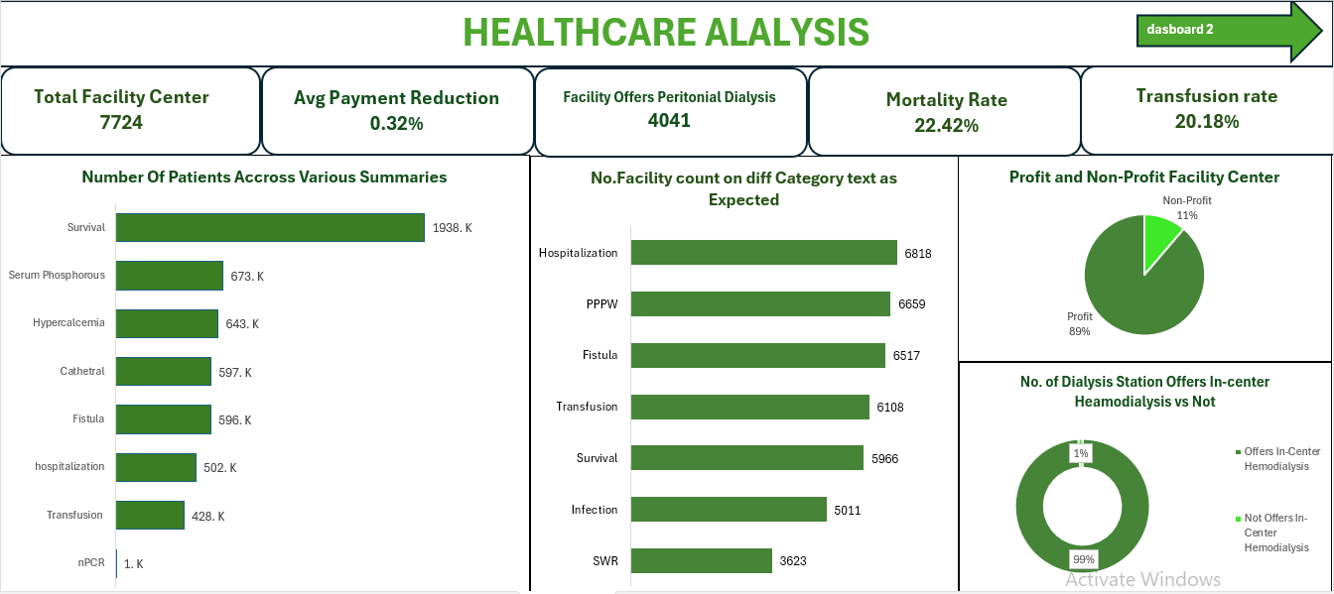

Slide 14
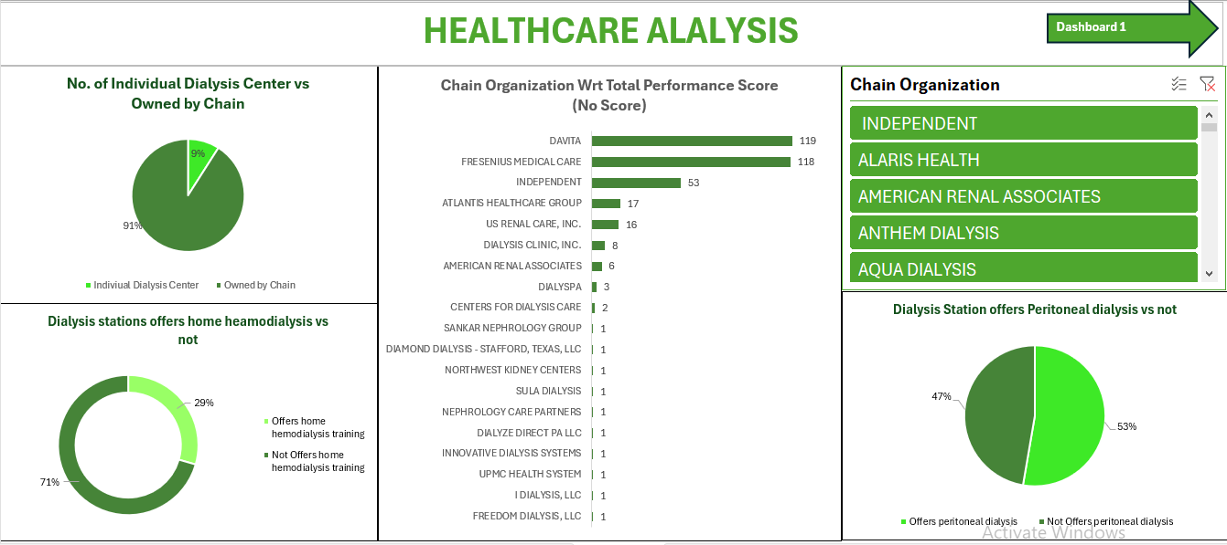

Slide 15
TABLEAU DASHBOARD

Slide 16
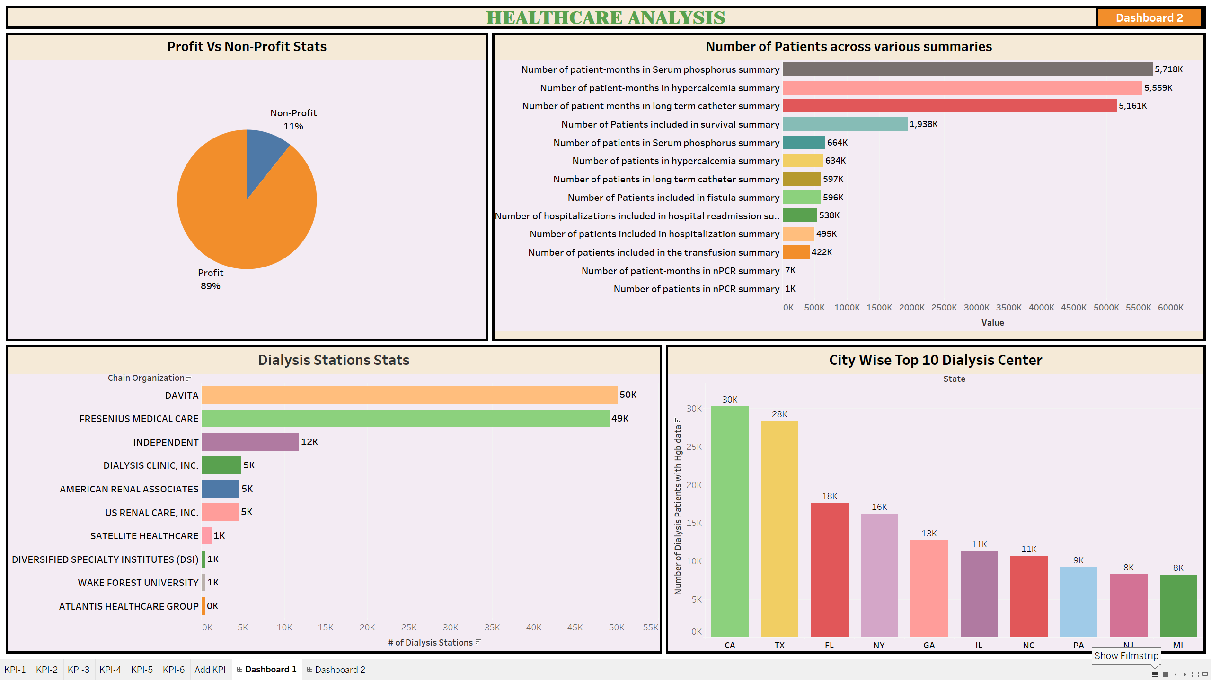

Slide 17
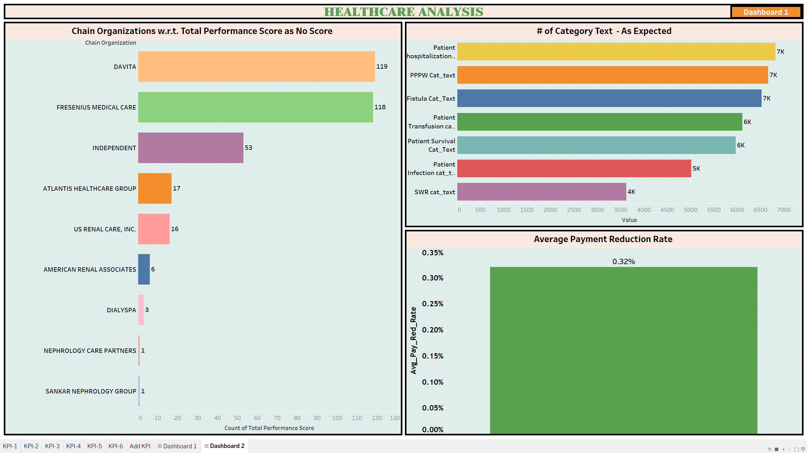

Slide 18
POWER BI DASHBOARD

Slide 19
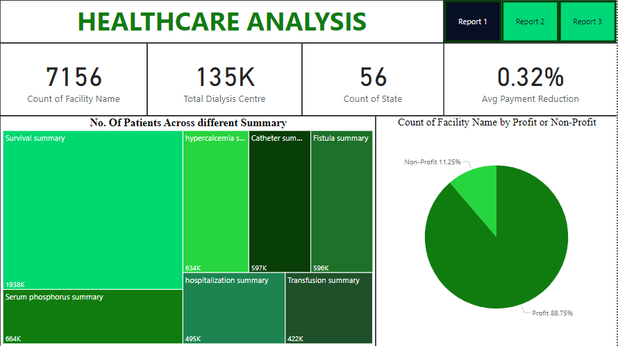

Slide 20
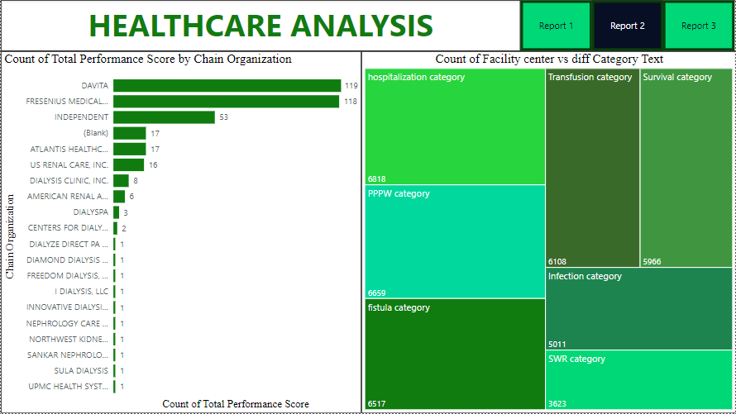

Slide 21
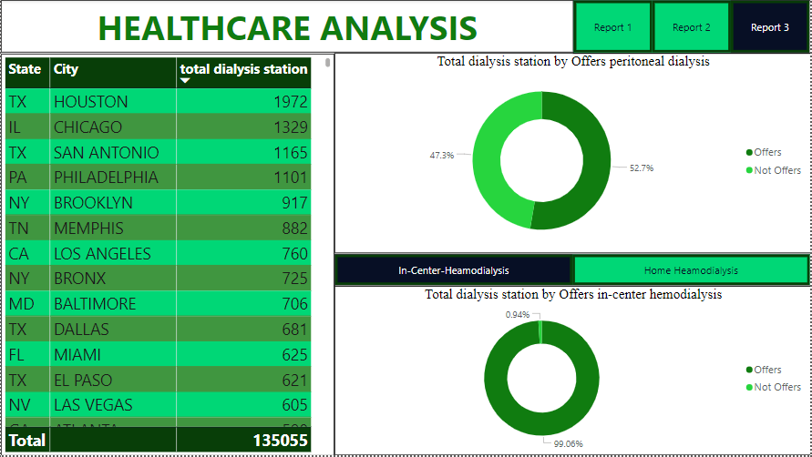

Slide 22
MY SQL

Slide 23
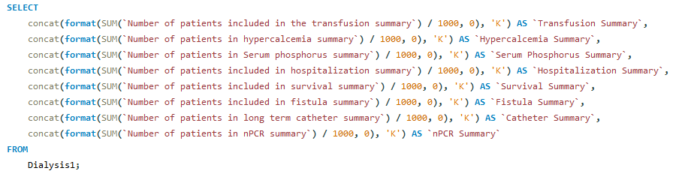
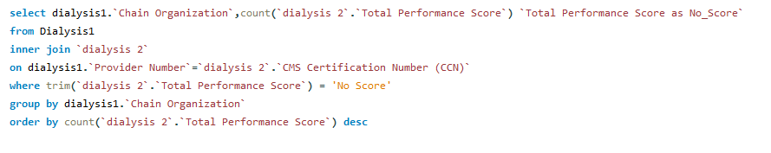

Slide 24
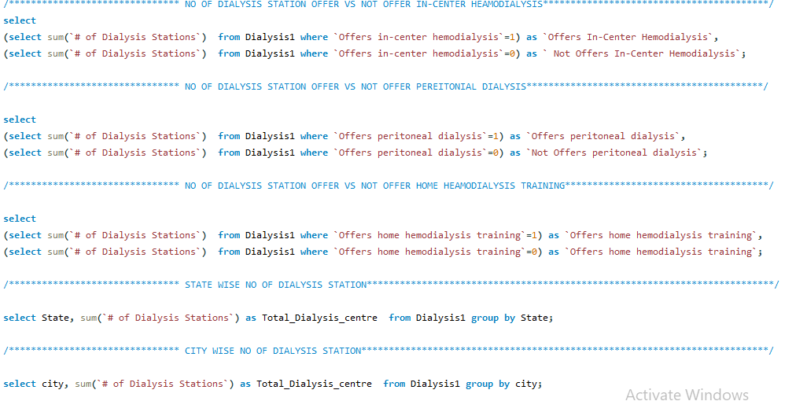

Slide 25
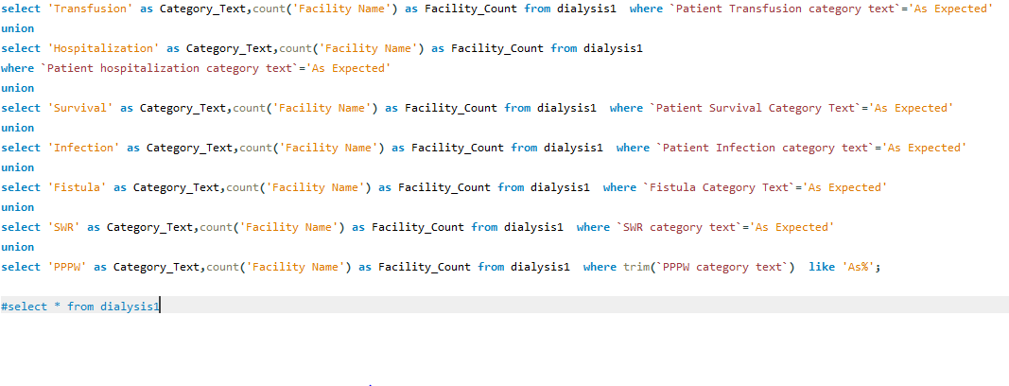

Slide 26
Challenges Faced and How we Overcame
1)While Cleaning Null values, we are not sure to what to replace
First, we replaced with Average value because it is a numerical column. But eventually we found that we must replace the null value based on KPI, In the KPI they asked count of different summary, to retain the data as it is we replaced with Zero.

