Slide 1



Slide 2
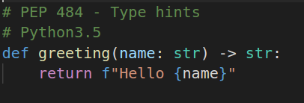
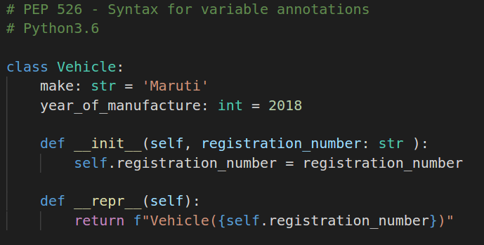
A bit of history

Slide 3
Motivation
Standard Library
  collections.namedtuple
  typing.NamedTuple
The popular attrs project.
George Sakkis' recordType recipe, a mutable data type inspired by collections.namedtuple.
Notes:
Data Classes are not, and are not intended to be, a replacement mechanism for all of the above libraries.
But being in the standard library will allow many of the simpler use cases to instead leverage Data Classes.
Many of the libraries listed have different feature sets, and will of course continue to exist and prosper.

Slide 4
Dataclasses
One main design goal of Data Classes is to support static type checkers
Standard library called Data Classes, can be thought of as "mutable namedtuples with defaults".
A class decorator is provided which inspects a class definition for variables with type annotations as defined in PEP 526 ( fields )
Data Classes use normal class definition syntax, you are free to use inheritance,metaclasses, docstrings, user-defined methods, class factories, and other Python class features.
Attribute type annotation is completely ignored by Data Classes, No base classes or metaclasses are used by Data Classes.

Slide 5
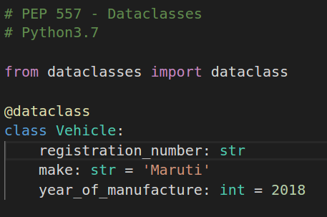
Dataclasses
Can be thought of as "mutable namedtuples with defaults".
Part of standard Library

Slide 6
dataclass parameters
“dataclass” function is typically used as a class decorator is provided to post-process classes and add generated methods (“dunder”)
The dataclass decorator examines the class to find “fields.” A field is defined as any variable identified in __annotations__, is guaranteed to be an ordered mapping
None of the Data Class machinery examines the type specified in the annotation.
The dataclass decorator is typically used with no parameters
def dataclass(*, init=True, repr=True, eq=True, order=False, unsafe_hash=False, frozen=False)

Slide 7
Field objects
Field objects describe each defined field
These objects are created internally, and are returned by the fields()
Users should never instantiate a Field object directly
Its documented attributes are
  name: The name of the field.
  type: The type of the field.
  default, default_factory, init, repr, hash, compare, and metadata

Slide 8
Customization
Post-init processing
Class variables
Init-only variables
Frozen instances
Default factory functions
Mutable default values
Exceptions

Slide 9
Behaviour
Inheritance
More than one constructor
Abstract classes

