Slide 1
Netkit4TIC lab
Name
PoPToP
Version
1.0
Author
Sandro Doro
E-mail
sandro.doro@istruzione.it
Web
http://www.tic.fdns.net/tic/html/lab.html
Description
configuring PoPToP firewall with Linux & Windows road warriors

Slide 2
copyright notice
All the pages/slides in this presentation, including but not limited to, images, photos, animations, videos, sounds, music, and text (hereby referred to as “material”) are protected by copyright.
This material, with the exception of some multimedia elements licensed by other organizations, is property of the authors and/or organizations appearing in the first slide.
This material, or its parts, can be reproduced and used for didactical purposes within universities and schools, provided that this happens for non-profit purposes.
Information contained in this material cannot be used within network design projects or other products of any kind.
Any other use is prohibited, unless explicitly authorized by the authors on the basis of an explicit agreement.
The authors assume no responsibility about this material and provide this material “as is”, with no implicit or explicit warranty about the correctness and completeness of its contents, which may be subject to changes.
This copyright notice must always be redistributed together with the material, or its portions.

Slide 3
VPNs
from Wikipediahttp://en.wikipedia.org/wiki/Virtual_private_network :
  VPN is a private communications network often used to communicate confidentially over a publicly accessible network.
There are many types of VPN. In this slide we choose PPTP (Point-to-point tunneling protocol)
  All releases of Microsoft Windows since Windows 95 are bundled with a PPTP client.
  PPTP connections are authenticated with Microsoft MSCHAP-v2 or EAP-TLS. MSCHAP-v2 can be compromised if users choose weak passwords.

Slide 4
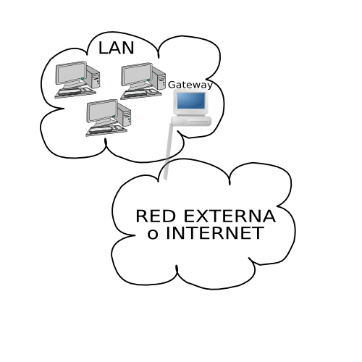

in this lab
…and usually in the real world…
  PPTP allows remote users to securely and inexpensively access their corporate network from anywhere on the Internet.
  with PoPTophttp://www.poptop.org/ Linux servers can now function seamlessly in a PPTP VPN environment

Slide 5
Configuring client
Microsoft:
  Google (keywords: XP PPTP Configure)
  http://cto.secs.oakland.edu/VPN
Linux http://pptpclient.sourceforge.net/howto-debian.phtml:
  Using PPTP client GUI: pptpconfig
  by hand

Slide 6
Configuring Server (uClibc)
LEAF/Bering uClibc:
  kernel just patched for mppe
  packages: pptpd.lrp (depends on ppp.lrp)
  shorewall:
    /etc/shorewall/tunnels
    /etc/shorewall/rules
  samba as wins server

Slide 7



step 1 - topology
Real side
203.1.1.0/24
202.1.1.0/24
road warrior
254
realHost
254
road warrior
tap1
tap2
1
1
1
1
1
eth0
206.1.1.0/24
eth0
eth0
eth0
eth0
254
tap0
Linux Debian
uBering
Windows XPP
192.168.1.0/24
1
1
1
1
254
253
eth0
eth0
eth0
eth0
eth1
eth0
UML side
Linux Debian
QEMU side

Slide 8
step2 – configuration (server)
fw
fw # cat /etc/ppp/pptpd.conf | grep -v \# | strings
option /etc/ppp/options.pptpd
mtu 1400
mru 1400
bcrelay eth1
localip 192.168.1.230-238
remoteip 192.168.1.130-138

Slide 9
step2 – configuration (server)
fw
fw# cat /etc/ppp/options.pptpd | grep -v \# | strings
name nk4tic
auth
refuse-pap
refuse-chap
refuse-mschap
require-mschap-v2
require-mppe-128
proxyarp
nodefaultroute
debug
dump
lock
nobsdcomp
nodeflate

Slide 10
step2 – configuration (server)
fw
fw# cat /etc/shorewall/interfaces
#ZONE INTERFACE BROADCAST OPTIONS
net eth0 detect dhcp,routefilter,norfc1918,tcpflags
loc eth1 192.168.1.255
loc ppp+
fw
fw# cat /etc/shorewall/tunnels
# TYPE ZONE GATEWAY GATEWAY ZONE
pptpserver net 0.0.0.0/0

Slide 11
step2 - configuration client
net
net# cat net.startup
modprobe ppp_async
modprobe ppp_mppe
net
net# cat /etc/ppp/peers/netkit
pty "pptp 206.1.1.253 --nolaunchpppd"s$ cat netkit
name nk4tic
require-mppe-128
mtu 1400
file /etc/ppp/options.pptp

Slide 12
step2 - configuration client
net
net
net
net# cat /etc/ppp/chap-secrets
nk4tic * not24get *
net
net# cat /etc/ppp/options.pptp
lock auth nobsdcomp nodeflate noproxyarp

Slide 13
step3 – starting the lab
host machine
realHost$ tar zxf PoPTop.tgz
realHost$ cd PoPToP
realHost:~/PoPToP$ cp netkit4tic.ds ~/.devilspie
realHost:~/PoPToP$ devilspie &
upon launching the lab
  3 virtual machines are started
  node fw is ready to accept pptp connection from road warriors
  road warrior with Linux OS can activare VPN with “pon netkit”
  road warrior with Windows XP OS can activate VPN

Slide 14
step3 – starting (UML side)
realHost
realHost$ ifname1=`sudo tunctl -b -u knoppix`; \
ifname2=`sudo tunctl -b -u knoppix`
realHost$ sudo ifconfig $ifname1 206.1.1.254; \
sudo ifconfig $ifname2 203.1.1.254
realHost# echo "1" > /proc/sys/net/ipv4/ip_forward
realHost$ lstart

Slide 15
step3 – starting (QEMU side)
realHost
realHost$ ifname3=`sudo tunctl -b -u knoppix`
realHost$ su
realHost# umount /dev/shm; \
mount -t tmpfs -o size=160m none /dev/shm; \
modprobe kqemu; \
cp qemu-ifup /etc; \
exit
realHost$ export VM-Repository="path locale/remote to VM images"
realHost$ qemu-img create -b $VM-Repository/XPPSP2.img \
-f qcow delta-XPPSP2.img
realHost$ export QEMU_SW="-usb -usbdevice tablet -kernel-kqemu"; \
export QEMU_NET="-net nic -net tap,$ifname3"; \
qemu -m 140 -hda delta-XPPSP2.img $QEMU_SW $QEMU_NET

Slide 16
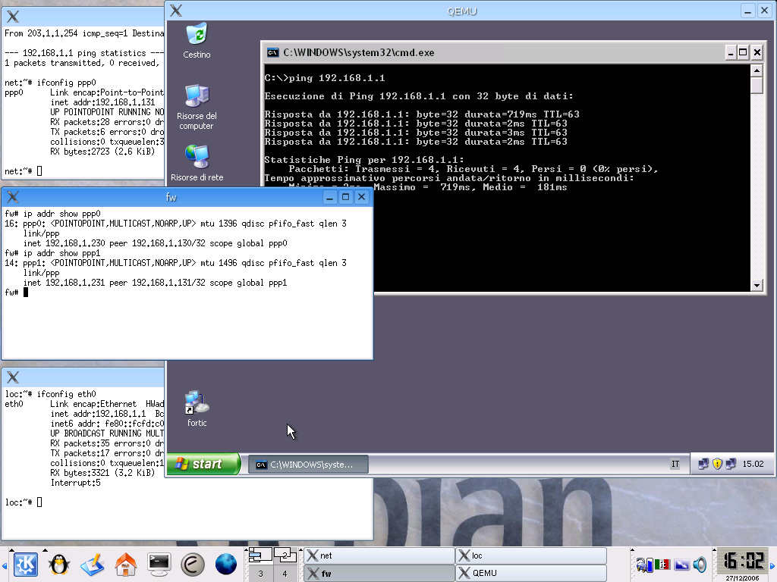
screenshot

