Slide 1
netkit lab
  gMapsCaching
Version
1.0
Author(s)
Sandro Doro
E-mail
sandro.doro@istruzione.it
Web
http://www.tic.fdns.net/tic/html/lab.html
Description
Testing special squid version to cache maps.google.com

Slide 2
copyright notice
All the pages/slides in this presentation, including but not limited to, images, photos, animations, videos, sounds, music, and text (hereby referred to as “material”) are protected by copyright.
This material, with the exception of some multimedia elements licensed by other organizations, is property of the authors and/or organizations appearing in the first slide.
This material, or its parts, can be reproduced and used for didactical purposes within universities and schools, provided that this happens for non-profit purposes.
Information contained in this material cannot be used within network design projects or other products of any kind.
Any other use is prohibited, unless explicitly authorized by the authors on the basis of an explicit agreement.
The authors assume no responsibility about this material and provide this material “as is”, with no implicit or explicit warranty about the correctness and completeness of its contents, which may be subject to changes.
This copyright notice must always be redistributed together with the material, or its portions.

Slide 3
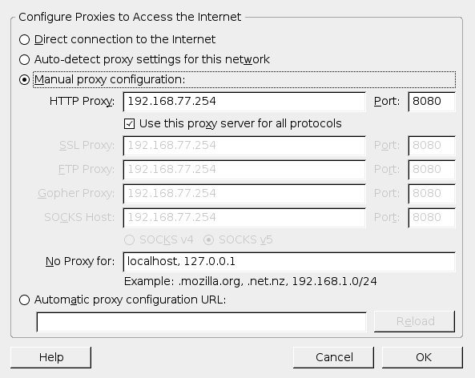
firefox setting

Slide 4
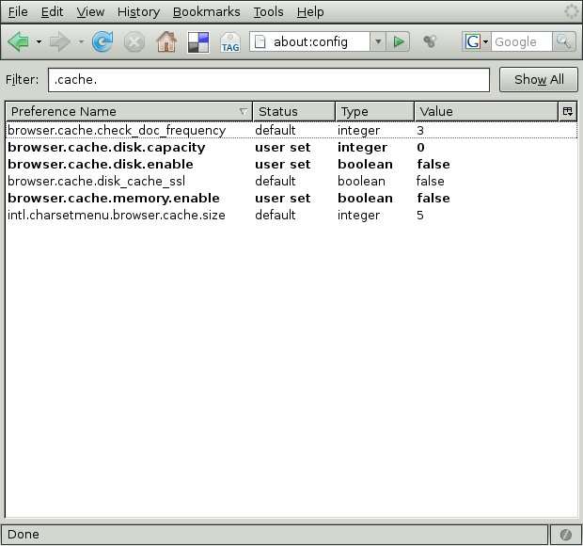
kiosk firefox setting

Slide 5
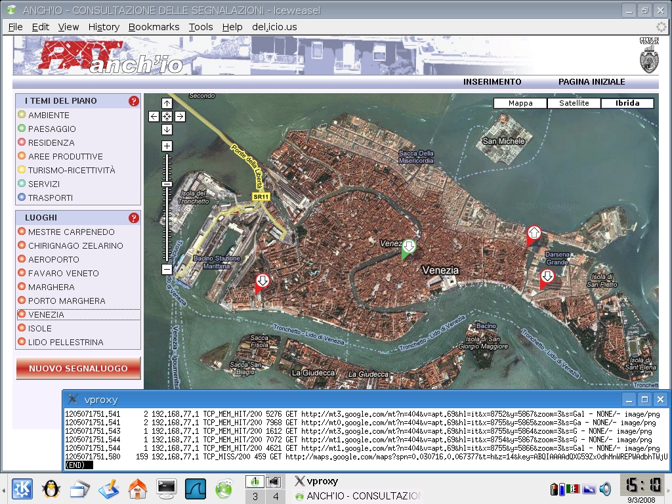

Slide 6
abstract topology
VLAN-unaware
VLAN-unaware
bridgeFactory
VLAN-aware
VLAN-aware

Slide 7
detailed topology
192.168.3.0/24 (VLAN 3)
192.168.2.0/24
192.168.3.0/24 (VLAN 3)
192.168.2.0/24
A
B
1
brVLAN3
brNoVLAN
2
eth0.3
eth0.3
eth1.3
eth0.3
1
eth0
eth1
2
eth0
eth0
pc1
pc2
bridgeFactory
# brctl show
bridge name bridge id STP enabled interfaces
brNoVLAN 8000.000000010000 no eth0
eth1
brVLAN3 8000.000000010000 no eth0.3
eth1.3

Slide 8
Problem
The traffic go all trough brNoVLAN bridge
sniffing brNoVLAN
brVLAN3
brNoVLAN
eth0.3
eth1.3
eth0
eth1
bridgeFactory

Slide 9
Solution: EBTables
Kernel space
Integrated into kernel 2.6 and patchable into kernel 2.4 (LEAF/Bering ready)
Enable in “Bridge: Netfilter Configuration” section:
CONFIG_BRIDGE_NT_EBTABLES=m
CONFIG_BRIDGE_EBT_* =m
User space: http://ebtables.sourceforge.net/
arptables: is used to set up, maintain, and inspect the tables of
ARP rules in the Linux kernel
ebtables: is used to set up, maintain, and inspect the tables of
Ethernet frame rules in the Linux kernel.

Slide 10
Solution: EBTables
-t broute, is used to make a brouter, it has one built-in chain: BROUTING.
The targets DROP and ACCEPT have special meaning in the broute table.
DROP actually means the frame has to be routed, while ACCEPT
means the frame has to be bridged.
The BROUTING chain is traversed very early. It is only traversed by
frames entering on a bridge enslaved NIC that is in forwarding state.
Normally those frames would be bridged, but you can decide otherwise
here.

Slide 11
EBTables commands
Filtering:
ebtables -t broute -A BROUTING -i eth0 -p 802_1q --vlan-id 3 -j DROP
ebtables -t broute -A BROUTING -i eth1 -p 802_1q --vlan-id 3 -j DROP
Counting purpose:
ebtables -t broute -A BROUTING -i eth0.3 -p ipv4 -j CONTINUE
ebtables -t broute -A BROUTING -i eth1.3 -p ipv4 -j CONTINUE
Logging:
ebtables -t broute -A BROUTING --log-ip --log-arp
Display counter:
ebtables -t broute -L BROUTING --Lc

Slide 12
modules loaded
bridgeFactory
# lsmod
Module Size Used by
ebt_log 3040 1
ebt_vlan 2788 2
ebtable_broute 1568 1
ebtables 20576 3 ebt_log,ebt_vlan,ebtable_broute
bridge 45720 1 ebtable_broute
atm 40824 1 bridge
8021q 17544 0
ebtables: base module for ebtables
ebtable_broute: bridge/routing decisions
ebtable_vlan: 802.1Q vlan match/filtering
ebtable_log: logging to the syslog

Slide 13
Testing brNoVLAN
bridgeFactory
# tcpdump -i brNoVLAN -n
pc1
# ping -c 1 192.168.2.2

Slide 14
Testing brVLAN3
bridgeFactory
# tcpdump -i brVLA3N -n
pc1
# ping -c 1 192.168.3.2

