Slide 1
Machine Learning
(By an interested newbie)
Guy de Carufel
Twitter: @GuydeCarufel
Github: carefulguy
carefulguy@gmail.com

Slide 2
DISCLAIMER
Did I mention that I’m not an expert?
What to expect:
  Basic concepts to get you interested
  My perspective on the field and its applications
  Some examples with python libraries
Don’t ask:
  What’s the math behind it?
    Answer: magic.

Slide 3
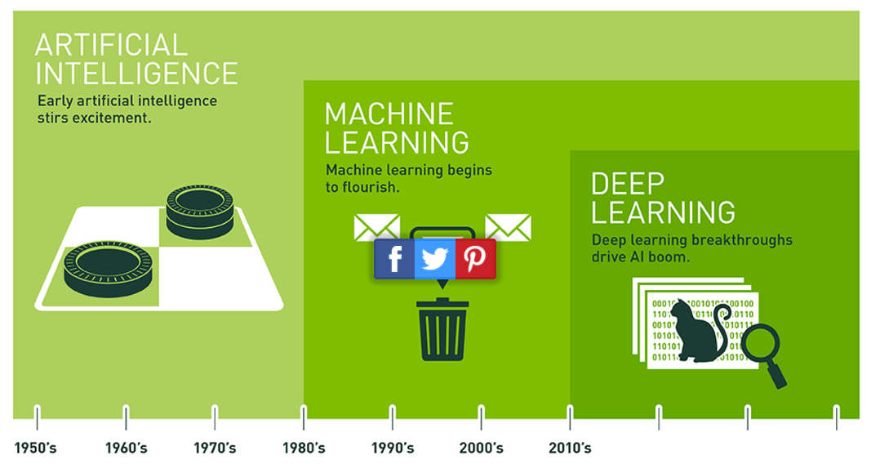
AI, Machine Learning,
Deep Learning… What’s what?
AI = Conceptual idea
Replicate human intelligence
Rough start… sci-fi mostly!
Learn from data / statistics
Spam filter, computer vision
Decision tree logic
Clustering / classifier
Neural networks – biology based
Crunching large data sets
Input / Output causality
Image recognition
Cutting edge of ML
Source: https://blogs.nvidia.com/blog/2016/07/29/whats-difference-artificial-intelligence-machine-learning-deep-learning-ai/
Notes:
About 30 years ago, it was the stuff of science fiction that machines could recognize human emotions through facial expressions. Reading a wide variety of cursive handwriting. Correctly identifying the words in spoken language. Driving autonomously through busy streets.

Slide 4
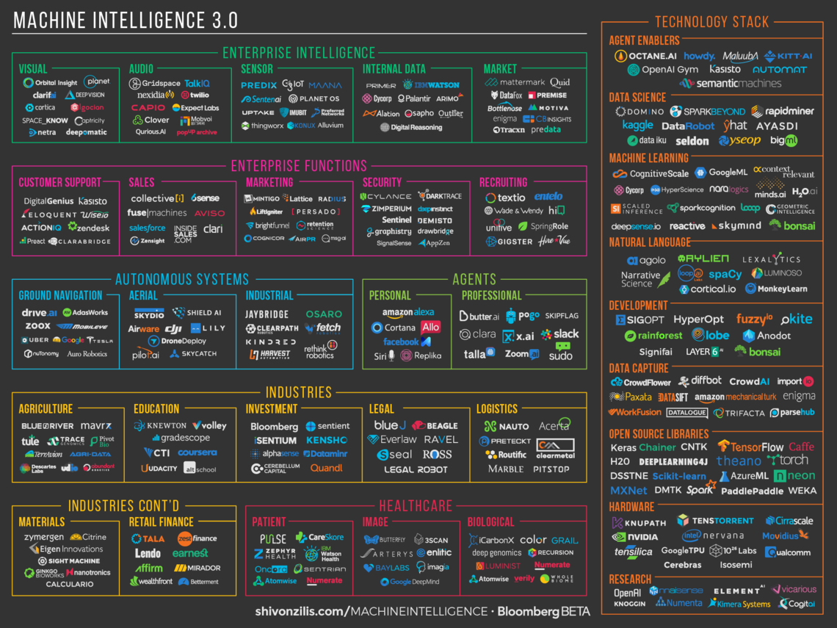

Slide 5
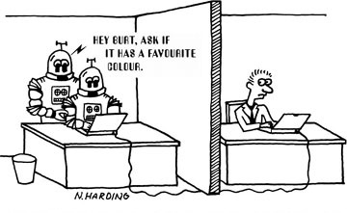
Future of ML in Deep Learning
Deep Learning is all the hype – for a reason
Why now? - Computer power and data storage
Will be even more accessible
  Researchers at Rice University developed a hashing technique to speed up training by 95-99% (link)
  Google invented Tensor Processor Units (TPU) 15-30x faster than CPUs and GPUs for machine learning. (Optimized for tensor-flow)
Incredible new applications
  Self-driving cars / drones
  Real-time language translation
  Artificial generation of music and art
  Artificial Intelligence in VR and gamming
  …

Slide 6
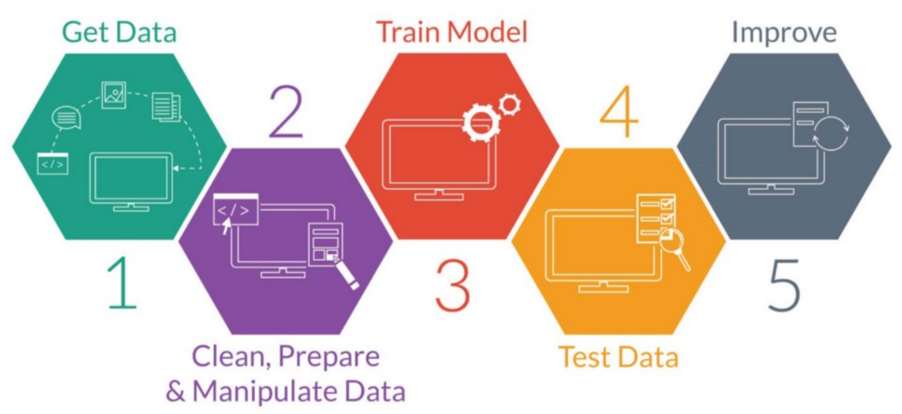
Basic steps in machine learning
Source: https://medium.freecodecamp.com/every-single-machine-learning-course-on-the-internet-ranked-by-your-reviews-3c4a7b8026c0

Slide 7
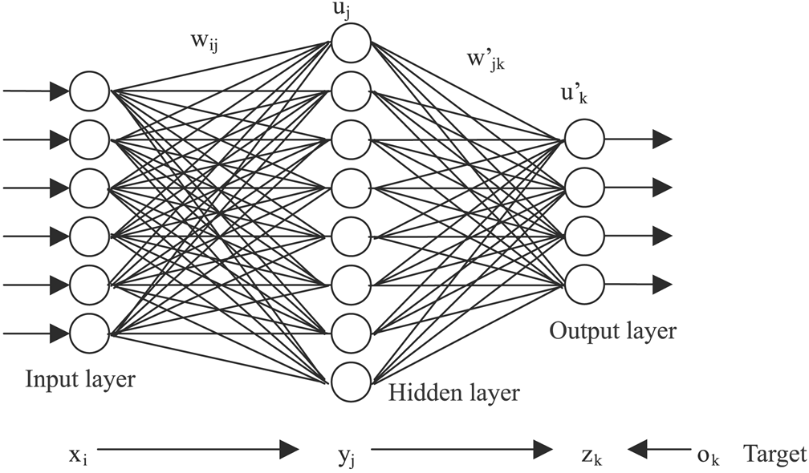
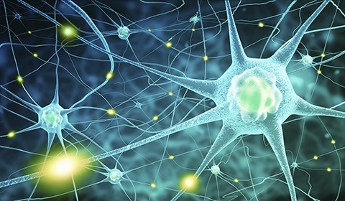
Artificial Neural Network (ANN)
From the late 1980s. Became popular again with “deep neural networks” – A multi-layered NN.
Based on the human brain where signals travel through neurons with varying activation to provide information.
Image sources: left, right
Notes:
Think of neural networks as a way to predict outputs from inputs by adjusting a series of weights (wjj) until the predictions match the expected outputs
In general terms, a forward propagation is where your inputs is feed through your neural network and outputs are obtained. Back propagation is then the operation of correcting your weights based on the error between resulting output and the expected output from data.

Slide 8
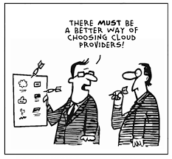
Technical Challenges in building any Neural Network
Feature engineering (aka. Picking the right inputs)
Model architecture selection (fully connected neural net, convolutional, recurring / LSTM…)
Training data collection and labelling
Data correction, cleaning, normalization
Splitting of data set into training, validation, testing sets
Hyper-parameter settings (model sizing, activation functions, number of iterations, batch size, learning rates…)
Initialization/randomization of weights and biases
Setting of libraries, use of GPU and server (cloud!)
Model validation against overfitting
Saving and re-use of trained models
…

Slide 9
Linear Regression
Linear regression is making use of a neural network to make a specific quantitative prediction
Example demo: predict bike sharing usage in a city based on inputs like temperature, day of the week, holiday, rainy day…
  Neural network in python with numpy
Code on github:
  https://github.com/carefulguy/udacity-dlnd-neural-net/blob/master/dlnd-your-first-neural-network.ipynb
Notes:
Takeaways:
You can design neural net with simple python + numpy + pandas
Simple steps: Data cleanup and split
Initialize your weights with random values
One Training cycle: forward propagation, backward propagation -> update weights from mean square error
Test run: forward propagation only
Train: Multiple epochs (800) with random data sets
Results from your training data always best. If results from validation start to diverge from training -> overfitting
Prediction pretty good, except around Christmas. Not enough training data for that period.

Slide 10

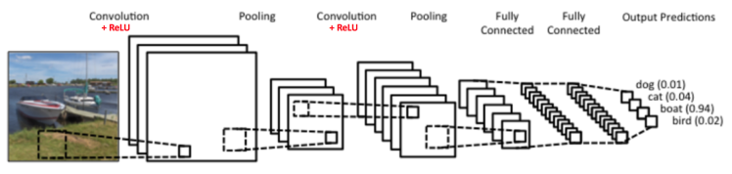
Convolutional Neural Network (CNN)
Google explains…
Two common uses:
  Image classification
  Style transfer
Source: https://www.clarifai.com/technology
Notes:
Stop video at 1.36s
A convolutional network involves panning a filter box over an image to detect features in images, where each layer then combines features into groups of features. The fully connected layer is then used to perform the classification.

Slide 11
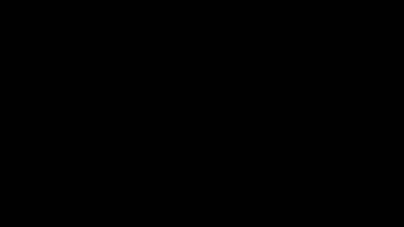
Image classification

Slide 12
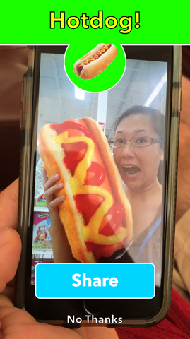
I can confirm that it works!
Ok, real example with TensorFlow: https://github.com/carefulguy/udacity-image-classification/blob/master/dlnd_image_classification.ipynb

Slide 13
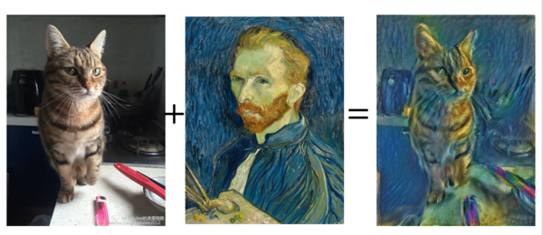
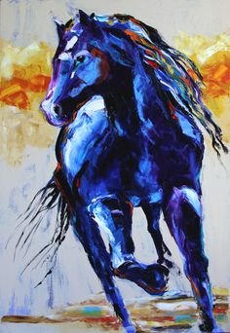
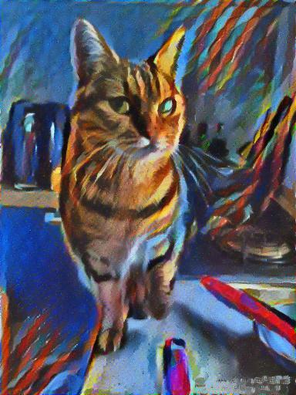
Style Transfer
Style transfer using: Mxnet
https://github.com/dmlc/mxnet
https://no2147483647.wordpress.com/2015/12/21/deep-learning-for-hackers-with-mxnet-2/

Slide 14
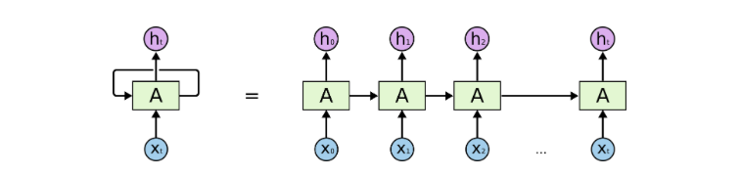
Recurring Neural Networks (RNN)
  Famous blog post:
    The Unreasonable Effectiveness of Recurrent Neural Networks
Mainly used to analyze sequential relationship of data, where context / sequence is important.
Demo: Generation of Moe’s Tavern conversation from Simpson episodes with TensorFlow:
  https://github.com/carefulguy/udacity-simpson-lstm/blob/master/dlnd_tv_script_generation.ipynb
Source: http://colah.github.io/posts/2015-08-Understanding-LSTMs/
Notes:
Takeaway:
- Prepare data: Turn words into digits and store in batches
- Tensor flow declares arrays and variables as tensors
Build your neural network using tensor flow layers
Example of storing and loading a trained model
Training was much much faster on GPU than on this laptop
Ultimately, the RNN analyses the conversations to sequences of words by determining probability that a word is followed by another.
Using these probabilities, you can then generate text, which in this case is somewhat nonsensical

Slide 15
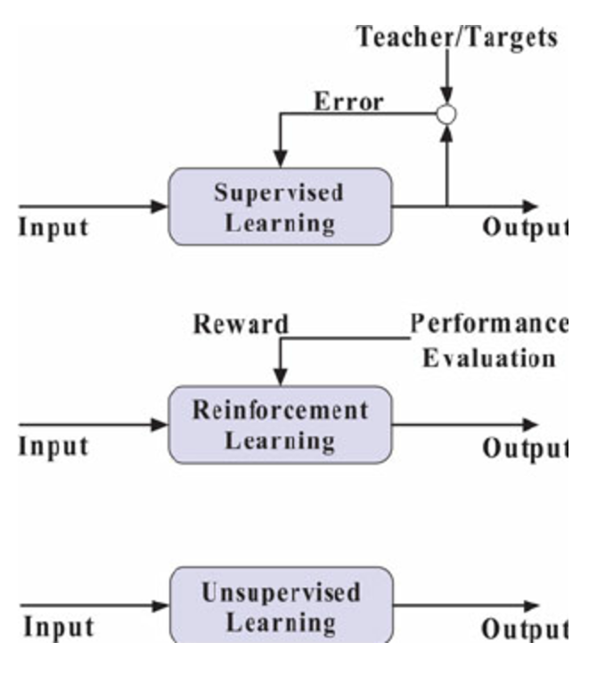
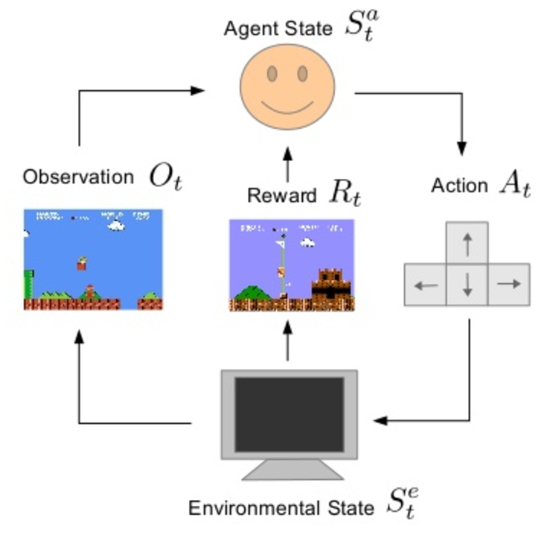
Reinforced Learning
Source: http://johnsonchen.net/tag/reinforcement-learning/
Demo of engineering application:
  https://medium.com/@tuzzer/cart-pole-balancing-with-q-learning-b54c6068d947
Notes:
We’ve covered supervised learning in the case of the image classification where we train our model on labelled images. Unsupervised learning is when we train our model without specified expectations and so there is no feedback of an error. An example of that is a network called a Generative Adversarial Network.
Reinforcement learning is similar to supervised learning in that we indirectly train our model through a reward when the outputs results is good.
The basic idea is to map different possible states with possible outcomes and train the model so that it finds the best actions to take for each possible state to maximize the rewards.

Slide 16
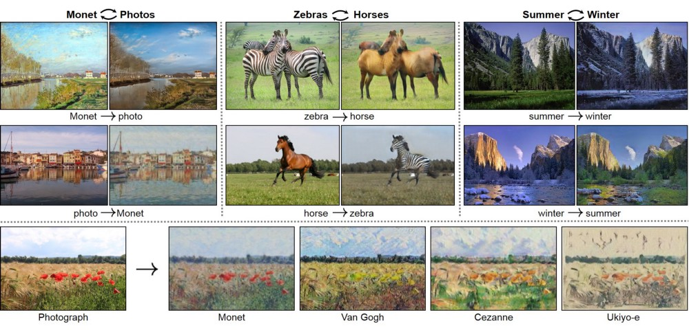
Generative Adversarial Network (GAN)
Source: https://junyanz.github.io/CycleGAN/
Notes:
GANs involve a training process with cooperative and dueling networks. This involves a generative network and a discriminative network. The discriminator network attempts to perform a classification against data that the generative network is creating. The generative network attempts to find data that tries to fool the discriminative network and as a final consequence a more robust discriminator and generator is formed.
When automation are embedded with a feedback loop and are able to simulate (some would call this ‘imagination’) many different scenarios and self test those scenarios for correctness

Slide 17
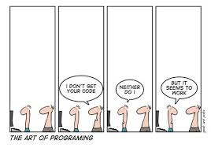
Python ML Libraries
Mxnet:
  Most languages supported (py, C++, js, R, …)
  Very fast but complex. Small community
PyTorch
  Used by Facebook’s Artificial Intelligence Research team (FAIR)
  Newer, less mature
Theano
  Low level (For academics), high learning curve, high performance
Blocks
  A higher level API around Theano (same devs as Theano)
Keras
  Highest level API. Can use with Theano or TensorFlow
  Large community
TensorFlow
  Good starting point!
  Developed by Google. Very large community.
  TensorBoard, web based gui for analysis
  Plans to integrate Keras API as part of TensorFlow

Slide 18
Web APIs
Microsoft Azure ML, Google ML, Amazon ML
  natural language processing, recommendation engine, pattern recognition, computer vision, and predictive modeling APIs
IBM Watson
  Conversation (Great for Chat bots)
  Discovery (Data analytics – news, weather, etc)
  Visual recognition (faces, age, gender, food, objects)
Wit.ai
  Popular language processing platform: add intelligent voice interface for home automation, connected car, smart TV, robotics…
  Similar API to Alexa, google home, and now… home pod
Api.ai
  Conversation user experience platform – extra information from queries
Diffbot
  Extract data from web pages (text, image, video, comments)
Notes:
Advantage of web APIs:
- In most cases: no need to understand how to do ML
Will use the server and pre developed models
Can quickly get something working
Some of them you must provide your own data set to train their models before you can use.
Others (especially language recognition) are pre-trained
Amazon, Microsoft and Google are more general ML with custom requirements, whereas the others here are for specific tasks

Slide 19
Some Useful Resources
Podcasts:
  Linear Digressions, TWiML & AI, Nvidia AI, The Talking Machine, Data Skeptic
Massive Open Online courses (MOOCs):
  Udacity, coursera, udemy (great article on options)
Free classes on YouTube:
  Andrew Ng – Stanford online classes
  CS231n Lectures by Andrew Karpathy
  Siraj Raval
Great Technical Blogs
  https://r2rt.com/
  http://colah.github.io/
  https://christopherolah.wordpress.com/
Good Blog posts
  The Unreasonable Effectiveness of Recurrent Neural Networks
  An Intuitive Explanation of Convolutional Neural Networks
  The Strange Loop in Deep Learning
  Hacker's guide to Neural Networks (extensive guide to neural networks)
Books
  Deep Learning (Adaptive Computation and Machine Learning Series)
  http://neuralnetworksanddeeplearning.com/ (Free online book)

Slide 20
Learning through Udacity Examples
https://github.com/udacity/deep-learning

Slide 21
Some Predictions…
Web 3.0
All companies essentially back-end data for Google (or next Google)
  Other companies will interface with them directly to provide data
  Mega corps will compete in how they mine, package and provide data
  Auto-generated / Dynamic personalized user interface and content
No more separate websites, mobile apps. Query base interface only.
Melding of online content, advertisement and real surroundings
Stock Market
Short term (< 8 years): machine learning players will become incredibly wealthy, investors will rely on artificial fund managing bots
Long term (20 years): AI will determine exact value of a company based on current events, fundamentals, predictions and live transactions
Notes:
“I like this shirt. Show me what it looks like in blue with a space theme. I’ll pay $20 to supplier based on best rated. Have it delivered when I’m home.”
Whoever owns all the data (ie. Google) will control and shape society

