Slide 1
Optimization-of-Responsive-Neurostimulation-RNS-Therapy-through-Data-Mining-Approaches
Anli Liu, Xiaojing Wu, Yueqiu Sun

Slide 2
Date against time plot
Each data point depicts the time and date for each EEG segments. X axis is the time of the day, from 00:00 to 24:00, Y axis is the date. The red points represent scheduled EEG segments, the blue points represent non-scheduled EEG segments(long episode, saturation, magnet, real-time). The plot also reflects the circadian pattern for the long episode.

Slide 3
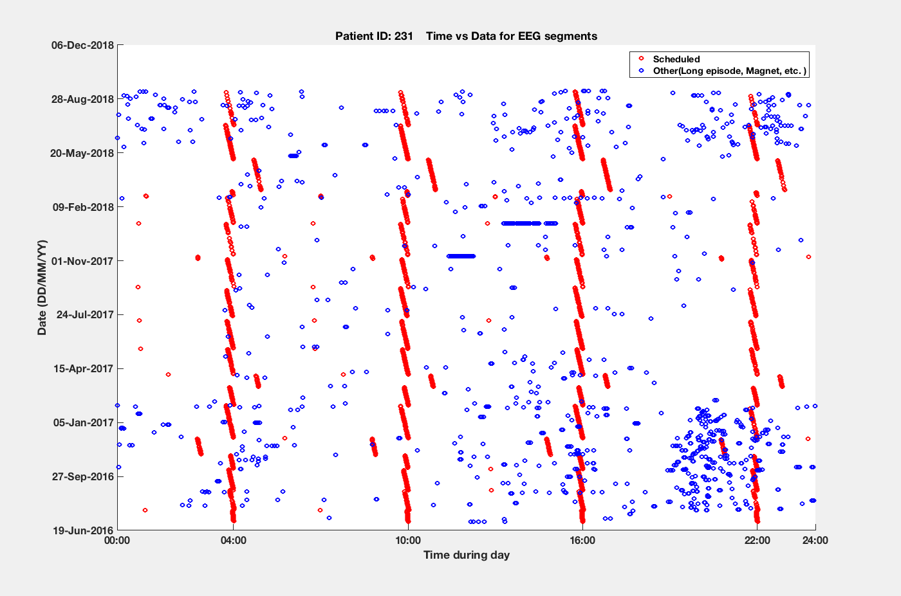
Date against time plot For 231

Slide 4
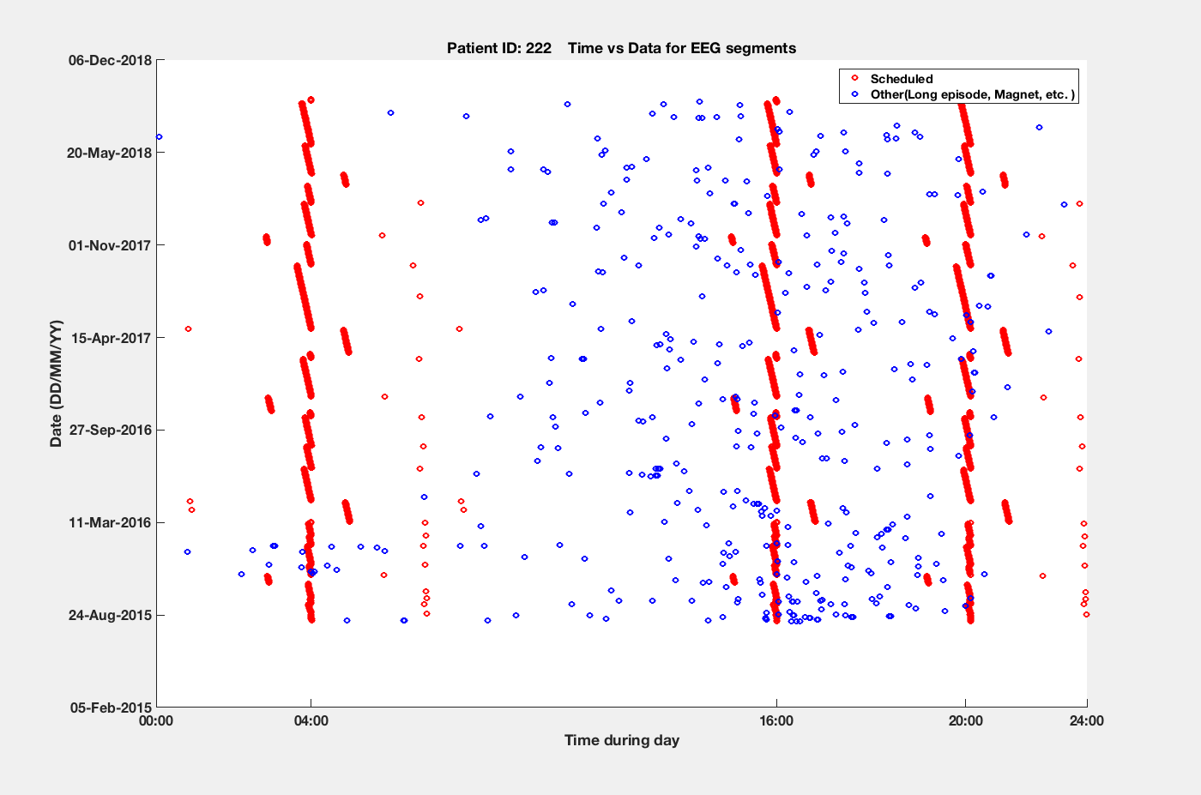
Date against time plot For 222

Slide 5
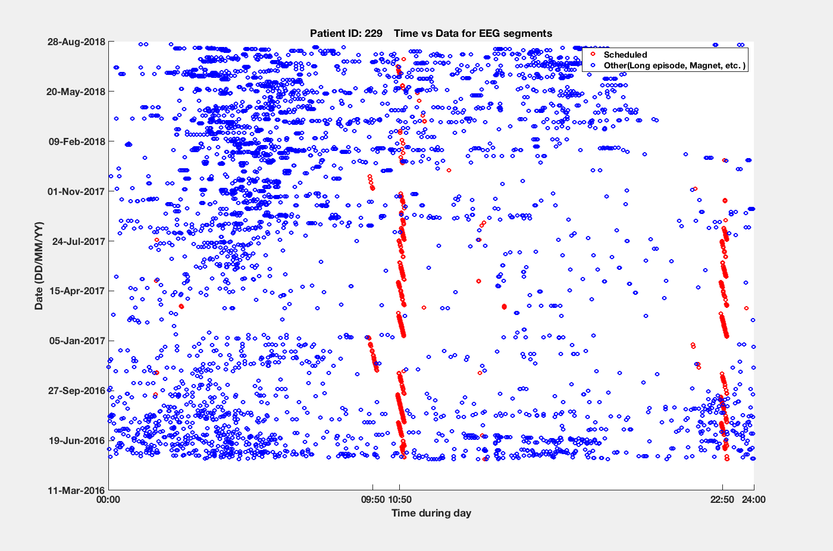
Date against time plot For 229

Slide 6
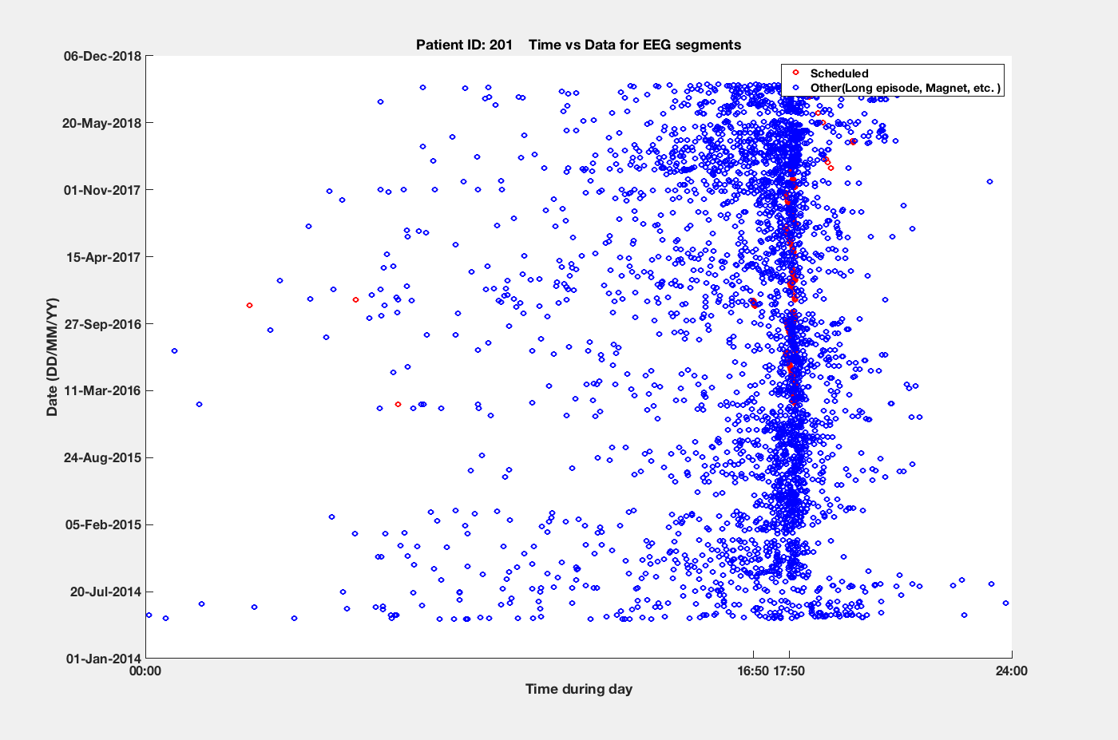
Date against time plot For 201

Slide 7
Classifier Performance
We try to predict ‘good’ or ‘bad’ epoch using the features(power within each bandwidth for each EEG segment).
Fitting 7 classifiers to the training data and tune the hyperparameter using 10-fold cross-validation. Evaluate the performance of each classifier using test data
Classifiers include 1:'Logistic Regression' 2: ‘SVM 3: 'Gaussian Naive Bayes classifier’ 4:'Linear Discriminant Analysis’ 5:'Decision Tree' 6:'Random Forest 7:'Gradient Boosting’
We use AUC for test set as metric for classifier performance.

Slide 8
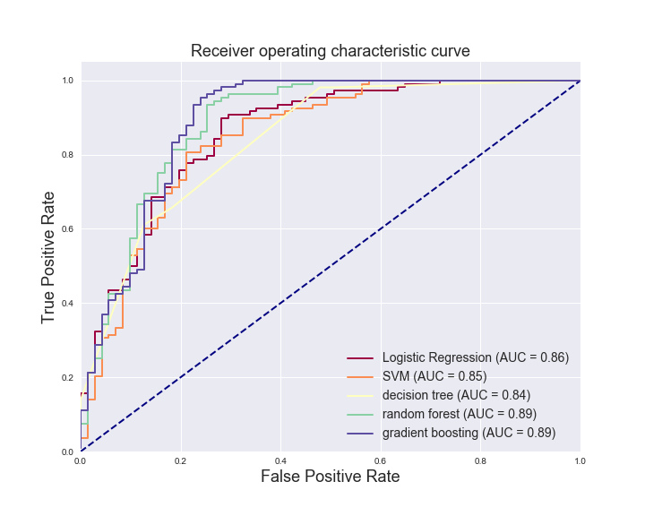
ROC CURVE
For 231 (clean period: 02/07/2017 – 02/21/2018)

Slide 9
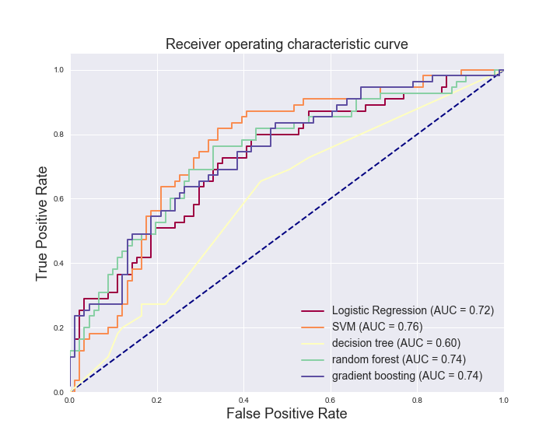
ROC CURVE
For 222_1(clean period: 02/12/2016 – 10/24/2016)

Slide 10
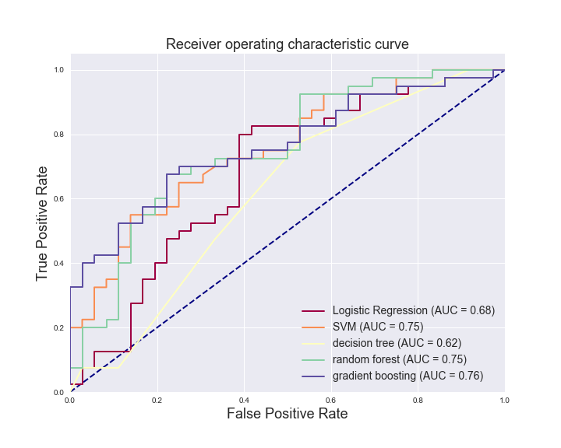
ROC CURVE
For 222_2(clean period: 10/26/2016 – 03/29/2017)

Slide 11
Feature Importance
Feature importance provides a score that indicates how useful or valuable each feature was in the construction of the classifier within the model.
The feature importance plot shows the coefficients of the logistic regression classifier for each patient after training.
The degree of the red implied strong positive correlation between the feature and the good performance. The same logic goes for the degree of blue.
The X axis represents the channel of the feature, whereas Y axis represents the frequency band of the feature.

Slide 12
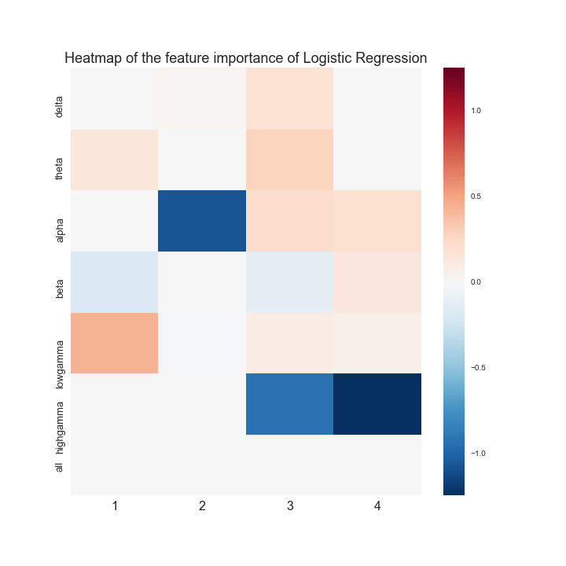
Feature Importance
For 231 (clean period: 02/07/2017 – 02/21/2018)

Slide 13
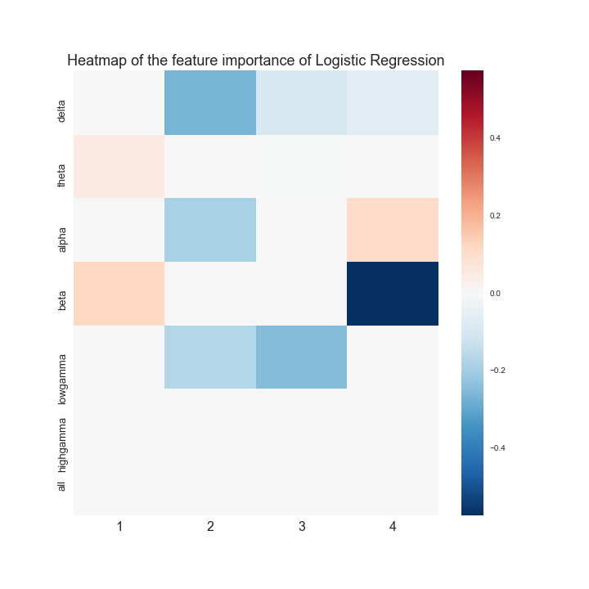
Feature Importance
For 222_1(clean period: 02/12/2016 – 10/24/2016)

Slide 14
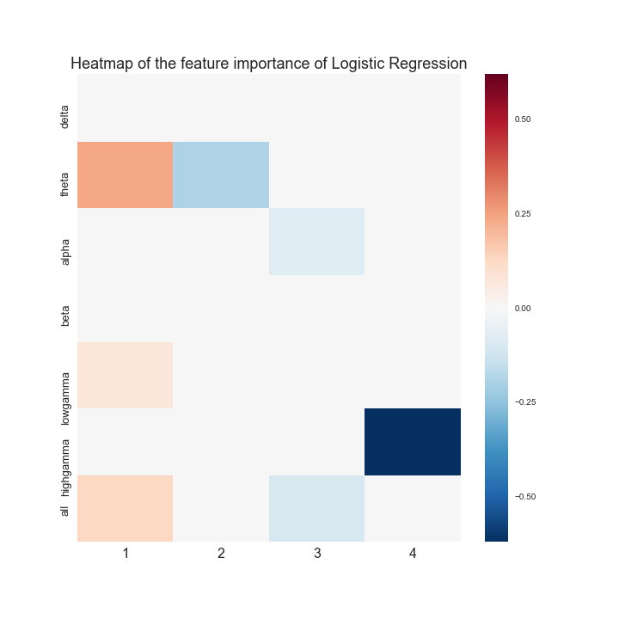
Feature Importance
For 222_2 (clean period: 10/26/2016 – 03/29/2017)

Slide 15
Next step, we try to solve
Too few data for 201 and 229 to train a good classifier.(60+ and 40+ data points for 201 and 229 respectively.)
Possible solution: 1. divide each EEG segments into 4 pieces, therefore augmenting the data by 4 fold.(issue: the variance of the classifier will still be large if the 4 pieces within the same EEG segments is highly correlated)
Possible solution: 2.Take the first 10 seconds as background EEG from each EEG segments(issue: Is it really background EEG if it happened before the stimulation)
Also, the feature importance is not consistent within one patient across different clean periods. What does it tell us?

