Slide 1

H.A.C.k.F.M.i.
HackFMI 6 – Team “Beer”:
Stefan Doychev
Kaloyan Yovchev

Slide 2
What is it about?
H . A . C . K . F . M . I .
ighly
utonomous
ourier
ar
ully
obile
nterface
with

Slide 3
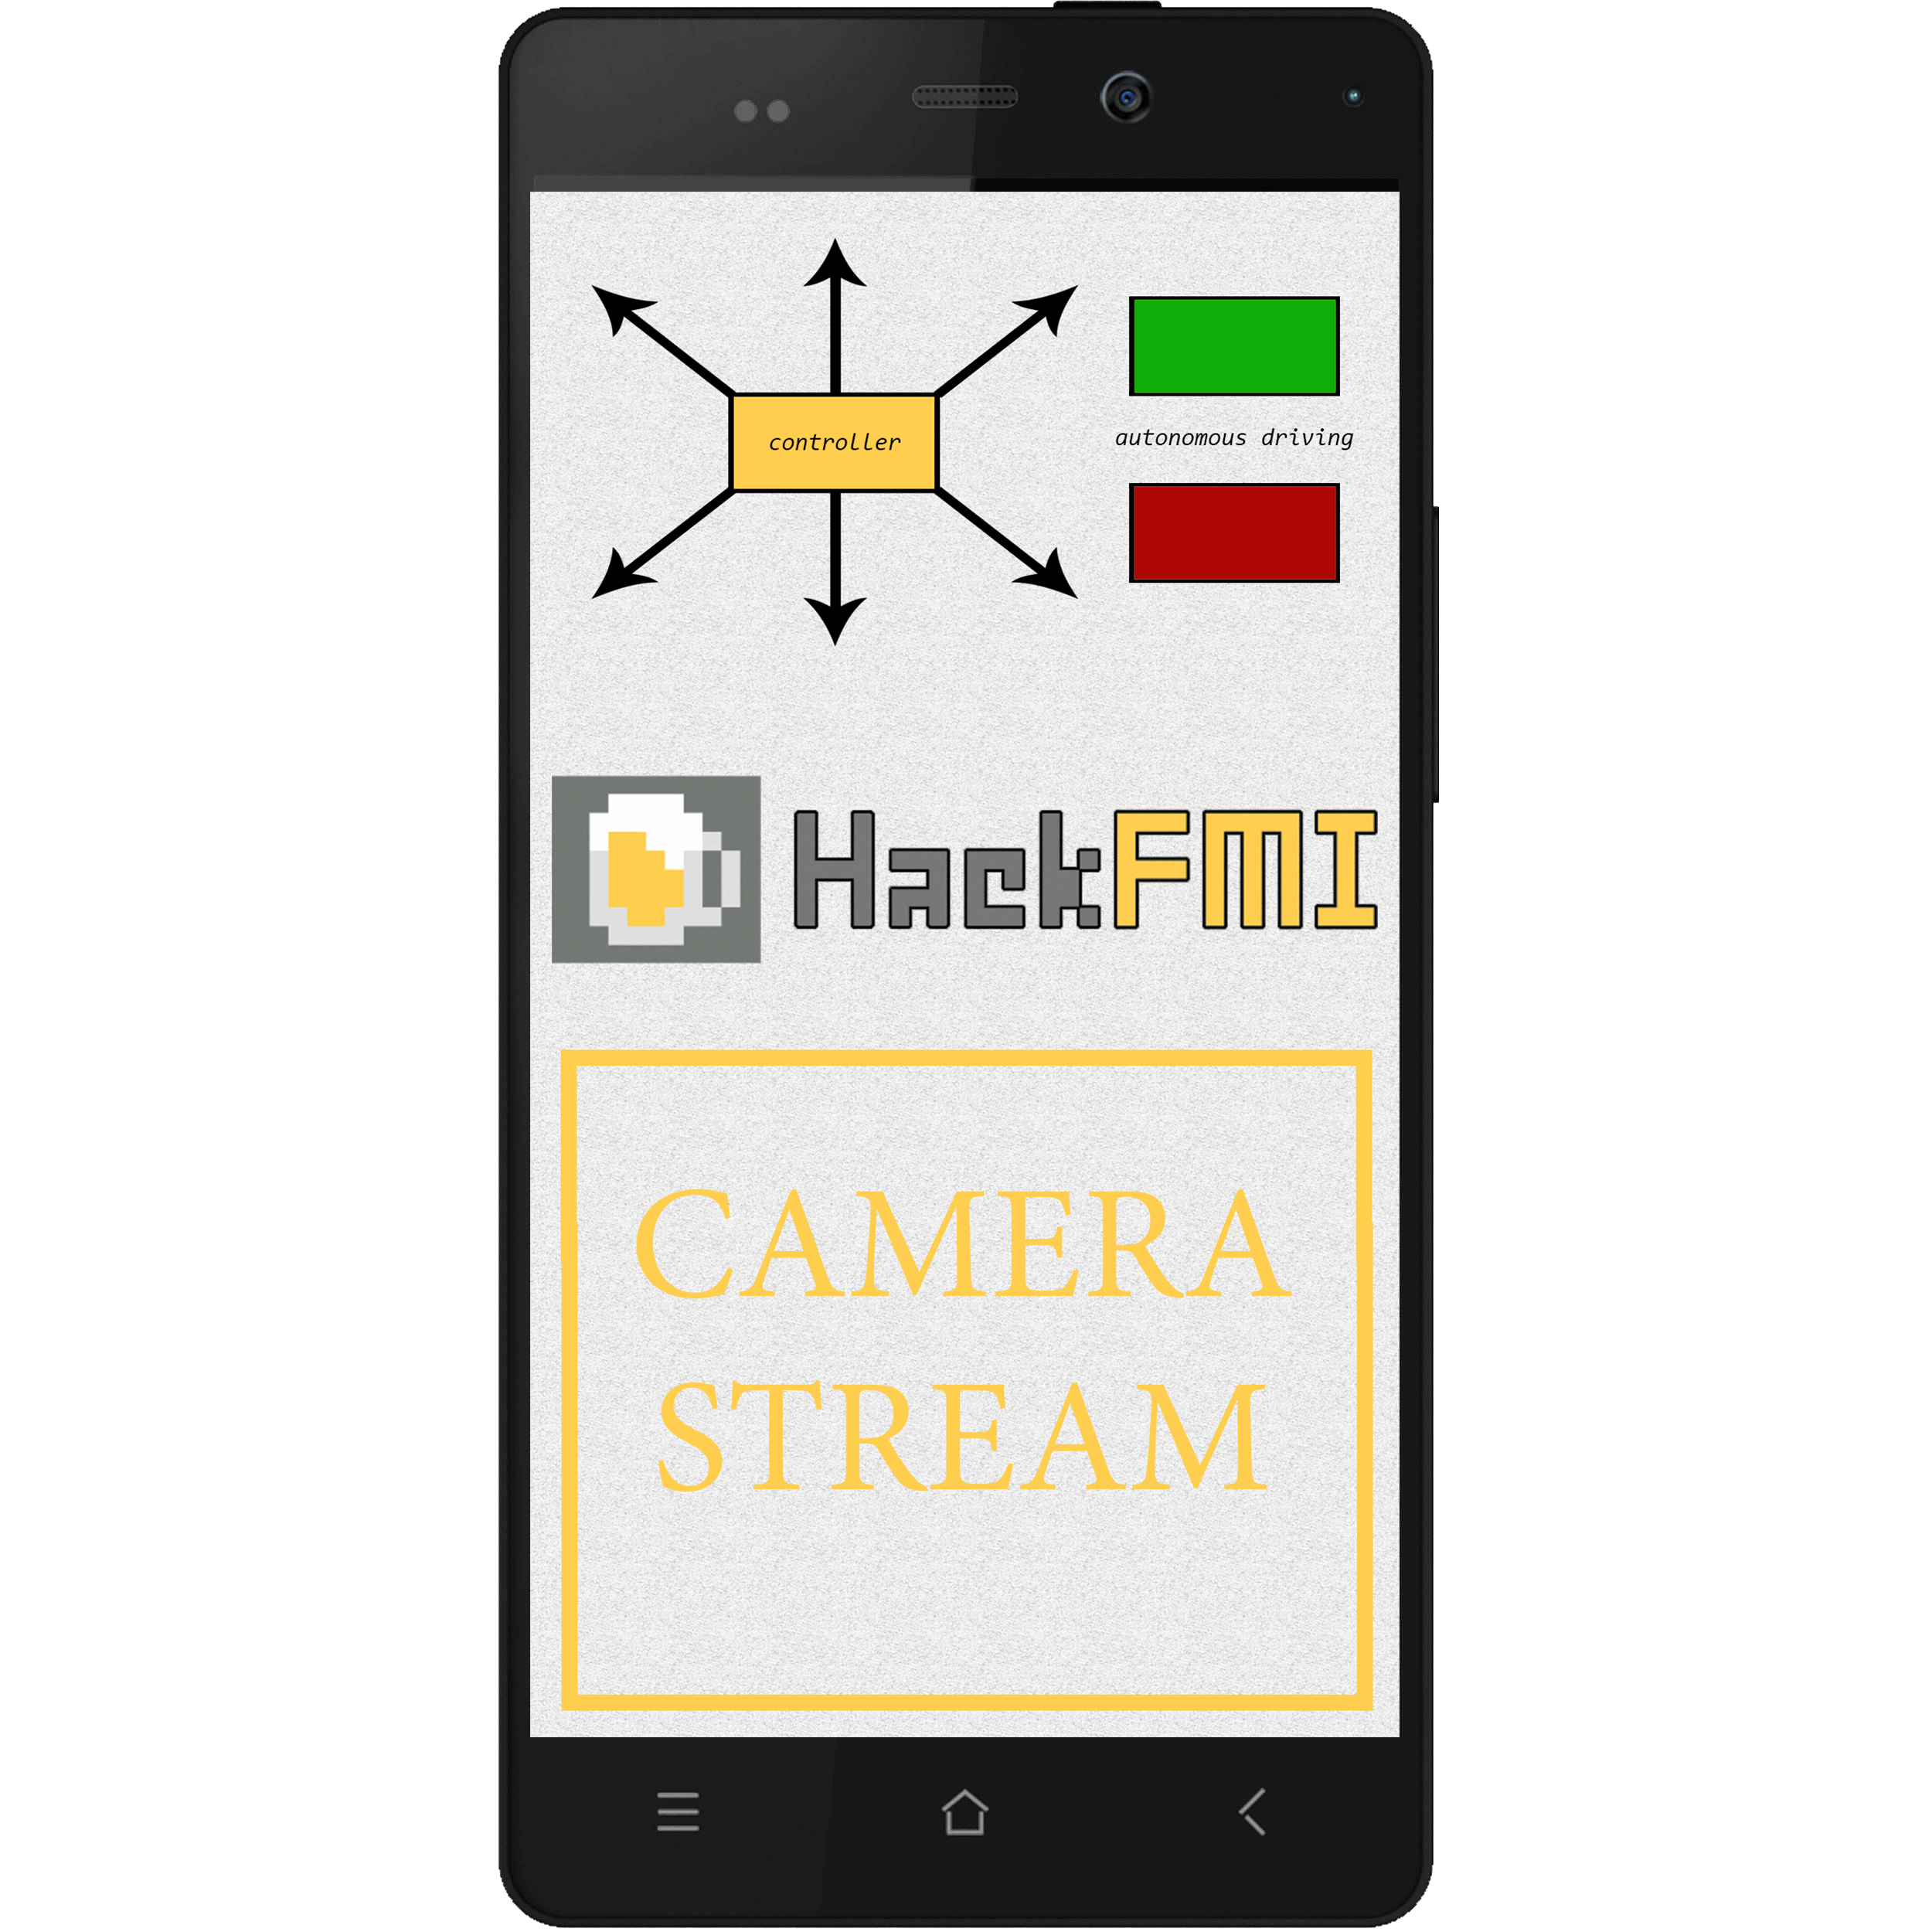
HARDWARE
2 cars – with modified suspension & lights
Arduino integration
Raspberry Pi integration
Complete external power supply (3.3V, 5V, 6V)
Sensors – 2 sonars, 1 IR sensor
Camera
Android mobile device & smart watch

Slide 4

SOFTWARE
Communication via serial port
Communication via Wi-Fi
Communication via Bluetooth
(smart watch <> smartphone)
Remote control – Android mobile app
& smart watch app, providing
speed control, autonomous mode on/off control
Autonomous mode – path following, avoiding obstacles,
automatic brake, 90° and 180° turns
Live streaming

Slide 5
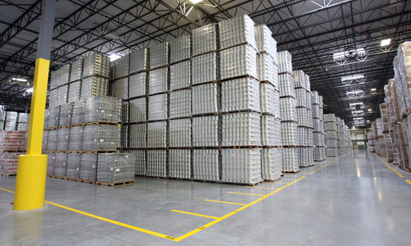
APPLICATIONS
Storehouses
Offices
Hospitals

Slide 6

FUTURE DEVELOPMENT
Improvements on the security
Improvements on the autonomous module
Compass orientation

Slide 7
THANK you!
Questions?

