Slide 1


Plagiarism
Velys Valeria and Iliahuieva Liia

Slide 2



Slide 3
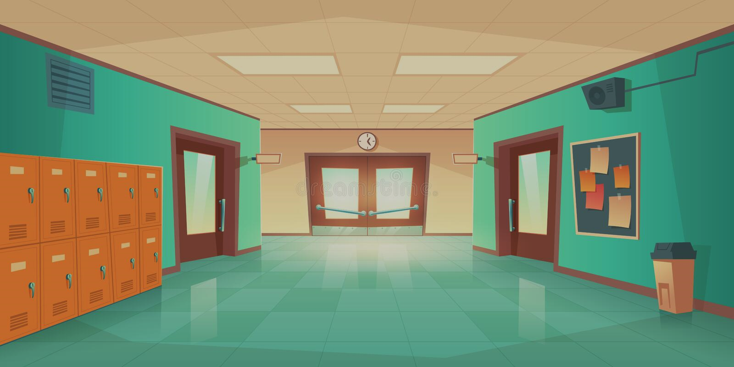

Slide 4






Slide 5
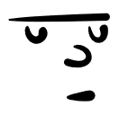
It is my business. Your plagiarized work may make my and other students’ grades worse because the professor may set your work as a standard. It’s unfair.
So what? It’s your problems.
Plagiarism is also a type of theft.
It was my friend who gave me the work.
You can get caught not by me but the professor and receive punishment.
Fine, I’ll change the work. Happy now?

Slide 6
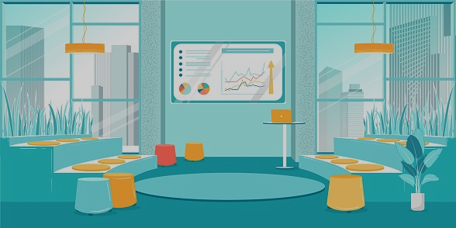
And yet she handed in the plagiarized work
Thank you
Very well done

Slide 7


Several days later

Slide 8




Slide 9
First, you diminish the value of the diploma. Not doing the assignment yourself, you don’t gain the knowledge and skills that you should have when you graduate, and it makes higher education seem weak and useless when you enter the labor market.
I never wanted it to be so.
Second, you are not improving. Plagiarizing a work, you don’t enhance your knowledge and give up on your vices.
And the most important, plagiarism means you think that the main purpose of this place is competition, and your aim is the best grade. But truth is, you are here to learn how to express yourself, and we, professors, are your helpers. It upsets to see you miss the point.

Slide 10
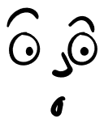
First, you diminish the value of the diploma. Not doing the assignment yourself, you don’t gain the knowledge and skills that you should have when you graduate, and it makes higher education seem weak and useless when you enter the labor market.
I never wanted it to be so.
Second, you are not improving. Plagiarizing a work, you don’t enhance your knowledge and give up on your vices.
And the most important, plagiarism means you think that the main purpose of this place is competition, and your aim is the best grade. But truth is, you are here to learn how to express yourself, and we, professors, are your helpers. It upsets to see you miss the point.

Slide 11
Thank you for the attention!

