Slide 1
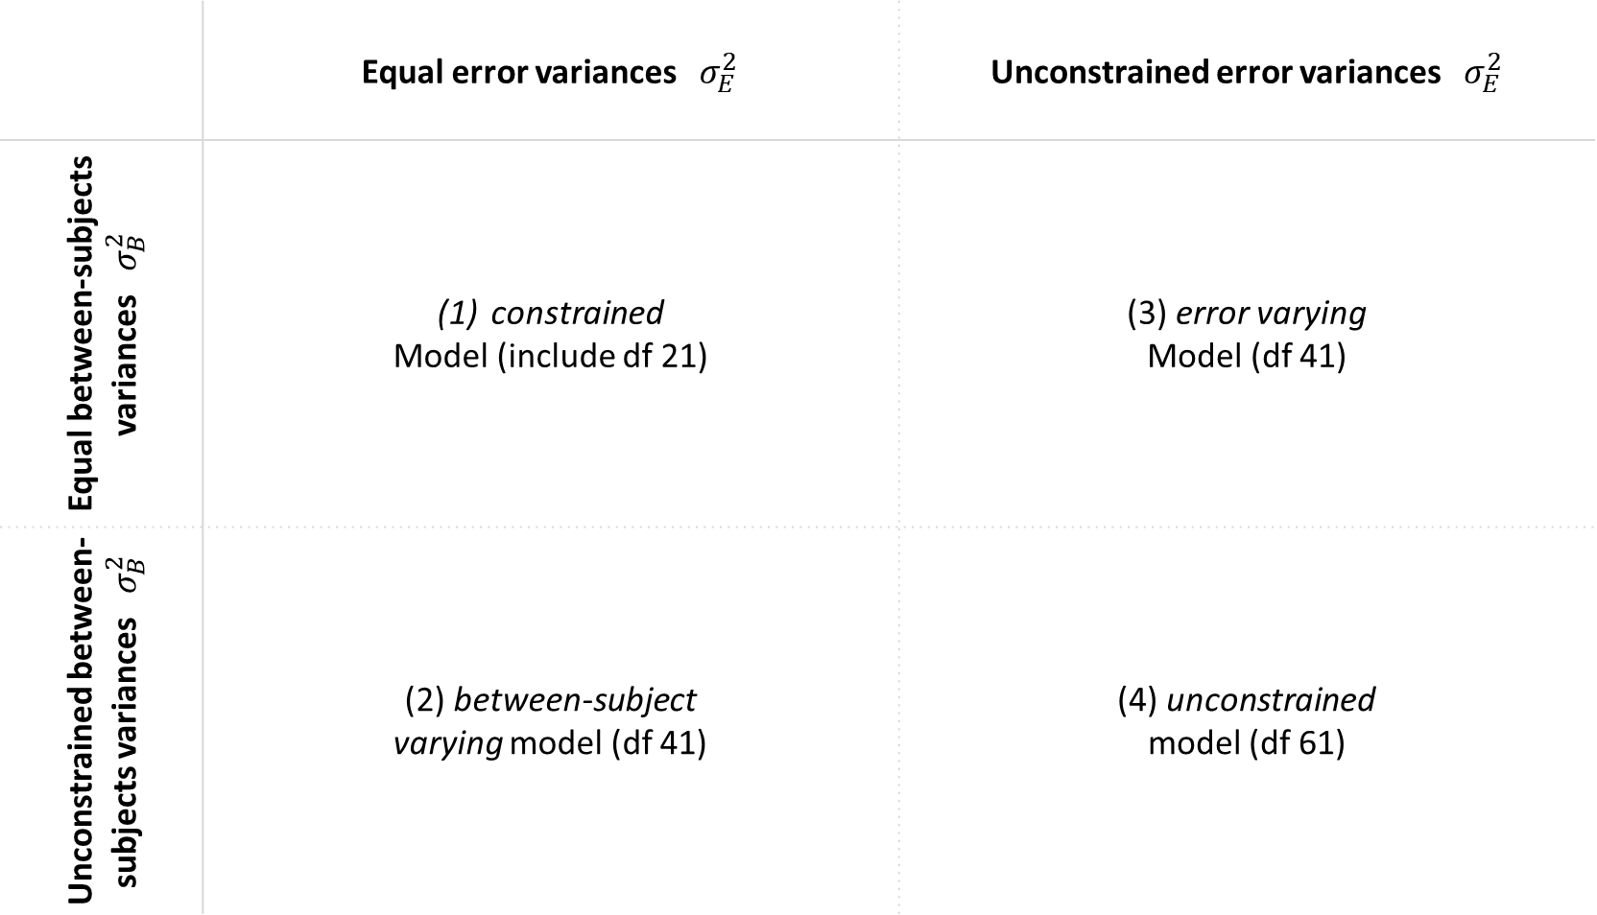
 | Equal error variances $σ_{E}^{2}$ | Unconstrained error variances $σ_{E}^{2}$
Equal between-subjects variances $σ_{B}^{2}$ | constrained Model (include df 21) | (3) error varying Model (df 41)
Unconstrained between-subjects variances $σ_{B}^{2}$ | (2) between-subject varying model (df 41) | (4) unconstrained model (df 61)
(C)
(A)
(E)
(D)
(B)

Slide 2
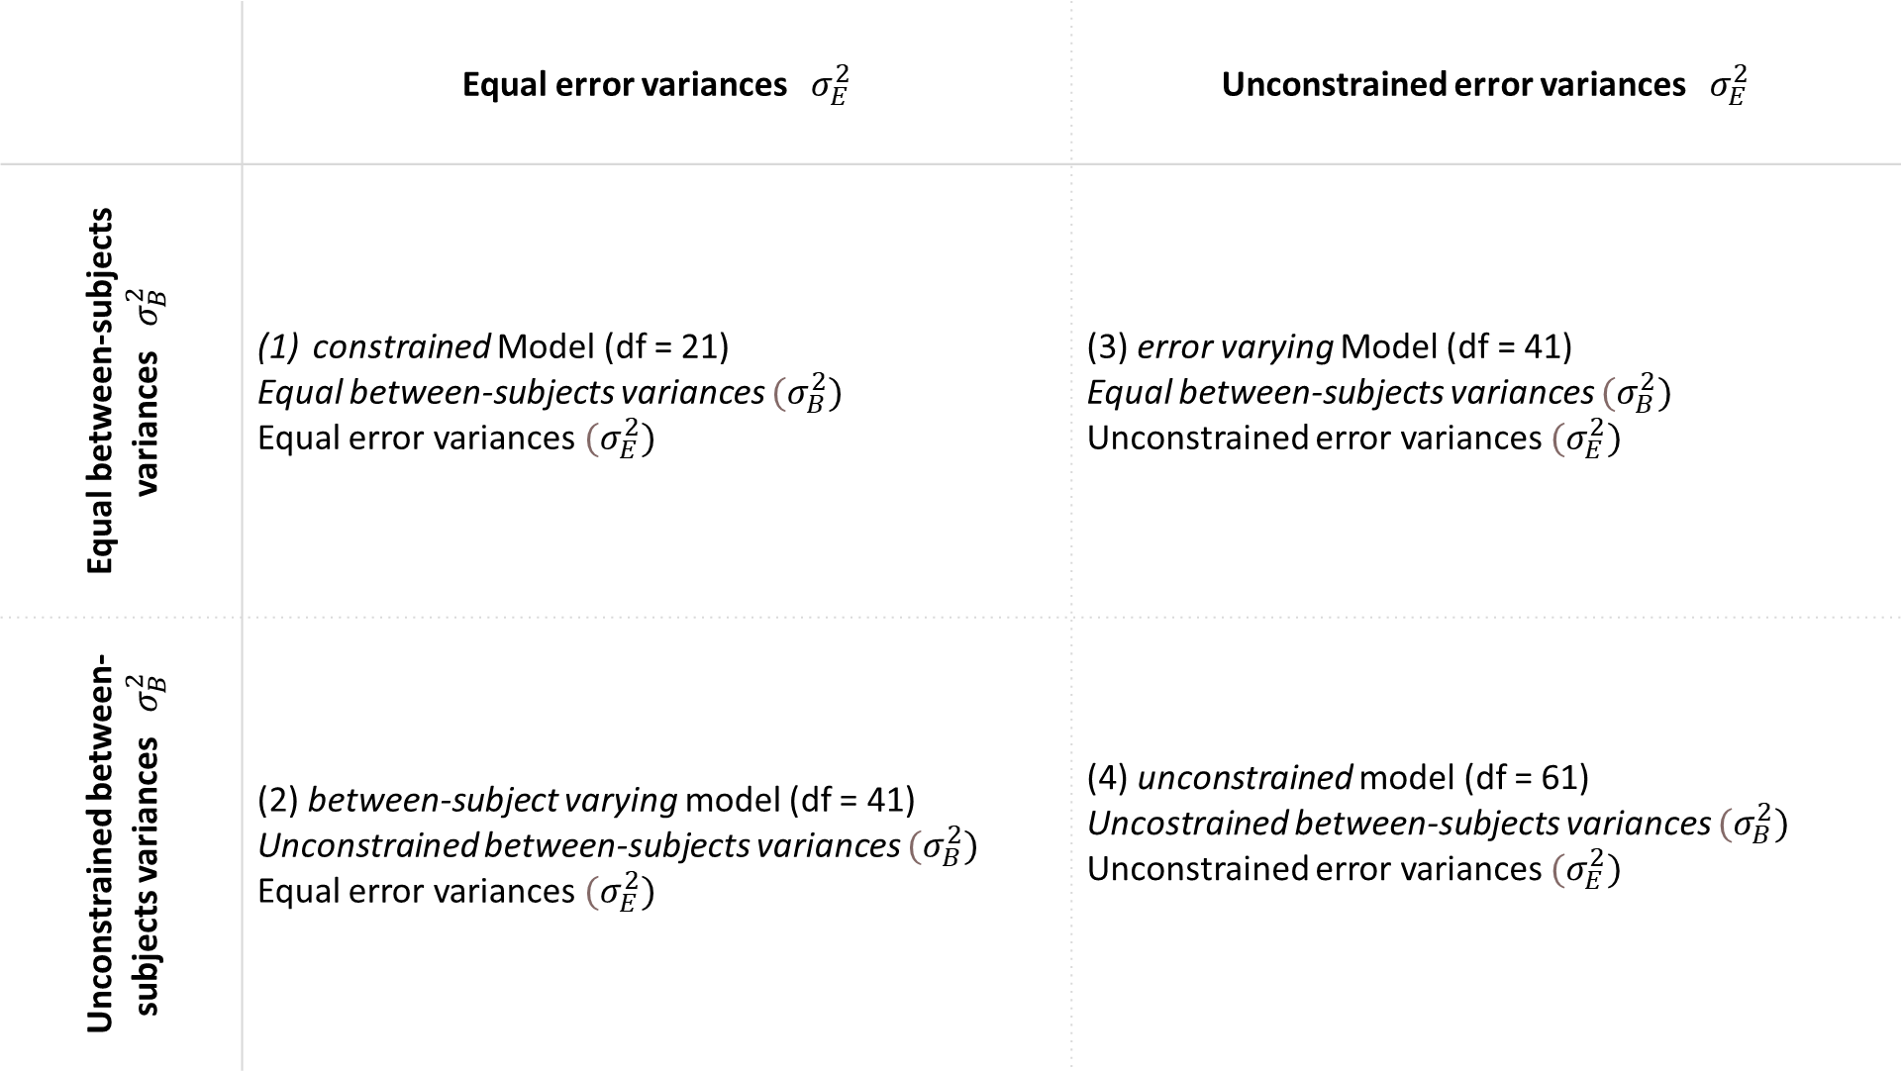
 | Equal error variances $σ_{E}^{2}$ | Unconstrained error variances $σ_{E}^{2}$
Equal between-subjects variances $σ_{B}^{2}$ | constrained Model (df = 21) Equal between-subjects variances $(σ_{B}^{2})$ Equal error variances $(σ_{E}^{2})$ | (3) error varying Model (df = 41) Equal between-subjects variances $(σ_{B}^{2})$ Unconstrained error variances $(σ_{E}^{2})$
Unconstrained between-subjects variances $σ_{B}^{2}$ | (2) between-subject varying model (df = 41) Unconstrained between-subjects variances $(σ_{B}^{2})$ Equal error variances $(σ_{E}^{2})$ | (4) unconstrained model (df = 61) Uncostrained between-subjects variances $(σ_{B}^{2})$ Unconstrained error variances $(σ_{E}^{2})$
(C)
(E)
(A)
(D)
(B)

Slide 3
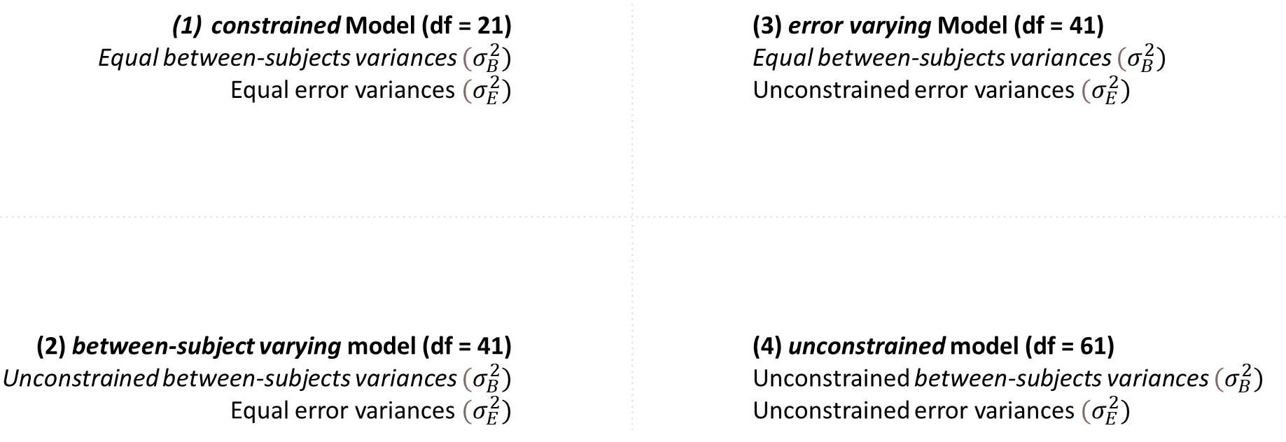
constrained Model (df = 21) Equal between-subjects variances $(σ_{B}^{2})$ Equal error variances $(σ_{E}^{2})$ | (3) error varying Model (df = 41) Equal between-subjects variances $(σ_{B}^{2})$ Unconstrained error variances $(σ_{E}^{2})$
(2) between-subject varying model (df = 41) Unconstrained between-subjects variances $(σ_{B}^{2})$ Equal error variances $(σ_{E}^{2})$ | (4) unconstrained model (df = 61) Unconstrained between-subjects variances $(σ_{B}^{2})$ Unconstrained error variances $(σ_{E}^{2})$
(C)
(A)
(E)
(D)
(B)

Slide 4
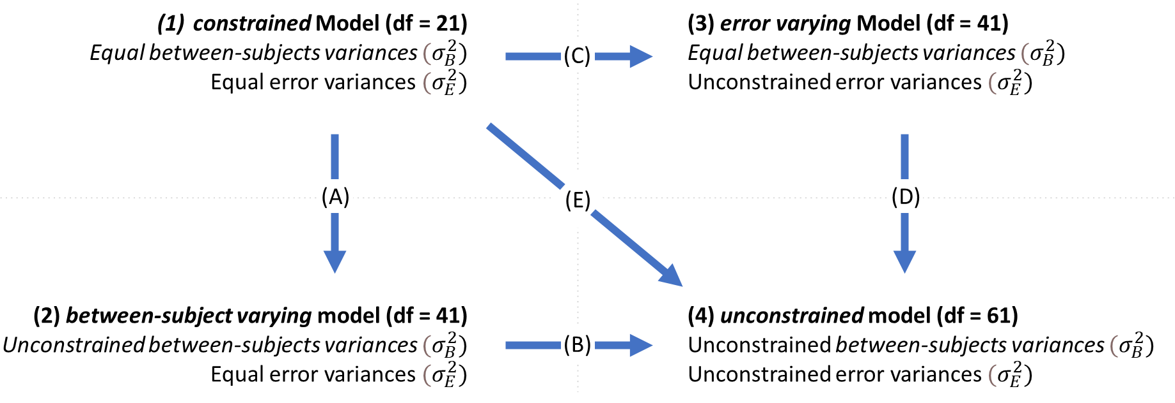

Slide 5
To do
Text description of each model
Legend for super clarity

