Slide 1
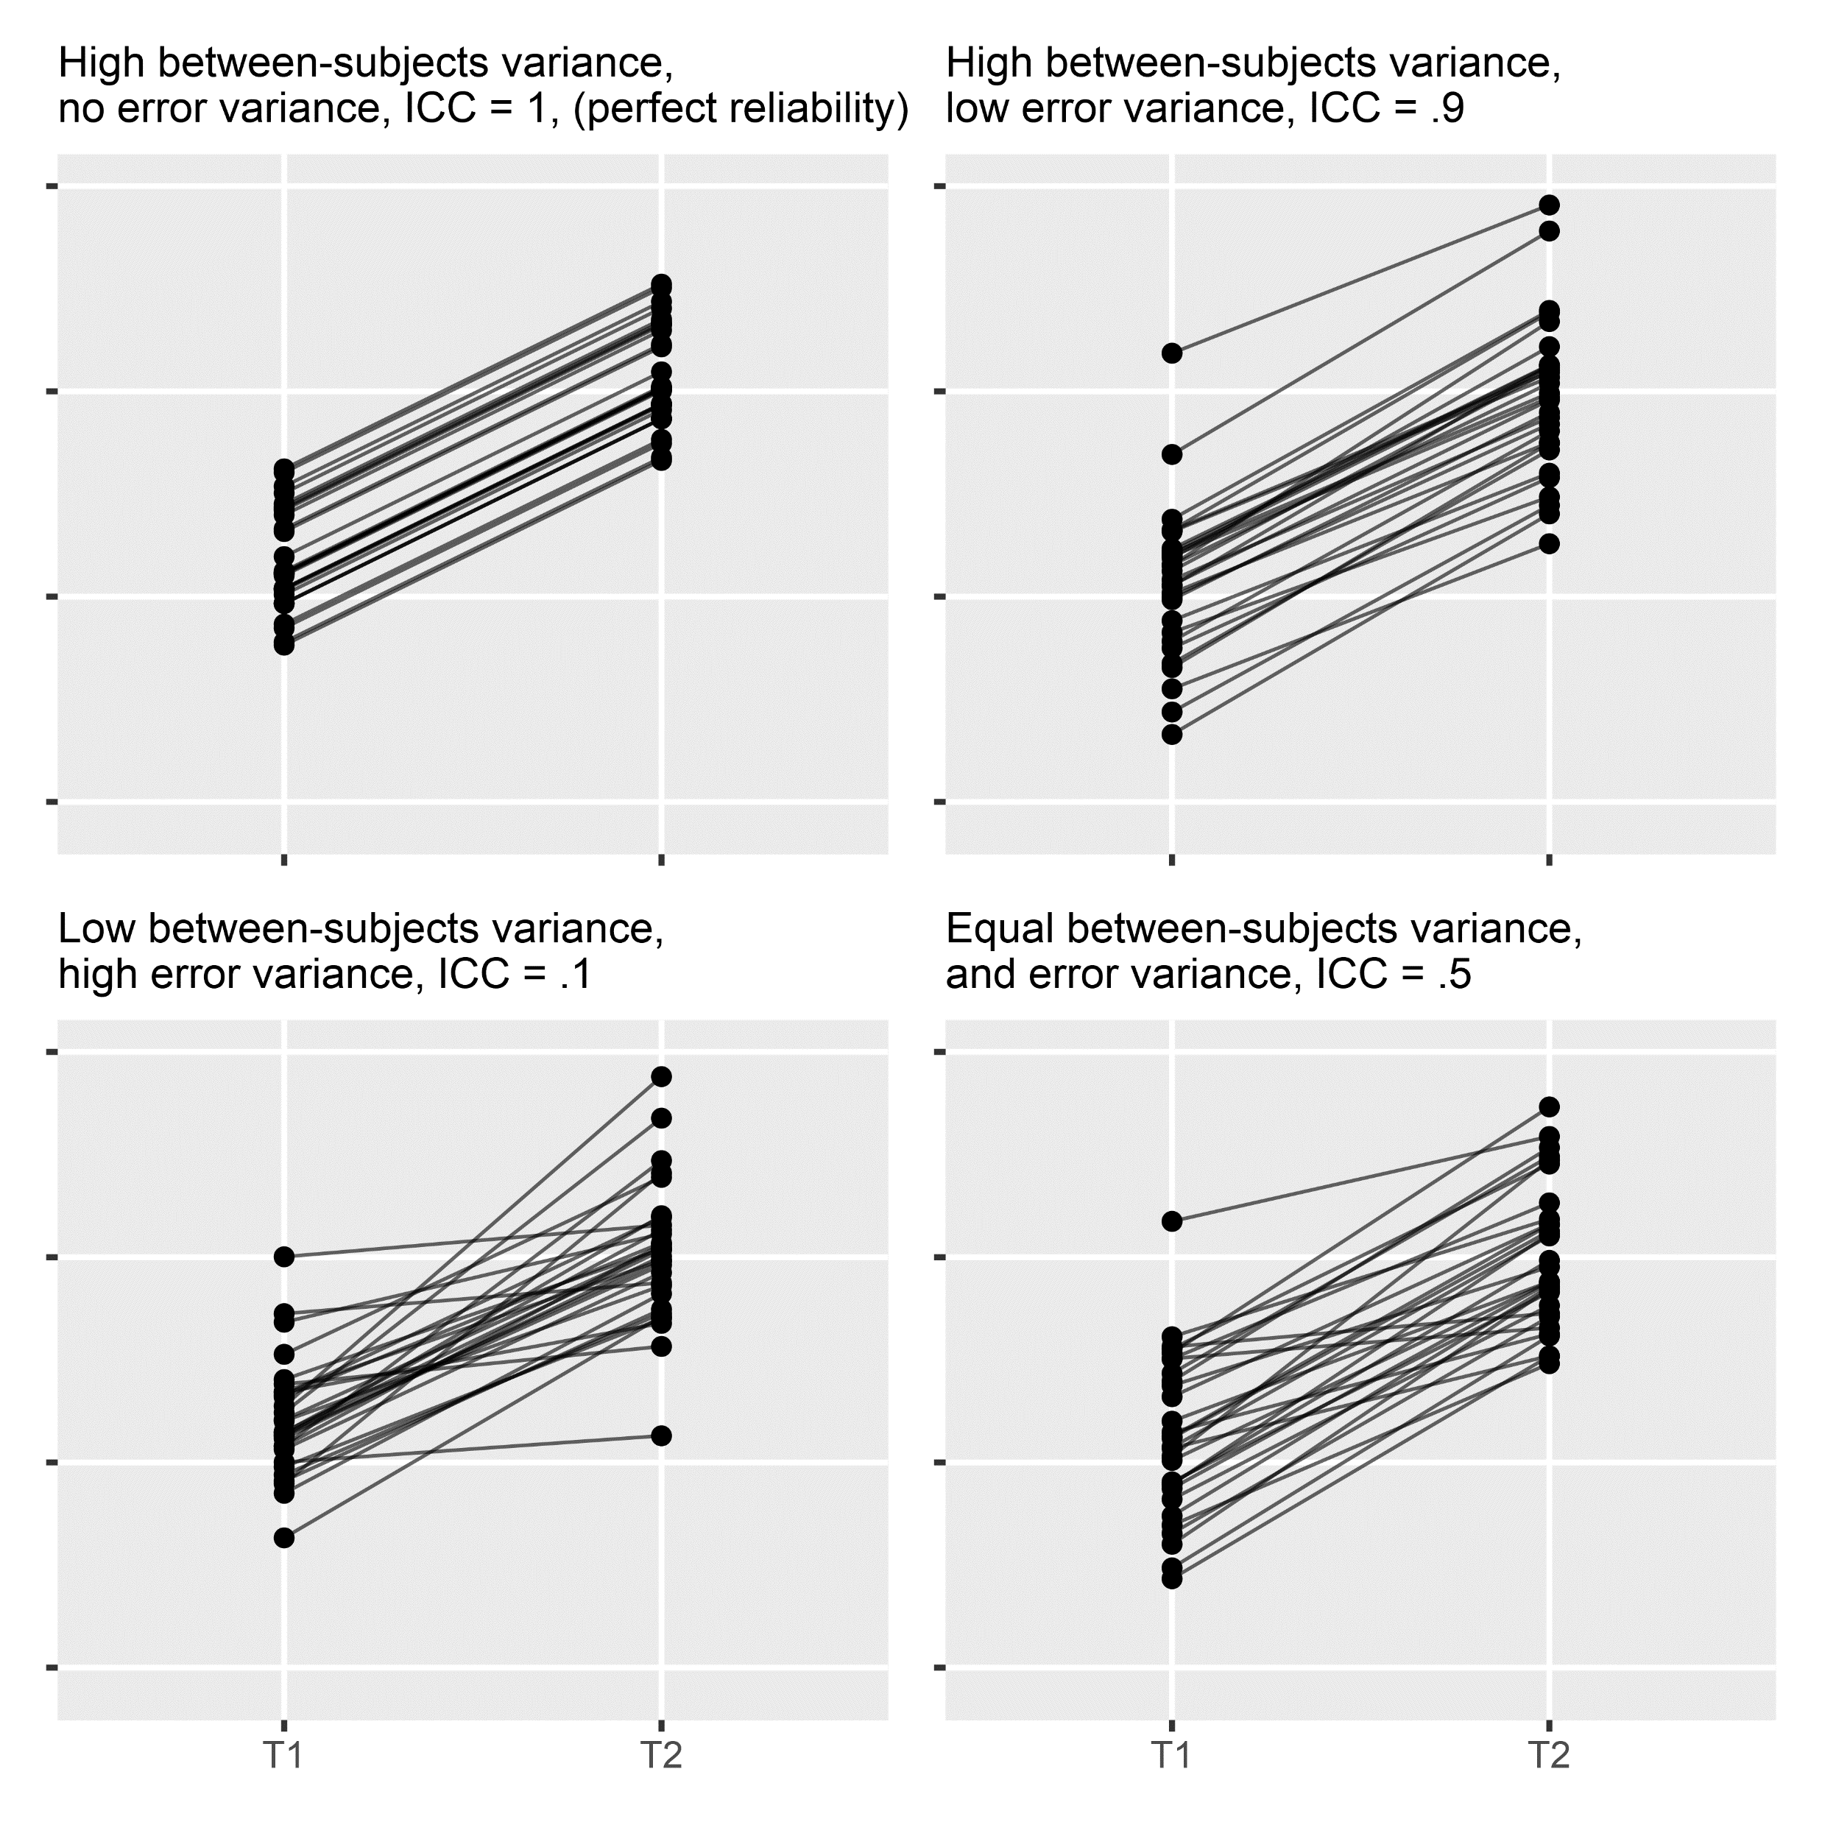







$$σ_{B}^{2}$$
t
$$1$$
$$1$$
T1
T2
$$1$$
$$1$$
E1
E2
$$σ_{E}^{2}$$
$$σ_{E}^{2}$$

Slide 2
