Slide 1
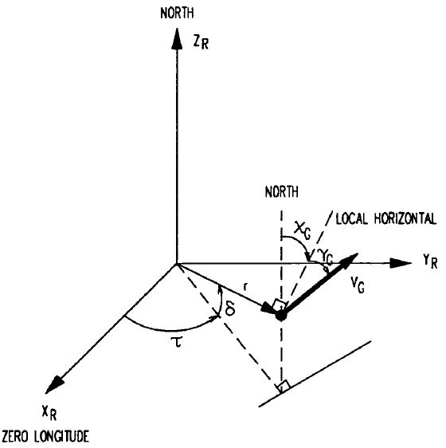



ZI
Local
horizontal
North
YI
XI
XX

