Slide 1
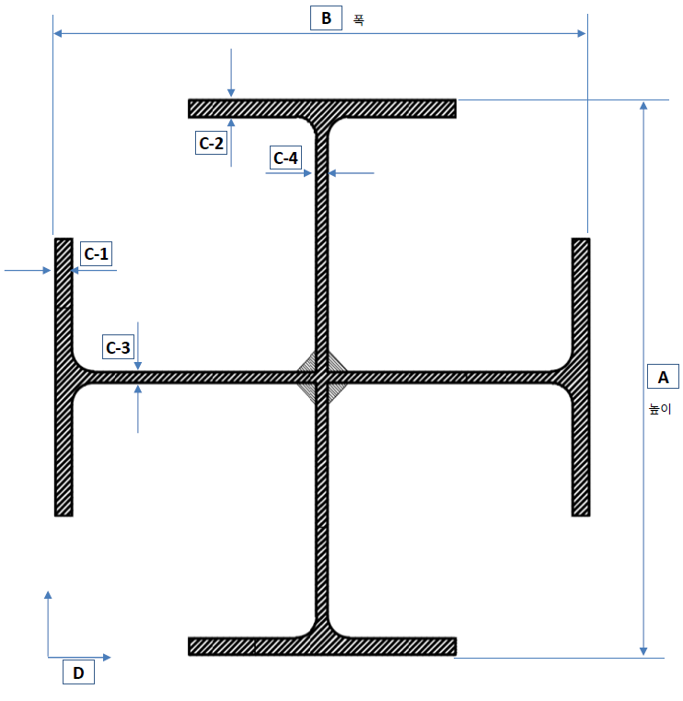
H2=
Minor
tw1
tf1
tf2
H1=
Major
tw2

