Slide 1

Retail Bank Transaction Analysis
A DATABASE Using MYSQL
Presented By :
SHANTANU PUNWATKAR

Slide 2
About Me
SHANTANU PUNWATKAR , B.Tech – CSE
Why Data Science?
- Data science gives you the ultimate power to predict trends and guide massive choices using everyday data. It has many open roles, high demand, good pay, job flexibility etc..
Work Experience : Fresher
LinkedIn : https://linkedin.com/in/shantanu-punwatkar-806406273
GitHub : https://github.com/sdpunwatkar2/Retail_Banking_Transaction_Analysis_

Slide 3
Agenda
Objective of the Project
Database Structure
ER Diagram
Key Analysis Questions
Experience/Challenges
Conclusion

Slide 4
Objective of the Project :
To analyze the customer profile and segmentation based on demographics, income, credit score, activity, KYC status, and tenure.
To examine account usage and branch activity across different account types, customers, balances, and branches.
To identify and analyze transaction patterns, including transaction types, channels, amounts, and activity over time.
To evaluate loan performance and repayment behaviour, including outstanding balances, delayed payments, penalties, and loan status.
To understand card usage and overall product engagement, including card types, credit limits, reward points, and customers using multiple banking products.

Slide 5
Database Structure :
This project contains 7 interrelated tables:
Customers
Branches
Accounts
Cards
Transactions
Loan
Loan payment
These tables are connected using Primary Keys and Foreign Keys to maintain relational database integrity.

Slide 6
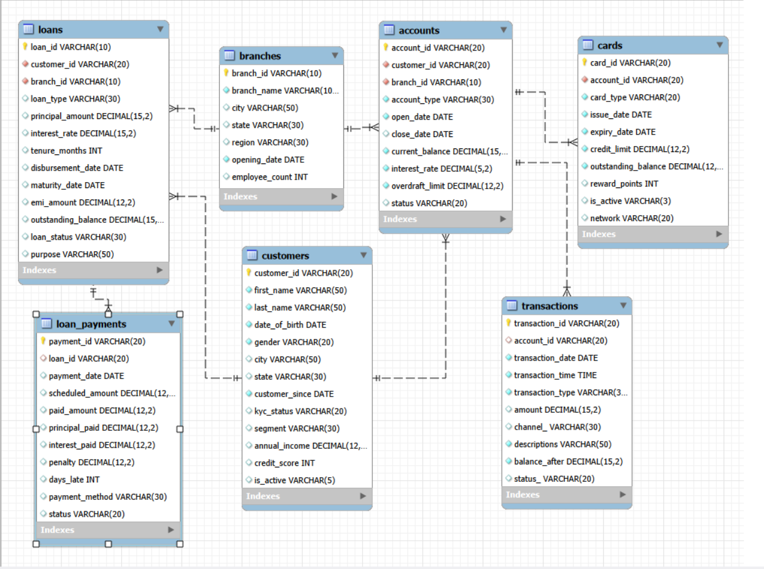
ER Diagram

Slide 7


Key Analysis Questions
1. Customer Profile & Segmentation
How many customers are currently in the database?
Query:
Business Insight: Provides the overall size of the bank's customer base.

Slide 8


How are customers distributed by activity status?
Query:
SELECT is_active,
COUNT(*) AS total_customers
FROM customers
GROUP BY is_active;
Business Insight: Helps compare active and inactive customers and identify engagement levels.

Slide 9
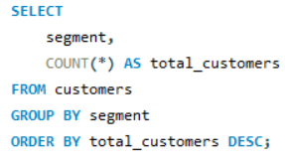
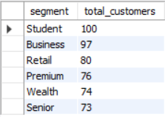
How are customers distributed across different segments?
Query:
Business Insight: Identifies the largest and smallest customer groups for targeted banking strategies.

Slide 10
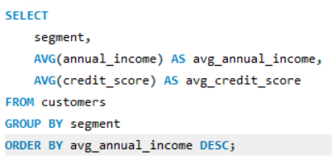
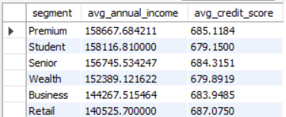
How do income and credit scores differ across customer segments?
Query:
Business Insight: Helps identify financially valuable customer segments and compare credit profiles.

Slide 11
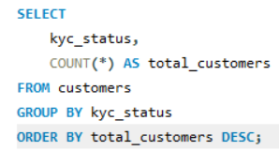
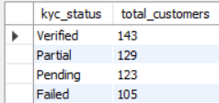
What is the KYC status distribution among customers?
Query:
Business Insight: Helps the bank monitor customer verification and regulatory compliance.

Slide 12
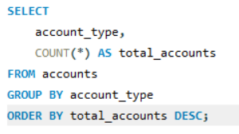
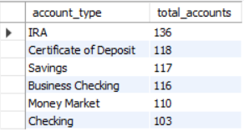
2. Account Usage & Branch Activity
How are accounts distributed across different account types?
Query:
Business Insight: Identifies the most popular banking account products.

Slide 13
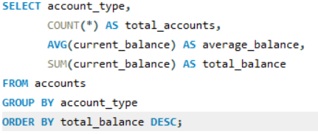
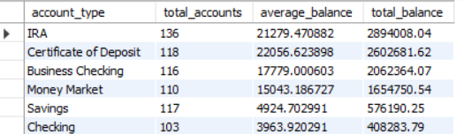
Which account types maintain the highest balances?
Query:
Business Insight: Shows which account products contribute the most to total deposits and balances.

Slide 14
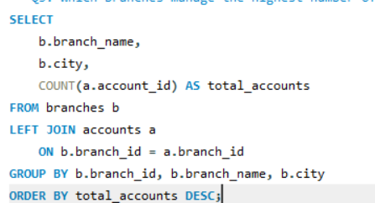
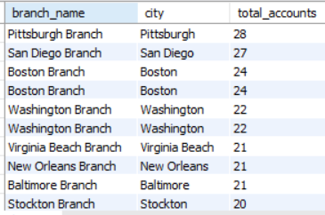
Which branches manage the highest number of accounts?
Query:
Business Insight: Helps compare branch-level account activity and customer reach.

Slide 15
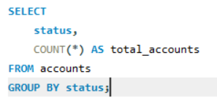

How are accounts distributed by account status?
Query:
Business Insight: Helps identify the proportion of active, closed, or other account statuses.

Slide 16
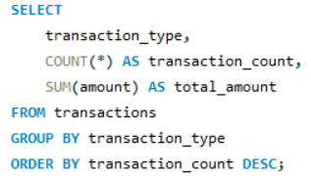
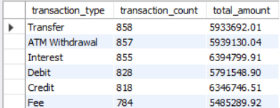
3. Transaction Pattern Analysis
Which transaction types are most common?
Query:
Business Insight: Identifies the most frequently used transaction services and their monetary volume.

Slide 17
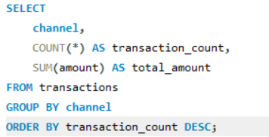
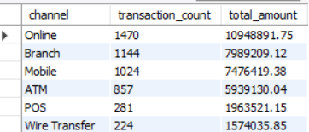
Which transaction channels are used most frequently?
Query:
Business Insight: Shows customer preferences for different banking channels.

Slide 18
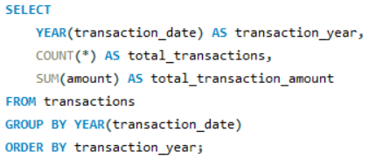
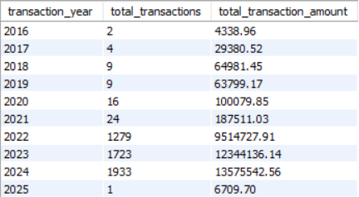
How does transaction activity change over time?
Query:
Business Insight: Helps identify monthly and yearly transaction trends.

Slide 19
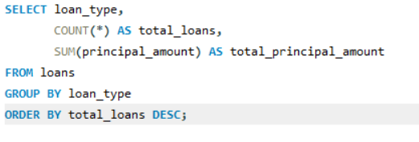
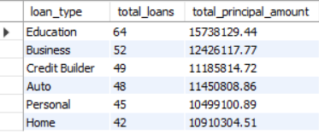
4. Loan Performance & Repayment Behaviour
How are loans distributed across different loan types?
Query:
Business Insight: Shows the popularity and financial exposure of different loan products.

Slide 20
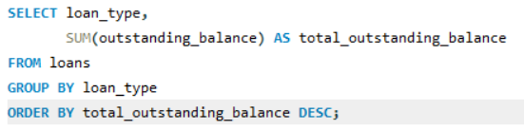
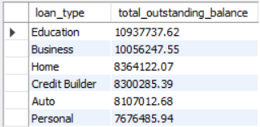
Which loan types have the highest outstanding balances?
Query:
Business Insight: Identifies loan categories contributing the highest outstanding credit exposure.

Slide 21
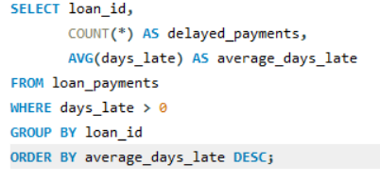
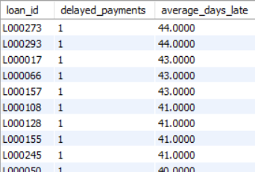
Which loans have delayed payments?
Query:
Business Insight: Helps identify loans with repayment delays and potential repayment risk.

Slide 22
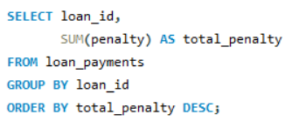
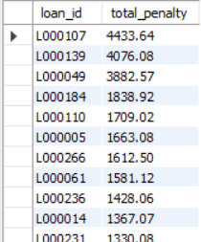
Which loans have generated the highest penalties?
Query:
Business Insight: Highlights loans with frequent late-payment penalties.

Slide 23
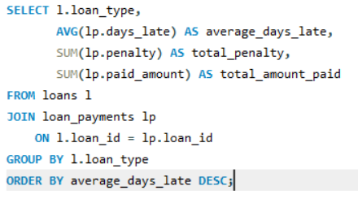
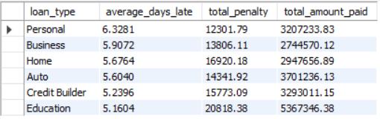
How does repayment behaviour differ across loan types?
Query:
Business Insight: Compares repayment behaviour and risk across different loan products.

Slide 24
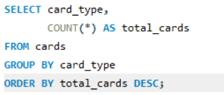

5. Card Usage & Product Engagement
How are cards distributed across different card types?
Query:
Business Insight: Identifies the most popular card products offered by the bank.

Slide 25
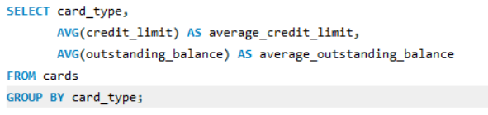

How do credit limits and outstanding balances vary by card type?
Query:
Business Insight: Helps compare customer credit exposure across different card products.

Slide 26
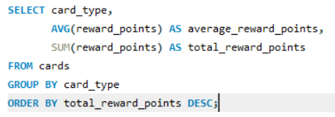

Which card types have the highest reward points?
Query:
Business Insight: Shows which card products generate the greatest customer reward engagement.

Slide 27
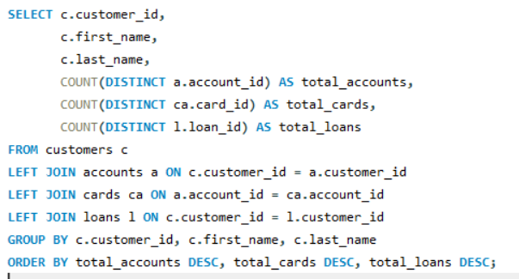
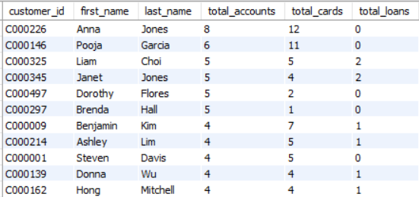
Which customers use multiple banking products?
Query:
Business Insight:
Identifies highly engaged customers and opportunities for cross-selling banking products.

Slide 28
Challenges / Experiences:
Understanding the ER diagram and relationships between multiple banking tables, including primary and foreign keys.
Designing the MySQL database with appropriate data types, constraints, and table dependencies.
Importing and validating data across seven interconnected tables containing customers, accounts, branches, loans, payments, cards, and transactions.
Creating meaningful SQL queries by connecting multiple tables to answer different business requirements.
Interpreting the query results and converting raw banking data into meaningful business insights and recommendations.
These challenges were solved using Primary Keys, Foreign Keys, JOIN operations, GROUP BY, SUM(), AVG(), and COUNT() functions.

Slide 29
Conclusion :
Successfully designed and implemented an Employee Management System using MySQL.
Managed six interrelated tables for employees, job roles, salaries, qualifications, leaves, and payroll.
Used SQL queries, joins, and aggregate functions to generate meaningful employee and payroll insights.
Improved understanding of relational database design, foreign keys, data integrity, and SQL-based analysis.
“This project helped me understand how SQL can be used to manage real-world employee data and generate meaningful business insights. Thank you.”

Slide 30

THANK YOU

