Slide 1
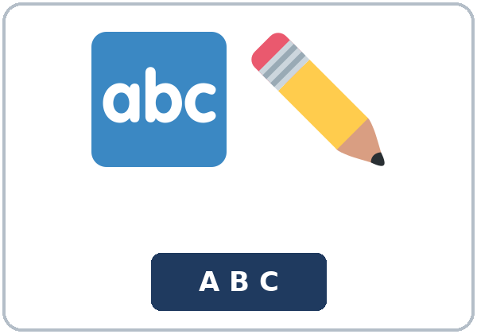
You Sent It, Didn't You?
Today you will:
• I can add a tag to a statement I think is true.
• I can answer a tag with a short yes or no.
• I can correct a wrong detail politely.
Lesson 7 · Level 5
Notes:
Welcome learners as they arrive.
Read the three lines under Today you will.
Do not collect real Social Security numbers, immigration papers, bank numbers, or medical record numbers.
Lesson plan: Topic; At a glance: Objectives.
Picture: Twemoji graphics by Twitter, Inc. and other contributors (https://github.com/jdecked/twemoji), CC BY 4.0 (https://creativecommons.org/licenses/by/4.0/); resized and combined, with signs and labels (images/CREDITS.md).

Slide 2
Today's
Goals
01
I can add a tag to a statement I think is true.
02
I can answer a tag with a short yes or no.
03
I can correct a wrong detail politely.
By the end of class, you can do these things.
04
I can write a confirmation email.
Notes:
Read each goal slowly. Learners repeat.
Lesson plan: At a glance: Objectives.

Slide 3
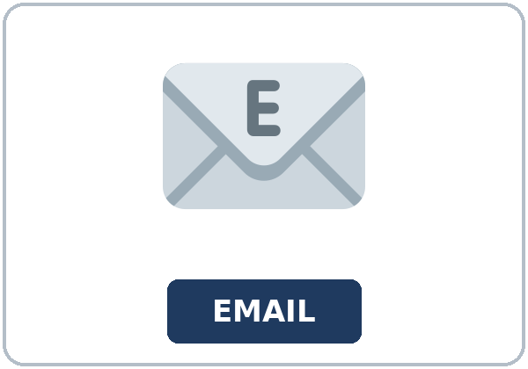
OPENING TALK · 6:00
Opening Talk
Work with a partner. A asks last
week's question. B answers with a short summary. Then compare one homework sentence.
Homework check: read one sentence from
your Lesson 6 message.
Notes:
Step 1 · 6:00–6:06 · Opening Talk.
Work with a partner.
Lesson plan: Step 1; Opening Talk page.
Picture: Twemoji graphics by Twitter, Inc. and other contributors (https://github.com/jdecked/twemoji), CC BY 4.0 (https://creativecommons.org/licenses/by/4.0/); resized and combined, with signs and labels (images/CREDITS.md).

Slide 4
Opening Talk
Cards
01
What did the person say? Use said or told.
02
What did the person ask you to do? Use asked me to.
Work with a partner. A asks last week's
question. B answers with a short summary. Then compare one homework sentence.
03
What yes/no question did the person ask? Use asked if.
04
Homework check: read one sentence from your Lesson 6 message.
Notes:
Each click shows the next card.
A asks. B answers. Then switch.
Lesson plan: Step 1; Opening Talk page.

Slide 5
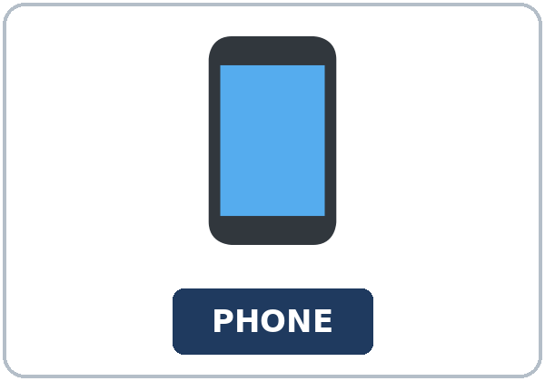
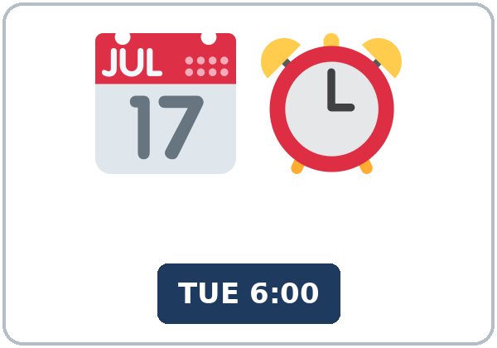
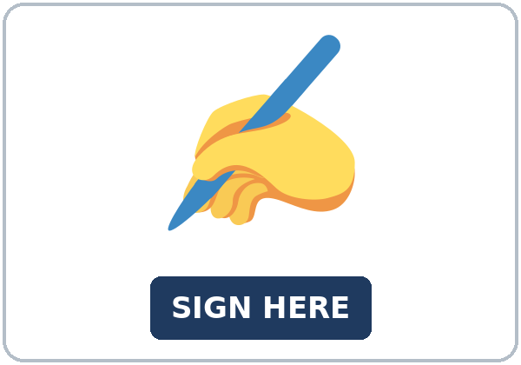
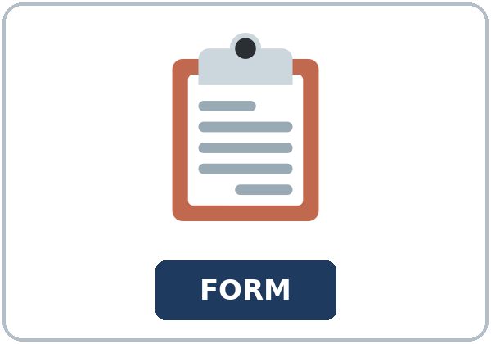
Look. Listen.
Repeat.
New Words
★ spelling
★ email address
★ phone number
★ schedule
★ signature
★ form
Notes:
Step 2 · 6:06–6:12 · New Words.
Point to each picture. Learners repeat. ★ = most important.
Lesson plan: Step 2; New Words page.
Pictures: Twemoji graphics by Twitter, Inc. and other contributors (https://github.com/jdecked/twemoji), CC BY 4.0 (https://creativecommons.org/licenses/by/4.0/); resized and combined, with signs and labels (images/CREDITS.md).

Slide 6
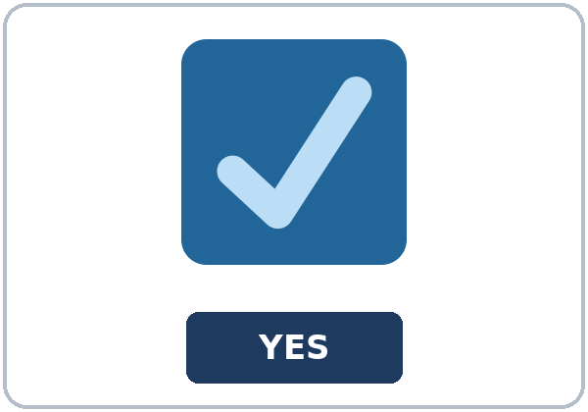
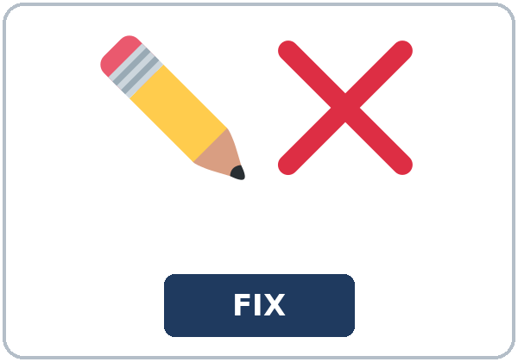
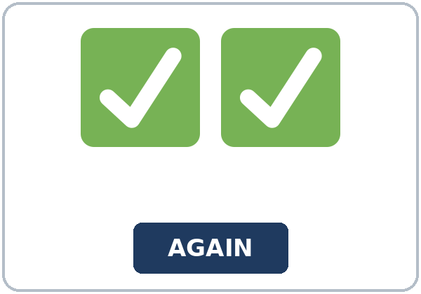
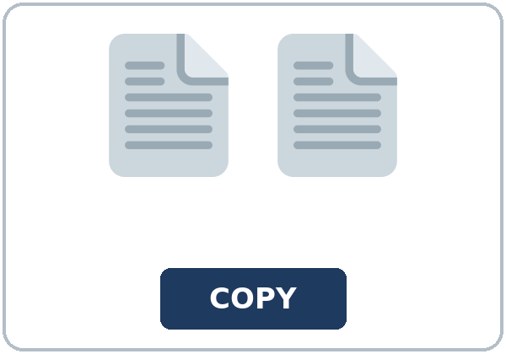
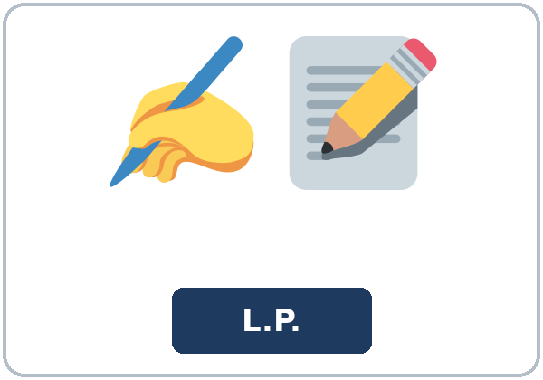
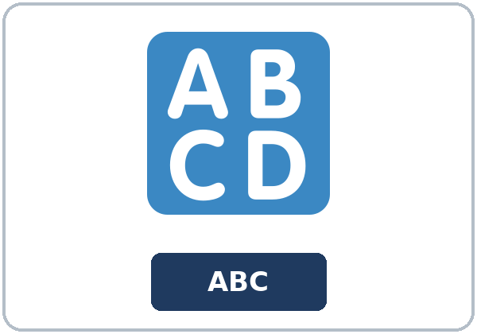
Partner game:
Check the form
More New Words
★ checkbox
★ correction
★ double-check
★ copy
initial
capital letter
Notes:
A points to a picture. B names it and uses it in one sentence. Then switch.
Lesson plan: Step 2; New Words page; Partner game.
Pictures: Twemoji graphics by Twitter, Inc. and other contributors (https://github.com/jdecked/twemoji), CC BY 4.0 (https://creativecommons.org/licenses/by/4.0/); resized and combined, with signs and labels (images/CREDITS.md).

Slide 7
Check the Meaning
Look at the picture. Answer the question.
1
2
3
Is this a phone number or an email address?
What small box do you mark on a form?
Is the L in Leah small or capital?
an email address
a checkbox
capital
Notes:
The answers are hidden. Ask, then click.
1. an email address
2. a checkbox
3. capital
Lesson plan: Step 2: Check the Meaning.
Pictures: Twemoji graphics by Twitter, Inc. and other contributors (https://github.com/jdecked/twemoji), CC BY 4.0 (https://creativecommons.org/licenses/by/4.0/); resized and combined, with signs and labels (images/CREDITS.md).

Slide 8
Before You
Listen for:
Listen
Listen. Is every detail correct at the start?
Leah is at a community center desk.
| 6:12–6:32 | Listening: play 1 (Task A), play 2 (Tasks B and C) +
01
Audio: about 1:30. It plays once.
Narrator
02
Mr. Ortiz
Play 1: Task A
03
Leah
Notes:
Step 3 · 6:12–6:32 · Listening. Play 1 is Task A. Play 2 is Tasks B and C. A third play is fine.
Leah is at a community center desk.
The script says going to and want to. Learners only need to recognize gonna and wanna.
Lesson plan: Step 3; Listening page.
Picture: Twemoji graphics by Twitter, Inc. and other contributors (https://github.com/jdecked/twemoji), CC BY 4.0 (https://creativecommons.org/licenses/by/4.0/); resized and combined, with signs and labels (images/CREDITS.md).

Slide 9
Listen. Is every detail correct at the
start?
Listening A
1.
a. Yes. Every detail is correct
b. No. The room is wrong
c. She did not send the form
Notes:
Click to circle b.
Lesson plan: Step 3; Listening Task A; Answer key.

Slide 10
B. Listen again. Mark each detail
correct or wrong.
Listening B
1. Class ID C-42
Correct
Wrong
2. Email leah@mail.example
Correct
Wrong
3. Day: Tuesday
Correct
Wrong
4. Time: 6:00
Correct
Wrong
5. Room on his copy: A
Correct
Wrong
Notes:
Click to circle each answer: 1 Correct • 2 Correct • 3 Correct • 4 Correct • 5 Wrong. C forty-two is class ID C-42. Tuesday at six is 6:00. The room on his copy is A; the schedule says room C
Lesson plan: Step 3; Listening Task B; Answer key.

Slide 11
Listen again.
Listen again. Write the tag.
Listening C
1
You sent the form, ______?
didn't you
2
Your class ID is C forty-two, ______?
isn't it
3
The email address is leah at mail dot example, ______?
isn't it
Write the missing words.
Then check together.
4
You wrote a phone number on line three, ______?
didn't you
5
The class is on Tuesday at six, ______?
isn't it
6
Your friend isn't in this class, ______?
is she
Notes:
Click to show each answer: 1 didn't you • 2 isn't it • 3 isn't it • 4 didn't you • 5 isn't it • 6 is she
Lesson plan: Step 3; Listening Task C; Answer key.

Slide 12
Hear it: gonna and wanna are short forms
Hear It,
Say It
Say it: use the full forms
I want to double-check every line.
I'm going to come straight from work.
gonna and wanna are short forms. This listening uses the full forms.
You can say going to and want to.
Say each line two times.
You sent the form, didn't you?
Actually, it isn't.
Notes:
gonna and wanna are short forms. This listening uses the full forms. Say each line two times.
Lesson plan: Step 3: Hear it, say it.

Slide 13
Grammar Box 1
a negative tag
QUESTION
ANSWER
You sent the form, didn't you?
Yes, I did.
The class is on Tuesday, isn't it?
Yes, it is.
She signed the copy, didn't she?
Yes, she did.
Notes:
Grammar Box 1: a negative tag. Each click shows the answer side.
Lesson plan: Step 4; Grammar Box 1.
Picture: Twemoji graphics by Twitter, Inc. and other contributors (https://github.com/jdecked/twemoji), CC BY 4.0 (https://creativecommons.org/licenses/by/4.0/); resized and combined, with signs and labels (images/CREDITS.md).

Slide 14
Grammar Box 2
a positive tag
QUESTION
ANSWER
She isn't on the list, is she?
No, she isn't.
The room isn't A, is it?
No, it isn't.
You didn't initial it, did you?
Actually, I did.
Notes:
Grammar Box 2: a positive tag. Each click shows the answer side.
Lesson plan: Step 4; Grammar Box 2.
Picture: Twemoji graphics by Twitter, Inc. and other contributors (https://github.com/jdecked/twemoji), CC BY 4.0 (https://creativecommons.org/licenses/by/4.0/); resized and combined, with signs and labels (images/CREDITS.md).

Slide 15
Grammar Box 3
do, does, or did
QUESTION
ANSWER
You need a copy, don't you?
Yes, I do.
The schedule starts at six, doesn't it?
Yes, it does.
Leah checked the spelling, didn't she?
Yes, she did.
Notes:
Grammar Box 3: do, does, or did. Each click shows the answer side.
Lesson plan: Step 4; Grammar Box 3.
Picture: Twemoji graphics by Twitter, Inc. and other contributors (https://github.com/jdecked/twemoji), CC BY 4.0 (https://creativecommons.org/licenses/by/4.0/); resized and combined, with signs and labels (images/CREDITS.md).

Slide 16
Grammar Box 4
correct a detail
QUESTION
ANSWER
The room is A, isn't it?
Actually, it's room C.
The class is on Wednesday, isn't it?
Actually, it's on Tuesday.
Your email ends in mail.example, doesn't it?
Yes, it does.
Notes:
Grammar Box 4: correct a detail. Each click shows the answer side.
Lesson plan: Step 4; Grammar Box 4.
Picture: Twemoji graphics by Twitter, Inc. and other contributors (https://github.com/jdecked/twemoji), CC BY 4.0 (https://creativecommons.org/licenses/by/4.0/); resized and combined, with signs and labels (images/CREDITS.md).

Slide 17
Practice A
Write.
Practice A
1
You sent the form, ______?
didn't you
2
The class is on Tuesday, ______?
isn't it
3
She isn't on the list, ______?
is she
Write the missing word.
Pairs: check your answers.
4
You need a copy, ______?
don't you
5
The schedule starts at six, ______?
doesn't it
6
Leah checked the spelling, ______?
didn't she
Notes:
Click to show each answer: 1 didn't you • 2 isn't it • 3 is she • 4 don't you • 5 doesn't it • 6 didn't she
Lesson plan: Step 4; Grammar Practice A; Answer key.

Slide 18
Circle the correct words.
Practice B
1. You sent it, didn't you?
Yes, I did.
Yes, I didn't.
2. The room is A, ______?
isn't it
is it
3. She isn't on the list, ______?
isn't she
is she
4. You checked the spelling, ______?
didn't you
did you
5. The class ID is C forty-two, ______?
isn't it
is it
6. You didn't sign it, did you?
No, I didn't.
Yes, I didn't.
Notes:
Click to circle each answer: 1 Yes, I did • 2 isn't it • 3 is she • 4 didn't you • 5 isn't it • 6 No, I didn't
Lesson plan: Step 4; Grammar Practice B; Answer key.

Slide 19
Common Mistakes
Don't say
Say
Yes, I didn't.
Yes, I did.
You sent it, did you?
You sent it, didn't you?
The class is on Tuesday, doesn't it?
The class is on Tuesday, isn't it?
She isn't on the list, isn't she?
She isn't on the list, is she?
You need a copy, doesn't you?
You need a copy, don't you?
Notes:
Read Don't say, then Say. Learners try first. Then click.
Lesson plan: Grammar: Common mistakes.
Picture: Twemoji graphics by Twitter, Inc. and other contributors (https://github.com/jdecked/twemoji), CC BY 4.0 (https://creativecommons.org/licenses/by/4.0/); resized and combined, with signs and labels (images/CREDITS.md).

Slide 20
Pair Check
A says.
01
Work with a partner.
Model: It's Tuesday, isn't it?
B answers.
02
| Detail | Copy A | Copy B | |---|---|---| | Day | Tuesday | Wednesday | | Time | 6:00 |
Notes:
Model: It's Tuesday, isn't it? Actually, it's Wednesday. | Detail | Copy A | Copy B | |---|---|---| | Day | Tuesday | Wednesday | | Time | 6:00 | 6:00 | | Room | C | C | | Email | leah@mail.example | leah@mail.example |
Break · 6:45–7:00.
Lesson plan: Step 4: Pair check.
Picture: Twemoji graphics by Twitter, Inc. and other contributors (https://github.com/jdecked/twemoji), CC BY 4.0 (https://creativecommons.org/licenses/by/4.0/); resized and combined, with signs and labels (images/CREDITS.md).

Slide 21
Talk Time
Talk Time
Work together.
A has four details.
7:00–7:18
1
A has four details.
2
A has four details.
3
A has four details.
Notes:
Round 1.
Lesson plan: Step 5; Talk Time.
Picture: Twemoji graphics by Twitter, Inc. and other contributors (https://github.com/jdecked/twemoji), CC BY 4.0 (https://creativecommons.org/licenses/by/4.0/); resized and combined, with signs and labels (images/CREDITS.md).

Slide 22
Talk Time
Talk Time
Pairs.
B says two sentences.
7:00–7:18
1
B says two sentences.
2
Then switch.
3
Then switch.
Notes:
Round 2.
Lesson plan: Step 5; Talk Time.
Picture: Twemoji graphics by Twitter, Inc. and other contributors (https://github.com/jdecked/twemoji), CC BY 4.0 (https://creativecommons.org/licenses/by/4.0/); resized and combined, with signs and labels (images/CREDITS.md).

Slide 23
Read.
Answer.
Read &
Write
1
What is Leah's class ID?
C-42
2
What day and time is the class?
Tuesday at 6:00
Read the page.
Answer the questions.
3
What room is on the form?
Room C
4
What room is in the email?
Room A
5
What is the mismatch?
The room
Notes:
Step 6 · 7:18–7:25 · Read & Write.
Click to show each answer: 1 C-42 • 2 Tuesday at 6:00 • 3 Room C • 4 Room A • 5 The room
Lesson plan: Step 6; Read & Write page; Answer key.

Slide 24
Before You Go 7:25–7:30
01
Exit ticket
02
Homework
Confirm two details about this class.
Name: Date:
Two of them are tags.
Give this page to your teacher.
About 20–25 minutes.
1. Add the tag.
2. Finish your confirmation email (Read & Write C). Read it one more
3. Confirm two details with a friend or a family member. Use a tag.
4. Review (said / told). Report one sentence from Lesson 6. Use said
Bring it next week!
Notes:
Step 7 · 7:25–7:30 · Exit ticket and homework. Never skip the exit ticket.
Confirm two details about this class.
Lesson plan: Step 7; Exit Ticket page; Homework page.
Picture: Twemoji graphics by Twitter, Inc. and other contributors (https://github.com/jdecked/twemoji), CC BY 4.0 (https://creativecommons.org/licenses/by/4.0/); resized and combined, with signs and labels (images/CREDITS.md).

Slide 25
Goodbye! See You Next Week!
Now you can:
• I can add a tag to a statement I think is true.
• I can answer a tag with a short yes or no.
• I can correct a wrong detail politely.
Lesson 7 · Level 5
Notes:
Read the three Now you can lines.
Homework is about 20–25 minutes. Bring it next week.
Lesson plan: At a glance: Objectives; Step 7.
Picture: Twemoji graphics by Twitter, Inc. and other contributors (https://github.com/jdecked/twemoji), CC BY 4.0 (https://creativecommons.org/licenses/by/4.0/); resized and combined, with signs and labels (images/CREDITS.md).

Slide 26
Credits
Pictures
Vocabulary pictures use Twemoji graphics by Twitter, Inc. and other contributors (https://github.com/jdecked/twemoji), licensed under CC BY 4.0 (https://creativecommons.org/licenses/by/4.0/). The graphics were resized and combined, and signs and labels were added.
Names and story
Mr. Ortiz and Leah are invented names. The listening story is invented.
Audio and font
Audio: synthetic voices made with Chatterbox TTS (MIT License), cloned from short synthetic reference clips made with Kokoro-82M (Apache License 2.0). No recordings of real people were used. Each file carries an inaudible Perth watermark marking it as AI-generated. Font: Lexend Deca (OFL 1.1).
© 2026 the authors. The authors license this deck under CC BY-NC-SA 4.0.
Notes:
Credits. You don't need to read this slide in class.
Pictures: Twemoji graphics by Twitter, Inc. and other contributors, CC BY 4.0; the file-by-file list is in images/CREDITS.md.
Audio: synthetic voices, computer-generated (Chatterbox TTS cloned from Kokoro-82M reference clips). No recordings of real people. The names and the story are invented.
Course materials: © 2026 the authors, licensed under CC BY-NC-SA 4.0 (https://creativecommons.org/licenses/by-nc-sa/4.0/).
Lesson plan: Picture Credits. Picture list: images/CREDITS.md.

