Slide 1


Health
Today you will:
• Name health problems
• Say I have a… / My … hurts
• Give advice: should / shouldn't
• Make an appointment
Lesson 10 (Week 11)
Notes:
Welcome back. Read the goals together; learners repeat.
Objectives: name common health problems (a headache, a cold, a fever…); say I have a… / My … hurts; give and ask for advice with should / shouldn't; make a simple appointment on the phone.
Language practice only, not medical advice. Use invented role cards. Never ask learners about their real health or medicines.
Source: Level2_Curriculum_v5_public.md, Lesson 10 (At a glance; Teacher notes).
Picture: Twemoji graphics by Twitter, Inc. and other contributors (https://github.com/jdecked/twemoji), CC BY 4.0 (https://creativecommons.org/licenses/by/4.0/); resized and combined.

Slide 2

OPENING TALK · 6:00
Warm-Up
Same partner.
Review Lesson 9.
What do you need from the store this week?
How many eggs? How much rice?
Notes:
Step 1 · 6:00–6:10 · Opening Talk + Homework Check. Pairs (same partner for both parts).
Minutes 0–5 (review Lesson 9): partners ask What do you need from the store this week? How many eggs? How much rice? Each click shows one question.
Source: Level2_Curriculum_v5_public.md, Lesson 10 (Step 1).
Picture: Twemoji graphics by Twitter, Inc. and other contributors (https://github.com/jdecked/twemoji), CC BY 4.0 (https://creativecommons.org/licenses/by/4.0/); resized and combined.

Slide 3
Homework
Check
HW
Homework check
Read your role play.
1
___ the soup, please.
I'd like
Polite: I'd like
or Can I have…?
2
___ I have the check?
Can
3
How ___ eggs?
many
4
How ___ rice?
much
Notes:
Step 1, minutes 5–10: partners read their homework restaurant conversation as a role play.
Each click shows one answer. The lines review Lesson 9 (Grammar Boxes 1 and 3).
Teacher: write 2 corrected sentences on the board. If behind: collect the homework.
Source: Level2_Curriculum_v5_public.md, Lesson 10 (Step 1); Lesson 9 Homework.

Slide 4
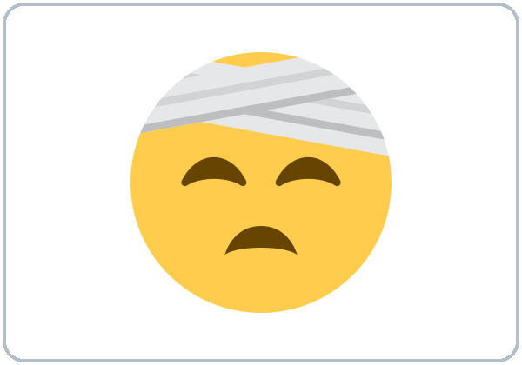

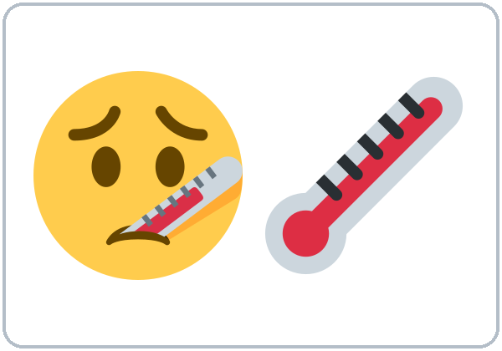
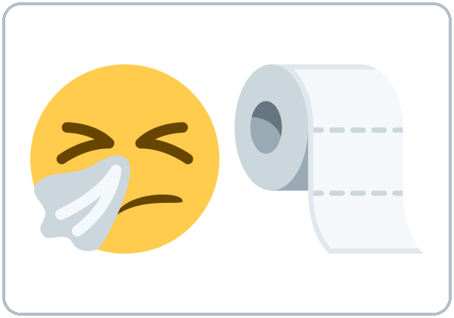
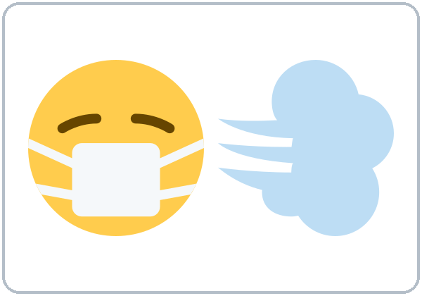
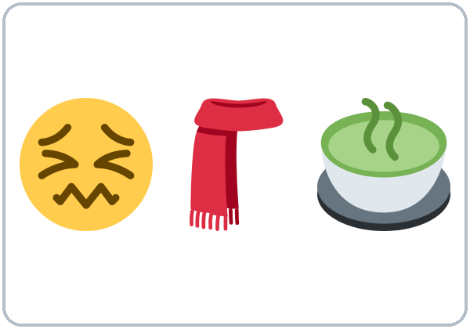
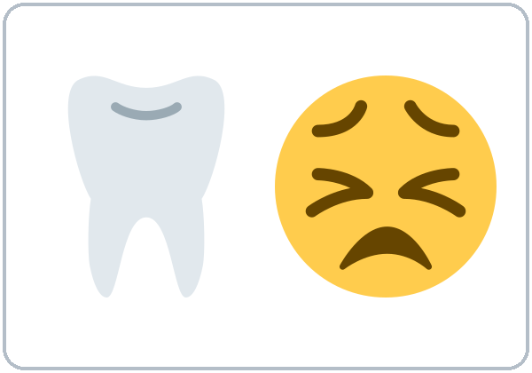
Act it
out!
New Words
a headache
a stomachache
a fever
a cold
a cough
a sore throat
a toothache
Notes:
Step 2 · 6:10–6:18 · New Words (pairs). Point, say, repeat twice. Each click shows one word.
Note: a headache, a cold (with a).
Star words here: a headache, a fever, a cold, a cough, a sore throat.
Act it out: one learner acts (cough, hand on head); the partner says "You have a cough!" If behind: teach the star words only.
Source: Level2_Curriculum_v5_public.md, Lesson 10 (Step 2; Student Page 10 New Words).
Picture: Twemoji graphics by Twitter, Inc. and other contributors (https://github.com/jdecked/twemoji), CC BY 4.0 (https://creativecommons.org/licenses/by/4.0/); resized and combined.

Slide 5
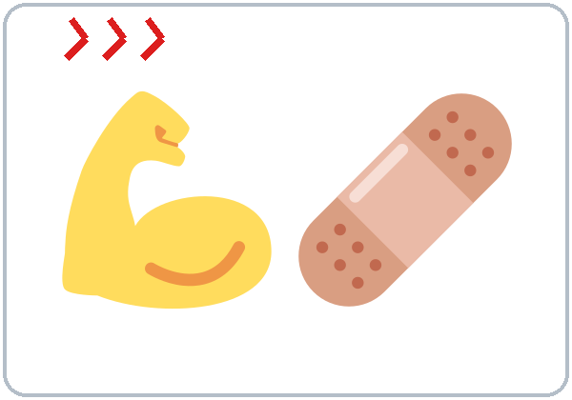
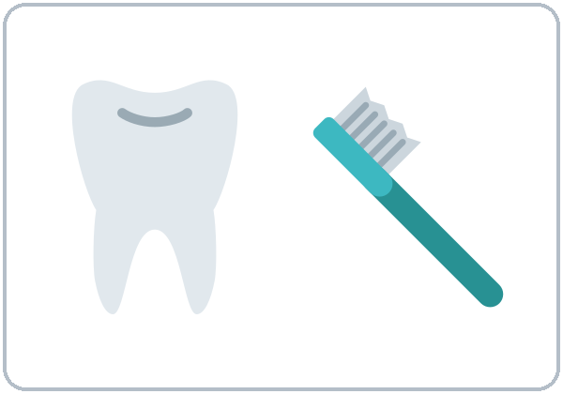

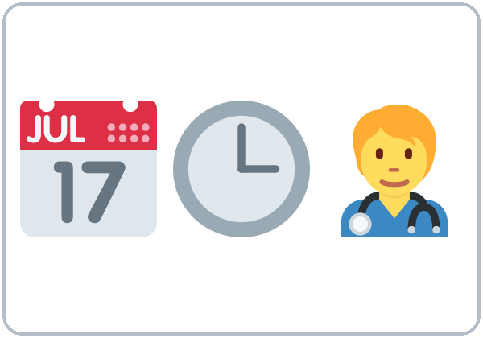
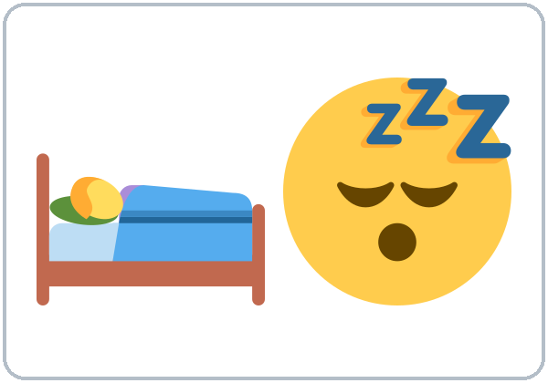

You have
a cough!
More New Words
hurts
(My arm hurts.)
doctor
dentist
medicine
appointment
rest
drink water
Notes:
New Words, part 2. Each click shows one word. Star words here: hurts (My arm hurts.), medicine, appointment.
Learners may want local information (clinics, low-cost care). Share a printed list from your program if it has one; don't give medical opinions.
Source: Level2_Curriculum_v5_public.md, Lesson 10 (Step 2; Student Page 10; Teacher notes).
Picture: Twemoji graphics by Twitter, Inc. and other contributors (https://github.com/jdecked/twemoji), CC BY 4.0 (https://creativecommons.org/licenses/by/4.0/); resized and combined.

Slide 6
a headache
No
Listening A
Listen. What's the matter?
a cough
Yes
a stomachache
No
a sore throat
Yes
a fever
Yes
a toothache
No
Notes:
Step 3 · 6:18–6:30 · Listening + "Say it" (L10_listening.mp3, about 1:01). Audio: L10_listening.mp3 (about 1:01). The audio plays once, play again if needed. No speaker? Read the script with a volunteer learner.
Before you listen: "Marco is sick. He calls the clinic. What does he say?" Take 2 guesses.
Listen 1 → Task A (check the problems). Each click shows Yes or No.
Answer key: ✓ a cough, a sore throat, a fever. ✗ a headache, a stomachache, a toothache.
Riverside Clinic and Marco Silva are invented.
Source: Level2_Curriculum_v5_public.md, Lesson 10 (Step 3; Answer key; Teacher notes).
Picture: Twemoji graphics by Twitter, Inc. and other contributors (https://github.com/jdecked/twemoji), CC BY 4.0 (https://creativecommons.org/licenses/by/4.0/); resized and combined.

Slide 7
Listen again.
True or False?
Listening B
1. Marco wants an appointment.
True
False
2. He got sick yesterday.
True
False
Three days ago.
3. He can come at 10:15.
True
False
He can't.
4. His appointment is at 3:30.
True
False
5. He should go to work today.
True
False
He shouldn't.
Notes:
Listen 2 → Task B (true / false). Each click circles one answer and shows the correction. The audio plays once, play again if needed.
Answer key: 1 T; 2 F (three days ago); 3 F (he can't come at 10:15); 4 T (3:30); 5 F (he shouldn't go to work).
Source: Level2_Curriculum_v5_public.md, Lesson 10 (Step 3; Answer key).

Slide 8
Listening C
C
Listen again.
Write the missing word.
1
I'm sorry. What's the ____?
matter
should = a good idea
shouldn't = not a good idea
2
Three days ____.
ago
3
You ____ rest and drink a lot of water.
should
4
You ____ go to work today.
shouldn't
Notes:
Listen 3 → Task C (fill in). Each click fills one blank. The audio plays once, play again if needed.
Answer key: matter; ago; should; shouldn't.
"Say it" (1–2 min): the class repeats "What's the matter?" and "You should rest."
If behind: skip the third play; do Task C together.
Source: Level2_Curriculum_v5_public.md, Lesson 10 (Step 3; Answer key).

Slide 9
Grammar Box 1
What's the
Matter?
QUESTION
ANSWER
What's the matter?
I have a headache.
My head hurts.
What's wrong?
I have a cold.
My feet hurt.
Notes:
Step 4 · 6:30–6:45 · Grammar: have / hurt / should. Say: "Problems: I have a headache. Body parts: My arm hurts. Advice: You should rest. Should + base verb, the same for everyone."
Grammar Box 1: click 1 and click 2 highlight one pair each.
Q: have or hurt? have + the problem: I have a headache. hurt + body part: My back hurts. Q: hurts or hurt? One part: My arm hurts. Two or more: My feet hurt.
Source: Level2_Curriculum_v5_public.md, Lesson 10 (Step 4; Grammar Box 1; Questions and answers).
Picture: Twemoji graphics by Twitter, Inc. and other contributors (https://github.com/jdecked/twemoji), CC BY 4.0 (https://creativecommons.org/licenses/by/4.0/); resized and combined.

Slide 10
Grammar Box 2
Does your ... hurt?
QUESTION
ANSWER
Does
your head hurt?
Yes, it does.
No, it doesn't.
Does
your arm hurt?
Yes, it does.
No, it doesn't.
Do
your feet hurt?
Yes, they do.
No, they don't.
Notes:
Grammar Box 2: Does your … hurt? Each click highlights Does / Do and its answers.
More from the box: Does your back hurt? Do your eyes hurt?
Source: Level2_Curriculum_v5_public.md, Lesson 10 (Grammar Box 2).
Picture: Twemoji graphics by Twitter, Inc. and other contributors (https://github.com/jdecked/twemoji), CC BY 4.0 (https://creativecommons.org/licenses/by/4.0/); resized and combined.

Slide 11
What should
Advice
I do?
You should rest.
He should see a doctor.
should + base verb
She shouldn't go to work.
What
should
I do?
What
should
he do?
No to. No -s.
What
should
she do?
Notes:
Grammar Box 3: What should I do? Each click highlights should.
More advice: drink water, take medicine; shouldn't eat a lot, shouldn't stay up late. Should I see a doctor? Yes, you should. / No, you shouldn't.
Q: should + what? The base verb, the same for everyone: She should rest. (not shoulds, not should to rest)
Source: Level2_Curriculum_v5_public.md, Lesson 10 (Grammar Box 3; Questions and answers).
Picture: Twemoji graphics by Twitter, Inc. and other contributors (https://github.com/jdecked/twemoji), CC BY 4.0 (https://creativecommons.org/licenses/by/4.0/); resized and combined.

Slide 12
Common Mistakes
Don't say
Say
I have headache.
I have a headache.
My head is hurting me.
My head hurts.
You should to rest.
You should rest.
Notes:
Common mistakes (part 1). Each click shows the correct sentence.
Write the correct form on the board. Learners can read the note on their Grammar page; you don't need to explain it.
Source: Level2_Curriculum_v5_public.md, Lesson 10 (Common mistakes; Teacher notes).
Picture: Twemoji graphics by Twitter, Inc. and other contributors (https://github.com/jdecked/twemoji), CC BY 4.0 (https://creativecommons.org/licenses/by/4.0/); resized and combined.

Slide 13
Fix These Mistakes
Don't say
Say
She shoulds go.
She should go.
I have pain in my throat.
I have a sore throat.
My feet hurts.
My feet hurt.
Notes:
Common mistakes (part 2). Each click shows the correct sentence.
I have pain in my throat is OK, but I have a sore throat is more common.
Source: Level2_Curriculum_v5_public.md, Lesson 10 (Common mistakes).
Picture: Twemoji graphics by Twitter, Inc. and other contributors (https://github.com/jdecked/twemoji), CC BY 4.0 (https://creativecommons.org/licenses/by/4.0/); resized and combined.

Slide 14
Quick Check
have, hurt, or should?
1
2
3
She should ___. (rest / to rest)
I have headache. OK?
My legs ___. (hurt / hurts)
rest
No: a headache
hurt
Notes:
Step 4 check questions. Learners answer; each click shows one answer.
Answers: rest · No: I have a headache · hurt.
Short "Advice Circle" (last 5 min): A says a problem; B gives advice; C gives a different idea. If behind: skip it.
Source: Level2_Curriculum_v5_public.md, Lesson 10 (Step 4 Check).

Slide 15
Grammar Box 4 · Appointments
Make an Appointment
Can you come at 10:15?
10:15
Sorry, I can't.
Is there a later time?
How about 3:30?
3:30
3:30 is fine.
Thank you.
Notes:
Grammar Box 4: Making an appointment. Click 1 and click 2 show one row each.
You say: I'd like to make an appointment, please. Is there a later time? / an earlier time? ___ is fine. Thank you.
The receptionist says: What's the matter? When did it start? How about 3:30? / tomorrow at 9? What's your name, please?
Source: Level2_Curriculum_v5_public.md, Lesson 10 (Grammar Box 4).
Picture: Twemoji graphics by Twitter, Inc. and other contributors (https://github.com/jdecked/twemoji), CC BY 4.0 (https://creativecommons.org/licenses/by/4.0/); resized and combined.

Slide 16
Talk Time
At the Clinic
Use the role card.
7:00–7:10
1
A: patient card.
B: What's the matter?
2
B offers a time.
How about 3:30?
3
Switch. New partner.
You should …
Notes:
Step 5 · 7:00–7:10 · Talk Time: At the Clinic. Pairs (15) / pairs + teacher (7–8). Each click shows one step.
Do: A takes a patient role card (an invented problem). B is the receptionist: What's the matter? When did it start? Then B offers a time, and A accepts or asks for another time.
Switch after 4 minutes. Then new partners: friend and friend: What's the matter? You should…
Rule: use the role card; nobody talks about their real health unless they want to. If behind: one role play only.
Source: Level2_Curriculum_v5_public.md, Lesson 10 (Step 5).
Picture: Twemoji graphics by Twitter, Inc. and other contributors (https://github.com/jdecked/twemoji), CC BY 4.0 (https://creativecommons.org/licenses/by/4.0/); resized and combined.

Slide 17
Before You Go
01
Exit ticket
02
Homework
Write one problem:
I have… / My … hurts.
Write one advice:
You should…
Write 4 problems
and advice for each.
Write a phone call:
make an appointment
(4–6 lines).
Notes:
Step 6 · 7:10–7:15 · Exit Ticket + Homework. NEVER SKIP.
Exit ticket: one problem (I have… / My … hurts) and one piece of advice with should or shouldn't.
Homework (10 minutes): 1. Write 4 health problems and advice for each (I have a cold. You should rest and drink water.). 2. Write a phone call to make an appointment (4–6 lines). Use an invented problem. 3. Bonus: learn the clinic and emergency numbers your program gives you.
Source: Level2_Curriculum_v5_public.md, Lesson 10 (Step 6; Student Page 10 Homework).
Picture: Twemoji graphics by Twitter, Inc. and other contributors (https://github.com/jdecked/twemoji), CC BY 4.0 (https://creativecommons.org/licenses/by/4.0/); resized and combined.

Slide 18
Credits
Pictures
Vocabulary pictures use Twemoji graphics by Twitter, Inc. and other contributors (https://github.com/jdecked/twemoji), licensed under CC BY 4.0 (https://creativecommons.org/licenses/by/4.0/). The graphics were resized and combined, and arrows, calendars, clocks, and labels were added.
This deck
© 2026 the authors. The authors license this deck under CC BY-NC-SA 4.0.
Audio and font
Audio: Chatterbox TTS (Resemble AI, MIT); AI voices with a Perth watermark. Font: Lexend Deca (OFL 1.1). Provided as-is, without warranty.
Notes:
Credits. Lesson content: Level 2 Adult ESL Curriculum v5, public edition, Lesson 10.
Image credit line copied exactly from images/CREDITS.md. Deck notice: © 2026 the authors; the authors license this deck under CC BY-NC-SA 4.0 (Section 7.2).
Audio and font credits: Chatterbox TTS (Resemble AI, MIT; Perth watermark), Lexend Deca (SIL OFL 1.1).

