Slide 1

Free Time
Today you will:
• Say what you like and hate
• Agree: Me too / Me neither
• Ask: What kind of...?
Lesson 3 · Level 2
Notes:
Welcome back. Read the three goals together; learners repeat.
Objectives: say likes and dislikes with love / like / don't mind / don't like / hate + noun or -ing; agree and disagree (Me too / Me neither / Really? I don't / Oh, I do!); keep a short conversation going with What kind of...?
Source: Level2_Curriculum_v4_1_public.md, Lesson 3 (At a glance).
Picture: Twemoji graphics by Twitter, Inc. and other contributors (https://github.com/jdecked/twemoji), CC BY 4.0 (https://creativecommons.org/licenses/by/4.0/); resized and combined.

Slide 2
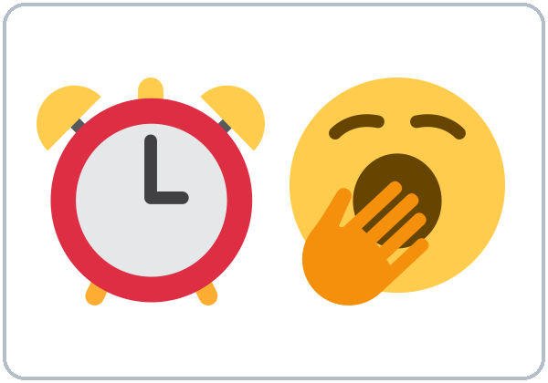
OPENING TALK · 6:00
Warm-Up
Same partner.
Ask 2 questions.
What time do you usually get up?
Does your family get up early?
Notes:
Step 1 · 6:00–6:10 · Opening Talk + Homework Check (pairs, same partner for both parts). Minutes 0–5: these two questions review Lesson 2. Each click shows one question.
Source: Level2_Curriculum_v4_1_public.md, Lesson 3 (Step 1).
Picture: Twemoji graphics by Twitter, Inc. and other contributors (https://github.com/jdecked/twemoji), CC BY 4.0 (https://creativecommons.org/licenses/by/4.0/); resized and combined.

Slide 3
Homework
Check
HW
Homework check
Read your 6 sentences.
1
My sister ____ up at 6.
gets
Raise a hand at every -s.
he / she / it = -s
2
She always ____ the bus.
takes
3
She ____ at a store.
works
4
He doesn't ____.
work
Notes:
Step 1, minutes 5–10: each partner reads their 6 homework sentences (Lesson 2 homework: someone's routine); the listener raises a hand at every -s.
Each click shows one answer. Say the verb for each line: get, take, work, work. Examples come from Lesson 2 (homework model and Common mistakes).
Teacher: note 2 common errors for the board. If behind: collect the homework.
Source: Level2_Curriculum_v4_1_public.md, Lesson 3 (Step 1); Lesson 2 Homework and Common mistakes.

Slide 4
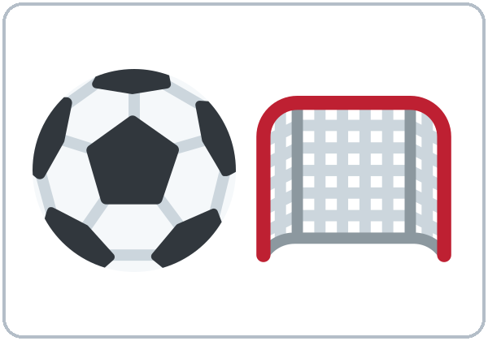
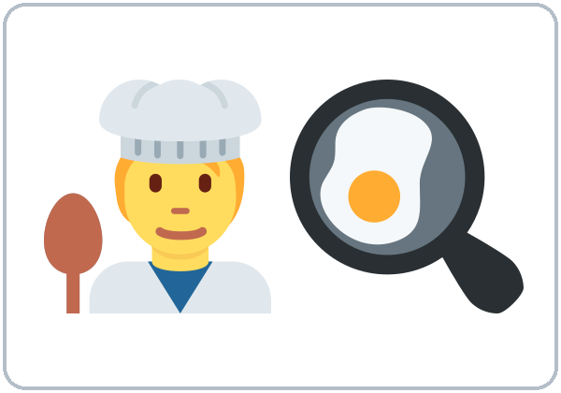
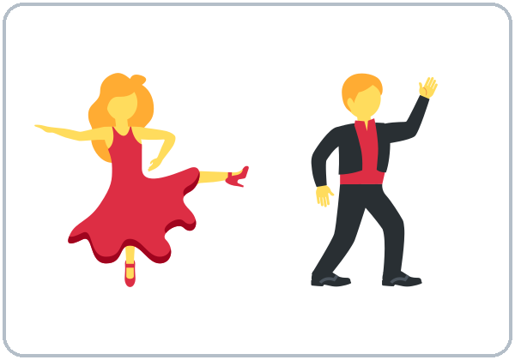

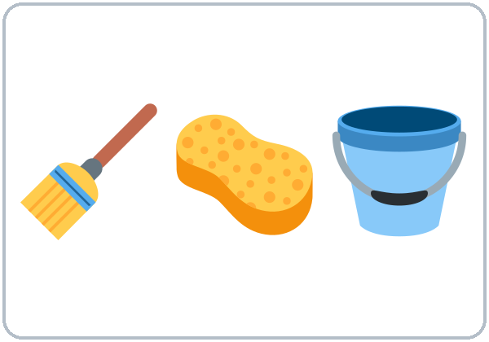
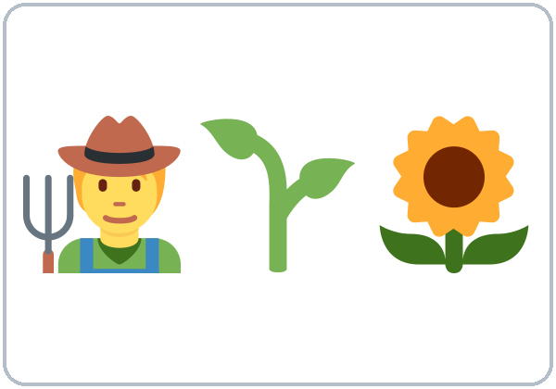

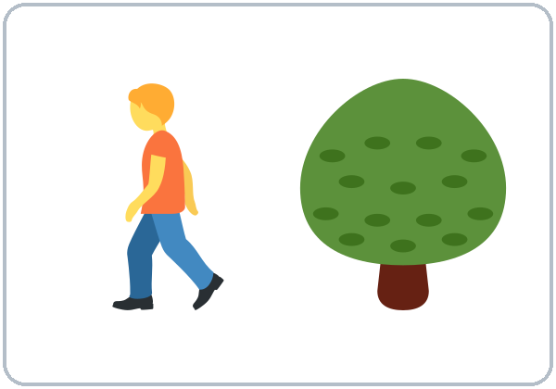
Look. Listen.
Repeat.
New Words
soccer
cooking
dancing
shopping
cleaning
gardening
fixing things
walking
Notes:
Step 2 · 6:10–6:18 · New Words (pairs). Point, say, repeat. Each click shows one word.
Star words here: soccer, cooking, dancing, shopping, cleaning.
If behind: teach the star words only; skip the picture sort.
Source: Level2_Curriculum_v4_1_public.md, Lesson 3 (Step 2; Student Page 3 New Words).
Picture: Twemoji graphics by Twitter, Inc. and other contributors (https://github.com/jdecked/twemoji), CC BY 4.0 (https://creativecommons.org/licenses/by/4.0/); resized and combined.

Slide 5


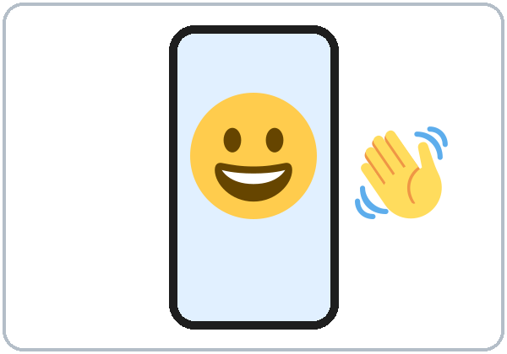
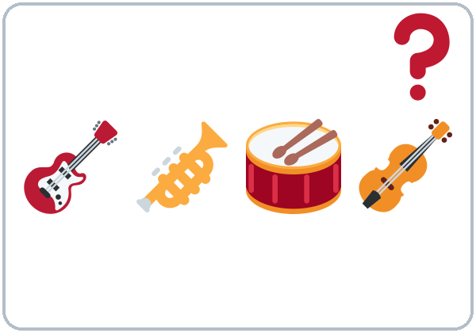
Like it?
Don't like it?
More New Words
watching TV / movies
reading
video calls
music
What kind of (music)?
Notes:
New Words, part 2. Each click shows one word. Star words here: watching TV / movies, What kind of (music)?
Music examples: salsa, cumbia, pop, rock (ask learners for their favorite kinds).
Feelings scale: teach with gestures (love → hate). Picture sort: pairs sort the free-time cards into "I like" and "I don't like."
Source: Level2_Curriculum_v4_1_public.md, Lesson 3 (Step 2; Student Page 3).
Picture: Twemoji graphics by Twitter, Inc. and other contributors (https://github.com/jdecked/twemoji), CC BY 4.0 (https://creativecommons.org/licenses/by/4.0/); resized and combined.

Slide 6
Listen to Kim and Carlos.
Yes = likes / doesn't mind
No = doesn't like / hates
Listening A
Kim
Carlos
playing soccer
No
Yes
watching soccer on TV
Yes
cooking
Yes
dancing
Yes
Yes
rock music
No
No
cleaning
No
Yes
Notes:
Step 3 · 6:18–6:30 · Listening (L3_listening.mp3, about 1:05). Before you listen: "What do you think Kim likes?"
Listen 1 → Task A (chart). Some boxes stay empty. Each click shows one row.
Answer key: playing soccer: Carlos yes, Kim no · watching soccer on TV: Kim yes · cooking: Kim yes · dancing: Kim yes, Carlos yes · rock music: Kim no, Carlos no · cleaning: Kim no (hates), Carlos yes (doesn't mind).
No speaker? Read the script with a volunteer learner.
Source: Level2_Curriculum_v4_1_public.md, Lesson 3 (Step 3; Answer key).

Slide 7
Listening B
Listen again. Circle the reply.
Kim: "I like dancing."
01
Me too!
Me neither!
Kim: "I don't like rock music."
02
Me too.
Me neither.
Notes:
Listen 2 → Task B (circle the reply Carlos says). Each click circles one answer.
Answer key: 1 Me too! 2 Me neither.
Source: Level2_Curriculum_v4_1_public.md, Lesson 3 (Step 3; Answer key).
Picture: Twemoji graphics by Twitter, Inc. and other contributors (https://github.com/jdecked/twemoji), CC BY 4.0 (https://creativecommons.org/licenses/by/4.0/); resized and combined.

Slide 8
Listening C
C
Listen again.
Write the missing word.
1
Kim goes dancing on ____.
Fridays
Say it: I love dancing.
Me neither!
2
Carlos plays soccer every ____.
Saturday
3
Kim: "Shopping? I don't ____ it."
mind
Notes:
Listen 3 → Task C (fill in). Each click fills one blank.
Answer key: Fridays; Saturday; mind.
"Say it" (1–2 min): repeat "I love dancing." and "Me neither!" with strong feeling.
If behind: skip the third play; do Task C together.
Source: Level2_Curriculum_v4_1_public.md, Lesson 3 (Step 3; Answer key).

Slide 9
Grammar Box 1
Do you like...?
QUESTION
ANSWER
Do
you like soccer?
Yes, I do.
No, I don't.
Does
she like shopping?
Yes, she does.
No, she doesn't.
Notes:
Step 4 · 6:30–6:45 · Grammar. Say: "After like, love, hate, don't mind, use a thing or an activity. To make an action an activity, add -ing."
Click 1 highlights Do and its answers; click 2 highlights Does and its answers.
More from the box: Do you like soccer? cooking? dancing? → Yes, I do. I love it. / It's OK. I don't mind it. / No, I don't. I hate it. Does he / she like shopping? cleaning? → Yes, he/she does. He/She loves it. / No, he/she doesn't. He/She hates it.
Source: Level2_Curriculum_v4_1_public.md, Lesson 3 (Step 4; Grammar Box 1).
Picture: Twemoji graphics by Twitter, Inc. and other contributors (https://github.com/jdecked/twemoji), CC BY 4.0 (https://creativecommons.org/licenses/by/4.0/); resized and combined.

Slide 10
What...?
How strong?
Questions
love
like
don't mind
Grammar Box 2: helper do.
don't like
hate
What
do
you like doing?
What
do
you hate doing?
I love dancing.
What kind of music
do
you like?
Notes:
Grammar Box 2: What...? questions. Each click highlights the helper do.
Answers: I like / love / hate / don't mind cooking. / dancing. / cleaning. What kind of music / food / movies do you like? → I like salsa. / cumbia. / pop.
Q: How strong are these words? love (strongest) → like → don't mind → don't like → hate. Spelling -ing: cook → cooking; dance → dancing; shop → shopping.
Source: Level2_Curriculum_v4_1_public.md, Lesson 3 (Grammar Box 2; Questions and answers).
Picture: Twemoji graphics by Twitter, Inc. and other contributors (https://github.com/jdecked/twemoji), CC BY 4.0 (https://creativecommons.org/licenses/by/4.0/); resized and combined.

Slide 11
Grammar Box 3
Agree or
Disagree
YOU SAY
YOUR PARTNER SAYS
I like dancing.
Me too!
Really? I don't.
I don't like coffee.
Me neither!
Oh, I do!
Notes:
Grammar Box 3: agree or disagree. Say: "Me too answers a positive sentence. Me neither answers a negative sentence."
Click 1 highlights the positive sentence and shows the replies; click 2 the negative sentence.
Short Ball Toss (last 5 min): the thrower says a true sentence; the catcher agrees or disagrees correctly, then makes a new sentence. If behind: skip it.
Source: Level2_Curriculum_v4_1_public.md, Lesson 3 (Step 4; Grammar Box 3).
Picture: Twemoji graphics by Twitter, Inc. and other contributors (https://github.com/jdecked/twemoji), CC BY 4.0 (https://creativecommons.org/licenses/by/4.0/); resized and combined.

Slide 12
Common Mistakes
Don't say
Say
I like cook.
I like cooking.
I am like pizza.
I like pizza.
She like dancing.
She likes dancing.
Notes:
Common mistakes (part 1). Read the left side; ask "What's wrong?" Each click shows the correct sentence.
I like to cook is also correct. At this level we practice the -ing form so learners learn one pattern well.
Source: Level2_Curriculum_v4_1_public.md, Lesson 3 (Common mistakes; Teacher notes).
Picture: Twemoji graphics by Twitter, Inc. and other contributors (https://github.com/jdecked/twemoji), CC BY 4.0 (https://creativecommons.org/licenses/by/4.0/); resized and combined.

Slide 13
Fix These Mistakes
Don't say
Say
I don't like coffee.
Me too.
I don't like coffee.
Me neither.
I like very much soccer.
I like soccer a lot.
I don't like nothing.
I don't like anything.
Notes:
Common mistakes (part 2). Each click shows the correct sentence.
a lot and very much go at the end: I like soccer a lot.
Source: Level2_Curriculum_v4_1_public.md, Lesson 3 (Common mistakes; Questions and answers).
Picture: Twemoji graphics by Twitter, Inc. and other contributors (https://github.com/jdecked/twemoji), CC BY 4.0 (https://creativecommons.org/licenses/by/4.0/); resized and combined.

Slide 14
Quick Check
Agree or disagree?
1
2
3
"I don't like snow."
"I like dancing."
dance + -ing = ?
Me neither!
Me too!
dancing
Notes:
Check questions. Learners answer; each click shows one answer.
1: Me neither! (or Really? I do!) · 2: Me too! (or Really? I don't.) · 3: dancing (silent e: drop it).
Source: Level2_Curriculum_v4_1_public.md, Lesson 3 (Step 4 Check; Grammar Box 3; -ing spelling).

Slide 15
Look at your partner's sentence.
Too or Neither?
I like coffee.
too
Me too!
I don't like coffee.
neither
Me neither!
Notes:
Q: Me too or Me neither? Look at your partner's sentence. Positive (I like...) → Me too. Negative (I don't like...) → Me neither.
Click 1: positive. Click 2: negative.
Source: Level2_Curriculum_v4_1_public.md, Lesson 3 (Questions and answers).
Picture: Twemoji graphics by Twitter, Inc. and other contributors (https://github.com/jdecked/twemoji), CC BY 4.0 (https://creativecommons.org/licenses/by/4.0/); resized and combined.

Slide 16
Talk Time
Four Corners
Put 4 signs on the walls.
7:00–7:10
1
Four Corners
Walk to a corner. Say why.
2
Break-Room Small Talk
You're on a break at work.
3
Find a match.
One thing you both like.
Notes:
Step 5 · 7:00–7:10 · Talk Time. Put the four corner signs up during the break. Each click shows one step.
Four Corners (5 min): call out an activity; learners walk to a corner and tell the others why ("...because it's boring"). 7–8 learners: use 2 corners only (LIKE / DON'T LIKE).
Break-Room Small Talk (5 min): "You're on a break with a new coworker. Find one thing you both like." Switch partners once. If behind: Small Talk only.
Source: Level2_Curriculum_v4_1_public.md, Lesson 3 (Step 5).
Picture: Twemoji graphics by Twitter, Inc. and other contributors (https://github.com/jdecked/twemoji), CC BY 4.0 (https://creativecommons.org/licenses/by/4.0/); resized and combined.

Slide 17
Before You Go
01
Exit ticket
02
Homework
Write one sentence:
love or hate + -ing
Ask 3 people:
What do you like doing?
What do you hate doing?
Write 6 sentences
in English.
Notes:
Step 6 · 7:10–7:15 · Exit Ticket + Homework. NEVER SKIP.
Exit ticket: one love / hate + -ing sentence.
Homework (10–15 minutes): 1. Ask 3 people (family, friends, coworkers): What do you like doing? What do you hate doing? If they don't speak English, they can answer in their language, but learners write in English. 2. Write 6 sentences: My son loves playing video games. My wife hates cleaning... Explain it and do item 1 together.
Source: Level2_Curriculum_v4_1_public.md, Lesson 3 (Step 6; Student Page 3 Homework).
Picture: Twemoji graphics by Twitter, Inc. and other contributors (https://github.com/jdecked/twemoji), CC BY 4.0 (https://creativecommons.org/licenses/by/4.0/); resized and combined.

Slide 18
Credits
Pictures
Vocabulary pictures use Twemoji graphics by Twitter, Inc. and other contributors (https://github.com/jdecked/twemoji), licensed under CC BY 4.0 (https://creativecommons.org/licenses/by/4.0/). The graphics were resized and combined, and arrows, calendars, clocks, and labels were added.
This deck
© 2026 the authors. The authors license this deck under CC BY-NC-SA 4.0.
Audio and font
Audio: Chatterbox TTS (Resemble AI, MIT); AI voices with a Perth watermark. Font: Lexend Deca (OFL 1.1). Provided as-is, without warranty.
Notes:
Credits. Lesson content: Level 2 Adult ESL Curriculum v4.1, public edition, Lesson 3.
Image credit line copied exactly from images/CREDITS.md. Deck notice: © 2026 the authors; the authors license this deck under CC BY-NC-SA 4.0 (Section 7.2).
Audio and font credits: Chatterbox TTS (Resemble AI, MIT; Perth watermark), Lexend Deca (SIL OFL 1.1).

