Slide 1

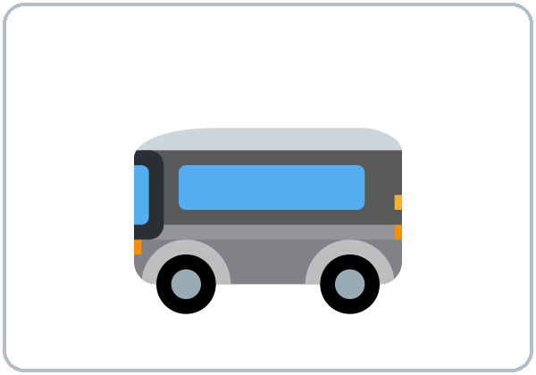
Getting Around
Today you will:
• Ask: How do you get to…?
• Say by bus / by car / on foot
• Compare: faster, more … than
• Compare your trip
Lesson 7 (Week 7)
Notes:
Welcome back. Read the goals together; learners repeat.
Objectives: ask and answer How do you get to…? How long does it take?; say by bus / by car / on foot; compare two things with -er / more … than, better, worse; compare their commute with a classmate's.
Source: Level2_Curriculum_v5_public.md, Lesson 7 (At a glance).
Picture: Twemoji graphics by Twitter, Inc. and other contributors (https://github.com/jdecked/twemoji), CC BY 4.0 (https://creativecommons.org/licenses/by/4.0/); resized and combined.

Slide 2
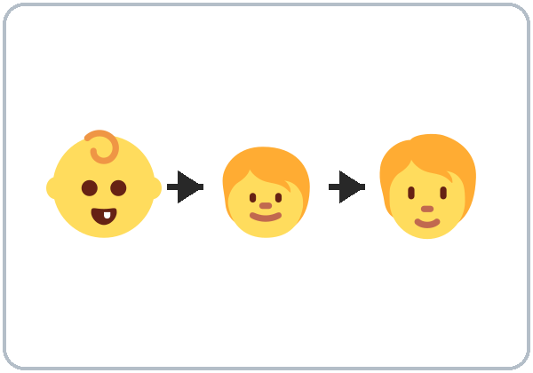
OPENING TALK · 6:00
Warm-Up
Same partner.
Review Lesson 6.
Tell 3 things from your story.
Ask: When did you…?
Notes:
Step 1 · 6:00–6:10 · Opening Talk + Homework Check. Pairs (same partner for both parts).
Minutes 0–5 (review Lesson 6): partners tell 3 sentences from their homework story. The listener asks one Did you…? or When did you…? question. Each click shows one prompt.
Source: Level2_Curriculum_v5_public.md, Lesson 7 (Step 1).
Picture: Twemoji graphics by Twitter, Inc. and other contributors (https://github.com/jdecked/twemoji), CC BY 4.0 (https://creativecommons.org/licenses/by/4.0/); resized and combined.

Slide 3
Homework
Check
HW
Homework check
Swap stories. Underline.
1
I ___ up by the sea.
grew
Underline the
irregular verbs.
2
I ___ a job. (get)
got
3
Did you ___ to school?
go
4
Five years ___.
ago
Notes:
Step 1, minutes 5–10: partners swap stories and underline the irregular verbs.
Each click shows one answer. The lines review Lesson 6 (homework model, Grammar Boxes 1–3).
Teacher: write 2 corrected sentences on the board (often did + past). If behind: collect the homework.
Source: Level2_Curriculum_v5_public.md, Lesson 7 (Step 1); Lesson 6 Homework.

Slide 4
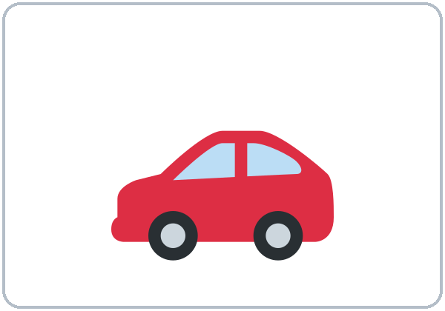
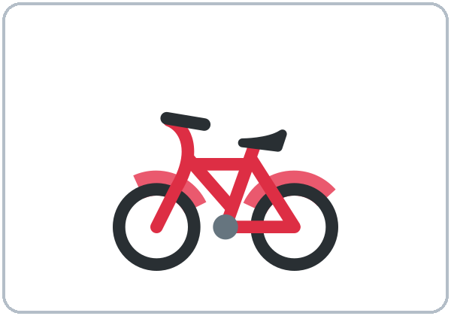
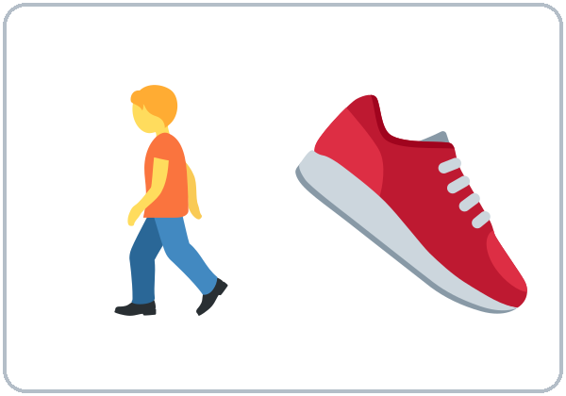
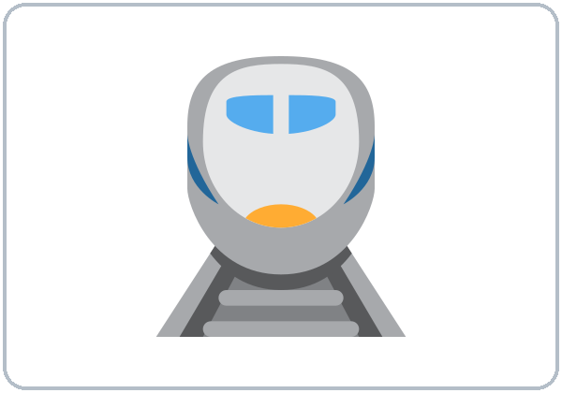
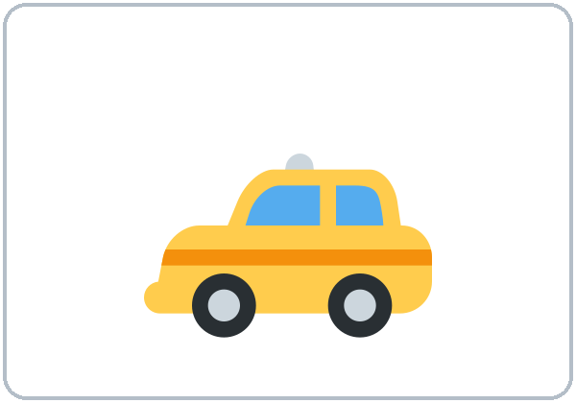
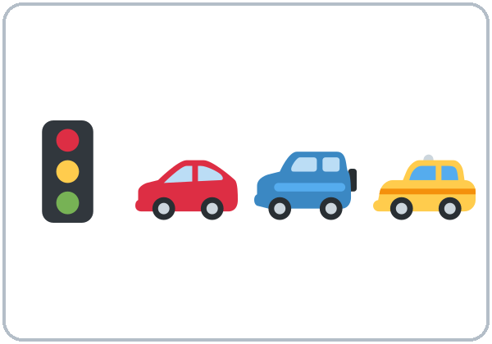
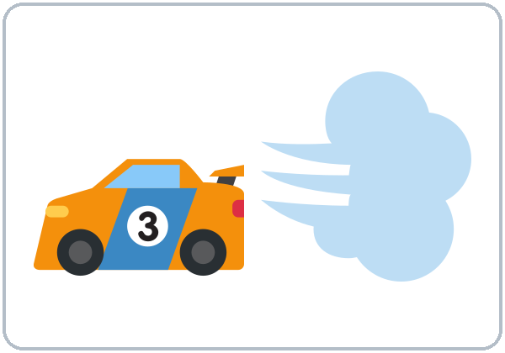
by bus,
on foot
New Words
by bus
by car
by bike
on foot
(walk)
by train
by taxi
traffic
fast
Notes:
Step 2 · 6:10–6:18 · New Words (pairs). Point, say, repeat twice. Each click shows one word.
Note: by bus, by car, but on foot.
Star words here: by bus, by car, on foot (walk), traffic, fast.
If behind: teach the star words only.
Source: Level2_Curriculum_v5_public.md, Lesson 7 (Step 2; Student Page 7 New Words).
Picture: Twemoji graphics by Twitter, Inc. and other contributors (https://github.com/jdecked/twemoji), CC BY 4.0 (https://creativecommons.org/licenses/by/4.0/); resized and combined.

Slide 5
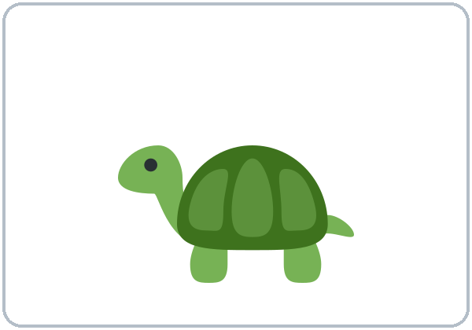

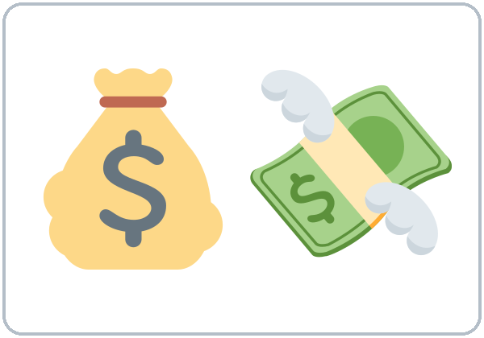
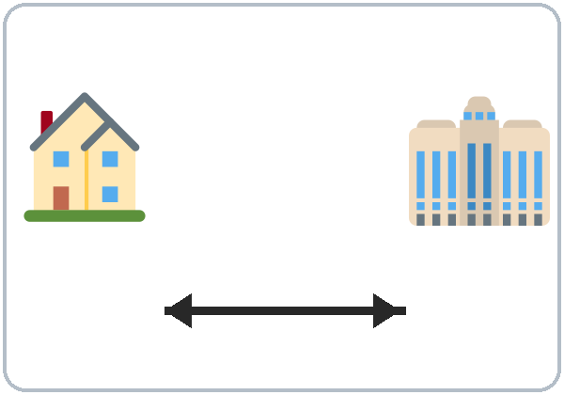
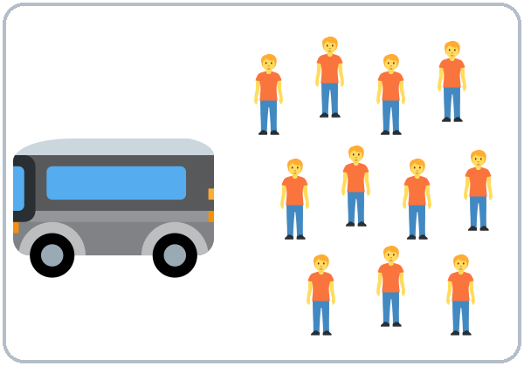

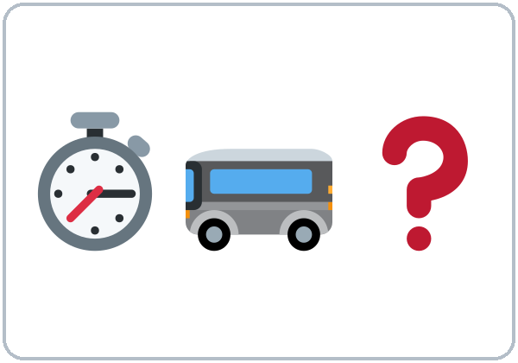
Faster or
slower?
More New Words
slow
cheap
expensive
far
crowded
comfortable
How long
does it take?
Notes:
New Words, part 2. Each click shows one word. Star words here: slow, cheap, expensive.
Faster or slower? Hold up two cards (bike / car). Learners call out "The car is faster!" Model only; grammar comes later.
Source: Level2_Curriculum_v5_public.md, Lesson 7 (Step 2; Student Page 7).
Picture: Twemoji graphics by Twitter, Inc. and other contributors (https://github.com/jdecked/twemoji), CC BY 4.0 (https://creativecommons.org/licenses/by/4.0/); resized and combined.

Slide 6
Carlos goes to work ...
Listening A
01
by car
by bus
by bike
Listen. Circle the answer.
By car, it takes ...
02
10
20
45 minutes
By bus, it takes ...
03
20
30
45 minutes
Parking costs ...
04
$5
$10
$20 a day
Notes:
Step 3 · 6:18–6:30 · Listening + "Say it" (L7_listening.mp3, about 1:09). Audio: L7_listening.mp3 (about 1:09). The audio plays once, play again if needed. No speaker? Read the script with a volunteer learner.
Before you listen: "Rosa takes the bus. Carlos drives. Which is better?" Take 2 opinions.
Listen 1 → Task A (circle). Each click circles one answer.
Answer key: 1 by car; 2 20 minutes; 3 45 minutes; 4 $10.
Source: Level2_Curriculum_v5_public.md, Lesson 7 (Step 3; Answer key).
Picture: Twemoji graphics by Twitter, Inc. and other contributors (https://github.com/jdecked/twemoji), CC BY 4.0 (https://creativecommons.org/licenses/by/4.0/); resized and combined.

Slide 7
Listen again.
Which one? Car or bus?
Listening B
faster
Car
Bus
cheaper
Car
Bus
more relaxing
Car
Bus
slower
Car
Bus
Notes:
Listen 2 → Task B (car or bus?). On the Student Page learners check ✓ Car or Bus. Each click circles one answer. The audio plays once, play again if needed.
Answer key: faster = car; cheaper = bus; more relaxing = bus; slower = bus.
Source: Level2_Curriculum_v5_public.md, Lesson 7 (Step 3; Answer key).

Slide 8
Listening C
C
Listen again.
Write the missing word.
1
The car is ____ than the bus.
faster
Rosa says slower.
What is the short word?
2
It's ____ relaxing than driving.
more
3
It ____ twenty minutes by car.
takes
4
A bike is ____ for my health.
better
Notes:
Listen 3 → Task C (fill in). Each click fills one blank. The audio plays once, play again if needed.
Answer key: faster; more; takes; better.
Ask: "Rosa says slower. What is the short word?" (slow)
"Say it" (1–2 min): the class repeats "How long does it take?" and "The car is faster than the bus."
If behind: skip the third play; do Task C together.
Source: Level2_Curriculum_v5_public.md, Lesson 7 (Step 3; Answer key).

Slide 9
How do you
Answers
get to work?
I take the bus.
She drives.
They walk.
he / she: does + verb.
How
do
you get to work?
How
does
she get to work?
by bus · on foot
How
do
they get to class?
Notes:
Step 4 · 6:30–6:45 · Grammar: comparatives + How long does it take? Grammar Box 1: How do you get to…? Each click highlights do / does.
More answers: I take the bus. / drive. / walk. / ride my bike. He / She takes the bus. / drives. / walks.
Q: By or on? by bus, by car, by train, by bike, but on foot (= walk).
Source: Level2_Curriculum_v5_public.md, Lesson 7 (Step 4; Grammar Box 1; Questions and answers).
Picture: Twemoji graphics by Twitter, Inc. and other contributors (https://github.com/jdecked/twemoji), CC BY 4.0 (https://creativecommons.org/licenses/by/4.0/); resized and combined.

Slide 10
Grammar Box 2
How long does it take?
QUESTION
ANSWER
By
car?
It takes
twenty minutes.
By
bus?
It takes
45 minutes.
On
foot?
It takes
an hour.
Notes:
Grammar Box 2: How long does it take? Each click highlights by / on and its answer.
Q: What does How long does it take? ask? How much time a trip needs. Answer: It takes twenty minutes.
Teacher note: How long does it take? asks about time. How much does it cost? asks about money. Write both on the board.
Source: Level2_Curriculum_v5_public.md, Lesson 7 (Grammar Box 2; Questions and answers; Teacher notes).
Picture: Twemoji graphics by Twitter, Inc. and other contributors (https://github.com/jdecked/twemoji), CC BY 4.0 (https://creativecommons.org/licenses/by/4.0/); resized and combined.

Slide 11
Grammar Box 3
Which Is
Better?
QUESTION
ANSWER
Which is faster?
The car is faster
than the bus.
Which is cheaper?
The bus is cheaper
than the car.
Notes:
Grammar Box 3: Which is…? Click 1 and click 2 highlight one pair each. Add than: The car is faster than the bus.
Say: "To compare two things: short words add -er; long words use more. Then say than."
Board: fast → faster than; expensive → more expensive than; good → better; bad → worse.
Source: Level2_Curriculum_v5_public.md, Lesson 7 (Step 4; Grammar Box 3).
Picture: Twemoji graphics by Twitter, Inc. and other contributors (https://github.com/jdecked/twemoji), CC BY 4.0 (https://creativecommons.org/licenses/by/4.0/); resized and combined.

Slide 12
Common Mistakes
Don't say
Say
The bus is more cheap.
The bus is cheaper.
The car is more faster.
The car is faster.
It's bigger that my house.
It's bigger than my house.
Notes:
Common mistakes (part 1). Each click shows the correct sentence.
Q: Can I say more faster? No. Use -er or more, never both. Write the correct form on the board. Learners can read the note on their Grammar page; you don't need to explain it.
Source: Level2_Curriculum_v5_public.md, Lesson 7 (Common mistakes; Questions and answers; Teacher notes).
Picture: Twemoji graphics by Twitter, Inc. and other contributors (https://github.com/jdecked/twemoji), CC BY 4.0 (https://creativecommons.org/licenses/by/4.0/); resized and combined.

Slide 13
Fix These Mistakes
Don't say
Say
The bike is more good.
The bike is better.
How much time it takes?
How long does it take?
I go by foot.
I go on foot. / I walk.
Notes:
Common mistakes (part 2). Each click shows the correct sentence.
Special words: good → better, bad → worse, far → farther.
Source: Level2_Curriculum_v5_public.md, Lesson 7 (Common mistakes; Questions and answers).
Picture: Twemoji graphics by Twitter, Inc. and other contributors (https://github.com/jdecked/twemoji), CC BY 4.0 (https://creativecommons.org/licenses/by/4.0/); resized and combined.

Slide 14
Quick Check
Compare two things
1
2
3
The bus is ___ than the car. (cheap)
more fast or faster?
bigger that or bigger than?
cheaper
faster
bigger than
Notes:
Step 4 check questions. Learners answer; each click shows one answer.
Answers: cheaper · faster · bigger than.
Short "Which is better?" (last 5 min): pairs compare two cards: A bike is cheaper than a car. A car is more comfortable. If behind: skip it.
Source: Level2_Curriculum_v5_public.md, Lesson 7 (Step 4 Check).

Slide 15
How to compare two things
Faster or More?
Short words: + er
-er
fast: faster than
cheap: cheaper than
Long words: more
more
more expensive than
more comfortable than
Notes:
How to compare two things. Click 1 and click 2 show one row each.
More rules: ends in e: +r (safe → safer); ends in y: -ier (easy → easier); short, 1 vowel + 1 consonant: double + er (big → bigger); irregular: good → better, bad → worse, far → farther.
Pronunciation (If time ①): weak -er and than: faster = "FAS-ter", than = weak /ðən/. Word stress: ex-PEN-sive, COM-for-ta-ble.
Source: Level2_Curriculum_v5_public.md, Lesson 7 (How to compare two things; If time).
Picture: Twemoji graphics by Twitter, Inc. and other contributors (https://github.com/jdecked/twemoji), CC BY 4.0 (https://creativecommons.org/licenses/by/4.0/); resized and combined.

Slide 16
Talk Time
Commute Survey
Close: two learners compare out loud.
7:00–7:10
1
Ask your partner.
How do you get to class?
2
Compare.
My trip is longer than Ana's.
3
Line up: short to long.
How long does it take?
Notes:
Step 5 · 7:00–7:10 · Talk Time: Commute Survey + Line-Up. Pairs, then whole class. Each click shows one step.
Survey (5 min): pairs ask How do you get to class? How long does it take? Is it expensive? Then compare: "My trip is longer than Ana's trip."
Line-Up (5 min): everyone stands in a line from the shortest trip to the longest, asking How long does it take? to find their place. (15 learners: two lines. 7–8: one line.)
Close: two learners compare out loud: "Carlos's trip is shorter than my trip." Accept every way of getting around; don't ask about owning a car or a driver's license. If behind: do the survey only.
Source: Level2_Curriculum_v5_public.md, Lesson 7 (Step 5; Teacher notes).
Picture: Twemoji graphics by Twitter, Inc. and other contributors (https://github.com/jdecked/twemoji), CC BY 4.0 (https://creativecommons.org/licenses/by/4.0/); resized and combined.

Slide 17
Before You Go
01
Exit ticket
02
Homework
Write one sentence:
compare two ways
to travel.
Write about your trip:
How do you get there?
Write 4 comparisons.
Midterm next week:
review Lessons 1–7.
Notes:
Step 6 · 7:10–7:15 · Exit Ticket + Homework. NEVER SKIP.
Exit ticket: one comparative sentence about two ways to travel.
Homework (10 minutes) + Midterm review: 1. Write about your trip to work or class: How do you get there? How long does it take? (2 sentences) 2. Write 4 comparison sentences about two ways to travel. 3. Midterm next week: look at the Midterm Review pages in the workbook and listen to the Lesson 1–7 audio again.
Remind learners: next week is the midterm (review, not a surprise). Bring the workbook.
Source: Level2_Curriculum_v5_public.md, Lesson 7 (Step 6; Student Page 7 Homework; Teacher notes).
Picture: Twemoji graphics by Twitter, Inc. and other contributors (https://github.com/jdecked/twemoji), CC BY 4.0 (https://creativecommons.org/licenses/by/4.0/); resized and combined.

Slide 18
Credits
Pictures
Vocabulary pictures use Twemoji graphics by Twitter, Inc. and other contributors (https://github.com/jdecked/twemoji), licensed under CC BY 4.0 (https://creativecommons.org/licenses/by/4.0/). The graphics were resized and combined, and arrows, calendars, clocks, and labels were added.
This deck
© 2026 the authors. The authors license this deck under CC BY-NC-SA 4.0.
Audio and font
Audio: Chatterbox TTS (Resemble AI, MIT); AI voices with a Perth watermark. Font: Lexend Deca (OFL 1.1). Provided as-is, without warranty.
Notes:
Credits. Lesson content: Level 2 Adult ESL Curriculum v5, public edition, Lesson 7.
Image credit line copied exactly from images/CREDITS.md. Deck notice: © 2026 the authors; the authors license this deck under CC BY-NC-SA 4.0 (Section 7.2).
Audio and font credits: Chatterbox TTS (Resemble AI, MIT; Perth watermark), Lexend Deca (SIL OFL 1.1).

