Slide 1
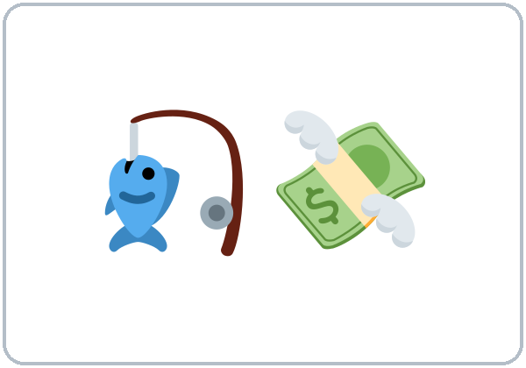
Is It a Scam?
Today you will:
• Describe a person or a message
• Name 4 warning signs of a scam
• Say what to do
Lesson 12 · Level 4
Notes:
Welcome learners as they arrive.
Point to the title and read it: "Is It a Scam?" Say: "Consumer protection, calm and practical: recognizing common scams by phone, text, and email (a fake prize, a fake bank text, a fake "pay your bill today" call, payment with gift cards) and what to do: stop, don't pay, check with the real company, and tell someone. Learners describe people and messages with who / that. All messages, names, and numbers are invented."
Read the three lines under "Today you will".
Keep it calm and practical: "Most calls and texts are real. A few are scams. Stop, check, and ask." No scary stories.
Lesson plan: Topic; At a glance: Objectives; Teacher notes.
Picture: Twemoji graphics by Twitter, Inc. and other contributors (https://github.com/jdecked/twemoji), CC BY 4.0 (https://creativecommons.org/licenses/by/4.0/); resized and combined, with signs and labels (images/CREDITS.md).

Slide 2
Today's
Goals
01
I can describe a person or a message with who / that (a caller who asks for gift cards).
02
I can name 4 warning signs of a scam.
03
I can say what to do with a suspicious call or text (stop, don't pay, check, tell someone).
By the end of class, you can do these five things.
Every goal is a good goal.
04
I can give a safe answer on the phone (I don't give information on the phone. Goodbye.).
05
I can write a message (5–8 sentences) to warn a family member about a scam.
Notes:
Read each goal slowly. Learners repeat.
Lesson plan: At a glance: Objectives.

Slide 3

OPENING TALK · 6:00
Opening Talk
A asks a card question.
Where would you like to go on a trip?
B answers in 3 sentences.
A asks one follow-up.
Why?
Then switch.
Notes:
Step 1 · 6:00–6:08 · Opening Talk + Homework Check · 8 min. Pairs (7 pairs + 1 trio with 15 learners; 3–4 pairs with 7–8).
Before class, write on the board: to + verb (why); enjoy + -ing
Model with one learner: you say, "Where would you like to go on a trip?" The learner answers with to + verb (I'd like to go to Chicago to see the lake.). Then you ask, "What do you enjoy doing there?" Help them say 3 sentences. (Click to show the follow-up.)
Opening Talk (5 min): learners open the Opening Talk page. A asks a card question; B answers in 3 sentences (the answer, a reason, a detail); A asks one follow-up. Switch after each card. The cards are on the next slide.
If behind: one card only.
Lesson plan: Step 1; Opening Talk page.
Picture: Twemoji graphics by Twitter, Inc. and other contributors (https://github.com/jdecked/twemoji), CC BY 4.0 (https://creativecommons.org/licenses/by/4.0/); resized and combined, with signs and labels (images/CREDITS.md).

Slide 4
Opening Talk
Cards
01
Where would you like to go on a trip?
02
What do you enjoy doing on the weekend?
B answers in 3 sentences: the answer, a reason, and a detail.
Follow-ups:
Why? What do you enjoy doing there?
03
Why do people take time off?
04
What do you need to pack for a short trip?
05
Homework check: Lesson 11, items 1 and 3.
Notes:
Step 1, continued. The four cards from the Opening Talk page. Each click shows the next card.
A asks a card question. B answers in 3 sentences. A asks one follow-up question (follow-ups on the right). Then switch.
Homework Check (3 min, last click): Pairs compare Homework item 1 (to / -ing) and read their trip plan (item 3) to each other. Then they fill in the box on the Opening Talk page. Walk around. Write 2 common errors on the board (often for see (→ to see) and enjoy to travel (→ enjoy traveling)) and correct them together. Also put up 2 corrections from last week's exit tickets.
Lesson plan: Step 1; Opening Talk page: cards, follow-ups; Homework check.

Slide 5
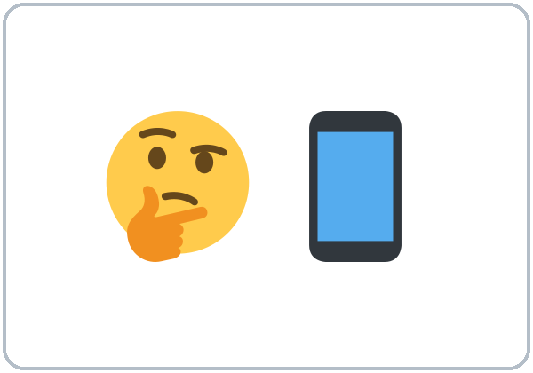
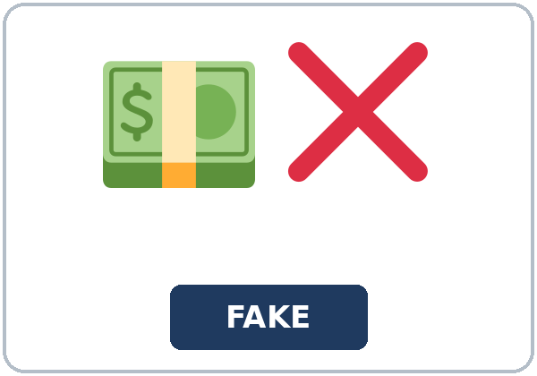
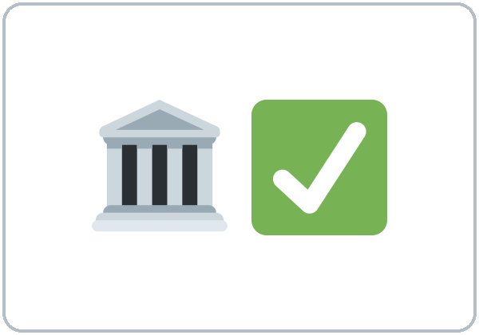
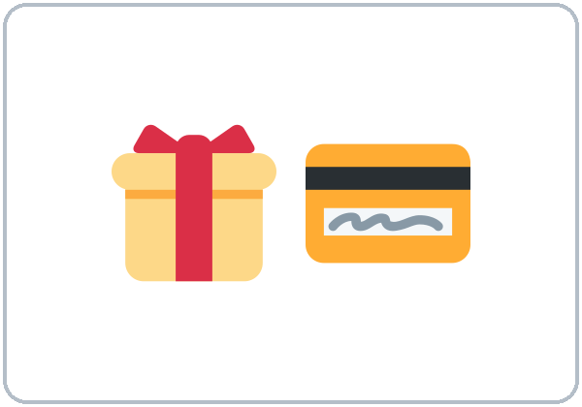
Look. Listen.
Repeat.
New Words
★ scam
★ warning sign
★ suspicious
★ fake
★ official
★ gift card
Notes:
Step 2 · 6:08–6:15 · New Words · 7 min (this slide and the next). Whole class, then pairs.
Point to each picture and say the word. Learners repeat once. ★ = the most important words. Each click shows the next word.
Show the hard words: scam (a trick that takes your money); warning sign (something that tells you to be careful); suspicious (strange, maybe not true); fake (not real); official (real, from the company); gift card; prize; link (you click it in a text or email); PIN (your secret number); hang up (end the call); block (a number); trust.
If behind: teach the ★ words only.
Lesson plan: Step 2; Key vocabulary; New Words page.
Pictures: Twemoji graphics by Twitter, Inc. and other contributors (https://github.com/jdecked/twemoji), CC BY 4.0 (https://creativecommons.org/licenses/by/4.0/); resized and combined, with signs and labels (images/CREDITS.md).

Slide 6
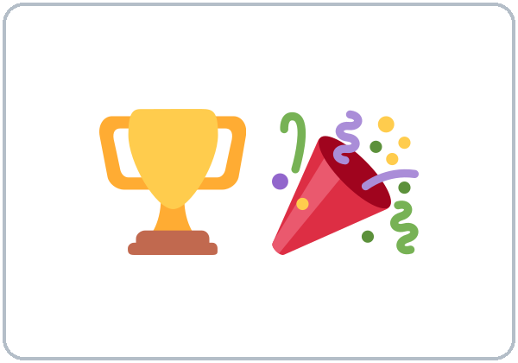
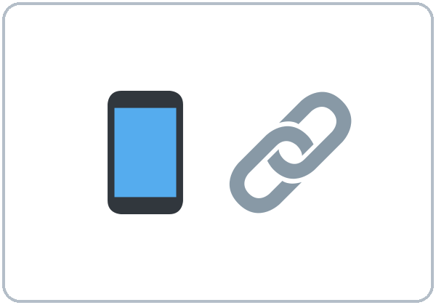
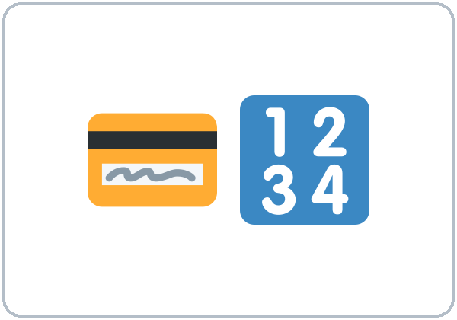
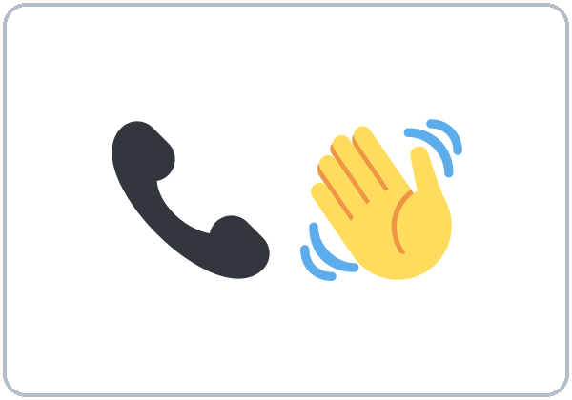
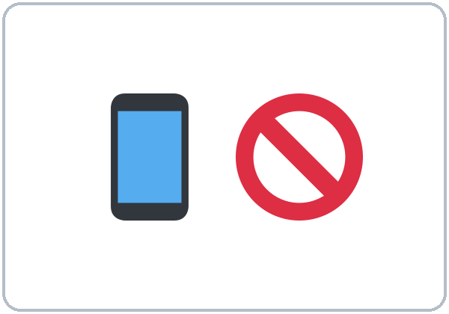
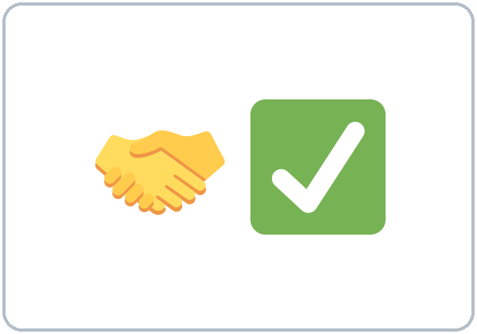
Partner game:
Who or that?
More New Words
★ prize
★ link
★ PIN
★ hang up
★ block (a number)
trust
Notes:
Step 2, continued. Point to each picture and say the word. Learners repeat once.
Partner game (2 min): A points to a picture and asks, "What's a fake prize?" B answers with who / that: "It's a message that says you won, but you must pay." Switch. 15 learners: finish with a quick team round (3 teams; you say a clue, the first team with the word gets a point). 7–8: 2 teams. 5 or fewer: one team against the clock.
My Words: "Write any word you want in your language on the My Words page. It's your personal list. It's optional." Learners do it at home.
If behind: teach the ★ words only.
Lesson plan: Step 2; New Words page; Partner game; My Words page.
Pictures: Twemoji graphics by Twitter, Inc. and other contributors (https://github.com/jdecked/twemoji), CC BY 4.0 (https://creativecommons.org/licenses/by/4.0/); resized and combined, with signs and labels (images/CREDITS.md).

Slide 7
Check the Meaning
Look at the picture. Answer the question.
1
2
3
Is a fake message real or not real?
Do you give your PIN to a caller or to nobody?
When a call is suspicious, do you hang up or pay?
not real
nobody
hang up
Notes:
Step 2 · Check meaning · 1 min. Whole class.
The answers are hidden. Ask each question and wait for the class to answer. Then click to show the answer. Each click shows one answer, in order: 1, 2, 3.
1. "Is a fake message real or not real?" (not real) • 2. "Do you give your PIN to a caller or to nobody?" (nobody) • 3. "When a call is suspicious, do you hang up or pay?" (hang up)
Lesson plan: Step 2: Check meaning.
Pictures: Twemoji graphics by Twitter, Inc. and other contributors (https://github.com/jdecked/twemoji), CC BY 4.0 (https://creativecommons.org/licenses/by/4.0/); resized and combined, with signs and labels (images/CREDITS.md).

Slide 8
Before You
Listen for:
Listen
Was it a scam?
Mrs. Lopez gets a phone call from a man who says he's from the electric company. Later, she talks to her son, Daniel.
Play 2: Tasks B and C.
01
Audio: about 2:01. It plays once.
Caller
02
Mrs. Lopez
Play 1: Task A
03
Daniel
Notes:
Step 3 · 6:15–6:30 · Listening + "Hear it, say it" · 15 min (slides 8 to 12). Individuals, then pairs check.
Before you listen (2 min). Say: "Mrs. Lopez gets a phone call from a man who says he's from the electric company. Later, she talks to her son, Daniel. Listen: was it a scam?"
There are 3 people: Caller, Mrs. Lopez and Daniel. A narrator starts and ends the listening. Each click highlights the next person.
The audio (L4_L12_listening.mp3, about 2:01) plays the conversation once. Press play again for play 2. A third play is fine if the class needs it.
No speaker? Read the script with a volunteer at a natural, friendly speed, two times. The script says going to and want to. People often say gonna and wanna; learners only need to recognize those words.
Audio: synthetic voices, computer-generated (Chatterbox TTS cloned from Kokoro-82M reference clips). No recordings of real people. The names and the story are invented.
Lesson plan: Step 3; Listening script; Listening page.
Picture: Twemoji graphics by Twitter, Inc. and other contributors (https://github.com/jdecked/twemoji), CC BY 4.0 (https://creativecommons.org/licenses/by/4.0/); resized and combined, with signs and labels (images/CREDITS.md).

Slide 9
Listen. Was it a scam?
Circle.
Listening A
a. Yes, it was a scam.
b. No, the bill was really late.
c. We don't know.
Notes:
Play 1 → Task A (the main idea). Pairs compare. Check together.
Click to circle the answer: a (Yes, it was a scam.).
Then read Tasks B and C together (1 min) so learners know what to listen for.
Lesson plan: Step 3; Listening Task A; Answer key.

Slide 10
Listen again.
Which warning signs did you hear?
Circle the answer.
Listening B
1. The caller said she must pay
today
next month
2. He wanted her to pay with
gift cards
a check
3. He said, " ____"
Don't tell anyone.
Call your son.
4. He said they would turn off her power in
one hour
one week
5. Mrs. Lopez
hung up
paid $200
6. Her real account is
fine
late
Notes:
Play 2 → Tasks B and C. Pairs compare. Then show the answers.
Click to circle each answer (one click per item, 1 to 6): 1 today • 2 gift cards • 3 Don't tell anyone. • 4 one hour • 5 hung up • 6 fine.
Lesson plan: Step 3; Listening Task B; Answer key.

Slide 11
Listen again.
Write who or that.
Listening C
1
I'm going to call the number ____ is on my real bill.
that
2
The man ____ called me knew my name.
who
3
A company ____ asks for gift cards is a scam.
that
Write who or that.
Pairs: compare your answers.
Then check together.
4
Scammers are people ____ want your money.
who
5
Be careful with texts ____ ask for your password, too.
that
6
never trust a caller ____ tells you to hurry.
who
Notes:
Task C (play 2). Click to show each answer (one click per item, 1 to 6): 1 that, 2 who, 3 that, 4 who, 5 that, 6 who.
If behind: do Task C together on the board, reading the lines yourself.
Lesson plan: Step 3; Listening Task C; Answer key.

Slide 12
Hear it: gonna = going to
Hear It,
Say It
Say it: weak that, and the stress
We're going to turn off your power.
a text that asks ("thut")
gonna is a short form. This listening says going to.
Say it in a calm, firm voice.
Say each line two times.
NEVER • GIFT cards
No, thank you. Goodbye.
Notes:
"Hear it, say it" (3 min): Point to the script line. gonna = going to: "We're going to turn off your power." Then practice the weak that (it sounds like "thut"): a text that asks. Stress the key words: NEVER, GIFT cards. Practice a calm, firm voice: No, thank you. Goodbye. The class repeats the two lines twice.
Reductions: the listening says going to. People often say gonna. Learners only need to recognize it.
Lesson plan: Step 3: "Hear it, say it"; Listening page: Hear it, say it; Teacher notes.

Slide 13
Grammar Box 1
describing with who / that
QUESTION
ANSWER
What's a scam?
It's a trick that takes your money.
Who called you?
A man who said he was from the bank.
What's a warning sign?
It's something that tells you to be careful.
Notes:
Step 4 · 6:30–6:45 · Grammar Q&A · 15 min (slides 13 to 20). Whole class, then pairs. Show the Grammar page. The left side is the question. The right side is the answer.
Show it (2 min): hold up your phone and say, "This morning I got a text. The text said I won a prize. → I got a text that said I won a prize." Then: "A man called. The man wanted my PIN. → A man who called wanted my PIN." Write: who = people, that = things (and people). Cross out a man who he called.
Box 1: read across: What's a scam? → It's a trick that takes your money. Each click shows the answer side of one row.
Lesson plan: Step 4; Grammar Box 1.
Picture: Twemoji graphics by Twitter, Inc. and other contributors (https://github.com/jdecked/twemoji), CC BY 4.0 (https://creativecommons.org/licenses/by/4.0/); resized and combined, with signs and labels (images/CREDITS.md).

Slide 14
Grammar Box 2
what to do
QUESTION
ANSWER
What about a text that wants my PIN?
Don't answer texts that ask for your PIN.
What about a caller who wants gift cards?
Hang up on a caller who asks for gift cards.
Who can I trust?
Call the company at the number that is on your card.
Notes:
Box 2: what to do: Hang up on a caller who asks for gift cards. Each click shows the answer side of one row.
Rule of thumb (read it aloud): who for people; that for things (and also people). The who / that part tells you which person or thing. Don't add he / it after it: a man who called (not a man who he called).
Lesson plan: Step 4; Grammar Box 2; Rule of thumb.
Picture: Twemoji graphics by Twitter, Inc. and other contributors (https://github.com/jdecked/twemoji), CC BY 4.0 (https://creativecommons.org/licenses/by/4.0/); resized and combined, with signs and labels (images/CREDITS.md).

Slide 15
Grammar Box 3
anyone, something, must, should
WORDS
EXAMPLE
Never… anyone
Never give your PIN to anyone.
If something…
If something sounds too good to be true, it probably is.
mustn't / should
You mustn't share your password. You should tell someone you trust.
Notes:
Box 3: never… anyone, must / should. Each click shows the answer side of one row.
Lesson plan: Step 4; Grammar Box 3.
Picture: Twemoji graphics by Twitter, Inc. and other contributors (https://github.com/jdecked/twemoji), CC BY 4.0 (https://creativecommons.org/licenses/by/4.0/); resized and combined, with signs and labels (images/CREDITS.md).

Slide 16
Grammar Box 4
4 steps
STEP
WHAT TO DO
Stop.
Don't answer or click right away.
Don't pay.
Never pay with gift cards.
Check.
Call the number on your real bill or card.
Tell someone.
Talk to a family member or friend you trust.
Notes:
Box 4: the 4 steps. Each click shows the answer side of one row.
Questions and answers (2 min): Q: who or that? A: who for people, that for things. that is OK for people too: a man who called / a text that came. • Q: a man who he called or a man who called? A: a man who called. Don't add he or it after who / that. • Q: Are all calls and texts scams? A: No. Most calls and texts are real. A few are scams. Stop, check, and ask.
Check questions: "who or that for a text?" (that) • "a man who he called or a man who called?" (a man who called) • "Are most calls scams?" (no, most are real).
Lesson plan: Step 4; Grammar Box 4; Questions and answers.
Picture: Twemoji graphics by Twitter, Inc. and other contributors (https://github.com/jdecked/twemoji), CC BY 4.0 (https://creativecommons.org/licenses/by/4.0/); resized and combined, with signs and labels (images/CREDITS.md).

Slide 17
Practice A
Write one word.
Practice A
1
A scam is a trick ____ takes your money.
that
2
Don't trust a caller ____ asks for gift cards.
who
3
Be careful with links ____ look strange.
that
Write one word.
Pairs: check your answers.
4
Never give your PIN to ____.
anyone
5
If ____ sounds too good to be true, it probably is.
something
6
You ____ share your password. (must / mustn't)
mustn't
Notes:
Practice A and B (3 min): learners write, then pairs check. Go over the answers.
Click to show each answer (one click per item, 1 to 6): 1 that, 2 who, 3 that, 4 anyone, 5 something, 6 mustn't.
Lesson plan: Step 4; Grammar Practice A; Answer key.

Slide 18
Circle the correct words.
Practice B
1. I got a text ____ said I won a prize.
that
who
2. The woman ____ called was from my bank.
who
what
3. A man ____ asked for my PIN.
who called
who he called
4. Don't click on links ____ look strange.
that
who
5. You ____ tell someone you trust.
should
shouldn't
6. ____ if the caller is pushy.
Hang up
Hang on
Notes:
Practice B. Learners circle the correct words. Pairs check.
Click to circle each answer (one click per item, 1 to 6): 1 that, 2 who, 3 who called, 4 that, 5 should, 6 Hang up.
Lesson plan: Step 4; Grammar Practice B; Answer key.

Slide 19
Common Mistakes
Don't say
Say
the man who he called
the man who called
a text who said
a text that said
Never give your PIN to nobody.
Never give your PIN to anyone.
Don't trust a caller asks for money.
Don't trust a caller who asks for money.
You must to call the bank.
You must call the bank.
Notes:
Common mistakes. Read the table together: "Don't say… Say…". Read a line from Don't say. Ask: "What's the right way?" Learners try first. Then click to show the right form. Each click shows one line, in order 1 to 5.
Learners can read the contrast tip on their Grammar page on their own; it is optional. You never need to read, translate, or explain it.
Lesson plan: Grammar: Common mistakes; Teacher notes.
Picture: Twemoji graphics by Twitter, Inc. and other contributors (https://github.com/jdecked/twemoji), CC BY 4.0 (https://creativecommons.org/licenses/by/4.0/); resized and combined, with signs and labels (images/CREDITS.md).

Slide 20
Pair Check
A asks.
01
A points to a picture and asks. Then switch.
A: What's a gift card scam?
B answers with who / that.
02
B: It's a call that asks you
to pay with gift cards.
Notes:
Pair check (last 3 min of Step 4). Pairs.
A points to a picture and asks, "What's a gift card scam?" B answers with who / that: "It's a call that asks you to pay with gift cards." Switch. 15 learners: swap partners once. 5 or fewer: you join one pair.
If behind: skip the pair check. Talk Time practices it.
Break · 6:45–7:00 · 15 min. Write on the board: It's a trick that takes your money. • Don't trust a caller who asks for gift cards. • Stop. Don't pay. Check. Tell someone.
Lesson plan: Step 4: Pair check; Break.
Picture: Twemoji graphics by Twitter, Inc. and other contributors (https://github.com/jdecked/twemoji), CC BY 4.0 (https://creativecommons.org/licenses/by/4.0/); resized and combined, with signs and labels (images/CREDITS.md).

Slide 21
Talk Time
Real or Scam?
Pairs.
Read the 10 messages.
7:00–7:15
1
Read the 10 invented messages.
Card 1 is probably a scam.
2
Probably real or probably a scam?
It's a text that has a strange link…
3
Say why.
It's a text that… • It's from someone who…
Notes:
Step 5 · 7:00–7:15 · Talk Time: Real or Scam? + Safe Answer · 15 min.
Model it first (1 min): read card 1: "Your package is late. Click this link and pay $2.99 today." Say, "I think it's probably a scam. It's a text that has a strange link, and it asks for money today." Then model a safe answer: a learner reads caller card 1, and you say calmly, "I don't give information on the phone. I'll call the number on my card. Goodbye."
Round 1 (7 min): Real or Scam? (pairs). Pairs sort the 10 invented message cards into probably real and probably a scam and explain with It's a text that… / It's from someone who… Then they compare with another pair. Each click shows the next step.
15 learners: pairs; then groups of 4 to compare; then pairs. 7–8 learners: pairs; then one group to compare. 5 or fewer: the whole group sorts together; then pairs.
Lesson plan: Step 5; Talk Time: Real or Scam?.
Picture: Twemoji graphics by Twitter, Inc. and other contributors (https://github.com/jdecked/twemoji), CC BY 4.0 (https://creativecommons.org/licenses/by/4.0/); resized and combined, with signs and labels (images/CREDITS.md).

Slide 22
Talk Time
Safe Answer
Pairs.
Read a caller card.
7:00–7:15
1
A is the caller: read a card.
Please tell me your PIN.
2
B gives a safe answer.
I don't give information on the phone.
3
Then switch.
No, thank you. Goodbye.
Notes:
Round 2 (6 min): Safe Answer (pairs). A is a caller with a pushy (but polite) card. B gives a safe answer. Switch. Each click shows the next step.
15 learners: pairs; then groups of 4 to compare; then pairs. 7–8 learners: pairs; then one group to compare. 5 or fewer: the whole group sorts together; then pairs.
Every answer needs a reason; every partner asks a follow-up. Walk around and listen. Note 2 good sentences to praise and 1 common error for next week.
If behind: round 1 only.
Lesson plan: Step 5; Talk Time: Safe Answer.
Picture: Twemoji graphics by Twitter, Inc. and other contributors (https://github.com/jdecked/twemoji), CC BY 4.0 (https://creativecommons.org/licenses/by/4.0/); resized and combined, with signs and labels (images/CREDITS.md).

Slide 23
Read fast first.
Answer the questions.
Read &
Write
1
Are most calls and texts scams?
No. Most are real.
2
Do real companies take gift cards for bills?
No, they don't.
RIVERSIDE COMMUNITY OFFICE · A flyer + a sample text (invented)
Pairs: answer together.
3
What is the first step?
Stop. Don't answer or click right away.
4
Which number should you call to check?
The number on your real bill or card.
5
What are two warning signs in the sample text?
It asks for your PIN, and it says you must hurry (30 minutes).
Notes:
Step 6 · 7:15–7:25 · Read & Write: A consumer tips flyer + a sample scam text · 10 min. Pairs read, then individual writing.
Read (4 min): Learners read the invented flyer and the sample text on the Read & Write page and answer the questions. Say: "Read fast first. Then find the answers." Pairs answer questions 1–5 together.
Check (1 min): click to show each answer (one click per question, 1 to 5): 1 No. Most are real. • 2 No, they don't. • 3 Stop. Don't answer or click right away. • 4 The number on your real bill or card. • 5 It asks for your PIN, and it says you must hurry (30 minutes).
Write (5 min): Learners write a message (5–8 sentences) to a family member about a scam text, with that / who and Don't…. Show the example. Learners start in class and finish at home (Homework item 2).
If behind: questions 1–5 only; the writing becomes homework.
Lesson plan: Step 6; Read & Write page; Answer key.

Slide 24
Before You Go 7:25–7:30
01
Exit ticket
02
Homework
What is one warning sign of a scam, and what should you do?
1. A warning sign, with who or that.
2. What to do.
3. A reason, with because.
Give it to me at the door.
About 15–20 minutes.
1. Write the sentence.
2. Finish your writing from Read & Write C (your message).
3. Write 3 warning signs of a scam.
4. Review (Lesson 11).
Bring it next week!
Notes:
Step 7 · 7:25–7:30 · Exit Ticket + Homework · 5 min · NEVER SKIP.
Exit ticket (3 min): learners open the Exit Ticket page and answer in 3 sentences with a reason: What is one warning sign of a scam, and what should you do? Example on the board: A caller who asks for gift cards is a warning sign. You should hang up and call the real company. Don't pay, because real companies don't take gift cards. With 5 or fewer, a learner can say it to you first and then write it.
Collect the pages. After class, sort them into ✓ / almost / not yet. Start next week with 2 corrections on the board (no names).
Homework (2 min): open the Homework page. Do item 1 together (item 1: don't trust / a caller / ask for gift cards (who) → Don't trust a caller who asks for gift cards.). Say: "About 15–20 minutes. Finish your Read & Write writing at home."
Homework items: 1. Write the sentence. Use who or that. • 2. Finish your writing from Read & Write C (your message). Read it one more time. Check ✓ the list in D. • 3. Write 3 warning signs of a scam. What should you do? • 4. Review (Lesson 11). Write one word.
Lesson plan: Step 7; Exit Ticket page; Homework page.
Picture: Twemoji graphics by Twitter, Inc. and other contributors (https://github.com/jdecked/twemoji), CC BY 4.0 (https://creativecommons.org/licenses/by/4.0/); resized and combined, with signs and labels (images/CREDITS.md).

Slide 25
Goodbye! See You Next Week!
Now you can:
• Describe a person or a message
• Name 4 warning signs of a scam
• Say what to do
Lesson 12 · Level 4
Notes:
Read the title: "Goodbye! See you next week!" Learners repeat.
Read the three "Now you can" lines.
Lesson plan: At a glance: Objectives; Step 7.
Picture: Twemoji graphics by Twitter, Inc. and other contributors (https://github.com/jdecked/twemoji), CC BY 4.0 (https://creativecommons.org/licenses/by/4.0/); resized and combined, with signs and labels (images/CREDITS.md).

Slide 26
Credits
Pictures
Vocabulary pictures use Twemoji graphics by Twitter, Inc. and other contributors (https://github.com/jdecked/twemoji), licensed under CC BY 4.0 (https://creativecommons.org/licenses/by/4.0/). The graphics were resized and combined, and signs and labels were added.
Names and story
Mrs. Lopez, Daniel, Mike, and Ana are invented names. The listening story is invented.
Audio and font
Audio: synthetic voices made with Chatterbox TTS (MIT License), cloned from short synthetic reference clips made with Kokoro-82M (Apache License 2.0). No recordings of real people were used. Each file carries an inaudible Perth watermark marking it as AI-generated. Font: Lexend Deca (OFL 1.1).
© 2026 the authors. The authors license this deck under CC BY-NC-SA 4.0.
Notes:
Credits. You don't need to read this slide in class.
Pictures: Twemoji graphics by Twitter, Inc. and other contributors, CC BY 4.0; the file-by-file list is in images/CREDITS.md.
Audio: synthetic voices, computer-generated (Chatterbox TTS cloned from Kokoro-82M reference clips). No recordings of real people. The names and the story are invented.
Course materials: © 2026 the authors, licensed under CC BY-NC-SA 4.0 (https://creativecommons.org/licenses/by-nc-sa/4.0/).
Lesson plan: Picture Credits. Picture list: images/CREDITS.md.

