Slide 1
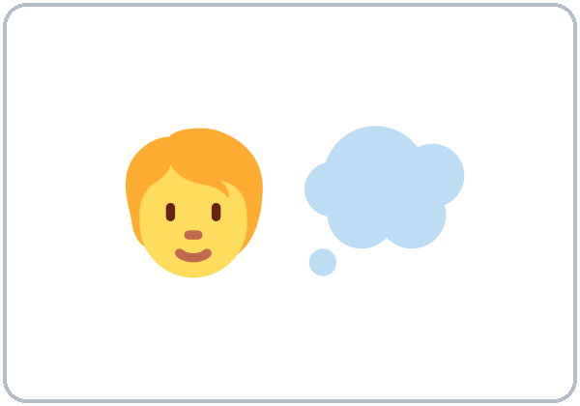
What Would You Do?
Today you will:
• Ask and answer What would you do if…?
• Talk about an imaginary situation
• Give advice
Lesson 6 · Level 4
Notes:
Welcome learners as they arrive.
Point to the title and read it: "What Would You Do?" Say: "Imagining situations and making choices: finding money, getting too much change, a free week, a magic wand, a dream job. Learners talk about imaginary situations with If I had / found / were…, I'd…, give reasons, and give advice with If I were you, I'd…. All situations are invented and everyday."
Read the three lines under "Today you will".
Past form, present meaning: If I had a car is about now, not the past. Say it: "I don't have a car. It's imaginary."
Lesson plan: Topic; At a glance: Objectives; Teacher notes.
Picture: Twemoji graphics by Twitter, Inc. and other contributors (https://github.com/jdecked/twemoji), CC BY 4.0 (https://creativecommons.org/licenses/by/4.0/); resized and combined, with signs and labels (images/CREDITS.md).

Slide 2
Today's
Goals
01
I can ask and answer What would you do if…?
02
I can talk about an imaginary situation with If I + past, I'd + verb.
03
I can give advice with If I were you, I'd… and a reason.
By the end of class, you can do these five things.
Every goal is a good goal.
04
I can tell a possible situation (If it rains, I'll…) from an imaginary one (If I had…, I'd…).
05
I can write a reply to an advice letter (5–8 sentences).
Notes:
Read each goal slowly. Learners repeat.
Lesson plan: At a glance: Objectives.

Slide 3
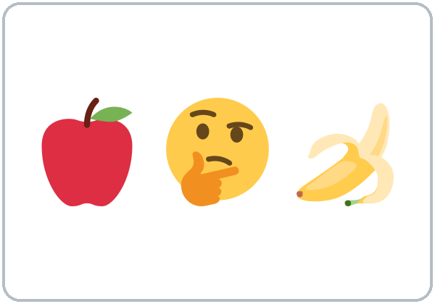
OPENING TALK · 6:00
Opening Talk
A asks a card question.
Would you mind lending me a pen?
B answers in 3 sentences.
B answers politely.
No, not at all. • Sorry, I can't, because…
Then switch.
Notes:
Step 1 · 6:00–6:08 · Opening Talk + Homework Check · 8 min. Pairs (7 pairs + 1 trio with 15 learners; 3–4 pairs with 7–8).
Before class, write on the board: favors: Would you mind…? / Do you mind if I…?
Model with one learner: you say, "Would you mind lending me a pen?" The learner answers, "No, not at all," or "Sorry, I can't, because…" Then they ask you a favor. Help them say 3 sentences. (Click to show the answer line.)
Opening Talk (5 min): learners open the Opening Talk page. A asks a card question; B answers in 3 sentences (the answer, a reason, a detail); A asks one follow-up. Switch after each card. The cards are on the next slide.
If behind: one card only.
Lesson plan: Step 1; Opening Talk page.
Picture: Twemoji graphics by Twitter, Inc. and other contributors (https://github.com/jdecked/twemoji), CC BY 4.0 (https://creativecommons.org/licenses/by/4.0/); resized and combined, with signs and labels (images/CREDITS.md).

Slide 4
Opening Talk
Cards
01
Would you mind lending me a pen?
02
Would you mind opening the window?
B answers in 3 sentences: the answer, a reason, and a detail.
Answer:
No, not at all or Sorry, I can't, because…
03
Do you mind if I sit here?
04
Would you mind helping me with my homework?
05
Homework check: Lesson 5, items 1 and 3.
Notes:
Step 1, continued. The four cards from the Opening Talk page. Each click shows the next card.
A asks a card question. B answers in 3 sentences. A asks one follow-up question. B answers with No, not at all or Sorry, I can't, because… (on the right). Then switch.
Homework Check (3 min, last click): Pairs compare Homework item 1 (Would you mind + -ing) and ask each other their 3 favors (item 3). Then they fill in the box on the Opening Talk page. Walk around. Write 2 common errors on the board (often Would you mind to get…? (→ Would you mind getting…?) and Yes, I'll help as the answer (→ No, not at all)) and correct them together. Also put up 2 corrections from last week's exit tickets.
Lesson plan: Step 1; Opening Talk page: cards, follow-ups; Homework check.

Slide 5
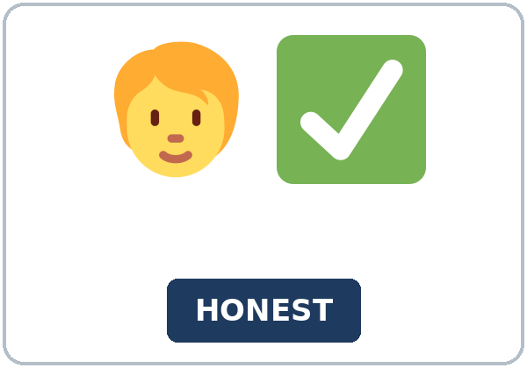
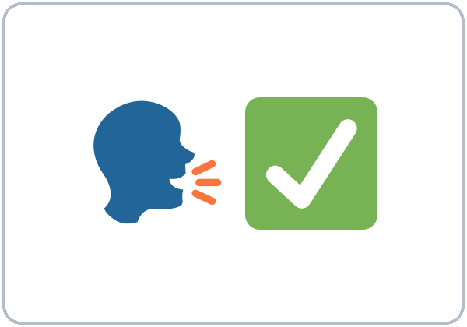
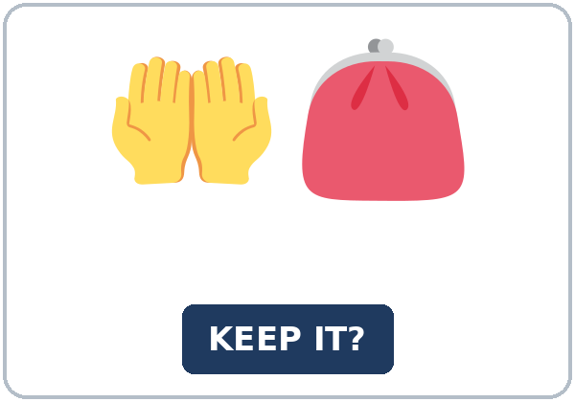
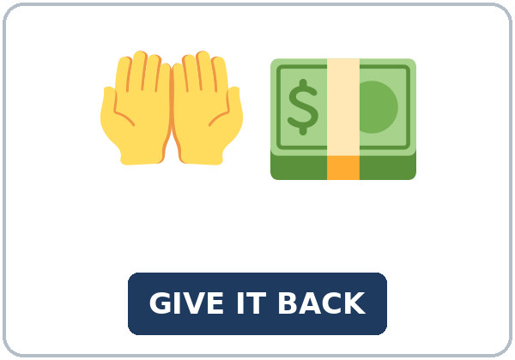
Look. Listen.
Repeat.
New Words
★ imagine
★ choose
★ honest
★ tell the truth
★ keep (it)
★ give back
Notes:
Step 2 · 6:08–6:15 · New Words · 7 min (this slide and the next). Whole class, then pairs.
Point to each picture and say the word. Learners repeat once. ★ = the most important words. Each click shows the next word.
Show the hard words: imagine (point to your head: a picture in your mind); choose (hold up two things: pick one); honest and tell the truth (you don't lie); keep it vs. give it back (mime with a coin); owner (the person it belongs to); envelope; extra money (more than you should get); mistake; magic wand (wave a pencil); dream job (the job you want most).
If behind: teach the ★ words only.
Lesson plan: Step 2; Key vocabulary; New Words page.
Pictures: Twemoji graphics by Twitter, Inc. and other contributors (https://github.com/jdecked/twemoji), CC BY 4.0 (https://creativecommons.org/licenses/by/4.0/); resized and combined, with signs and labels (images/CREDITS.md).

Slide 6
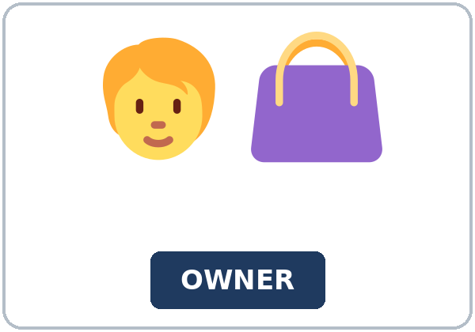

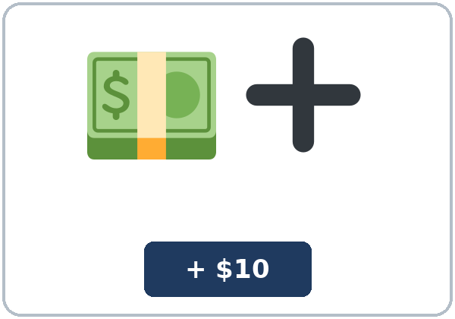
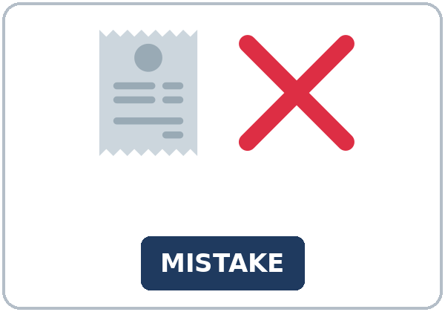
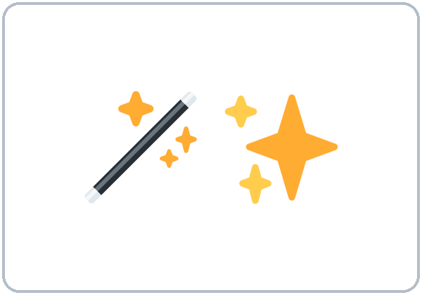

Partner game:
What would you do?
More New Words
★ owner
★ envelope
★ extra money
★ mistake
magic wand
dream job
Notes:
Step 2, continued. Point to each picture and say the word. Learners repeat once.
Partner game (2 min): A points to a picture and asks, "What would you do if you found an envelope with money?" B answers, "If I found…, I'd…" and gives a reason. Switch. 15 learners: finish with a quick team round (3 teams; you say a clue, the first team with the word gets a point). 7–8: 2 teams. 5 or fewer: one team against the clock.
My Words: "Write any word you want in your language on the My Words page. It's your personal list. It's optional." Learners do it at home.
If behind: teach the ★ words only.
Lesson plan: Step 2; New Words page; Partner game; My Words page.
Pictures: Twemoji graphics by Twitter, Inc. and other contributors (https://github.com/jdecked/twemoji), CC BY 4.0 (https://creativecommons.org/licenses/by/4.0/); resized and combined, with signs and labels (images/CREDITS.md).

Slide 7
Check the Meaning
Look at the picture. Answer the question.
1
2
3
If a cashier gives you extra money, is it a mistake?
Is the owner the person who found it or the person it belongs to?
If you tell the truth, are you honest?
yes
it belongs to
yes
Notes:
Step 2 · Check meaning · 1 min. Whole class.
The answers are hidden. Ask each question and wait for the class to answer. Then click to show the answer. Each click shows one answer, in order: 1, 2, 3.
1. "If a cashier gives you extra money, is it a mistake?" (yes) • 2. "Is the owner the person who found it or the person it belongs to?" (it belongs to) • 3. "If you tell the truth, are you honest?" (yes)
Lesson plan: Step 2: Check meaning.
Pictures: Twemoji graphics by Twitter, Inc. and other contributors (https://github.com/jdecked/twemoji), CC BY 4.0 (https://creativecommons.org/licenses/by/4.0/); resized and combined, with signs and labels (images/CREDITS.md).

Slide 8
Before You
Listen for:
Listen
What is the situation?
This is a radio show called What Would You Do? Mike is the host. He tells a situation, and two people call the show with their answers.
Play 2: Tasks B and C.
01
Audio: about 1:40. It plays once.
Mike
02
Grace
Play 1: Task A
03
Teresa
Notes:
Step 3 · 6:15–6:30 · Listening + "Hear it, say it" · 15 min (slides 8 to 12). Individuals, then pairs check.
Before you listen (2 min). Say: "This is a radio show called What Would You Do? Mike is the host. He tells a situation, and two people call the show with their answers. Listen: what is the situation?"
There are 3 people: Mike, Grace and Teresa. A narrator starts and ends the listening. Each click highlights the next person.
The audio (L4_L6_listening.mp3, about 1:40) plays the conversation once. Press play again for play 2. A third play is fine if the class needs it.
No speaker? Read the script with a volunteer at a natural, friendly speed, two times. The script says going to and want to. People often say gonna and wanna; learners only need to recognize those words.
Audio: synthetic voices, computer-generated (Chatterbox TTS cloned from Kokoro-82M reference clips). No recordings of real people. The names and the story are invented.
Lesson plan: Step 3; Listening script; Listening page.
Picture: Twemoji graphics by Twitter, Inc. and other contributors (https://github.com/jdecked/twemoji), CC BY 4.0 (https://creativecommons.org/licenses/by/4.0/); resized and combined, with signs and labels (images/CREDITS.md).

Slide 9
Listen. What is the situation?
Circle.
Listening A
a. A cashier gives you too much change.
b. You find money on the floor at work.
c. A friend asks you to tell a small lie.
Notes:
Play 1 → Task A (the main idea). Pairs compare. Check together.
Click to circle the answer: a (A cashier gives you too much change.).
Then read Tasks B and C together (1 min) so learners know what to listen for.
Lesson plan: Step 3; Listening Task A; Answer key.

Slide 10
Listen again.
Who says it, and what?
Circle the answer.
Listening B
1. Grace would
give the money back
keep the money
2. Grace's reason: the cashier
made a mistake
was her friend
3. Teresa once got ____ too much.
$10
$20
4. Teresa gave it back
the same day
the next day
5. If it were one dollar, Teresa would
probably keep it
give it back
6. Next week's situation:
an envelope with money at work
a lost phone on the bus
Notes:
Play 2 → Tasks B and C. Pairs compare. Then show the answers.
Click to circle each answer (one click per item, 1 to 6): 1 give the money back • 2 made a mistake • 3 $20 • 4 the next day • 5 probably keep it • 6 an envelope with money at work.
Lesson plan: Step 3; Listening Task B; Answer key.

Slide 11
Listen again.
Write the missing word: would, were, I'd, or a past verb.
Listening C
1
Really? Why ____ you go back?
would
2
If I ____ the money, she would have a problem at the end of her shift.
kept
3
And what would you do if it ____ only one dollar?
were
Write the missing word: would, were, I'd, or a past verb.
Pairs: compare your answers.
Then check together.
4
If it were one dollar, ____ probably keep it.
I'd
5
But ____ feel a little bad.
I'd
6
what would you do if you ____ an envelope with money at work?
found
Notes:
Task C (play 2). Click to show each answer (one click per item, 1 to 6): 1 would, 2 kept, 3 were, 4 I'd, 5 I'd, 6 found.
If behind: do Task C together on the board, reading the lines yourself.
Lesson plan: Step 3; Listening Task C; Answer key.

Slide 12
Hear it: gonna = going to, wanna = want to
Hear It,
Say It
Say it: I'd, and the stress
I want to hear your ideas.
If you're going to call, call early!
gonna and wanna are short forms. This listening uses the full forms.
Say the d in I'd. Stress do.
Say each line two times.
I'd give it back.
What would you DO?
Notes:
"Hear it, say it" (3 min): Point to the script lines. wanna = want to: "I want to hear your ideas." gonna = going to: "If you're going to call, call early!" Then practice I'd (say the d): I'd give it back, and What would you DO? with the stress on do. The class repeats the two lines twice.
Reductions: the listening says going to and want to. People often say gonna and wanna. Learners only need to recognize the short forms.
Lesson plan: Step 3: "Hear it, say it"; Listening page: Hear it, say it; Teacher notes.

Slide 13
Grammar Box 1
What would you do if…?
QUESTION
ANSWER
What would you do if you found $50 at work?
If I found $50, I'd give it to my supervisor.
What would you do if you had a free week?
If I had a free week, I'd visit my cousin.
Would you keep the extra money?
No, I wouldn't. I'd give it back.
What would you do if you were me?
If I were you, I'd call the owner.
Notes:
Step 4 · 6:30–6:45 · Grammar Q&A · 15 min (slides 13 to 20). Whole class, then pairs. Show the Grammar page. The left side is the question. The right side is the answer.
Show it (2 min): hold up a pencil as a magic wand. Say, "I don't have a magic wand. But if I had a magic wand, I'd fix all the potholes in this city." Write it in two halves: If I had a magic wand, | I'd fix the potholes. Say: "It's not real. We use the past form after if and would in the other half."
Box 1: read across: What would you do if you found $50 at work? → If I found $50, I'd give it to my supervisor. Each click shows the answer side of one row.
Lesson plan: Step 4; Grammar Box 1.
Picture: Twemoji graphics by Twitter, Inc. and other contributors (https://github.com/jdecked/twemoji), CC BY 4.0 (https://creativecommons.org/licenses/by/4.0/); resized and combined, with signs and labels (images/CREDITS.md).

Slide 14
Grammar Box 2
possible or imaginary?
QUESTION
ANSWER
If it rains tomorrow, I'll take the bus.
If I had a car, I'd drive to work.
If I get the job, I'll buy a new phone.
If I won $1,000, I'd pay my bills.
If you find my keys, will you call me?
If I found a wallet, I'd look for the owner.
Notes:
Box 2: possible (If it rains, I'll…) vs. imaginary (If I had a car, I'd…). Each click shows the answer side of one row.
Rule of thumb (read it aloud): Imaginary: use the past form after if (found, had, were). Use would / 'd + base verb in the other half (I'd give, I'd visit). Never put would right after if.
Lesson plan: Step 4; Grammar Box 2; Rule of thumb.
Picture: Twemoji graphics by Twitter, Inc. and other contributors (https://github.com/jdecked/twemoji), CC BY 4.0 (https://creativecommons.org/licenses/by/4.0/); resized and combined, with signs and labels (images/CREDITS.md).

Slide 15
Grammar Box 3
would short forms
LONG
SHORT · EXAMPLE
I would
I'd
I'd give it back.
she would
she'd
She'd keep it.
would not
wouldn't
I wouldn't keep it.
Notes:
Box 3: I'd and wouldn't. Each click shows the answer side of one row.
Lesson plan: Step 4; Grammar Box 3.
Picture: Twemoji graphics by Twitter, Inc. and other contributors (https://github.com/jdecked/twemoji), CC BY 4.0 (https://creativecommons.org/licenses/by/4.0/); resized and combined, with signs and labels (images/CREDITS.md).

Slide 16
Grammar Box 4
advice with If I were you…
SAY
USE · EXAMPLE
If I were you, I'd…
advice
If I were you, I'd talk to the supervisor.
were for every person
imaginary
If it were one dollar, I'd keep it.
If I was…
you hear it in speaking; it's OK
in writing, use If I were
Notes:
Box 4: If I were you, I'd… for advice. Each click shows the answer side of one row.
Questions and answers (2 min): Q: Can I say If I would have time, I'd take a class? A: No. Never put would right after if: If I had time, I'd take a class. • Q: If I was you or If I were you? A: Write If I were you. In speaking, many people say If I was you. That's OK. • Q: If it rains or If it rained? A: Possible (maybe tomorrow): If it rains, I'll stay home. Imaginary (not real now): If I had a car, I'd drive.
Check questions: "Do I have a magic wand?" (no) "So do I say If I have or If I had?" (If I had) • "If I would have time or If I had time?" (If I had time) • "If I were you or If I am you?" (If I were you).
Lesson plan: Step 4; Grammar Box 4; Questions and answers.
Picture: Twemoji graphics by Twitter, Inc. and other contributors (https://github.com/jdecked/twemoji), CC BY 4.0 (https://creativecommons.org/licenses/by/4.0/); resized and combined, with signs and labels (images/CREDITS.md).

Slide 17
Practice A
Write the correct form of the verb.
Practice A
1
If I ____ a wallet, I'd look for the owner. (find)
found
2
If I had more time, I'd ____ a computer class. (take)
take
3
If I ____ you, I'd tell the truth. (be)
were
Write the correct form of the verb.
Pairs: check your answers.
4
What would you ____ if you won $500? (do)
do
5
If she ____ a car, she'd drive to work. (have)
had
6
If it rains tomorrow, ____ take the bus. (I'll / I'd)
I'll
Notes:
Practice A and B (3 min): learners write, then pairs check. Go over the answers.
Click to show each answer (one click per item, 1 to 6): 1 found, 2 take, 3 were, 4 do, 5 had, 6 I'll.
Lesson plan: Step 4; Grammar Practice A; Answer key.

Slide 18
Circle the correct words.
Practice B
1. If I ____ a magic wand, I'd fix all the potholes.
had
have
2. If I found $50, I ____ give it back.
would
will
3. If I ____ you, I'd call the owner.
were
would be
4. If it ____ tomorrow, I'll stay home.
rains
rained
5. Would you keep it? No, I ____.
wouldn't
don't
6. ____ if you had a free week?
What would you do
What you would do
Notes:
Practice B. Learners circle the correct words. Pairs check.
Click to circle each answer (one click per item, 1 to 6): 1 had, 2 would, 3 were, 4 rains, 5 wouldn't, 6 What would you do.
Lesson plan: Step 4; Grammar Practice B; Answer key.

Slide 19
Common Mistakes
Don't say
Say
If I would have time, I'd take a class.
If I had time, I'd take a class.
If I found $50, I will give it back.
If I found $50, I'd give it back.
What you would do?
What would you do?
If I am you, I'd call.
If I were you, I'd call.
I'd to give it back.
I'd give it back.
Notes:
Common mistakes. Read the table together: "Don't say… Say…". Read a line from Don't say. Ask: "What's the right way?" Learners try first. Then click to show the right form. Each click shows one line, in order 1 to 5.
Learners can read the contrast tip on their Grammar page on their own; it is optional. You never need to read, translate, or explain it.
Lesson plan: Grammar: Common mistakes; Teacher notes.
Picture: Twemoji graphics by Twitter, Inc. and other contributors (https://github.com/jdecked/twemoji), CC BY 4.0 (https://creativecommons.org/licenses/by/4.0/); resized and combined, with signs and labels (images/CREDITS.md).

Slide 20
Pair Check
A asks.
01
A reads a situation from the pictures. Then switch.
A: What would you do if you found an envelope with money?
B answers with a reason.
02
B: If I found…, I'd…
because…
Notes:
Pair check (last 3 min of Step 4). Pairs.
A reads a situation from the pictures: "What would you do if you found an envelope with money?" B answers with If I found…, I'd… and a reason. Switch. 15 learners: swap partners once. 5 or fewer: you join one pair.
If behind: skip the pair check. Talk Time practices it.
Break · 6:45–7:00 · 15 min. Write on the board: What would you do if you found $50? → If I found $50, I'd give it back. • If I were you, I'd… • If it rains, I'll… (possible)
Lesson plan: Step 4: Pair check; Break.
Picture: Twemoji graphics by Twitter, Inc. and other contributors (https://github.com/jdecked/twemoji), CC BY 4.0 (https://creativecommons.org/licenses/by/4.0/); resized and combined, with signs and labels (images/CREDITS.md).

Slide 21
Talk Time
What Would You Do?
Groups of 3–4.
Read a situation card.
7:00–7:15
1
One person reads a situation card.
You find $50 on the floor at work.
2
Each person answers with a reason.
If I found $50, I'd give it to my supervisor because…
3
Write your group's most common answer.
We'd… because…
Notes:
Step 5 · 7:00–7:15 · Talk Time: What Would You Do? + Magic Wand Chain · 15 min.
Model it first (1 min): read a card: "You find $50 on the floor at work. What would you do?" Help a learner say, "If I found $50, I'd give it to my supervisor because it isn't mine." Say: "Your answer, then because."
Round 1 (7 min): What Would You Do? (groups of 3–4). One person reads a situation card. Each person answers with If I…, I'd… and a reason. The group writes the most common answer. Then the next person reads a card. Each click shows the next step.
15 learners: groups of 3–4 for round 1; then two circles for round 2. 7–8 learners: two groups for round 1; then one circle. 5 or fewer: one group for round 1: you read the cards. Then one circle.
Lesson plan: Step 5; Talk Time: What Would You Do?.
Picture: Twemoji graphics by Twitter, Inc. and other contributors (https://github.com/jdecked/twemoji), CC BY 4.0 (https://creativecommons.org/licenses/by/4.0/); resized and combined, with signs and labels (images/CREDITS.md).

Slide 22
Talk Time
Magic Wand Chain
Sit in a circle.
Pass the "magic wand."
7:00–7:15
1
Each person says one sentence.
If I had a magic wand, I'd…
2
Then do one more round.
If I had my dream job, I'd…
3
Classmates can ask one question.
Why?
Notes:
Round 2 (6 min): Magic Wand Chain (circle). Pass the "magic wand." Each person says, "If I had a magic wand, I'd…" One more round: "If I had my dream job, I'd…" Classmates can ask one follow-up question. Each click shows the next step.
15 learners: groups of 3–4 for round 1; then two circles for round 2. 7–8 learners: two groups for round 1; then one circle. 5 or fewer: one group for round 1: you read the cards. Then one circle.
Every answer needs a reason; every partner asks a follow-up. Walk around and listen. Note 2 good sentences to praise and 1 common error for next week.
If behind: round 1 only.
Lesson plan: Step 5; Talk Time: Magic Wand Chain.
Picture: Twemoji graphics by Twitter, Inc. and other contributors (https://github.com/jdecked/twemoji), CC BY 4.0 (https://creativecommons.org/licenses/by/4.0/); resized and combined, with signs and labels (images/CREDITS.md).

Slide 23
Read fast first.
Answer the questions.
Read &
Write
1
Where does the writer work?
At a busy restaurant.
2
How long are Leo's breaks sometimes?
30 minutes, not 15.
ADVICE COLUMN · Ask Gloria: Work and Life
Pairs: answer together.
3
What would Gloria do first?
She'd talk to Leo.
4
Where would she talk to him?
Alone, not in front of other people.
5
When would she talk to the supervisor?
If Leo still took long breaks after that.
Notes:
Step 6 · 7:15–7:25 · Read & Write: An advice column · 10 min. Pairs read, then individual writing.
Read (4 min): Learners read a letter to an advice column and the answer on the Read & Write page and answer the questions. Say: "Read fast first. Then find the answers." Pairs answer questions 1–5 together.
Check (1 min): click to show each answer (one click per question, 1 to 5): 1 At a busy restaurant. • 2 30 minutes, not 15. • 3 She'd talk to Leo. • 4 Alone, not in front of other people. • 5 If Leo still took long breaks after that.
Write (5 min): Learners read a short letter about a noisy neighbor and write a reply (5–8 sentences) with If I were you, I'd… because…. Show the example. Invented details are fine. Learners start in class and finish at home (Homework item 2).
If behind: questions 1–5 only; the writing becomes homework.
Lesson plan: Step 6; Read & Write page; Answer key.

Slide 24
Before You Go 7:25–7:30
01
Exit ticket
02
Homework
What would you do if you had a free week?
1. An if-sentence (If I had a free week, I'd…).
2. A second idea (I'd also…).
3. The reason, with because.
Give it to me at the door.
About 15–20 minutes.
1. Write the sentence.
2. Finish your writing from Read & Write C (your reply).
3. Write 3 sentences about your dreams.
4. Review (Lesson 5).
Bring it next week!
Notes:
Step 7 · 7:25–7:30 · Exit Ticket + Homework · 5 min · NEVER SKIP.
Exit ticket (3 min): learners open the Exit Ticket page and answer in 3 sentences with a reason: What would you do if you had a free week? Example on the board: If I had a free week, I'd visit my sister in Chicago. I'd also cook a big dinner for my family. I'd do that because I don't see them very often. With 5 or fewer, a learner can say it to you first and then write it.
Collect the pages. After class, sort them into ✓ / almost / not yet. Start next week with 2 corrections on the board (no names).
Homework (2 min): open the Homework page. Do item 1 together (item 1: if I / have / a free week, I / visit / my cousin → If I had a free week, I'd visit my cousin.). Say: "About 15–20 minutes. Finish your Read & Write writing at home."
Homework items: 1. Write the sentence. Use the words. • 2. Finish your writing from Read & Write C (your reply). Read it one more time. Check ✓ the list in D. • 3. Write 3 sentences about your dreams. Use If I had…, I'd… and a reason. • 4. Review (Lesson 5). Write one word.
Lesson plan: Step 7; Exit Ticket page; Homework page.
Picture: Twemoji graphics by Twitter, Inc. and other contributors (https://github.com/jdecked/twemoji), CC BY 4.0 (https://creativecommons.org/licenses/by/4.0/); resized and combined, with signs and labels (images/CREDITS.md).

Slide 25
Goodbye! See You Next Week!
Now you can:
• Ask and answer What would you do if…?
• Talk about an imaginary situation
• Give advice
Lesson 6 · Level 4
Notes:
Read the title: "Goodbye! See you next week!" Learners repeat.
Read the three "Now you can" lines.
Lesson plan: At a glance: Objectives; Step 7.
Picture: Twemoji graphics by Twitter, Inc. and other contributors (https://github.com/jdecked/twemoji), CC BY 4.0 (https://creativecommons.org/licenses/by/4.0/); resized and combined, with signs and labels (images/CREDITS.md).

Slide 26
Credits
Pictures
Vocabulary pictures use Twemoji graphics by Twitter, Inc. and other contributors (https://github.com/jdecked/twemoji), licensed under CC BY 4.0 (https://creativecommons.org/licenses/by/4.0/). The graphics were resized and combined, and signs and labels were added.
Names and story
Mike, Grace, Teresa, Gloria, and Leo are invented names. The listening story is invented.
Audio and font
Audio: synthetic voices made with Chatterbox TTS (MIT License), cloned from short synthetic reference clips made with Kokoro-82M (Apache License 2.0). No recordings of real people were used. Each file carries an inaudible Perth watermark marking it as AI-generated. Font: Lexend Deca (OFL 1.1).
© 2026 the authors. The authors license this deck under CC BY-NC-SA 4.0.
Notes:
Credits. You don't need to read this slide in class.
Pictures: Twemoji graphics by Twitter, Inc. and other contributors, CC BY 4.0; the file-by-file list is in images/CREDITS.md.
Audio: synthetic voices, computer-generated (Chatterbox TTS cloned from Kokoro-82M reference clips). No recordings of real people. The names and the story are invented.
Course materials: © 2026 the authors, licensed under CC BY-NC-SA 4.0 (https://creativecommons.org/licenses/by-nc-sa/4.0/).
Lesson plan: Picture Credits. Picture list: images/CREDITS.md.

