Slide 1
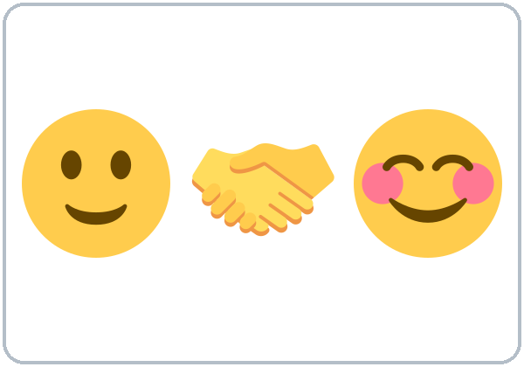
Nice to Meet You
Today you will:
• Ask and answer questions about you
• Choose: be or do?
• Introduce a partner
Lesson 1 · Level 2
Notes:
Welcome everyone. Read the three goals together; learners repeat.
Source: Level2_Curriculum_v4_1_public.md, Lesson 1 (At a glance: Objectives).
Picture: Twemoji graphics by Twitter, Inc. and other contributors (https://github.com/jdecked/twemoji), CC BY 4.0 (https://creativecommons.org/licenses/by/4.0/); resized and combined.

Slide 2

WARM-UP · 6:00
Name Chain
Say your name.
Say one thing you like.
Ana: I'm Ana. I like coffee.
Carlos:
She's Ana. She likes coffee.
I'm Carlos. I like soccer.
Notes:
Step 1 · 6:00–6:10 · Welcome + Name Chain (10 min). Two circles (15 learners) / one circle (7–8 learners).
Click 1: model it yourself: "I'm Ana. I like coffee."
Click 2: each next person repeats the previous person, then adds their own: "She's Ana. She likes coffee. I'm Carlos. I like soccer."
Late arrivals join the circle. If behind: go around once only.
Source: Level2_Curriculum_v4_1_public.md, Lesson 1 (Step 1).
Picture: Twemoji graphics by Twitter, Inc. and other contributors (https://github.com/jdecked/twemoji), CC BY 4.0 (https://creativecommons.org/licenses/by/4.0/); resized and combined.

Slide 3
How Our
Class Works
01
Class times
6:00–6:45 and 7:00–7:15
02
Break: 6:45–7:00
Stuck? A classmate can help for a few seconds. Then back to English.
Homework every week.
It's short!
03
If time: 7:15–7:30
04
English in class, please!
05
Phones OK: audio, dictionary
Notes:
Step 2 · 6:10–6:15 · Orientation: "How Our Class Works" (5 min, whole class). Each click shows one row.
Class times and the break: core class 6:00–6:45 and 7:00–7:15; break 6:45–7:00; 7:15–7:30 is optional ("If time").
Language rule: "English in class. If you're stuck, a classmate can help you for a few seconds. Then back to English." You don't need to understand what classmates say to each other. Just smile and say "Now in English, please."
Also say: phones are OK for audio and dictionary. "You can tell the truth or make it up." Homework every week (short!), checked at the start of class.
If behind: hand out the sheet and read the 3 key rules only.
Source: Level2_Curriculum_v4_1_public.md, Lesson 1 (Clock-time plan; Step 2).

Slide 4
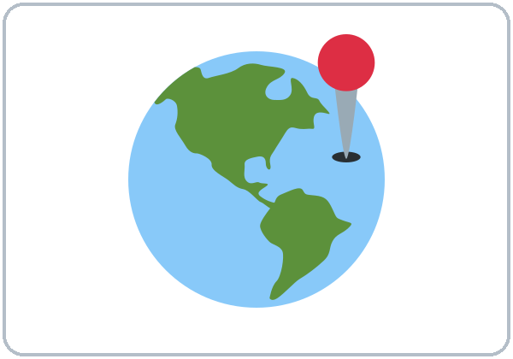
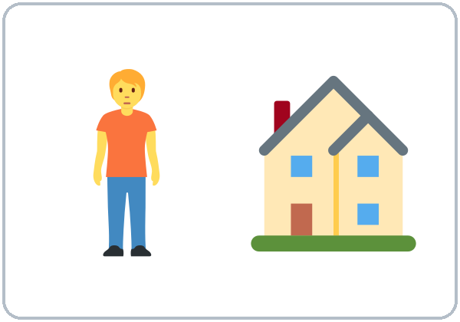
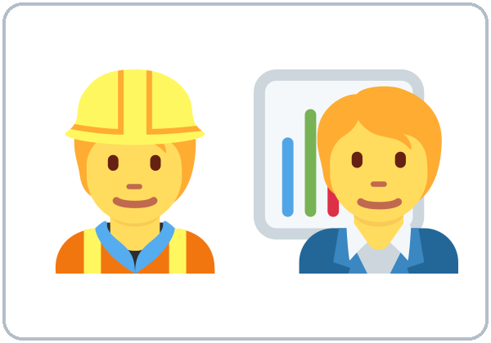

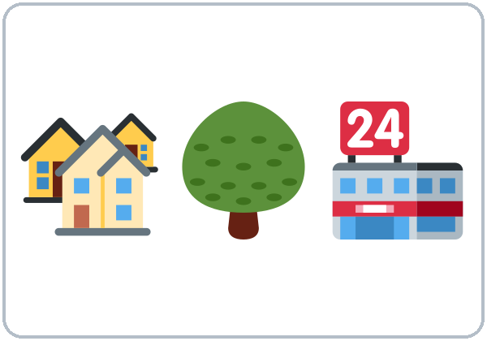
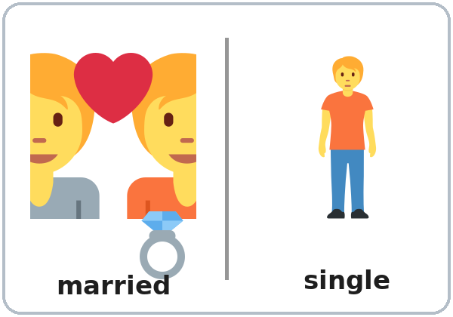
Look. Listen.
Repeat.
New Words
from
live
work
job
neighborhood
married / single
Notes:
Step 3 · 6:15–6:23 · New Words (8 min, pairs). Each click shows one word under its picture.
Point to each picture and say the word; learners repeat twice. Star (most important) words here: from, live, work, job, married / single.
Privacy: married / single is optional. Alternative question: "Do you have family here?"
If behind: teach only the star words.
Source: Level2_Curriculum_v4_1_public.md, Lesson 1 (Step 3; Student Page 1 New Words; Teacher notes).
Picture: Twemoji graphics by Twitter, Inc. and other contributors (https://github.com/jdecked/twemoji), CC BY 4.0 (https://creativecommons.org/licenses/by/4.0/); resized and combined.

Slide 5
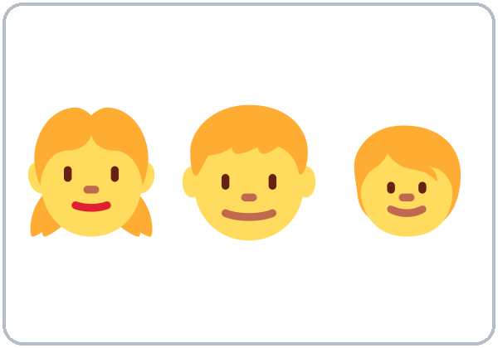
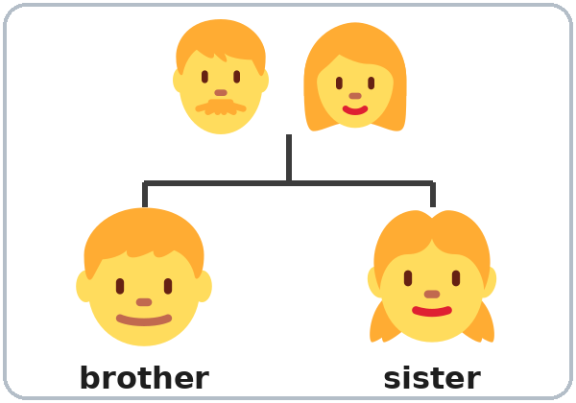
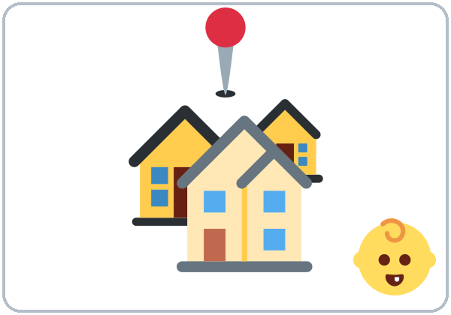
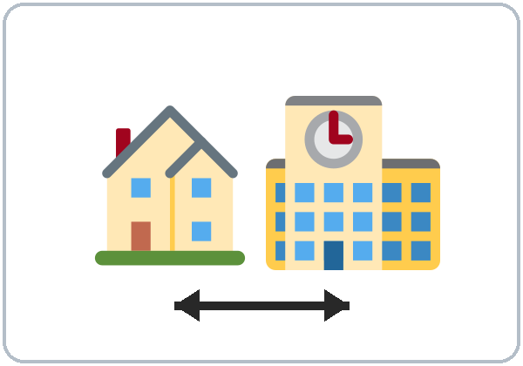
Point. Say.
Switch!
More New Words
kids (children)
brother / sister
hometown
near
Nice to meet you
What about you?
Notes:
New Words, part 2. Each click shows one word.
Star words here: kids, Nice to meet you, What about you?
Pairs: A points to a picture, B says the word. Then switch.
Extra example: show the ID card for a fictional person.
Source: Level2_Curriculum_v4_1_public.md, Lesson 1 (Step 3; Student Page 1 New Words).
Picture: Twemoji graphics by Twitter, Inc. and other contributors (https://github.com/jdecked/twemoji), CC BY 4.0 (https://creativecommons.org/licenses/by/4.0/); resized and combined.

Slide 6
Listen to Rosa and Sam.
True or False?
Listening A
1. Sam is new.
True
False
2. Sam is from Colombia.
True
False
Honduras
3. Rosa lives on Pine Street.
True
False
4. Sam works at a bakery.
True
False
a hotel
5. Rosa has two daughters.
True
False
Notes:
Step 4 · 6:23–6:33 · Listening (L1_listening.mp3, about 1:10; plays once, so play the audio again if needed). Before you listen (1 min): "Rosa and Sam meet. What questions do they ask?" Write 2–3 guesses.
Listen 1 → Task A. Pairs compare. Each click circles one answer.
Answer key: 1 T, 2 F (Honduras), 3 T, 4 F (a hotel), 5 T.
No speaker? Read the script aloud with a volunteer learner.
Source: Level2_Curriculum_v4_1_public.md, Lesson 1 (Step 4; Listening script; Answer key; Student Page Listening A).

Slide 7
Listening B
Sam is a ...
01
cook
driver
teacher
Listen. Circle the answer.
Rosa starts work at ...
02
5:00
7:00
9:00
Sam lives with his ...
03
wife
brother
sister
Notes:
Step 4 · Listen 2 → Task B (circle the answer). Pairs compare. Each click circles one answer.
Answer key: 1 a cook, 2 5:00, 3 brother.
Source: Level2_Curriculum_v4_1_public.md, Lesson 1 (Step 4; Answer key; Student Page Listening B).
Picture: Twemoji graphics by Twitter, Inc. and other contributors (https://github.com/jdecked/twemoji), CC BY 4.0 (https://creativecommons.org/licenses/by/4.0/); resized and combined.

Slide 8
Listening C
C
Listen again.
Write are or do.
1
Where ____ you from?
are
Pairs: compare your answers.
When do we use are?
When do we use do?
2
Where ____ you live?
do
3
____ you work near here?
Do
4
____ you married?
Are
Notes:
Step 4 · Listen 3 → Task C (write are / do). Pairs compare. Each click fills one blank.
Answer key: 1 are, 2 do, 3 Do, 4 Are.
"Say it" (1–2 min): pause after "Where are you from?" and "Where do you live?" The class repeats each line twice.
Bridge to grammar: "When do we use are? When do we use do?"
If behind: skip the third play; do Task C together (you read the 4 lines).
Source: Level2_Curriculum_v4_1_public.md, Lesson 1 (Step 4; Answer key; Student Page Listening C).

Slide 9
Grammar Box 1
Questions with be
QUESTION
ANSWER
Are
you new here?
Yes, I am.
No, I'm not.
Is
she a cook?
Yes, she is.
No, she isn't.
Notes:
Step 5 · 6:33–6:45 · Grammar: be or do? Show the Grammar Box (question side / answer side).
Say: "English questions need a helper word at the front. With am/is/are, move it to the front."
Click 1 highlights Are and its answer; click 2 highlights Is and its answer. Learners read across: choose one word from each column.
More choices from the box: Are you from Mexico? / married? / new here? · Is he/she a cook? / from Peru? / married?
Q&A: we use am/is/are with where you're from, age, job title, feelings, married/single, and places.
Source: Level2_Curriculum_v4_1_public.md, Lesson 1 (Step 5; Grammar Box 1; Questions and answers).
Picture: Twemoji graphics by Twitter, Inc. and other contributors (https://github.com/jdecked/twemoji), CC BY 4.0 (https://creativecommons.org/licenses/by/4.0/); resized and combined.

Slide 10
Grammar Box 2
Questions with
do / does
QUESTION
ANSWER
Do
you have kids?
Yes, I do.
No, I don't.
Does
she work at night?
Yes, she does.
No, she doesn't.
Notes:
Step 5 · Grammar Box 2. Say: "With no be, borrow do or does."
Click 1 highlights Do and its answer; click 2 highlights Does and its answer.
More choices from the box: Do you live here? / work near here? / have kids? · Does he/she live here? / work at night? / have kids?
Q&A: we use do/does with action verbs like live, work, have, like, speak.
Source: Level2_Curriculum_v4_1_public.md, Lesson 1 (Step 5; Grammar Box 2; Questions and answers).
Picture: Twemoji graphics by Twitter, Inc. and other contributors (https://github.com/jdecked/twemoji), CC BY 4.0 (https://creativecommons.org/licenses/by/4.0/); resized and combined.

Slide 11
Wh-
Word order
Questions
1
Question word
2
Helper
Grammar Box 3: the question word comes first.
3
Person
01
Where
are
you from?
4
The rest
02
Where
do
you live?
Where do you live?
03
What
do
you do?
Notes:
Step 5 · Grammar Box 3: Wh- questions. Word order: question word, helper, person, the rest.
Each click highlights the helper word: are, do, do.
More from the box: Where do you work? I work at a hotel. / at a bakery. · What do you do? I'm a cook. / driver. / teacher.
Check questions: "___ you like rice?" (do) · "___ you tired?" (are) · "Where ___ she work?" (does).
Source: Level2_Curriculum_v4_1_public.md, Lesson 1 (Step 5; Grammar Box 3; Questions and answers).
Picture: Twemoji graphics by Twitter, Inc. and other contributors (https://github.com/jdecked/twemoji), CC BY 4.0 (https://creativecommons.org/licenses/by/4.0/); resized and combined.

Slide 12
Common Mistakes
Don't say
Say
Where you are from?
Where are you from?
Where you live?
Where do you live?
Do you are married?
Are you married?
Notes:
Common mistakes (part 1). Read the left side; ask "What's wrong?" Each click shows the correct question.
English questions need a helper word at the front. Never use do and are together: Do you are married? → Are you married?
Typical mistake this week: Where you live? (no helper word). Write the correct form on the board and point learners to the note on their Grammar page.
Source: Level2_Curriculum_v4_1_public.md, Lesson 1 (Common mistakes table; Questions and answers; Teacher notes).
Picture: Twemoji graphics by Twitter, Inc. and other contributors (https://github.com/jdecked/twemoji), CC BY 4.0 (https://creativecommons.org/licenses/by/4.0/); resized and combined.

Slide 13
Fix These Mistakes
Don't say
Say
I have 35 years.
I'm 35.
Is from Peru.
She's from Peru.
Yes, I live.
Yes, I do.
Notes:
Common mistakes (part 2). Each click shows the correct sentence.
Age uses be: I'm 35 (not I have 35 years). Always say the person: She's from Peru. Short answers use the same helper: Do you live here? Yes, I do.
Typical mistake this week: I have 35 years. Write the correct form on the board and point learners to the note on their Grammar page; you don't need to explain it.
Privacy: married / single is optional; never ask about immigration status, money, or exact addresses.
Source: Level2_Curriculum_v4_1_public.md, Lesson 1 (Common mistakes table; Questions and answers; Teacher notes).
Picture: Twemoji graphics by Twitter, Inc. and other contributors (https://github.com/jdecked/twemoji), CC BY 4.0 (https://creativecommons.org/licenses/by/4.0/); resized and combined.

Slide 14
Be or Do?
Which helper word goes in the blank?
1
2
3
____ you like rice?
____ you tired?
Where ____ she work?
do
are
does
Notes:
Step 5 · Check questions. Learners say the helper word; each click shows one answer.
Answers: ___ you like rice? (do) · ___ you tired? (are) · Where ___ she work? (does).
Pair check (last 3–4 min): A builds a question from the Grammar Box; B answers from the answer side. If behind: skip the pair check; it becomes homework item 1.
Source: Level2_Curriculum_v4_1_public.md, Lesson 1 (Step 5 check questions).

Slide 15
Use the same helper word.
Short Answers
Are you new here?
am
Yes, I am.
No, I'm not.
Do you have kids?
do
Yes, I do.
No, I don't.
Notes:
Short answers use the same helper as the question. Click 1: Are you...? → Yes, I am. Click 2: Do you...? → Yes, I do.
Q&A: Can I use do and are together? No, never. Do you are married? → Are you married?
Pair practice: A asks a question from the Grammar Box; B gives a short answer.
Source: Level2_Curriculum_v4_1_public.md, Lesson 1 (Questions and answers: short answers).
Picture: Twemoji graphics by Twitter, Inc. and other contributors (https://github.com/jdecked/twemoji), CC BY 4.0 (https://creativecommons.org/licenses/by/4.0/); resized and combined.

Slide 16
Talk Time
Find Someone Who
Mingle. Talk to 6 or more people.
7:00–7:10
1
Make the question.
Do you live near here?
2
Someone says yes?
Write their name.
3
Ask one more question.
Then find a new person.
Notes:
Step 6 · 7:00–7:10 · Talk Time: Find Someone Who (mingle; talk to 6+ people / everyone). Set up the sheets during the break.
Learners turn each prompt into a correct question (Do you live near here? / Are you a morning person?). When someone says yes: write their name and ask one follow-up question. One name per row. Each click shows one step.
Baseline snapshot: the teacher (or a second volunteer) uses the checklist: Can they ask a do question? Answer in a full sentence? Give 1 extra detail?
If behind: learners talk to 4 people.
Source: Level2_Curriculum_v4_1_public.md, Lesson 1 (Step 6).
Picture: Twemoji graphics by Twitter, Inc. and other contributors (https://github.com/jdecked/twemoji), CC BY 4.0 (https://creativecommons.org/licenses/by/4.0/); resized and combined.

Slide 17
Before You Go
01
Exit ticket
02
Homework
Write one be question
and one do question.
Write 5 questions:
3 with do / does
2 with am / is / are
Write the answers.
Bonus: ask one person!
Notes:
Step 7 · 7:10–7:15 · Exit Ticket + Homework. NEVER SKIP.
Exit ticket: on a slip, learners write one be question and one do question. Read the slips after class.
Homework (10 minutes, bring it next week): 1. Write 5 questions for a friend, family member, or coworker: 3 with do/does and 2 with am/is/are. 2. Write their answers (in English!). 3. Bonus: ask one person your questions in English. Explain it from the workbook and do item 1 together.
Source: Level2_Curriculum_v4_1_public.md, Lesson 1 (Step 7; Student Page Homework).
Picture: Twemoji graphics by Twitter, Inc. and other contributors (https://github.com/jdecked/twemoji), CC BY 4.0 (https://creativecommons.org/licenses/by/4.0/); resized and combined.

Slide 18
Credits
Pictures
Vocabulary pictures use Twemoji graphics by Twitter, Inc. and other contributors (https://github.com/jdecked/twemoji), licensed under CC BY 4.0 (https://creativecommons.org/licenses/by/4.0/). The graphics were resized and combined, and arrows, calendars, clocks, and labels were added.
This deck
License: CC BY-NC-SA 4.0
About
Independent project, not affiliated with or endorsed by Intercambio Uniting Communities.
Notes:
Credits. Lesson content: Level 2 Adult ESL Curriculum v4.1, public edition, Lesson 1.
Image credit line copied exactly from images/CREDITS.md. Deck license: CC BY-NC-SA 4.0 (proposed curriculum license, Section 7.4).
Independence notice from the curriculum front matter.

