Slide 1
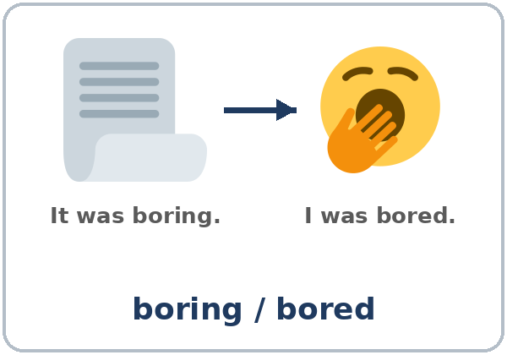
Bored or Boring?
Today you will:
• Say how something was (-ing)
• Say how you felt (-ed)
• Give an opinion with a reason
Lesson 11 · Level 3
Notes:
Welcome learners as they arrive.
Point to the title and read it: "Bored or boring?" Say: "Tonight we talk about events: how they were and how we felt."
Read the three lines under "Today you will". Give one quick example of each: "It was exciting." • "I was excited." • "I thought it was confusing, so I left early."
General events only (important): use community events, TV, movies, or sports. Learners never have to share where they spend their money or free time; the event cards are always an option.
Lesson plan: Topic; At a glance: Objectives; Teacher notes.
Picture: Twemoji graphics by Twitter, Inc. and other contributors (https://github.com/jdecked/twemoji), CC BY 4.0 (https://creativecommons.org/licenses/by/4.0/); resized and combined, with speech bubbles, signs, and labels (images/CREDITS.md).

Slide 2
Today's
Goals
01
I can say how something was.
It was exciting. / It was boring.
02
I can say how I felt: I was excited.
By the end of class, you can do these five things.
-ing = the thing. -ed = the feeling.
We check at 7:25!
03
I can choose -ing or -ed.
04
I can give an opinion with a reason.
05
I can read reviews and write a review.
Notes:
Read each goal slowly. Learners repeat.
Goal 1: It was exciting. / It was boring. Goal 2: I was excited. / I was bored. Goal 3: -ing (the thing, the experience) or -ed (the person's feeling).
Goal 4: I thought it was confusing, so I left early. Goal 5: read three short reviews and write a 3–4 sentence review with stars.
"We check at 7:25" = the Progress Check. It is not a test grade.
Lesson plan: At a glance: Objectives.

Slide 3
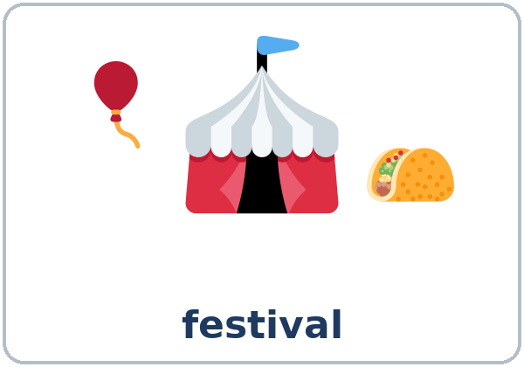
OPENING TALK · 6:00
Opening Talk
A asks a card question.
How do you make your favorite food?
B answers with 2–3 sentences.
A asks one follow-up.
What do you do after that?
Then switch.
Notes:
Step 1 · 6:00–6:10 · Opening Talk + Homework Check · 10 min. Pairs (7 pairs + 1 trio with 15 learners; 3–4 pairs with 7–8).
Before class, write on the board: First, … Next, … Then, … Finally, …
Model with one learner: "How do you make your favorite food?" → (answer) → "What do you do after that?" (Click to show the follow-up.)
Opening Talk (6 min): learners open the Opening Talk page. A asks a card question; B answers with 2–3 sentences; A asks one follow-up. Switch after each card. The cards are on the next slide.
If behind: one card only, then the homework check.
Lesson plan: Step 1; Opening Talk page.
Picture: Twemoji graphics by Twitter, Inc. and other contributors (https://github.com/jdecked/twemoji), CC BY 4.0 (https://creativecommons.org/licenses/by/4.0/); resized and combined, with speech bubbles, signs, and labels (images/CREDITS.md).

Slide 4
Opening Talk
Cards
01
How do you make your favorite food?
02
How do you send a photo on your phone?
Work with a partner. Then switch.
Follow-ups:
What do you do next? And after that? Is it easy?
03
What do you do first when you get home?
04
What instructions do you follow at work or at home?
05
Homework check: Lesson 10, item 2.
Notes:
Step 1, continued. The four cards from the Opening Talk page. Each click shows the next card.
A asks a card question. B answers with 2–3 sentences. A asks one follow-up question (follow-ups on the right). Then switch.
Homework Check (4 min, last click): partners read their Lesson 10 Homework item 2 (4 steps) to each other. The partner mimes the steps. Walk around. Write 2 common errors on the board (often You press or No open) and correct them together.
Lesson plan: Step 1; Opening Talk page: cards, follow-ups, homework check.

Slide 5
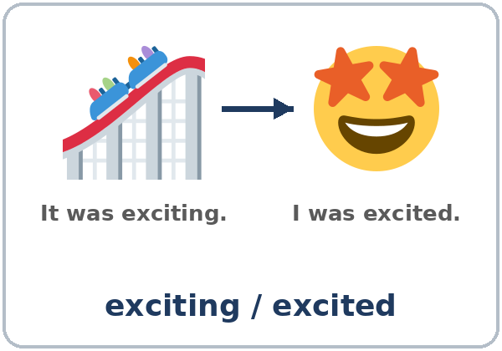
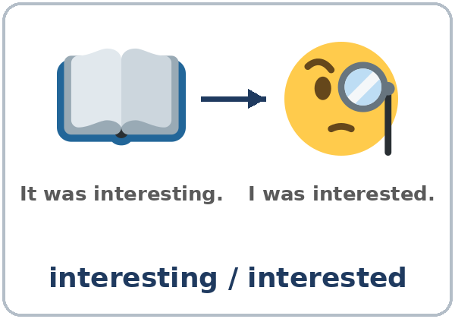
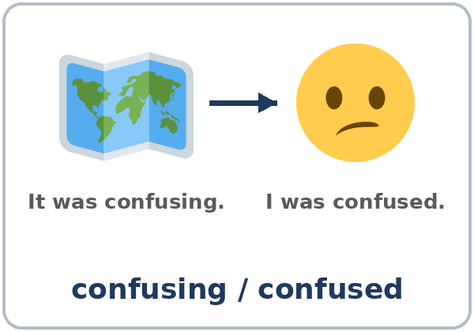
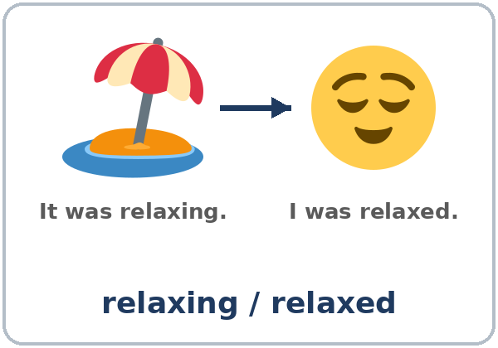
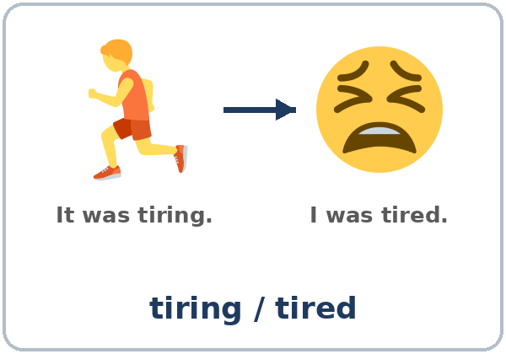
Look. Listen.
Repeat.
New Words
★ exciting / excited
★ boring / bored
★ interesting / interested
★ confusing / confused
★ relaxing / relaxed
★ tiring / tired
Notes:
Step 2 · 6:10–6:18 · New Words · 8 min (this slide and the next). Whole class, then pairs.
Point to each picture and say both words. Learners repeat once. For each pair, point to the left picture: "It was exciting." Point to the face: "I was excited." Each click shows the next word.
Show it with your face: yawn: "The movie was boring. I was bored." Look confused: "The map was confusing. I was confused."
If behind: teach the ★ words only.
Lesson plan: Step 2; Key vocabulary; New Words page.
Pictures: Twemoji graphics by Twitter, Inc. and other contributors (https://github.com/jdecked/twemoji), CC BY 4.0 (https://creativecommons.org/licenses/by/4.0/); resized and combined, with speech bubbles, signs, and labels (images/CREDITS.md).

Slide 6
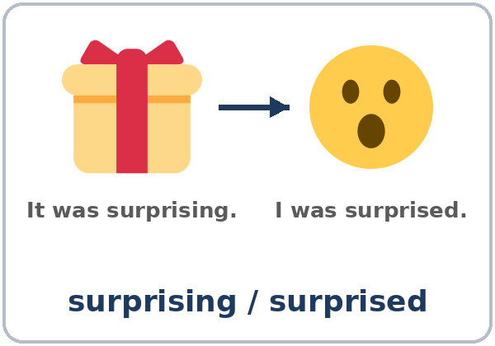


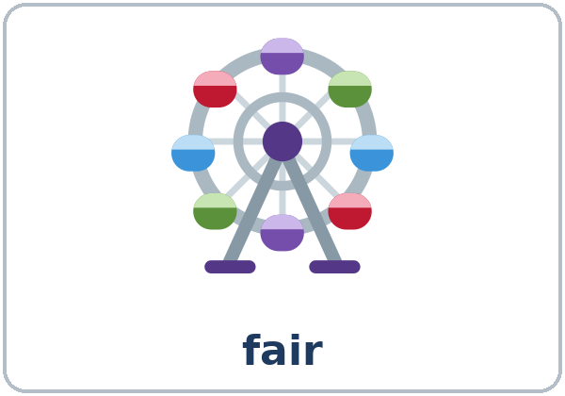
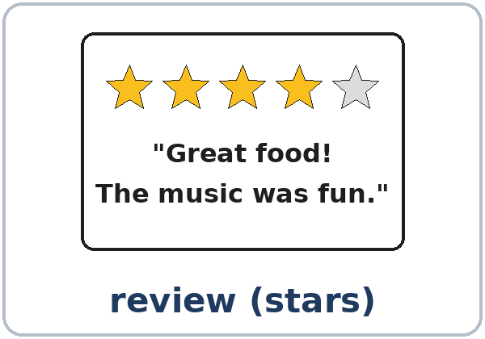
Partner game:
A points. B says.
More New Words
★ surprising / surprised
★ festival
★ concert
★ museum
fair
review (stars)
Notes:
Step 2, continued. Point to each picture and say the word. Learners repeat once.
Partner game (2 min): A points to a picture; B says two sentences (A: points to the beach. B: It was relaxing. I was relaxed.). Switch.
If behind: teach the ★ words only.
Lesson plan: Step 2; New Words page; Partner game.
Pictures: Twemoji graphics by Twitter, Inc. and other contributors (https://github.com/jdecked/twemoji), CC BY 4.0 (https://creativecommons.org/licenses/by/4.0/); resized and combined, with speech bubbles, signs, and labels (images/CREDITS.md).

Slide 7
Check the Meaning
Look at the picture. Answer the question.
1
2
3
A big event in a park with food and music?
You see old pictures and things at a…?
You go to hear music at a…?
a festival
museum
concert
Notes:
Step 2 · Check meaning · 1 min. Whole class.
The answers are hidden. Ask each question and wait for the class to answer. Then click to show the answer. Each click shows one answer, in order: 1, 2, 3.
1. "A big event in a park with food and music is a…?" (festival) • 2. "You see old pictures and things at a…?" (museum) • 3. "You go to hear music at a…?" (concert)
Lesson plan: Step 2: Check meaning.
Pictures: Twemoji graphics by Twitter, Inc. and other contributors (https://github.com/jdecked/twemoji), CC BY 4.0 (https://creativecommons.org/licenses/by/4.0/); resized and combined, with speech bubbles, signs, and labels (images/CREDITS.md).

Slide 8
Before You
Listen for:
Listen
Did they like their weekend events?
It's Monday. Elena and Luis are coworkers. They're talking about the weekend.
How was it? How did they feel?
01
Audio: about 1:17. It plays once.
Narrator
02
Elena
Play 1: Task A
03
Luis
Notes:
Step 3 · 6:18–6:30 · Listening + "Say it" · 12 min (slides 8 to 12). Individuals, then pairs check.
Before you listen (1 min). Say: "It's Monday. Elena and Luis are coworkers. They're talking about the weekend. Did they like their weekend events? Listen."
There are three voices: a Narrator, Elena, and Luis. Each click highlights the next voice.
The audio (L3_L11_listening.mp3, about 1:17) plays the conversation once. Press play again for play 2. A third play is fine if the class needs it.
No speaker? Read the script with a volunteer at a normal, friendly speed.
Audio: synthetic voices, computer-generated (Chatterbox TTS cloned from Kokoro-82M reference clips). No recordings of real people. The names and the story are invented.
Lesson plan: Step 3; Listening script; Listening page.
Picture: Twemoji graphics by Twitter, Inc. and other contributors (https://github.com/jdecked/twemoji), CC BY 4.0 (https://creativecommons.org/licenses/by/4.0/); resized and combined, with speech bubbles, signs, and labels (images/CREDITS.md).

Slide 9
Listen. Did they like it?
Check ✓ a face.
Listening A
Elena: the food festival
😀
😐
Luis: the photo workshop
😀
😐
Notes:
Play 1 → Task A (did they like it?). Pairs compare. Check together.
Click to circle each answer (one click per line): Elena (the food festival) 😀 • Luis (the photo workshop) 😐.
Then read Tasks B and C together (1 min) so learners know what to listen for.
Lesson plan: Step 3; Listening Task A; Answer key.

Slide 10
Listen again. Match.
Write the letter.
Listening B
1
the food festival
c (exciting)
2
Elena at the end
a (tired)
a. tired
b. relaxing
c. exciting
d. bored
e. confusing
3
the photo workshop
e (confusing)
4
Luis at the workshop
d (bored)
5
the museum coffee shop
b (relaxing)
Notes:
Play 2 → Tasks B and C. Pairs compare. Then show the answers.
Click to show each answer (one click per item, 1 to 5): 1 c (exciting) • 2 a (tired) • 3 e (confusing) • 4 d (bored) • 5 b (relaxing).
Lesson plan: Step 3; Listening Task B; Answer key.

Slide 11
Listen again.
Write -ing or -ed.
Listening C
1
It was so excit____.
exciting
2
I was a little tir____ at the end.
tired
3
Oh, nice! Was it interest____?
interesting
Pairs: compare your answers.
Then check together.
4
I thought it was confus____.
confusing
5
Yes, I was bor____, so I left early.
bored
6
But the museum coffee shop was really relax____.
relaxing
Notes:
Task C (play 2). Click to show each answer (one click per item, 1 to 6): 1 exciting, 2 tired, 3 interesting, 4 confusing, 5 bored, 6 relaxing.
If behind: do Task C together on the board, reading the lines yourself.
Lesson plan: Step 3; Listening Task C; Answer key.

Slide 12
Say it: -ed sounds
Say It
The class repeats each line.
relaxed (t) · bored (d)
interested (id)
-ed has 3 sounds.
t · d · id
Say each word two times.
I was bored, so I left early.
Notes:
"Say it" (2 min). Say: "-ed has 3 sounds." Read: relaxed (t), bored (d), interested (id, one more syllable). The class repeats each word twice. Then the line in the box.
-ed sounds: /t/ after x, k, s, sh, ch, p (relaxed); /id/ after t, d (interested, one more syllable); /d/ for the rest (bored, tired, surprised). Don't teach the rule; just model and repeat.
Lesson plan: Step 3: "Say it"; Listening page: Say it; Teacher notes: -ed sounds.

Slide 13
Grammar Box 1
How was it?
the thing: -ing
QUESTION
ANSWER
How was
the concert? / the festival?
It was exciting! / boring.
Was the workshop
interesting?
Yes, it was. / No, it was confusing.
Notes:
Step 4 · 6:30–6:45 · Grammar Q&A · 15 min (slides 13 to 20). Whole class, then pairs. Show the Grammar page. The left side is the question. The right side is the answer.
Show it (2 min): draw on the board: a TV (the thing) → a face (the person). Under the TV write boring, under the face bored. Say: "-ing is the thing. -ed is the person's feeling."
Boxes 1 and 2 (4 min): read a question from the left; the class answers from the right. Point out: It was… + -ing; I was… + -ed. Each click shows the answer side of one row.
Lesson plan: Step 4; Grammar Box 1; Teacher notes: The one rule.
Picture: Twemoji graphics by Twitter, Inc. and other contributors (https://github.com/jdecked/twemoji), CC BY 4.0 (https://creativecommons.org/licenses/by/4.0/); resized and combined, with speech bubbles, signs, and labels (images/CREDITS.md).

Slide 14
Grammar Box 2
How did you feel?
the person: -ed
QUESTION
ANSWER
How did you
feel?
I was excited. / bored.
Were you
interested?
Yes, I was very interested.
Was she
tired?
Yes, she was tired at the end.
Notes:
Box 2: How did you feel? Each click shows the answer side of one row.
Careful: I'm boring means people don't enjoy talking to me. Learners laugh when they hear it; use that.
Lesson plan: Step 4; Grammar Box 2; Teacher notes: Careful.
Picture: Twemoji graphics by Twitter, Inc. and other contributors (https://github.com/jdecked/twemoji), CC BY 4.0 (https://creativecommons.org/licenses/by/4.0/); resized and combined, with speech bubbles, signs, and labels (images/CREDITS.md).

Slide 15
Grammar Box 3
An Opinion + a Reason
QUESTION
ANSWER
What did you think?
I thought it was confusing,
so I left early.
Did you like it?
Yes. I thought it was relaxing,
because the music was soft.
Notes:
Box 3 (2 min): an opinion + a reason: I thought it was confusing, so I left early. Each click shows the answer side of one row.
I thought it was… gives an opinion in the past. Accept I think it was… too.
Lesson plan: Step 4; Grammar Box 3; Teacher notes: I thought it was.
Picture: Twemoji graphics by Twitter, Inc. and other contributors (https://github.com/jdecked/twemoji), CC BY 4.0 (https://creativecommons.org/licenses/by/4.0/); resized and combined, with speech bubbles, signs, and labels (images/CREDITS.md).

Slide 16
Grammar Box 4
-ing or -ed?
THE THING: It was…
THE PERSON: I was…
exciting
excited
boring
bored
interesting
interested
confusing
confused
relaxing
relaxed
tiring
tired
surprising
surprised
Notes:
Box 4 (1 min): the -ing / -ed table; read across. Each click shows one -ed word.
Check questions: "The movie was ___ (bore)." (boring) • "I was very ___ (excite)." (excited) • "Were you ___ (interest)?" (interested) • "I thought it was ___ (confuse)." (confusing)
Lesson plan: Step 4; Grammar Box 4.
Picture: Twemoji graphics by Twitter, Inc. and other contributors (https://github.com/jdecked/twemoji), CC BY 4.0 (https://creativecommons.org/licenses/by/4.0/); resized and combined, with speech bubbles, signs, and labels (images/CREDITS.md).

Slide 17
Practice A: write -ing or -ed.
the thing: -ing · the feeling: -ed
Practice A
1
The class was very bor____. Everyone was sleepy.
boring
2
I was bor____, so I went home.
bored
3
The museum was interest____.
interesting
Write -ing or -ed.
Pairs: check your answers.
4
She was surpris____. It was her birthday party!
surprised
5
Work was tir____ today. I worked 10 hours.
tiring
6
The map was hard. I was confus____.
confused
Notes:
Practice A and B (3 min): learners write, then pairs check. Go over the answers.
Click to show each answer (one click per item, 1 to 6): 1 boring, 2 bored, 3 interesting, 4 surprised, 5 tiring, 6 confused.
Lesson plan: Step 4; Grammar Practice A; Answer key.

Slide 18
Circle the right word.
Practice B
1. The soccer game was ____.
exciting
excited
2. The kids were ____.
exciting
excited
3. Are you ____ in art?
interesting
interested
4. The instructions were ____.
confusing
confused
5. After the beach, I felt ____.
relaxing
relaxed
Notes:
Practice B. Learners circle the right word. Pairs check.
Click to circle each answer (one click per item, 1 to 5): 1 exciting, 2 excited, 3 interested, 4 confusing, 5 relaxed.
Lesson plan: Step 4; Grammar Practice B; Answer key.

Slide 19
Common Mistakes
Don't say
Say
I'm boring. (for a feeling)
I'm bored.
The movie was bored.
The movie was boring.
I was interesting in the museum.
I was interested in the museum.
I thought was confusing.
I thought it was confusing.
Notes:
Common mistakes (never skip this table). Read a line from Don't say. Ask: "What's the right way?" Learners try first. Then click to show the right form. Each click shows one line, in order 1 to 4.
1 and 3: the person's feeling = -ed • 2: the thing = -ing • 4: I thought it was… needs it. Also listen for It was excited.
Say the right form clearly; the learner repeats. Learners can read the Spanish note and the tip on their Grammar page themselves; you don't need to explain them.
Lesson plan: Grammar: Common mistakes; Teacher notes: Typical mistakes.
Picture: Twemoji graphics by Twitter, Inc. and other contributors (https://github.com/jdecked/twemoji), CC BY 4.0 (https://creativecommons.org/licenses/by/4.0/); resized and combined, with speech bubbles, signs, and labels (images/CREDITS.md).

Slide 20
Pair Drill
A asks.
01
A asks. B answers with one -ing and one -ed word.
A: How was your weekend?
B: one -ing, one -ed.
02
B: It was relaxing. I was relaxed.
Then switch roles.
Notes:
Pair drill (last 2 min of Step 4). Pairs.
A asks "How was your weekend?" B answers with one -ing and one -ed word (It was relaxing. I was relaxed.). Switch.
If behind: skip the pair drill. Talk Time practices it.
Lesson plan: Step 4: Pair drill.
Picture: Twemoji graphics by Twitter, Inc. and other contributors (https://github.com/jdecked/twemoji), CC BY 4.0 (https://creativecommons.org/licenses/by/4.0/); resized and combined, with speech bubbles, signs, and labels (images/CREDITS.md).

Slide 21
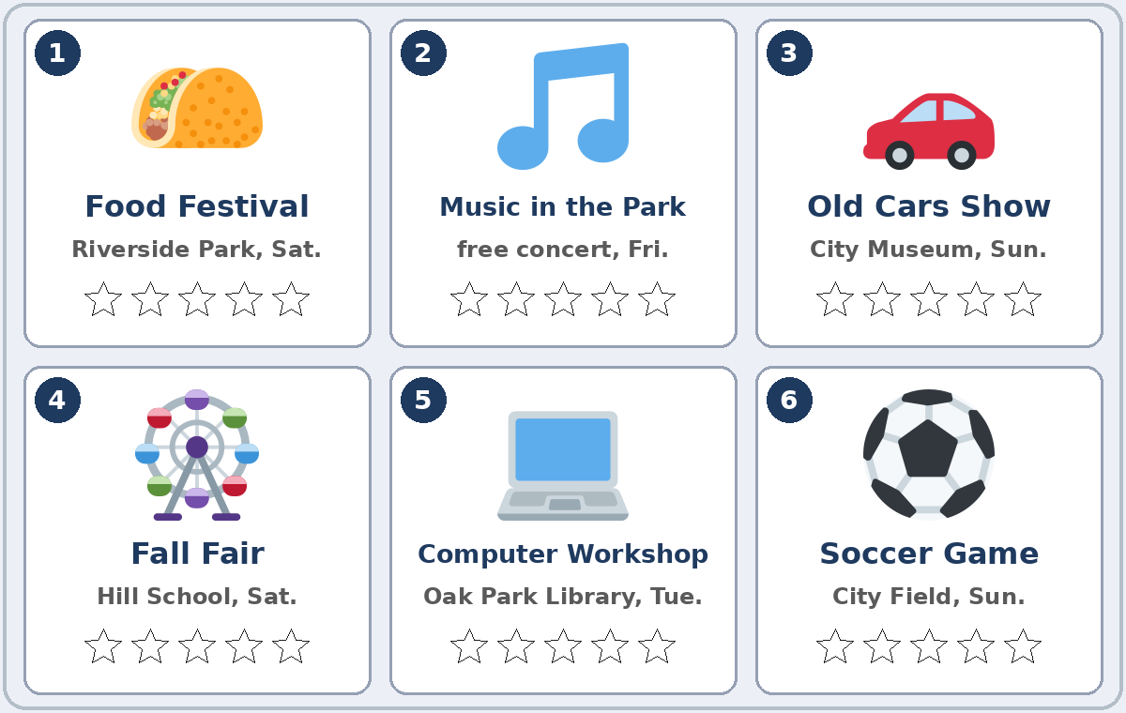
Talk Time
Star Ratings
Round 1: pairs.
An event card or a real event.
7:00–7:12
1
A tells B about an event.
How was it? How did you feel? Why?
2
B asks 2 follow-up questions.
Who did you go with? Was the food good?
3
B gives it 1–5 stars. Switch.
4 stars!
Notes:
Step 5 · 7:00–7:12 · Talk Time: Star Ratings · 12 min.
Round 1 (7 min): each learner chooses an event card (1–6) or a real event (a TV show or a sports game is fine). A tells B about it: how it was, how they felt, and one reason. B asks two follow-up questions and gives it 1–5 stars in the table. Switch. Each click shows the next step.
Model with one learner (1 min): "Last Saturday, I went to the Fall Fair. It was exciting, but the lines were long, so I was tired." The learner asks: "Who did you go with? Was the food good?" → "4 stars!"
General events only (important): use community events, TV, movies, or sports. Learners never have to share where they spend their money or free time; the event cards are always an option.
Lesson plan: Step 5; Talk Time page.
Picture: Twemoji graphics by Twitter, Inc. and other contributors (https://github.com/jdecked/twemoji), CC BY 4.0 (https://creativecommons.org/licenses/by/4.0/); resized and combined, with speech bubbles, signs, and labels (images/CREDITS.md).

Slide 22
Talk Time
The Best Weekend Event
Round 2: groups of 3–4.
Agree on two reasons.
7:00–7:12
1
Choose the best weekend event.
For the class board.
2
Agree on two reasons.
It was exciting, and it was free.
3
One person reports to the class.
Our best event is… because… and…
Notes:
Round 2, groups (4 min): each group chooses "the best weekend event" for the class bulletin board and agrees on two reasons (It was exciting, and it was free.). One person reports to the class. Each click shows the next step.
Mixed levels: stronger learners add a second reason and a recommendation (You should go!). Newer learners use Boxes 1 and 2 as a script.
If behind: Round 1 only.
Lesson plan: Step 5; Talk Time page: Round 2; Teacher notes: Mixed levels.
Picture: Twemoji graphics by Twitter, Inc. and other contributors (https://github.com/jdecked/twemoji), CC BY 4.0 (https://creativecommons.org/licenses/by/4.0/); resized and combined, with speech bubbles, signs, and labels (images/CREDITS.md).

Slide 23
Before You Go 7:12–7:17
01
Exit ticket
02
Homework
Write two sentences:
One with -ing and one with -ed, about the same event.
Add a reason with because or so:
The concert was exciting, so I was excited all night.
Give it to me at the door.
About 15 minutes.
1. Write the sentence with -ing or -ed.
2. An event: 3 sentences.
3. Ask: What was the best event this year?
4. Review: 3 steps for coffee or tea.
Bring it next week!
Notes:
Step 6 · 7:12–7:17 · Exit Ticket + Homework · 5 min · NEVER SKIP.
Exit ticket: each learner writes two sentences on a slip: one with -ing and one with -ed about the same event, and a reason with because or so (The concert was exciting, so I was excited all night.). Collect at the door.
Homework: open the Homework page. Do item 1 together (one sentence on the board). Say: "About 15 minutes. Bring it next week."
Homework items: 1 write the sentence with -ing or -ed • 2 an event, a movie, or a game from this month: 3 sentences (how it was, how you felt, and why) • 3 ask a family member or a coworker: What was the best event or movie this year? Why? • 4 review (Lesson 10): 3 steps for making a cup of coffee or tea with First, Then, Finally.
Read & Write (7:17–7:25, on the Student Pages): three short reviews; questions 1–5; then a 3–4 sentence review with 1–5 stars and one reason. If behind: questions 1–5 only; the review becomes homework.
Lesson plan: Step 6; Homework page; Read & Write step.
Picture: Twemoji graphics by Twitter, Inc. and other contributors (https://github.com/jdecked/twemoji), CC BY 4.0 (https://creativecommons.org/licenses/by/4.0/); resized and combined, with speech bubbles, signs, and labels (images/CREDITS.md).

Slide 24
Progress Check 7:25
D. I can…
😀 🙂 😐
Check one face.
I can say how something was (It was interesting).
I can say how I felt (I was interested).
I can give an opinion with a reason.
I can write a short review.
A. Listen to the teacher. Circle a or b.
Answer
1. a. The concert was not fun. b. The concert was fun.
a
2. a. It was surprising. b. I felt surprised.
b
3. a. I liked the museum. b. I didn't like the museum.
a
4. a. They stayed until the end. b. They left because they were tired.
b
Notes:
Progress Check · 7:25–7:30 · 5 min. Individuals. Open the Progress Check page.
Part A: read each sentence slowly, 2 times. Learners circle a or b. Then click to show the answer (one click per item, 1 to 4).
Say: 1 "The concert was boring." (a) • 2 "I was surprised." (b) • 3 "The museum was interesting." (a) • 4 "We were tired, so we left." (b)
Parts B and C: learners do them alone. Walk around and help with the instructions only. B answers: 1 exciting, 2 bored, 3 confusing, 4 relaxed. C: answers will vary (for example The festival was exciting. I was excited. / I thought it was boring, so I left early.).
Part D: read each "I can…" line aloud and point to the 3 faces: 😀 "I can do it." 🙂 "With a little help." 😐 "Not yet."
Scoring: A /4 + B /4 + C /2 = /10. This is not a test grade. It shows who needs more help hearing the endings (A) and choosing -ing / -ed (B, C).
Collect the pages (or check them at the start of Week 13). If behind: do the Progress Check in Week 13 at 6:00, while learners arrive.
Lesson plan: Progress Check step; Progress Check page; Answer key.

Slide 25
Goodbye! See You Next Week!
Now you can:
• Say how something was (-ing)
• Say how you felt (-ed)
• Give an opinion with a reason
Lesson 11 · Level 3
Notes:
Read the title: "Goodbye! See you next week!" Learners repeat.
Read the three "Now you can" lines. Ask one learner: "How was the class tonight?" and wait for an -ing or -ed answer.
Remind learners: homework is about 15 minutes. Bring it next week.
Lesson plan: At a glance: Objectives; Step 6.
Picture: Twemoji graphics by Twitter, Inc. and other contributors (https://github.com/jdecked/twemoji), CC BY 4.0 (https://creativecommons.org/licenses/by/4.0/); resized and combined, with speech bubbles, signs, and labels (images/CREDITS.md).

Slide 26
Credits
Pictures
Vocabulary pictures use Twemoji graphics by Twitter, Inc. and other contributors (https://github.com/jdecked/twemoji), licensed under CC BY 4.0 (https://creativecommons.org/licenses/by/4.0/). The graphics were resized and combined, and speech bubbles, signs, and labels were added.
The faces on the Progress Check are standard emoji characters shown with the computer's emoji font.
Names and story
Elena and Luis are invented names. The listening story is invented.
Audio and font
Audio: synthetic voices made with Chatterbox TTS (MIT License), cloned from short synthetic reference clips made with Kokoro-82M (Apache License 2.0). No recordings of real people were used. Each file carries an inaudible Perth watermark marking it as AI-generated. Font: Lexend Deca (OFL 1.1).
© 2026 the authors. The authors license this deck under CC BY-NC-SA 4.0.
Notes:
Credits. You don't need to read this slide in class.
Pictures: Twemoji graphics by Twitter, Inc. and other contributors, CC BY 4.0; the file-by-file list is in images/CREDITS.md.
Audio: synthetic voices, computer-generated (Chatterbox TTS cloned from Kokoro-82M reference clips). No recordings of real people. The names and the story are invented.
Course materials: © 2026 the authors, licensed under CC BY-NC-SA 4.0 (https://creativecommons.org/licenses/by-nc-sa/4.0/).
Lesson plan: Picture Credits. Picture list: images/CREDITS.md.

