Slide 1

It Must Be an Ad
Today you will:
• I can say how sure I am with must, might, and can't.
• I can name two clues (author, date, ad, a mismatch).
• I can say what I would do before I believed the page.
Lesson 9 · Level 5
Notes:
Welcome learners as they arrive.
Read the three lines under Today you will.
Lesson plan: Topic; At a glance: Objectives.
Picture: Twemoji graphics by Twitter, Inc. and other contributors (https://github.com/jdecked/twemoji), CC BY 4.0 (https://creativecommons.org/licenses/by/4.0/); resized and combined, with signs and labels (images/CREDITS.md).

Slide 2
Today's
Goals
01
I can say how sure I am with must, might, and can't.
02
I can name two clues (author, date, ad, a mismatch).
03
I can say what I would do before I believed the page.
By the end of class, you can do these things.
04
I can tell a classmate, with a reason.
Notes:
Read each goal slowly. Learners repeat.
Lesson plan: At a glance: Objectives.

Slide 3

OPENING TALK · 6:00
Opening Talk
Work with a partner. A asks Do you
know if…? B keeps statement order and reports one answer. Then compare one homework sentence.
Homework check: read one indirect question
from your email.
Notes:
Step 1 · 6:00–6:06 · Opening Talk.
Work with a partner.
Lesson plan: Step 1; Opening Talk page.
Picture: Twemoji graphics by Twitter, Inc. and other contributors (https://github.com/jdecked/twemoji), CC BY 4.0 (https://creativecommons.org/licenses/by/4.0/); resized and combined, with signs and labels (images/CREDITS.md).

Slide 4
Opening Talk
Cards
01
Ask: Do you know if the office is open?
02
Keep statement order. Not: if is the office open.
Work with a partner. A asks Do you know if…? B
keeps statement order and reports one answer. Then compare one homework sentence.
03
Report the answer: He said… / He told me…
04
Homework check: read one indirect question from your email.
Notes:
Each click shows the next card.
A asks. B answers. Then switch.
Lesson plan: Step 1; Opening Talk page.

Slide 5
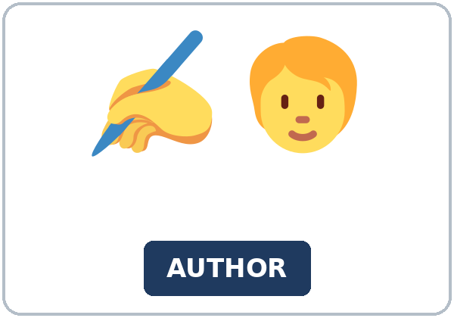
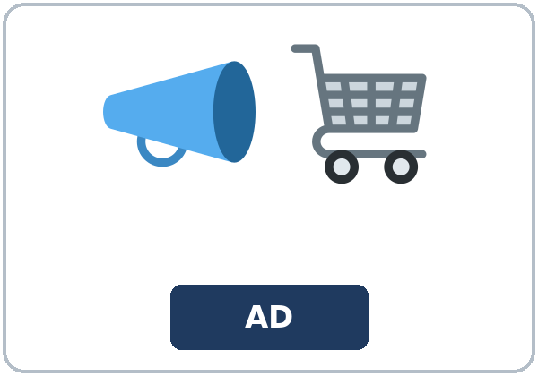
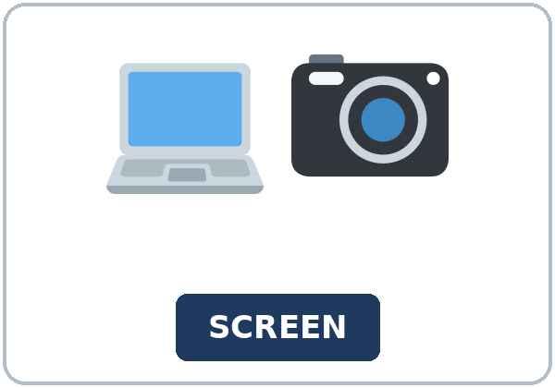
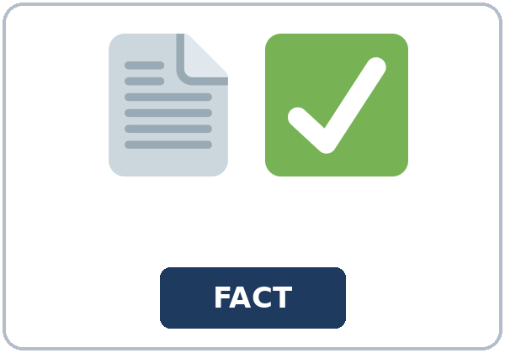
Look. Listen.
Repeat.
New Words
★ website
★ source
★ author
★ advertisement
★ screenshot
★ fact
Notes:
Step 2 · 6:06–6:12 · New Words.
Point to each picture. Learners repeat. ★ = most important.
Lesson plan: Step 2; New Words page.
Pictures: Twemoji graphics by Twitter, Inc. and other contributors (https://github.com/jdecked/twemoji), CC BY 4.0 (https://creativecommons.org/licenses/by/4.0/); resized and combined, with signs and labels (images/CREDITS.md).

Slide 6

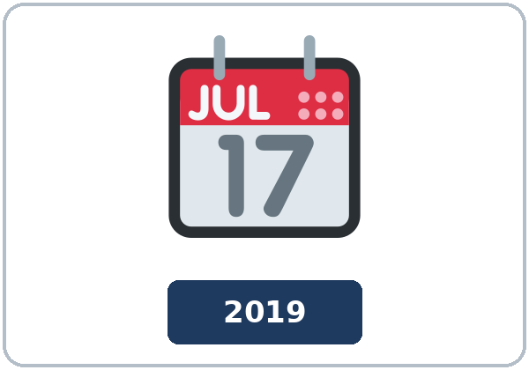
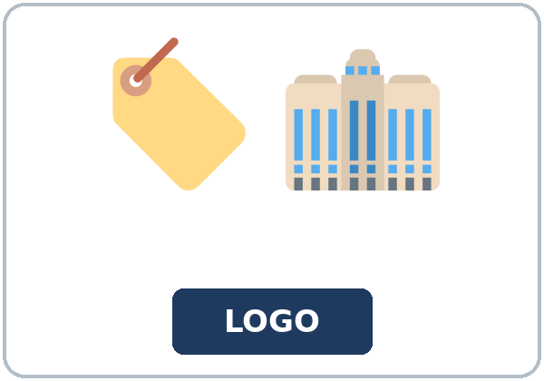

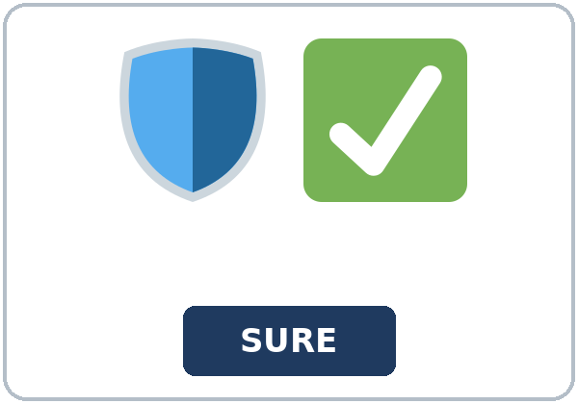

Partner game:
Must, might, or can't?
More New Words
★ rumor
★ date stamp
★ logo
★ comment
reliable
share button
Notes:
A points to a picture. B names it and uses it in one sentence. Then switch.
Lesson plan: Step 2; New Words page; Partner game.
Pictures: Twemoji graphics by Twitter, Inc. and other contributors (https://github.com/jdecked/twemoji), CC BY 4.0 (https://creativecommons.org/licenses/by/4.0/); resized and combined, with signs and labels (images/CREDITS.md).

Slide 7
Check the Meaning
Look at the picture. Answer the question.
1
2
3
A page with Buy now is what?
Who writes a page?
What shows how old a page is?
an ad
the author
the date stamp
Notes:
The answers are hidden. Ask, then click.
1. an ad
2. the author
3. the date stamp
Lesson plan: Step 2: Check the Meaning.
Pictures: Twemoji graphics by Twitter, Inc. and other contributors (https://github.com/jdecked/twemoji), CC BY 4.0 (https://creativecommons.org/licenses/by/4.0/); resized and combined, with signs and labels (images/CREDITS.md).

Slide 8
Before You
Listen for:
Listen
Listen. Is the store closing?
Noah shows Aisha a post.
| 6:12–6:32 | Listening: play 1 (Task A), play 2 (Tasks B and C) +
01
Audio: about 1:50. It plays once.
Narrator
02
Noah
Play 1: Task A
03
Aisha
Notes:
Step 3 · 6:12–6:32 · Listening. Play 1 is Task A. Play 2 is Tasks B and C. A third play is fine.
Noah shows Aisha a post.
The script says going to and want to. Learners only need to recognize gonna and wanna.
Lesson plan: Step 3; Listening page.
Picture: Twemoji graphics by Twitter, Inc. and other contributors (https://github.com/jdecked/twemoji), CC BY 4.0 (https://creativecommons.org/licenses/by/4.0/); resized and combined, with signs and labels (images/CREDITS.md).

Slide 9
Listen. Is the store closing?
Listening A
1.
a. Yes. It closes on Friday
b. No. The store's page says it is open
c. No one can tell
Notes:
Click to circle b.
Lesson plan: Step 3; Listening Task A; Answer key.

Slide 10
B. Listen again. Circle the clue.
Listening B
1. Author on the post
yes
no
2. Date stamp on the post
yes
no
3. Store logo
matches
is different
4. Store's own page
open
closing
5. The share button
he shares it
he does not share it
6. The comment
it is a fact
it is not a fact
Notes:
Click to circle each answer: 1 no • 2 no • 3 matches • 4 open • 5 he does not share it • 6 it is not a fact
Lesson plan: Step 3; Listening Task B; Answer key.

Slide 11
Listen again.
Listen again. Write must, mi
Listening C
1
Then it ______ be old.
might
2
(First guess) It ______ be a rumor.
might
3
The closing post ______ be true.
can't
Write the missing words.
Then check together.
4
(After the store page) It ______ be a rumor.
must
5
That page ______ be the one we trust.
must
6
It ______ be a fact.
can't
Notes:
Click to show each answer: 1 might • 2 might • 3 can't • 4 must • 5 must • 6 can't
Lesson plan: Step 3; Listening Task C; Answer key.

Slide 12
Hear it: gonna and wanna are short forms
Hear It,
Say It
Say it: use the full forms
We want to check a second source first.
I'm going to look for the store's own page.
gonna and wanna are short forms. This listening uses the full forms.
You can say going to and want to.
Say each line two times.
It must be a rumor.
It can't be a fact.
Notes:
gonna and wanna are short forms. This listening uses the full forms. Say each line two times.
Lesson plan: Step 3: Hear it, say it.

Slide 13
Grammar Box 1
must be
CLUE
ANSWER
The page has a Buy now button. What is it?
It must be an ad.
The store's page says the store is open. What is the closing post?
It must be a rumor.
The logo, the author, and the date all match. What is the page?
It must be the store's page.
Notes:
Grammar Box 1: must be. Each click shows the answer side.
Lesson plan: Step 4; Grammar Box 1.
Picture: Twemoji graphics by Twitter, Inc. and other contributors (https://github.com/jdecked/twemoji), CC BY 4.0 (https://creativecommons.org/licenses/by/4.0/); resized and combined, with signs and labels (images/CREDITS.md).

Slide 14
Grammar Box 2
might be
CLUE
ANSWER
The date says 2019. What do you think?
It might be old.
There is no author. What do you think?
It might be a rumor.
The comment has no source. What do you think?
It might be a guess.
Notes:
Grammar Box 2: might be. Each click shows the answer side.
Lesson plan: Step 4; Grammar Box 2.
Picture: Twemoji graphics by Twitter, Inc. and other contributors (https://github.com/jdecked/twemoji), CC BY 4.0 (https://creativecommons.org/licenses/by/4.0/); resized and combined, with signs and labels (images/CREDITS.md).

Slide 15
Grammar Box 3
can't be
CLUE
ANSWER
The logo is different. Is it the city's page?
It can't be the city's page.
The store's page says open. Is the store closing?
It can't be closing.
The first post has no author and no date. Is it a fact?
It can't be a fact.
Notes:
Grammar Box 3: can't be. Each click shows the answer side.
Lesson plan: Step 4; Grammar Box 3.
Picture: Twemoji graphics by Twitter, Inc. and other contributors (https://github.com/jdecked/twemoji), CC BY 4.0 (https://creativecommons.org/licenses/by/4.0/); resized and combined, with signs and labels (images/CREDITS.md).

Slide 16
Grammar Box 4
how sure?
HOW SURE?
SAY
You are almost sure.
must be
You are less sure.
might be
It is not possible.
can't be
Notes:
Grammar Box 4: how sure?. Each click shows the answer side.
Lesson plan: Step 4; Grammar Box 4.
Picture: Twemoji graphics by Twitter, Inc. and other contributors (https://github.com/jdecked/twemoji), CC BY 4.0 (https://creativecommons.org/licenses/by/4.0/); resized and combined, with signs and labels (images/CREDITS.md).

Slide 17
Practice A
Write.
Practice A
1
The page has a Buy now button. It ______ be an ad.
must
2
The date says 2019. It ______ be old.
might
3
The logo is different. It ______ be the city's page.
can't
Write the missing word.
Pairs: check your answers.
4
There is no author. It ______ be a rumor.
might
5
The store's own page says the store is open. The post ______ be true.
can't
6
Aisha is almost sure. She says it ______ be a rumor.
must
Notes:
Click to show each answer: 1 must • 2 might • 3 can't • 4 might • 5 can't • 6 must
Lesson plan: Step 4; Grammar Practice A; Answer key.

Slide 18
Circle the correct words.
Practice B
1. It ______ an ad.
must
must be
2. It ______ the city page.
can be not
can't be
3. The date says 2019. It ______ old.
must be
might be
4. It ______ an ad.
must to be
must be
5. It can't ______ official.
be
to be
6. Can't here means ______ .
not able
not possible
Notes:
Click to circle each answer: 1 must be • 2 can't be • 3 might be • 4 must be • 5 be • 6 not possible
Lesson plan: Step 4; Grammar Practice B; Answer key.

Slide 19
Common Mistakes
Don't say
Say
It must an ad.
It must be an ad.
It can be not the city page.
It can't be the city page.
It must to be an ad.
It must be an ad.
It can't means she is not able.
It can't be means it is not possible.
It must be not official.
It can't be official.
Notes:
Read Don't say, then Say. Learners try first. Then click.
Lesson plan: Grammar: Common mistakes.
Picture: Twemoji graphics by Twitter, Inc. and other contributors (https://github.com/jdecked/twemoji), CC BY 4.0 (https://creativecommons.org/licenses/by/4.0/); resized and combined, with signs and labels (images/CREDITS.md).

Slide 20
Pair Check
A says.
01
Work with a partner.
Use only these pages.
B answers.
02
| Page 1 · City bus notice | Page 2 · Amazing deal | Page 3 · Neighborhood post |
Notes:
Use only these pages. | Page 1 · City bus notice | Page 2 · Amazing deal | Page 3 · Neighborhood post | |---|---|---| | Author: the city bus office. Date: this week. Logo: the city bus logo. The evening bus still stops
Break · 6:45–7:00.
Lesson plan: Step 4: Pair check.
Picture: Twemoji graphics by Twitter, Inc. and other contributors (https://github.com/jdecked/twemoji), CC BY 4.0 (https://creativecommons.org/licenses/by/4.0/); resized and combined, with signs and labels (images/CREDITS.md).

Slide 21
Talk Time
Talk Time
Groups.
Read the three class pages.
7:00–7:18
1
Read the three class pages.
2
Read the three class pages.
3
Read the three class pages.
Notes:
Round 1.
Lesson plan: Step 5; Talk Time.
Picture: Twemoji graphics by Twitter, Inc. and other contributors (https://github.com/jdecked/twemoji), CC BY 4.0 (https://creativecommons.org/licenses/by/4.0/); resized and combined, with signs and labels (images/CREDITS.md).

Slide 22
Talk Time
Talk Time
Groups.
Before you share, name one check.
7:00–7:18
1
Before you share, name one check.
2
Before you share, name one check.
3
Before you share, name one check.
Notes:
Round 2.
Lesson plan: Step 5; Talk Time.
Picture: Twemoji graphics by Twitter, Inc. and other contributors (https://github.com/jdecked/twemoji), CC BY 4.0 (https://creativecommons.org/licenses/by/4.0/); resized and combined, with signs and labels (images/CREDITS.md).

Slide 23
Read.
Answer.
Read &
Write
1
Which page names an author?
The library's page
2
What time is on the library's page?
Thursday at 6:30
Read the page.
Answer the questions.
3
What time is on the repost?
Thursday at 8:00
4
Which page do you trust?
The library's page
5
What is one clue?
The author and the date
Notes:
Step 6 · 7:18–7:25 · Read & Write.
Click to show each answer: 1 The library's page • 2 Thursday at 6:30 • 3 Thursday at 8:00 • 4 The library's page • 5 The author and the date
Lesson plan: Step 6; Read & Write page; Answer key.

Slide 24
Before You Go 7:25–7:30
01
Exit ticket
02
Homework
How can you tell that a page might be wrong?
Name: Date:
Use must, might, or can't.
Give this page to your teacher.
About 20–25 minutes.
1. Write must, might, or can't.
2. Finish your message to a friend (Read & Write C).
3. Tell a friend one clue you would check before you shared a class
4. Review (Do you know if). Finish the question in statement order.
Bring it next week!
Notes:
Step 7 · 7:25–7:30 · Exit ticket and homework. Never skip the exit ticket.
How can you tell that a page might be wrong?
Lesson plan: Step 7; Exit Ticket page; Homework page.
Picture: Twemoji graphics by Twitter, Inc. and other contributors (https://github.com/jdecked/twemoji), CC BY 4.0 (https://creativecommons.org/licenses/by/4.0/); resized and combined, with signs and labels (images/CREDITS.md).

Slide 25
Goodbye! See You Next Week!
Now you can:
• I can say how sure I am with must, might, and can't.
• I can name two clues (author, date, ad, a mismatch).
• I can say what I would do before I believed the page.
Lesson 9 · Level 5
Notes:
Read the three Now you can lines.
Homework is about 20–25 minutes. Bring it next week.
Lesson plan: At a glance: Objectives; Step 7.
Picture: Twemoji graphics by Twitter, Inc. and other contributors (https://github.com/jdecked/twemoji), CC BY 4.0 (https://creativecommons.org/licenses/by/4.0/); resized and combined, with signs and labels (images/CREDITS.md).

Slide 26
Credits
Pictures
Vocabulary pictures use Twemoji graphics by Twitter, Inc. and other contributors (https://github.com/jdecked/twemoji), licensed under CC BY 4.0 (https://creativecommons.org/licenses/by/4.0/). The graphics were resized and combined, and signs and labels were added.
Names and story
Noah and Aisha are invented names. The listening story is invented.
Audio and font
Audio: synthetic voices made with Chatterbox TTS (MIT License), cloned from short synthetic reference clips made with Kokoro-82M (Apache License 2.0). No recordings of real people were used. Each file carries an inaudible Perth watermark marking it as AI-generated. Font: Lexend Deca (OFL 1.1).
© 2026 the authors. The authors license this deck under CC BY-NC-SA 4.0.
Notes:
Credits. You don't need to read this slide in class.
Pictures: Twemoji graphics by Twitter, Inc. and other contributors, CC BY 4.0; the file-by-file list is in images/CREDITS.md.
Audio: synthetic voices, computer-generated (Chatterbox TTS cloned from Kokoro-82M reference clips). No recordings of real people. The names and the story are invented.
Course materials: © 2026 the authors, licensed under CC BY-NC-SA 4.0 (https://creativecommons.org/licenses/by-nc-sa/4.0/).
Lesson plan: Picture Credits. Picture list: images/CREDITS.md.

