Slide 1

How Long Have You Been Working Here?
Today you will:
• I can answer How long have you been…?
• I can also answer with I've worked… for / since
• I can give one example of an accomplishment
Lesson 1 · Level 5
Notes:
Welcome learners as they arrive.
Read the three lines under Today you will.
Lesson plan: Topic; At a glance: Objectives.
Picture: Twemoji graphics by Twitter, Inc. and other contributors (https://github.com/jdecked/twemoji), CC BY 4.0 (https://creativecommons.org/licenses/by/4.0/); resized and combined, with signs and labels (images/CREDITS.md).

Slide 2
Today's
Goals
01
I can answer How long have you been…?
02
I can also answer with I've worked… for / since
03
I can give one example of an accomplishment
By the end of class, you can do these things.
04
I can ask a follow-up question
Notes:
Read each goal slowly. Learners repeat.
Lesson plan: At a glance: Objectives.

Slide 3
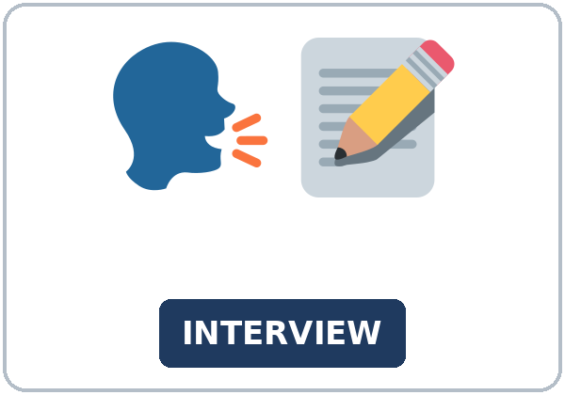
OPENING TALK · 6:00
Opening Talk
Work with a partner. A asks a
question. B answers in a short summary. A asks one follow-up. Then switch.
What have you been doing this week?
Notes:
Step 1 · 6:00–6:06 · Opening Talk.
Work with a partner.
Lesson plan: Step 1; Opening Talk page.
Picture: Twemoji graphics by Twitter, Inc. and other contributors (https://github.com/jdecked/twemoji), CC BY 4.0 (https://creativecommons.org/licenses/by/4.0/); resized and combined, with signs and labels (images/CREDITS.md).

Slide 4
Opening Talk
Cards
01
How long have you lived in this city?
02
How long have you studied English?
Work with a partner. A asks a question. B
answers in a short summary. A asks one follow-up. Then switch.
03
Have you finished a class or a training?
04
What have you been doing this week?
Notes:
Each click shows the next card.
A asks. B answers. Then switch.
Lesson plan: Step 1; Opening Talk page.

Slide 5
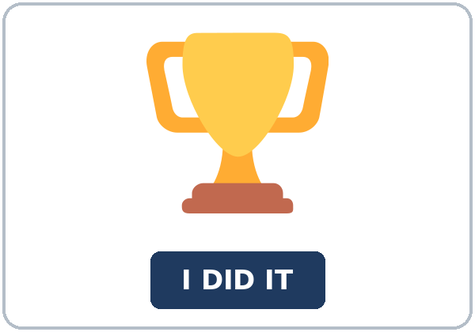
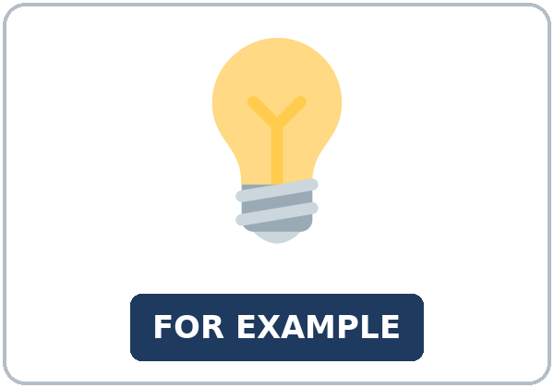
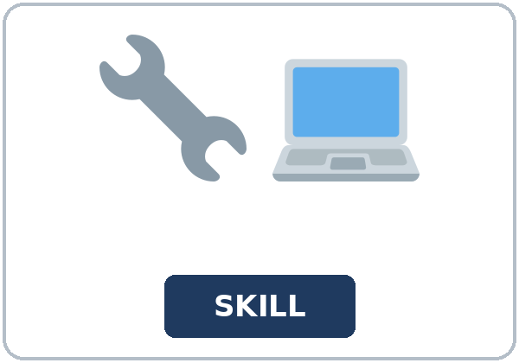

Look. Listen.
Repeat.
New Words
★ résumé
★ interview
★ accomplishment
★ example
★ skill
★ job offer
Notes:
Step 2 · 6:06–6:12 · New Words.
Point to each picture. Learners repeat. ★ = most important.
Lesson plan: Step 2; New Words page.
Pictures: Twemoji graphics by Twitter, Inc. and other contributors (https://github.com/jdecked/twemoji), CC BY 4.0 (https://creativecommons.org/licenses/by/4.0/); resized and combined, with signs and labels (images/CREDITS.md).

Slide 6


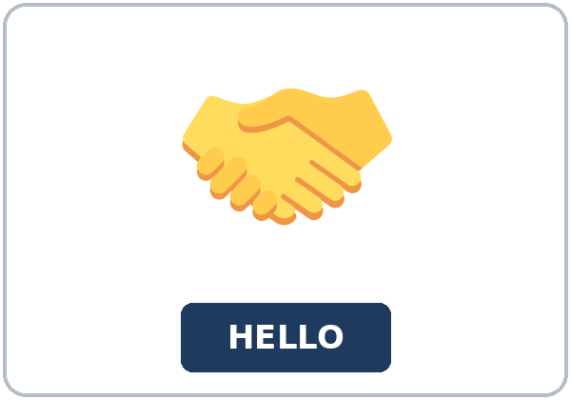


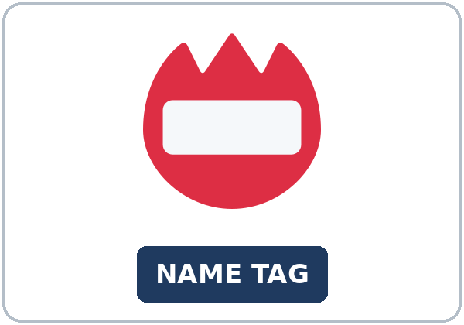
Partner game:
Ask one question
More New Words
★ training
★ portfolio
★ handshake
★ follow-up
qualification
name tag
Notes:
A points to a picture. B names it and uses it in one sentence. Then switch.
Lesson plan: Step 2; New Words page; Partner game.
Pictures: Twemoji graphics by Twitter, Inc. and other contributors (https://github.com/jdecked/twemoji), CC BY 4.0 (https://creativecommons.org/licenses/by/4.0/); resized and combined, with signs and labels (images/CREDITS.md).

Slide 7
Check the Meaning
Look at the picture. Answer the question.
1
2
3
Is a résumé a paper about your work?
Is a handshake a follow-up?
Does a name tag show a skill?
yes, a work paper
no
no, it shows a name
Notes:
The answers are hidden. Ask, then click.
1. yes, a work paper
2. no
3. no, it shows a name
Lesson plan: Step 2: Check the Meaning.
Pictures: Twemoji graphics by Twitter, Inc. and other contributors (https://github.com/jdecked/twemoji), CC BY 4.0 (https://creativecommons.org/licenses/by/4.0/); resized and combined, with signs and labels (images/CREDITS.md).

Slide 8
Before You
Listen for:
Listen
Listen. What job is the practice for?
Nora is practicing for a hotel front-desk job.
| 6:12–6:32 | Listening (play 1 = Task A; play 2 = Tasks B and C) +
01
Audio: about 1:37. It plays once.
Samir
02
Nora
Play 1: Task A
03
Ms. Hale
Notes:
Step 3 · 6:12–6:32 · Listening. Play 1 is Task A. Play 2 is Tasks B and C. A third play is fine.
Nora is practicing for a hotel front-desk job.
The script says going to and want to. Learners only need to recognize gonna and wanna.
Lesson plan: Step 3; Listening page.
Picture: Twemoji graphics by Twitter, Inc. and other contributors (https://github.com/jdecked/twemoji), CC BY 4.0 (https://creativecommons.org/licenses/by/4.0/); resized and combined, with signs and labels (images/CREDITS.md).

Slide 9
Listen. What job is the practice for?
Listening A
1.
a. a bakery job
b. a hotel front-desk job
c. a coach's job
Notes:
Click to circle b.
Lesson plan: Step 3; Listening Task A; Answer key.

Slide 10
B. Listen again. Circle the answers.
Listening B
1. How long with customers?
three years
two years
since September
2. Accomplishment?
trained two new cashiers
finished the training
sent a follow-up
3. Example?
stayed for a week
worked in 2022
a handshake
4. The job in 2022?
the hotel
a bakery
this class
Notes:
Click to circle each answer: 1 three years • 2 trained two new cashiers • 3 stayed for a week • 4 a bakery
Lesson plan: Step 3; Listening Task B; Answer key.

Slide 11
Listen again.
Listen again. Write been wor
Listening C
1
I've ______ with customers for three years.
been working
2
I ______ at a bakery in 2022.
worked
Write the missing words.
Then check together.
3
You said, "I've ______."
been working
4
I ______ at a bakery in 2022. That job is finished.
worked
Notes:
Click to show each answer: 1 been working • 2 worked • 3 been working • 4 worked
Lesson plan: Step 3; Listening Task C; Answer key.

Slide 12
Hear it: gonna and wanna are short forms
Hear It,
Say It
Say it: use the full forms
I want to practice for a front-desk job.
Ms. Hale is going to ask the questions.
gonna and wanna are short forms. This listening uses the full forms.
You can say going to and want to.
Say each line two times.
I've been working with customers.
How long have you been working here?
Notes:
gonna and wanna are short forms. This listening uses the full forms. Say each line two times.
Lesson plan: Step 3: Hear it, say it.

Slide 13
Grammar Box 1
been + -ing (the
QUESTION
ANSWER
How long have you been working here?
I've been working here for two years.
How long have you been working at the hotel?
I've been working there for two years.
How long has she been taking this class?
She's been taking this class since September.
Notes:
Grammar Box 1: been + -ing (the activity, still going on). Each click shows the answer side.
Lesson plan: Step 4; Grammar Box 1.
Picture: Twemoji graphics by Twitter, Inc. and other contributors (https://github.com/jdecked/twemoji), CC BY 4.0 (https://creativecommons.org/licenses/by/4.0/); resized and combined, with signs and labels (images/CREDITS.md).

Slide 14
Grammar Box 2
have + past participle is
QUESTION
ANSWER
How long have you worked here?
I've worked here since 2024.
How long have you worked there?
I've worked there for two years.
Have you finished the training?
Yes, I have.
Notes:
Grammar Box 2: have + past participle is also correct for How long. Each click shows the answer side.
Lesson plan: Step 4; Grammar Box 2.
Picture: Twemoji graphics by Twitter, Inc. and other contributors (https://github.com/jdecked/twemoji), CC BY 4.0 (https://creativecommons.org/licenses/by/4.0/); resized and combined, with signs and labels (images/CREDITS.md).

Slide 15
Grammar Box 3
a finished time needs the
QUESTION
ANSWER
What did you do in your last job?
I helped customers at a store.
Where did you work in 2022?
I worked at a bakery in 2022.
Notes:
Grammar Box 3: a finished time needs the simple past. Each click shows the answer side.
Lesson plan: Step 4; Grammar Box 3.
Picture: Twemoji graphics by Twitter, Inc. and other contributors (https://github.com/jdecked/twemoji), CC BY 4.0 (https://creativecommons.org/licenses/by/4.0/); resized and combined, with signs and labels (images/CREDITS.md).

Slide 16
Grammar Box 4
Which form?
FORM
EXAMPLE
been + -ing
the activity, still going on: I've been working here for two years.
have + past participle
also correct for How long: I've worked here since 2024.
simple past
a finished time (in 2022): I worked at a bakery in 2022.
Notes:
Grammar Box 4: Which form?. Each click shows the answer side.
Lesson plan: Step 4; Grammar Box 4.
Picture: Twemoji graphics by Twitter, Inc. and other contributors (https://github.com/jdecked/twemoji), CC BY 4.0 (https://creativecommons.org/licenses/by/4.0/); resized and combined, with signs and labels (images/CREDITS.md).

Slide 17
Practice A
Write.
Practice A
1
I've been ______ here for two years.
working
2
I've worked here ______ 2024.
since
3
I've worked here ______ two years.
for
Write the missing word.
Pairs: check your answers.
4
I ______ at a bakery in 2022.
worked
5
Have you ______ the training?
finished
6
She's been ______ this class since September.
taking
Notes:
Click to show each answer: 1 working • 2 since • 3 for • 4 worked • 5 finished • 6 taking
Lesson plan: Step 4; Grammar Practice A; Answer key.

Slide 18
Circle the correct words.
Practice B
1. I ______ here since 2024.
am working
've been working
2. I ______ here in 2022.
've been working
worked
3. How long ______ at the hotel?
have you been working
you have been working
4. I've ______ there for two years.
been working
working
5. I've worked there ______ two years.
for
since
6. She's been taking this class ______ September.
since
for
Notes:
Click to circle each answer: 1 've been working • 2 worked • 3 have you been working • 4 been working • 5 for • 6 since
Lesson plan: Step 4; Grammar Practice B; Answer key.

Slide 19
Common Mistakes
Don't say
Say
I am working here since 2024.
I've been working here since 2024. or I've worked here since 2024.
I've been working here in 2022.
I worked here in 2022.
Notes:
Read Don't say, then Say. Learners try first. Then click.
Lesson plan: Grammar: Common mistakes.
Picture: Twemoji graphics by Twitter, Inc. and other contributors (https://github.com/jdecked/twemoji), CC BY 4.0 (https://creativecommons.org/licenses/by/4.0/); resized and combined, with signs and labels (images/CREDITS.md).

Slide 20
Pair Check
A says.
01
Then switch.
A says still true or finished in 2022.
B answers.
02
B makes one sentence (I've been working… or I worked…).
Notes:
A says still true or finished in 2022. B makes one sentence (I've been working… or I worked…). Then switch. ---
Break · 6:45–7:00.
Lesson plan: Step 4: Pair check.
Picture: Twemoji graphics by Twitter, Inc. and other contributors (https://github.com/jdecked/twemoji), CC BY 4.0 (https://creativecommons.org/licenses/by/4.0/); resized and combined, with signs and labels (images/CREDITS.md).

Slide 21
Talk Time
Talk Time
Work together.
A is the interviewer.
7:00–7:18
1
A is the interviewer.
2
How long have you been working at your
job?
3
How long have you been studying English?
Notes:
Round 1.
Lesson plan: Step 5; Talk Time.
Picture: Twemoji graphics by Twitter, Inc. and other contributors (https://github.com/jdecked/twemoji), CC BY 4.0 (https://creativecommons.org/licenses/by/4.0/); resized and combined, with signs and labels (images/CREDITS.md).

Slide 22
Talk Time
Talk Time
Work together.
Kind Feedback.
7:00–7:18
1
Kind Feedback.
2
Kind Feedback.
3
Kind Feedback.
Notes:
Round 2.
Lesson plan: Step 5; Talk Time.
Picture: Twemoji graphics by Twitter, Inc. and other contributors (https://github.com/jdecked/twemoji), CC BY 4.0 (https://creativecommons.org/licenses/by/4.0/); resized and combined, with signs and labels (images/CREDITS.md).

Slide 23
Read.
Answer.
Read &
Write
1
What job is the posting for?
Front desk at Harbor Hotel
2
How long with customers?
For one year or more
Read the page.
Answer the questions.
3
What example do they give?
Stayed for a week
4
A finished job in 2022 uses…?
The simple past
5
What does the coach send after?
A short follow-up note
Notes:
Step 6 · 7:18–7:25 · Read & Write.
Click to show each answer: 1 Front desk at Harbor Hotel • 2 For one year or more • 3 Stayed for a week • 4 The simple past • 5 A short follow-up note
Lesson plan: Step 6; Read & Write page; Answer key.

Slide 24
Before You Go 7:25–7:30
01
Exit ticket
02
Homework
How long have you been studying English (or doing your job)?
Name: Date:
1.
Give this page to your teacher.
About 20–25 minutes.
1. Write the sentence. If the work is still true, been working or
2. Finish your email from Read & Write. Read it one more time.
3. Ask one person: How long have you been…? Write the answer in one
4. Review (for or since).
Bring it next week!
Notes:
Step 7 · 7:25–7:30 · Exit ticket and homework. Never skip the exit ticket.
How long have you been studying English (or doing your job)?
Lesson plan: Step 7; Exit Ticket page; Homework page.
Picture: Twemoji graphics by Twitter, Inc. and other contributors (https://github.com/jdecked/twemoji), CC BY 4.0 (https://creativecommons.org/licenses/by/4.0/); resized and combined, with signs and labels (images/CREDITS.md).

Slide 25
Goodbye! See You Next Week!
Now you can:
• I can answer How long have you been…?
• I can also answer with I've worked… for / since
• I can give one example of an accomplishment
Lesson 1 · Level 5
Notes:
Read the three Now you can lines.
Homework is about 20–25 minutes. Bring it next week.
Lesson plan: At a glance: Objectives; Step 7.
Picture: Twemoji graphics by Twitter, Inc. and other contributors (https://github.com/jdecked/twemoji), CC BY 4.0 (https://creativecommons.org/licenses/by/4.0/); resized and combined, with signs and labels (images/CREDITS.md).

Slide 26
Credits
Pictures
Vocabulary pictures use Twemoji graphics by Twitter, Inc. and other contributors (https://github.com/jdecked/twemoji), licensed under CC BY 4.0 (https://creativecommons.org/licenses/by/4.0/). The graphics were resized and combined, and signs and labels were added.
Names and story
Samir, Nora, and Ms. Hale are invented names. The listening story is invented.
Audio and font
Audio: synthetic voices made with Chatterbox TTS (MIT License), cloned from short synthetic reference clips made with Kokoro-82M (Apache License 2.0). No recordings of real people were used. Each file carries an inaudible Perth watermark marking it as AI-generated. Font: Lexend Deca (OFL 1.1).
© 2026 the authors. The authors license this deck under CC BY-NC-SA 4.0.
Notes:
Credits. You don't need to read this slide in class.
Pictures: Twemoji graphics by Twitter, Inc. and other contributors, CC BY 4.0; the file-by-file list is in images/CREDITS.md.
Audio: synthetic voices, computer-generated (Chatterbox TTS cloned from Kokoro-82M reference clips). No recordings of real people. The names and the story are invented.
Course materials: © 2026 the authors, licensed under CC BY-NC-SA 4.0 (https://creativecommons.org/licenses/by-nc-sa/4.0/).
Lesson plan: Picture Credits. Picture list: images/CREDITS.md.

