Slide 1
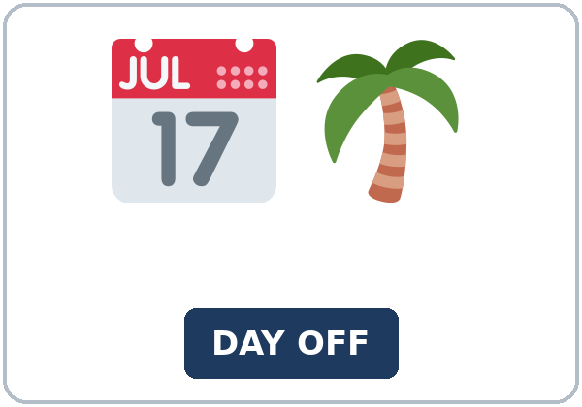
Time Off
Today you will:
• Ask for time off and give a reason
• Say why with to + verb
• Leave a voicemail and take notes
Lesson 11 · Level 4
Notes:
Welcome learners as they arrive.
Point to the title and read it: "Time Off" Say: "Asking for time off at work, planning a short trip to visit family or see a new place, packing, and leaving a detailed voicemail. Learners say why with to + verb and use verbs + to or + -ing. The company, the policy, the trips, and the phone numbers are invented."
Read the three lines under "Today you will".
Trips can be invented: don't assume learners can travel or have paid vacation days. A day trip in the city is always fine.
Lesson plan: Topic; At a glance: Objectives; Teacher notes.
Picture: Twemoji graphics by Twitter, Inc. and other contributors (https://github.com/jdecked/twemoji), CC BY 4.0 (https://creativecommons.org/licenses/by/4.0/); resized and combined, with signs and labels (images/CREDITS.md).

Slide 2
Today's
Goals
01
I can ask for time off and give a reason.
02
I can say why with to + verb (I'm going to Houston to see my sister.).
03
I can use verbs + to (want, need, plan, decide, hope, forget, would like) and verbs + -ing (enjoy, don't mind, finish, avoid, keep).
By the end of class, you can do these five things.
Every goal is a good goal.
04
I can leave a detailed voicemail and take voicemail notes.
05
I can write an email (5–8 sentences) to a supervisor asking for time off.
Notes:
Read each goal slowly. Learners repeat.
Lesson plan: At a glance: Objectives.

Slide 3
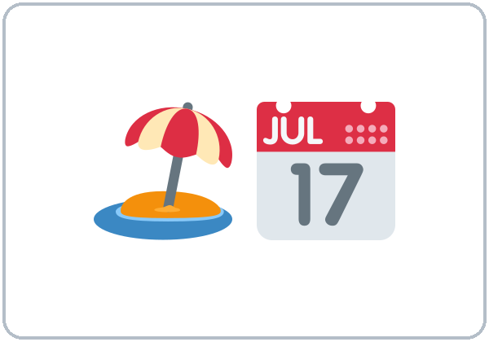
OPENING TALK · 6:00
Opening Talk
A asks a card question.
What do you turn off before you go to bed?
B answers in 3 sentences.
A asks one follow-up.
When?
Then switch.
Notes:
Step 1 · 6:00–6:08 · Opening Talk + Homework Check · 8 min. Pairs (7 pairs + 1 trio with 15 learners; 3–4 pairs with 7–8).
Before class, write on the board: phrasal verbs + it / them
Model with one learner: you say, "What do you turn off before you go to bed?" The learner answers with it / them (I turn the TV off. I turn it off at 10:00.). Then you ask, "What do you put on when it's cold?" Help them say 3 sentences. (Click to show the follow-up.)
Opening Talk (5 min): learners open the Opening Talk page. A asks a card question; B answers in 3 sentences (the answer, a reason, a detail); A asks one follow-up. Switch after each card. The cards are on the next slide.
If behind: one card only.
Lesson plan: Step 1; Opening Talk page.
Picture: Twemoji graphics by Twitter, Inc. and other contributors (https://github.com/jdecked/twemoji), CC BY 4.0 (https://creativecommons.org/licenses/by/4.0/); resized and combined, with signs and labels (images/CREDITS.md).

Slide 4
Opening Talk
Cards
01
What do you turn off before you go to bed?
02
What do you put on when it's cold?
B answers in 3 sentences: the answer, a reason, and a detail.
Follow-ups:
When? Why? Did you turn it off?
03
Did you take out the trash this week?
04
What can you do to save energy at home?
05
Homework check: Lesson 10, items 1 and 3.
Notes:
Step 1, continued. The four cards from the Opening Talk page. Each click shows the next card.
A asks a card question. B answers in 3 sentences. A asks one follow-up question (follow-ups on the right). Then switch.
Homework Check (3 min, last click): Pairs compare Homework item 1 (it / them) and read their 3 home tips (item 3) to each other. Then they fill in the box on the Opening Talk page. Walk around. Write 2 common errors on the board (often turn off it (→ turn it off) and close the light (→ turn off the light)) and correct them together. Also put up 2 corrections from last week's exit tickets.
Lesson plan: Step 1; Opening Talk page: cards, follow-ups; Homework check.

Slide 5

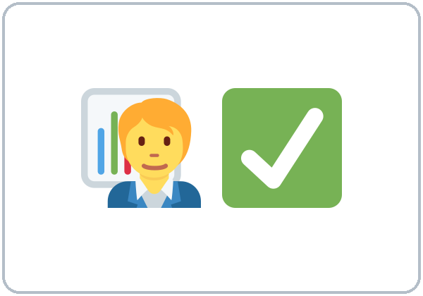
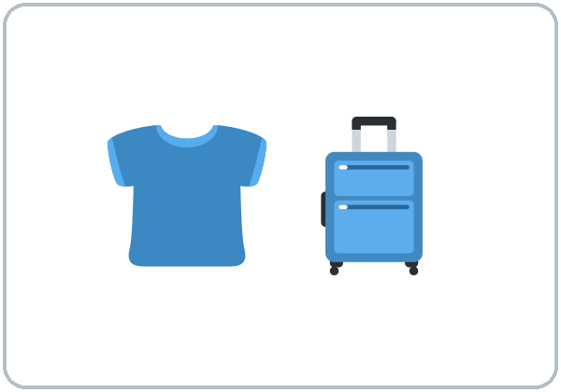

Look. Listen.
Repeat.
New Words
★ time off
★ vacation days
★ request form
★ approve
★ pack
★ suitcase
Notes:
Step 2 · 6:08–6:15 · New Words · 7 min (this slide and the next). Whole class, then pairs.
Point to each picture and say the word. Learners repeat once. ★ = the most important words. Each click shows the next word.
Show the hard words: time off (days you don't work); vacation days (paid days off); request form; approve (say yes); pack (put things in a bag); suitcase; carry-on bag (a small bag on the plane or bus); round-trip ticket (there and back); boarding pass; toiletries (toothbrush, soap); voicemail (a phone message); itinerary (the plan for a trip, with times).
If behind: teach the ★ words only.
Lesson plan: Step 2; Key vocabulary; New Words page.
Pictures: Twemoji graphics by Twitter, Inc. and other contributors (https://github.com/jdecked/twemoji), CC BY 4.0 (https://creativecommons.org/licenses/by/4.0/); resized and combined, with signs and labels (images/CREDITS.md).

Slide 6
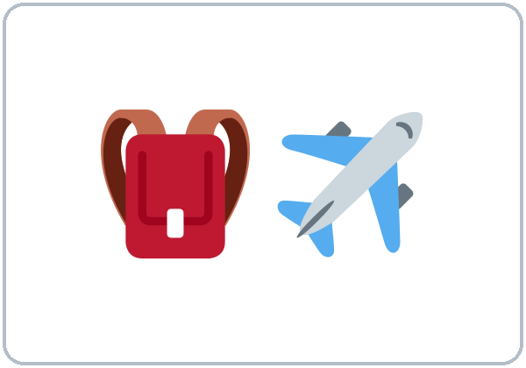
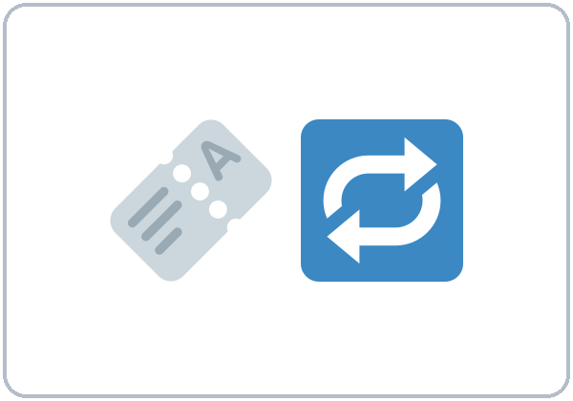
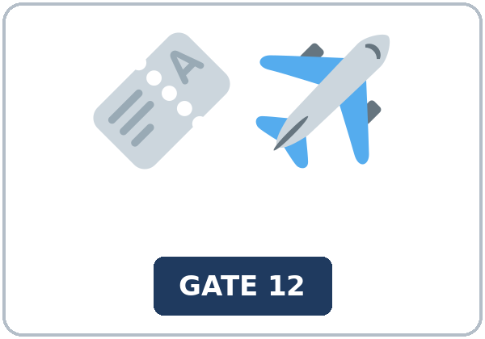
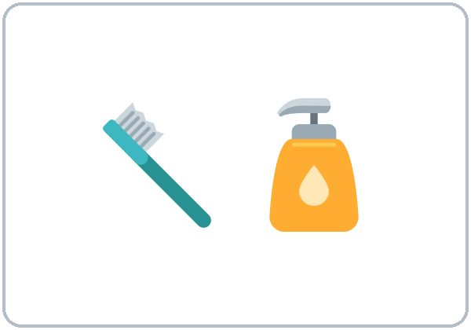
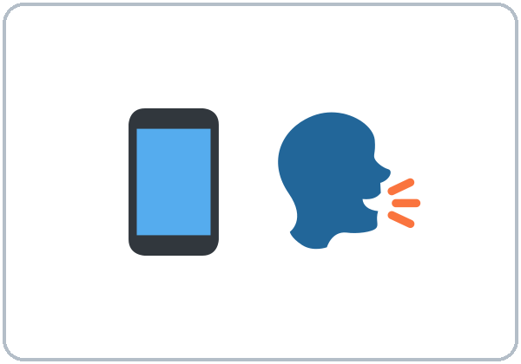

Partner game:
Why do you need it?
More New Words
★ carry-on bag
★ round-trip ticket
★ boarding pass
★ toiletries
★ voicemail
itinerary
Notes:
Step 2, continued. Point to each picture and say the word. Learners repeat once.
Partner game (2 min): A points to a picture and asks, "Why do you need a boarding pass?" B answers with to + verb: "To get on the plane." Then B asks, "What do you enjoy doing on a trip?" Switch. 15 learners: finish with a quick team round (3 teams; you say a clue, the first team with the word gets a point). 7–8: 2 teams. 5 or fewer: one team against the clock.
My Words: "Write any word you want in your language on the My Words page. It's your personal list. It's optional." Learners do it at home.
If behind: teach the ★ words only.
Lesson plan: Step 2; New Words page; Partner game; My Words page.
Pictures: Twemoji graphics by Twitter, Inc. and other contributors (https://github.com/jdecked/twemoji), CC BY 4.0 (https://creativecommons.org/licenses/by/4.0/); resized and combined, with signs and labels (images/CREDITS.md).

Slide 7
Check the Meaning
Look at the picture. Answer the question.
1
2
3
Does a supervisor approve or pack a request?
Is a round-trip ticket for one way or there and back?
Is a toothbrush a toiletry or a boarding pass?
approve
there and back
a toiletry
Notes:
Step 2 · Check meaning · 1 min. Whole class.
The answers are hidden. Ask each question and wait for the class to answer. Then click to show the answer. Each click shows one answer, in order: 1, 2, 3.
1. "Does a supervisor approve or pack a request?" (approve) • 2. "Is a round-trip ticket for one way or there and back?" (there and back) • 3. "Is a toothbrush a toiletry or a boarding pass?" (a toiletry)
Lesson plan: Step 2: Check meaning.
Pictures: Twemoji graphics by Twitter, Inc. and other contributors (https://github.com/jdecked/twemoji), CC BY 4.0 (https://creativecommons.org/licenses/by/4.0/); resized and combined, with signs and labels (images/CREDITS.md).

Slide 8
Before You
Listen for:
Listen
Why does he need time off?
Luis asks his supervisor, Ms. Adams, for time off. Then he leaves a voicemail for his sister, Rosa, and she calls back.
Play 2: Tasks B and C.
01
Audio: about 1:44. It plays once.
Luis
02
Ms. Adams
Play 1: Task A
03
Rosa
Notes:
Step 3 · 6:15–6:30 · Listening + "Hear it, say it" · 15 min (slides 8 to 12). Individuals, then pairs check.
Before you listen (2 min). Say: "Luis asks his supervisor, Ms. Adams, for time off. Then he leaves a voicemail for his sister, Rosa, and she calls back. Listen: why does he need time off?"
There are 3 people: Luis, Ms. Adams and Rosa. A narrator starts and ends the listening. Each click highlights the next person.
The audio (L4_L11_listening.mp3, about 1:44) plays the conversation once. Press play again for play 2. A third play is fine if the class needs it.
No speaker? Read the script with a volunteer at a natural, friendly speed, two times. The script says going to and want to. People often say gonna and wanna; learners only need to recognize those words.
Audio: synthetic voices, computer-generated (Chatterbox TTS cloned from Kokoro-82M reference clips). No recordings of real people. The names and the story are invented.
Lesson plan: Step 3; Listening script; Listening page.
Picture: Twemoji graphics by Twitter, Inc. and other contributors (https://github.com/jdecked/twemoji), CC BY 4.0 (https://creativecommons.org/licenses/by/4.0/); resized and combined, with signs and labels (images/CREDITS.md).

Slide 9
Listen. Why does Luis need time off?
Circle.
Listening A
a. to visit his mother
b. to see a doctor
c. to move to a new apartment
Notes:
Play 1 → Task A (the main idea). Pairs compare. Check together.
Click to circle the answer: a (to visit his mother).
Then read Tasks B and C together (1 min) so learners know what to listen for.
Lesson plan: Step 3; Listening Task A; Answer key.

Slide 10
Listen again.
Complete the notes.
Circle the answer.
Listening B
1. Dates: June
5 to 7
15 to 17
2. Reason: his mother's
birthday
wedding
3. Anna will cover
Thursday and Friday
Saturday
4. For Saturday, Ms. Adams says to ask
Ben
Rosa
5. Bus number:
42
24
6. Arrival time:
6:30 p.m.
7:30 p.m.
Notes:
Play 2 → Tasks B and C. Pairs compare. Then show the answers.
Click to circle each answer (one click per item, 1 to 6): 1 5 to 7 • 2 birthday • 3 Thursday and Friday • 4 Ben • 5 42 • 6 6:30 p.m..
Lesson plan: Step 3; Listening Task B; Answer key.

Slide 11
Listen again.
Write to or the -ing form of the verb.
Listening C
1
I'd like ____ ask for some time off.
to
2
He doesn't mind ____ on weekends.
working
3
I'm calling ____ tell you about my trip.
to
Write to or the -ing form of the verb.
Pairs: compare your answers.
Then check together.
4
don't forget ____ bring Mom's birthday card.
to
5
I want everyone ____ sign it.
to
6
I enjoy ____ surprises!
planning
Notes:
Task C (play 2). Click to show each answer (one click per item, 1 to 6): 1 to, 2 working, 3 to, 4 to, 5 to, 6 planning.
If behind: do Task C together on the board, reading the lines yourself.
Lesson plan: Step 3; Listening Task C; Answer key.

Slide 12
Hear it: gonna = going to, wanna = want to
Hear It,
Say It
Say it: a phone number, in groups
When do you want to take it?
I'm going to take the bus.
gonna = going to, wanna = want to: fine in everyday talk.
Phone numbers: groups with pauses.
Say each line two times.
555 · 214 · 8830
Notes:
"Hear it, say it" (3 min): Point to the script lines. wanna = want to: "When do you want to take it?" gonna = going to: "I'm going to take the bus." Then practice the phone number in groups with pauses: 555 · 214 · 8830. The class repeats the two lines twice.
Reductions: the listening says going to and want to. People often say gonna and wanna. Learners only need to recognize the short forms, and they never write them.
Everyday English: people often say gonna (going to) and wanna (want to). Learners will hear them often. They are fine in casual talk; in writing, at a job interview, or in a formal email, use going to and want to. The listening uses the full forms.
Lesson plan: Step 3: "Hear it, say it"; Listening page: Hear it, say it; Teacher notes.

Slide 13
Grammar Box 1
to + verb answers Why?
QUESTION
ANSWER
Why are you taking time off?
To visit my sister in Houston.
Why are you going to Houston?
I'm going there to see my family.
Why are you calling?
I'm calling to ask about my vacation days.
Notes:
Step 4 · 6:30–6:45 · Grammar Q&A · 15 min (slides 13 to 20). Whole class, then pairs. Show the Grammar page. The left side is the question. The right side is the answer.
Show it (2 min): say, "I'm going to the store." Ask, "Why?" Answer, "To buy milk." Write: Why? → To + verb. Then say, "I enjoy cooking. I want to cook for my family." Write two lists on the board: + to: want, need, plan, decide, hope, forget, would like; + -ing: enjoy, don't mind, finish, avoid, keep.
Box 1: read across: Why are you taking time off? → To visit my sister. Each click shows the answer side of one row.
Lesson plan: Step 4; Grammar Box 1.
Picture: Twemoji graphics by Twitter, Inc. and other contributors (https://github.com/jdecked/twemoji), CC BY 4.0 (https://creativecommons.org/licenses/by/4.0/); resized and combined, with signs and labels (images/CREDITS.md).

Slide 14
Grammar Box 2
verbs + to and verbs + -ing
QUESTION
ANSWER
What do you want to do?
I want to visit the lake.
What do you enjoy doing on a trip?
I enjoy taking pictures.
What did you decide to do?
We decided to take the bus.
Do you mind driving?
No, I don't mind driving. It's fine.
Notes:
Box 2: verbs + to and verbs + -ing. Each click shows the answer side of one row.
Rule of thumb (read it aloud): There is no rule for which verbs take to and which take -ing: learn the two short lists in Box 3. to + verb also answers Why? (To visit my sister.)
Lesson plan: Step 4; Grammar Box 2; Rule of thumb.
Picture: Twemoji graphics by Twitter, Inc. and other contributors (https://github.com/jdecked/twemoji), CC BY 4.0 (https://creativecommons.org/licenses/by/4.0/); resized and combined, with signs and labels (images/CREDITS.md).

Slide 15
Grammar Box 3
the two lists
+ to + verb
+ -ing
want, need, plan, decide
enjoy, don't mind
hope, forget, would like
finish, avoid, keep
I'm planning to leave on Friday.
I enjoy traveling by bus.
Notes:
Box 3: the two lists. Each click shows the answer side of one row.
Lesson plan: Step 4; Grammar Box 3.
Picture: Twemoji graphics by Twitter, Inc. and other contributors (https://github.com/jdecked/twemoji), CC BY 4.0 (https://creativecommons.org/licenses/by/4.0/); resized and combined, with signs and labels (images/CREDITS.md).

Slide 16
Grammar Box 4
review
WORDS
EXAMPLE
already / yet
I've already packed. Have you packed yet?
Would you mind + -ing?
Would you mind covering my shift?
going to
I'm going to leave on Friday.
Notes:
Box 4: review (already, Would you mind…?, going to). Each click shows the answer side of one row.
Questions and answers (2 min): Q: for see or to see? A: Use to: I'm going to Houston to see my sister. (not for see, not for to see) • Q: enjoy to travel or enjoy traveling? A: enjoy traveling. After enjoy, use -ing. • Q: How do I know: to or -ing? A: Look at the two lists in Box 3. Learn them like vocabulary.
Check questions: "for see or to see?" (to see) • "enjoy to travel or enjoy traveling?" (enjoy traveling) • "want to visit or want visiting?" (want to visit).
Lesson plan: Step 4; Grammar Box 4; Questions and answers.
Picture: Twemoji graphics by Twitter, Inc. and other contributors (https://github.com/jdecked/twemoji), CC BY 4.0 (https://creativecommons.org/licenses/by/4.0/); resized and combined, with signs and labels (images/CREDITS.md).

Slide 17
Practice A
Write one word.
Practice A
1
I'm taking a day off ____ see the doctor.
to
2
I enjoy ____ by train. (travel)
traveling
3
We decided ____ stay for 3 days.
to
Write one word.
Pairs: check your answers.
4
Don't forget ____ pack your charger.
to
5
She doesn't mind ____ on Saturday. (work)
working
6
I've ____ filled out the request form.
already
Notes:
Practice A and B (3 min): learners write, then pairs check. Go over the answers.
Click to show each answer (one click per item, 1 to 6): 1 to, 2 traveling, 3 to, 4 to, 5 working, 6 already.
Lesson plan: Step 4; Grammar Practice A; Answer key.

Slide 18
Circle the correct words.
Practice B
1. I'm calling ____ about my vacation days.
to ask
for ask
2. I want ____ my aunt.
to visit
visiting
3. Did you finish ____?
packing
to pack
4. I hope ____ you soon.
to see
seeing
5. Try to avoid ____ too many bags.
taking
to take
6. Would you mind ____ my shift?
covering
to cover
Notes:
Practice B. Learners circle the correct words. Pairs check.
Click to circle each answer (one click per item, 1 to 6): 1 to ask, 2 to visit, 3 packing, 4 to see, 5 taking, 6 covering.
Lesson plan: Step 4; Grammar Practice B; Answer key.

Slide 19
Common Mistakes
Don't say
Say
I went to Houston for see my sister.
I went to Houston to see my sister.
I enjoy to travel.
I enjoy traveling.
I want visit my family.
I want to visit my family.
I'm planning leave on Friday.
I'm planning to leave on Friday.
Don't forget pack your toiletries.
Don't forget to pack your toiletries.
Notes:
Common mistakes. Read the table together: "Don't say… Say…". Read a line from Don't say. Ask: "What's the right way?" Learners try first. Then click to show the right form. Each click shows one line, in order 1 to 5.
Learners can read the contrast tip on their Grammar page on their own; it is optional. You never need to read, translate, or explain it.
Lesson plan: Grammar: Common mistakes; Teacher notes.
Picture: Twemoji graphics by Twitter, Inc. and other contributors (https://github.com/jdecked/twemoji), CC BY 4.0 (https://creativecommons.org/licenses/by/4.0/); resized and combined, with signs and labels (images/CREDITS.md).

Slide 20
Pair Check
A asks.
01
A points to a picture and asks. Then switch.
A: Why do you need a suitcase?
B answers with to + verb.
02
B: To pack my clothes.
What do you enjoy doing on a trip?
Notes:
Pair check (last 3 min of Step 4). Pairs.
A points to a picture and asks, "Why do you need a suitcase?" B answers with to + verb: "To pack my clothes." Then B asks, "What do you enjoy doing on a trip?" Switch. 15 learners: swap partners once. 5 or fewer: you join one pair.
If behind: skip the pair check. Talk Time practices it.
Break · 6:45–7:00 · 15 min. Write on the board: Why are you taking time off? → To visit my sister. • I want to go. I enjoy traveling. • I'm calling to ask about my vacation days.
Lesson plan: Step 4: Pair check; Break.
Picture: Twemoji graphics by Twitter, Inc. and other contributors (https://github.com/jdecked/twemoji), CC BY 4.0 (https://creativecommons.org/licenses/by/4.0/); resized and combined, with signs and labels (images/CREDITS.md).

Slide 21
Talk Time
Trip Planner
Pairs.
Choose a trip card.
7:00–7:15
1
Choose a trip card.
We're going to the lake to relax.
2
Plan the trip together.
I enjoy swimming. Don't forget to pack…
3
Fill in the time-off request.
Name • Dates • Reason (to…) • Who can cover my shift
Notes:
Step 5 · 7:00–7:15 · Talk Time: Trip Planner + Voicemail Relay · 15 min.
Model it first (1 min): read trip card A: "Visit family in another state for 4 days." Say, "I'm going to Dallas to visit my cousins. I want to see the new baby. I enjoy cooking with my aunt." Then model a voicemail: "Hi, it's Ms. Lee. I'm calling to tell you about my trip. I'm leaving on Friday. Call me back at 555 · 301 · 7720."
Round 1 (7 min): Trip Planner (pairs). Pairs choose a trip card. They plan why (to…), what they want to do and enjoy doing, and what to pack. Then they fill in the time-off request. Each click shows the next step.
15 learners: pairs; then back-to-back rows. 7–8 learners: pairs; then one rotation. 5 or fewer: pairs; you check the notes.
Lesson plan: Step 5; Talk Time: Trip Planner.
Picture: Twemoji graphics by Twitter, Inc. and other contributors (https://github.com/jdecked/twemoji), CC BY 4.0 (https://creativecommons.org/licenses/by/4.0/); resized and combined, with signs and labels (images/CREDITS.md).

Slide 22
Talk Time
Voicemail Relay
Sit back to back.
30–45 seconds.
7:00–7:15
1
A leaves a voicemail.
Hi, this is… I'm calling to…
2
B takes notes and reads them back.
So, your name is… and your number is…
3
Then switch.
Could you call me back at…?
Notes:
Round 2 (6 min): Voicemail Relay (back to back). A leaves a voicemail of 30–45 seconds: name, reason for calling (to…), dates, and an invented callback number. B takes notes and reads them back. Switch. Each click shows the next step.
15 learners: pairs; then back-to-back rows. 7–8 learners: pairs; then one rotation. 5 or fewer: pairs; you check the notes.
Every answer needs a reason; every partner asks a follow-up. Walk around and listen. Note 2 good sentences to praise and 1 common error for next week.
If behind: round 1 only.
Lesson plan: Step 5; Talk Time: Voicemail Relay.
Picture: Twemoji graphics by Twitter, Inc. and other contributors (https://github.com/jdecked/twemoji), CC BY 4.0 (https://creativecommons.org/licenses/by/4.0/); resized and combined, with signs and labels (images/CREDITS.md).

Slide 23
Read fast first.
Answer the questions.
Read &
Write
1
How early should you ask for time off?
At least two weeks ahead.
2
Where can you get the form?
From your supervisor or in the break room.
GREENLEAF FOODS · A policy + a packing list (invented)
Pairs: answer together.
3
When will the supervisor answer?
Within three days.
4
How many vacation days do part-time workers get?
5.
5
What is Luis bringing for his mother?
A birthday card.
Notes:
Step 6 · 7:15–7:25 · Read & Write: A time-off policy + a packing list · 10 min. Pairs read, then individual writing.
Read (4 min): Learners read the invented company policy and Luis's packing list on the Read & Write page and answer the questions. Say: "Read fast first. Then find the answers." Pairs answer questions 1–5 together.
Check (1 min): click to show each answer (one click per question, 1 to 5): 1 At least two weeks ahead. • 2 From your supervisor or in the break room. • 3 Within three days. • 4 5. • 5 A birthday card.
Write (5 min): Learners write an email (5–8 sentences) to a supervisor asking for time off: the dates, the reason (to…), who can cover, and thanks. Show the example. Writing check 4: collect this email and write one strength and one fix. Learners start in class and finish at home (Homework item 2).
If behind: questions 1–5 only; the writing becomes homework.
Lesson plan: Step 6; Read & Write page; Answer key.

Slide 24
Before You Go 7:25–7:30
01
Exit ticket
02
Homework
Where would you like to go on a trip, and why?
1. Where and why, with to + verb.
2. Something you enjoy, with enjoy + -ing.
3. One more reason, with because.
Give it to me at the door.
About 15–20 minutes.
1. Write the sentence.
2. Finish your writing from Read & Write C (your email).
3. Plan a short trip (real or invented).
4. Review (Lesson 10).
Bring it next week!
Notes:
Step 7 · 7:25–7:30 · Exit Ticket + Homework · 5 min · NEVER SKIP.
Exit ticket (3 min): learners open the Exit Ticket page and answer in 3 sentences with a reason: Where would you like to go on a trip, and why? Example on the board: I would like to go to the beach to relax. I enjoy swimming in the ocean. It's also a good place for my family, because my kids love the water. With 5 or fewer, a learner can say it to you first and then write it.
Collect the pages. After class, sort them into ✓ / almost / not yet. Start next week with 2 corrections on the board (no names).
Homework (2 min): open the Homework page. Do item 1 together (item 1: I / enjoy / travel / by bus → I enjoy traveling by bus.). Say: "About 15–20 minutes. Finish your Read & Write writing at home."
Homework items: 1. Write the sentence. Use to or -ing. • 2. Finish your writing from Read & Write C (your email). Read it one more time. Check ✓ the list in D. • 3. Plan a short trip (real or invented). Write where, why (to…), and 3 things to pack. • 4. Review (Lesson 10). Write one word.
Writing check 4 (Week 12): collect the time-off email. Write one strength and one fix on each. Learners keep them in their writing folder.
Lesson plan: Step 7; Exit Ticket page; Homework page.
Picture: Twemoji graphics by Twitter, Inc. and other contributors (https://github.com/jdecked/twemoji), CC BY 4.0 (https://creativecommons.org/licenses/by/4.0/); resized and combined, with signs and labels (images/CREDITS.md).

Slide 25
Goodbye! See You Next Week!
Now you can:
• Ask for time off and give a reason
• Say why with to + verb
• Leave a voicemail and take notes
Lesson 11 · Level 4
Notes:
Read the title: "Goodbye! See you next week!" Learners repeat.
Read the three "Now you can" lines.
Lesson plan: At a glance: Objectives; Step 7.
Picture: Twemoji graphics by Twitter, Inc. and other contributors (https://github.com/jdecked/twemoji), CC BY 4.0 (https://creativecommons.org/licenses/by/4.0/); resized and combined, with signs and labels (images/CREDITS.md).

Slide 26
Credits
Pictures
Vocabulary pictures use Twemoji graphics by Twitter, Inc. and other contributors (https://github.com/jdecked/twemoji), licensed under CC BY 4.0 (https://creativecommons.org/licenses/by/4.0/). The graphics were resized and combined, and signs and labels were added.
Names and story
Luis, Ms. Adams, Rosa, Ms. Lee, Ben, and Carla are invented names. The listening story is invented.
Audio and font
Audio: synthetic voices made with Chatterbox TTS (MIT License), cloned from short synthetic reference clips made with Kokoro-82M (Apache License 2.0). No recordings of real people were used. Each file carries an inaudible Perth watermark marking it as AI-generated. Font: Lexend Deca (OFL 1.1).
© 2026 the authors. The authors license this deck under CC BY-NC-SA 4.0.
Notes:
Credits. You don't need to read this slide in class.
Pictures: Twemoji graphics by Twitter, Inc. and other contributors, CC BY 4.0; the file-by-file list is in images/CREDITS.md.
Audio: synthetic voices, computer-generated (Chatterbox TTS cloned from Kokoro-82M reference clips). No recordings of real people. The names and the story are invented.
Course materials: © 2026 the authors, licensed under CC BY-NC-SA 4.0 (https://creativecommons.org/licenses/by-nc-sa/4.0/).
Lesson plan: Picture Credits. Picture list: images/CREDITS.md.

