Slide 1
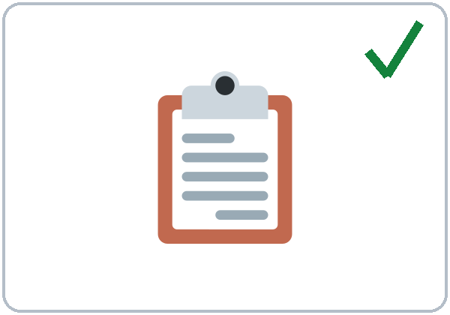
Have You Finished Yet?
Today you will:
• Say what you've already done
• Ask and answer Have you… yet?
• Answer a supervisor's check-in
Lesson 3 · Level 4
Notes:
Welcome learners as they arrive.
Point to the title and read it: "Have you finished yet?" Say: "Tonight we talk about work: what is done, what is not done yet, and a short check-in with a supervisor."
Read the three lines under "Today you will". Give one quick example of each: "I've already clocked in." • "Have you cleaned the break room yet? No, not yet." • "What have you done this week?"
Keep work talk positive and invented. Learners never discuss real problems with real bosses or coworkers. Any job works in the role plays; invented answers are fine.
Lesson plan: Topic; At a glance: Objectives; Teacher notes.
Picture: Twemoji graphics by Twitter, Inc. and other contributors (https://github.com/jdecked/twemoji), CC BY 4.0 (https://creativecommons.org/licenses/by/4.0/); resized and combined, with signs and labels (images/CREDITS.md).

Slide 2
Today's
Goals
01
I can say what I've already done and what I've just done.
02
I can ask Have you… yet? and answer Yes, I've already… / No, not yet.
03
I can put already, just, and yet in the right place.
By the end of class, you can do these five things.
Every goal is a good goal.
04
I can answer a supervisor's check-in questions in 3 sentences.
05
I can write a reply email (5–8 sentences) about what is done and not done yet.
Notes:
Read each goal slowly. Learners repeat.
Goal 1: I've already restocked the shelves. I've just cleaned the board. Goal 2: Have you clocked in yet? Yes, I've already clocked in. / No, not yet. Goal 3: already and just before the past participle; yet at the end.
Goal 4: the Check-in in Talk Time. Goal 5: the reply email in Read & Write (Writing Check 1).
Lesson plan: At a glance: Objectives.

Slide 3
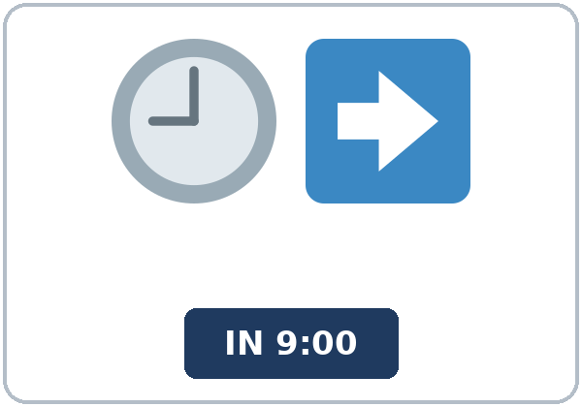
OPENING TALK · 6:00
Opening Talk
A asks a card question.
How long have you lived in this city?
B answers in 3 sentences.
A asks one follow-up.
Where did you live before?
Then switch.
Notes:
Step 1 · 6:00–6:08 · Opening Talk + Homework Check · 8 min. Pairs (7 pairs + 1 trio with 15 learners; 3–4 pairs with 7–8).
Before class, write on the board: How long have you…? and for / since
Model with one learner: you ask, "How long have you lived in this city?" The learner answers with for or since. Then you ask, "Where did you live before? How long did you live there?" Help them say 3 sentences. (Click to show the follow-up.)
Opening Talk (5 min): learners open the Opening Talk page. A asks a card question; B answers in 3 sentences (the answer, a reason, a detail); A asks one follow-up. Switch after each card. The cards are on the next slide.
If behind: one card only.
Lesson plan: Step 1; Opening Talk page.
Picture: Twemoji graphics by Twitter, Inc. and other contributors (https://github.com/jdecked/twemoji), CC BY 4.0 (https://creativecommons.org/licenses/by/4.0/); resized and combined, with signs and labels (images/CREDITS.md).

Slide 4
Opening Talk
Cards
01
How long have you lived in this city?
02
How long have you had your phone?
B answers in 3 sentences: the answer, a reason, and a detail.
Follow-ups:
When did you…? Where did you… before? Why?
03
How long have you known your best friend?
04
How long have you studied English?
05
Homework check: Lesson 2, items 1 and 3.
Notes:
Step 1, continued. The four cards from the Opening Talk page. Each click shows the next card.
A asks a card question. B answers in 3 sentences. A asks one follow-up question (follow-ups on the right). Then switch. Pairs write the partner's name and one How long…? answer (for / since).
Homework Check (3 min, last click): pairs compare Homework item 1 (for / since sentences) and read one answer from item 3 to each other. Then they fill in the box on the Opening Talk page. Walk around. Write 2 common errors on the board (often I live here since 2020 (→ I've lived here since 2020) and since three years (→ for three years)) and correct them together. Also put up 2 corrections from last week's exit tickets.
Lesson plan: Step 1; Opening Talk page: cards, follow-ups; Homework check.

Slide 5
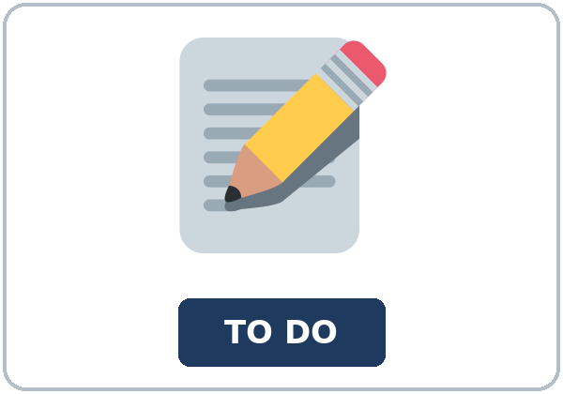
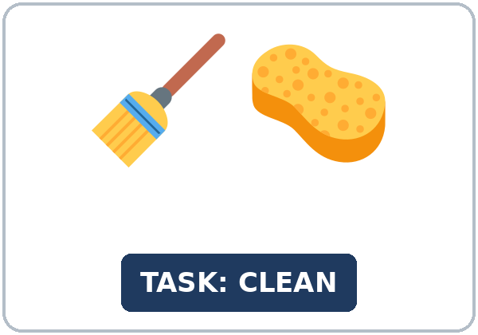
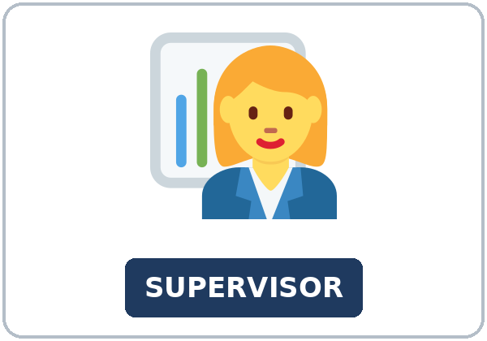
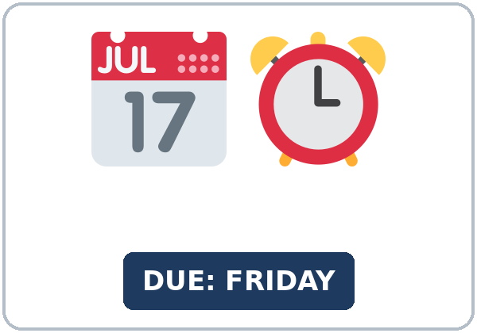
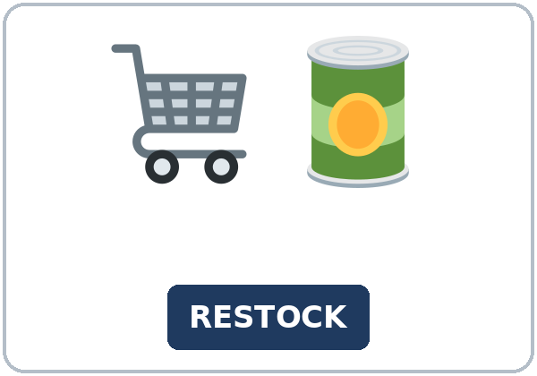
Look. Listen.
Repeat.
New Words
★ to-do list
★ task
★ checklist
★ supervisor
★ deadline
★ restock
Notes:
Step 2 · 6:08–6:15 · New Words · 7 min (this slide and the next). Whole class, then pairs.
Point to each picture and say the word. Learners repeat once. ★ = the most important words. Each click shows the next word.
Show the hard words: to-do list (things to do) vs. checklist (a list with boxes to tick ✓); deadline (the last day); restock (put more on the shelves).
If behind: teach the ★ words only.
Lesson plan: Step 2; Key vocabulary; New Words page.
Pictures: Twemoji graphics by Twitter, Inc. and other contributors (https://github.com/jdecked/twemoji), CC BY 4.0 (https://creativecommons.org/licenses/by/4.0/); resized and combined, with signs and labels (images/CREDITS.md).

Slide 6
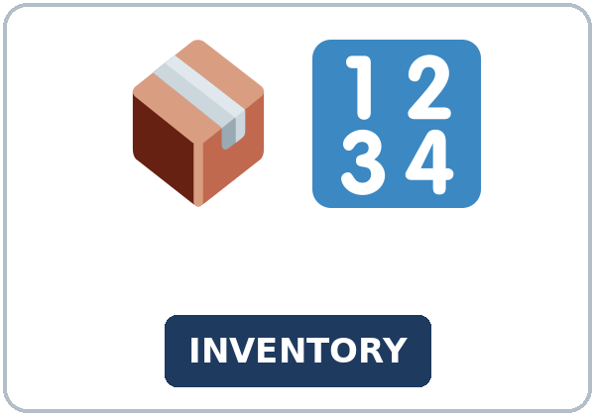
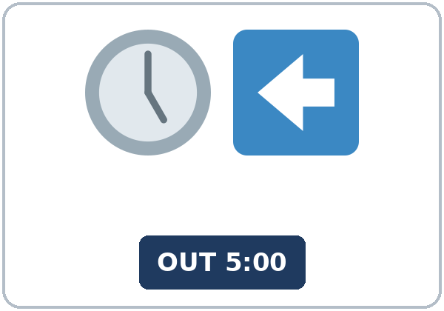
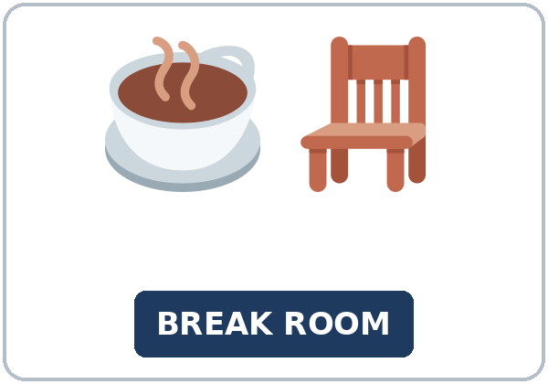
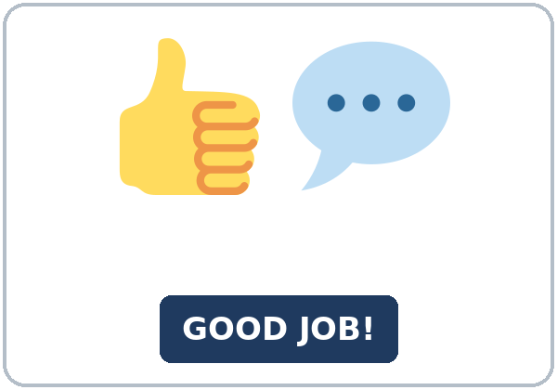
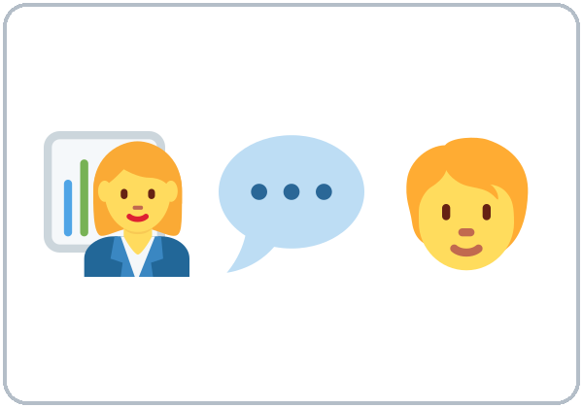
Partner game:
Done or not yet?
More New Words
★ inventory
★ clock in
★ clock out
★ break room
★ feedback
check-in (a short meeting)
Notes:
Step 2, continued. Point to each picture and say the word. Learners repeat once.
Show the hard words: inventory (count what you have); clock in / clock out (start and end work; mime a time clock); feedback (what a supervisor says about your work); check-in (a short meeting).
Partner game (2 min): A points to a picture and asks, "Have you clocked in yet?" B answers, "Yes, I've already clocked in." or "No, not yet." Switch. 15 learners: finish with a quick team round (3 teams; you say a clue, the first team with the word gets a point). 7–8: 2 teams. 5 or fewer: one team against the clock.
My Words: "Write any word you want in your language on the My Words page. It's your personal list. It's optional." Learners do it at home.
If behind: teach the ★ words only.
Lesson plan: Step 2; New Words page; Partner game; My Words page.
Pictures: Twemoji graphics by Twitter, Inc. and other contributors (https://github.com/jdecked/twemoji), CC BY 4.0 (https://creativecommons.org/licenses/by/4.0/); resized and combined, with signs and labels (images/CREDITS.md).

Slide 7
Check the Meaning
Look at the picture. Answer the question.
1
2
3
Is a deadline the first day or the last day?
Do you clock in at the start or the end of your shift?
Is Great job! feedback?
the last day
the start
yes, positive feedback
Notes:
Step 2 · Check meaning · 1 min. Whole class.
The answers are hidden. Ask each question and wait for the class to answer. Then click to show the answer. Each click shows one answer, in order: 1, 2, 3.
1. "Is a deadline the first day or the last day?" (the last day) • 2. "Do you clock in at the start or the end of your shift?" (the start) • 3. "Is Great job! feedback?" (yes, positive feedback)
Lesson plan: Step 2: Check meaning.
Pictures: Twemoji graphics by Twitter, Inc. and other contributors (https://github.com/jdecked/twemoji), CC BY 4.0 (https://creativecommons.org/licenses/by/4.0/); resized and combined, with signs and labels (images/CREDITS.md).

Slide 8
Before You
Listen for:
Listen
Is all the work finished?
It's the end of the evening shift at a grocery store. Ms. Rivera, the night supervisor, checks the work with Jamal and Kim.
Play 2: Tasks B and C.
01
Audio: about 1:59. It plays once.
Ms. Rivera
02
Jamal
Play 1: Task A
03
Kim
Notes:
Step 3 · 6:15–6:30 · Listening + "Hear it, say it" · 15 min (slides 8 to 12). Individuals, then pairs check.
Before you listen (2 min). Say: "It's the end of the evening shift at a grocery store. Ms. Rivera, the supervisor, talks to two workers, Jamal and Kim. Listen: is all the work finished?"
There are three people: Ms. Rivera (the supervisor), Jamal, and Kim. A narrator starts and ends the listening. Each click highlights the next person.
The audio (L4_L3_listening.mp3, about 1:59) plays the conversation once. Press play again for play 2. A third play is fine if the class needs it.
No speaker? Read the script with a volunteer at a natural, friendly speed, two times. The script says going to and want to. People often say gonna and wanna; learners only need to recognize those words.
Audio: synthetic voices, computer-generated (Chatterbox TTS cloned from Kokoro-82M reference clips). No recordings of real people. The names and the story are invented.
Lesson plan: Step 3; Listening script; Listening page.
Picture: Twemoji graphics by Twitter, Inc. and other contributors (https://github.com/jdecked/twemoji), CC BY 4.0 (https://creativecommons.org/licenses/by/4.0/); resized and combined, with signs and labels (images/CREDITS.md).

Slide 9
Listen. Is all the work finished?
Circle.
Listening A
The work:
a. Yes, everything is done.
b. No, two things aren't done yet.
c. No, nothing is done yet.
Notes:
Play 1 → Task A (the main idea). Pairs compare. Check together.
Click to circle the answer: b (No, two things aren't done yet.).
Then read Tasks B and C together (1 min) so learners know what to listen for.
Lesson plan: Step 3; Listening Task A; Answer key.

Slide 10
Listen again. Look at the checklist.
Circle done or not yet.
Listening B
1. restock the shelves
done
not yet
2. put away the milk and the eggs
done
not yet
3. clean the cooler
done
not yet
4. check the bakery inventory
done
not yet
5. clean the break room
done
not yet
6. Kim's safety training
done
not yet
Notes:
Play 2 → Tasks B and C. Pairs compare. Then show the answers.
Click to circle each answer (one click per item, 1 to 6): 1 done, 2 done, 3 not yet, 4 done, 5 not yet, 6 not yet.
Lesson plan: Step 3; Listening Task B; Answer key.

Slide 11
Listen again.
Write already, yet, or just.
Listening C
1
Yes, I've ____ restocked them.
already
2
Has the truck arrived ____?
yet
3
Yes, it's ____ arrived.
just
Words: already, yet, just
Pairs: compare your answers.
Then check together.
4
I haven't cleaned it ____.
yet
5
I've ____ finished it.
just
6
We've ____ put away the milk and the eggs.
already
Notes:
Task C (play 2). Click to show each answer (one click per item, 1 to 6): 1 already, 2 yet, 3 just, 4 yet, 5 just, 6 already.
If behind: do Task C together on the board, reading the lines yourself.
Lesson plan: Step 3; Listening Task C; Answer key.

Slide 12
Hear it: gonna = going to, wanna = want to
Hear It,
Say It
Say it: 's = has, and the stress
I'm going to clean it before I clock out.
I want to finish it this week.
gonna = going to, wanna = want to: fine in everyday talk.
Listen for 's = has.
Say the stress: JUST, alREADY.
It's just arrived. (it has)
I've JUST finished it. • I've alREADY restocked them.
Notes:
"Hear it, say it" (3 min). Point to the script lines. gonna = going to: "I'm going to clean it before I clock out." wanna = want to: "I want to finish it this week." You can say going to and want to.
Then practice hearing 's = has: It's just arrived (= it has just arrived), the weak have in Have you… yet?, and the stress: I've JUST finished it. • I've alREADY restocked them. The class repeats the two lines twice.
's = has: It's just arrived. She's already left. Ask: "is or has?" If a past participle comes next, it is has.
Everyday English: people often say gonna (going to) and wanna (want to). Learners will hear them often. They are fine in casual talk; in writing, at a job interview, or in a formal email, use going to and want to. The listening uses the full forms.
Lesson plan: Step 3: "Hear it, say it"; Listening page: Hear it, say it; Teacher notes.

Slide 13
Grammar Box 1
already / yet / just
QUESTION
ANSWER
Have you cleaned the break room yet?
Yes, I have. I've already cleaned it.
No, not yet. I haven't cleaned it yet.
Has the truck arrived yet?
Yes, it has. It's just arrived.
Have they restocked the shelves yet?
Yes, they have. They've already restocked them.
Has she finished the training yet?
No, she hasn't. She's going to finish it on Friday.
Notes:
Step 4 · 6:30–6:45 · Grammar Q&A · 15 min (slides 13 to 20). Whole class, then pairs. Show the Grammar page. The left side is the question. The right side is the answer.
Show it (2 min): draw a checklist on the board with 5 tasks. Tick two and say, "I've already restocked the shelves. I've already clocked in." Tick one now, in front of the class: "I've just cleaned the board." Point to an empty box: "I haven't checked the inventory yet."
Box 1: read across: Have you cleaned the break room yet? → Yes, I've already cleaned it. / No, not yet. Each click shows the answer side of one row.
Lesson plan: Step 4; Grammar Box 1; Teacher notes: The board checklist.
Picture: Twemoji graphics by Twitter, Inc. and other contributors (https://github.com/jdecked/twemoji), CC BY 4.0 (https://creativecommons.org/licenses/by/4.0/); resized and combined, with signs and labels (images/CREDITS.md).

Slide 14
Grammar Box 2
done → when? (simple past)
QUESTION
ANSWER
Have you finished the orders?
Yes, I have. I've finished them.
When did you finish them?
I finished them at 3:00. / an hour ago.
What have you done this week?
I've checked the inventory, and I've cleaned the cooler.
Notes:
Box 2: add a time → simple past: I finished them at 3:00. Each click shows the answer side of one row.
Rule of thumb (read it aloud): already = done (maybe sooner than expected). yet = in questions and not sentences, at the end. just = a very short time ago. Add a time (at 3:00, yesterday) → simple past.
Lesson plan: Step 4; Grammar Box 2; Rule of thumb.
Picture: Twemoji graphics by Twitter, Inc. and other contributors (https://github.com/jdecked/twemoji), CC BY 4.0 (https://creativecommons.org/licenses/by/4.0/); resized and combined, with signs and labels (images/CREDITS.md).

Slide 15
Grammar Box 3
word place
WORD · WHERE?
EXAMPLE
already: before the past participle
I've already cleaned it.
just: before the past participle
The truck has just arrived.
yet: at the end (questions and not)
Have you finished yet? I haven't finished yet.
it / them: after the verb
the cooler → I've cleaned it.
the shelves → I've restocked them.
Notes:
Box 3: word place: already and just before the past participle; yet at the end. Each click shows the example of one row.
Word place: teach already before the past participle. In speaking, I've cleaned it already is also common; accept it. yet always goes at the end.
Lesson plan: Step 4; Grammar Box 3; Teacher notes: Word place.
Picture: Twemoji graphics by Twitter, Inc. and other contributors (https://github.com/jdecked/twemoji), CC BY 4.0 (https://creativecommons.org/licenses/by/4.0/); resized and combined, with signs and labels (images/CREDITS.md).

Slide 16
Grammar Box 4
Which one?
FORM
WHEN? · EXAMPLE
have / has + past participle
it is done (or not done); no time
I've finished the orders. I haven't called her yet.
simple past
a finished time (at 3:00, yesterday, an hour ago)
I finished the orders at 3:00.
Notes:
Box 4: which one? Each click shows one row.
Questions and answers (2 min): Q: Can I say I've finished it yesterday? A: No. With a finished time, use the simple past: I finished it yesterday. • Q: Where does yet go? A: At the end: Have you clocked out yet? I haven't clocked out yet. • Q: What does It's just arrived mean? A: It's = it has. just = a very short time ago. The truck arrived a minute ago.
Check questions: "I've finished it yesterday. Right or wrong?" (wrong: I finished it yesterday.) • "Where does yet go?" (at the end) • "It's just arrived. It's = it is or it has?" (it has).
Lesson plan: Step 4; Grammar Box 4; Questions and answers.
Picture: Twemoji graphics by Twitter, Inc. and other contributors (https://github.com/jdecked/twemoji), CC BY 4.0 (https://creativecommons.org/licenses/by/4.0/); resized and combined, with signs and labels (images/CREDITS.md).

Slide 17
Practice A
Write already, yet, or just.
Practice A
1
Have you clocked out ____?
yet
2
The truck arrived one minute ago. It has ____ arrived.
just
3
She hasn't restocked the shelves ____.
yet
Words: already, yet, just
Pairs: check your answers.
4
Has the supervisor given you feedback ____?
yet
5
The deadline is Friday, but I've ____ finished the training. It's only Monday!
already
6
I can't talk now. I've ____ clocked in, and I need to start work.
just
Notes:
Practice A and B (3 min): learners write, then pairs check. Go over the answers.
Click to show each answer (one click per item, 1 to 6): 1 yet, 2 just, 3 yet, 4 yet, 5 already, 6 just.
Lesson plan: Step 4; Grammar Practice A; Answer key.

Slide 18
Circle the correct words.
Practice B
1. I ____ cleaned the cooler yet.
haven't
didn't
2. I ____ the inventory at 8:00.
finished
've finished
3. The shelves? Yes, I've restocked ____.
them
it
4. ____ the truck arrived yet?
Has
Have
5. The delivery ____ arrived.
has just
just has
6. When ____?
did you clock in
have you clocked in
Notes:
Practice B. Learners circle the correct words. Pairs check.
Click to circle each answer (one click per item, 1 to 6): 1 haven't, 2 finished, 3 them, 4 Has, 5 has just, 6 did you clock in.
Lesson plan: Step 4; Grammar Practice B; Answer key.

Slide 19
Common Mistakes
Don't say
Say
I've finished it yesterday.
I finished it yesterday.
I didn't finish yet.
I haven't finished yet.
Have you yet finished?
Have you finished yet?
I have already clean it.
I've already cleaned it.
Has arrived the truck?
Has the truck arrived?
Notes:
Common mistakes. Read the table together: "Don't say… Say…". Read a line from Don't say. Ask: "What's the right way?" Learners try first. Then click to show the right form. Each click shows one line, in order 1 to 5.
Learners can read the contrast tip on their Grammar page on their own; it is optional. You never need to read, translate, or explain it.
Lesson plan: Grammar: Common mistakes; Teacher notes.
Picture: Twemoji graphics by Twitter, Inc. and other contributors (https://github.com/jdecked/twemoji), CC BY 4.0 (https://creativecommons.org/licenses/by/4.0/); resized and combined, with signs and labels (images/CREDITS.md).

Slide 20
Pair Check
A asks.
01
A reads a task from the board checklist. Then switch.
A: Have you… yet?
B answers.
02
B: Yes, I've already… / I've just… / No, not yet.
Then switch.
Notes:
Pair check (last 3 min of Step 4). Pairs.
A reads a task from the board checklist and asks Have you… yet? B answers Yes, I've already… / I've just… / No, not yet. Switch. 15 learners: swap partners once. 5 or fewer: you join one pair.
If behind: skip the pair check. Talk Time practices it.
Break · 6:45–7:00 · 15 min.
Lesson plan: Step 4: Pair check; Break.
Picture: Twemoji graphics by Twitter, Inc. and other contributors (https://github.com/jdecked/twemoji), CC BY 4.0 (https://creativecommons.org/licenses/by/4.0/); resized and combined, with signs and labels (images/CREDITS.md).

Slide 21
Talk Time
Shift Handoff
Pairs.
A looks at Card A. B covers it.
7:00–7:15
1
B asks about each task.
Have you restocked aisle 3 yet?
2
A answers.
Yes, I've already restocked it. / No, not yet.
3
B ticks done or not yet. Then switch.
A asks about Card B.
Notes:
Step 5 · 7:00–7:15 · Talk Time: Shift Handoff + Check-in · 15 min.
Model it first (1 min): hold up Card A and ask a learner to ask you, "Have you restocked aisle 3 yet?" Answer, "Yes, I've already restocked it." Then point to a task with no tick: "No, not yet. I'm going to do it before I clock out." Say: "Answer, then add one more sentence."
Round 1 (7 min): Shift Handoff (pairs, information gap). A looks at Card A; B covers it. B asks Have you… yet? about each task and ticks done or not yet in the notes. Then switch: A asks about Card B. Each click shows the next step.
15 learners: pairs for round 1. 7–8 learners: pairs for round 1. 5 or fewer: pairs (or one group of 3) for round 1.
Keep work talk positive and invented. Learners never discuss real problems with real bosses or coworkers. Any job works in the role plays; invented answers are fine.
Lesson plan: Step 5; Talk Time: Shift Handoff; Teacher notes.
Picture: Twemoji graphics by Twitter, Inc. and other contributors (https://github.com/jdecked/twemoji), CC BY 4.0 (https://creativecommons.org/licenses/by/4.0/); resized and combined, with signs and labels (images/CREDITS.md).

Slide 22
Talk Time
Check-in
Groups of 3.
A supervisor, a worker, an observer.
7:00–7:15
1
The supervisor asks the 3 questions.
What have you done this week?
2
The worker answers in 3 sentences.
I've already… I haven't… yet.
3
The observer ticks the words. Then rotate.
already • yet • just • 3 sentences?
Notes:
Round 2 (6 min): Check-in (groups of 3). The supervisor reads the 3 question cards. The worker answers with already and yet (invented answers are fine). The observer ticks each already / yet / just they hear. Rotate roles so everyone is the worker once. Each click shows the next step.
Question cards: 1. What have you done this week? 2. Have you finished the training yet? 3. What's one thing you'd like to learn? Useful (supervisor): Great job! • Thanks for your hard work. • When are you going to finish it? • Let me know if you need help.
Example (worker): "This week I've already restocked the drinks aisle, and I've trained a new coworker. I haven't finished the safety training yet. I'm going to do it on Thursday because the deadline is Friday."
15 learners: 5 groups of 3. 7–8 learners: 2 groups (the group of 4 has two workers). 5 or fewer: you play the supervisor first; then learners take turns.
Every answer needs a reason; every partner asks a follow-up. Walk around and listen. Note 2 good sentences to praise and 1 common error for next week.
If behind: round 1 only.
Lesson plan: Step 5; Talk Time: Check-in.
Picture: Twemoji graphics by Twitter, Inc. and other contributors (https://github.com/jdecked/twemoji), CC BY 4.0 (https://creativecommons.org/licenses/by/4.0/); resized and combined, with signs and labels (images/CREDITS.md).

Slide 23
Read the email.
Answer the questions.
Read &
Write
1
Who is the email to?
The evening team.
2
When should the workers reply?
By Thursday.
An email from Sandra Ortiz
(Supervisor).
Pairs: answer together.
3
What is the deadline for the safety training?
Friday, May 16.
4
Where can workers do the training?
On the computer in the break room.
5
What has just arrived?
The new schedule.
Notes:
Step 6 · 7:15–7:25 · Read & Write: An email from a supervisor + a reply · 10 min. Pairs read, then individual writing.
Read (4 min): learners read the email from Sandra on the Read & Write page and answer the questions. Say: "Read fast first. Then find the answers." Pairs answer questions 1–5 together.
Check (1 min): click to show each answer (one click per question, 1 to 5): 1 The evening team. • 2 By Thursday. • 3 Friday, May 16. • 4 On the computer in the break room. • 5 The new schedule.
Write (5 min): learners write a reply email (5–8 sentences): what they've already done, what they haven't done yet, when they'll finish it, and one question. Show the example. Invented details are fine. This is Writing Check 1: collect it. Learners start in class and finish at home (Homework item 2).
Writing Check 1: collect the reply emails. Write one strength and one fix on each (for example, the place of yet). Return them next week; learners keep them in a folder to see progress. No scores.
If behind: questions 1–5 only; the writing becomes homework.
Lesson plan: Step 6; Read & Write page; Answer key; Teacher notes: Writing Check 1.

Slide 24
Before You Go 7:25–7:30
01
Exit ticket
02
Homework
Answer in 3 sentences:
1. Something you've already done.
2. Something you haven't done yet.
3. A reason, with because.
Give it to me at the door.
About 15–20 minutes.
1. Write the sentence. Use the words.
2. Finish your reply email (Read & Write C).
3. Make a to-do list for this week.
4. Review: it or them.
Bring it next week!
Notes:
Step 7 · 7:25–7:30 · Exit Ticket + Homework · 5 min · NEVER SKIP.
Exit ticket (3 min): learners open the Exit Ticket page and answer in 3 sentences with a reason: What have you done this week, and what haven't you done yet? Example on the board: I've already paid my phone bill. I haven't done my laundry yet. I haven't done it because I worked late every night. With 5 or fewer, a learner can say it to you first and then write it.
Collect the pages. After class, sort them into ✓ / almost / not yet. Start next week with 2 corrections on the board (no names).
Homework (2 min): open the Homework page. Do item 1 together (you / finish / the checklist / yet? → Have you finished the checklist yet?). Say: "About 15–20 minutes. Finish your Read & Write writing at home."
Homework items: 1 write the sentence with the words • 2 finish the reply email from Read & Write C and check it with the list in D • 3 make a to-do list for this week: 3 things you've already done and 2 things you haven't done yet • 4 review (object pronouns): it or them.
Lesson plan: Step 7; Exit Ticket page; Homework page.
Picture: Twemoji graphics by Twitter, Inc. and other contributors (https://github.com/jdecked/twemoji), CC BY 4.0 (https://creativecommons.org/licenses/by/4.0/); resized and combined, with signs and labels (images/CREDITS.md).

Slide 25
Goodbye! See You Next Week!
Now you can:
• Say what you've already done
• Ask and answer Have you… yet?
• Answer a supervisor's check-in
Lesson 3 · Level 4
Notes:
Read the title: "Goodbye! See you next week!" Learners repeat.
Read the three "Now you can" lines. Ask one learner: "Have you finished your homework yet?" and wait for an answer (Yes, I've already… / No, not yet.).
Remind learners: homework, about 15–20 minutes. Bring it next week.
Lesson plan: At a glance: Objectives; Step 7.
Picture: Twemoji graphics by Twitter, Inc. and other contributors (https://github.com/jdecked/twemoji), CC BY 4.0 (https://creativecommons.org/licenses/by/4.0/); resized and combined, with signs and labels (images/CREDITS.md).

Slide 26
Credits
Pictures
Vocabulary pictures use Twemoji graphics by Twitter, Inc. and other contributors (https://github.com/jdecked/twemoji), licensed under CC BY 4.0 (https://creativecommons.org/licenses/by/4.0/). The graphics were resized and combined, and signs and labels were added.
Names and story
Jamal, Kim, Ms. Rivera, Sandra Ortiz, and Leo are invented names. The listening story is invented.
Audio and font
Audio: synthetic voices made with Chatterbox TTS (MIT License), cloned from short synthetic reference clips made with Kokoro-82M (Apache License 2.0). No recordings of real people were used. Each file carries an inaudible Perth watermark marking it as AI-generated. Font: Lexend Deca (OFL 1.1).
© 2026 the authors. The authors license this deck under CC BY-NC-SA 4.0.
Notes:
Credits. You don't need to read this slide in class.
Pictures: Twemoji graphics by Twitter, Inc. and other contributors, CC BY 4.0; the file-by-file list is in images/CREDITS.md.
Audio: synthetic voices, computer-generated (Chatterbox TTS cloned from Kokoro-82M reference clips). No recordings of real people. The names and the story are invented.
Course materials: © 2026 the authors, licensed under CC BY-NC-SA 4.0 (https://creativecommons.org/licenses/by-nc-sa/4.0/).
Lesson plan: Picture Credits. Picture list: images/CREDITS.md.

