Slide 1
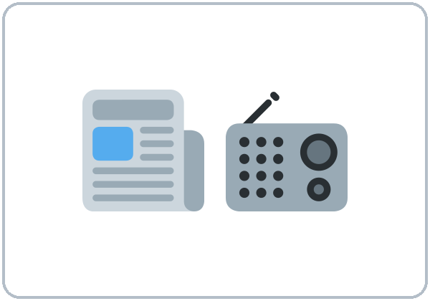
In the News
Today you will:
• Understand a short local news report
• Say what might or may happen
• Ask Do you know where / when / why…?
Lesson 8 · Level 4
Notes:
Welcome learners as they arrive.
Point to the title and read it: "In the News" Say: "Understanding short local news reports and city notices: a road closure, a bus detour, a water pipe repair, a new bus route, a new store. Learners say what might or may happen and ask Do you know where / when / why…?. All stories, streets, and cities are invented and neutral."
Read the three lines under "Today you will".
Class stories only: all news is invented and neutral (roads, buses, a library, a store). No politics, crime, injuries, or real current events. If a learner brings up real news, say, "Let's keep to our class stories."
Lesson plan: Topic; At a glance: Objectives; Teacher notes.
Picture: Twemoji graphics by Twitter, Inc. and other contributors (https://github.com/jdecked/twemoji), CC BY 4.0 (https://creativecommons.org/licenses/by/4.0/); resized and combined, with signs and labels (images/CREDITS.md).

Slide 2
Today's
Goals
01
I can understand the main points of a short local news report.
02
I can say what might or may happen, and what will happen.
03
I can ask Do you know where / when / why…? with statement order.
By the end of class, you can do these five things.
Every goal is a good goal.
04
I can tell a classmate about a local news story.
05
I can write a text or email (5–8 sentences) telling a friend the news.
Notes:
Read each goal slowly. Learners repeat.
Lesson plan: At a glance: Objectives.

Slide 3
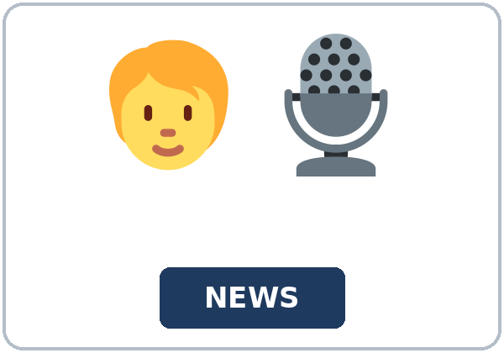
OPENING TALK · 6:00
Opening Talk
A asks a card question.
Is 6:55 early enough for a 7:00 shift?
B answers in 3 sentences.
A asks one follow-up.
Why?
Then switch.
Notes:
Step 1 · 6:00–6:08 · Opening Talk + Homework Check · 8 min. Pairs (7 pairs + 1 trio with 15 learners; 3–4 pairs with 7–8).
Before class, write on the board: too / enough; must / mustn't / don't have to
Model with one learner: you say, "Is 6:55 early enough for a 7:00 shift?" The learner answers with too or enough and a reason. Then you ask, "What must you wear at your job or school?" Help them say 3 sentences. (Click to show the follow-up.)
Opening Talk (5 min): learners open the Opening Talk page. A asks a card question; B answers in 3 sentences (the answer, a reason, a detail); A asks one follow-up. Switch after each card. The cards are on the next slide.
If behind: one card only.
Lesson plan: Step 1; Opening Talk page.
Picture: Twemoji graphics by Twitter, Inc. and other contributors (https://github.com/jdecked/twemoji), CC BY 4.0 (https://creativecommons.org/licenses/by/4.0/); resized and combined, with signs and labels (images/CREDITS.md).

Slide 4
Opening Talk
Cards
01
Is 6:55 early enough for a 7:00 shift?
02
What must you wear at your job or school?
B answers in 3 sentences: the answer, a reason, and a detail.
Follow-ups:
Why? Is it the same in your hometown? What don't you have to do?
03
Are jeans OK for a job interview?
04
What is too expensive in this city?
05
Homework check: Lesson 7, items 1 and 3.
Notes:
Step 1, continued. The four cards from the Opening Talk page. Each click shows the next card.
A asks a card question. B answers in 3 sentences. A asks one follow-up question (follow-ups on the right). Then switch.
Homework Check (3 min, last click): Pairs compare Homework item 1 (too / enough / mustn't) and read their 3 rules (item 3) to each other. Then they fill in the box on the Opening Talk page. Also return the midterm and go over 2 common mistakes. Walk around. Write 2 common errors on the board (often It's enough big (→ It's big enough) and You don't have to smoke here for a rule (→ You mustn't smoke here)) and correct them together. Also put up 2 corrections from last week's exit tickets.
After the midterm: this is Week 9. Return the midterm in the Opening Talk and put 2 common mistakes on the board.
Lesson plan: Step 1; Opening Talk page: cards, follow-ups; Homework check.

Slide 5

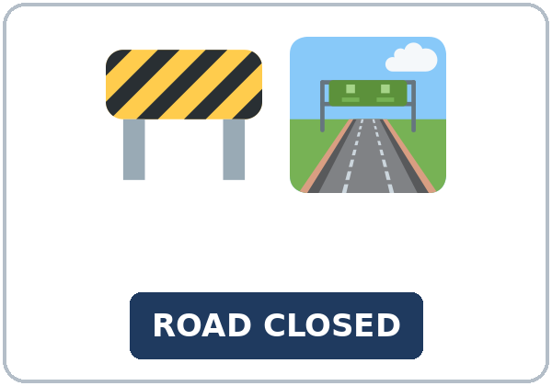
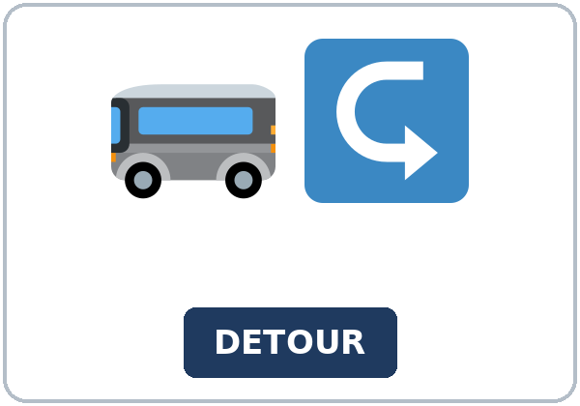
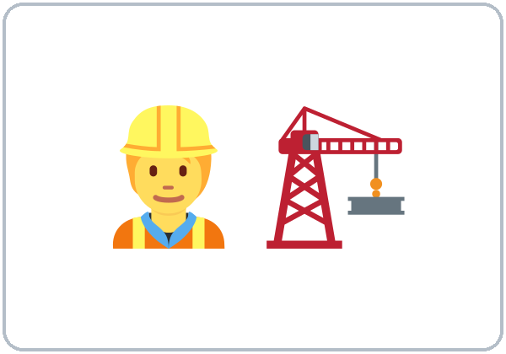
Look. Listen.
Repeat.
New Words
★ news
★ reporter
★ headline
★ road closure
★ detour
★ construction
Notes:
Step 2 · 6:08–6:15 · New Words · 7 min (this slide and the next). Whole class, then pairs.
Point to each picture and say the word. Learners repeat once. ★ = the most important words. Each click shows the next word.
Show the hard words: news, local (in our city); reporter (the person who tells the news); headline (the big words at the top); road closure and detour (draw a street with an X and an arrow around it); construction; water pipe; bus route; delay (the bus is late); announce (say it to everyone); update (new information).
If behind: teach the ★ words only.
Lesson plan: Step 2; Key vocabulary; New Words page.
Pictures: Twemoji graphics by Twitter, Inc. and other contributors (https://github.com/jdecked/twemoji), CC BY 4.0 (https://creativecommons.org/licenses/by/4.0/); resized and combined, with signs and labels (images/CREDITS.md).

Slide 6
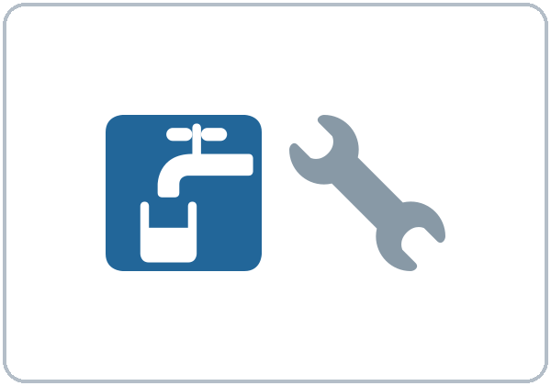
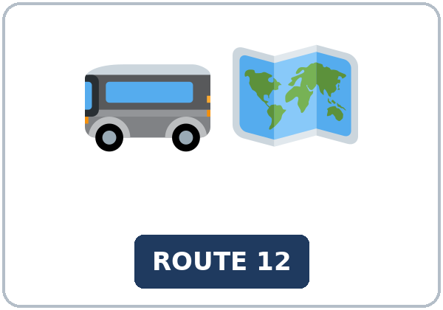
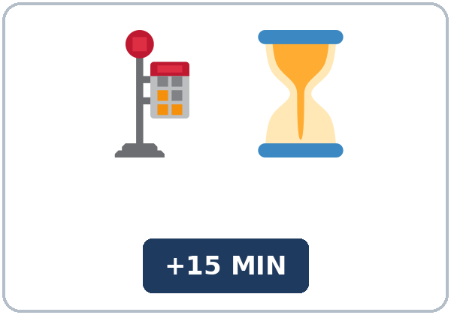
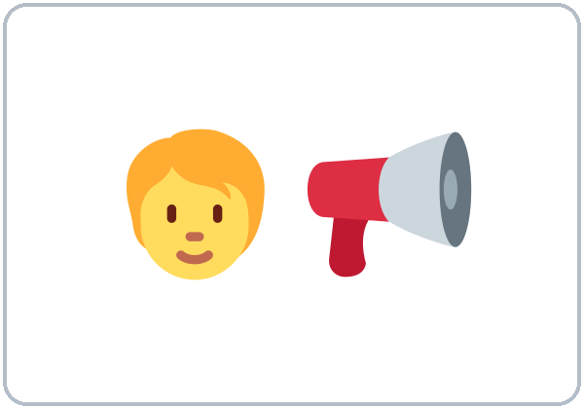
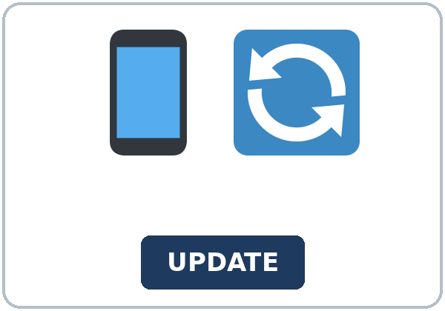
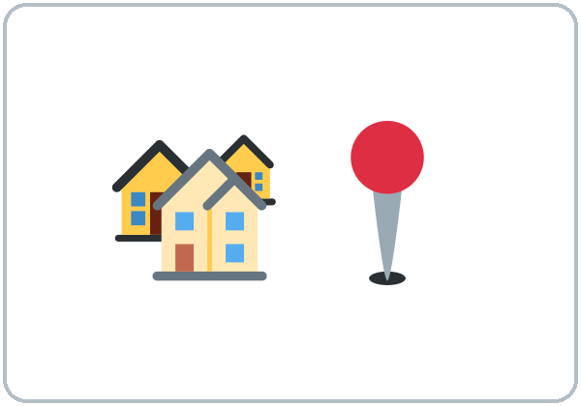
Partner game:
Do you know…?
More New Words
★ water pipe
★ bus route
★ delay
★ announce
★ update
local
Notes:
Step 2, continued. Point to each picture and say the word. Learners repeat once.
Partner game (2 min): A points to a picture and asks, "Do you know when the construction ends?" B answers with a fact or "I'm not sure. It might end in May." Switch. 15 learners: finish with a quick team round (3 teams; you say a clue, the first team with the word gets a point). 7–8: 2 teams. 5 or fewer: one team against the clock.
My Words: "Write any word you want in your language on the My Words page. It's your personal list. It's optional." Learners do it at home.
If behind: teach the ★ words only.
Lesson plan: Step 2; New Words page; Partner game; My Words page.
Pictures: Twemoji graphics by Twitter, Inc. and other contributors (https://github.com/jdecked/twemoji), CC BY 4.0 (https://creativecommons.org/licenses/by/4.0/); resized and combined, with signs and labels (images/CREDITS.md).

Slide 7
Check the Meaning
Look at the picture. Answer the question.
1
2
3
If the road is closed, does the bus take a detour?
Is a headline long or short?
If there is a delay, is the bus early or late?
yes
short
late
Notes:
Step 2 · Check meaning · 1 min. Whole class.
The answers are hidden. Ask each question and wait for the class to answer. Then click to show the answer. Each click shows one answer, in order: 1, 2, 3.
1. "If the road is closed, does the bus take a detour?" (yes) • 2. "Is a headline long or short?" (short) • 3. "If there is a delay, is the bus early or late?" (late)
Lesson plan: Step 2: Check meaning.
Pictures: Twemoji graphics by Twitter, Inc. and other contributors (https://github.com/jdecked/twemoji), CC BY 4.0 (https://creativecommons.org/licenses/by/4.0/); resized and combined, with signs and labels (images/CREDITS.md).

Slide 8
Before You
Listen for:
Listen
What is the news?
First, you'll hear a short local news report on the radio. Then two coworkers, Marco and Joy, talk about the news.
Play 2: Tasks B and C.
01
Audio: about 1:50. It plays once.
Diane Lee
02
Marco
Play 1: Task A
03
Joy
Notes:
Step 3 · 6:15–6:30 · Listening + "Hear it, say it" · 15 min (slides 8 to 12). Individuals, then pairs check.
Before you listen (2 min). Say: "First, you'll hear a short local news report on the radio. Then two coworkers, Marco and Joy, talk about the news. Listen: what is the news?"
There are 3 people: Diane Lee, Marco and Joy. A narrator starts and ends the listening. Each click highlights the next person.
The audio (L4_L8_listening.mp3, about 1:50) plays the conversation once. Press play again for play 2. A third play is fine if the class needs it.
No speaker? Read the script with a volunteer at a natural, friendly speed, two times. The script says going to and want to. People often say gonna and wanna; learners only need to recognize those words.
Audio: synthetic voices, computer-generated (Chatterbox TTS cloned from Kokoro-82M reference clips). No recordings of real people. The names and the story are invented.
Lesson plan: Step 3; Listening script; Listening page.
Picture: Twemoji graphics by Twitter, Inc. and other contributors (https://github.com/jdecked/twemoji), CC BY 4.0 (https://creativecommons.org/licenses/by/4.0/); resized and combined, with signs and labels (images/CREDITS.md).

Slide 9
Listen. What is the news?
Circle.
Listening A
a. Oak Street will close for a water pipe repair.
b. A new grocery store is opening.
c. The bus will be free next week.
Notes:
Play 1 → Task A (the main idea). Pairs compare. Check together.
Click to circle the answer: a (Oak Street will close for a water pipe repair.).
Then read Tasks B and C together (1 min) so learners know what to listen for.
Lesson plan: Step 3; Listening Task A; Answer key.

Slide 10
Listen again.
Complete the notes.
Circle the answer.
Listening B
1. Where: Oak Street, between First and ____ Avenue
Fifth
Ninth
2. When: starting
Monday
Friday
3. Why: workers will replace an old
water pipe
bus stop
4. How long: maybe
two weeks
two days
5. The bus detour: on
Pine Street
Main Street
6. Delays: about ____ minutes
fifteen
fifty
Notes:
Play 2 → Tasks B and C. Pairs compare. Then show the answers.
Click to circle each answer (one click per item, 1 to 6): 1 Fifth • 2 Monday • 3 water pipe • 4 two weeks • 5 Pine Street • 6 fifteen.
Lesson plan: Step 3; Listening Task B; Answer key.

Slide 11
Listen again.
Write the missing word: might, will, or a question word.
Listening C
1
The city says the construction ____ take two weeks.
might
2
The city ____ post updates on its website.
will
3
Do you know ____ the bus leaves Pine Street?
when
Write the missing word: might, will, or a question word.
Pairs: compare your answers.
Then check together.
4
Do you know ____ long the closure is?
how
5
But it ____ take longer if it rains.
might
6
Do you know ____ the detour starts?
where
Notes:
Task C (play 2). Click to show each answer (one click per item, 1 to 6): 1 might, 2 will, 3 when, 4 how, 5 might, 6 where.
If behind: do Task C together on the board, reading the lines yourself.
Lesson plan: Step 3; Listening Task C; Answer key.

Slide 12
Hear it: gonna = going to
Hear It,
Say It
Say it: might, and Do you know…?
The bus is going to take a detour.
I'm going to look at the map tonight.
gonna = going to, wanna = want to: fine in everyday talk.
In might, the last t is very short.
Say each line two times.
It migh' be late.
Do you know…?
Notes:
"Hear it, say it" (3 min): Point to the script lines. gonna = going to: "The bus is going to take a detour." Then practice might (the last t is very short: It migh' be late) and Do you know…? with the voice going up at the end. Listen to the reporter's pauses. The class repeats the two lines twice.
Reductions: the listening says going to. People often say gonna. Learners only need to recognize it.
Everyday English: people often say gonna (going to) and wanna (want to). Learners will hear them often. They are fine in casual talk; in writing, at a job interview, or in a formal email, use going to and want to. The listening uses the full forms.
Lesson plan: Step 3: "Hear it, say it"; Listening page: Hear it, say it; Teacher notes.

Slide 13
Grammar Box 1
might / may / could (maybe)
QUESTION
ANSWER
Will the road be closed tomorrow?
It might be. I'm not sure.
Will the repair take two weeks?
It may take longer. It depends on the rain.
When will the road open?
I'm not sure. It could open next week.
Will the bus be on time?
It might not be. It might be 15 minutes late.
Notes:
Step 4 · 6:30–6:45 · Grammar Q&A · 15 min (slides 13 to 20). Whole class, then pairs. Show the Grammar page. The left side is the question. The right side is the answer.
Show it (2 min): draw a cloud. Say, "Will it rain tomorrow? I'm not sure. It might rain. It may rain." Draw a sign ROAD CLOSED MONDAY: "The road will close on Monday. I'm sure." Then ask a learner, "Do you know where the library is?" Write it and underline the library is: "Statement order."
Box 1: read across: Will the road be closed tomorrow? → It might be. / It may be closed until Friday. Each click shows the answer side of one row.
Lesson plan: Step 4; Grammar Box 1.
Picture: Twemoji graphics by Twitter, Inc. and other contributors (https://github.com/jdecked/twemoji), CC BY 4.0 (https://creativecommons.org/licenses/by/4.0/); resized and combined, with signs and labels (images/CREDITS.md).

Slide 14
Grammar Box 2
Do you know where…? (a first look)
QUESTION
ANSWER
Do you know where the meeting is?
Yes, it's at the library.
Do you know when the new bus route starts?
I think it starts in May.
Do you know what time the store opens?
I'm not sure. It might open at 8:00.
Do you know why the street is closed?
Yes. Workers are fixing a water pipe.
Notes:
Box 2: Do you know where / when / what time / why…? Each click shows the answer side of one row.
Rule of thumb (read it aloud): might / may / could + base verb: never to, never -s (It might rain). After Do you know where / when / why, use statement order: where the meeting is (not where is the meeting).
Lesson plan: Step 4; Grammar Box 2; Rule of thumb.
Picture: Twemoji graphics by Twitter, Inc. and other contributors (https://github.com/jdecked/twemoji), CC BY 4.0 (https://creativecommons.org/licenses/by/4.0/); resized and combined, with signs and labels (images/CREDITS.md).

Slide 15
Grammar Box 3
will (sure) or might (maybe)?
SAY
HOW SURE? · EXAMPLE
will
sure
The road will close at 8:00 on Monday.
will probably
almost sure
It will probably take two weeks.
might / may / could
maybe
It might open early.
might not / may not
maybe not
The bus might not be on time.
Notes:
Box 3: will (sure) vs. might (maybe). Each click shows the answer side of one row.
Lesson plan: Step 4; Grammar Box 3.
Picture: Twemoji graphics by Twitter, Inc. and other contributors (https://github.com/jdecked/twemoji), CC BY 4.0 (https://creativecommons.org/licenses/by/4.0/); resized and combined, with signs and labels (images/CREDITS.md).

Slide 16
Grammar Box 4
from a question to Do you know…?
QUESTION
DO YOU KNOW…?
Where is the meeting?
Do you know where the meeting is?
When does the bus leave?
Do you know when the bus leaves? (no does; add -s)
Why is the street closed?
Do you know why the street is closed?
Notes:
Box 4: from a question to Do you know…? Each click shows the answer side of one row.
Questions and answers (2 min): Q: It might rains or It might rain? A: might + base verb: It might rain. Never -s, never to. • Q: Can I say Do you know where is the meeting? A: Use statement order: Do you know where the meeting is? • Q: will or might? A: will = I'm sure. might = maybe. The road will close on Monday. It might open early.
Check questions: "It might rains or It might rain?" (might rain) • "Do you know where is the bank or where the bank is?" (where the bank is) • "The sign says Closed Monday. will or might?" (will).
Lesson plan: Step 4; Grammar Box 4; Questions and answers.
Picture: Twemoji graphics by Twitter, Inc. and other contributors (https://github.com/jdecked/twemoji), CC BY 4.0 (https://creativecommons.org/licenses/by/4.0/); resized and combined, with signs and labels (images/CREDITS.md).

Slide 17
Practice A
Write the correct word or form.
Practice A
1
It's very cloudy. It ____ rain later. (might / will)
might
2
The sign says the road ____ close at 8:00 on Monday. (might / will)
will
3
The store might ____ next month. (open)
open
Write the correct word or form.
Pairs: check your answers.
4
Do you know where the library ____? (be)
is
5
Do you know when the bus ____? (leave)
leaves
6
I'm not sure. The bus may ____ late. (be)
be
Notes:
Practice A and B (3 min): learners write, then pairs check. Go over the answers.
Click to show each answer (one click per item, 1 to 6): 1 might, 2 will, 3 open, 4 is, 5 leaves, 6 be.
Lesson plan: Step 4; Grammar Practice A; Answer key.

Slide 18
Circle the correct words.
Practice B
1. The repair might ____ two weeks.
take
to take
2. Do you know ____?
where the meeting is
where is the meeting
3. It ____ rain tomorrow.
might not
doesn't might
4. Do you know what time the store ____?
opens
does open
5. The schedule says the bus ____ leave at 7:05. (sure)
will
might
6. I'm not sure. It ____ open in June. (maybe)
may
will
Notes:
Practice B. Learners circle the correct words. Pairs check.
Click to circle each answer (one click per item, 1 to 6): 1 take, 2 where the meeting is, 3 might not, 4 opens, 5 will, 6 may.
Lesson plan: Step 4; Grammar Practice B; Answer key.

Slide 19
Common Mistakes
Don't say
Say
It might rains tomorrow.
It might rain tomorrow.
The road might to close.
The road might close.
Do you know where is the bank?
Do you know where the bank is?
Do you know when does the bus leave?
Do you know when the bus leaves?
I'm sure. The road might close at 8:00.
I'm sure. The road will close at 8:00.
Notes:
Common mistakes. Read the table together: "Don't say… Say…". Read a line from Don't say. Ask: "What's the right way?" Learners try first. Then click to show the right form. Each click shows one line, in order 1 to 5.
Learners can read the contrast tip on their Grammar page on their own; it is optional. You never need to read, translate, or explain it.
Lesson plan: Grammar: Common mistakes; Teacher notes.
Picture: Twemoji graphics by Twitter, Inc. and other contributors (https://github.com/jdecked/twemoji), CC BY 4.0 (https://creativecommons.org/licenses/by/4.0/); resized and combined, with signs and labels (images/CREDITS.md).

Slide 20
Pair Check
A asks.
01
A points to a picture and asks. Then switch.
A: Do you know when the construction ends?
B answers.
02
B: A fact, or:
I'm not sure. It might end in May.
Notes:
Pair check (last 3 min of Step 4). Pairs.
A points to a picture and asks, "Do you know when the construction ends?" B answers with a fact or I'm not sure. It might… Switch. 15 learners: swap partners once. 5 or fewer: you join one pair.
If behind: skip the pair check. Talk Time practices it.
Break · 6:45–7:00 · 15 min. Write on the board: It might / may / could + base verb (maybe) • It will… (sure) • Do you know where the meeting is? (statement order)
Lesson plan: Step 4: Pair check; Break.
Picture: Twemoji graphics by Twitter, Inc. and other contributors (https://github.com/jdecked/twemoji), CC BY 4.0 (https://creativecommons.org/licenses/by/4.0/); resized and combined, with signs and labels (images/CREDITS.md).

Slide 21
Talk Time
News Swap
Pairs.
Don't show your card.
7:00–7:15
1
A reads card A, and B reads card B.
Don't show your card.
2
Ask and write your partner's facts.
Do you know when / where / why…?
3
Then change partners and retell the story.
Do you know why? Because…
Notes:
Step 5 · 7:00–7:15 · Talk Time: News Swap + What Might Happen? · 15 min.
Model it first (1 min): hold news card A. Ask a learner, "Do you know when the library will open on Sundays?" Help them find it and answer, "Yes, starting March 3." Then ask, "Do you know why?" Say: "Ask with Do you know…? Answer with a fact, or say I'm not sure. It might…"
Round 1 (7 min): News Swap (pairs). A and B have different news cards. Partners ask Do you know when / where / why…? and write the facts. Then they change partners and retell their partner's story. Each click shows the next step.
15 learners: pairs with one rotation for round 1; then groups of 4. 7–8 learners: pairs for round 1; then 2 groups. 5 or fewer: pairs for round 1 (you take a card if there is an odd number); then one group.
Lesson plan: Step 5; Talk Time: News Swap.
Picture: Twemoji graphics by Twitter, Inc. and other contributors (https://github.com/jdecked/twemoji), CC BY 4.0 (https://creativecommons.org/licenses/by/4.0/); resized and combined, with signs and labels (images/CREDITS.md).

Slide 22
Talk Time
What Might Happen?
Groups.
Choose a headline.
7:00–7:15
1
Choose a headline.
Write 4 predictions.
2
Use might, may, and will probably.
There might be more traffic on Main Street.
3
Then read them to the class.
I'm not sure, but… • Maybe, but…
Notes:
Round 2 (6 min): What Might Happen? (groups). Groups choose a headline and write 4 predictions with might, may, and will probably. Then they read them to the class. Each click shows the next step.
15 learners: pairs with one rotation for round 1; then groups of 4. 7–8 learners: pairs for round 1; then 2 groups. 5 or fewer: pairs for round 1 (you take a card if there is an odd number); then one group.
Every answer needs a reason; every partner asks a follow-up. Walk around and listen. Note 2 good sentences to praise and 1 common error for next week.
If behind: round 1 only.
Lesson plan: Step 5; Talk Time: What Might Happen?.
Picture: Twemoji graphics by Twitter, Inc. and other contributors (https://github.com/jdecked/twemoji), CC BY 4.0 (https://creativecommons.org/licenses/by/4.0/); resized and combined, with signs and labels (images/CREDITS.md).

Slide 23
Read fast first.
Answer the questions.
Read &
Write
1
What is the main idea?
A new bus route, Route 9, will start on May 6.
2
How often will the buses run?
Every 20 minutes.
MAPLE FALLS NEWS · New Bus Route Will Connect Hospital and College (invented city)
Pairs: answer together.
3
How much will a ride cost?
$1.50 (and free for the first week).
4
What might the city add in the fall?
Sunday service.
5
Where can riders see the map?
On the city website or at the library.
Notes:
Step 6 · 7:15–7:25 · Read & Write: A local news article · 10 min. Pairs read, then individual writing.
Read (4 min): Learners read the news article on the Read & Write page, find the main idea, and answer the questions. Say: "Read fast first. Then find the answers." Pairs answer questions 1–5 together.
Check (1 min): click to show each answer (one click per question, 1 to 5): 1 A new bus route, Route 9, will start on May 6. • 2 Every 20 minutes. • 3 $1.50 (and free for the first week). • 4 Sunday service. • 5 On the city website or at the library.
Write (5 min): Learners write a text or email to a friend about the news (5–8 sentences) with one might or may and one Do you know…?. Show the example. Learners start in class and finish at home (Homework item 2).
If behind: questions 1–5 only; the writing becomes homework.
Lesson plan: Step 6; Read & Write page; Answer key.

Slide 24
Before You Go 7:25–7:30
01
Exit ticket
02
Homework
What might change in your neighborhood or at your job next year?
1. One change, with might or may.
2. Another change, with might or may.
3. A reason, with because.
Give it to me at the door.
About 15–20 minutes.
1. Write the sentence or question.
2. Finish your writing from Read & Write C (your text or email).
3. Write 3 things that might change in your neighborhood or city.
4. Review (Lesson 7).
Bring it next week!
Notes:
Step 7 · 7:25–7:30 · Exit Ticket + Homework · 5 min · NEVER SKIP.
Exit ticket (3 min): learners open the Exit Ticket page and answer in 3 sentences with a reason: What might change in your neighborhood or at your job next year? Example on the board: A new store might open near my house. My job may change my schedule. I think so because there's construction on my street and my company is very busy. With 5 or fewer, a learner can say it to you first and then write it.
Collect the pages. After class, sort them into ✓ / almost / not yet. Start next week with 2 corrections on the board (no names).
Homework (2 min): open the Homework page. Do item 1 together (item 1: the store / may / open / in June → The store may open in June.). Say: "About 15–20 minutes. Finish your Read & Write writing at home."
Homework items: 1. Write the sentence or question. Use the words. • 2. Finish your writing from Read & Write C (your text or email). Read it one more time. Check ✓ the list in D. • 3. Write 3 things that might change in your neighborhood or city. Then write why you think so. • 4. Review (Lesson 7). Write one word.
Lesson plan: Step 7; Exit Ticket page; Homework page.
Picture: Twemoji graphics by Twitter, Inc. and other contributors (https://github.com/jdecked/twemoji), CC BY 4.0 (https://creativecommons.org/licenses/by/4.0/); resized and combined, with signs and labels (images/CREDITS.md).

Slide 25
Goodbye! See You Next Week!
Now you can:
• Understand a short local news report
• Say what might or may happen
• Ask Do you know where / when / why…?
Lesson 8 · Level 4
Notes:
Read the title: "Goodbye! See you next week!" Learners repeat.
Read the three "Now you can" lines.
Lesson plan: At a glance: Objectives; Step 7.
Picture: Twemoji graphics by Twitter, Inc. and other contributors (https://github.com/jdecked/twemoji), CC BY 4.0 (https://creativecommons.org/licenses/by/4.0/); resized and combined, with signs and labels (images/CREDITS.md).

Slide 26
Credits
Pictures
Vocabulary pictures use Twemoji graphics by Twitter, Inc. and other contributors (https://github.com/jdecked/twemoji), licensed under CC BY 4.0 (https://creativecommons.org/licenses/by/4.0/). The graphics were resized and combined, and signs and labels were added.
Names and story
Diane Lee, Marco, Joy, Ana Ruiz, and Lina are invented names. The listening story is invented.
Audio and font
Audio: synthetic voices made with Chatterbox TTS (MIT License), cloned from short synthetic reference clips made with Kokoro-82M (Apache License 2.0). No recordings of real people were used. Each file carries an inaudible Perth watermark marking it as AI-generated. Font: Lexend Deca (OFL 1.1).
© 2026 the authors. The authors license this deck under CC BY-NC-SA 4.0.
Notes:
Credits. You don't need to read this slide in class.
Pictures: Twemoji graphics by Twitter, Inc. and other contributors, CC BY 4.0; the file-by-file list is in images/CREDITS.md.
Audio: synthetic voices, computer-generated (Chatterbox TTS cloned from Kokoro-82M reference clips). No recordings of real people. The names and the story are invented.
Course materials: © 2026 the authors, licensed under CC BY-NC-SA 4.0 (https://creativecommons.org/licenses/by-nc-sa/4.0/).
Lesson plan: Picture Credits. Picture list: images/CREDITS.md.

