Slide 1
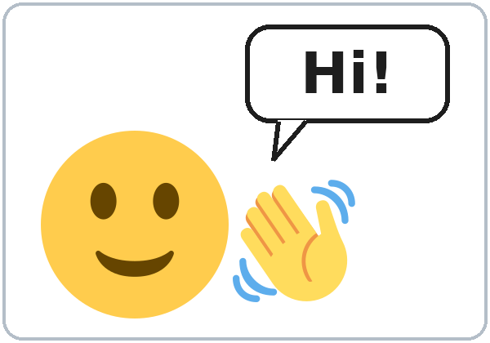
Hello! What's Your Name?
Today you will:
• Say hello and goodbye
• Say and spell your name
• Ask: Can you repeat, please?
Lesson 1 · Level 1
Notes:
Welcome everyone. Smile, wave, and say: "Hello! Welcome to English class."
Point to the title. Read it slowly: "Hello! What's your name?" Learners repeat.
Read the three goals, one at a time. Learners repeat each one. Use gestures: wave for hello and goodbye, point to yourself for your name, write in the air for spell.
Keep it short. Don't explain. Show and smile.
Source: Level1_Lesson1.md, Lesson 1 (Topic; At a glance: Objectives).
Picture: Twemoji graphics by Twitter, Inc. and other contributors (https://github.com/jdecked/twemoji), CC BY 4.0 (https://creativecommons.org/licenses/by/4.0/); resized and combined, with a drawn speech bubble.

Slide 2
Today's
Goals
01
I can say hello and goodbye.
Hello! · Hi! · Goodbye!
02
I can say my first and last name.
By the end of class, you can do these five things.
Listen. Repeat.
We check at 7:25!
03
I can spell my name.
04
I can ask: Can you repeat, please?
05
I can say and write A to Z.
Notes:
Click once for each line. Read it slowly. Learners repeat.
1: Wave and say "Hello!" Walk to the door, wave, and say "Goodbye!"
2: Write your name on the board. Point to the first part: "First name." Point to the second part: "Last name."
3: Write A-N-A in the air and say "A-N-A."
4: Say a word very fast. Then ask: "Can you repeat, please?"
5: Point to the alphabet on the board.
Say: "At 7:25 we check. 'Not yet' is OK."
Source: Level1_Lesson1.md, Lesson 1 (At a glance: Objectives; Progress Check, Part D).

Slide 3
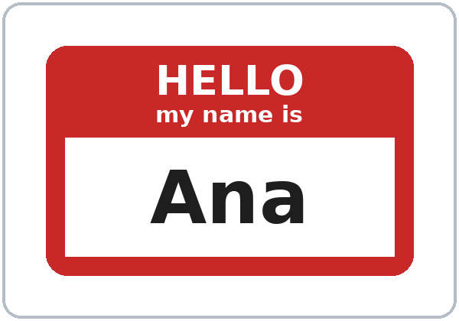
WARM-UP · 6:00
Hello Circle
Hello! My name is ___.
I'm ___.
Ana: Hello! My name is Ana.
Carlos:
Hello, Ana!
I'm Carlos.
Notes:
Time: 6:00-6:10 (10 minutes). Everyone stands. 15 learners: two circles. 7-8 learners: one circle.
Before class: write on the board "Hello! My name is ___." Each learner writes a first name on a name tag.
Model: wave and say "Hello! My name is" and your name. Point to yourself. Then point to a learner and wait. Help with "My name is...".
Click 1: Ana says "Hello! My name is Ana."
Click 2: Carlos answers "Hello, Ana!" and says "I'm Carlos."
Round 1: around the circle, each person says "Hello! My name is ___." The group answers "Hello, ___!"
Round 2: the same with "I'm ___." Point to the board: My name is = I'm.
Late arrivals: they join a circle. Give them a name tag.
If you are behind: go around once only.
Source: Level1_Lesson1.md, Lesson 1 (Step 1: Welcome + Hello Circle).
Picture: name tag drawn for this curriculum (no outside source).

Slide 4
How Our
Class Works
01
Listen.
02
Say. Repeat.
Class: 6:00–7:30
Break: 6:45–7:00
English in class.
Homework every week.
Phones OK: audio, dictionary.
03
Write.
04
Work with a partner.
05
Walk and talk.
Notes:
Time: 6:10-6:15 (5 minutes). Whole class.
Click once for each row. Say each word and do the action. Learners copy your gesture.
Hand to your ear: "Listen." "Say." Mime writing: "Write." Point to two people: "Partner." Walk a few steps: "Walk and talk."
Point to the clock: class at 6:00, break at 6:45, back at 7:00, end at 7:30.
Say the 3 rules: (1) "English in class. A classmate can help you for a few seconds. Then back to English." (2) "Homework every week. It's short." (3) "Phones are OK for the audio and a dictionary."
Also say: "You can use a real name or a practice name."
If you are behind: say the 3 rules only.
Source: Level1_Lesson1.md, Lesson 1 (Step 2: Orientation; Student Pages: How Our Class Works).

Slide 5
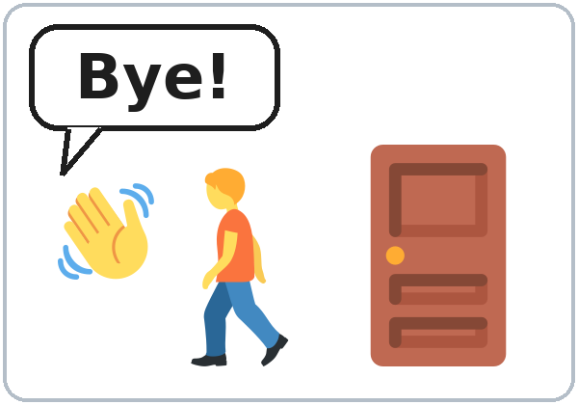
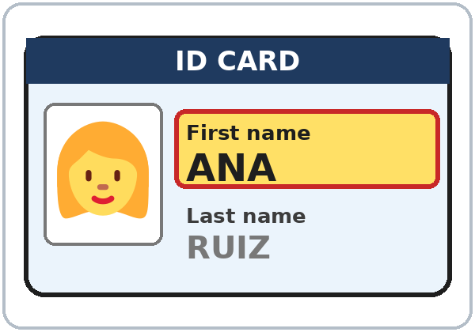
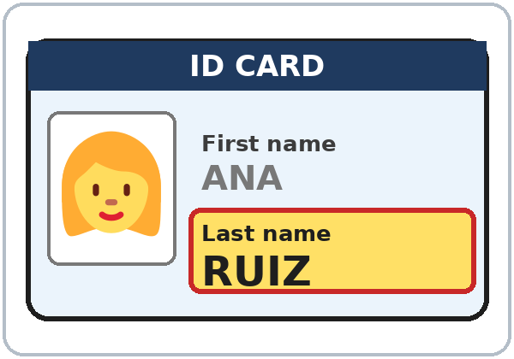
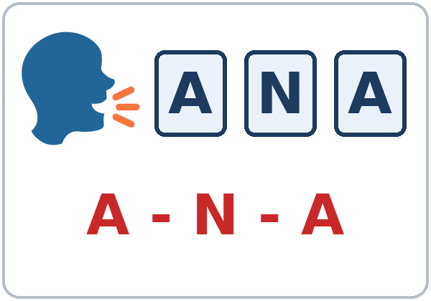
Look. Listen.
Repeat.
New Words
★ hello
★ goodbye
★ name
★ first name
★ last name
★ spell
Notes:
Time: 6:15-6:25 (10 minutes, with the next slide). Whole class.
★ = the most important words. Teach these first.
Click once for each word. Point to the picture and say the word slowly. Learners repeat 2 times.
Act it out: hello (wave), goodbye (wave and walk to the door), spell (write A-N-A in the air).
First name / last name: write your own name on the board. Point to the first part: "First name." Point to the second part: "Last name." Do the same with 2 learners' names.
If you are behind: teach the ★ words only.
Source: Level1_Lesson1.md, Lesson 1 (Key vocabulary; Step 3: New Words; Student Pages: New Words).
Pictures: Twemoji graphics by Twitter, Inc. and other contributors (https://github.com/jdecked/twemoji), CC BY 4.0 (https://creativecommons.org/licenses/by/4.0/); resized and combined. ID cards, the name tag, speech bubbles, letter tiles, the table, and labels were drawn for this curriculum.

Slide 6
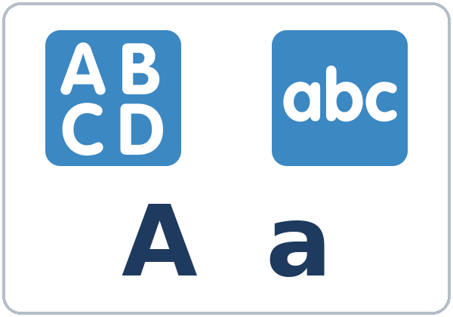
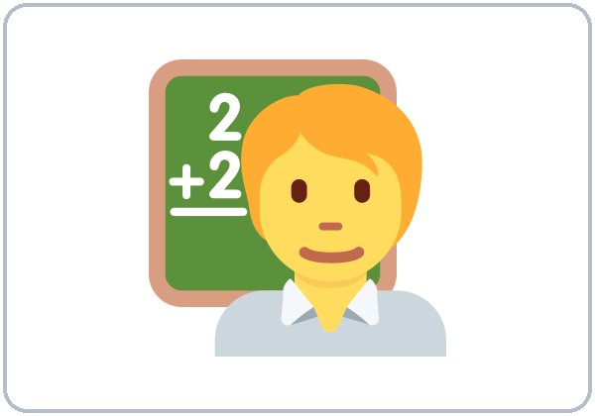

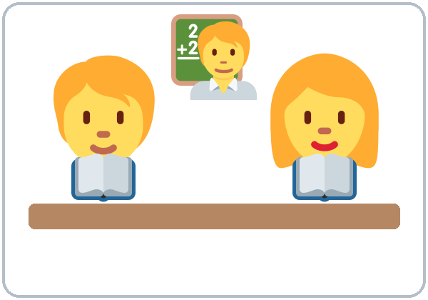


Partner game:
A points. B says.
More New Words
letter
★ teacher
★ student
classmate
book
pen
Notes:
Hold up a real book and a real pen first.
Click once for each word. Point to the picture and say the word. Learners repeat 2 times.
Partner game (4 minutes): A points to a picture. B says the word. Then switch.
Pairs: 15 learners = 7 pairs + 1 group of 3. 7-8 learners = 3-4 pairs.
Show it: point to two people ("Partner"), point to a picture ("Point"), and say the word ("Say").
If you are behind: teach the ★ words only (teacher, student). The other words stay on the page for home study.
Source: Level1_Lesson1.md, Lesson 1 (Key vocabulary; Step 3: New Words; Student Pages: New Words, Partner game).
Pictures: Twemoji graphics by Twitter, Inc. and other contributors (https://github.com/jdecked/twemoji), CC BY 4.0 (https://creativecommons.org/licenses/by/4.0/); resized and combined. ID cards, the name tag, speech bubbles, letter tiles, the table, and labels were drawn for this curriculum.

Slide 7
Which Word?
Look at the picture. Say the word.
1
2
3
_________
_________
_________
goodbye
teacher
book
Notes:
Quick check of the new words (about 2 minutes). Whole class.
Point to picture 1. Ask: "What's this?" Wait. Learners say the word. Then click to show it. Learners repeat 2 times.
Do the same with pictures 2 and 3. Answers: 1 goodbye, 2 teacher, 3 book.
Wave and walk to the door for goodbye. Point to yourself for teacher. Hold up a real book.
Source: Level1_Lesson1.md, Lesson 1 (Key vocabulary; Step 3: New Words).
Pictures: Twemoji graphics by Twitter, Inc. and other contributors (https://github.com/jdecked/twemoji), CC BY 4.0 (https://creativecommons.org/licenses/by/4.0/); resized and combined, with drawn speech bubbles and borders.

Slide 8
Classroom
Help!
Phrases
Can you repeat, please?
Listen. Repeat. Use these phrases in class.
I don't understand.
01
How do you say ___ in English?
Listen.
02
Repeat.
Ask in English!
03
Write.
Notes:
Time: about 2 minutes, at the end of New Words. Whole class.
Click once for each row. Say the word with its gesture. Learners repeat.
Hand to your ear: "Listen." Point to your mouth: "Repeat." Mime writing: "Write."
Help box: say each phrase slowly. Learners repeat 2 times. Shrug for "I don't understand."
Practice "Can you repeat, please?" right away: say a word very fast, and wait for someone to ask. Smile and say it again slowly.
Use these phrases every week. Point to this slide when someone is stuck.
Source: Level1_Lesson1.md, Lesson 1 (Classroom phrases; Step 3: New Words; Student Pages: Classroom Phrases).
Picture: Twemoji graphics by Twitter, Inc. and other contributors (https://github.com/jdecked/twemoji), CC BY 4.0 (https://creativecommons.org/licenses/by/4.0/); resized, with a drawn border.

Slide 9
Listen. Who is it?
Check ✓ Ana or Carlos.
Listening A
1. Last name: Ruiz
Ana
Carlos
2. Last name: Vega
Ana
Carlos
3. “I'm fine, thanks.”
Ana
Carlos
4. Gets a book and a pen.
Ana
Carlos
Notes:
Time: 6:25-6:35 for all of Listening (Tasks A, B, C). Learners work alone, then check with a partner.
Before you listen (1 minute): point to the names. Say: "This is Ana. This is Carlos. First night. They say their names. They spell their names."
Listen 1 (Task A): play the audio. Pause after Ana spells her name and ask: "Ana or Carlos?" Learners point.
Learners check Ana or Carlos for each line. Then: "Show your partner."
Click once for each answer: 1 Ana, 2 Carlos, 3 Carlos, 4 Carlos.
The audio plays the conversation once. Press play again for the next listen. No speaker? Read the script with a volunteer, slowly.
If you are behind: play the audio 2 times in total, not 3.
Source: Level1_Lesson1.md, Lesson 1 (Step 4: Listening; Listening script; Answer key: Listening Task A; Student Pages: Listening A).

Slide 10
Listening B
👩 Ana
01
Listen. Circle the letters.
R
U
O
I
E
Z
S
👨 Carlos
02
V
B
E
I
G
J
A
Notes:
Listen 2 (Task B). Learners work alone, then check with a partner.
Say: "Listen again. Circle the letters." R (Ana) and A (Carlos) are already there.
Play the audio. Then: "Show your partner."
Click once for each answer (6 clicks). Ana: R-U-I-Z (U, I, Z). Carlos: V-E-G-A (V, E, G).
Say each letter slowly. Learners repeat. Watch E / I and G / J: many learners mix them up.
Source: Level1_Lesson1.md, Lesson 1 (Step 4: Listening; Answer key: Listening Task B; Student Pages: Listening B).
Picture: Twemoji graphics by Twitter, Inc. and other contributors (https://github.com/jdecked/twemoji), CC BY 4.0 (https://creativecommons.org/licenses/by/4.0/); resized, with drawn letter tiles.

Slide 11
Listening C
C
Listen again.
Write the last names.
1
👩 Ana: __ __ __ __
RUIZ
Pairs: compare your answers.
Then say it: listen and repeat.
2
👨 Carlos: __ __ __ __
VEGA
Say it: How do you spell it?
Say it: Can you repeat, please?
Notes:
Listen 3 (Task C). Learners write the two last names. Then: "Show your partner."
Click 1: RUIZ (Ana). Click 2: VEGA (Carlos). Spell each name slowly. Learners repeat.
Say it (2 minutes): play or read the 2 lines: "How do you spell it?" and "Can you repeat, please?" The class repeats each line 2 times.
Use a flat, clear voice first. Then make it friendly.
If you are behind: play the audio 2 times in total, and do Task C together on the board.
Source: Level1_Lesson1.md, Lesson 1 (Step 4: Listening; Answer key: Listening Task C; Student Pages: Listening C, Say it).

Slide 12
Grammar Box 1
Hello and Goodbye
SAY
ANSWER
Hello! / Hi!
Hello! / Hi!
Nice to meet you.
Nice to meet you, too.
How are you?
I'm fine, thanks. And you?
I'm good, thanks. And you?
Goodbye! / Bye!
Goodbye!
See you next week!
Notes:
Time: 6:35-6:45 for all the grammar boxes. Whole class, then pairs.
Point left: "Say." Point right: "Answer."
Read the left side. Wait. Click to show the answer. The class reads the answer. Do all 4 rows like this (4 clicks).
Act it out: wave for Hello and Goodbye. Shake hands for Nice to meet you. Smile for How are you?
Then do it again: you read the left side, the class answers without looking.
Source: Level1_Lesson1.md, Lesson 1 (Step 5: Grammar Q&A; Student Pages: Grammar Box 1).
Picture: Twemoji graphics by Twitter, Inc. and other contributors (https://github.com/jdecked/twemoji), CC BY 4.0 (https://creativecommons.org/licenses/by/4.0/); resized and combined, with a drawn speech bubble.

Slide 13
Grammar Box 2
What's your name?
QUESTION
ANSWER
What's
your name? /
first name?
My name is / I'm
Ana. / Carlos.
What's
your last name?
It's / My last name is
Ruiz. / Vega.
Notes:
Part of Grammar Q&A (6:35-6:45). Whole class.
Point left: "Question." Point right: "Answer."
Read the question in row 1. Wait. Click to show the answer. The class reads it: "My name is Ana." or "I'm Ana." Do row 2 the same way (2 clicks).
Point to the picture: Ana = first name. Ruiz = last name. In English, the first name comes first: Ana Ruiz.
Some learners have two last names. That is fine.
Then ask a few learners: "What's your name?" "What's your last name?" A practice name is OK.
Source: Level1_Lesson1.md, Lesson 1 (Step 5: Grammar Q&A; Student Pages: Grammar Box 2; Questions and answers).
Picture: Twemoji graphics by Twitter, Inc. and other contributors (https://github.com/jdecked/twemoji), CC BY 4.0 (https://creativecommons.org/licenses/by/4.0/); resized, with a drawn ID card.

Slide 14
Grammar Box 3
How do you spell it?
How do you spell it?
What's
= What is
R-U-I-Z.
V-E-G-A.
Can you repeat, please?
I'm
= I am
Yes. V-E-G-A.
Sure. R-U-I-Z.
Notes:
Part of Grammar Q&A (6:35-6:45). Whole class.
Read: "How do you spell it?" Click 1: the class spells R-U-I-Z and V-E-G-A with you. Say each letter in English, with a short stop.
Read: "Can you repeat, please?" Click 2: the class answers "Yes. V-E-G-A." and "Sure. R-U-I-Z."
Point to the big words and write them on the board: What's = What is. I'm = I am.
Check question: "How do you ___ it?" (spell).
Watch the letters learners mix up: A / E / I, G / J, V / B. Say them slowly and point.
Source: Level1_Lesson1.md, Lesson 1 (Step 5: Grammar Q&A; Student Pages: Grammar Box 3; Questions and answers; Teacher notes).
Picture: Twemoji graphics by Twitter, Inc. and other contributors (https://github.com/jdecked/twemoji), CC BY 4.0 (https://creativecommons.org/licenses/by/4.0/); resized and combined, with drawn letters.

Slide 15
Write the missing word.
Use one word.
Write the
Missing Word
1
What's your ____?
My name is Ana.
name
2
____ your last name?
It's Vega.
What's
Look at the answer. It helps you find the word.
Pairs: check your answers.
3
How do you ____ it?
V-E-G-A.
spell
4
Can you ____, please?
Yes. V-E-G-A.
repeat
5
Are you a student?
Yes, I ____.
am
Notes:
Part of Grammar (6:35-6:45). Learners write alone first.
Say: "Write one word." Do number 1 together.
Pairs check: "Show your partner."
Click once for each answer: 1 name, 2 What's, 3 spell, 4 repeat, 5 am.
Number 5 is a first look at Box 4: "Are you a student?" "Yes, I am." Point to yourself: "Am I a student?" Class: "No, you're not. You're a teacher!" Don't teach more; Lesson 2 does.
Pair drill (last 3-4 minutes): A asks a question, B answers with real information or a practice name. Then switch.
If you are behind: skip the pair drill. Talk Time practices the same questions.
Source: Level1_Lesson1.md, Lesson 1 (Step 5: Grammar Q&A; Student Pages: Practice; Answer key: Grammar practice).

Slide 16
Common Mistakes
Don't say
Say
My name Ana.
My name is Ana.
I Ana.
I'm Ana.
What your name?
What's your name?
How you spell it?
How do you spell it?
Notes:
Use this slide after the grammar boxes, or any time you hear these mistakes.
Read the left side. Ask: "OK?" Shake your head: "No." Click to show the right answer. The class repeats it 2 times.
4 clicks: My name is Ana. / I'm Ana. / What's your name? / How do you spell it?
Correct by saying the right form clearly. The learner repeats. Don't explain the grammar.
Also listen for Spanish letter names: E said as "eh", I said as "ee". Say the English letter slowly and point to it.
Source: Level1_Lesson1.md, Lesson 1 (Student Pages: Common mistakes; Teacher notes: Typical mistakes this week).
Picture: name tag drawn for this curriculum (no outside source).

Slide 17
Talk Time
Name Mingle
Walk and talk.
Ask 5–6 classmates.
7:00–7:10
1
Hello! What's your name?
How do you spell it?
2
Write the name.
First name and last name.
3
Your partner checks.
Goodbye! Find a new person.
Notes:
Time: 7:00-7:10 (10 minutes). Everyone stands and mingles.
15 learners: each person talks to 5-6 people. 7-8 learners: talk to everyone. 5 or fewer: sit at one table and go around; everyone writes everyone's name.
Model with one learner first: "Hello! What's your name?" "Rosa." "How do you spell it?" "R-O-S-A." Write R-O-S-A on the board as you hear it. Show the learner: "Is this right?" "Yes!"
Click once for each step. Learners greet, ask, and write the first and last name on the sign-in sheet. The partner looks and checks ✓ the spelling. Then "Goodbye!" and a new person.
When someone is stuck, point to the board: "Can you repeat, please?"
Baseline snapshot: while learners mingle, you (or a second volunteer) call about 5 learners, one at a time, for 2 minutes. Use the checklist in the answer key. Do the rest in Weeks 2 and 3.
A practice name is fine. Practice phone numbers only (555-0100 to 555-0199).
If you are behind: learners talk to 3 people.
Source: Level1_Lesson1.md, Lesson 1 (Step 6: Talk Time; Student Pages: Talk Time; Baseline snapshot checklist; Teacher notes).
Picture: Twemoji graphics by Twitter, Inc. and other contributors (https://github.com/jdecked/twemoji), CC BY 4.0 (https://creativecommons.org/licenses/by/4.0/); resized and combined, with a drawn table.

Slide 18
Before You Go 7:10–7:15
01
Exit ticket
02
Homework
Say one sentence:
My name is ___.
Or write it on paper.
1. Write your name.
2. Ask a friend's name.
3. Write the words.
4. Say A to Z, 2 times.
Bring it next week!
Notes:
Time: 7:10-7:15 (5 minutes). Never skip this step.
Exit ticket: each learner says one sentence to you at the door: "My name is ___." and a practice phone number (555-01__). Or they write one sentence on a slip: "My name is ___." Copying from the grammar box is fine.
15 learners: stand at the door and listen to each person quickly. 7-8 learners: each person says it to the whole group.
Homework (10 minutes): open the Homework page. Do item 1 together. Point to each instruction so learners know what to do at home.
Say: "Bring it next week!"
Source: Level1_Lesson1.md, Lesson 1 (Step 7: Exit Ticket + Homework; Student Pages: Homework).
Picture: Twemoji graphics by Twitter, Inc. and other contributors (https://github.com/jdecked/twemoji), CC BY 4.0 (https://creativecommons.org/licenses/by/4.0/); resized, with a drawn border.

Slide 19
Letters & Numbers · 7:15
Tricky Letters
The alphabet
A B C D E F G
H I J K L M N
O P Q R S T U
V W X Y Z
LETTER · SAY IT
EXAMPLE
A a
“ay” (like day)
A-N-A
E e
“ee” (like see)
V-E-G-A
I i
“eye”
R-U-I-Z
G g
“jee”
V-E-G-A
J j
“jay”
J-U-A-N
Notes:
Time: 7:15-7:25 (10 minutes). Whole class, then pairs. Write A to Z on the board before class.
See it (2 minutes): point to each letter, A to Z. Say each letter once. Point to a capital and its small letter: "Big A, small a."
Say it (4 minutes): learners repeat after you in groups of 4-5 letters (A B C D, E F G, H I J K...).
Tricky letters: say each letter 3 times, slowly. Click to show the example word. Spend the most time on A / E / I and G / J.
Quick check (1 minute): say a tricky letter; learners point to it. "E." (E, not I.) "G." (G, not J.)
Learners who can't read or write yet: they say the letters with everyone and point instead of writing.
If you are behind: do the tricky letters and Task D (spell your name to a partner) only.
Source: Level1_Lesson1.md, Lesson 1 (Letters & Numbers step; Student Pages: Letters & Numbers A, Tricky letters).

Slide 20
Listen to the teacher.
Circle the letter.
Letters: Task B
1.
A
E
I
2.
G
J
H
3.
E
I
Y
4.
G
J
Y
5.
A
E
I
Notes:
Task B (3 minutes). Learners listen and circle on their page.
Say each letter 2 times, slowly: 1 E, 2 G, 3 I, 4 J, 5 A.
Click once for each answer (5 clicks). Learners check their page.
Then Task C: learners write their name in capital letters and small letters.
Then Task D (pairs): A spells their name; B writes it. A checks. Switch.
Learners who can't read or write yet: they point instead of circle, and copy their name from their name tag.
Source: Level1_Lesson1.md, Lesson 1 (Letters & Numbers step; Answer key: Letters & Numbers Task B; Student Pages: Letters & Numbers B-D).

Slide 21
Progress Check 7:25
D. I can…
😀 🙂 😐
Check one face.
Match the question
Answer
1. What's your name?
c. My name is Ana.
2. What's your last name?
d. It's Ruiz.
3. How do you spell it?
a. R-U-I-Z.
4. How are you?
b. I'm fine, thanks.
Notes:
Time: 7:25-7:30 (5 minutes). Learners work alone. Open the Progress Check page.
Part A: read the 5 letters slowly, 2 times each: 1 I, 2 J, 3 E, 4 H, 5 G. Learners circle.
Part B (this slide): learners match each question to an answer on their page. Then click once for each answer: 1 c, 2 d, 3 a, 4 b.
Part C: learners write their first and last name.
Part D: read each "I can..." line aloud and point to the 3 faces: 😀 "I can do it." 🙂 "A little." 😐 "Not yet." Learners check one. "Not yet" is OK.
This is not a test grade. Collect the pages, or check them at the start of Week 2. It shows who needs more help with letters.
If you are behind: do the Progress Check in Week 2 at 6:00, while learners arrive.
Source: Level1_Lesson1.md, Lesson 1 (Progress Check step; Answer key: Progress Check Parts A, B, scoring; Student Pages: Progress Check).

Slide 22
Goodbye! See You Next Week!
Now you can:
• Say hello and goodbye
• Say and spell your name
• Ask: Can you repeat, please?
Lesson 1 · Level 1
Notes:
Wave and say: "Goodbye! See you next week!" Learners answer: "Goodbye!" or "Bye!"
Read the three lines. Learners repeat. Say: "Great work tonight!"
Remind them: "Homework. Bring it next week!"
Source: Level1_Lesson1.md, Lesson 1 (Objectives; Grammar Box 1; Step 7).
Picture: Twemoji graphics by Twitter, Inc. and other contributors (https://github.com/jdecked/twemoji), CC BY 4.0 (https://creativecommons.org/licenses/by/4.0/); resized and combined, with a drawn speech bubble.

Slide 23
Credits
Pictures
Vocabulary pictures use Twemoji graphics by Twitter, Inc. and other contributors (https://github.com/jdecked/twemoji), licensed under CC BY 4.0 (https://creativecommons.org/licenses/by/4.0/). The graphics were resized and combined, and ID cards, a name tag, speech bubbles, letters, and labels were added.
Other small pictures (for example, the faces on the Progress Check) are standard emoji characters shown with the computer's emoji font.
Names and numbers
Ana Ruiz and Carlos Vega are invented names. Practice phone numbers start with 555-01.
Audio and font
Audio: synthetic voices made with Chatterbox TTS (MIT License); each file carries an inaudible Perth watermark marking it as AI-generated. The voices are copied from short reference clips made with Kokoro-82M (Apache 2.0); no recordings of real people were used. Font: Lexend Deca (OFL 1.1).
© 2026 the authors. The authors license this deck under CC BY-NC-SA 4.0.
Notes:
This slide is for the record. You don't need to show it in class.
Pictures: 12 vocabulary cards (hello, goodbye, name, first name, last name, spell, letter, teacher, student, classmate, book, pen) made from Twemoji graphics, CC BY 4.0, with drawn ID cards, a name tag, speech bubbles, letter tiles, a table, and labels. The file-by-file list is in images/CREDITS.md.
Audio: L1_listening.mp3, synthetic voices (Chatterbox TTS, MIT License) with an inaudible Perth watermark.
Source: Level1_Lesson1.md (Picture Credits); images/CREDITS.md.

