Slide 1
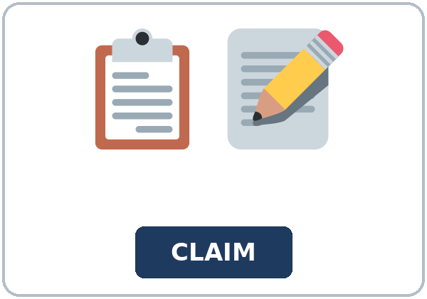
I'd Like to File a Claim
Today you will:
• I can start a sentence with a gerund (Waiting on hold is tiring)
• I can soften a request with I was wondering if…
• I can say what was sent or attached, in the passive
Lesson 11 · Level 5
Notes:
Welcome learners as they arrive.
Read the three lines under Today you will.
It is not insurance advice.
Lesson plan: Topic; At a glance: Objectives.
Picture: Twemoji graphics by Twitter, Inc. and other contributors (https://github.com/jdecked/twemoji), CC BY 4.0 (https://creativecommons.org/licenses/by/4.0/); resized and combined, with signs and labels (images/CREDITS.md).

Slide 2
Today's
Goals
01
I can start a sentence with a gerund (Waiting on hold is tiring)
02
I can soften a request with I was wondering if…
03
I can say what was sent or attached, in the passive
By the end of class, you can do these things.
04
I can write a 1–2 paragraph letter
Notes:
Read each goal slowly. Learners repeat.
Lesson plan: At a glance: Objectives.

Slide 3

OPENING TALK · 6:00
Opening Talk
Work with a partner. A asks a card
question. B answers in about four sentences. A asks one follow-up. Then switch.
sentences. A asks one follow-up. Then
switch.
Notes:
Step 1 · 6:00–6:06 · Opening Talk.
Work with a partner.
Lesson plan: Step 1; Opening Talk page.
Picture: Twemoji graphics by Twitter, Inc. and other contributors (https://github.com/jdecked/twemoji), CC BY 4.0 (https://creativecommons.org/licenses/by/4.0/); resized and combined, with signs and labels (images/CREDITS.md).

Slide 4
Opening Talk
Cards
01
Work with a partner. A asks a card question. B answers in about four
02
sentences. A asks one follow-up. Then switch.
Work with a partner. A asks a card question. B
answers in about four sentences. A asks one follow-up. Then switch.
Notes:
Each click shows the next card.
A asks. B answers. Then switch.
Lesson plan: Step 1; Opening Talk page.

Slide 5

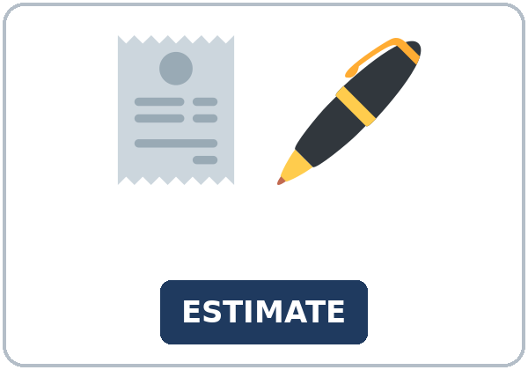
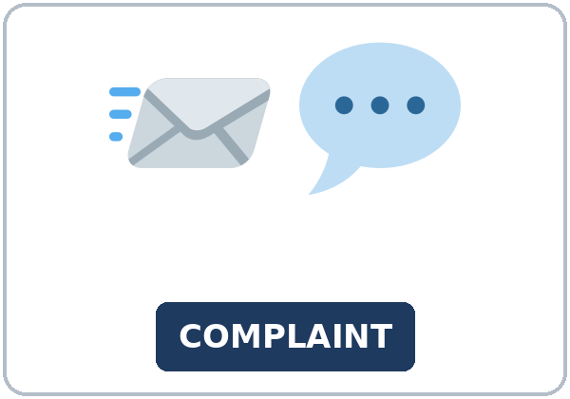

Look. Listen.
Repeat.
New Words
★ claim form
★ policy number
★ photo
★ estimate
★ complaint
★ attachment
Notes:
Step 2 · 6:06–6:12 · New Words.
Point to each picture. Learners repeat. ★ = most important.
Lesson plan: Step 2; New Words page.
Pictures: Twemoji graphics by Twitter, Inc. and other contributors (https://github.com/jdecked/twemoji), CC BY 4.0 (https://creativecommons.org/licenses/by/4.0/); resized and combined, with signs and labels (images/CREDITS.md).

Slide 6
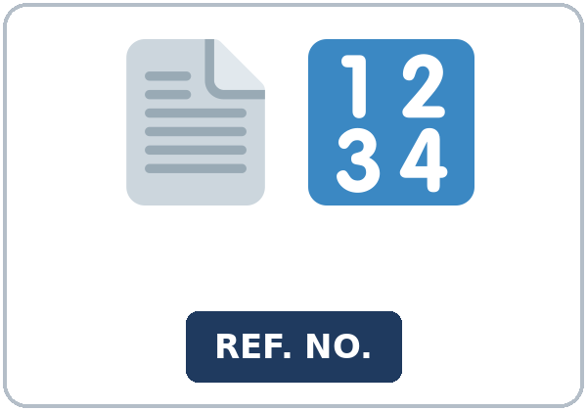

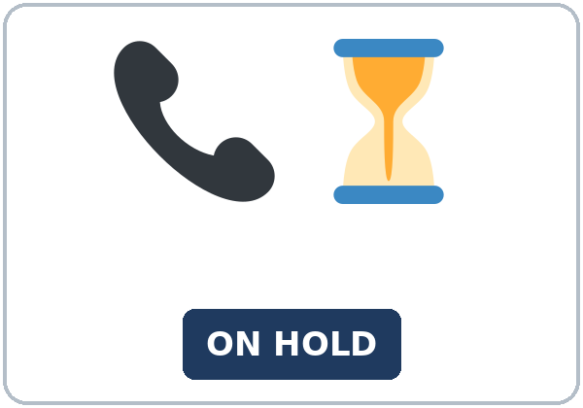
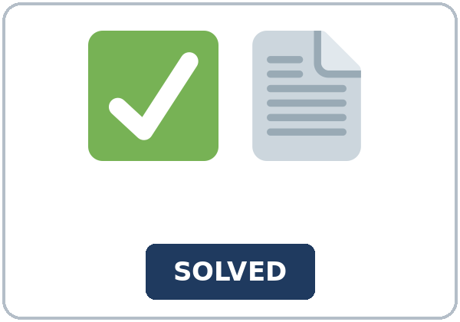
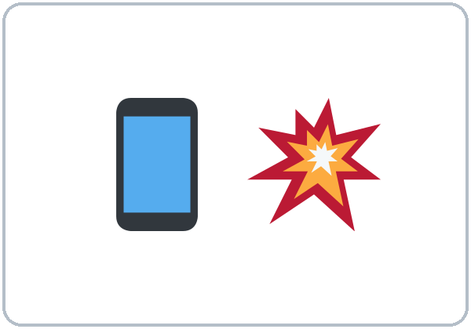

Partner game:
Say it in a sentence
More New Words
★ reference number
★ customer service
★ on hold
★ resolution
cracked screen
water stain
Notes:
A points to a picture. B names it and uses it in one sentence. Then switch.
Lesson plan: Step 2; New Words page; Partner game.
Pictures: Twemoji graphics by Twitter, Inc. and other contributors (https://github.com/jdecked/twemoji), CC BY 4.0 (https://creativecommons.org/licenses/by/4.0/); resized and combined, with signs and labels (images/CREDITS.md).

Slide 7
Check the Meaning
Look at the picture. Answer the question.
1
2
3
Is Waiting one activity or many?
Does the verb after Waiting take is or are?
Was the photo attached, or did Hector forget it?
One.
is
It was attached.
Notes:
The answers are hidden. Ask, then click.
1. One.
2. *is*
3. It was attached.
Lesson plan: Step 2: Check the Meaning.
Pictures: Twemoji graphics by Twitter, Inc. and other contributors (https://github.com/jdecked/twemoji), CC BY 4.0 (https://creativecommons.org/licenses/by/4.0/); resized and combined, with signs and labels (images/CREDITS.md).

Slide 8
Before You
Listen for:
Listen
Listen. What is the claim about?
Hector calls about a cracked-screen claim.
- Play 1 → Task A.
01
Audio: about 2:02. It plays once.
Narrator
02
Ms. Lane
Play 1: Task A
03
Hector
Notes:
Step 3 · 6:12–6:32 · Listening. Play 1 is Task A. Play 2 is Tasks B and C. A third play is fine.
Hector calls about a cracked-screen claim.
The script says going to and want to. Learners only need to recognize gonna and wanna.
Lesson plan: Step 3; Listening page.
Picture: Twemoji graphics by Twitter, Inc. and other contributors (https://github.com/jdecked/twemoji), CC BY 4.0 (https://creativecommons.org/licenses/by/4.0/); resized and combined, with signs and labels (images/CREDITS.md).

Slide 9
Listen. What is the claim about?
Listening A
1.
a. A new phone he wants to buy
b. A cracked phone screen
c. A water stain that is still wet
Notes:
Click to circle b.
Lesson plan: Step 3; Listening Task A; Answer key.

Slide 10
B. Listen again. Circle the answers.
Listening B
1. The form
was received
was lost
was not sent
2. The photo
was attached
is missing
is a water stain
3. He still must send
the estimate
the phone
a new complaint
4. Reference number
seven one
four two eight
nine nine
5. Policy number
four two eight
seven one
three three
6. He is going to
send it today
stay on hold
buy a new phone
Notes:
Click to circle each answer: 1 was received • 2 was attached • 3 the estimate • 4 seven one • 5 four two eight • 6 send it today
Lesson plan: Step 3; Listening Task B; Answer key.

Slide 11
Listen again.
Listen again. Write the geru
Listening C
1
______ on hold was tiring.
Waiting
2
The form ______.
was received
3
The photo ______.
was attached
Write the missing words.
Then check together.
4
______ a claim takes time.
Filing
5
______ a photo helps.
Sending
6
______ the estimate is my next step.
Sending
Notes:
Click to show each answer: 1 Waiting • 2 was received • 3 was attached • 4 Filing • 5 Sending • 6 Sending
Lesson plan: Step 3; Listening Task C; Answer key.

Slide 12
Hear it: gonna and wanna are short forms
Hear It,
Say It
Say it: use the full forms
I want to file a claim.
I was wondering if you could look up my claim.
gonna and wanna are short forms. This listening uses the full forms.
You can say going to and want to.
Say each line two times.
I'm going to send it today.
Waiting on hold was tiring.
Notes:
gonna and wanna are short forms. This listening uses the full forms. Say each line two times.
Lesson plan: Step 3: Hear it, say it.

Slide 13
Grammar Box 1
a gerund is the subject
THE ACTIVITY
THE VERB IS SINGUL
Waiting on hold
is tiring.
Filing a claim
takes time.
Sending a photo
helps.
Sending the estimate
is my next step.
Notes:
Grammar Box 1: a gerund is the subject. Each click shows the answer side.
Lesson plan: Step 4; Grammar Box 1.
Picture: Twemoji graphics by Twitter, Inc. and other contributors (https://github.com/jdecked/twemoji), CC BY 4.0 (https://creativecommons.org/licenses/by/4.0/); resized and combined, with signs and labels (images/CREDITS.md).

Slide 14
Grammar Box 2
a soft request
YOU CAN SAY
STATEMENT ORDER
I was wondering if
you could check the claim.
I was wondering if
you could look up the reference number.
Would you mind
looking up the reference number?
Notes:
Grammar Box 2: a soft request. Each click shows the answer side.
Lesson plan: Step 4; Grammar Box 2.
Picture: Twemoji graphics by Twitter, Inc. and other contributors (https://github.com/jdecked/twemoji), CC BY 4.0 (https://creativecommons.org/licenses/by/4.0/); resized and combined, with signs and labels (images/CREDITS.md).

Slide 15
Grammar Box 3
what was sent
THE THING
PASSIVE
The photo
was attached.
The form
was received.
The estimate
was not attached yet.
Notes:
Grammar Box 3: what was sent. Each click shows the answer side.
Lesson plan: Step 4; Grammar Box 3.
Picture: Twemoji graphics by Twitter, Inc. and other contributors (https://github.com/jdecked/twemoji), CC BY 4.0 (https://creativecommons.org/licenses/by/4.0/); resized and combined, with signs and labels (images/CREDITS.md).

Slide 16
Grammar Box 4
have to
YOU HAVE TO
YOU DON'T HAVE TO
include the policy number
stay on hold
send the estimate
call again if the letter is complete
write the reference number
add a different problem
Notes:
Grammar Box 4: have to. Each click shows the answer side.
Lesson plan: Step 4; Grammar Box 4.
Picture: Twemoji graphics by Twitter, Inc. and other contributors (https://github.com/jdecked/twemoji), CC BY 4.0 (https://creativecommons.org/licenses/by/4.0/); resized and combined, with signs and labels (images/CREDITS.md).

Slide 17
Practice A
Write.
Practice A
1
Waiting on hold ______ tiring.
is
2
The photo was ______.
attached
3
Filing a claim ______ time.
takes
Write the missing word.
Pairs: check your answers.
4
I was wondering if you ______ check it.
could
5
The form was ______.
received
6
Sending a photo ______.
helps
Notes:
Click to show each answer: 1 is • 2 attached • 3 takes • 4 could • 5 received • 6 helps
Lesson plan: Step 4; Grammar Practice A; Answer key.

Slide 18
Circle the correct words.
Practice B
1. Waiting on hold ______ tiring.
is
are
2. I was wondering if ______ check.
could you
you could
3. The photo was ______ .
attach
attached
4. ______ a claim takes time.
Filing
File
5. You ______ include the policy number.
have to
has to
6. Sending a photo ______ .
help
helps
Notes:
Click to circle each answer: 1 is • 2 you could • 3 attached • 4 Filing • 5 have to • 6 helps
Lesson plan: Step 4; Grammar Practice B; Answer key.

Slide 19
Common Mistakes
Don't say
Say
Waiting on hold are tiring.
Waiting on hold is tiring.
I was wondering if could you check.
I was wondering if you could check.
The photo was attach.
The photo was attached.
Waiting are hard.
Waiting is hard.
Notes:
Read Don't say, then Say. Learners try first. Then click.
Lesson plan: Grammar: Common mistakes.
Picture: Twemoji graphics by Twitter, Inc. and other contributors (https://github.com/jdecked/twemoji), CC BY 4.0 (https://creativecommons.org/licenses/by/4.0/); resized and combined, with signs and labels (images/CREDITS.md).

Slide 20
Pair Check
A says.
01
Then switch.
A says: "Waiting on hold." B says: "Waiting on hold is tiring." Then switch.
B answers.
02
Use filing and sending too.
Notes:
A says: "Waiting on hold." B says: "Waiting on hold is tiring." Then switch. Use filing and sending too. ---
Break · 6:45–7:00.
Lesson plan: Step 4: Pair check.
Picture: Twemoji graphics by Twitter, Inc. and other contributors (https://github.com/jdecked/twemoji), CC BY 4.0 (https://creativecommons.org/licenses/by/4.0/); resized and combined, with signs and labels (images/CREDITS.md).

Slide 21
Talk Time
Talk Time
Pairs.
Pairs.
7:00–7:18
1
Pairs.
2
Then switch.
3
Then switch.
Notes:
Round 1.
Lesson plan: Step 5; Talk Time.
Picture: Twemoji graphics by Twitter, Inc. and other contributors (https://github.com/jdecked/twemoji), CC BY 4.0 (https://creativecommons.org/licenses/by/4.0/); resized and combined, with signs and labels (images/CREDITS.md).

Slide 22
Talk Time
Talk Time
Pairs.
List the two paragraphs before anyone writes full sentences.
7:00–7:18
1
List the two paragraphs before anyone
writes full sentences.
2
Then switch.
3
Then switch.
Notes:
Round 2.
Lesson plan: Step 5; Talk Time.
Picture: Twemoji graphics by Twitter, Inc. and other contributors (https://github.com/jdecked/twemoji), CC BY 4.0 (https://creativecommons.org/licenses/by/4.0/); resized and combined, with signs and labels (images/CREDITS.md).

Slide 23
Read.
Answer.
Read &
Write
1
What is the claim about?
A cracked phone screen
2
What was attached?
The photo
Read the page.
Answer the questions.
3
What is still missing?
The estimate
4
What is the reference number?
Seven one
5
What is the policy number?
Four two eight
Notes:
Step 6 · 7:18–7:25 · Read & Write.
Click to show each answer: 1 A cracked phone screen • 2 The photo • 3 The estimate • 4 Seven one • 5 Four two eight
Lesson plan: Step 6; Read & Write page; Answer key.

Slide 24
Before You Go 7:25–7:30
01
Exit ticket
02
Homework
Start a claim letter.
Name: Date:
1.
Give this page to your teacher.
About 20–25 minutes.
1. Write the verb.
2. Finish your letter (Read & Write). About 8–12 sentences.
3. Say I was wondering if to a friend. Write the sentence.
4. Review: write one passive. The photo was attached. Then write one
Bring it next week!
Notes:
Step 7 · 7:25–7:30 · Exit ticket and homework. Never skip the exit ticket.
Start a claim letter.
Lesson plan: Step 7; Exit Ticket page; Homework page.
Picture: Twemoji graphics by Twitter, Inc. and other contributors (https://github.com/jdecked/twemoji), CC BY 4.0 (https://creativecommons.org/licenses/by/4.0/); resized and combined, with signs and labels (images/CREDITS.md).

Slide 25
Goodbye! See You Next Week!
Now you can:
• I can start a sentence with a gerund (Waiting on hold is tiring)
• I can soften a request with I was wondering if…
• I can say what was sent or attached, in the passive
Lesson 11 · Level 5
Notes:
Read the three Now you can lines.
Homework is about 20–25 minutes. Bring it next week.
Lesson plan: At a glance: Objectives; Step 7.
Picture: Twemoji graphics by Twitter, Inc. and other contributors (https://github.com/jdecked/twemoji), CC BY 4.0 (https://creativecommons.org/licenses/by/4.0/); resized and combined, with signs and labels (images/CREDITS.md).

Slide 26
Credits
Pictures
Vocabulary pictures use Twemoji graphics by Twitter, Inc. and other contributors (https://github.com/jdecked/twemoji), licensed under CC BY 4.0 (https://creativecommons.org/licenses/by/4.0/). The graphics were resized and combined, and signs and labels were added.
Names and story
Ms. Lane and Hector are invented names. The listening story is invented.
Audio and font
Audio: synthetic voices made with Chatterbox TTS (MIT License), cloned from short synthetic reference clips made with Kokoro-82M (Apache License 2.0). No recordings of real people were used. Each file carries an inaudible Perth watermark marking it as AI-generated. Font: Lexend Deca (OFL 1.1).
© 2026 the authors. The authors license this deck under CC BY-NC-SA 4.0.
Notes:
Credits. You don't need to read this slide in class.
Pictures: Twemoji graphics by Twitter, Inc. and other contributors, CC BY 4.0; the file-by-file list is in images/CREDITS.md.
Audio: synthetic voices, computer-generated (Chatterbox TTS cloned from Kokoro-82M reference clips). No recordings of real people. The names and the story are invented.
Course materials: © 2026 the authors, licensed under CC BY-NC-SA 4.0 (https://creativecommons.org/licenses/by-nc-sa/4.0/).
Lesson plan: Picture Credits. Picture list: images/CREDITS.md.

