Slide 1
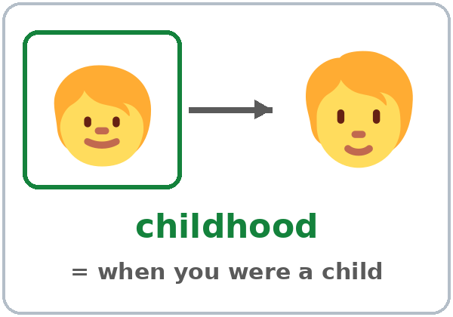
When I Was Young
Today you will:
• Say what you used to do
• Ask Did you use to…?
• Compare then and now
Lesson 3 · Level 3
Notes:
Welcome learners as they arrive.
Point to the title and read it: "When I was young." Say: "Tonight we talk about life in the past and how things have changed."
Read the three lines under "Today you will". Give one quick example of each: "I used to help on the farm." • "Did you use to walk to school?" • "I used to write letters. Now I send text messages."
Choice and comfort: learners choose what to share. "A place I used to live," "a job I used to have," or an invented story are always OK.
Source: Level3_Lesson3.md (Topic; At a glance: Objectives; Teacher notes: Choice and comfort).
Picture: Twemoji graphics by Twitter, Inc. and other contributors (https://github.com/jdecked/twemoji), CC BY 4.0 (https://creativecommons.org/licenses/by/4.0/); resized and combined, with drawings (a river, a rope, a photo frame, bodies) and labels (images/CREDITS.md).

Slide 2
01
I can say what I used to do.
I used to help on the farm.
Today's
Goals
02
I can say what I didn't use to do.
03
I can ask Did you use to…?
By the end of class, you can do these six things.
You choose what to share.
We check at 7:25!
04
I can compare then and now.
05
I can tell a habit, one time, or now.
06
I can write about then and now.
Notes:
Read each goal slowly. Learners repeat.
Goal 1: used to (I used to help on the farm.). Goal 2: didn't use to (I didn't use to drink coffee.). Goal 3: Did you use to…? → Yes, I did. / No, I didn't.
Goal 4: then and now (I used to write letters. Now I send text messages.). Goal 5: a past habit (used to), one time in the past (simple past), and now (simple present). Goal 6: read a short memory story and write 4 sentences about then and now.
"We check at 7:25" = the Progress Check. It is not a test grade.
Source: Level3_Lesson3.md (At a glance: Objectives).

Slide 3
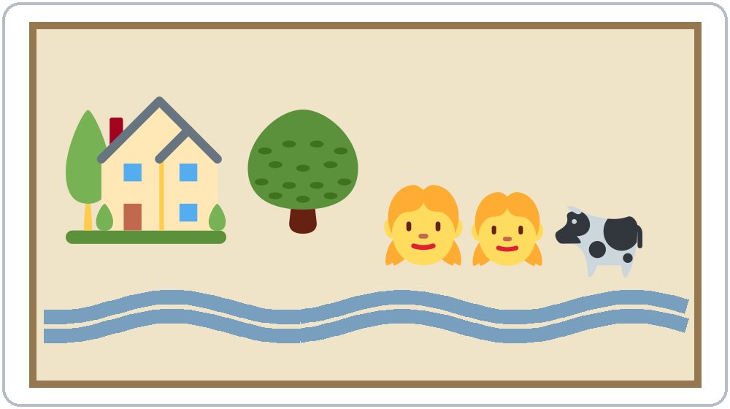
OPENING TALK · 6:00
Opening Talk
A asks a card question.
Tell me about your best friend. What's she like?
B answers with 2–3 sentences.
A asks one follow-up.
Really? What does she look like?
Then switch.
Notes:
Step 1 · 6:00–6:10 · Opening Talk + Homework Check · 10 min. Pairs, the same partner for both parts. 15 learners: 7 pairs + 1 group of 3. 7–8 learners: 3–4 pairs.
Before class, write on the board: What does he / she look like? What's he / she like?
Model with one learner: "Tell me about your best friend. What's she like?" → (answer) → "Really? What does she look like?" (Click to show the follow-up.)
Opening Talk (6 min): learners open the Opening Talk page. A asks a card question; B answers with 2–3 sentences; A asks one follow-up. Switch after each card. The cards are on the next slide.
Late arrivals join any pair as a group of 3. If behind: one card only, then the homework check.
Source: Level3_Lesson3.md (Step 1; Opening Talk page).
Picture: Twemoji graphics by Twitter, Inc. and other contributors (https://github.com/jdecked/twemoji), CC BY 4.0 (https://creativecommons.org/licenses/by/4.0/); resized and combined, with drawings (a river, a rope, a photo frame, bodies) and labels (images/CREDITS.md).

Slide 4
Opening Talk
Cards
01
Tell me about your best friend. What's he / she like?
02
What does your neighbor look like?
Work with a partner. Then switch.
Follow-ups:
Really? Why? What does he / she look like? What's he / she like? What about you?
03
Who is the funniest person in your family? Why?
04
Describe a coworker or a classmate. Is he / she friendly?
05
Homework check: Lesson 2, item 1.
Notes:
Step 1, continued. The four cards from the Opening Talk page. Each click shows the next card.
A asks a card question. B answers with 2–3 sentences. A asks one follow-up question (follow-ups on the right). Then switch.
Homework Check (4 min, last click): partners read their Lesson 2 Homework item 1 (the person they described) to each other. The partner asks one question about the person. Walk around. Write 2 common errors on the board (often long hairs or What does she like?) and correct them together.
Source: Level3_Lesson3.md (Step 1; Opening Talk page: cards, follow-ups, homework check).

Slide 5
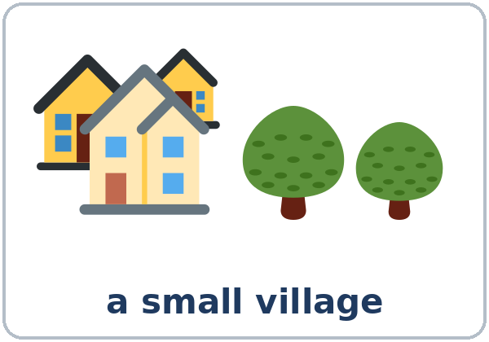
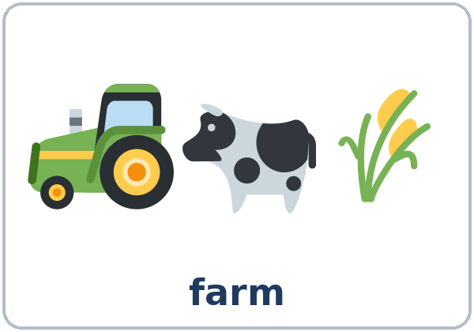
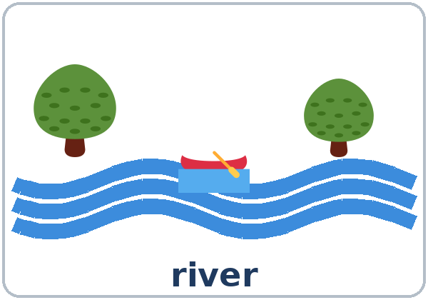
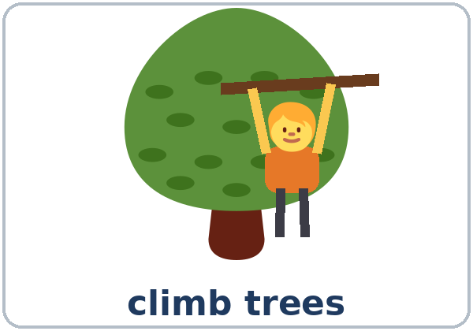
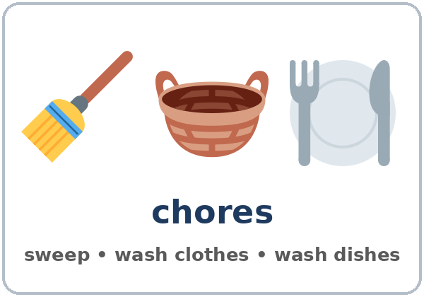
Look. Listen.
Repeat.
New Words
★ childhood
★ village
★ farm
★ river
★ climb trees
★ chores
Notes:
Step 2 · 6:10–6:18 · New Words · 8 min (this slide and the next). Whole class, then pairs.
Point to each picture and say the word. Learners repeat once. ★ = the most important words. Each click shows the next word.
Act out climb trees (climb with your arms) and feed the animals (on the next slide: throw corn to chickens).
If behind: teach the ★ words only.
Source: Level3_Lesson3.md (Step 2; Key vocabulary; New Words page).
Pictures: Twemoji graphics by Twitter, Inc. and other contributors (https://github.com/jdecked/twemoji), CC BY 4.0 (https://creativecommons.org/licenses/by/4.0/); resized and combined, with drawings (a river, a rope, a photo frame, bodies) and labels (images/CREDITS.md).

Slide 6
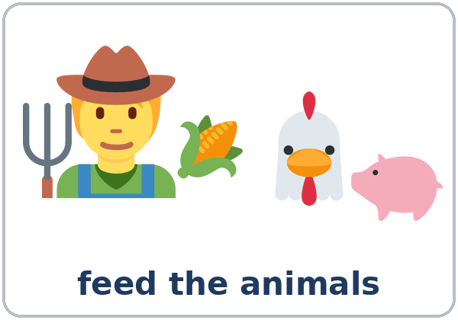
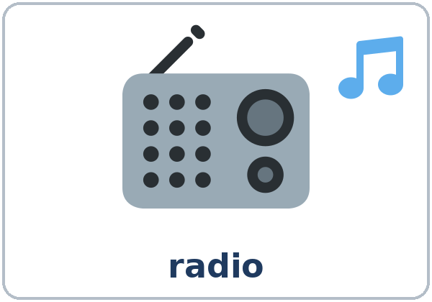

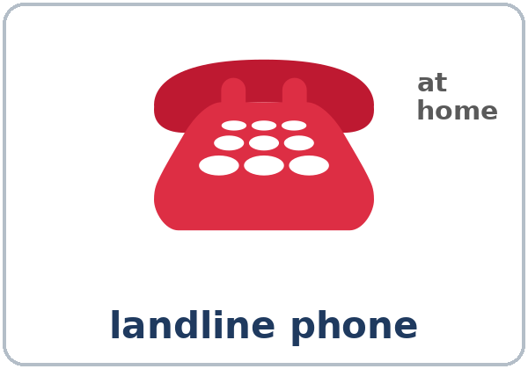
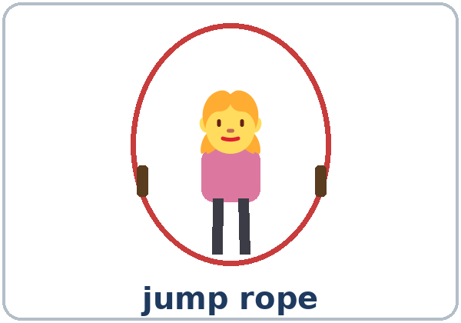
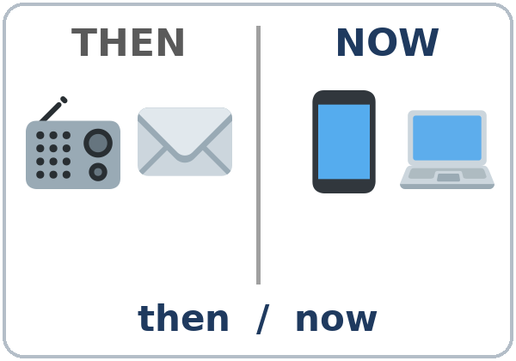
Partner game:
A says. B points.
More New Words
★ feed the animals
★ radio
★ letter (mail)
★ landline phone
jump rope
then / now
Notes:
Step 2, continued. Point to each picture and say the word. Learners repeat once. Act out feed the animals and jump rope (turn a rope and jump).
Then / now: point to the last picture. Say: "Then, people listened to the radio. Now, we use a phone." Make two columns on the board: THEN and NOW. Learners say where radio, letter, landline phone, text message go.
Partner game (2 min): A says a word. B points to the picture and makes a sentence (A: radio. B: My grandfather used to listen to the radio. / My grandmother had a farm.). Switch.
If behind: teach the ★ words only.
Source: Level3_Lesson3.md (Step 2; New Words page; Partner game).
Pictures: Twemoji graphics by Twitter, Inc. and other contributors (https://github.com/jdecked/twemoji), CC BY 4.0 (https://creativecommons.org/licenses/by/4.0/); resized and combined, with drawings (a river, a rope, a photo frame, bodies) and labels (images/CREDITS.md).

Slide 7
Check the Meaning
Look at the picture. Answer the question.
1
2
3
Is a village big or small?
Are chores fun or work?
Is your childhood now or in the past?
small
work
in the past
Notes:
Step 2 · Check meaning · 1 min. Whole class.
The answers are hidden. Ask each question and wait for the class to answer. Then click to show the answer. Each click shows one answer, in order: 1, 2, 3.
1. "Is a village big or small?" (small) • 2. "Are chores fun or work?" (work: cleaning, cooking, washing) • 3. "Is your childhood now or in the past?" (in the past)
Source: Level3_Lesson3.md (Step 2: Check meaning).
Pictures: Twemoji graphics by Twitter, Inc. and other contributors (https://github.com/jdecked/twemoji), CC BY 4.0 (https://creativecommons.org/licenses/by/4.0/); resized and combined, with drawings (a river, a rope, a photo frame, bodies) and labels (images/CREDITS.md).

Slide 8
Before You
Listen for:
Listen
Where did Teresa live?
Daniel and his mother, Teresa, are looking at an old photo of Teresa's childhood.
Then or now?
01
Audio: about 1:20. It plays once.
Narrator
02
Daniel
Play 1: Task A
03
Teresa
Notes:
Step 3 · 6:18–6:30 · Listening + "Say it" · 12 min (slides 8 to 12). Individuals, then pairs check.
Before you listen (1 min). Point to the old photo and say: "This is Daniel. This is his mother, Teresa. They're looking at an old photo of Teresa's childhood. Where did she live? Listen."
There are three voices: a Narrator, Daniel, and Teresa. Each click highlights the next voice.
The audio (L3_L3_listening.mp3, about 1:20) plays the conversation once. Press play again for play 2. A third play is fine if the class needs it.
No speaker? Read the script with a volunteer at a normal, friendly speed.
Audio: L3_L3_listening.mp3 (about 1:20) is not recorded yet (see level3/AUDIO_STATUS.md). It will use computer-generated voices (Chatterbox TTS cloned from synthetic Kokoro-82M reference clips); no recordings of real people. Until the file is ready, read the listening script with a volunteer. The names and the story are invented.
Source: Level3_Lesson3.md (Step 3; Listening script; Listening page).
Picture: Twemoji graphics by Twitter, Inc. and other contributors (https://github.com/jdecked/twemoji), CC BY 4.0 (https://creativecommons.org/licenses/by/4.0/); resized and combined, with drawings (a river, a rope, a photo frame, bodies) and labels (images/CREDITS.md).

Slide 9
Listen. Teresa: then or now?
Check ✓ Then or Now.
Listening A
1. lives on a farm
Then
Now
2. walks to school for an hour
Then
Now
3. sends text messages
Then
Now
4. writes letters to her aunt
Then
Now
Notes:
Play 1 → Task A. Then (her childhood) or now? Pairs compare. Check together.
Click to circle each answer (one click per item, 1 to 4): 1 Then, 2 Then, 3 Now, 4 Then.
Then read Tasks B and C together (1 min) so learners know what to listen for.
Source: Level3_Lesson3.md (Step 3; Listening Task A; Answer key).

Slide 10
Listen again. What did Teresa use to do?
Check ✓ the things she used to do.
Listening B
1. feed the animals
✓
✗
2. walk to school
✓
✗
3. climb trees
✓
✗
4. swim in the river
✓
✗
5. watch TV
✓
✗
6. listen to the radio
✓
✗
7. write letters
✓
✗
8. talk on a landline phone
✓
✗
Notes:
Play 2 → Tasks B and C. Pairs compare. Then show the answers.
Click to circle each answer (one click per item, 1 to 8): 1 ✓ feed the animals, 2 ✓ walk to school, 3 ✓ climb trees, 4 ✓ swim in the river, 5 ✗ watch TV, 6 ✓ listen to the radio, 7 ✓ write letters, 8 ✗ talk on a landline phone. (6 checks.)
Source: Level3_Lesson3.md (Step 3; Listening Task B; Answer key).

Slide 11
Listen again.
Write used to or use to.
Listening C
1
We ____ live in a small village.
used to
2
Did you ____ help on the farm?
use to
3
Every morning, I ____ feed the animals before school.
used to
Pairs: compare your answers.
Then check together.
4
Did you ____ walk to school?
use to
5
No, we didn't ____ have a TV.
use to
6
We ____ write letters to my aunt in the city.
used to
Notes:
Task C (same play 2 as Task B). Learners write used to or use to. Pairs compare.
Click to show each answer (one click per item, 1 to 6): 1 used to, 2 use to, 3 used to, 4 use to, 5 use to, 6 used to.
After did and didn't, write use (no -d). They sound the same, so this is a spelling point. Don't spend a lot of time on it.
If behind: do Task C together on the board, reading the lines yourself.
Source: Level3_Lesson3.md (Step 3; Listening Task C; Answer key; Teacher notes).

Slide 12
Say it: used to = "yoos-tuh"
Say It
The class repeats each line.
We used to live on a farm.
Did you use to walk?
used to = use to
They sound the same.
Say each line two times.
I didn't use to have a TV.
Notes:
"Say it" (2 min). Say: "used to sounds like yoos-tuh."
Read the line in the "Say it" box (We used to live on a farm.), then Did you use to walk? and I didn't use to have a TV. The class repeats each line twice.
Point out that used to and use to sound the same.
Source: Level3_Lesson3.md (Step 3: "Say it"; Listening page: Say it).

Slide 13
Grammar Box 1
What did you use to do?
used to = many times in the past, not now
QUESTION
ANSWER
What did
you use to do after school? / on weekends?
I used to help on the farm. / play soccer. / do chores.
What did
she / he use to do in the evening? / in the summer?
She used to / He used to listen to the radio. / swim in the river.
Where did
you use to live? / work?
I used to live in a village. / work on a farm.
Notes:
Step 4 · 6:30–6:45 · Grammar Q&A · 15 min (slides 13 to 19). Whole class, then pairs. Show the Grammar page. The left side is the question. The right side is the answer.
Draw a timeline on the board: THEN on the left, NOW on the right. Many small marks on the THEN side: I used to walk to school (many times). On the NOW side: Now I drive.
Box 1 (3 min): read a question from the left; the class answers from the right. Each click shows the answer side of one row. Then ask learners: "What did you use to do after school?"
Source: Level3_Lesson3.md (Step 4; Grammar Box 1; Teacher notes: What used to means).
Picture: Twemoji graphics by Twitter, Inc. and other contributors (https://github.com/jdecked/twemoji), CC BY 4.0 (https://creativecommons.org/licenses/by/4.0/); resized and combined, with drawings (a river, a rope, a photo frame, bodies) and labels (images/CREDITS.md).

Slide 14
Grammar Box 2 · short answers
Did you use to…?
QUESTION
ANSWER
Did you use to walk to school? / climb trees?
Yes, I did.
No, I didn't.
Did your family use to have a radio? / have a TV?
Yes, we did.
No, we didn't.
Notes:
Box 2 (3 min): questions and short answers: Did you use to…? → Yes, I did. / No, I didn't.
Point to use (no -d) after did and didn't. Each click shows the answer side of one row.
Check questions: "I ___ live in a village." (used to) • "Did you ___ walk to school?" (use to)
Source: Level3_Lesson3.md (Step 4; Grammar Box 2).
Picture: Twemoji graphics by Twitter, Inc. and other contributors (https://github.com/jdecked/twemoji), CC BY 4.0 (https://creativecommons.org/licenses/by/4.0/); resized and combined, with drawings (a river, a rope, a photo frame, bodies) and labels (images/CREDITS.md).

Slide 15
Grammar Box 3
Then and Now
THEN = used to · NOW = simple present
THEN (used to / didn't use to)
NOW (simple present)
I used to write letters.
Now I send text messages.
I didn't use to drink coffee.
Now I drink it every day.
We used to live in a village.
Now we live in a city.
She used to be very shy.
Now she's very friendly.
Notes:
Boxes 3 and 4 (3 min): read the THEN / NOW rows. A reads THEN; B reads NOW. Each click shows the NOW side of one row.
For now, use the simple present with usually / every day: Now I usually drive. Learners sometimes say I use to drive for now; say "Now you usually drive."
Source: Level3_Lesson3.md (Step 4; Grammar Box 3; Teacher notes: Now).
Picture: Twemoji graphics by Twitter, Inc. and other contributors (https://github.com/jdecked/twemoji), CC BY 4.0 (https://creativecommons.org/licenses/by/4.0/); resized and combined, with drawings (a river, a rope, a photo frame, bodies) and labels (images/CREDITS.md).

Slide 16
Grammar Box 4
A Habit, One Time, or Now?
A HABIT (many times) · ONE TIME · NOW
used to
= many times
Habit: I used to walk to school.
One time: One day I took the bus.
Now: Now I usually drive.
Another example:
usually
= now
Habit: We used to eat dinner at 8:00.
One time: Last night we ate at 6:00.
Now: Now we usually eat at 7:00.
Notes:
Box 4: a habit (used to), one time (went, took, ate), now (usually). Each click shows one example: habit, one time, now.
used to = something that happened many times in the past and is not true now. If it happened one time, use the simple past (Last year I went to Texas).
Check questions: "Last Saturday I ___ to the park." (went, one time) • "Now I ___ drive to work." (usually)
Source: Level3_Lesson3.md (Step 4; Grammar Box 4; Teacher notes: What used to means, Now).
Picture: Twemoji graphics by Twitter, Inc. and other contributors (https://github.com/jdecked/twemoji), CC BY 4.0 (https://creativecommons.org/licenses/by/4.0/); resized and combined, with drawings (a river, a rope, a photo frame, bodies) and labels (images/CREDITS.md).

Slide 17
Practice A: write the words.
used to · use to · didn't use to
Practice A
1
When I was a child, I ____ climb trees every day.
used to
2
We had no TV. We ____ watch TV at night.
didn't use to
3
Did your grandparents ____ have a farm?
use to
Write used to, use to, or didn't use to.
Pairs: check your answers.
4
My mother ____ make bread every morning.
used to
5
I ____ like coffee, but now I love it!
didn't use to
6
Did you ____ write letters?
use to
Notes:
Practice A and B (3 min): learners write, then pairs check. Go over the answers.
Click to show each answer (one click per item, 1 to 6): 1 used to, 2 didn't use to, 3 use to, 4 used to, 5 didn't use to, 6 use to.
Source: Level3_Lesson3.md (Step 4; Grammar Practice A; Answer key).

Slide 18
A habit, one time, or now?
Circle.
Practice B
1. I used to swim in the river.
a habit
one time
now
2. Last Sunday I went to the river.
a habit
one time
now
3. My father used to work on weekends.
a habit
one time
now
4. I usually send text messages.
a habit
one time
now
Notes:
Practice B. Learners circle a habit, one time, or now. Pairs check.
Click to circle each answer (one click per item, 1 to 4): 1 a habit, 2 one time, 3 a habit, 4 now.
Source: Level3_Lesson3.md (Step 4; Grammar Practice B; Answer key).

Slide 19
Common Mistakes
Don't say
Say
I use to live on a farm. (the past)
I used to live on a farm.
Did you used to walk to school?
Did you use to walk to school?
I didn't used to drink coffee.
I didn't use to drink coffee.
She used to walked to school.
She used to walk to school.
I used to go to Texas last year.
I went to Texas last year.
I use to take the bus now.
Now I usually take the bus.
Notes:
Common mistakes (never skip this table). Read a line from Don't say. Ask: "What's the right way?" Learners try first. Then click to show the right form. Each click shows one line, in order 1 to 6.
1: the past = used to (with -d) • 2 and 3: after did / didn't, write use (no -d) • 4: the verb after used to has no -ed • 5: one time = simple past (went) • 6: now = usually + the simple present.
Say the right form clearly; the learner repeats. Learners can read the Spanish note and the tip on their Grammar page themselves; you don't need to explain them.
Source: Level3_Lesson3.md (Grammar: Common mistakes; Teacher notes: Typical mistakes).
Picture: Twemoji graphics by Twitter, Inc. and other contributors (https://github.com/jdecked/twemoji), CC BY 4.0 (https://creativecommons.org/licenses/by/4.0/); resized and combined, with drawings (a river, a rope, a photo frame, bodies) and labels (images/CREDITS.md).

Slide 20
Pair Drill
A asks. B answers.
01
A asks Did you use to…? B answers and says one more sentence.
A: Did you use to walk far to school?
B: Yes, I did.
B says one more sentence.
02
B: About one hour, because there was no bus.
Then switch roles.
Notes:
Pair drill (last 2 min of Step 4). Pairs.
A asks Did you use to…? with a word from the New Words page; B answers with a short answer and one more sentence. Switch.
Model it with one learner first (the example is from the Talk Time page).
If behind: skip the pair drill. Talk Time practices it.
Source: Level3_Lesson3.md (Step 4: Pair drill; Talk Time page model).
Picture: Twemoji graphics by Twitter, Inc. and other contributors (https://github.com/jdecked/twemoji), CC BY 4.0 (https://creativecommons.org/licenses/by/4.0/); resized and combined, with drawings (a river, a rope, a photo frame, bodies) and labels (images/CREDITS.md).

Slide 21
Talk Time
Then and Now Mingle
Everyone stands.
A different name for each line.
7:00–7:12
1
Ask one classmate.
Did you use to have a radio?
2
Yes? Write the name.
Yes, I did.
3
Ask one follow-up.
Where? Why? How far? And now?
Notes:
Step 5 · 7:00–7:12 · Talk Time: Then and Now Mingle · 12 min. Mingle, then groups of 3. 15 or 7–8 learners: everyone stands. 5 or fewer: sit together and ask everyone.
Round 1, mingle (7 min): learners take the "Then and Now" sheet. They walk and ask one classmate one question (Did you use to have a radio?). If the answer is Yes, they write the name, ask one follow-up (Where? Why?), and write a short answer. If No, they say thank you and ask another person. Try to get a different name for each line. (Each click shows the next step.)
Find someone who… 1 used to have a radio • 2 used to walk far to school • 3 didn't use to cook • 4 used to live in a village or on a farm • 5 used to play a sport • 6 used to write letters • 7 used to have a different job • 8 didn't use to drink coffee.
Model with one learner (1 min): "Did you use to walk far to school?" → "Yes, I did." → "Really? How far?" → "About one hour." Write the name and "1 hour."
Round 2, groups of 3 (4 min): learners fill in 3 rows of the "My Then and Now Chart" (1 minute). Then each learner says 3 sentences comparing then and now (I used to live in a village. Now I live in a city.). Listeners ask one follow-up each.
Baseline snapshot: finish the Lesson 1 baseline checklist with the last learners. If behind: the mingle only.
Source: Level3_Lesson3.md (Step 5; Talk Time pages).
Picture: Twemoji graphics by Twitter, Inc. and other contributors (https://github.com/jdecked/twemoji), CC BY 4.0 (https://creativecommons.org/licenses/by/4.0/); resized and combined, with drawings (a river, a rope, a photo frame, bodies) and labels (images/CREDITS.md).

Slide 22
Before You Go 7:12–7:17
01
Exit ticket
02
Homework
Write two sentences:
1. One with used to or didn't use to.
2. One about now, with because or so:
I used to walk to work. Now I take the bus because I live far away.
Give it to me at the door.
About 15 minutes.
1. Write 3 used to sentences.
2. Write with used to or Did… use to.
3. Ask an older person. Follow up.
4. Review: describe a friend.
Bring it next week!
Notes:
Step 6 · 7:12–7:17 · Exit Ticket + Homework · 5 min · NEVER SKIP.
Exit ticket: each learner writes two sentences on a slip: one with used to or didn't use to, and one about now with because or so (I used to walk to work. Now I take the bus because I live far away.). Collect at the door.
Homework: open the Homework page. Do item 1 together (one used to sentence on the board). Say: "About 15 minutes. Bring it next week."
Homework items: 1 write 3 sentences about your childhood or a place you used to live; 2 write the sentence with used to, didn't use to, or Did… use to; 3 ask an older family member, a neighbor, or a friend What did you use to do when you were young? (2 answers + one follow-up); 4 review (Lesson 2): describe a friend (looks + personality).
Read & Write (7:17–7:25, on the Student Pages): a memory story ("My Childhood, by Marta"); questions 1–5; then 4 sentences about then and now.
Source: Level3_Lesson3.md (Step 6; Homework page; Read & Write step).
Picture: Twemoji graphics by Twitter, Inc. and other contributors (https://github.com/jdecked/twemoji), CC BY 4.0 (https://creativecommons.org/licenses/by/4.0/); resized and combined, with drawings (a river, a rope, a photo frame, bodies) and labels (images/CREDITS.md).

Slide 23
Progress Check 7:25
D. I can…
😀 🙂 😐
Check one face.
I can say what I used to do.
I can say what I didn't use to do.
I can ask Did you use to…?
I can compare then and now.
A. Listen to the teacher. Then or now? Check ✓.
Answer
1. Then Now
Then
2. Then Now
Now
3. Then Now
Then
4. Then Now
Now
Notes:
Progress Check · 7:25–7:30 · 5 min. Individuals. Open the Progress Check page.
Part A: read each sentence slowly, 2 times. Learners check Then or Now. Then click to show the answer (one click per item, 1 to 4).
Say: 1 "I used to live with my grandparents." (Then) • 2 "I usually take the bus to work." (Now) • 3 "We didn't use to have a car." (Then) • 4 "My children send me text messages." (Now)
Parts B and C: learners do them alone. Walk around and help with the instructions only. B answers: 1 used to, 2 use to, 3 use to, 4 used to. C: answers will vary (for example I used to live in a village. / Now I live in a big city.).
Part D: read each "I can…" line aloud and point to the 3 faces: 😀 "I can do it." 🙂 "With a little help." 😐 "Not yet."
Scoring: A /4 + B /4 + C /2 = /10. This is not a test grade. It shows who needs more help hearing then vs. now (A) and with used to / use to (B, C).
Collect the pages (or check them at the start of Week 4). If behind: do the Progress Check in Week 4 at 6:00, while learners arrive.
Source: Level3_Lesson3.md (Progress Check step; Progress Check page; Answer key).

Slide 24
Goodbye! See You Next Week!
Now you can:
• Say what you used to do
• Ask Did you use to…?
• Compare then and now
Lesson 3 · Level 3
Notes:
Read the title: "Goodbye! See you next week!" Learners repeat.
Read the three "Now you can" lines. Ask one learner: "Did you use to…?" and wait for a short answer.
Remind learners: homework is about 15 minutes. Bring it next week.
Source: Level3_Lesson3.md (At a glance: Objectives; Step 6).
Picture: Twemoji graphics by Twitter, Inc. and other contributors (https://github.com/jdecked/twemoji), CC BY 4.0 (https://creativecommons.org/licenses/by/4.0/); resized and combined, with drawings (a river, a rope, a photo frame, bodies) and labels (images/CREDITS.md).

Slide 25
Credits
Pictures
Vocabulary pictures use Twemoji graphics by Twitter, Inc. and other contributors (https://github.com/jdecked/twemoji), licensed under CC BY 4.0 (https://creativecommons.org/licenses/by/4.0/). The graphics were resized and combined, and drawings (a river, a rope, a photo frame, bodies) and labels were added.
The faces on the Progress Check are standard emoji characters shown with the computer's emoji font.
Names and story
Daniel and Teresa are invented names. The listening story is invented.
Audio and font
Audio: synthetic voices made with Chatterbox TTS (MIT License), cloned from short synthetic reference clips made with Kokoro-82M (Apache License 2.0). No recordings of real people were used. Each file carries an inaudible Perth watermark marking it as AI-generated. Font: Lexend Deca (OFL 1.1).
© 2026 the authors. The authors license this deck under CC BY-NC-SA 4.0.
Notes:
Credits. You don't need to read this slide in class.
Pictures: Twemoji graphics by Twitter, Inc. and other contributors, CC BY 4.0; the file-by-file list is in images/CREDITS.md.
Audio: L3_L3_listening.mp3 (about 1:20) is not recorded yet (see level3/AUDIO_STATUS.md). It will use computer-generated voices (Chatterbox TTS cloned from synthetic Kokoro-82M reference clips); no recordings of real people. Until the file is ready, read the listening script with a volunteer. The names and the story are invented.
Course materials: © 2026 the authors, licensed under CC BY-NC-SA 4.0 (https://creativecommons.org/licenses/by-nc-sa/4.0/).
Source: Level3_Lesson3.md (Picture Credits); images/CREDITS.md.

