Slide 1
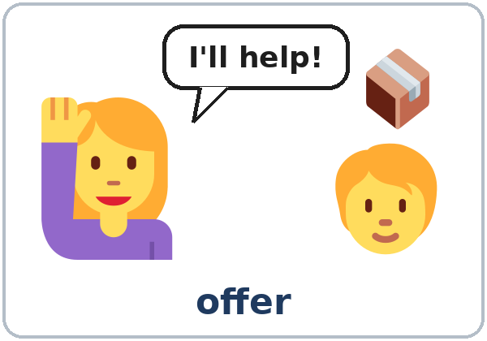
Don't Worry, I'll Do It
Today you will:
• Offer help with I'll
• Make a promise
• Choose will or going to
Lesson 5 · Level 3
Notes:
Welcome learners as they arrive.
Point to the title and read it: "Don't worry, I'll do it." Say: "Tonight we offer help and make promises: at work, with a neighbor, and at a school event."
Read the three lines under "Today you will". Give one quick example of each: "The phone's ringing. I'll get it." • "I'll call you back. Don't worry, I won't forget." • "I'm going to visit my mom. I bought a ticket."
Invented events (important): every event, job, and sign-up sheet in this lesson is invented. Volunteering is an example, not a request: never ask learners to sign up for a real event, give a real phone number, or offer a real ride. "I can't help this time" is always an OK answer.
Source: Level3_Lesson5.md (Topic; At a glance: Objectives; Teacher notes: Invented events).
Picture: Twemoji graphics by Twitter, Inc. and other contributors (https://github.com/jdecked/twemoji), CC BY 4.0 (https://creativecommons.org/licenses/by/4.0/); resized and combined, with speech bubbles, signs, and labels (images/CREDITS.md).

Slide 2
01
I can offer help with I'll.
The phone's ringing. I'll get it.
Today's
Goals
02
I can make a promise.
03
I can ask Will you…? → Yes, I will.
By the end of class, you can do these six things.
All the events are invented.
We check at 7:25!
04
I can understand Do you want me to…?
05
I can choose will or going to.
06
I can write a text message offering help.
Notes:
Read each goal slowly. Learners repeat.
Goal 1: offers with I'll (The phone's ringing. I'll get it.). Goal 2: promises (I'll call you back. Don't worry, I won't forget.). Goal 3: Will you…? → Yes, I will. / No, I won't.
Goal 4: understand Do you want me to…? and Shall I…? Goal 5: will (decided now) or going to (planned before). Goal 6: read a school flyer and a sign-up sheet, and write a short text message offering help.
"We check at 7:25" = the Progress Check. It is not a test grade.
Source: Level3_Lesson5.md (At a glance: Objectives).

Slide 3
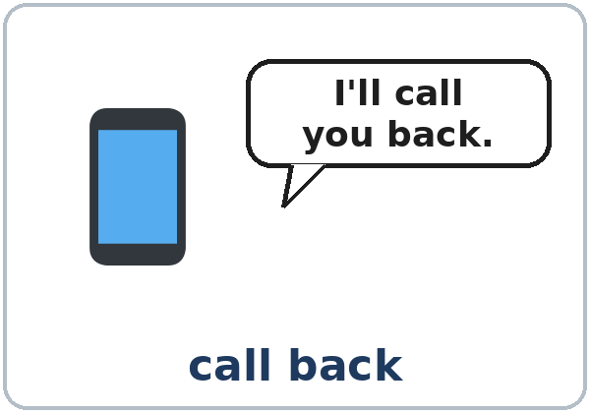
OPENING TALK · 6:00
Opening Talk
A asks a card question.
What were you doing at 8:00 last night?
B answers with 2–3 sentences.
A asks one follow-up.
Really? Who were you with?
Then switch.
Notes:
Step 1 · 6:00–6:10 · Opening Talk + Homework Check · 10 min. Pairs (7 pairs + 1 trio with 15 learners; 3–4 pairs with 7–8).
Before class, write on the board: What were you doing at…? I was…ing when…
Model with one learner: "What were you doing at 8:00 last night?" → (answer) → "Really? Who were you with?" (Click to show the follow-up.)
Opening Talk (6 min): learners open the Opening Talk page. A asks a card question; B answers with 2–3 sentences; A asks one follow-up. Switch after each card. The cards are on the next slide.
If behind: one card only, then the homework check.
Source: Level3_Lesson5.md (Step 1; Opening Talk page).
Picture: Twemoji graphics by Twitter, Inc. and other contributors (https://github.com/jdecked/twemoji), CC BY 4.0 (https://creativecommons.org/licenses/by/4.0/); resized and combined, with speech bubbles, signs, and labels (images/CREDITS.md).

Slide 4
Opening Talk
Cards
01
What were you doing at 8:00 last night?
02
What were you doing when this class started last week?
Work with a partner. Then switch.
Follow-ups:
Really? Who were you with? What happened then? What did you do?
03
What was your family doing at 7:00 this morning?
04
Tell me about a time it started to rain while you were outside.
05
Homework check: Lesson 4, item 1.
Notes:
Step 1, continued. The four cards from the Opening Talk page. Each click shows the next card.
A asks a card question. B answers with 2–3 sentences. A asks one follow-up question (follow-ups on the right). Then switch.
Homework Check (4 min, last click): partners read their Lesson 4 Homework item 1 (At 7:00 a.m., I was…) to each other. The partner asks one question about it. Walk around. Write 2 common errors on the board (often I was cook or They was…) and correct them together.
Source: Level3_Lesson5.md (Step 1; Opening Talk page: cards, follow-ups, homework check).

Slide 5
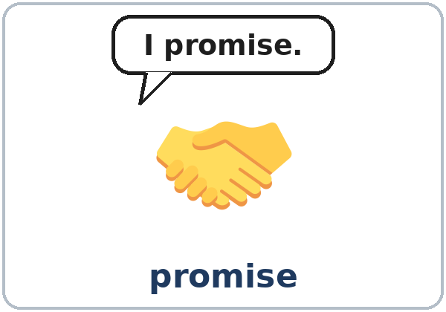
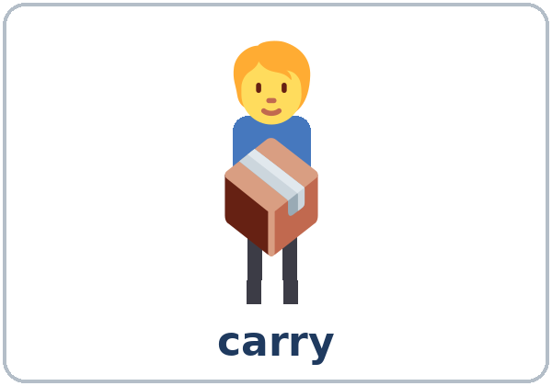
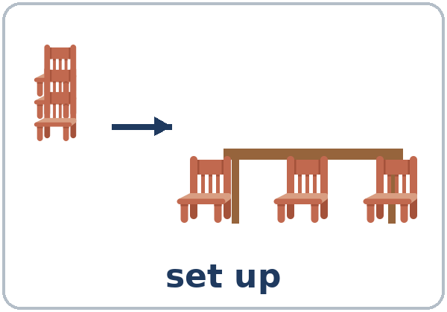

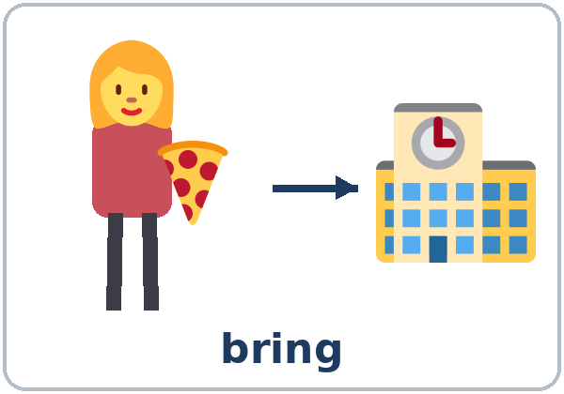
Look. Listen.
Repeat.
New Words
★ offer
★ promise
★ carry
★ set up
★ clean up
★ bring
Notes:
Step 2 · 6:10–6:18 · New Words · 8 min (this slide and the next). Whole class, then pairs.
Point to each picture and say the word. Learners repeat once. ★ = the most important words. Each click shows the next word.
Act out carry (pick up a bag), offer (raise your hand: "I'll help!"), promise (hand on your heart: "I promise"), and clean up (sweep).
Show offer: pick up a heavy bag and look tired. Wait. When a learner says something, smile: "Thank you! That's an offer." Then say it for them: "I'll carry it."
If behind: teach the ★ words only.
Source: Level3_Lesson5.md (Step 2; Key vocabulary; New Words page).
Pictures: Twemoji graphics by Twitter, Inc. and other contributors (https://github.com/jdecked/twemoji), CC BY 4.0 (https://creativecommons.org/licenses/by/4.0/); resized and combined, with speech bubbles, signs, and labels (images/CREDITS.md).

Slide 6
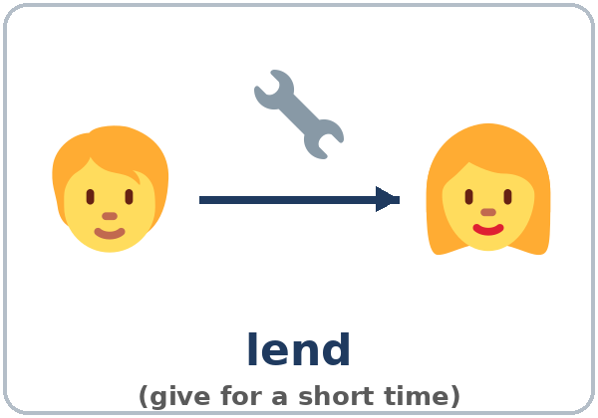
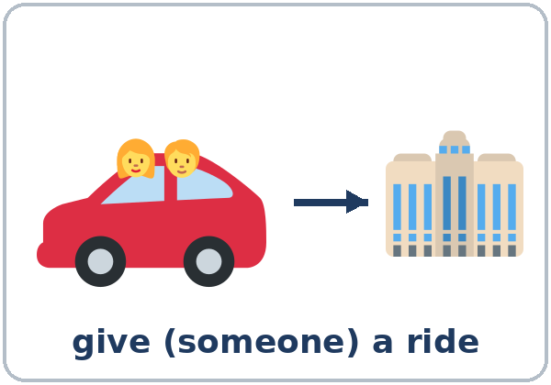
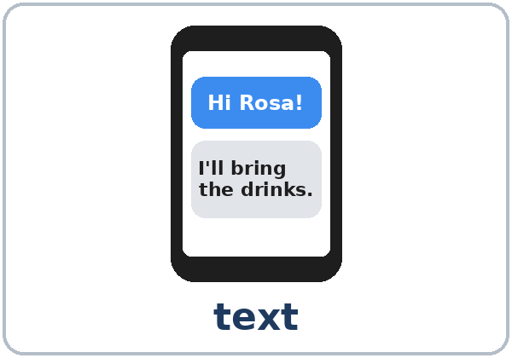

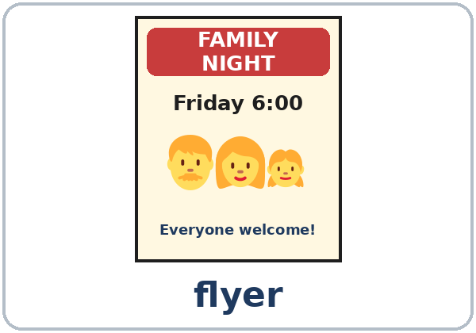
Partner game:
A says. B points.
More New Words
★ lend
★ give a ride
★ call back
★ text
school event
flyer
Notes:
Step 2, continued. Point to each picture and say the word. Learners repeat once.
Partner game (2 min): A says a word. B points to the picture and makes a sentence (A: lend. B: I can lend you my pen. / I can give you a ride.). Switch.
If behind: teach the ★ words only.
Source: Level3_Lesson5.md (Step 2; New Words page; Partner game).
Pictures: Twemoji graphics by Twitter, Inc. and other contributors (https://github.com/jdecked/twemoji), CC BY 4.0 (https://creativecommons.org/licenses/by/4.0/); resized and combined, with speech bubbles, signs, and labels (images/CREDITS.md).

Slide 7
Check the Meaning
Look at the picture. Answer the question.
1
2
3
Your pen, for 5 minutes: lend or give?
Drive your neighbor to work. You…?
Put out chairs before a party. You…?
lend
give a ride
set up
Notes:
Step 2 · Check meaning · 1 min. Whole class.
The answers are hidden. Ask each question and wait for the class to answer. Then click to show the answer. Each click shows one answer, in order: 1, 2, 3.
1. "You give your pen to a classmate for 5 minutes. Is that lend or give?" (lend) • 2. "You drive your neighbor to work. You…?" (give a ride) • 3. "Before a party, you put out the chairs. You…?" (set up)
One more question: "After the party?" (clean up)
Source: Level3_Lesson5.md (Step 2: Check meaning).
Pictures: Twemoji graphics by Twitter, Inc. and other contributors (https://github.com/jdecked/twemoji), CC BY 4.0 (https://creativecommons.org/licenses/by/4.0/); resized and combined, with speech bubbles, signs, and labels (images/CREDITS.md).

Slide 8
Before You
Listen for:
Listen
What is the event?
Carmen and David are parents. Their children go to Hillside School. Carmen is calling David.
Who will do each job?
01
Audio: about 1:17. It plays once.
Narrator
02
Carmen
Play 1: Task A
03
David
Notes:
Step 3 · 6:18–6:30 · Listening + "Say it" · 12 min (slides 8 to 12). Individuals, then pairs check.
Before you listen (1 min). Point to the school event picture and say: "Carmen and David are parents. Their children go to Hillside School. Carmen is calling David. What is the event? Listen."
There are three voices: a Narrator, Carmen, and David. Each click highlights the next voice.
The audio (L3_L5_listening.mp3, about 1:17; the teacher steps say about 1:15) plays the conversation once. Press play again for play 2. A third play is fine if the class needs it.
No speaker? Read the script with a volunteer at a normal, friendly speed.
Audio: L3_L5_listening.mp3 uses computer-generated voices (Chatterbox TTS, MIT License, cloned from synthetic Kokoro-82M reference clips, Apache License 2.0). No recordings of real people. The names and the story are invented.
Source: Level3_Lesson5.md (Step 3; Listening script; Listening page).
Picture: Twemoji graphics by Twitter, Inc. and other contributors (https://github.com/jdecked/twemoji), CC BY 4.0 (https://creativecommons.org/licenses/by/4.0/); resized and combined, with speech bubbles, signs, and labels (images/CREDITS.md).

Slide 9
Listen. What is the event?
Circle.
Listening A
What is the event?
a. a birthday party
b. a family night at a school
c. a park cleanup
1
b
Pairs: compare your answers.
Then check together.
Notes:
Play 1 → Task A (what is the event?). Pairs compare. Check together.
Click to show the answer: b (a family night at a school).
Then read Tasks B and C together (1 min) so learners know what to listen for. For Task B, show the letters: D = David, R = Rosa, S = David's sister, C = Carmen.
Source: Level3_Lesson5.md (Step 3; Listening Task A; Answer key).

Slide 10
Listen again. Who will do it?
Write D, R, S, or C.
Listening B
1
set up the tables and chairs
D
2
bring pizza
R
3
bring drinks
D
D = David
R = Rosa
S = David's sister
C = Carmen
One job has two letters.
4
make a flyer
S
5
call back tonight
D
6
clean up after the event
C and D
Notes:
Play 2 → Tasks B and C. Pairs compare. Then show the answers.
Click to show each answer (one click per job, 1 to 6): 1 D (set up the tables and chairs) • 2 R (bring pizza) • 3 D (bring drinks) • 4 S (make a flyer) • 5 D (call back tonight) • 6 C and D (clean up after the event: Carmen, and David helps).
Source: Level3_Lesson5.md (Step 3; Listening Task B; Answer key).

Slide 11
Listen again.
Write 'll or going to.
Listening C
1
No problem. I____ set them up.
'll
2
Rosa is ____ bring pizza.
going to
3
OK, I____ bring the drinks.
'll
Pairs: compare your answers.
Then check together.
4
I'm ____ be very busy at work this week.
going to
5
I____ ask her and call you back tonight.
'll
6
I'm ____ clean up after the event.
going to
Notes:
Task C (play 2). Click to show each answer (one click per item, 1 to 6): 1 'll, 2 going to, 3 'll, 4 going to, 5 'll, 6 going to.
If behind: do Task C together on the board, reading the lines yourself.
Source: Level3_Lesson5.md (Step 3; Listening Task C; Answer key).

Slide 12
Say it: I'll, won't, want
Say It
The class repeats each line.
I'll · you'll · we'll
I won't forget. (like don't)
I will = I'll: one short sound.
won't sounds like don't.
Say each line two times.
I want pizza.
Notes:
"Say it" (2 min). Say: "I will is usually I'll: one short sound." Read I'll, you'll, we'll.
Then contrast won't (like don't) and want: I won't forget. / I want pizza. The class repeats each line twice.
Source: Level3_Lesson5.md (Step 3: "Say it"; Listening page: Say it).

Slide 13
Grammar Box 1
Offers with I'll
PROBLEM
OFFER (I'll = I will)
The phone's ringing.
I'll get it. / answer it.
These boxes are heavy.
I'll carry them. / help you.
We need chairs for the party.
I'll bring them. / set them up.
I don't have a ride.
I'll give you a ride. / pick you up.
I forgot my pen.
I'll lend you one. / lend you mine.
Notes:
Step 4 · 6:30–6:45 · Grammar Q&A · 15 min (slides 13 to 21). Whole class, then pairs. Show the Grammar page. Read across: A reads from the left side; B answers from the right side.
Box 1 (3 min): act it out. Drop a pen: "Oh no!" A learner picks it up: "I'll get it." Read Box 1: you read the problem; the class answers with I'll…. Each click shows one offer.
will never changes: I will, she will, they will. No -s, no to: She'll call (not She wills call, not She will to call).
Source: Level3_Lesson5.md (Step 4; Grammar Box 1; Teacher notes: will never changes).
Picture: Twemoji graphics by Twitter, Inc. and other contributors (https://github.com/jdecked/twemoji), CC BY 4.0 (https://creativecommons.org/licenses/by/4.0/); resized and combined, with speech bubbles, signs, and labels (images/CREDITS.md).

Slide 14
Grammar Box 2 · promises
Will you…?
QUESTION
ANSWER
Will you call me tonight? / be there at five?
Yes, I will. I promise.
No, I won't. Sorry, I'm busy.
Will you remember? / be late?
Don't worry. I won't forget. / I won't be late.
Notes:
Box 2 (3 min): promises. Ask a learner: "Will you bring your homework next week?" → "Yes, I will." → "Promise?" → "I promise. I won't forget."
Point to won't = will not. Each click shows the answer side of one row.
Source: Level3_Lesson5.md (Step 4; Grammar Box 2).
Picture: Twemoji graphics by Twitter, Inc. and other contributors (https://github.com/jdecked/twemoji), CC BY 4.0 (https://creativecommons.org/licenses/by/4.0/); resized and combined, with speech bubbles, signs, and labels (images/CREDITS.md).

Slide 15
Grammar Box 3
Other Ways to Offer
understand and answer
OFFER
ANSWER
Do you want me to
carry that? / open the door?
Yes, please. Thanks!
No, thanks. I'm OK.
Shall I
call a taxi? / close the window?
Yes, please. That's very kind.
No, thanks.
Notes:
Box 3 (1 min): Do you want me to…? / Shall I…? are other ways to offer. Learners only need to understand them and answer Yes, please. / No, thanks.
Each click shows the answer side of one row.
Source: Level3_Lesson5.md (Step 4; Grammar Box 3; Teacher notes: Shall I…? / Do you want me to…?).
Picture: Twemoji graphics by Twitter, Inc. and other contributors (https://github.com/jdecked/twemoji), CC BY 4.0 (https://creativecommons.org/licenses/by/4.0/); resized and combined, with speech bubbles, signs, and labels (images/CREDITS.md).

Slide 16
Grammar Box 4
will or going to?
decided now · planned before
will: I decide NOW
going to: I PLANNED IT BEFORE
A: We need drinks.
B: OK, I'll bring juice.
I'm going to bake a cake. (I bought eggs yesterday.)
A: The phone's ringing.
B: I'll get it.
We're going to visit my mother. (We bought tickets.)
A: It's cold in here.
B: I'll close the window.
She's going to work on Saturday. (It's on her schedule.)
Notes:
Box 4 (3 min): draw two pictures on the board: a light bulb (an idea now → I'll) and a calendar (planned before → I'm going to). Read Box 4 across. Each click shows the going to side of one row.
I'll = I decide now (an offer, a promise, a quick decision). going to = I planned it before (I bought the ticket; I ordered the pizza). Don't spend a long time on cases where both are possible.
Check questions: "The phone's ringing. I ___ get it." ('ll) • "I bought a ticket. I ___ visit my mom." ('m going to) • "Don't worry, I ___ forget." (won't)
Source: Level3_Lesson5.md (Step 4; Grammar Box 4; Teacher notes: will or going to).
Picture: Twemoji graphics by Twitter, Inc. and other contributors (https://github.com/jdecked/twemoji), CC BY 4.0 (https://creativecommons.org/licenses/by/4.0/); resized and combined, with speech bubbles, signs, and labels (images/CREDITS.md).

Slide 17
Practice A: write the words.
'll · won't · Will
Practice A
1
A: It's cold in here. B: I____ close the window.
'll
2
Don't worry, I ____ forget.
won't
3
A: I don't have a pen. B: I____ lend you one.
'll
Write 'll, won't, or Will.
Pairs: check your answers.
4
I promise I ____ be late.
won't
5
A: Can someone help me? B: I____ help you!
'll
6
____ you call me tonight?
Will
Notes:
Practice A and B (3 min): learners write, then pairs check. Go over the answers.
Click to show each answer (one click per item, 1 to 6): 1 'll, 2 won't, 3 'll, 4 won't, 5 'll, 6 Will.
Source: Level3_Lesson5.md (Step 4; Grammar Practice A; Answer key).

Slide 18
Practice B
Circle the right words.
Practice B
1
A: The phone's ringing! B: OK, (I'll get / I'm going to get) it.
I'll get
2
I bought eggs and flour yesterday. I (will bake / am going to bake) a cake on Saturday.
am going to bake
3
A: We need someone to clean up. B: (I'll do / I'm going to do) it!
I'll do
Decided now: will.
Planned before: going to.
Pairs: check your answers.
4
We have tickets. We (will see / are going to see) a movie tonight.
are going to see
5
A: Oh no, I forgot my lunch. B: (I'll share / I'm going to share) mine.
I'll share
6
She (will / is going to) visit her mother next week. She bought the bus ticket.
is going to
Notes:
Practice B. Learners circle the right words. Pairs check.
Click to show each answer (one click per item, 1 to 6): 1 I'll get, 2 am going to bake, 3 I'll do, 4 are going to see, 5 I'll share, 6 is going to.
Source: Level3_Lesson5.md (Step 4; Grammar Practice B; Answer key).

Slide 19
Common Mistakes
Don't say
Say
The phone's ringing. I answer it.
The phone's ringing. I'll answer it.
I will to bring the drinks.
I will bring (I'll bring) the drinks.
She wills call you.
She will call you.
Don't worry, I don't forget.
Don't worry, I won't forget.
Will you calling me?
Will you call me?
I'll visit my sister Sunday. (I bought the ticket.)
I'm going to visit my sister on Sunday.
Notes:
Common mistakes (never skip this table). Read a line from Don't say. Ask: "What's the right way?" Learners try first. Then click to show the right form. Each click shows one line, in order 1 to 6.
1: an offer needs I'll • 2, 3, 5: will never changes: no to, no -s, no -ing after it • 4: a promise = won't • 6: planned before = going to.
Say the right form clearly; the learner repeats. Learners can read the Spanish note and the tip on their Grammar page themselves; you don't need to explain them.
Source: Level3_Lesson5.md (Grammar: Common mistakes; Teacher notes: Typical mistakes).
Picture: Twemoji graphics by Twitter, Inc. and other contributors (https://github.com/jdecked/twemoji), CC BY 4.0 (https://creativecommons.org/licenses/by/4.0/); resized and combined, with speech bubbles, signs, and labels (images/CREDITS.md).

Slide 20
Pair Drill
A says a problem.
01
A says a problem. B offers help with I'll…. Then switch.
A: I'm hungry. / It's cold.
A: My bag is heavy.
B offers help with I'll….
02
B: I'll…
Then switch roles.
Notes:
Pair drill (last 2 min of Step 4). Pairs.
A says a problem (I'm hungry. / It's cold. / My bag is heavy.); B offers help with I'll…. Switch.
If behind: skip the pair drill. Talk Time practices it.
Source: Level3_Lesson5.md (Step 4: Pair drill).
Picture: Twemoji graphics by Twitter, Inc. and other contributors (https://github.com/jdecked/twemoji), CC BY 4.0 (https://creativecommons.org/licenses/by/4.0/); resized and combined, with speech bubbles, signs, and labels (images/CREDITS.md).

Slide 21
Talk Time
Problem / Offer Cards
Round 1: pairs.
Try all 8 cards.
7:00–7:12
1
A reads a problem card.
My car won't start, and I have to go to work.
2
B offers help with I'll….
Don't worry. I'll give you a ride, because I'm going that way.
3
A says thank you.
Really? Thanks! That's very kind.
Notes:
Step 5 · 7:00–7:12 · Talk Time: Problem / Offer Cards + Event Board · 12 min.
Round 1, pairs (5 min): A reads a problem card (My car won't start.). B offers help with I'll… and one reason or detail. A says thank you. Switch after each card. Try to use all 8 cards. Each click shows the next step.
Model with one learner (1 min): read card 1. Help the learner say "I'll give you a ride." Answer: "Really? Thank you so much!"
Cards: 1 My car won't start, and I have to go to work. 2 I forgot my dictionary at home. 3 I have five heavy boxes in my car. 4 My boss called, but I was in a meeting. 5 My kitchen is a mess after the party. 6 Thirty people are coming, and we have no chairs. 7 It's raining, and I don't have an umbrella. 8 I don't know how to send a photo by text.
Sample offers: 1 I'll give you a ride. 2 I'll lend you mine. 3 I'll help you carry them. 4 I'll call him for you. / I'll text him. 5 I'll help you clean up. 6 I'll set up the chairs. 7 I'll lend you an umbrella. 8 I'll show you. / I'll help you.
Useful: Don't worry. No problem. I'll… Thanks! That's very kind. You're the best!
Source: Level3_Lesson5.md (Step 5; Talk Time: Problem / Offer Cards; Answer key).
Picture: Twemoji graphics by Twitter, Inc. and other contributors (https://github.com/jdecked/twemoji), CC BY 4.0 (https://creativecommons.org/licenses/by/4.0/); resized and combined, with speech bubbles, signs, and labels (images/CREDITS.md).

Slide 22

Talk Time
Event Board
Round 2: groups of 3–4.
Two jobs each.
7:00–7:12
1
Choose one event.
Park Cleanup or Family Night
2
Two jobs each, with I'll….
I'll bring water and I'll take photos.
3
One plan with going to.
I'm going to work on Saturday morning, so I'll come at 11:00.
Notes:
Round 2, groups (6 min): each group chooses one event on the Event Board: a park cleanup or a school family night. Each person volunteers for two jobs with I'll… and writes their name. Then each person says one plan with going to (something they planned before). Each click shows the next step.
A Park Cleanup (Saturday, 9:00–12:00): bring trash bags • bring water for everyone • make a flyer • give rides to the park • pick up trash near the river • take photos • text everyone the time.
A School Family Night (Friday, 6:00–8:00): set up the tables and chairs • bring food • bring drinks • play games with the children • play music • clean up after the event • text the families a reminder.
Share (1 min): one person from each group reads their board: "Ana will bring water. Tom will set up the tables." If behind: Round 1 only.
Invented events (important): every event, job, and sign-up sheet in this lesson is invented. Volunteering is an example, not a request: never ask learners to sign up for a real event, give a real phone number, or offer a real ride. "I can't help this time" is always an OK answer.
Source: Level3_Lesson5.md (Step 5; Talk Time: Event Board).
Picture: Twemoji graphics by Twitter, Inc. and other contributors (https://github.com/jdecked/twemoji), CC BY 4.0 (https://creativecommons.org/licenses/by/4.0/); resized and combined, with speech bubbles, signs, and labels (images/CREDITS.md).

Slide 23
Before You Go 7:12–7:17
01
Exit ticket
02
Homework
Write two sentences:
1. An offer or a promise with I'll or I won't.
2. A plan with going to and because or so:
I'm going to visit my sister on Sunday, because it's her birthday.
Give it to me at the door.
About 15 minutes.
1. Write an offer with I'll for each problem.
2. Write 'll, going to, won't, or Will.
3. Ask: What are you going to do this weekend?
4. Review: was / were + -ing and when.
Bring it next week!
Notes:
Step 6 · 7:12–7:17 · Exit Ticket + Homework · 5 min · NEVER SKIP.
Exit ticket: each learner writes two sentences on a slip: one offer or promise with I'll or I won't, and one plan with going to and because or so (I'm going to visit my sister on Sunday, because it's her birthday.). Collect at the door.
Homework: open the Homework page. Do item 1 together (one offer on the board). Say: "About 15 minutes. Bring it next week."
Homework items: 1 write an offer with I'll for each problem • 2 write 'll, 'm going to, 're going to, won't, or Will • 3 ask a family member or a friend: What are you going to do this weekend? Then offer to help with one thing • 4 review (Lesson 4): 2 sentences with was / were + -ing and when.
Read & Write (7:17–7:25, on the Student Pages): a flyer and a volunteer sign-up sheet; questions 1–5; then a short text message to Carmen offering help with I'll. If behind: questions 1–5 only; the text message becomes homework.
Source: Level3_Lesson5.md (Step 6; Homework page; Read & Write step).
Picture: Twemoji graphics by Twitter, Inc. and other contributors (https://github.com/jdecked/twemoji), CC BY 4.0 (https://creativecommons.org/licenses/by/4.0/); resized and combined, with speech bubbles, signs, and labels (images/CREDITS.md).

Slide 24
Progress Check 7:25
D. I can…
😀 🙂 😐
Check one face.
I can offer help with I'll….
I can make a promise.
I can make a quick decision.
I can tell the difference between will and going to.
A. Listen to the teacher. Circle a or b.
Answer
1. a. decided now (will) b. planned before (going to)
a
2. a. decided now (will) b. planned before (going to)
b
3. a. decided now (will) b. planned before (going to)
a
4. a. decided now (will) b. planned before (going to)
b
Notes:
Progress Check · 7:25–7:30 · 5 min. Individuals. Open the Progress Check page.
Part A: read each sentence slowly, 2 times. Learners circle a (decided now) or b (planned before). Then click to show the answer (one click per item, 1 to 4).
Say: 1 "OK, I'll carry that box for you." (a) • 2 "I'm going to visit my sister on Sunday. I bought the bus ticket." (b) • 3 "Don't worry. I'll call you back in five minutes." (a) • 4 "We're going to have a party next week. We sent the invitations." (b)
Parts B and C: learners do them alone. Walk around and help with the instructions only. B answers: 1 will, 2 won't, 3 open, 4 are going to. C: answers will vary (for example I'll carry it for you. / I'll give you a ride.).
Part D: read each "I can…" line aloud and point to the 3 faces: 😀 "I can do it." 🙂 "With a little help." 😐 "Not yet."
Scoring: A /4 + B /4 + C /2 = /10. This is not a test grade. It shows who needs more help hearing will vs. going to (A) and with the forms (B, C).
Collect the pages (or check them at the start of Week 6). If behind: do the Progress Check in Week 6 at 6:00, while learners arrive.
Source: Level3_Lesson5.md (Progress Check step; Progress Check page; Answer key).

Slide 25
Goodbye! See You Next Week!
Now you can:
• Offer help with I'll
• Make a promise
• Choose will or going to
Lesson 5 · Level 3
Notes:
Read the title: "Goodbye! See you next week!" Learners repeat.
Read the three "Now you can" lines. Say: "My bag is heavy." Wait for an offer: "I'll carry it!"
Remind learners: homework is about 15 minutes. Bring it next week.
Source: Level3_Lesson5.md (At a glance: Objectives; Step 6).
Picture: Twemoji graphics by Twitter, Inc. and other contributors (https://github.com/jdecked/twemoji), CC BY 4.0 (https://creativecommons.org/licenses/by/4.0/); resized and combined, with speech bubbles, signs, and labels (images/CREDITS.md).

Slide 26
Credits
Pictures
Vocabulary pictures use Twemoji graphics by Twitter, Inc. and other contributors (https://github.com/jdecked/twemoji), licensed under CC BY 4.0 (https://creativecommons.org/licenses/by/4.0/). The graphics were resized and combined, and speech bubbles, signs, and labels were added.
The faces on the Progress Check are standard emoji characters shown with the computer's emoji font.
Names and story
Carmen, David, and Rosa are invented names. The listening story is invented.
Audio and font
Audio: synthetic voices made with Chatterbox TTS (MIT License), cloned from short synthetic reference clips made with Kokoro-82M (Apache License 2.0). No recordings of real people were used. Each file carries an inaudible Perth watermark marking it as AI-generated. Font: Lexend Deca (OFL 1.1).
© 2026 the authors. The authors license this deck under CC BY-NC-SA 4.0.
Notes:
Credits. You don't need to read this slide in class.
Pictures: Twemoji graphics by Twitter, Inc. and other contributors, CC BY 4.0; the file-by-file list is in images/CREDITS.md.
Audio: L3_L5_listening.mp3 uses computer-generated voices (Chatterbox TTS, MIT License, cloned from synthetic Kokoro-82M reference clips, Apache License 2.0). No recordings of real people. The names and the story are invented.
Course materials: © 2026 the authors, licensed under CC BY-NC-SA 4.0 (https://creativecommons.org/licenses/by-nc-sa/4.0/).
Source: Level3_Lesson5.md (Picture Credits); images/CREDITS.md.

