Slide 1

Be Ready
Today you will:
• Say what will happen if…
• Make predictions with probably / maybe
• Make a simple Ready Plan
Lesson 6 · Level 3
Notes:
Welcome learners as they arrive.
Point to the title and read it: "Be ready." Say: "Tonight we talk about weather alerts, storms, heat, and power outages, and what to do if…"
Read the three lines under "Today you will". Give one quick example of each: "If the power goes out, I'll use a flashlight." • "It will probably rain. It probably won't snow." • "If it's very hot, we'll go to the library."
Choose your weather: use the weather that fits your area (snow, heat, storms, floods). Skip a word that never happens where you live, or teach it quickly for the news.
Feelings: some learners have lived through a hurricane, a flood, or an earthquake. Keep the stories in the lesson invented. Never ask about real disasters. "I don't want to say" is always OK.
Source: Level3_Lesson6.md (Topic; At a glance: Objectives; Teacher notes).
Picture: Twemoji graphics by Twitter, Inc. and other contributors (https://github.com/jdecked/twemoji), CC BY 4.0 (https://creativecommons.org/licenses/by/4.0/); resized and combined, with speech bubbles, signs, and labels (images/CREDITS.md).

Slide 2
01
I can understand a weather alert.
A big storm will arrive tonight.
Today's
Goals
02
I can say what will happen if….
03
I can ask What will you do if…?
By the end of class, you can do these six things.
The stories are invented.
We check at 7:25!
04
I can make predictions with probably and maybe.
05
I can give safety tips with should.
06
I can fill in a Ready Plan card.
Notes:
Read each goal slowly. Learners repeat.
Goal 1: understand a short weather forecast and a weather alert. Goal 2: If the power goes out, I'll use a flashlight. Goal 3: What will you do if…?
Goal 4: It will probably rain. It probably won't snow. Goal 5: simple safety tips with should (review). Goal 6: read a weather alert text and fill in a simple "My Ready Plan" card.
"We check at 7:25" = the Progress Check. It is not a test grade.
Source: Level3_Lesson6.md (At a glance: Objectives).

Slide 3
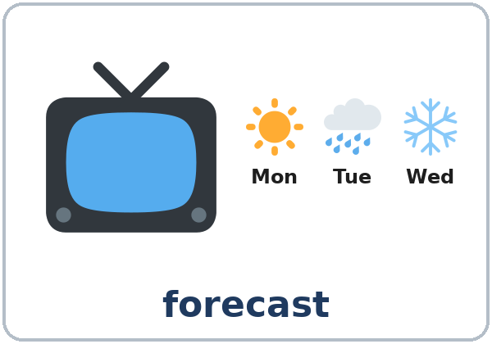
OPENING TALK · 6:00
Opening Talk
A asks a card question.
What are you going to do this weekend?
B answers with 2–3 sentences.
A asks one follow-up.
Really? Who with?
Then switch.
Notes:
Step 1 · 6:00–6:10 · Opening Talk + Homework Check · 10 min. Pairs (7 pairs + 1 trio with 15 learners; 3–4 pairs with 7–8).
Before class, write on the board: I'll… / I'm going to… / Don't worry, I won't…
Model with one learner: "What are you going to do this weekend?" → (answer) → "Really? Who with?" (Click to show the follow-up.)
Opening Talk (6 min): learners open the Opening Talk page. A asks a card question or reads a problem; B answers with 2–3 sentences; A asks one follow-up. Switch after each card. The cards are on the next slide.
If behind: one card only, then the homework check.
Source: Level3_Lesson6.md (Step 1; Opening Talk page).
Picture: Twemoji graphics by Twitter, Inc. and other contributors (https://github.com/jdecked/twemoji), CC BY 4.0 (https://creativecommons.org/licenses/by/4.0/); resized and combined, with speech bubbles, signs, and labels (images/CREDITS.md).

Slide 4
Opening Talk
Cards
01
What are you going to do this weekend?
02
"I'm moving to a new apartment on Saturday." (B offers help with I'll…)
Work with a partner. Then switch.
Follow-ups:
Really? Who with? Why? Thanks! That's very kind.
03
What are you going to do after class tonight?
04
"I forgot my lunch today." (B offers help with I'll…)
05
Homework check: Lesson 5, item 1.
Notes:
Step 1, continued. The four cards from the Opening Talk page. Each click shows the next card.
A asks a card question or reads a problem. B answers with 2–3 sentences (for a problem card, B offers help with I'll…). A asks one follow-up question. Then switch.
Homework Check (4 min, last click): partners read their Lesson 5 Homework item 1 (offers with I'll) to each other. The partner says one more offer. Walk around. Write 2 common errors on the board (often I help you or I will to…) and correct them together.
Source: Level3_Lesson6.md (Step 1; Opening Talk page: cards, follow-ups, homework check).

Slide 5
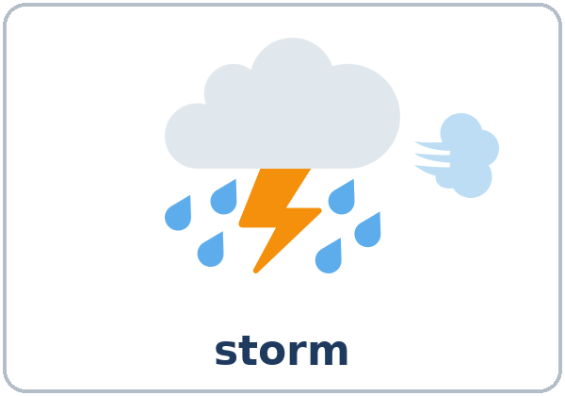
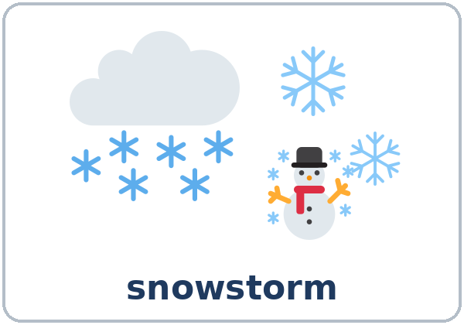
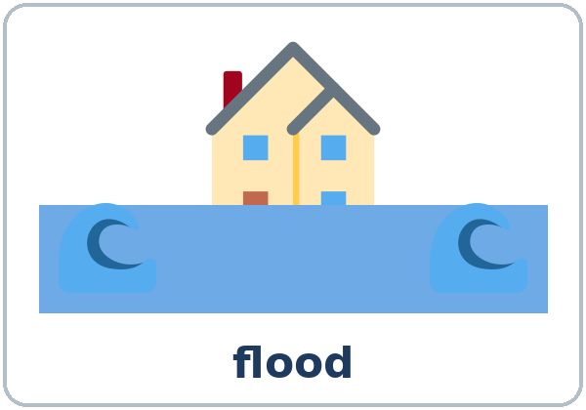
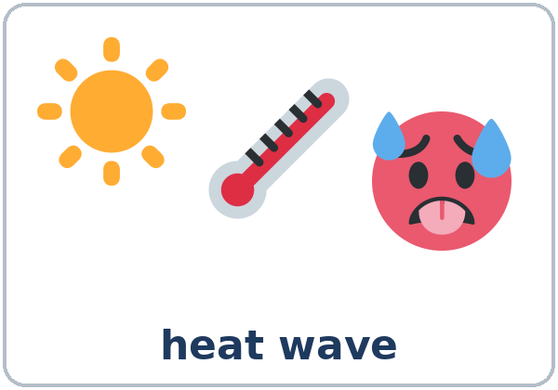
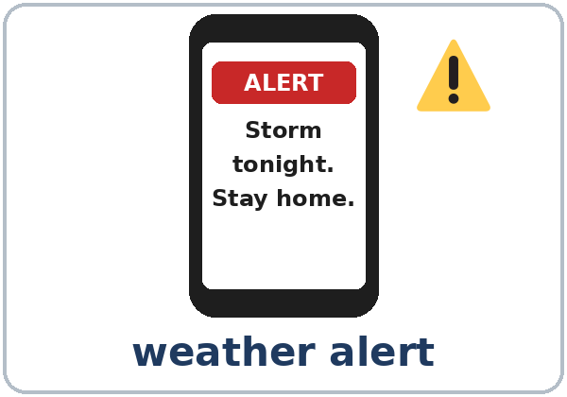
Look. Listen.
Repeat.
New Words
★ forecast
★ storm
★ snowstorm
★ flood
★ heat wave
★ weather alert
Notes:
Step 2 · 6:10–6:18 · New Words · 8 min (this slide and the next). Whole class, then pairs.
Point to each picture and say the word. Learners repeat once. ★ = the most important words. Each click shows the next word.
Act out heat wave (fan your face), snowstorm (shiver), and power outage (click a light switch: "Oh no! No lights!").
If behind: teach the ★ words only.
Source: Level3_Lesson6.md (Step 2; Key vocabulary; New Words page).
Pictures: Twemoji graphics by Twitter, Inc. and other contributors (https://github.com/jdecked/twemoji), CC BY 4.0 (https://creativecommons.org/licenses/by/4.0/); resized and combined, with speech bubbles, signs, and labels (images/CREDITS.md).

Slide 6
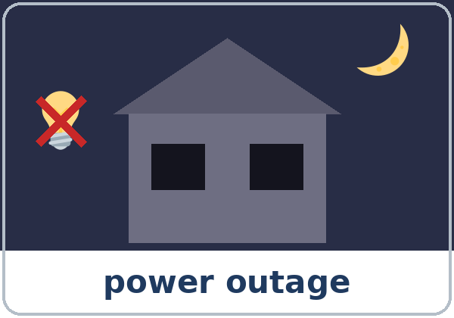

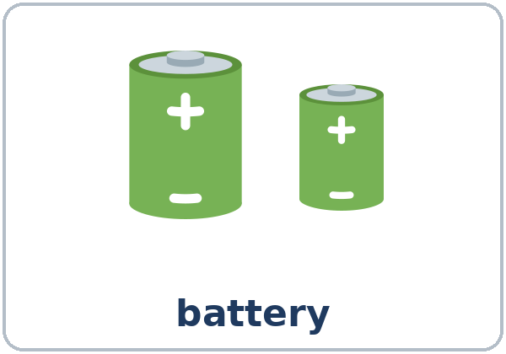

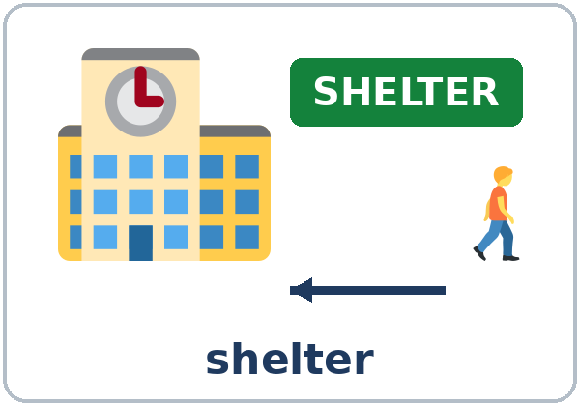
Partner game:
A says. B points.
More New Words
★ power outage
★ flashlight
★ battery
★ emergency kit
★ bottled water
shelter
Notes:
Step 2, continued. Point to each picture and say the word. Learners repeat once.
Group the words (1 min): draw three columns on the board: WEATHER (forecast, storm, snowstorm, flood, heat wave), PROBLEMS (weather alert, power outage), and BE READY (flashlight, battery, emergency kit, bottled water, shelter). Learners say where each word goes.
Partner game (2 min): A says a word. B points to the picture and makes a sentence (A: flashlight. B: If the power goes out, I'll use a flashlight. / I have a flashlight in my kitchen.). Switch.
If behind: teach the ★ words only.
Source: Level3_Lesson6.md (Step 2; New Words page; Partner game).
Pictures: Twemoji graphics by Twitter, Inc. and other contributors (https://github.com/jdecked/twemoji), CC BY 4.0 (https://creativecommons.org/licenses/by/4.0/); resized and combined, with speech bubbles, signs, and labels (images/CREDITS.md).

Slide 7
Check the Meaning
Look at the picture. Answer the question.
1
2
3
No lights, no fridge, no TV. It's a…?
A flashlight, water, and batteries go in…?
A safe public building for a storm?
power outage
an emergency kit
a shelter
Notes:
Step 2 · Check meaning · 1 min. Whole class.
The answers are hidden. Ask each question and wait for the class to answer. Then click to show the answer. Each click shows one answer, in order: 1, 2, 3.
1. "No lights, no fridge, no TV. It's a…?" (power outage) • 2. "Where do you put a flashlight, water, and batteries?" (an emergency kit) • 3. "A safe public building for a storm?" (a shelter)
Source: Level3_Lesson6.md (Step 2: Check meaning).
Pictures: Twemoji graphics by Twitter, Inc. and other contributors (https://github.com/jdecked/twemoji), CC BY 4.0 (https://creativecommons.org/licenses/by/4.0/); resized and combined, with speech bubbles, signs, and labels (images/CREDITS.md).

Slide 8
Before You
Listen for:
Listen
What is the weather problem?
First, a weather alert on the radio. Then two roommates, Nadia and Ben, talk about it.
What will they use or buy?
01
Audio: about 1:20. It plays once.
Narrator
02
Nadia
Play 1: Task A
03
Ben
Notes:
Step 3 · 6:18–6:30 · Listening + "Say it" · 12 min (slides 8 to 12). Individuals, then pairs check.
Before you listen (1 min). Say: "First, you'll hear a weather alert on the radio. Then two roommates, Nadia and Ben, talk about it. What is the weather problem? Listen."
There are three voices: a Narrator (who also reads the weather alert), Nadia, and Ben. Each click highlights the next voice.
The audio (L3_L6_listening.mp3, about 1:20) plays once. Press play again for play 2. A third play is fine if the class needs it.
No speaker? Read the script with a volunteer at a normal, friendly speed.
Audio: L3_L6_listening.mp3 (about 1:20) is not recorded yet (see level3/AUDIO_STATUS.md). It will use computer-generated voices (Chatterbox TTS cloned from synthetic Kokoro-82M reference clips); no recordings of real people. Until the file is ready, read the listening script with a volunteer. The names and the story are invented.
Source: Level3_Lesson6.md (Step 3; Listening script; Listening page).
Picture: Twemoji graphics by Twitter, Inc. and other contributors (https://github.com/jdecked/twemoji), CC BY 4.0 (https://creativecommons.org/licenses/by/4.0/); resized and combined, with speech bubbles, signs, and labels (images/CREDITS.md).

Slide 9
Listen. What is the weather problem?
Circle.
Listening A
What is the weather problem?
a. a heat wave
b. a storm with strong wind and heavy rain
c. a snowstorm
1
b
Pairs: compare your answers.
Then check together.
Notes:
Play 1 → Task A (what is the weather problem?). Pairs compare. Check together.
Click to show the answer: b (a storm: strong wind and heavy rain).
Then read Tasks B and C together (1 min) so learners know what to listen for.
Source: Level3_Lesson6.md (Step 3; Listening Task A; Answer key).

Slide 10
Listen again. What will Ben and Nadia use or buy?
Check ✓.
Listening B
1. batteries
✓
✗
2. bottled water
✓
✗
3. candles
✓
✗
4. charged phones
✓
✗
5. a snow shovel
✓
✗
6. a new fridge
✓
✗
Notes:
Play 2 → Tasks B and C. Pairs compare. Then show the answers.
Click to circle each answer (one click per item, 1 to 6): ✓ 1 batteries, ✓ 2 bottled water, ✗ 3 candles, ✓ 4 charged phones, ✗ 5 a snow shovel, ✗ 6 a new fridge. (3 checks.)
Candles: keep them out of practice plans (fire risk); use flashlights.
Source: Level3_Lesson6.md (Step 3; Listening Task B; Answer key; Teacher notes: Safety).

Slide 11
Listen again.
Write the missing word.
Listening C
1
If the power ____ out, we ____ have any lights.
goes, won't
2
I____ buy some after work.
'll
3
If the power goes out, the fridge ____ work.
won't
Pairs: compare your answers.
Then check together.
4
Then we____ eat the food in the fridge first!
'll
5
If the storm ____ really bad, will we go to work tomorrow?
is
6
It____ probably rain all night.
'll
Notes:
Task C (play 2). Click to show each answer (one click per item, 1 to 6): 1 goes, won't • 2 'll • 3 won't • 4 'll • 5 is • 6 'll.
If behind: do Task C together on the board, reading the lines yourself.
Source: Level3_Lesson6.md (Step 3; Listening Task C; Answer key).

Slide 12
Say it: it'll, we'll
Say It
The class repeats each line.
it'll (id-ul) · we'll · I'll
If the power goes out,
it will = it'll
It sounds like id-ul.
Say each line two times.
we'll use a flashlight.
Notes:
"Say it" (2 min). Say: "It will is usually it'll. It sounds like id-ul." Read it'll, we'll, I'll.
Then read the line in the "Say it" box, stressing the key words: If the POWER goes OUT, we'll use a FLASHLIGHT. The class repeats each line twice.
Source: Level3_Lesson6.md (Step 3: "Say it"; Listening page: Say it).

Slide 13
Grammar Box 1
What will you do if…?
If + present, will
QUESTION
ANSWER
What will you do
if the power goes out?
If the power goes out, I'll use a flashlight. / I'll call my landlord.
What will you do
if it snows tomorrow?
If it snows, I'll stay home. / I'll take the bus.
What will you do
if it's very hot?
If it's very hot, I'll drink a lot of water. / I'll go to the library.
Notes:
Step 4 · 6:30–6:45 · Grammar Q&A · 15 min (slides 13 to 21). Whole class, then pairs. Show the Grammar page. The left side is the question. The right side is the answer.
Draw on the board: IF + present → will. Under it write: If it rains, I'll take the bus. Circle rains and say "present, no will." Circle 'll and say "the result: will."
Box 1 (3 min): read a question from the left; the class answers from the right. Each click shows the answer side of one row. Then ask learners: "What will you do if it snows tomorrow?"
After if, use the present: If it rains (not If it will rain). In English if needs a subject: If it rains (not If rains).
Source: Level3_Lesson6.md (Step 4; Grammar Box 1; Teacher notes: After if, use the present).
Picture: Twemoji graphics by Twitter, Inc. and other contributors (https://github.com/jdecked/twemoji), CC BY 4.0 (https://creativecommons.org/licenses/by/4.0/); resized and combined, with speech bubbles, signs, and labels (images/CREDITS.md).

Slide 14
Grammar Box 2
If First or Second
if first: comma · if second: no comma
IF FIRST (comma)
IF SECOND (no comma)
If it rains, I'll take the bus.
I'll take the bus if it rains.
If school closes, my kids will stay home.
My kids will stay home if school closes.
Notes:
Box 2 (2 min): the two halves can change places: I'll stay home if it snows. No comma when if is in the middle.
A reads the left side; B reads the right side. Each click shows the right side of one row.
Source: Level3_Lesson6.md (Step 4; Grammar Box 2).
Picture: Twemoji graphics by Twitter, Inc. and other contributors (https://github.com/jdecked/twemoji), CC BY 4.0 (https://creativecommons.org/licenses/by/4.0/); resized and combined, with speech bubbles, signs, and labels (images/CREDITS.md).

Slide 15
Grammar Box 3 · short answers
Will…?
QUESTION
ANSWER
If it snows tomorrow, will school be closed?
Yes, it will. / Probably. / Maybe.
Probably not. / No, it won't.
If the storm is bad, will the buses run?
Probably not. / Maybe. / I don't know.
Notes:
Boxes 3 and 4 (3 min): draw a line from 0% to 100% on the board. Put won't at 0%, probably won't at 25%, maybe at 50%, probably at 75%, will at 100%.
Box 3: read across. Each click shows the answer side of one row.
Source: Level3_Lesson6.md (Step 4; Grammar Box 3).
Picture: Twemoji graphics by Twitter, Inc. and other contributors (https://github.com/jdecked/twemoji), CC BY 4.0 (https://creativecommons.org/licenses/by/4.0/); resized and combined, with speech bubbles, signs, and labels (images/CREDITS.md).

Slide 16
Grammar Box 4
probably and maybe
How sure?
Prediction
100% sure
It will rain.
75% sure
It will probably rain.
50% sure
Maybe it will rain.
25% sure
It probably won't rain.
0%
It won't rain.
Notes:
Box 4: predictions with probably and maybe. Point to the 0%–100% line. Each click shows one prediction, from 100% to 0%.
probably goes after will and before won't: It will probably rain. It probably won't snow. Maybe goes at the start: Maybe it will snow.
Check questions: "If it ___ tomorrow, I'll stay home." (snows) • "If the power goes out, we ___ use flashlights." ('ll) • "It will ___ rain." (probably) • "It ___ won't snow." (probably)
Source: Level3_Lesson6.md (Step 4; Grammar Box 4; Teacher notes: probably).
Picture: Twemoji graphics by Twitter, Inc. and other contributors (https://github.com/jdecked/twemoji), CC BY 4.0 (https://creativecommons.org/licenses/by/4.0/); resized and combined, with speech bubbles, signs, and labels (images/CREDITS.md).

Slide 17
Grammar Box 5 · review
Safety tips with should
QUESTION
ANSWER
What should we do before a storm?
You should buy batteries. / keep bottled water at home. / charge your phone.
You shouldn't use candles. / drive in a flood.
Notes:
Box 5 is a quick should review. A reads the question; B answers from the right side. The click shows the answers.
Safety (important): keep candles out of practice plans (fire risk); use flashlights. Never use a grill or a generator inside. Use local alert systems only as examples. Don't do real sign-ups in class. Say once: "In a real emergency, call 911."
Source: Level3_Lesson6.md (Step 4; Grammar Box 5; Teacher notes: Safety).
Picture: Twemoji graphics by Twitter, Inc. and other contributors (https://github.com/jdecked/twemoji), CC BY 4.0 (https://creativecommons.org/licenses/by/4.0/); resized and combined, with speech bubbles, signs, and labels (images/CREDITS.md).

Slide 18
Practice A: write the verbs.
If + present · will
Practice A
1
If it ____ (rain), I ____ (take) the bus.
rains, 'll take
2
If the power ____ (go) out, we ____ (use) flashlights.
goes, 'll use
3
She ____ (stay) home if it ____ (snow).
'll stay, snows
Write the verbs.
Pairs: check your answers.
4
If you ____ (not / have) water, I ____ (bring) some.
don't have, 'll bring
5
If it ____ (be) very hot, we ____ (go) to the library.
is, 'll go
6
What ____ you do if school ____ (close)?
will, closes
Notes:
Practice A and B (3 min): learners write, then pairs check. Go over the answers.
Click to show each answer (one click per item, 1 to 6): 1 rains, 'll take • 2 goes, 'll use • 3 'll stay, snows • 4 don't have, 'll bring • 5 is, 'll go • 6 will, closes.
Source: Level3_Lesson6.md (Step 4; Grammar Practice A; Answer key).

Slide 19
Circle the right words.
Practice B
1. If it ____, I'll stay home.
rains
will rain
2. It will ____ tonight.
probably rain
rain probably
3. It ____ snow.
probably won't
won't probably
4. If ____, school will be closed.
it snows
snows
5. If the power goes out tonight, I ____ a flashlight.
use
will use
6. You ____ keep water at home.
should
should to
Notes:
Practice B. Learners circle the right words. Pairs check.
Click to circle each answer (one click per item, 1 to 6): 1 rains, 2 probably rain, 3 probably won't, 4 it snows, 5 will use, 6 should.
Source: Level3_Lesson6.md (Step 4; Grammar Practice B; Answer key).

Slide 20
Common Mistakes
Don't say
Say
If it will rain, I'll stay home.
If it rains, I'll stay home.
If rains, I'll take the bus.
If it rains, I'll take the bus.
If the power goes out, I use a flashlight. (tonight)
If the power goes out, I'll use a flashlight.
It will rain probably.
It will probably rain.
It won't probably snow.
It probably won't snow.
You should to buy batteries.
You should buy batteries.
Notes:
Common mistakes (never skip this table). Read a line from Don't say. Ask: "What's the right way?" Learners try first. Then click to show the right form. Each click shows one line, in order 1 to 6.
1: never put will right after if • 2: if needs a subject (it) • 3: the result needs will • 4 and 5: probably goes after will and before won't • 6: should + verb (no to).
Say the right form clearly; the learner repeats. Learners can read the Spanish note and the tip on their Grammar page themselves; you don't need to explain them.
Source: Level3_Lesson6.md (Grammar: Common mistakes; Teacher notes: Typical mistakes).
Picture: Twemoji graphics by Twitter, Inc. and other contributors (https://github.com/jdecked/twemoji), CC BY 4.0 (https://creativecommons.org/licenses/by/4.0/); resized and combined, with speech bubbles, signs, and labels (images/CREDITS.md).

Slide 21
Pair Drill
A asks.
01
A asks What will you do if…? B answers with If…, I'll…. Then switch.
A: What will you do if the bus doesn't come?
A: …if it's very hot tomorrow?
B answers.
02
B: If…, I'll….
Then switch roles.
Notes:
Pair drill (last 2 min of Step 4). Pairs.
A says "What will you do if…" + a problem (the bus doesn't come? / it's very hot tomorrow?); B answers with If…, I'll…. Switch.
If behind: skip the pair drill. Talk Time practices it.
Source: Level3_Lesson6.md (Step 4: Pair drill).
Picture: Twemoji graphics by Twitter, Inc. and other contributors (https://github.com/jdecked/twemoji), CC BY 4.0 (https://creativecommons.org/licenses/by/4.0/); resized and combined, with speech bubbles, signs, and labels (images/CREDITS.md).

Slide 22
Talk Time
What If? Chain
Round 1: groups of 3–4.
Go around the group.
7:00–7:12
1
Person 1 reads a start card.
If it snows tomorrow, I'll stay home.
2
Person 2 starts with the end.
If I stay home, I'll cook soup.
3
Keep going around the group.
If I cook soup, I'll invite my neighbor.
Notes:
Step 5 · 7:00–7:12 · Talk Time: What If? Chain + Ready Plan · 12 min. Groups of 3–4.
Round 1, the chain (5 min): the first person says a sentence from a start card (If it snows tomorrow, I'll stay home.). The next person starts with the end of that sentence (If I stay home, I'll cook soup.), and so on around the group. Keep going until the chain stops, then start a new card. Each click shows the next step.
Model with two learners (1 min): "If it snows tomorrow, I'll stay home." → Learner 1: "If I stay home, I'll watch TV." → Learner 2: "If I watch TV, I'll…" Laugh at funny chains; that's fine.
Start cards: 1 If it snows tomorrow, I'll stay home. 2 If the power goes out tonight, I'll use a flashlight. 3 If it's very hot this weekend, I'll go to the beach. 4 If the bus doesn't come, I'll walk to work. 5 If it rains on Saturday, I'll clean my house. 6 If I win some money, I'll buy a new car.
Useful: If I…, I'll… • Then… • That's funny! • Your turn.
Source: Level3_Lesson6.md (Step 5; Talk Time: What If? Chain).
Picture: Twemoji graphics by Twitter, Inc. and other contributors (https://github.com/jdecked/twemoji), CC BY 4.0 (https://creativecommons.org/licenses/by/4.0/); resized and combined, with speech bubbles, signs, and labels (images/CREDITS.md).

Slide 23
Talk Time
Ready Plan
Round 2: your group.
One scenario card.
7:00–7:12
1
Choose one scenario.
A big storm · A heat wave · A power outage
2
Write 4 sentences with If…, we'll….
If the power goes out, we'll use flashlights.
3
List 5 things for your kit. Present.
One person presents the plan in 1 minute.
Notes:
Round 2, Ready Plan (6 min): each group gets one Scenario Card (a storm, a heat wave, or a power outage). Together they write 4 sentences with If…, we'll… and a list of 5 things for the emergency kit. Then one person presents the plan in 1 minute. Each click shows the next step.
Scenario Cards: A. A big storm: strong wind and rain tonight. The power will probably go out. • B. A heat wave: about 100 degrees for 4 days. • C. A power outage: no power for 2 days in winter.
Sample Ready Plan (power outage): If the power goes out, we'll use flashlights. If the fridge doesn't work, we'll eat the cold food first. If our phones die, we'll use a radio with batteries. If it's very cold, we'll wear coats. Kit: flashlight, batteries, bottled water, food in cans, a first aid kit.
If behind: Round 1 only.
Safety (important): keep candles out of practice plans (fire risk); use flashlights. Never use a grill or a generator inside. Use local alert systems only as examples. Don't do real sign-ups in class. Say once: "In a real emergency, call 911."
Source: Level3_Lesson6.md (Step 5; Talk Time: Ready Plan; Answer key).
Picture: Twemoji graphics by Twitter, Inc. and other contributors (https://github.com/jdecked/twemoji), CC BY 4.0 (https://creativecommons.org/licenses/by/4.0/); resized and combined, with speech bubbles, signs, and labels (images/CREDITS.md).

Slide 24
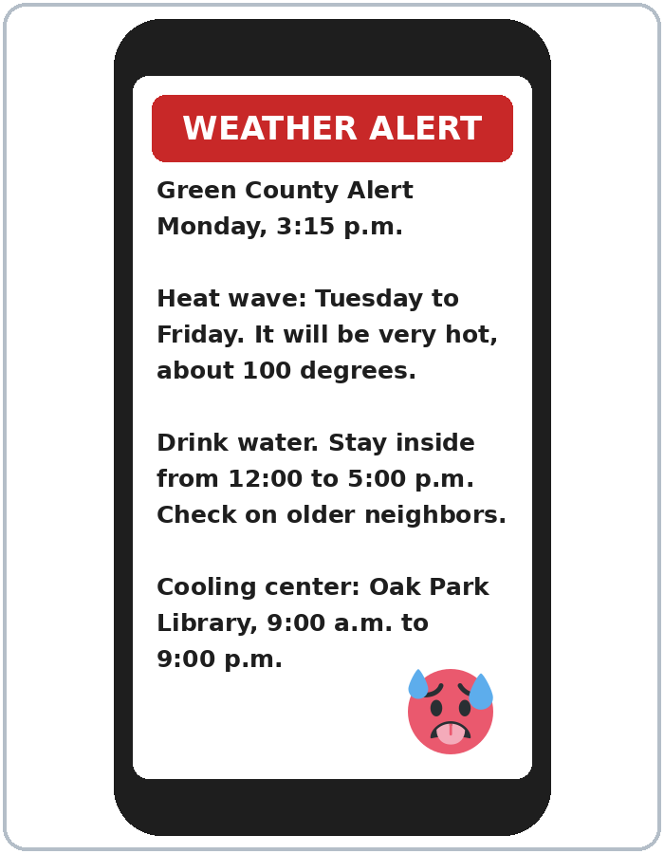
Before You Go 7:12–7:17
01
Exit ticket
02
Homework
Write two sentences:
1. One with If…, I'll….
2. A prediction with probably and because or so:
It will probably rain tomorrow, so I'll take my umbrella.
Give it to me at the door.
About 15 minutes.
1. Finish the sentences with I'll….
2. Write 3 predictions for tomorrow.
3. Ask: What will you do if the power goes out?
4. Review: 2 offers with I'll.
Bring it next week!
Notes:
Step 6 · 7:12–7:17 · Exit Ticket + Homework · 5 min · NEVER SKIP.
Exit ticket: each learner writes two sentences on a slip: one with If…, I'll…, and one prediction with probably and because or so (It will probably rain tomorrow, so I'll take my umbrella.). Collect at the door.
Homework: open the Homework page. Do item 1 together (one sentence on the board). Say: "About 15 minutes. Bring it next week."
Homework items: 1 finish the sentences with I'll… • 2 write 3 predictions for tomorrow with will probably, probably won't, or maybe • 3 ask a family member or a friend: What will you do if the power goes out? (2 answers) • 4 review (Lesson 5): 2 offers with I'll.
Read & Write (7:17–7:25, on the Student Pages): a weather alert text and a kit checklist; questions 1–5; then the "My Ready Plan" card. Say: "First names only. Don't write phone numbers or addresses." An invented plan is fine. If behind: questions 1–5 only; the plan card becomes homework.
Source: Level3_Lesson6.md (Step 6; Homework page; Read & Write step).
Picture: Twemoji graphics by Twitter, Inc. and other contributors (https://github.com/jdecked/twemoji), CC BY 4.0 (https://creativecommons.org/licenses/by/4.0/); resized and combined, with speech bubbles, signs, and labels (images/CREDITS.md).

Slide 25
Progress Check 7:25
D. I can…
😀 🙂 😐
Check one face.
I can understand a weather forecast.
I can say what will happen if….
I can make a simple emergency plan.
I can make predictions with probably and maybe.
A. Listen to the teacher. Circle a or b.
Answer
1. a. stay home b. go to work
a
2. a. It will probably rain. b. It won't rain.
a
3. a. candles b. flashlights
b
4. a. It will be hot. b. It probably won't be hot.
b
Notes:
Progress Check · 7:25–7:30 · 5 min. Individuals. Open the Progress Check page.
Part A: read each sentence slowly, 2 times. Learners circle a or b. Then click to show the answer (one click per item, 1 to 4).
Say: 1 "If it snows tomorrow, I'll stay home." (a) • 2 "It will probably rain tonight." (a) • 3 "If the power goes out, we'll use flashlights." (b) • 4 "It probably won't be hot tomorrow." (b)
Parts B and C: learners do them alone. Walk around and help with the instructions only. B answers: 1 rains, 2 'll call, 3 probably won't, 4 it snows. C: answers will vary (for example If the power goes out, I'll use a flashlight. / It will probably rain this weekend.).
Part D: read each "I can…" line aloud and point to the 3 faces: 😀 "I can do it." 🙂 "With a little help." 😐 "Not yet."
Scoring: A /4 + B /4 + C /2 = /10. This is not a test grade. It shows who needs more help hearing if sentences and predictions (A) and with the forms (B, C).
Collect the pages (or check them at the start of Week 7). If behind: do the Progress Check in Week 7 at 6:00, while learners arrive.
Source: Level3_Lesson6.md (Progress Check step; Progress Check page; Answer key).

Slide 26
Goodbye! See You Next Week!
Now you can:
• Say what will happen if…
• Make predictions with probably / maybe
• Make a simple Ready Plan
Lesson 6 · Level 3
Notes:
Read the title: "Goodbye! See you next week!" Learners repeat.
Read the three "Now you can" lines. Ask one learner: "What will you do if it rains tomorrow?" and wait for an answer with If…, I'll….
Remind learners: homework is about 15 minutes. Bring it next week.
Source: Level3_Lesson6.md (At a glance: Objectives; Step 6).
Picture: Twemoji graphics by Twitter, Inc. and other contributors (https://github.com/jdecked/twemoji), CC BY 4.0 (https://creativecommons.org/licenses/by/4.0/); resized and combined, with speech bubbles, signs, and labels (images/CREDITS.md).

Slide 27
Credits
Pictures
Vocabulary pictures use Twemoji graphics by Twitter, Inc. and other contributors (https://github.com/jdecked/twemoji), licensed under CC BY 4.0 (https://creativecommons.org/licenses/by/4.0/). The graphics were resized and combined, and speech bubbles, signs, and labels were added.
The faces on the Progress Check are standard emoji characters shown with the computer's emoji font.
Names and story
Nadia and Ben are invented names. The listening story is invented.
Audio and font
Audio: synthetic voices made with Chatterbox TTS (MIT License), cloned from short synthetic reference clips made with Kokoro-82M (Apache License 2.0). No recordings of real people were used. Each file carries an inaudible Perth watermark marking it as AI-generated. Font: Lexend Deca (OFL 1.1).
© 2026 the authors. The authors license this deck under CC BY-NC-SA 4.0.
Notes:
Credits. You don't need to read this slide in class.
Pictures: Twemoji graphics by Twitter, Inc. and other contributors, CC BY 4.0; the file-by-file list is in images/CREDITS.md.
Audio: L3_L6_listening.mp3 (about 1:20) is not recorded yet (see level3/AUDIO_STATUS.md). It will use computer-generated voices (Chatterbox TTS cloned from synthetic Kokoro-82M reference clips); no recordings of real people. Until the file is ready, read the listening script with a volunteer. The names and the story are invented.
Course materials: © 2026 the authors, licensed under CC BY-NC-SA 4.0 (https://creativecommons.org/licenses/by-nc-sa/4.0/).
Source: Level3_Lesson6.md (Picture Credits); images/CREDITS.md.

