Slide 1
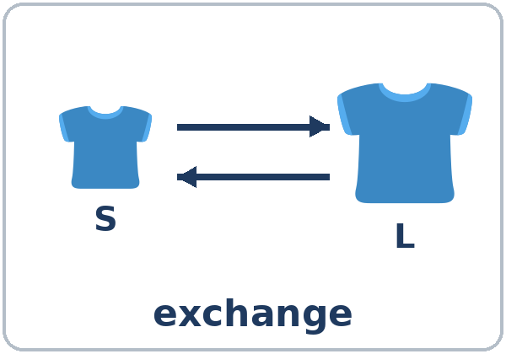
Can I Exchange This?
Today you will:
• Say I'd like to return / exchange this
• Ask Could I / May I…?
• Change or cancel an appointment
Lesson 7 · Level 3
Notes:
Welcome learners as they arrive.
Point to the title and read it: "Can I exchange this?" Say: "Tonight we return and exchange things at a store, and we change an appointment by phone."
Read the three lines under "Today you will". Give one quick example of each: "I'd like to return this, because it's too small." • "May I speak to the manager?" • "I'd like to reschedule my appointment."
Invented stores only (important): Valley Mart, its policy, and the eye center are invented. No play money is needed. Learners never talk about their own purchases, debts, or money problems.
Midterm next week: remind learners. The midterm reviews Lessons 1–7.
Source: Level3_Lesson7.md (Topic; At a glance: Objectives; Teacher notes).
Picture: Twemoji graphics by Twitter, Inc. and other contributors (https://github.com/jdecked/twemoji), CC BY 4.0 (https://creativecommons.org/licenses/by/4.0/); resized and combined, with speech bubbles, signs, and labels (images/CREDITS.md).

Slide 2
01
I can say I'd like to return this.
…because it's too small.
Today's
Goals
02
I can ask Could I / Can I / May I…?
03
I can ask for a refund or store credit.
By the end of class, you can do these six things.
The stores are invented.
We check at 7:25!
04
I can change or cancel an appointment.
05
I can use I'd like and I'd like to.
06
I can read a return policy and fill out a form.
Notes:
Read each goal slowly. Learners repeat.
Goal 1: I'd like to return / exchange this, and a reason (because it's too small). Goal 2: ask for permission with Could I / Can I / May I…? and answer. Goal 3: ask for a refund or store credit, and ask for the manager politely.
Goal 4: change or cancel an appointment by phone. Goal 5: I'd like + a thing and I'd like to + a verb. Goal 6: read a store return policy and fill out a return form.
"We check at 7:25" = the Progress Check. It is not a test grade.
Source: Level3_Lesson7.md (At a glance: Objectives).

Slide 3
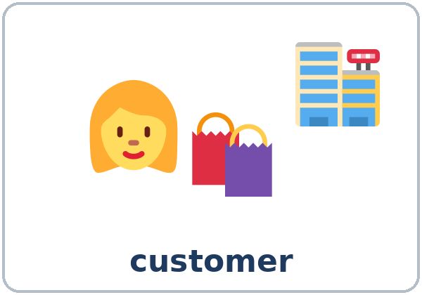
OPENING TALK · 6:00
Opening Talk
A asks a card question.
What will you do if it rains this weekend?
B answers with 2–3 sentences.
A asks one follow-up.
Really? With who?
Then switch.
Notes:
Step 1 · 6:00–6:10 · Opening Talk + Homework Check · 10 min. Pairs (7 pairs + 1 trio with 15 learners; 3–4 pairs with 7–8).
Before class, write on the board: What will you do if…? If…, I'll…
Model with one learner: "What will you do if it rains this weekend?" → (answer) → "Really? With who?" (Click to show the follow-up.)
Opening Talk (6 min): learners open the Opening Talk page. A asks a card question; B answers with 2–3 sentences; A asks one follow-up. Switch after each card. The cards are on the next slide.
If behind: one card only, then the homework check.
Source: Level3_Lesson7.md (Step 1; Opening Talk page).
Picture: Twemoji graphics by Twitter, Inc. and other contributors (https://github.com/jdecked/twemoji), CC BY 4.0 (https://creativecommons.org/licenses/by/4.0/); resized and combined, with speech bubbles, signs, and labels (images/CREDITS.md).

Slide 4
Opening Talk
Cards
01
What will you do if it rains this weekend?
02
What will you do if the power goes out tonight?
Work with a partner. Then switch.
Follow-ups:
Really? Why? With who? What else will you do?
03
What will the weather probably be like tomorrow?
04
What will you do if you have a free day next week?
05
Homework check: Lesson 6, item 1.
Notes:
Step 1, continued. The four cards from the Opening Talk page. Each click shows the next card.
A asks a card question. B answers with 2–3 sentences. A asks one follow-up question (follow-ups on the right). Then switch.
Homework Check (4 min, last click): partners read their Lesson 6 Homework item 1 (If it rains this weekend, I'll…) to each other. The partner asks one question about it. Walk around. Write 2 common errors on the board (often If it will rain or If rains) and correct them together.
Source: Level3_Lesson7.md (Step 1; Opening Talk page: cards, follow-ups, homework check).

Slide 5
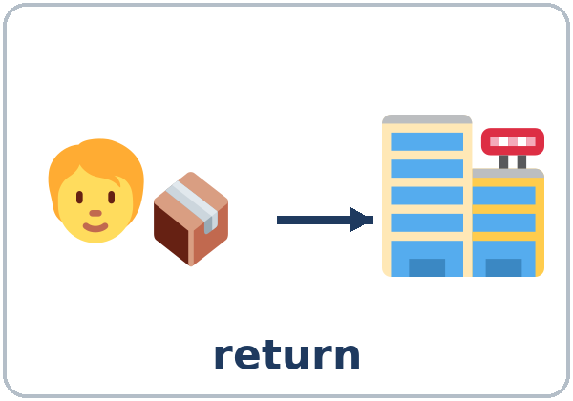
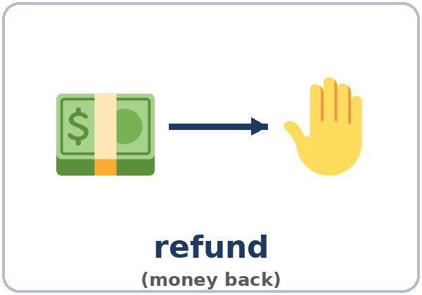
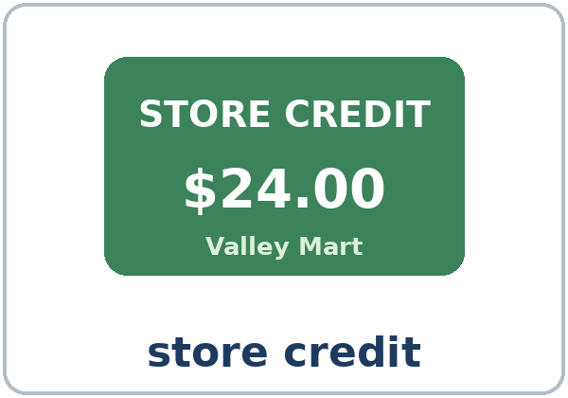
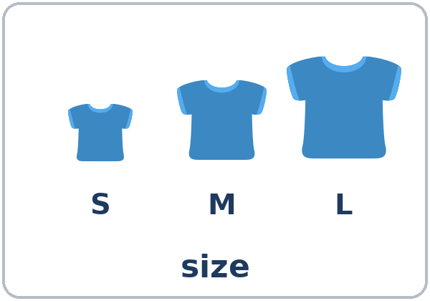
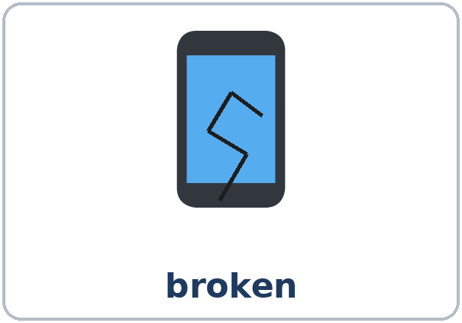
Look. Listen.
Repeat.
New Words
★ return
★ exchange
★ refund
★ store credit
★ size
★ broken
Notes:
Step 2 · 6:10–6:18 · New Words · 8 min (this slide and the next). Whole class, then pairs.
Point to each picture and say the word. Learners repeat once. ★ = the most important words. Each click shows the next word.
Hold up a T-shirt: "It's too small. I'd like to return it… or exchange it for a large."
Two pairs of words (1 min): refund (money back) vs. store credit (money for this store only). cancel (no appointment) vs. reschedule (a new day or time).
If behind: teach the ★ words only.
Source: Level3_Lesson7.md (Step 2; Key vocabulary; New Words page).
Pictures: Twemoji graphics by Twitter, Inc. and other contributors (https://github.com/jdecked/twemoji), CC BY 4.0 (https://creativecommons.org/licenses/by/4.0/); resized and combined, with speech bubbles, signs, and labels (images/CREDITS.md).

Slide 6
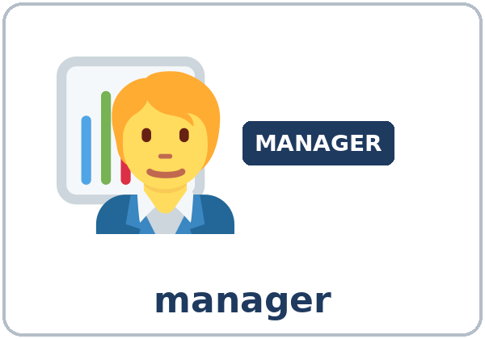
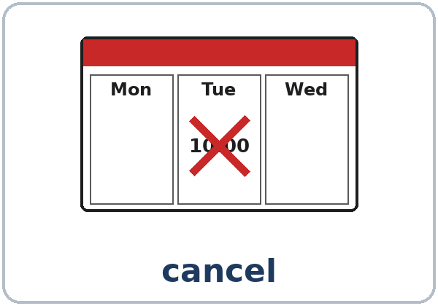
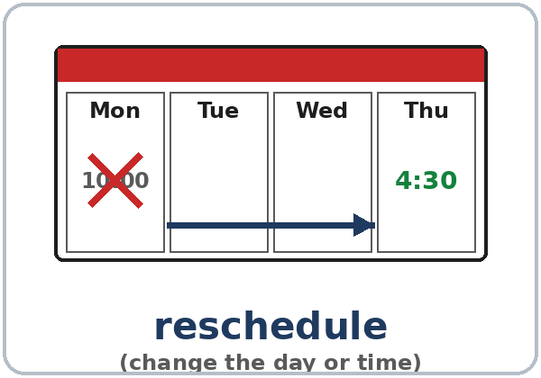
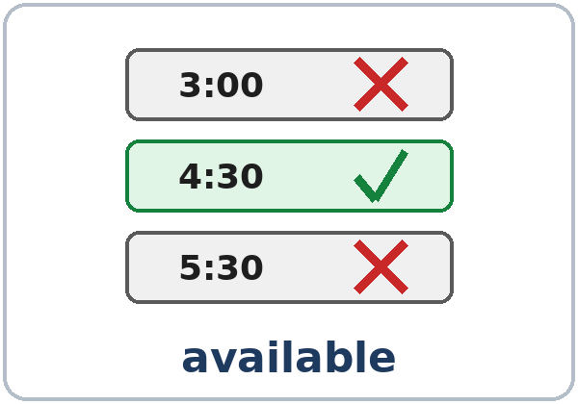
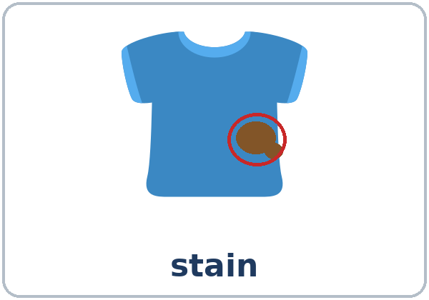
Partner game:
A says. B points.
More New Words
★ customer
★ manager
★ cancel
★ reschedule
★ available
stain
Notes:
Step 2, continued. Point to each picture and say the word. Learners repeat once.
Partner game (2 min): A says a word. B points to the picture and makes a sentence (A: exchange. B: I'd like to exchange this shirt for a large. / I'd like a refund.). Switch.
If behind: teach the ★ words only.
Source: Level3_Lesson7.md (Step 2; New Words page; Partner game).
Pictures: Twemoji graphics by Twitter, Inc. and other contributors (https://github.com/jdecked/twemoji), CC BY 4.0 (https://creativecommons.org/licenses/by/4.0/); resized and combined, with speech bubbles, signs, and labels (images/CREDITS.md).

Slide 7
Check the Meaning
Look at the picture. Answer the question.
1
2
3
The shirt has a brown spot. It has a…?
The phone doesn't work. It's…?
Who is the boss in the store?
stain
broken
the manager
Notes:
Step 2 · Check meaning · 1 min. Whole class.
The answers are hidden. Ask each question and wait for the class to answer. Then click to show the answer. Each click shows one answer, in order: 1, 2, 3.
1. "The shirt has a brown spot. It has a…?" (stain) • 2. "The phone doesn't work. It's…?" (broken) • 3. "Who is the boss in the store?" (the manager)
One more question: "Thursday at 4:30 is free. It's…?" (available)
Source: Level3_Lesson7.md (Step 2: Check meaning).
Pictures: Twemoji graphics by Twitter, Inc. and other contributors (https://github.com/jdecked/twemoji), CC BY 4.0 (https://creativecommons.org/licenses/by/4.0/); resized and combined, with speech bubbles, signs, and labels (images/CREDITS.md).

Slide 8
Before You
Listen for:
Listen
What does she want to do?
Lina is at the service desk at Valley Mart, a big store. She has a phone case.
Refund or store credit?
01
Audio: about 1:15. It plays once.
Narrator
02
Lina
Play 1: Task A
03
Clerk
Notes:
Step 3 · 6:18–6:30 · Listening + "Say it" · 12 min (slides 8 to 12). Individuals, then pairs check.
Before you listen (1 min). Point to the customer picture and say: "This is Lina. She's at the service desk at Valley Mart, a big store. She has a phone case. What does she want to do? Listen."
There are three voices: a Narrator, Lina, and the Clerk. Each click highlights the next voice.
The audio (L3_L7_listening.mp3, about 1:15) plays the conversation once. Press play again for play 2. A third play is fine if the class needs it.
No speaker? Read the script with a volunteer at a normal, friendly speed.
Audio: L3_L7_listening.mp3 (about 1:15) is not recorded yet (see level3/AUDIO_STATUS.md). It will use computer-generated voices (Chatterbox TTS cloned from synthetic Kokoro-82M reference clips); no recordings of real people. Until the file is ready, read the listening script with a volunteer. The names and the story are invented.
Source: Level3_Lesson7.md (Step 3; Listening script; Listening page).
Picture: Twemoji graphics by Twitter, Inc. and other contributors (https://github.com/jdecked/twemoji), CC BY 4.0 (https://creativecommons.org/licenses/by/4.0/); resized and combined, with speech bubbles, signs, and labels (images/CREDITS.md).

Slide 9
Listen. Circle a or b.
Play 1
Listening A
What does Lina want to do first?
a. return a phone case
b. buy a phone
1
a
Pairs: compare your answers.
Then check together.
What does she get?
a. a refund (money back)
b. store credit
2
b
Notes:
Play 1 → Task A (return or exchange? refund or store credit?). Pairs compare. Check together.
Click to show each answer (one click per item): 1 a (return it) • 2 b (store credit; she has no receipt).
Then read Tasks B and C together (1 min) so learners know what to listen for.
Source: Level3_Lesson7.md (Step 3; Listening Task A; Answer key).

Slide 10
Listen again.
Circle the right answer.
Listening B
What's wrong with the phone case?
too big / too small / broken
1
too small
When is her eye appointment now?
Monday / Tuesday / Friday
2
Monday
Pairs: compare your answers.
Then check together.
What is the new day?
Wednesday / Thursday / Saturday
3
Thursday
What is the new time?
4:00 / 4:30 / 5:30
4
4:30
Notes:
Play 2 → Tasks B and C. Pairs compare. Then show the answers.
Click to show each answer (one click per item, 1 to 4): 1 too small • 2 Monday • 3 Thursday • 4 4:30.
Source: Level3_Lesson7.md (Step 3; Listening Task B; Answer key).

Slide 11
Listen again.
Write like, like to, or Could.
Listening C
1
Yes, I'd ____ return this phone case.
like to
2
____ I get a refund?
Could
Pairs: compare your answers.
Then check together.
3
OK, that's fine. I'd ____ a bigger case.
like
4
I'd ____ change it.
like to
5
Perfect. I'd ____ take that time.
like to
Notes:
Task C (play 2). Click to show each answer (one click per item, 1 to 5): 1 like to, 2 Could, 3 like, 4 like to, 5 like to.
If behind: do Task C together on the board, reading the lines yourself.
Source: Level3_Lesson7.md (Step 3; Listening Task C; Answer key).

Slide 12
Say it: polite and fast
Say It
The class repeats each line two times.
Could I exchange it? ↗
I'd like to (I'd-like-tuh) return this.
Polite questions go up ↗ at the end.
I'd like to is fast:
I'd-like-tuh.
May I speak to the manager? ↗
Notes:
"Say it" (2 min). Say: "Polite questions go up at the end: Could I exchange it?" Then: "I'd like to is fast: I'd-like-tuh."
Read the lines in the "Say it" box. The class repeats each line twice.
Source: Level3_Lesson7.md (Step 3: "Say it"; Listening page: Say it).

Slide 13
Grammar Box 1
Can I help you?
QUESTION
ANSWER
Can I help you?
Yes, I'd like to return / exchange
this shirt. / these shoes.
Can I help you?
Yes, I'd like a refund, / store credit,
please.
Notes:
Step 4 · 6:30–6:45 · Grammar Q&A · 15 min (slides 13 to 22). Whole class, then pairs. Show the Grammar page. Read across: A reads from the left side; B answers from the right side.
Write on the board: I'd like + a thing (I'd like a bag) and I'd like to + a verb (I'd like to return it).
Boxes 1 and 2 (4 min): you are the clerk: "Can I help you?" The class answers from Box 1. Each click shows the answer side of one row.
Source: Level3_Lesson7.md (Step 4; Grammar Box 1; Teacher notes: I'd like vs. I'd like to).
Picture: Twemoji graphics by Twitter, Inc. and other contributors (https://github.com/jdecked/twemoji), CC BY 4.0 (https://creativecommons.org/licenses/by/4.0/); resized and combined, with speech bubbles, signs, and labels (images/CREDITS.md).

Slide 14
Grammar Box 2
Reasons
because + a reason
QUESTION
ANSWER (because + a reason)
Why? /
What's wrong with it?
Because it's too small. / too big. / broken.
Why? /
What's wrong with them?
Because they have a stain. / don't fit.
Notes:
Box 2: "What's wrong with it?" The class answers from Box 2 (It's too small. It has a stain.). Each click shows the answer side of one row.
too + adjective: It's too small means it's a problem (it doesn't fit). very small is not a problem. Teach too small / too big / too long as fixed phrases.
Source: Level3_Lesson7.md (Step 4; Grammar Box 2; Teacher notes: too + adjective).
Picture: Twemoji graphics by Twitter, Inc. and other contributors (https://github.com/jdecked/twemoji), CC BY 4.0 (https://creativecommons.org/licenses/by/4.0/); resized and combined, with speech bubbles, signs, and labels (images/CREDITS.md).

Slide 15
Grammar Box 3
Asking for Permission
Could I / Can I / May I…?
QUESTION
ANSWER
Could I / Can I
exchange it for a large? / get a refund?
Sure. / Of course.
May I (very polite)
speak to the manager? / pay with a card?
Sorry, you need the receipt. / Sorry, cash only.
Notes:
Box 3 (3 min): Could I / Can I / May I…? May I is the most polite and formal. Read the answers: Sure. / Of course. / Sorry, you need the receipt.
Each click shows the answer side of one row.
Source: Level3_Lesson7.md (Step 4; Grammar Box 3; Teacher notes: Could I / Can I / May I).
Picture: Twemoji graphics by Twitter, Inc. and other contributors (https://github.com/jdecked/twemoji), CC BY 4.0 (https://creativecommons.org/licenses/by/4.0/); resized and combined, with speech bubbles, signs, and labels (images/CREDITS.md).

Slide 16
Grammar Box 4
Changing an Appointment
CALLER
RECEPTIONIST
I'd like to change my appointment. / reschedule my appointment.
What day is good for you?
Is Thursday available?
Yes, at 4:30. / Sorry, we're full. Is Friday OK?
I'd like to cancel my appointment.
OK. Your appointment is canceled.
Notes:
Box 4 (2 min): appointments. Read the phone lines across with one learner: you are the caller; the learner is the receptionist. Each click shows the receptionist's line.
Source: Level3_Lesson7.md (Step 4; Grammar Box 4).
Picture: Twemoji graphics by Twitter, Inc. and other contributors (https://github.com/jdecked/twemoji), CC BY 4.0 (https://creativecommons.org/licenses/by/4.0/); resized and combined, with speech bubbles, signs, and labels (images/CREDITS.md).

Slide 17
Grammar Box 5
I'd like or I'd like to?
I'd like + a thing · I'd like to + a verb
I'd like + A THING
I'd like to + A VERB
I'd like a refund.
I'd like to return this.
I'd like a bigger size.
I'd like to exchange it.
I'd like an appointment on Friday.
I'd like to cancel my appointment.
Notes:
Box 5: I'd like + a thing; I'd like to + a verb. A reads the left side; B reads the right side. Each click shows the right side of one row.
I'd like = I would like: more polite than I want.
Check questions: "I'd like ___ return this." (to) • "I'd like ___ refund." (a) • "It's ___ small. It doesn't fit." (too) • "___ I speak to the manager?" (May / Could)
Source: Level3_Lesson7.md (Step 4; Grammar Box 5; Teacher notes: I'd like vs. I'd like to).
Picture: Twemoji graphics by Twitter, Inc. and other contributors (https://github.com/jdecked/twemoji), CC BY 4.0 (https://creativecommons.org/licenses/by/4.0/); resized and combined, with speech bubbles, signs, and labels (images/CREDITS.md).

Slide 18
Practice A: write the words.
like · like to
Practice A
1
I'd ____ return these shoes.
like to
2
I'd ____ a bag, please.
like
Write like or like to.
Pairs: check your answers.
3
I'd ____ exchange this shirt for a medium.
like to
4
I'd ____ a refund, please.
like
5
I'd ____ cancel my appointment.
like to
Notes:
Practice A and B (3 min): learners write, then pairs check. Go over the answers.
Click to show each answer (one click per item, 1 to 5): 1 like to, 2 like, 3 like to, 4 like, 5 like to.
Source: Level3_Lesson7.md (Step 4; Grammar Practice A; Answer key).

Slide 19
Circle the right words.
Practice B
1. ____ I exchange this?
Could
Would
2. May I ____ to the manager?
speak
to speak
3. It's ____. It doesn't fit.
too small
small too
4. I'd like to ____ my appointment.
cancel
canceling
5. Is Thursday ____?
available
free time
Notes:
Practice B. Learners circle the right words. Pairs check.
Click to circle each answer (one click per item, 1 to 5): 1 Could, 2 speak, 3 too small, 4 cancel, 5 available.
Source: Level3_Lesson7.md (Step 4; Grammar Practice B; Answer key).

Slide 20
Common Mistakes
Don't say
Say
I'd like return this.
I'd like to return this.
I want change my appointment.
I'd like to change my appointment.
Could I to exchange it?
Could I exchange it?
It's very small. It doesn't fit.
It's too small. It doesn't fit.
I'd like to a refund.
I'd like a refund.
Notes:
Common mistakes (never skip this table). Read a line from Don't say. Ask: "What's the right way?" Learners try first. Then click to show the right form. Each click shows one line, in order 1 to 5.
1 and 2: I'd like to + a verb • 3: Could I + verb (no to) • 4: a problem = too • 5: I'd like + a thing.
Say the right form clearly; the learner repeats. Learners can read the Spanish note and the tip on their Grammar page themselves; you don't need to explain them.
Source: Level3_Lesson7.md (Grammar: Common mistakes; Teacher notes: Typical mistakes).
Picture: Twemoji graphics by Twitter, Inc. and other contributors (https://github.com/jdecked/twemoji), CC BY 4.0 (https://creativecommons.org/licenses/by/4.0/); resized and combined, with speech bubbles, signs, and labels (images/CREDITS.md).

Slide 21
Pair Drill
A is the clerk.
01
A is the clerk. B returns something with a reason.
A: Can I help you?
B returns something.
02
B: I'd like to return…, because…
Then switch roles.
Notes:
Pair drill (last 2 min of Step 4). Pairs.
A is the clerk: "Can I help you?" B returns something from the New Words page with a reason. Switch.
If behind: skip the pair drill. Talk Time practices it.
Source: Level3_Lesson7.md (Step 4: Pair drill).
Picture: Twemoji graphics by Twitter, Inc. and other contributors (https://github.com/jdecked/twemoji), CC BY 4.0 (https://creativecommons.org/licenses/by/4.0/); resized and combined, with speech bubbles, signs, and labels (images/CREDITS.md).

Slide 22
Talk Time
Service Desk
Round 1: pairs.
A = clerk. B = customer.
7:00–7:12
1
The clerk reads the Store Policy Card.
30 days · receipt: refund · no receipt: store credit
2
The customer chooses a card.
Hi. I'd like to return these shoes.
3
The clerk follows the policy. Switch.
Do you have the receipt?
Notes:
Step 5 · 7:00–7:12 · Talk Time: Service Desk · 12 min. Pairs.
Round 1 (6 min): the clerk reads the Store Policy Card. The customer chooses a Customer Card and returns or exchanges the item. The clerk follows the policy. After each card, switch roles. Each click shows the next step.
Store Policy Card: returns within 30 days • with a receipt: a refund or an exchange • no receipt: store credit or an exchange • sale items: store credit only • more than 30 days: "Sorry, we can't take it." (The customer can ask for the manager.)
Model with one learner (1 min): you are the customer with card 1: "Hi. I'd like to return these shoes." → "What's wrong with them?" → "They're too big." → "Do you have the receipt?" → "Yes, here it is."
Customer Cards (answers): 1 shoes, too big, receipt, 10 days → refund or exchange • 2 lamp, broken, no receipt → store credit • 3 jacket on sale, stain → store credit only • 4 shirt, 45 days → sorry, more than 30 days (the customer can ask for the manager) • 5 coffee maker, wrong color, receipt, 5 days → refund or exchange • 6 pants, too long, no receipt → store credit or exchange. Wording will vary.
Invented stores only (important): Valley Mart, its policy, and the eye center are invented. No play money is needed. Learners never talk about their own purchases, debts, or money problems.
Source: Level3_Lesson7.md (Step 5; Talk Time: Service Desk; Answer key).
Picture: Twemoji graphics by Twitter, Inc. and other contributors (https://github.com/jdecked/twemoji), CC BY 4.0 (https://creativecommons.org/licenses/by/4.0/); resized and combined, with speech bubbles, signs, and labels (images/CREDITS.md).

Slide 23
Talk Time
On the Phone
Round 2: back to back.
No looking.
7:00–7:12
1
A is the receptionist.
A has the open times.
2
B is the patient. B uses a slip.
I'd like to reschedule my appointment.
3
A offers a time. Then switch.
Yes, Wednesday at 3:00 is available.
Notes:
Round 2, phone call (5 min): pairs sit back to back (no looking). A is the receptionist at Valley Eye Center with the available times. B is the patient and wants to change or cancel an appointment. B uses the calendar slip. Then switch with the second slip. Each click shows the next step.
Open times (A only): Mon 2:00 p.m. • Tue full • Wed 3:00 p.m. • Thu 11:00 a.m. • Fri 9:30 a.m. and 4:30 p.m.
Slip 1: Tuesday 10:00 → a new time on Wednesday or Friday (Wednesday 3:00, Friday 9:30, or Friday 4:30). Slip 2: cancel the Thursday 2:00 appointment (because I have to work). Answers will vary.
If behind: Round 1 only.
Source: Level3_Lesson7.md (Step 5; Talk Time: On the Phone; Answer key).
Picture: Twemoji graphics by Twitter, Inc. and other contributors (https://github.com/jdecked/twemoji), CC BY 4.0 (https://creativecommons.org/licenses/by/4.0/); resized and combined, with speech bubbles, signs, and labels (images/CREDITS.md).

Slide 24
Before You Go 7:12–7:17
01
Exit ticket
02
Homework
Write two sentences:
1. I'd like to… and a reason with because:
I'd like to exchange this shirt, because it has a stain.
2. A polite question with Could I or May I.
Give it to me at the door.
About 15 minutes.
1. Write I'd like to… + because.
2. Write like or like to.
3. Finish the phone call.
4. Review: 2 sentences with If…, I'll….
Next week: the midterm review!
Notes:
Step 6 · 7:12–7:17 · Exit Ticket + Homework · 5 min · NEVER SKIP.
Exit ticket: each learner writes two sentences on a slip: one with I'd like to… and a reason with because (I'd like to exchange this shirt, because it has a stain.), and one polite question with Could I or May I. Collect at the door.
Homework: open the Homework page. Do item 1 together (one sentence on the board). Say: "About 15 minutes. Bring it next week. Next week is the midterm review."
Homework items: 1 what do you say at the service desk? Write I'd like to… and a reason with because • 2 write like or like to • 3 finish the phone call (the patient's words) • 4 review (Lesson 6): 2 sentences with If…, I'll….
Read & Write (7:17–7:25, on the Student Pages): the Valley Mart return policy; questions 1–5; then a return form. If behind: questions 1–5 only; the form becomes homework.
Source: Level3_Lesson7.md (Step 6; Homework page; Read & Write step).
Picture: Twemoji graphics by Twitter, Inc. and other contributors (https://github.com/jdecked/twemoji), CC BY 4.0 (https://creativecommons.org/licenses/by/4.0/); resized and combined, with speech bubbles, signs, and labels (images/CREDITS.md).

Slide 25
Progress Check 7:25
D. I can…
😀 🙂 😐
Check one face.
I can say I'd like to return / exchange this.
I can give a reason.
I can ask for permission with Could I / May I…?
I can change or cancel an appointment.
A. Listen to the teacher. Circle a or b.
Answer
1. a. return b. exchange
a
2. a. return b. exchange
b
3. a. cancel b. reschedule
a
4. a. cancel b. reschedule
b
Notes:
Progress Check · 7:25–7:30 · 5 min. Individuals. Open the Progress Check page.
Part A: read each sentence slowly, 2 times. Learners circle a or b. Then click to show the answer (one click per item, 1 to 4).
Say: 1 "I'd like to return these shoes. They're too big." (a) • 2 "Could I exchange this shirt for a large?" (b) • 3 "I'd like to cancel my appointment on Friday." (a) • 4 "Is Tuesday at ten available? I'd like to change my appointment." (b)
Parts B and C: learners do them alone. Walk around and help with the instructions only. B answers: 1 to return, 2 exchange, 3 too small, 4 a refund. C: answers will vary (for example I'd like to return this lamp, because it's broken. / May I speak to the manager, please?).
Part D: read each "I can…" line aloud and point to the 3 faces: 😀 "I can do it." 🙂 "With a little help." 😐 "Not yet."
Scoring: A /4 + B /4 + C /2 = /10. This is not a test grade. It shows who needs more help hearing requests (A) and with I'd like / I'd like to and polite questions (B, C).
Collect the pages (or check them at the start of Week 8). If behind: do the Progress Check at the start of the midterm review, while learners arrive.
Source: Level3_Lesson7.md (Progress Check step; Progress Check page; Answer key).

Slide 26
Goodbye! See You Next Week!
Now you can:
• Say I'd like to return / exchange this
• Ask Could I / May I…?
• Change or cancel an appointment
Lesson 7 · Level 3
Notes:
Read the title: "Goodbye! See you next week!" Learners repeat.
Read the three "Now you can" lines. Say: "Can I help you?" Wait for an answer with I'd like to….
Remind learners: homework is about 15 minutes. Next week is the midterm review (Lessons 1–7).
Source: Level3_Lesson7.md (At a glance: Objectives; Step 6; Teacher notes: Midterm next week).
Picture: Twemoji graphics by Twitter, Inc. and other contributors (https://github.com/jdecked/twemoji), CC BY 4.0 (https://creativecommons.org/licenses/by/4.0/); resized and combined, with speech bubbles, signs, and labels (images/CREDITS.md).

Slide 27
Credits
Pictures
Vocabulary pictures use Twemoji graphics by Twitter, Inc. and other contributors (https://github.com/jdecked/twemoji), licensed under CC BY 4.0 (https://creativecommons.org/licenses/by/4.0/). The graphics were resized and combined, and speech bubbles, signs, and labels were added.
The faces on the Progress Check are standard emoji characters shown with the computer's emoji font.
Names and story
Lina, Valley Mart, and Valley Eye Center are invented names. The listening story is invented.
Audio and font
Audio: synthetic voices made with Chatterbox TTS (MIT License), cloned from short synthetic reference clips made with Kokoro-82M (Apache License 2.0). No recordings of real people were used. Each file carries an inaudible Perth watermark marking it as AI-generated. Font: Lexend Deca (OFL 1.1).
© 2026 the authors. The authors license this deck under CC BY-NC-SA 4.0.
Notes:
Credits. You don't need to read this slide in class.
Pictures: Twemoji graphics by Twitter, Inc. and other contributors, CC BY 4.0; the file-by-file list is in images/CREDITS.md.
Audio: L3_L7_listening.mp3 (about 1:15) is not recorded yet (see level3/AUDIO_STATUS.md). It will use computer-generated voices (Chatterbox TTS cloned from synthetic Kokoro-82M reference clips); no recordings of real people. Until the file is ready, read the listening script with a volunteer. The names and the story are invented.
Course materials: © 2026 the authors, licensed under CC BY-NC-SA 4.0 (https://creativecommons.org/licenses/by-nc-sa/4.0/).
Source: Level3_Lesson7.md (Picture Credits); images/CREDITS.md.

