Slide 1
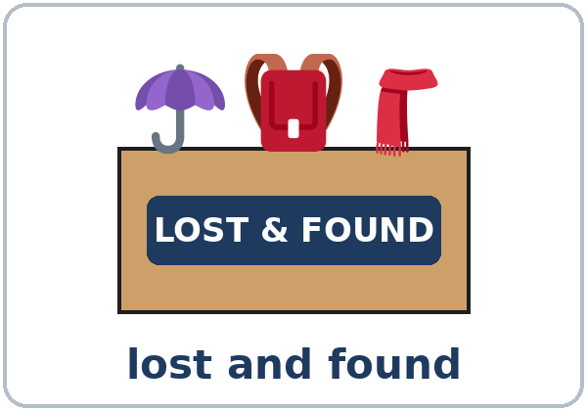
Lost and Found
Today you will:
• Ask Whose… is this?
• Say It's mine / It's hers
• Describe a lost item
Lesson 8 · Level 3
Notes:
Welcome learners as they arrive. This is Lesson 8 (Week 9), the first class after the midterm.
Point to the title and read it: "Lost and found." Say: "Tonight we talk about things people lose, and whose things they are."
Read the three lines under "Today you will". Give one quick example of each: "Whose keys are these?" • "It's mine. / It's Ana's." • "It's a small black wallet with a zipper."
Picture cards, not real things (important): use the pictures and Owner Cards, not learners' real wallets, purses, or phones. Remind learners never to write real ID numbers, bank card numbers, or addresses on any form, in class or in real life on a public notice.
Source: Level3_Lesson8.md (Topic; At a glance: Objectives; Teacher notes).
Picture: Twemoji graphics by Twitter, Inc. and other contributors (https://github.com/jdecked/twemoji), CC BY 4.0 (https://creativecommons.org/licenses/by/4.0/); resized and combined, with speech bubbles, signs, and labels (images/CREDITS.md).

Slide 2
01
I can ask Whose… is this?
Whose keys are these?
Today's
Goals
02
I can say mine, yours, hers, or Ana's.
03
I can ask Is this yours? → Yes, it's mine.
By the end of class, you can do these six things.
We use picture cards.
We check at 7:25!
04
I can describe a lost item.
05
I can say what I was doing when I lost it.
06
I can read and write a FOUND notice.
Notes:
Read each goal slowly. Learners repeat.
Goal 1: Whose… is this? / Whose… are these? Goal 2: mine, yours, his, hers, ours, theirs or a name + 's (It's Ana's.). Goal 3: Is this yours? → Yes, it's mine. / No, it isn't mine.
Goal 4: size, color, and details (a small black wallet with a zipper). Goal 5: I was waiting for the bus when I lost it. Goal 6: read a FOUND notice, fill out a lost-item report, and write a short FOUND notice.
"We check at 7:25" = the Progress Check. It is not a test grade.
Source: Level3_Lesson8.md (At a glance: Objectives).

Slide 3

OPENING TALK · 6:00
Opening Talk
A asks a card question.
What did you do last weekend?
B answers with 2–3 sentences.
A asks one follow-up.
Really? How was it?
Then switch.
Notes:
Step 1 · 6:00–6:10 · Opening Talk + Midterm check-in · 10 min. Pairs (7 pairs + 1 trio with 15 learners; 3–4 pairs with 7–8).
Before class, write on the board: I'd like to… / Could I…? / May I…?
Model with one learner: "What did you do last weekend?" → (answer) → "Really? How was it?" (Click to show the follow-up.)
Opening Talk (6 min): learners open the Opening Talk page. A asks a card question; B answers with 2–3 sentences; A asks one follow-up. Switch after each card. The cards are on the next slide.
If behind: one card only, then the check-in.
Source: Level3_Lesson8.md (Step 1; Opening Talk page).
Picture: Twemoji graphics by Twitter, Inc. and other contributors (https://github.com/jdecked/twemoji), CC BY 4.0 (https://creativecommons.org/licenses/by/4.0/); resized and combined, with speech bubbles, signs, and labels (images/CREDITS.md).

Slide 4
Opening Talk
Cards
01
What did you do last weekend?
02
What will you do if it's sunny next Saturday?
Work with a partner. Then switch.
Follow-ups:
Really? How was it? Why? What did they say?
03
You bought shoes, and they're too small. What do you say at the store?
04
You'd like to change an appointment. What do you say on the phone?
05
Midterm check-in: one easy part, one hard part.
Notes:
Step 1, continued. The four cards from the Opening Talk page. Each click shows the next card.
A asks a card question. B answers with 2–3 sentences. A asks one follow-up question (follow-ups on the right). Then switch.
Midterm check-in (4 min, last click): give back the midterms (if they are marked). Partners say one thing that was easy and one thing that was hard (The listening was easy. Part C was hard, because…). Write 2 common errors from the midterm on the board and correct them together.
Source: Level3_Lesson8.md (Step 1; Opening Talk page: cards, follow-ups, midterm check-in).

Slide 5
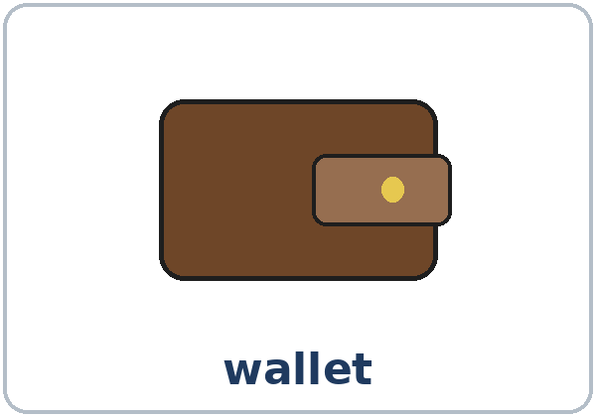

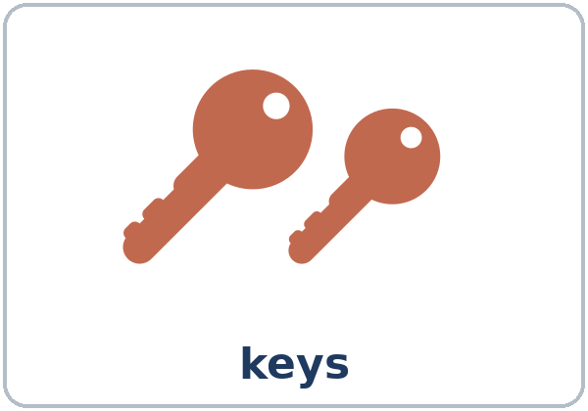


Look. Listen.
Repeat.
New Words
★ wallet
★ purse
★ keys
★ umbrella
★ backpack
★ sunglasses
Notes:
Step 2 · 6:10–6:18 · New Words · 8 min (this slide and the next). Whole class, then pairs.
Point to each picture and say the word. Learners repeat once. ★ = the most important words. Each click shows the next word.
Look for your keys in your pockets: "Where are my keys? I lost them!"
If behind: teach the ★ words only.
Source: Level3_Lesson8.md (Step 2; Key vocabulary; New Words page).
Pictures: Twemoji graphics by Twitter, Inc. and other contributors (https://github.com/jdecked/twemoji), CC BY 4.0 (https://creativecommons.org/licenses/by/4.0/); resized and combined, with speech bubbles, signs, and labels (images/CREDITS.md).

Slide 6



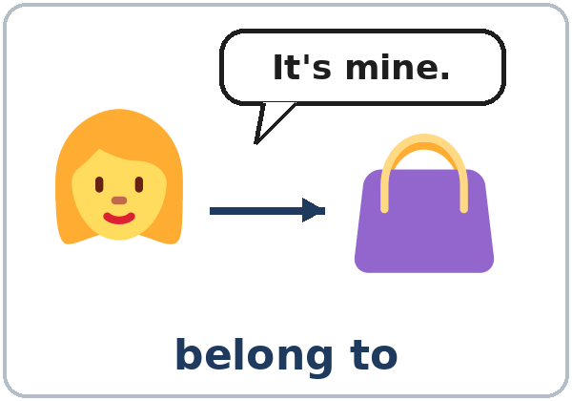
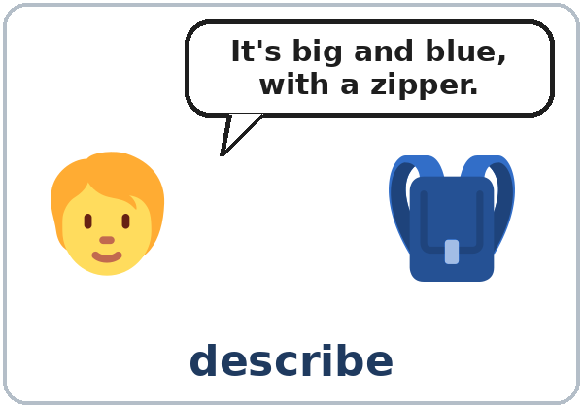
Partner game:
A says. B points.
More New Words
★ headphones
★ gloves
★ scarf
★ lost and found
★ belong to
describe
Notes:
Step 2, continued. Point to each picture and say the word. Learners repeat once. Put on imaginary gloves and a scarf.
Show belong to: hold up your own pen. "This pen belongs to me. It's mine." Point to a learner's book (don't take it): "That book belongs to you. It's yours."
Partner game (2 min): A says a word. B points to the picture and makes a sentence (A: umbrella. B: My umbrella is black. It's small.). Switch.
If behind: teach the ★ words only.
Source: Level3_Lesson8.md (Step 2; New Words page; Partner game).
Pictures: Twemoji graphics by Twitter, Inc. and other contributors (https://github.com/jdecked/twemoji), CC BY 4.0 (https://creativecommons.org/licenses/by/4.0/); resized and combined, with speech bubbles, signs, and labels (images/CREDITS.md).

Slide 7
Check the Meaning
Look at the picture. Answer the question.
1
2
3
Where do you keep money?
You listen to music with…?
Where do they keep lost things?
a wallet / a purse
headphones
the lost and found
Notes:
Step 2 · Check meaning · 1 min. Whole class.
The answers are hidden. Ask each question and wait for the class to answer. Then click to show the answer. Each click shows one answer, in order: 1, 2, 3.
1. "Where do you keep money?" (a wallet / a purse) • 2. "You listen to music with…?" (headphones) • 3. "At the bus station, where do they keep lost things?" (the lost and found)
Source: Level3_Lesson8.md (Step 2: Check meaning).
Pictures: Twemoji graphics by Twitter, Inc. and other contributors (https://github.com/jdecked/twemoji), CC BY 4.0 (https://creativecommons.org/licenses/by/4.0/); resized and combined, with speech bubbles, signs, and labels (images/CREDITS.md).

Slide 8
Before You
Listen for:
Listen
What did David lose?
David lost something on the bus. He's calling the lost and found at City Bus. Joan answers the phone.
What color? What size?
01
Audio: about 1:15. It plays once.
Narrator
02
Joan
Play 1: Task A
03
David
Notes:
Step 3 · 6:18–6:30 · Listening + "Say it" · 12 min (slides 8 to 12). Individuals, then pairs check.
Before you listen (1 min). Say: "David lost something on the bus. He's calling the lost and found. What did he lose? Listen."
There are three voices: a Narrator, Joan (the lost and found at City Bus), and David. Each click highlights the next voice.
The audio (L3_L8_listening.mp3, about 1:15) plays the conversation once. Press play again for play 2. A third play is fine if the class needs it.
No speaker? Read the script with a volunteer at a normal, friendly speed.
Audio: L3_L8_listening.mp3 (about 1:15) is not recorded yet (see level3/AUDIO_STATUS.md). It will use computer-generated voices (Chatterbox TTS cloned from synthetic Kokoro-82M reference clips); no recordings of real people. Until the file is ready, read the listening script with a volunteer. The names and the story are invented.
Source: Level3_Lesson8.md (Step 3; Listening script; Listening page).
Picture: Twemoji graphics by Twitter, Inc. and other contributors (https://github.com/jdecked/twemoji), CC BY 4.0 (https://creativecommons.org/licenses/by/4.0/); resized and combined, with speech bubbles, signs, and labels (images/CREDITS.md).

Slide 9
Listen. What did David lose?
Circle.
Listening A
What did David lose?
a. a wallet
b. a backpack
c. an umbrella
1
b
Pairs: compare your answers.
Then check together.
Notes:
Play 1 → Task A (what did he lose?). Pairs compare. Check together.
Click to show the answer: b (a backpack).
Then read Tasks B and C together (1 min) so learners know what to listen for.
Source: Level3_Lesson8.md (Step 3; Listening Task A; Answer key).

Slide 10
Listen again.
Circle or check ✓ the details.
Listening B
1
Color: blue / green / black
blue
2
Size: big / small
big
What was inside?
☐ headphones ☐ a scarf ☐ gloves
☐ a wallet ☐ keys
Pairs: compare your answers.
Then check together.
3
✓ headphones, a scarf, gloves
4
Where did he get off the bus?
Park Street / Main Street
Park Street
5
Pick it up today before: 5:00 / 9:00
5:00
Notes:
Play 2 → Tasks B and C. Pairs compare. Then show the answers.
Click to show each answer (one click per item, 1 to 5): 1 blue • 2 big • 3 ✓ headphones, ✓ a scarf, ✓ gloves, ✗ a wallet, ✗ keys • 4 Park Street • 5 5:00.
Source: Level3_Lesson8.md (Step 3; Listening Task B; Answer key).

Slide 11
Listen again.
Write his, mine, or yours.
Listening C
1
My brother has the same one, but ____ is green.
his
2
The big one is ____.
mine
Pairs: compare your answers.
Then check together.
3
There are white headphones inside. Are they ____?
yours
4
No, ____ are black.
mine
5
Yes! That's ____. Thank you!
mine
Notes:
Task C (play 2). Click to show each answer (one click per item, 1 to 5): 1 his, 2 mine, 3 yours, 4 mine, 5 mine.
If behind: do Task C together on the board, reading the lines yourself.
Source: Level3_Lesson8.md (Step 3; Listening Task C; Answer key).

Slide 12
Say it: the z sound
Say It
The class repeats each line.
yours · hers · ours · theirs
Whose = who's (hooz)
yours, hers, ours, theirs: a z sound.
Whose = who's: hooz.
Say each line two times.
Whose bag is this?
Notes:
"Say it" (2 min). Say: "yours, hers, ours, theirs end with a z sound." Read them; the class repeats.
Then: "Whose and who's sound the same: hooz." Read the line in the "Say it" box (Whose bag is this?). The class repeats each line twice.
Whose = which person owns it (Whose bag is this?). Who's = who is (Who's that?).
Source: Level3_Lesson8.md (Step 3: "Say it"; Listening page: Say it; Teacher notes: Whose and who's).

Slide 13
Grammar Box 1
Whose…?
is this (one) · are these (more than one)
QUESTION
ANSWER
Whose
umbrella / wallet is this?
It's mine. / hers. / Ana's.
Whose
keys / gloves are these?
They're ours. / his. / Tom's.
Whose
backpack is that?
I think it's theirs. / yours.
Notes:
Step 4 · 6:30–6:45 · Grammar Q&A · 15 min (slides 13 to 21). Whole class, then pairs. Show the Grammar page. The left side is the question. The right side is the answer.
Show it (2 min): put three things on your desk: your pen, a cup, a book. Point to the pen: "Whose pen is this? It's my pen. It's mine." Give the cup to a woman: "It's her cup. It's hers." Give the book to a man: "It's his."
Boxes 1 and 2 (4 min): read a question from the left; the class answers from the right. Point out is this / are these (one / more than one). Each click shows the answer side of one row.
Source: Level3_Lesson8.md (Step 4; Grammar Box 1).
Picture: Twemoji graphics by Twitter, Inc. and other contributors (https://github.com/jdecked/twemoji), CC BY 4.0 (https://creativecommons.org/licenses/by/4.0/); resized and combined, with speech bubbles, signs, and labels (images/CREDITS.md).

Slide 14
Grammar Box 2
Is this yours?
QUESTION
ANSWER
Is this yours? / his?
Yes, it's mine. / Yes, it's his. Thank you!
No, it isn't mine. Maybe it's hers.
Are these yours? / theirs?
No, they aren't ours. Ours are black.
Notes:
Box 2: Is this yours? Read across. Each click shows the answer side of one row.
No the: It's mine (not It's the mine). No apostrophe: yours, hers, ours, theirs (not your's).
Source: Level3_Lesson8.md (Step 4; Grammar Box 2; Teacher notes: No the).
Picture: Twemoji graphics by Twitter, Inc. and other contributors (https://github.com/jdecked/twemoji), CC BY 4.0 (https://creativecommons.org/licenses/by/4.0/); resized and combined, with speech bubbles, signs, and labels (images/CREDITS.md).

Slide 15
Grammar Box 3
my bag → mine
+ A NOUN
NO NOUN
It's my bag.
It's mine.
It's your bag.
It's yours.
It's his bag.
It's his.
It's her bag.
It's hers.
It's our bag.
It's ours.
It's their bag.
It's theirs.
Notes:
Box 3 (2 min): read across: my bag → mine. In each pair, the first column needs a noun; the second stands alone. Each click shows one row.
my, your, his, her, our, their need a noun (my bag). mine, yours, his, hers, ours, theirs stand alone (It's mine). his is the same in both.
Source: Level3_Lesson8.md (Step 4; Grammar Box 3; Teacher notes: Two kinds of words).
Picture: Twemoji graphics by Twitter, Inc. and other contributors (https://github.com/jdecked/twemoji), CC BY 4.0 (https://creativecommons.org/licenses/by/4.0/); resized and combined, with speech bubbles, signs, and labels (images/CREDITS.md).

Slide 16
Grammar Box 4
Describing an Item
SIZE → COLOR → ITEM
DETAIL
It's a small / big black / blue wallet. / backpack.
with a zipper. / with two pockets.
They're brown / red gloves. / sunglasses.
with a star. / in a black case.
Notes:
Box 4 (2 min): describing: size → color → item → with… Hold up something: "It's a small blue pen with a cap." Each click shows the detail of one row.
Describing order: size → color → item → with… (a small black wallet with a zipper). Don't teach a long rule; this one order is enough.
Check questions: "This is my book. It's ___." (mine) • "___ keys are these?" (Whose) • "It's her umbrella. It's ___." (hers) • "a ___ wallet: black / small" (small black)
Source: Level3_Lesson8.md (Step 4; Grammar Box 4; Teacher notes: Describing order).
Picture: Twemoji graphics by Twitter, Inc. and other contributors (https://github.com/jdecked/twemoji), CC BY 4.0 (https://creativecommons.org/licenses/by/4.0/); resized and combined, with speech bubbles, signs, and labels (images/CREDITS.md).

Slide 17
Practice A: write the words.
mine · yours · his · hers · ours · theirs
Practice A
1
This is my bag. It's ____.
mine
2
That's her umbrella. It's ____.
hers
3
These are our keys. They're ____.
ours
Write mine, yours, his, hers, ours, or theirs.
Pairs: check your answers.
4
Is this your scarf? Is it ____?
yours
5
Those are their gloves. They're ____.
theirs
6
That's his wallet. It's ____.
his
Notes:
Practice A and B (3 min): learners write, then pairs check. Go over the answers.
Click to show each answer (one click per item, 1 to 6): 1 mine, 2 hers, 3 ours, 4 yours, 5 theirs, 6 his.
Source: Level3_Lesson8.md (Step 4; Grammar Practice A; Answer key).

Slide 18
Circle the right words.
Practice B
1. ____ bag is this?
Whose
Who's
2. It's ____.
my
mine
3. Is this ____ umbrella?
your
yours
4. Those sunglasses are ____.
her
hers
5. It's a ____ wallet.
black small
small black
Notes:
Practice B. Learners circle the right words. Pairs check.
Click to circle each answer (one click per item, 1 to 5): 1 Whose, 2 mine, 3 your, 4 hers, 5 small black.
Source: Level3_Lesson8.md (Step 4; Grammar Practice B; Answer key).

Slide 19
Common Mistakes
Don't say
Say
It's the mine.
It's mine.
Is this your?
Is this yours?
Who's bag is this?
Whose bag is this?
It's a wallet black.
It's a black wallet.
Notes:
Common mistakes (never skip this table). Read a line from Don't say. Ask: "What's the right way?" Learners try first. Then click to show the right form. Each click shows one line, in order 1 to 4.
1: no the before mine • 2: yours stands alone • 3: Whose = which person owns it • 4: color before the item. Also listen for It's mine bag and his for a woman (It's Maria's. It's hers.).
Say the right form clearly; the learner repeats. Learners can read the Spanish note and the tip on their Grammar page themselves; you don't need to explain them.
Source: Level3_Lesson8.md (Grammar: Common mistakes; Teacher notes: Typical mistakes).
Picture: Twemoji graphics by Twitter, Inc. and other contributors (https://github.com/jdecked/twemoji), CC BY 4.0 (https://creativecommons.org/licenses/by/4.0/); resized and combined, with speech bubbles, signs, and labels (images/CREDITS.md).

Slide 20
Pair Drill
A points and asks.
01
A points to a picture. B answers. Then switch.
A: Whose ____ is this?
B answers.
02
B: It's mine. / It's hers. / It's Ana's.
Then switch roles.
Notes:
Pair drill (last 2 min of Step 4). Pairs.
A points to something in a picture on the New Words page: "Whose ___ is this?" B answers with a pronoun or a classmate's name + 's. Switch.
If behind: skip the pair drill. Talk Time practices it.
Source: Level3_Lesson8.md (Step 4: Pair drill).
Picture: Twemoji graphics by Twitter, Inc. and other contributors (https://github.com/jdecked/twemoji), CC BY 4.0 (https://creativecommons.org/licenses/by/4.0/); resized and combined, with speech bubbles, signs, and labels (images/CREDITS.md).

Slide 21
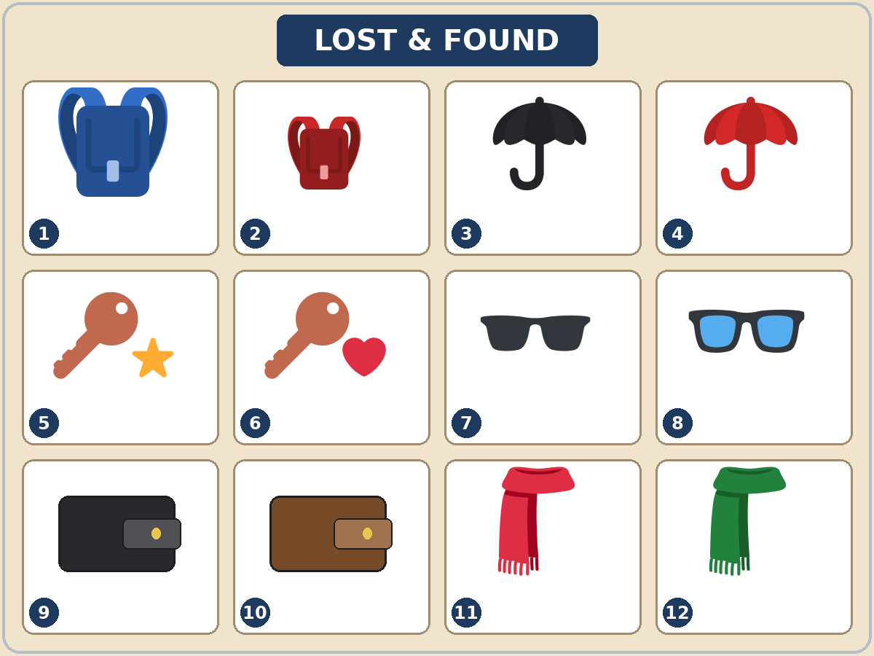
Talk Time
The Lost and Found Box
Round 1: pairs.
A = clerk. B = owner.
7:00–7:12
1
B fills in the form on an Owner Card.
small, red, backpack…
2
B describes the item.
I lost my backpack. It's big and blue.
3
A points: Is this yours?
Yes, it's mine! / No, it isn't mine. Mine is…
Notes:
Step 5 · 7:00–7:12 · Talk Time: The Lost and Found Box · 12 min.
Round 1 (7 min): each owner takes an Owner Card (the teacher gives one number, 1–8; use the cards in order). The owner fills in the short lost-item form on the card. Then the owner describes the item to the clerk. The clerk looks at the Lost and Found picture and asks Is this yours? (pointing to a number). The owner answers. Then switch with a new card. Each click shows the next step.
Model with one learner (1 min): you are the owner with card 1: "I lost my backpack. It's big and blue." The learner points: "Is number 1 yours?" → "Yes, it's mine! Thank you!"
Answers (Owner Card → picture number): 1 → 1 (big blue backpack) • 2 → 4 (red umbrella) • 3 → 6 (keys with a heart) • 4 → 10 (brown wallet) • 5 → 12 (green scarf) • 6 → 8 (glasses with blue lenses) • 7 → 2 (small red backpack) • 8 → 9 (black wallet). Items 3, 5, 7, and 11 have no owner.
Useful: Whose… is this? Is this yours? What color is it? Is it big or small? Does it have…?
Picture cards, not real things (important): use the pictures and Owner Cards, not learners' real wallets, purses, or phones. Remind learners never to write real ID numbers, bank card numbers, or addresses on any form, in class or in real life on a public notice.
Source: Level3_Lesson8.md (Step 5; Talk Time pages; Answer key).
Picture: Twemoji graphics by Twitter, Inc. and other contributors (https://github.com/jdecked/twemoji), CC BY 4.0 (https://creativecommons.org/licenses/by/4.0/); resized and combined, with speech bubbles, signs, and labels (images/CREDITS.md).

Slide 22
Talk Time
Whose Is It?
Round 2: groups of 3–4.
Keep your last card.
7:00–7:12
1
Look at the picture together.
Keep your last Owner Card.
2
Say whose each item is.
Number 3 is Maria's. It's hers.
3
No card for it?
It isn't ours. Maybe it's theirs.
Notes:
Round 2, groups (4 min): each person keeps their last Owner Card. The group looks at the picture together and says whose each item is: Number 3 is Maria's. It's hers. Number 9 is mine. If no one has the card, say It isn't ours. Maybe it's theirs (another group's). Each click shows the next step.
Round 2: answers will vary. Mixed levels: stronger learners add when and where they lost the item with the past continuous. Newer learners use Boxes 1 and 2 as a script.
If behind: Round 1 only.
Source: Level3_Lesson8.md (Step 5; Talk Time: Owner Cards, Round 2; Teacher notes: Mixed levels).
Picture: Twemoji graphics by Twitter, Inc. and other contributors (https://github.com/jdecked/twemoji), CC BY 4.0 (https://creativecommons.org/licenses/by/4.0/); resized and combined, with speech bubbles, signs, and labels (images/CREDITS.md).

Slide 23
Before You Go 7:12–7:17
01
Exit ticket
02
Homework
Write two sentences:
1. One with mine, yours, hers…
2. One with when and because or so:
I was waiting for the bus when I lost my keys, so I called the lost and found.
Give it to me at the door.
About 15 minutes.
1. Write it again with mine, yours….
2. Describe 2 things.
3. At home, find 3 things. Whose are they?
4. Review: 2 sentences with I'd like to….
Bring it next week!
Notes:
Step 6 · 7:12–7:17 · Exit Ticket + Homework · 5 min · NEVER SKIP.
Exit ticket: each learner writes two sentences on a slip: one with a possessive pronoun (This umbrella isn't mine. It's hers.), and one about losing something with when and because or so (I was waiting for the bus when I lost my keys, so I called the lost and found.). Collect at the door.
Homework: open the Homework page. Do item 1 together (one sentence on the board). Say: "About 15 minutes. Bring it next week."
Homework items: 1 write the sentence again with mine, yours, his, hers, ours, or theirs • 2 describe 2 things (size → color → item → with…) • 3 at home, find 3 things and write whose they are • 4 review (Lesson 7): 2 sentences with I'd like to… and because.
Read & Write (7:17–7:25, on the Student Pages): a FOUND notice and a lost-item report; questions 1–5; then a short FOUND notice. Say: "Invent a first name and use a 555 phone number." If behind: questions 1–5 only; the notice becomes homework.
Source: Level3_Lesson8.md (Step 6; Homework page; Read & Write step).
Picture: Twemoji graphics by Twitter, Inc. and other contributors (https://github.com/jdecked/twemoji), CC BY 4.0 (https://creativecommons.org/licenses/by/4.0/); resized and combined, with speech bubbles, signs, and labels (images/CREDITS.md).

Slide 24
Progress Check 7:25
D. I can…
😀 🙂 😐
Check one face.
I can ask Whose… is this?
I can say It's mine / It's hers.
I can describe a lost item.
I can fill out a lost-item report.
A. Listen to the teacher. Circle a or b.
Answer
1. a. They're the speaker's keys. b. They're someone else's keys.
a
2. a. It's his umbrella. b. It's her umbrella.
b
3. a. a small black wallet b. a big brown wallet
a
4. a. The gloves are ours. b. The gloves are theirs.
b
Notes:
Progress Check · 7:25–7:30 · 5 min. Individuals. Open the Progress Check page.
Part A: read each sentence slowly, 2 times. Learners circle a or b. Then click to show the answer (one click per item, 1 to 4).
Say: 1 "Whose keys are these? They're mine." (a) • 2 "Is this your umbrella? No, it's hers." (b) • 3 "I lost a small black wallet." (a) • 4 "These gloves aren't ours. They're theirs." (b)
Parts B and C: learners do them alone. Walk around and help with the instructions only. B answers: 1 Whose, 2 mine, 3 Their, 4 yours. C: answers will vary (for example I lost a big red backpack with a zipper. / It's mine. / It's Ana's.).
Part D: read each "I can…" line aloud and point to the 3 faces: 😀 "I can do it." 🙂 "With a little help." 😐 "Not yet."
Scoring: A /4 + B /4 + C /2 = /10. This is not a test grade. It shows who needs more help hearing possessives (A) and with the forms (B, C).
Collect the pages (or check them at the start of Week 10). If behind: do the Progress Check in Week 10 at 6:00, while learners arrive.
Source: Level3_Lesson8.md (Progress Check step; Progress Check page; Answer key).

Slide 25
Goodbye! See You Next Week!
Now you can:
• Ask Whose… is this?
• Say It's mine / It's hers
• Describe a lost item
Lesson 8 · Level 3
Notes:
Read the title: "Goodbye! See you next week!" Learners repeat.
Read the three "Now you can" lines. Hold up your pen: "Whose pen is this?" Wait for "It's yours."
Remind learners: homework is about 15 minutes. Bring it next week.
Source: Level3_Lesson8.md (At a glance: Objectives; Step 6).
Picture: Twemoji graphics by Twitter, Inc. and other contributors (https://github.com/jdecked/twemoji), CC BY 4.0 (https://creativecommons.org/licenses/by/4.0/); resized and combined, with speech bubbles, signs, and labels (images/CREDITS.md).

Slide 26
Credits
Pictures
Vocabulary pictures use Twemoji graphics by Twitter, Inc. and other contributors (https://github.com/jdecked/twemoji), licensed under CC BY 4.0 (https://creativecommons.org/licenses/by/4.0/). The graphics were resized and combined, and speech bubbles, signs, and labels were added.
The faces on the Progress Check are standard emoji characters shown with the computer's emoji font.
Names and story
David, Joan, and City Bus are invented names. The listening story is invented.
Audio and font
Audio: synthetic voices made with Chatterbox TTS (MIT License), cloned from short synthetic reference clips made with Kokoro-82M (Apache License 2.0). No recordings of real people were used. Each file carries an inaudible Perth watermark marking it as AI-generated. Font: Lexend Deca (OFL 1.1).
© 2026 the authors. The authors license this deck under CC BY-NC-SA 4.0.
Notes:
Credits. You don't need to read this slide in class.
Pictures: Twemoji graphics by Twitter, Inc. and other contributors, CC BY 4.0; the file-by-file list is in images/CREDITS.md.
Audio: L3_L8_listening.mp3 (about 1:15) is not recorded yet (see level3/AUDIO_STATUS.md). It will use computer-generated voices (Chatterbox TTS cloned from synthetic Kokoro-82M reference clips); no recordings of real people. Until the file is ready, read the listening script with a volunteer. The names and the story are invented.
Course materials: © 2026 the authors, licensed under CC BY-NC-SA 4.0 (https://creativecommons.org/licenses/by-nc-sa/4.0/).
Source: Level3_Lesson8.md (Picture Credits); images/CREDITS.md.

