Slide 1

My Strengths
Today you will:
• Say what you're good at
• Say what you're interested in
• Answer Tell me about yourself
Lesson 9 · Level 3
Notes:
Welcome learners as they arrive.
Point to the title and read it: "My strengths." Say: "Tonight we talk about what we are good at, for a job interview."
Read the three lines under "Today you will". Give one quick example of each: "I'm good at fixing things." • "I'm interested in learning new skills." • "Tell me about yourself." → 3–4 sentences.
Invented job histories are fine (important): invite, don't require, real job details. Learners can talk about home, family, or volunteer work, or invent a job history. Never ask about immigration or work status, papers, or pay.
Source: Level3_Lesson9.md (Topic; At a glance: Objectives; Teacher notes).
Picture: Twemoji graphics by Twitter, Inc. and other contributors (https://github.com/jdecked/twemoji), CC BY 4.0 (https://creativecommons.org/licenses/by/4.0/); resized and combined, with speech bubbles, signs, and labels (images/CREDITS.md).

Slide 2
01
I can say what I'm good at.
I'm good at fixing things.
Today's
Goals
02
I can say what I'm interested in.
03
I can say what I enjoy and don't mind.
By the end of class, you can do these six things.
You can invent your job history.
We check at 7:25!
04
I can give an example after a strength.
05
I can answer Tell me about yourself.
06
I can read job ads and write a skills summary.
Notes:
Read each goal slowly. Learners repeat.
Goal 1: I'm good at fixing things. / I'm good with people. Goal 2: I'm interested in learning new skills. Goal 3: I enjoy helping people. I don't mind working weekends.
Goal 4: I'm reliable. I was never late at my last job. Goal 5: answer Tell me about yourself in 3–4 sentences. Goal 6: read two short job ads and write a 3-sentence skills summary.
"We check at 7:25" = the Progress Check. It is not a test grade.
Source: Level3_Lesson9.md (At a glance: Objectives).

Slide 3
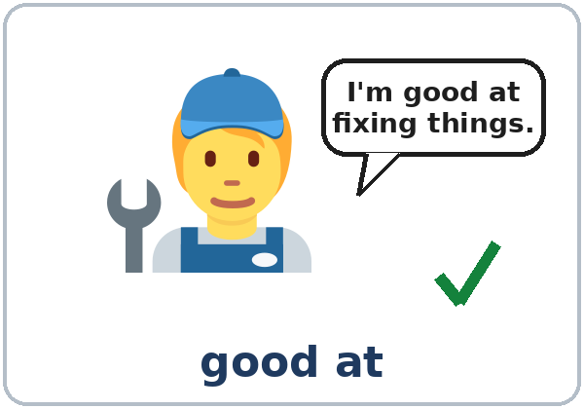
OPENING TALK · 6:00
Opening Talk
A asks a card question.
Did you ever lose something important?
B answers with 2–3 sentences.
A asks one follow-up.
Really? Where did you find it?
Then switch.
Notes:
Step 1 · 6:00–6:10 · Opening Talk + Homework Check · 10 min. Pairs (7 pairs + 1 trio with 15 learners; 3–4 pairs with 7–8).
Before class, write on the board: Whose… is this? It's mine. / It's hers.
Model with one learner: "Did you ever lose something important?" → (answer) → "Really? Where did you find it?" (Click to show the follow-up.)
Opening Talk (6 min): learners open the Opening Talk page. A asks a card question; B answers with 2–3 sentences; A asks one follow-up. Switch after each card. The cards are on the next slide.
If behind: one card only, then the homework check.
Source: Level3_Lesson9.md (Step 1; Opening Talk page).
Picture: Twemoji graphics by Twitter, Inc. and other contributors (https://github.com/jdecked/twemoji), CC BY 4.0 (https://creativecommons.org/licenses/by/4.0/); resized and combined, with speech bubbles, signs, and labels (images/CREDITS.md).

Slide 4
Opening Talk
Cards
01
Did you ever lose something important? What was it?
02
Look at your bag. What is in it? Is it all yours?
Work with a partner. Then switch.
Follow-ups:
Really? Where did you find it? Whose is it? What color is it?
03
Your friend finds a phone in class. What does she say?
04
Describe your favorite jacket or bag.
05
Homework check: Lesson 8, item 3.
Notes:
Step 1, continued. The four cards from the Opening Talk page. Each click shows the next card.
A asks a card question. B answers with 2–3 sentences. A asks one follow-up question (follow-ups on the right). Then switch.
Homework Check (4 min, last click): partners read their Lesson 8 Homework item 3 (The blue cup is mine…) to each other. The partner asks one question about it. Walk around. Write 2 common errors on the board (often It's the mine or his for a woman) and correct them together.
Source: Level3_Lesson9.md (Step 1; Opening Talk page: cards, follow-ups, homework check).

Slide 5
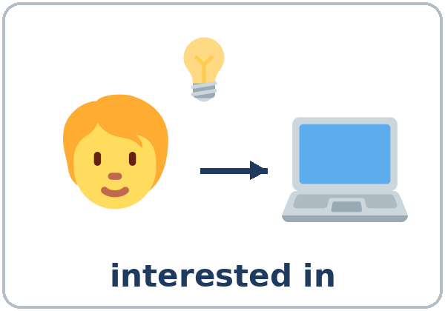

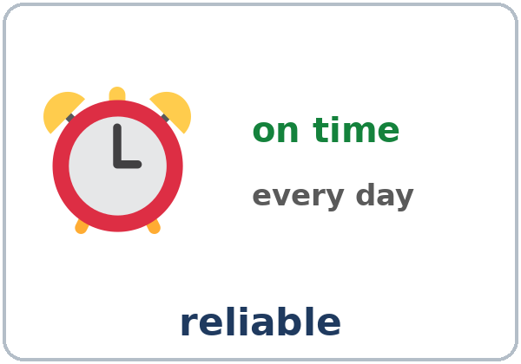
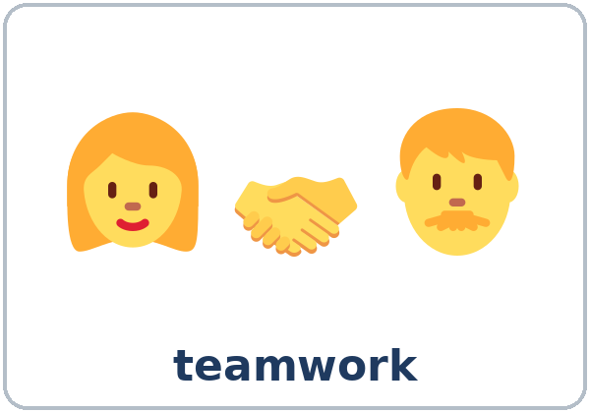
Look. Listen.
Repeat.
New Words
★ strength
★ good at
★ interested in
★ experience
★ reliable
★ teamwork
Notes:
Step 2 · 6:10–6:18 · New Words · 8 min (this slide and the next). Whole class, then pairs.
Point to each picture and say the word. Learners repeat once. ★ = the most important words. Each click shows the next word.
Show strength: make a strong arm. Show reliable: point to the clock, "always on time." Show good at: "I'm good at cooking. I'm not good at singing!" Mime both.
If behind: teach the ★ words only.
Source: Level3_Lesson9.md (Step 2; Key vocabulary; New Words page).
Pictures: Twemoji graphics by Twitter, Inc. and other contributors (https://github.com/jdecked/twemoji), CC BY 4.0 (https://creativecommons.org/licenses/by/4.0/); resized and combined, with speech bubbles, signs, and labels (images/CREDITS.md).

Slide 6
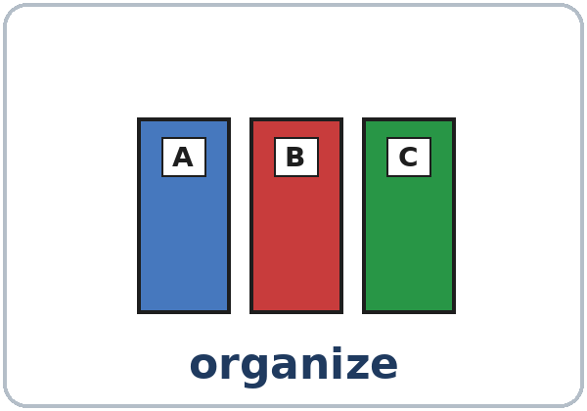
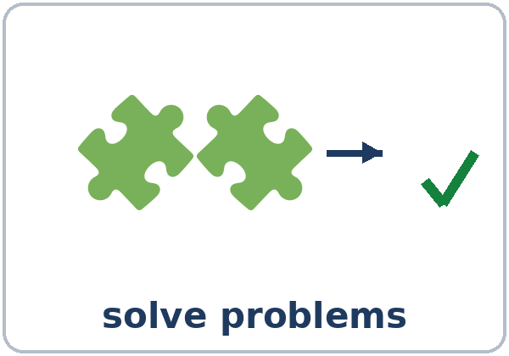
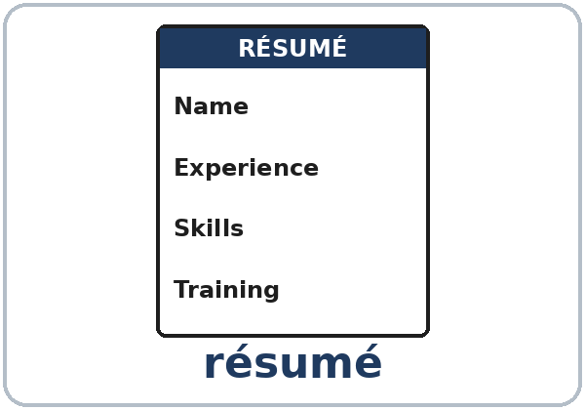

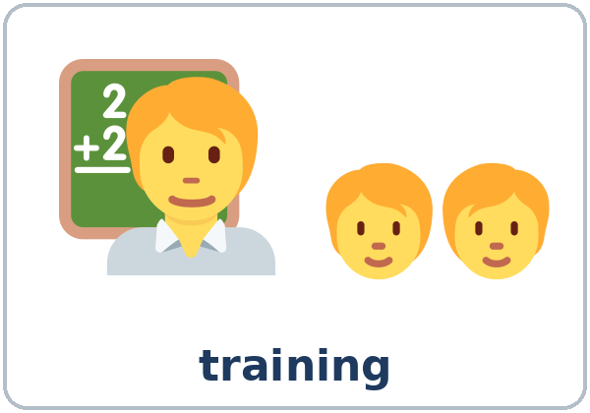

Partner game:
A says. B points.
More New Words
★ organize
★ solve problems
★ résumé
★ apply
★ training
shift
Notes:
Step 2, continued. Point to each picture and say the word. Learners repeat once.
Partner game (2 min): A says a word. B points to the picture and makes a sentence (A: reliable. B: I'm reliable. I'm always on time. / I'm good at solving problems.). Switch.
If behind: teach the ★ words only.
Source: Level3_Lesson9.md (Step 2; New Words page; Partner game).
Pictures: Twemoji graphics by Twitter, Inc. and other contributors (https://github.com/jdecked/twemoji), CC BY 4.0 (https://creativecommons.org/licenses/by/4.0/); resized and combined, with speech bubbles, signs, and labels (images/CREDITS.md).

Slide 7
Check the Meaning
Look at the picture. Answer the question.
1
2
3
A paper with your jobs and skills is a…?
Morning, evening, or night work time is a…?
A class at work for new workers is…?
résumé
shift
training
Notes:
Step 2 · Check meaning · 1 min. Whole class.
The answers are hidden. Ask each question and wait for the class to answer. Then click to show the answer. Each click shows one answer, in order: 1, 2, 3.
1. "A paper with your jobs and skills is a…?" (résumé) • 2. "Morning, evening, or night work time is a…?" (shift) • 3. "A class at work for new workers is…?" (training)
Source: Level3_Lesson9.md (Step 2: Check meaning).
Pictures: Twemoji graphics by Twitter, Inc. and other contributors (https://github.com/jdecked/twemoji), CC BY 4.0 (https://creativecommons.org/licenses/by/4.0/); resized and combined, with speech bubbles, signs, and labels (images/CREDITS.md).

Slide 8
Before You
Listen for:
Listen
Does she get a second interview?
Lucia has a job interview at a hotel. She wants a maintenance job. Mr. Hall is the manager.
What is she good at?
01
Audio: about 1:15. It plays once.
Narrator
02
Mr. Hall
Play 1: Task A
03
Lucia
Notes:
Step 3 · 6:18–6:30 · Listening + "Say it" · 12 min (slides 8 to 12). Individuals, then pairs check.
Before you listen (1 min). Say: "Lucia has a job interview at a hotel. She wants a maintenance job. Does she get a second interview? Listen."
There are three voices: a Narrator, Mr. Hall (the manager), and Lucia. Each click highlights the next voice.
The audio (L3_L9_listening.mp3, about 1:15) plays the conversation once. Press play again for play 2. A third play is fine if the class needs it.
No speaker? Read the script with a volunteer at a normal, friendly speed.
Audio: L3_L9_listening.mp3 (about 1:15) is not recorded yet (see level3/AUDIO_STATUS.md). It will use computer-generated voices (Chatterbox TTS cloned from synthetic Kokoro-82M reference clips); no recordings of real people. Until the file is ready, read the listening script with a volunteer. The names and the story are invented.
Source: Level3_Lesson9.md (Step 3; Listening script; Listening page).
Picture: Twemoji graphics by Twitter, Inc. and other contributors (https://github.com/jdecked/twemoji), CC BY 4.0 (https://creativecommons.org/licenses/by/4.0/); resized and combined, with speech bubbles, signs, and labels (images/CREDITS.md).

Slide 9
Listen.
Circle.
Listening A
Does Lucia get a second interview?
Yes No
1
Yes
Pairs: compare your answers.
Then check together.
Notes:
Play 1 → Task A (a second interview?). Pairs compare. Check together.
Click to show the answer: Yes (on Thursday).
Then read Tasks B and C together (1 min) so learners know what to listen for.
Source: Level3_Lesson9.md (Step 3; Listening Task A; Answer key).

Slide 10
Listen again.
Circle or check ✓.
Listening B
1
Experience: three years / five years
three years
She's good at… / She enjoys…
☐ fixing things ☐ solving problems ☐ helping people
☐ cooking ☐ driving
2
✓ fixing things, solving problems, helping people
Pairs: compare your answers.
Then check together.
3
Shift: the day shift / the night shift
the day shift
4
Can she work weekends? Yes / No
Yes
5
The second interview is on: Tuesday / Thursday
Thursday
Notes:
Play 2 → Tasks B and C. Pairs compare. Then show the answers.
Click to show each answer (one click per item, 1 to 5): 1 three years • 2 ✓ fixing things, ✓ solving problems, ✓ helping people, ✗ cooking, ✗ driving • 3 the day shift • 4 Yes, she doesn't mind working weekends. • 5 Thursday.
Source: Level3_Lesson9.md (Step 3; Listening Task B; Answer key).

Slide 11
Listen again.
Write the -ing word.
Listening C
1
I'm good at ____ things.
fixing
2
I'm good at ____ problems.
solving
3
Do you enjoy ____ on a team?
working
Pairs: compare your answers.
Then check together.
4
Yes, I enjoy ____ people.
helping
5
I'm very interested in ____ about the machines here.
learning
6
I don't mind ____ weekends.
working
Notes:
Task C (play 2). Click to show each answer (one click per item, 1 to 6): 1 fixing, 2 solving, 3 working, 4 helping, 5 learning, 6 working.
If behind: do Task C together on the board, reading the lines yourself.
Source: Level3_Lesson9.md (Step 3; Listening Task C; Answer key).

Slide 12
Say it: -ing and stress
Say It
The class repeats each word.
fixing · helping · working
INterested
The end of -ing is in the nose.
No g or k sound at the end.
Say each word two times.
exPERience
Notes:
"Say it" (2 min). Say: "The end of -ing is in the nose: fix-ing, help-ing, work-ing." Don't add a g or k sound at the end.
Then stress: INterested, exPERience. The class repeats each word twice.
Source: Level3_Lesson9.md (Step 3: "Say it"; Listening page: Say it).

Slide 13
Grammar Box 1
good at
good at + -ing · good with + people or things
QUESTION
ANSWER
What are you
good at?
I'm good at fixing things. / cooking.
Are you
good at organizing?
Yes, I am. I'm good at organizing shelves.
Are you
good with people?
Yes, I'm good with people. / numbers. / my hands.
Notes:
Step 4 · 6:30–6:45 · Grammar Q&A · 15 min (slides 13 to 20). Whole class, then pairs. Show the Grammar page. The left side is the question. The right side is the answer.
Show it (2 min): write on the board: good at + fixing. Say: "After at, in, about, the verb gets -ing." Write I'm good at fix. and cross it out.
Boxes 1, 2, and 3 (5 min): read a question from the left; the class answers from the right. Each click shows the answer side of one row. Then ask 3 learners: "What are you good at?" Help them finish with an -ing word.
good at + an activity (good at cooking). good with + people or things (good with people, good with numbers, good with my hands).
Source: Level3_Lesson9.md (Step 4; Grammar Box 1; Teacher notes: good at or good with).
Picture: Twemoji graphics by Twitter, Inc. and other contributors (https://github.com/jdecked/twemoji), CC BY 4.0 (https://creativecommons.org/licenses/by/4.0/); resized and combined, with speech bubbles, signs, and labels (images/CREDITS.md).

Slide 14
Grammar Box 2
interested in
interested in + -ing
QUESTION
ANSWER
What are you
interested in?
I'm interested in learning new skills.
Are you
interested in training?
Yes, I'm very interested in working with computers.
Notes:
Box 2: interested in + -ing. Each click shows the answer side of one row.
The one rule: after at, in, about (and after enjoy and don't mind), use -ing: good at fixing, interested in learning, enjoy helping, don't mind working.
Source: Level3_Lesson9.md (Step 4; Grammar Box 2; Teacher notes: The one rule).
Picture: Twemoji graphics by Twitter, Inc. and other contributors (https://github.com/jdecked/twemoji), CC BY 4.0 (https://creativecommons.org/licenses/by/4.0/); resized and combined, with speech bubbles, signs, and labels (images/CREDITS.md).

Slide 15
Grammar Box 3
enjoy / don't mind
enjoy + -ing · don't mind + -ing
QUESTION
ANSWER
Do you
enjoy working on a team?
Yes, I enjoy helping people.
Can you
work weekends?
Yes, I don't mind working weekends. / working at night.
Notes:
Box 3: enjoy / don't mind + -ing. Each click shows the answer side of one row.
Give an example: in a real interview, a strength is stronger with an example: I'm reliable. I was never late at my last job. Praise every example.
Source: Level3_Lesson9.md (Step 4; Grammar Box 3; Teacher notes: Give an example).
Picture: Twemoji graphics by Twitter, Inc. and other contributors (https://github.com/jdecked/twemoji), CC BY 4.0 (https://creativecommons.org/licenses/by/4.0/); resized and combined, with speech bubbles, signs, and labels (images/CREDITS.md).

Slide 16
Grammar Box 4
-ing Spelling
RULE
EXAMPLES
MOST VERBS: + -ing
fix → fixing · help → helping · work → working
END IN e: no e + -ing
organize → organizing · solve → solving · drive → driving
SHORT WORDS: double + -ing
shop → shopping · run → running · plan → planning
Notes:
Box 4 (2 min): read the spelling rows: fix → fixing, organize → organizing (no e), shop → shopping (double letter). Each click shows one row.
Spelling: most verbs add -ing. Drop a final e (organize → organizing). Short words like shop, run double the last letter (shopping, running). Don't teach more rules than this.
Check questions: "I'm interested ___ learning." (in) • "I enjoy ___ (help) people." (helping) • "I'm good ___ cooking." (at) • "I don't mind ___ (work) at night." (working)
Source: Level3_Lesson9.md (Step 4; Grammar Box 4; Teacher notes: Spelling).
Picture: Twemoji graphics by Twitter, Inc. and other contributors (https://github.com/jdecked/twemoji), CC BY 4.0 (https://creativecommons.org/licenses/by/4.0/); resized and combined, with speech bubbles, signs, and labels (images/CREDITS.md).

Slide 17
Practice A: write the -ing word.
good at · interested in · enjoy · don't mind
Practice A
1
I'm good at ____ (cook).
cooking
2
She's interested in ____ (learn) English.
learning
3
Do you enjoy ____ (work) outside?
working
Write the -ing word.
Pairs: check your answers.
4
He's good at ____ (organize) things.
organizing
5
They don't mind ____ (shop) for the office.
shopping
6
I'm good at ____ (fix) bikes.
fixing
Notes:
Practice A and B (3 min): learners write, then pairs check. Go over the answers.
Click to show each answer (one click per item, 1 to 6): 1 cooking, 2 learning, 3 working, 4 organizing, 5 shopping, 6 fixing.
Source: Level3_Lesson9.md (Step 4; Grammar Practice A; Answer key).

Slide 18
Circle the right words.
Practice B
1. I'm good ____ solving problems.
at
in
2. Are you interested ____ training?
on
in
3. I enjoy ____ customers.
help
helping
4. I don't mind ____ at night.
work
working
5. She's ____ people.
good at
good with
Notes:
Practice B. Learners circle the right words. Pairs check.
Click to circle each answer (one click per item, 1 to 5): 1 at, 2 in, 3 helping, 4 working, 5 good with.
Source: Level3_Lesson9.md (Step 4; Grammar Practice B; Answer key).

Slide 19
Common Mistakes
Don't say
Say
I'm good at cook.
I'm good at cooking.
I'm interested on computers.
I'm interested in computers.
I enjoy to work on a team.
I enjoy working on a team.
I don't mind work weekends.
I don't mind working weekends.
Notes:
Common mistakes (never skip this table). Read a line from Don't say. Ask: "What's the right way?" Learners try first. Then click to show the right form. Each click shows one line, in order 1 to 4.
1, 3, 4: after at, enjoy, and don't mind, use -ing • 2: interested in (not on). Save bored / boring for Lesson 11.
Say the right form clearly; the learner repeats. Learners can read the Spanish note and the tip on their Grammar page themselves; you don't need to explain them.
Source: Level3_Lesson9.md (Grammar: Common mistakes; Teacher notes: Typical mistakes).
Picture: Twemoji graphics by Twitter, Inc. and other contributors (https://github.com/jdecked/twemoji), CC BY 4.0 (https://creativecommons.org/licenses/by/4.0/); resized and combined, with speech bubbles, signs, and labels (images/CREDITS.md).

Slide 20
Pair Drill
A asks.
01
A asks What are you good at? B answers and gives one example.
A: What are you good at?
B answers + one example.
02
B: I'm good at cooking. I cook for my family every day.
Then switch roles.
Notes:
Pair drill (last 2 min of Step 4). Pairs.
A asks "What are you good at?" B answers and gives one example (I'm good at cooking. I cook for my family every day.). Switch.
If behind: skip the pair drill. Talk Time practices it.
Source: Level3_Lesson9.md (Step 4: Pair drill).
Picture: Twemoji graphics by Twitter, Inc. and other contributors (https://github.com/jdecked/twemoji), CC BY 4.0 (https://creativecommons.org/licenses/by/4.0/); resized and combined, with speech bubbles, signs, and labels (images/CREDITS.md).

Slide 21
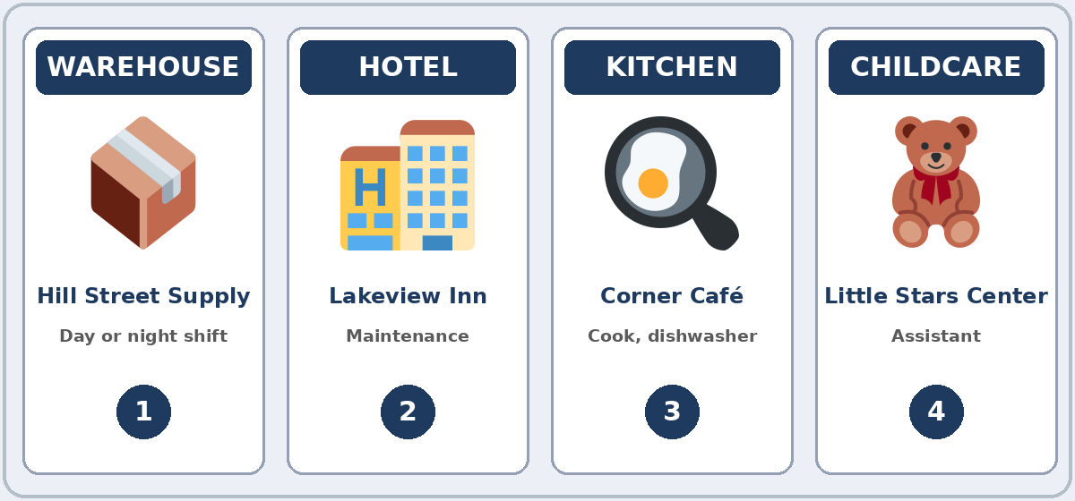
Talk Time
Interview Rotation
Two circles.
Inside = managers.
7:00–7:12
1
Managers choose a job card.
Applicants fill in "My answers."
2
Ask 3 questions + 1 follow-up.
Can you give me an example?
3
Write one strength. Then: Move!
The outer circle moves one to the right.
Notes:
Step 5 · 7:00–7:12 · Talk Time: Interview Rotation · 12 min. Two circles: the inner circle are managers; the outer circle are applicants.
Before (2 min): each manager chooses a job card (1–4: warehouse, hotel, kitchen, childcare) and the Manager Questions. Each applicant fills in the "My answers" box on their page (strengths, experience, shifts). Invented details are fine.
Model with one learner (1 min): you are the manager at the hotel (card 2). "Tell me about yourself." → (answer) → "What are you good at?" → (answer) → follow-up: "Can you give me an example?"
Rotation (6 min): each interview is about 2 minutes: the manager asks 3 questions from the card and one follow-up, then writes one strength in the notes table. Then say "Move!" The outer circle moves one person to the right. 3 rotations. Each click shows the next step.
Switch (3 min): managers and applicants change places for one or two more rotations. Finish: ask 2 managers: "Who gets a second interview? Why?" (Ana, because she's good at organizing.) If behind: 2 rotations, no role switch.
Invented job histories are fine (important): invite, don't require, real job details. Learners can talk about home, family, or volunteer work, or invent a job history. Never ask about immigration or work status, papers, or pay.
Source: Level3_Lesson9.md (Step 5; Talk Time pages).
Picture: Twemoji graphics by Twitter, Inc. and other contributors (https://github.com/jdecked/twemoji), CC BY 4.0 (https://creativecommons.org/licenses/by/4.0/); resized and combined, with speech bubbles, signs, and labels (images/CREDITS.md).

Slide 22
Manager
Questions
01
Tell me about yourself.
02
What are you good at?
03
Are you interested in training?
Ask 3 questions + 1 follow-up.
Follow-ups:
Can you give me an example? Why? Where did you learn that?
04
Do you enjoy working on a team?
05
Which shift can you work?
06
Do you mind working weekends?
Notes:
Step 5, continued. The Manager Questions from the Talk Time page. Each click shows the next question.
Applicants answer with good at / interested in / enjoy / don't mind and give an example. Managers write one strength after each interview. Do they get a second interview? Why?
Source: Level3_Lesson9.md (Talk Time: Manager Questions; My Notes).

Slide 23
Before You Go 7:12–7:17
01
Exit ticket
02
Homework
Write two sentences:
1. One with good at or interested in + -ing.
2. One with an example and because or so:
I'm reliable, so I'm never late.
Give it to me at the door.
About 15 minutes.
1. Write the sentence with -ing.
2. Tell me about yourself: 3–4 sentences.
3. Ask: What are you good at?
4. Review: 2 sentences with mine, yours….
Bring it next week!
Notes:
Step 6 · 7:12–7:17 · Exit Ticket + Homework · 5 min · NEVER SKIP.
Exit ticket: each learner writes two sentences on a slip: one with good at or interested in + -ing (I'm good at organizing things.), and one with an example and because or so (I'm reliable, so I'm never late.). Collect at the door.
Homework: open the Homework page. Do item 1 together (one sentence on the board). Say: "About 15 minutes. Bring it next week."
Homework items: 1 write the sentence with the -ing word (I / good at / drive → I'm good at driving.) • 2 a manager says Tell me about yourself: write 3–4 sentences (you can invent the details) • 3 ask a family member or a coworker: What are you good at? Write the answer and one example • 4 review (Lesson 8): 2 sentences with mine, yours, his, hers, ours, or theirs.
Read & Write (7:17–7:25, on the Student Pages): two job ads; questions 1–5; then a 3-sentence skills summary for themselves or an invented person. If behind: questions 1–5 only; the summary becomes homework.
Source: Level3_Lesson9.md (Step 6; Homework page; Read & Write step).
Picture: Twemoji graphics by Twitter, Inc. and other contributors (https://github.com/jdecked/twemoji), CC BY 4.0 (https://creativecommons.org/licenses/by/4.0/); resized and combined, with speech bubbles, signs, and labels (images/CREDITS.md).

Slide 24
Progress Check 7:25
D. I can…
😀 🙂 😐
Check one face.
I can say what I'm good at.
I can say what I'm interested in.
I can talk about my experience.
I can answer Tell me about yourself.
A. Listen to the teacher. Circle a or b.
Answer
1. a. He can fix cars. b. He wants to learn about cars.
a
2. a. She works with children now. b. She wants to work with children.
b
3. a. Night work is OK for him. b. Night work is a problem for him.
a
4. a. He doesn't like cooking. b. He likes cooking for his family.
b
Notes:
Progress Check · 7:25–7:30 · 5 min. Individuals. Open the Progress Check page.
Part A: read each sentence slowly, 2 times. Learners circle a or b. Then click to show the answer (one click per item, 1 to 4).
Say: 1 "He's good at fixing cars." (a) • 2 "She's interested in working with children." (b) • 3 "He doesn't mind working at night." (a) • 4 "He enjoys cooking for his family." (b)
Parts B and C: learners do them alone. Walk around and help with the instructions only. B answers: 1 at, 2 in, 3 working, 4 helping. C: answers will vary (for example I'm good at organizing. I organize the shelves at my job. / I'm interested in learning about computers.).
Part D: read each "I can…" line aloud and point to the 3 faces: 😀 "I can do it." 🙂 "With a little help." 😐 "Not yet."
Scoring: A /4 + B /4 + C /2 = /10. This is not a test grade. It shows who needs more help hearing the phrases (A) and with at / in + -ing (B, C).
Collect the pages (or check them at the start of Week 11). If behind: do the Progress Check in Week 11 at 6:00, while learners arrive.
Source: Level3_Lesson9.md (Progress Check step; Progress Check page; Answer key).

Slide 25
Goodbye! See You Next Week!
Now you can:
• Say what you're good at
• Say what you're interested in
• Answer Tell me about yourself
Lesson 9 · Level 3
Notes:
Read the title: "Goodbye! See you next week!" Learners repeat.
Read the three "Now you can" lines. Ask one learner: "What are you good at?" and wait for an answer with an example.
Remind learners: homework is about 15 minutes. Bring it next week.
Source: Level3_Lesson9.md (At a glance: Objectives; Step 6).
Picture: Twemoji graphics by Twitter, Inc. and other contributors (https://github.com/jdecked/twemoji), CC BY 4.0 (https://creativecommons.org/licenses/by/4.0/); resized and combined, with speech bubbles, signs, and labels (images/CREDITS.md).

Slide 26
Credits
Pictures
Vocabulary pictures use Twemoji graphics by Twitter, Inc. and other contributors (https://github.com/jdecked/twemoji), licensed under CC BY 4.0 (https://creativecommons.org/licenses/by/4.0/). The graphics were resized and combined, and speech bubbles, signs, and labels were added.
The faces on the Progress Check are standard emoji characters shown with the computer's emoji font.
Names and story
Lucia and Mr. Hall are invented names. The listening story is invented.
Audio and font
Audio: synthetic voices made with Chatterbox TTS (MIT License), cloned from short synthetic reference clips made with Kokoro-82M (Apache License 2.0). No recordings of real people were used. Each file carries an inaudible Perth watermark marking it as AI-generated. Font: Lexend Deca (OFL 1.1).
© 2026 the authors. The authors license this deck under CC BY-NC-SA 4.0.
Notes:
Credits. You don't need to read this slide in class.
Pictures: Twemoji graphics by Twitter, Inc. and other contributors, CC BY 4.0; the file-by-file list is in images/CREDITS.md.
Audio: L3_L9_listening.mp3 (about 1:15) is not recorded yet (see level3/AUDIO_STATUS.md). It will use computer-generated voices (Chatterbox TTS cloned from synthetic Kokoro-82M reference clips); no recordings of real people. Until the file is ready, read the listening script with a volunteer. The names and the story are invented.
Course materials: © 2026 the authors, licensed under CC BY-NC-SA 4.0 (https://creativecommons.org/licenses/by-nc-sa/4.0/).
Source: Level3_Lesson9.md (Picture Credits); images/CREDITS.md.

