Slide 1
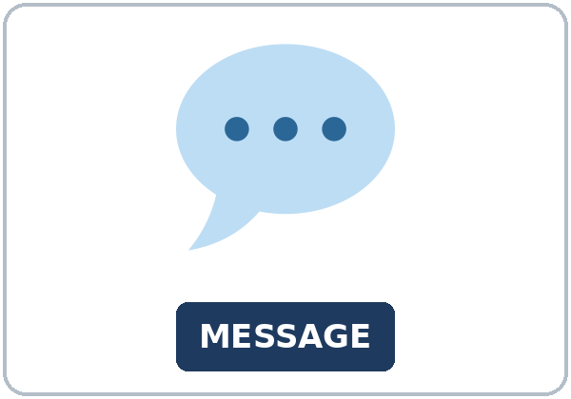
She Told Me to Call
Today you will:
• I can report a statement with said and told.
• I can report a request with asked me to.
• I can report a yes or no question with asked if.
Lesson 6 · Level 5
Notes:
Welcome learners as they arrive.
Read the three lines under Today you will.
This lesson is not medical advice.
Lesson plan: Topic; At a glance: Objectives.
Picture: Twemoji graphics by Twitter, Inc. and other contributors (https://github.com/jdecked/twemoji), CC BY 4.0 (https://creativecommons.org/licenses/by/4.0/); resized and combined, with signs and labels (images/CREDITS.md).

Slide 2
Today's
Goals
01
I can report a statement with said and told.
02
I can report a request with asked me to.
03
I can report a yes or no question with asked if.
By the end of class, you can do these things.
04
I can write the message so another person can act on it.
Notes:
Read each goal slowly. Learners repeat.
Lesson plan: At a glance: Objectives.

Slide 3
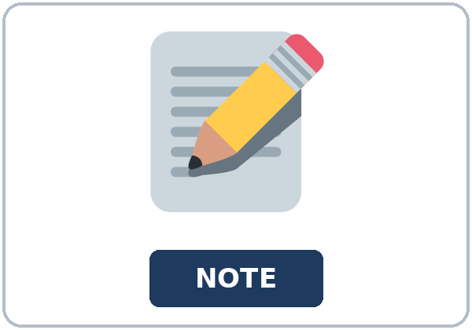
OPENING TALK · 6:00
Opening Talk
Work with a partner. Say one
passive line from last week. Then switch.
Homework check: read one budget line. Use
invented numbers only.
Notes:
Step 1 · 6:00–6:06 · Opening Talk.
Work with a partner.
Lesson plan: Step 1; Opening Talk page.
Picture: Twemoji graphics by Twitter, Inc. and other contributors (https://github.com/jdecked/twemoji), CC BY 4.0 (https://creativecommons.org/licenses/by/4.0/); resized and combined, with signs and labels (images/CREDITS.md).

Slide 4
Opening Talk
Cards
01
Say one line from the practice statement with was.
02
What was added on Tuesday?
Work with a partner. Say one passive line from
last week. Then switch.
03
What does credit mean on that page?
04
Homework check: read one budget line. Use invented numbers only.
Notes:
Each click shows the next card.
A asks. B answers. Then switch.
Lesson plan: Step 1; Opening Talk page.

Slide 5

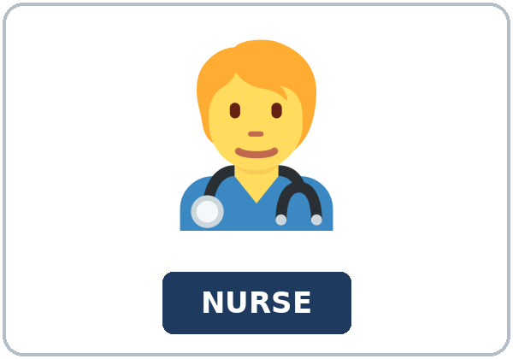
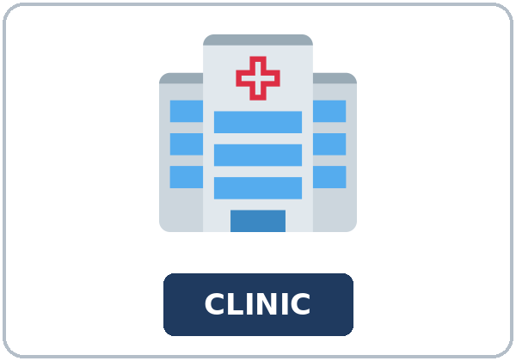

Look. Listen.
Repeat.
New Words
★ message
★ note
★ callback
★ nurse
★ clinic
★ folder
Notes:
Step 2 · 6:06–6:12 · New Words.
Point to each picture. Learners repeat. ★ = most important.
Lesson plan: Step 2; New Words page.
Pictures: Twemoji graphics by Twitter, Inc. and other contributors (https://github.com/jdecked/twemoji), CC BY 4.0 (https://creativecommons.org/licenses/by/4.0/); resized and combined, with signs and labels (images/CREDITS.md).

Slide 6
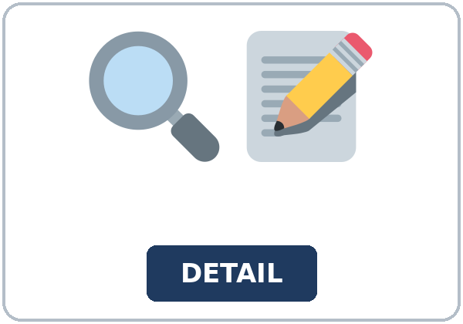
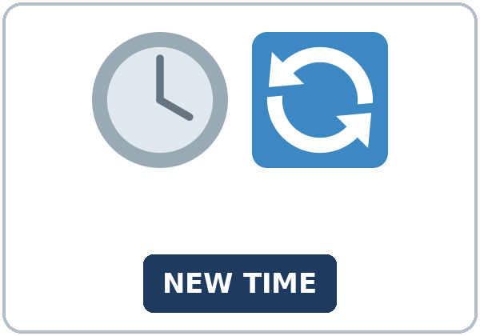
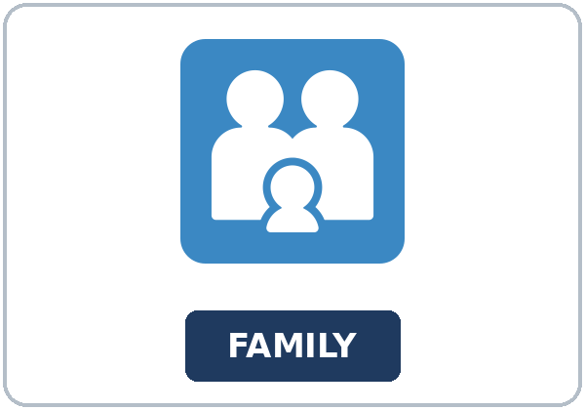
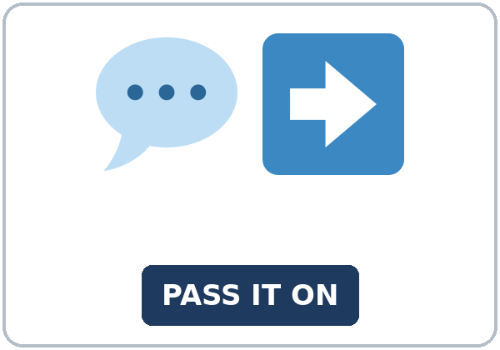
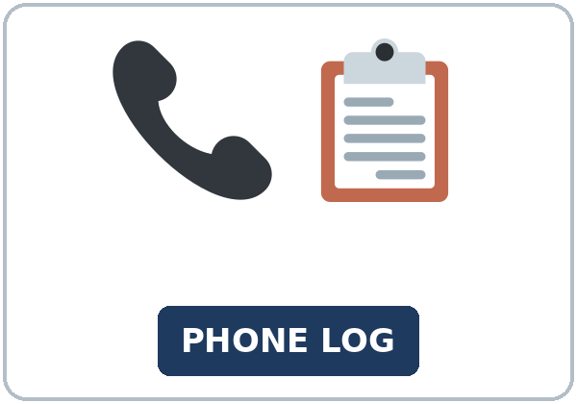
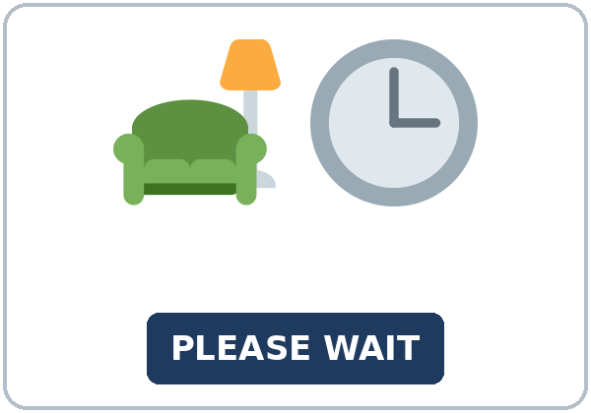
Partner game:
Pass the word
More New Words
★ detail
★ time change
★ family member
★ relay
phone log
waiting room
Notes:
A points to a picture. B names it and uses it in one sentence. Then switch.
Lesson plan: Step 2; New Words page; Partner game.
Pictures: Twemoji graphics by Twitter, Inc. and other contributors (https://github.com/jdecked/twemoji), CC BY 4.0 (https://creativecommons.org/licenses/by/4.0/); resized and combined, with signs and labels (images/CREDITS.md).

Slide 7
Check the Meaning
Look at the picture. Answer the question.
1
2
3
What do you write a message on?
Where do you sit before the call?
Who can you pass the message to?
a note
the waiting room
a family member
Notes:
The answers are hidden. Ask, then click.
1. a note
2. the waiting room
3. a family member
Lesson plan: Step 2: Check the Meaning.
Pictures: Twemoji graphics by Twitter, Inc. and other contributors (https://github.com/jdecked/twemoji), CC BY 4.0 (https://creativecommons.org/licenses/by/4.0/); resized and combined, with signs and labels (images/CREDITS.md).

Slide 8
Before You
Listen for:
Listen
Listen. Did the checkup stay on the same day?
Jana calls the clinic.
| 6:12–6:32 | Listening.
01
Audio: about 1:41. It plays once.
Jana
02
Nurse Patel
Play 1: Task A
03
Ken
Notes:
Step 3 · 6:12–6:32 · Listening. Play 1 is Task A. Play 2 is Tasks B and C. A third play is fine.
Jana calls the clinic.
The script says going to and want to. Learners only need to recognize gonna and wanna.
Lesson plan: Step 3; Listening page.
Picture: Twemoji graphics by Twitter, Inc. and other contributors (https://github.com/jdecked/twemoji), CC BY 4.0 (https://creativecommons.org/licenses/by/4.0/); resized and combined, with signs and labels (images/CREDITS.md).

Slide 9
Listen. Did the checkup stay on the same
day?
Listening A
1.
a. Yes. It stayed on the same day
b. No. It moved to Thursday
c. It was canceled
Notes:
Click to circle b.
Lesson plan: Step 3; Listening Task A; Answer key.

Slide 10
B. Listen again. Complete the message.
Listening B
1. New day
Thursday
Monday
Friday
2. Call before
3:00
5:00
9:00
3. Bring
the appointment card
a lunch
a photo
4. She tells the message to
Ken
the nurse
a teacher
5. They will call if
the room changes
the clinic closes
the class is off
Notes:
Click to circle each answer: 1 Thursday • 2 3:00 • 3 the appointment card • 4 Ken • 5 the room changes
Lesson plan: Step 3; Listening Task B; Answer key.

Slide 11
Listen again.
Listen again. Write said, to
Listening C
1
She ______ the checkup was on Thursday.
said
2
She ______ me the time had changed.
told
3
She ______ me to call before 3:00.
asked
Write the missing words.
Then check together.
4
She ______ if Thursday was OK.
asked
5
She ______ they would call me.
said
6
She ______ me to bring the card.
asked
Notes:
Click to show each answer: 1 said • 2 told • 3 asked • 4 asked • 5 said • 6 asked
Lesson plan: Step 3; Listening Task C; Answer key.

Slide 12
Hear it: gonna and wanna are short forms
Hear It,
Say It
Say it: use the full forms
I want to write the message down.
I am going to call before 3:00.
gonna and wanna are short forms. This listening uses the full forms.
You can say going to and want to.
Say each line two times.
She told me to bring the card.
She said they would call.
Notes:
gonna and wanna are short forms. This listening uses the full forms. Say each line two times.
Lesson plan: Step 3: Hear it, say it.

Slide 13
Grammar Box 1
said
DIRECT
REPORTED
The nurse said, "The checkup is on Thursday."
She said the checkup was on Thursday.
"We will call you."
She said they would call me.
She said the time had changed.
said does not need a person
Notes:
Grammar Box 1: said. Each click shows the answer side.
Lesson plan: Step 4; Grammar Box 1.
Picture: Twemoji graphics by Twitter, Inc. and other contributors (https://github.com/jdecked/twemoji), CC BY 4.0 (https://creativecommons.org/licenses/by/4.0/); resized and combined, with signs and labels (images/CREDITS.md).

Slide 14
Grammar Box 2
told
SAY THIS
NOTE
She told me the time had changed.
tell needs a person
She told me the checkup was on Thursday.
told me, not told to me
She told Ken the new day.
a person after told
Notes:
Grammar Box 2: told. Each click shows the answer side.
Lesson plan: Step 4; Grammar Box 2.
Picture: Twemoji graphics by Twitter, Inc. and other contributors (https://github.com/jdecked/twemoji), CC BY 4.0 (https://creativecommons.org/licenses/by/4.0/); resized and combined, with signs and labels (images/CREDITS.md).

Slide 15
Grammar Box 3
asked me to
REQUEST
FORM
She asked me to call before 3:00.
a request
She asked me to bring the card.
asked me to + verb
She asked me to write it in the folder.
a request
Notes:
Grammar Box 3: asked me to. Each click shows the answer side.
Lesson plan: Step 4; Grammar Box 3.
Picture: Twemoji graphics by Twitter, Inc. and other contributors (https://github.com/jdecked/twemoji), CC BY 4.0 (https://creativecommons.org/licenses/by/4.0/); resized and combined, with signs and labels (images/CREDITS.md).

Slide 16
Grammar Box 4
asked if
QUESTION
REPORTED
She asked if Thursday was OK.
statement order
She asked if I could come before 3:00.
can becomes could
She asked if Ken was at home.
yes or no, then statement order
Notes:
Grammar Box 4: asked if. Each click shows the answer side.
Lesson plan: Step 4; Grammar Box 4.
Picture: Twemoji graphics by Twitter, Inc. and other contributors (https://github.com/jdecked/twemoji), CC BY 4.0 (https://creativecommons.org/licenses/by/4.0/); resized and combined, with signs and labels (images/CREDITS.md).

Slide 17
Practice A
Write.
Practice A
1
She ______ the checkup was on Thursday.
said
2
She ______ me the time had changed.
told
3
She ______ me to call before 3:00.
asked
Write the missing word.
Pairs: check your answers.
4
She ______ if Thursday was OK.
asked
5
She said they ______ call me.
would
6
She told ______ the new day.
me
Notes:
Click to show each answer: 1 said • 2 told • 3 asked • 4 asked • 5 would • 6 me
Lesson plan: Step 4; Grammar Practice A; Answer key.

Slide 18
Circle the correct words.
Practice B
1. She
said the day had changed
said me the day had changed
2. She
told me the new time
told to me the new time
3. She
asked me to call
asked that I call
4. She asked
if Thursday was OK
if was Thursday OK
5. She said they
would call
will call
6. She asked if I
could come
can come
Notes:
Click to circle each answer: 1 said the day had changed • 2 told me the new time • 3 asked me to call • 4 if Thursday was OK • 5 would call • 6 could come
Lesson plan: Step 4; Grammar Practice B; Answer key.

Slide 19
Common Mistakes
Don't say
Say
She said me the day.
She told me the day.
She told that the time had changed.
She said that the time had changed.
She asked me if I can come.
She asked if I could come.
She told to me.
She told me.
Notes:
Read Don't say, then Say. Learners try first. Then click.
Lesson plan: Grammar: Common mistakes.
Picture: Twemoji graphics by Twitter, Inc. and other contributors (https://github.com/jdecked/twemoji), CC BY 4.0 (https://creativecommons.org/licenses/by/4.0/); resized and combined, with signs and labels (images/CREDITS.md).

Slide 20
Pair Check
A says.
01
Then switch.
A reads one direct sentence.
B answers.
02
B reports it with said, told, or asked.
Notes:
A reads one direct sentence. B reports it with said, told, or asked. Then switch. ---
Break · 6:45–7:00.
Lesson plan: Step 4: Pair check.
Picture: Twemoji graphics by Twitter, Inc. and other contributors (https://github.com/jdecked/twemoji), CC BY 4.0 (https://creativecommons.org/licenses/by/4.0/); resized and combined, with signs and labels (images/CREDITS.md).

Slide 21
Talk Time
Talk Time
Groups.
Groups of 3.
7:00–7:18
1
Groups of 3.
2
She said the checkup was on Thursday.
3
She asked me to call before 3:00.
Notes:
Round 1.
Lesson plan: Step 5; Talk Time.
Picture: Twemoji graphics by Twitter, Inc. and other contributors (https://github.com/jdecked/twemoji), CC BY 4.0 (https://creativecommons.org/licenses/by/4.0/); resized and combined, with signs and labels (images/CREDITS.md).

Slide 22
Talk Time
Talk Time
Groups.
Groups of 3.
7:00–7:18
1
Groups of 3.
2
Who called?
3
What day is the checkup?
Notes:
Round 2.
Lesson plan: Step 5; Talk Time.
Picture: Twemoji graphics by Twitter, Inc. and other contributors (https://github.com/jdecked/twemoji), CC BY 4.0 (https://creativecommons.org/licenses/by/4.0/); resized and combined, with signs and labels (images/CREDITS.md).

Slide 23
Read.
Answer.
Read &
Write
1
What day is the checkup?
Thursday
2
What did the nurse ask Jana to do first?
Call before 3:00
Read the page.
Answer the questions.
3
What should she bring?
The appointment card
4
What did the nurse say about a later call?
They would call if the room changes
5
Who is the message for?
Ken, a family member
Notes:
Step 6 · 7:18–7:25 · Read & Write.
Click to show each answer: 1 Thursday • 2 Call before 3:00 • 3 The appointment card • 4 They would call if the room changes • 5 Ken, a family member
Lesson plan: Step 6; Read & Write page; Answer key.

Slide 24
Before You Go 7:25–7:30
01
Exit ticket
02
Homework
Report one thing someone said in class tonight.
Name: Date:
Use said or told, and asked me to or asked if.
Give this page to your teacher.
About 20–25 minutes.
1. Report one sentence with said or told.
2. Finish the message for a family member. Six to eight sentences.
3. Read the message to a friend. They name the day and the task.
4. Review: one passive line from Lesson 5.
Bring it next week!
Notes:
Step 7 · 7:25–7:30 · Exit ticket and homework. Never skip the exit ticket.
Report one thing someone said in class tonight.
Lesson plan: Step 7; Exit Ticket page; Homework page.
Picture: Twemoji graphics by Twitter, Inc. and other contributors (https://github.com/jdecked/twemoji), CC BY 4.0 (https://creativecommons.org/licenses/by/4.0/); resized and combined, with signs and labels (images/CREDITS.md).

Slide 25
Goodbye! See You Next Week!
Now you can:
• I can report a statement with said and told.
• I can report a request with asked me to.
• I can report a yes or no question with asked if.
Lesson 6 · Level 5
Notes:
Read the three Now you can lines.
Homework is about 20–25 minutes. Bring it next week.
Lesson plan: At a glance: Objectives; Step 7.
Picture: Twemoji graphics by Twitter, Inc. and other contributors (https://github.com/jdecked/twemoji), CC BY 4.0 (https://creativecommons.org/licenses/by/4.0/); resized and combined, with signs and labels (images/CREDITS.md).

Slide 26
Credits
Pictures
Vocabulary pictures use Twemoji graphics by Twitter, Inc. and other contributors (https://github.com/jdecked/twemoji), licensed under CC BY 4.0 (https://creativecommons.org/licenses/by/4.0/). The graphics were resized and combined, and signs and labels were added.
Names and story
Jana, Nurse Patel, and Ken are invented names. The listening story is invented.
Audio and font
Audio: synthetic voices made with Chatterbox TTS (MIT License), cloned from short synthetic reference clips made with Kokoro-82M (Apache License 2.0). No recordings of real people were used. Each file carries an inaudible Perth watermark marking it as AI-generated. Font: Lexend Deca (OFL 1.1).
© 2026 the authors. The authors license this deck under CC BY-NC-SA 4.0.
Notes:
Credits. You don't need to read this slide in class.
Pictures: Twemoji graphics by Twitter, Inc. and other contributors, CC BY 4.0; the file-by-file list is in images/CREDITS.md.
Audio: synthetic voices, computer-generated (Chatterbox TTS cloned from Kokoro-82M reference clips). No recordings of real people. The names and the story are invented.
Course materials: © 2026 the authors, licensed under CC BY-NC-SA 4.0 (https://creativecommons.org/licenses/by-nc-sa/4.0/).
Lesson plan: Picture Credits. Picture list: images/CREDITS.md.

