Slide 1
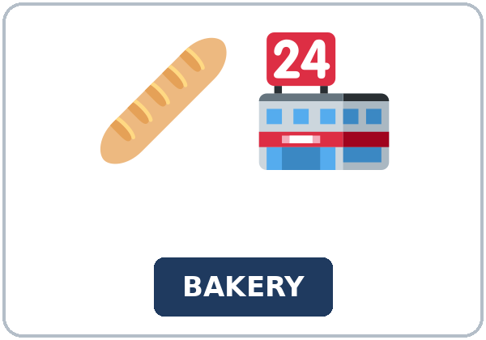
By the Time We Opened
Today you will:
• I can say what had already happened
• I can use by the time and when with two past times
• I can put four events in order
Lesson 2 · Level 5
Notes:
Welcome learners as they arrive.
Read the three lines under Today you will.
Lesson plan: Topic; At a glance: Objectives.
Picture: Twemoji graphics by Twitter, Inc. and other contributors (https://github.com/jdecked/twemoji), CC BY 4.0 (https://creativecommons.org/licenses/by/4.0/); resized and combined, with signs and labels (images/CREDITS.md).

Slide 2
Today's
Goals
01
I can say what had already happened
02
I can use by the time and when with two past times
03
I can put four events in order
By the end of class, you can do these things.
04
I can write a short project note
Notes:
Read each goal slowly. Learners repeat.
Lesson plan: At a glance: Objectives.

Slide 3
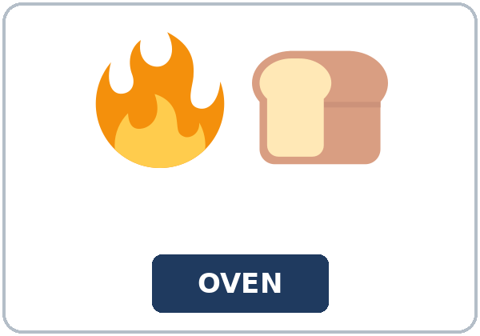
OPENING TALK · 6:00
Opening Talk
Work with a partner. A asks. B
answers in a short summary. A asks one follow-up. Then switch.
Give one example from last week.
Notes:
Step 1 · 6:00–6:06 · Opening Talk.
Work with a partner.
Lesson plan: Step 1; Opening Talk page.
Picture: Twemoji graphics by Twitter, Inc. and other contributors (https://github.com/jdecked/twemoji), CC BY 4.0 (https://creativecommons.org/licenses/by/4.0/); resized and combined, with signs and labels (images/CREDITS.md).

Slide 4
Opening Talk
Cards
01
How long have you been working, or studying English?
02
What have you been practicing?
Work with a partner. A asks. B answers in a
short summary. A asks one follow-up. Then switch.
03
Have you finished any training?
04
Give one example from last week.
Notes:
Each click shows the next card.
A asks. B answers. Then switch.
Lesson plan: Step 1; Opening Talk page.

Slide 5
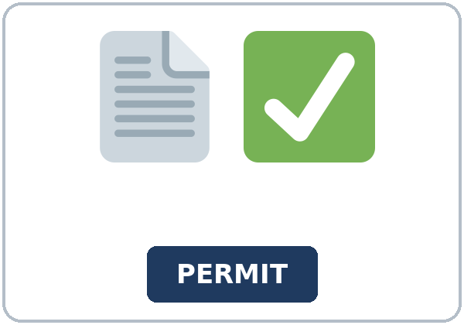

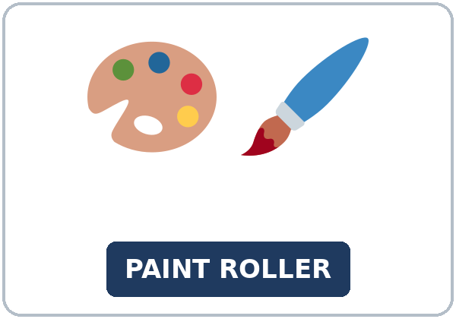
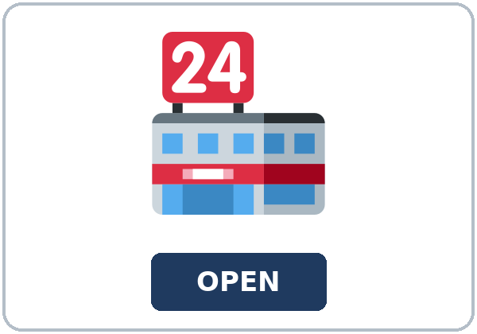
Look. Listen.
Repeat.
New Words
★ bakery
★ oven
★ permit
★ inspector
★ paint roller
★ store sign
Notes:
Step 2 · 6:06–6:12 · New Words.
Point to each picture. Learners repeat. ★ = most important.
Lesson plan: Step 2; New Words page.
Pictures: Twemoji graphics by Twitter, Inc. and other contributors (https://github.com/jdecked/twemoji), CC BY 4.0 (https://creativecommons.org/licenses/by/4.0/); resized and combined, with signs and labels (images/CREDITS.md).

Slide 6


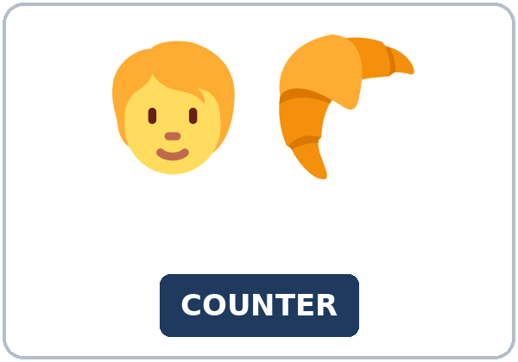
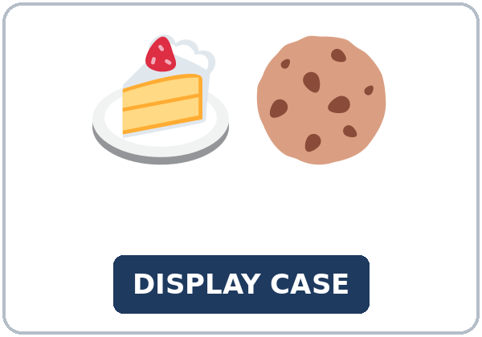
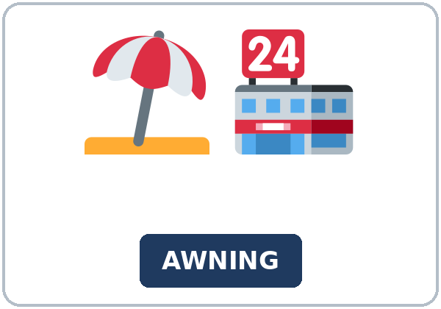

Partner game:
Which one comes first?
More New Words
★ ribbon
★ opening day
★ counter
★ display case
awning
poster
Notes:
A points to a picture. B names it and uses it in one sentence. Then switch.
Lesson plan: Step 2; New Words page; Partner game.
Pictures: Twemoji graphics by Twitter, Inc. and other contributors (https://github.com/jdecked/twemoji), CC BY 4.0 (https://creativecommons.org/licenses/by/4.0/); resized and combined, with signs and labels (images/CREDITS.md).

Slide 7
Check the Meaning
Look at the picture. Answer the question.
1
2
3
Is the oven a person?
Who comes before opening day?
Is an awning a cover or a cake?
no, it bakes
the inspector
a cover
Notes:
The answers are hidden. Ask, then click.
1. no, it bakes
2. the inspector
3. a cover
Lesson plan: Step 2: Check the Meaning.
Pictures: Twemoji graphics by Twitter, Inc. and other contributors (https://github.com/jdecked/twemoji), CC BY 4.0 (https://creativecommons.org/licenses/by/4.0/); resized and combined, with signs and labels (images/CREDITS.md).

Slide 8
Before You
Listen for:
Listen
Listen. Is the bakery open yet?
Priya and Ben work at a new bakery.
| 6:12–6:32 | Listening (play 1 = Task A; play 2 = Tasks B and C) +
01
Audio: about 1:39. It plays once.
Ms. Cole
02
Priya
Play 1: Task A
03
Ben
Notes:
Step 3 · 6:12–6:32 · Listening. Play 1 is Task A. Play 2 is Tasks B and C. A third play is fine.
Priya and Ben work at a new bakery.
The script says going to and want to. Learners only need to recognize gonna and wanna.
Lesson plan: Step 3; Listening page.
Picture: Twemoji graphics by Twitter, Inc. and other contributors (https://github.com/jdecked/twemoji), CC BY 4.0 (https://creativecommons.org/licenses/by/4.0/); resized and combined, with signs and labels (images/CREDITS.md).

Slide 9
Listen. Is the bakery open yet?
Listening A
1.
a. Yes. It is open now
b. No. It opens tomorrow
c. No. It failed the visit
Notes:
Click to circle b.
Lesson plan: Step 3; Listening Task A; Answer key.

Slide 10
B. Listen again. What happened first,
second, third, fourth, and last? Circle.
Listening B
1. First
cleaned the kitchen
the poster
the inspector
2. Second
the oven arrived
opening day
the ribbon
3. Third
we painted
we opened
we failed
4. Fourth
the poster went up
the oven
the permit
5. Last
the inspector
the oven
the sign
Notes:
Click to circle each answer: 1 cleaned the kitchen • 2 the oven arrived • 3 we painted • 4 the poster went up • 5 the inspector
Lesson plan: Step 3; Listening Task B; Answer key.

Slide 11
Listen again.
Listen again. Write had or t
Listening C
1
We ______ already painted the walls.
had
2
You ______ last.
arrived
3
Ben ______ already cleaned the kitchen.
had
Write the missing words.
Then check together.
4
The poster ______ up.
went
5
We ______ already picked up the permit.
had
6
The oven ______ delivered.
was
Notes:
Click to show each answer: 1 had • 2 arrived • 3 had • 4 went • 5 had • 6 was
Lesson plan: Step 3; Listening Task C; Answer key.

Slide 12
Hear it: gonna and wanna are short forms
Hear It,
Say It
Say it: use the full forms
We want to open tomorrow.
We are going to cut the ribbon.
gonna and wanna are short forms. This listening uses the full forms.
You can say going to and want to.
Say each line two times.
We had already painted the walls.
By the time the inspector arrived, we had painted.
Notes:
gonna and wanna are short forms. This listening uses the full forms. Say each line two times.
Lesson plan: Step 3: Hear it, say it.

Slide 13
Grammar Box 1
by the time and when
QUESTION
ANSWER
What had you done by the time the inspector arrived?
We had already painted the walls.
What had Ben done when the oven was delivered?
Ben had already cleaned the kitchen.
Had you finished the sign before the poster went up?
Yes, we had. / No, we hadn't.
Notes:
Grammar Box 1: by the time and when. Each click shows the answer side.
Lesson plan: Step 4; Grammar Box 1.
Picture: Twemoji graphics by Twitter, Inc. and other contributors (https://github.com/jdecked/twemoji), CC BY 4.0 (https://creativecommons.org/licenses/by/4.0/); resized and combined, with signs and labels (images/CREDITS.md).

Slide 14
Grammar Box 2
earlier and later
EARLIER: HAD + PAS
LATER: SIMPLE PAST
we had already painted the walls
the inspector arrived
Ben had already cleaned the kitchen
the oven was delivered
we had finished the sign
the poster went up
Notes:
Grammar Box 2: earlier and later. Each click shows the answer side.
Lesson plan: Step 4; Grammar Box 2.
Picture: Twemoji graphics by Twitter, Inc. and other contributors (https://github.com/jdecked/twemoji), CC BY 4.0 (https://creativecommons.org/licenses/by/4.0/); resized and combined, with signs and labels (images/CREDITS.md).

Slide 15
Grammar Box 3
the later moment's
QUESTION
ANSWER
What was the painter doing when the inspector knocked?
The painter was still working.
Notes:
Grammar Box 3: the later moment's background. Each click shows the answer side.
Lesson plan: Step 4; Grammar Box 3.
Picture: Twemoji graphics by Twitter, Inc. and other contributors (https://github.com/jdecked/twemoji), CC BY 4.0 (https://creativecommons.org/licenses/by/4.0/); resized and combined, with signs and labels (images/CREDITS.md).

Slide 16
Grammar Box 4
Which time?
FORM
EXAMPLE
earlier past
had + past participle: we had already painted
later past
simple past: the inspector arrived
by the time
marks the later time: By the time the inspector arrived, …
Notes:
Grammar Box 4: Which time?. Each click shows the answer side.
Lesson plan: Step 4; Grammar Box 4.
Picture: Twemoji graphics by Twitter, Inc. and other contributors (https://github.com/jdecked/twemoji), CC BY 4.0 (https://creativecommons.org/licenses/by/4.0/); resized and combined, with signs and labels (images/CREDITS.md).

Slide 17
Practice A
Write.
Practice A
1
By the time the inspector arrived, we ______ already painted the walls.
had
2
When the oven was delivered, Ben ______ already cleaned the kitchen.
had
3
The inspector ______ after the painting.
arrived
Write the missing word.
Pairs: check your answers.
4
The poster ______ up after the sign.
went
5
Had you finished the sign? Yes, we ______.
had
6
The painter ______ still working when the inspector knocked.
was
Notes:
Click to show each answer: 1 had • 2 had • 3 arrived • 4 went • 5 had • 6 was
Lesson plan: Step 4; Grammar Practice A; Answer key.

Slide 18
Circle the correct words.
Practice B
1. By the time the inspector ______ , we had already painted.
arrived
had arrived
2. We ______ the walls.
already painted
had already painted
3. By the time we ______ , the inspector had arrived.
had opened
opened
4. When the oven ______ , Ben had cleaned the kitchen.
was delivered
had delivered
5. Had you finished the sign?
Yes, we had.
Yes, we did.
6. The painter ______ when the inspector knocked.
was working
had worked
Notes:
Click to circle each answer: 1 arrived • 2 had already painted • 3 opened • 4 was delivered • 5 Yes, we had • 6 was working
Lesson plan: Step 4; Grammar Practice B; Answer key.

Slide 19
Common Mistakes
Don't say
Say
When the inspector arrived, we already painted.
When the inspector arrived, we had already painted.
By the time we had opened, the inspector arrived.
By the time we opened, the inspector had arrived.
Notes:
Read Don't say, then Say. Learners try first. Then click.
Lesson plan: Grammar: Common mistakes.
Picture: Twemoji graphics by Twitter, Inc. and other contributors (https://github.com/jdecked/twemoji), CC BY 4.0 (https://creativecommons.org/licenses/by/4.0/); resized and combined, with signs and labels (images/CREDITS.md).

Slide 20
Pair Check
A says.
01
Then switch.
A says a later time: the inspector arrived.
B answers.
02
B says what had already happened: We had already painted the walls.
Notes:
A says a later time: the inspector arrived. B says what had already happened: We had already painted the walls. Then switch. ---
Break · 6:45–7:00.
Lesson plan: Step 4: Pair check.
Picture: Twemoji graphics by Twitter, Inc. and other contributors (https://github.com/jdecked/twemoji), CC BY 4.0 (https://creativecommons.org/licenses/by/4.0/); resized and combined, with signs and labels (images/CREDITS.md).

Slide 21
Talk Time
Talk Time
Work together.
Four picture cards, shuffled.
7:00–7:18
1
Four picture cards, shuffled.
2
Four picture cards, shuffled.
3
Four picture cards, shuffled.
Notes:
Round 1.
Lesson plan: Step 5; Talk Time.
Picture: Twemoji graphics by Twitter, Inc. and other contributors (https://github.com/jdecked/twemoji), CC BY 4.0 (https://creativecommons.org/licenses/by/4.0/); resized and combined, with signs and labels (images/CREDITS.md).

Slide 22
Talk Time
Talk Time
Groups.
Tell the other group.
7:00–7:18
1
Tell the other group.
2
Tell the other group.
3
Tell the other group.
Notes:
Round 2.
Lesson plan: Step 5; Talk Time.
Picture: Twemoji graphics by Twitter, Inc. and other contributors (https://github.com/jdecked/twemoji), CC BY 4.0 (https://creativecommons.org/licenses/by/4.0/); resized and combined, with signs and labels (images/CREDITS.md).

Slide 23
Read.
Answer.
Read &
Write
1
Is the bakery open yet?
No. It opens tomorrow
2
What had Ben done when the oven was delivered?
He had cleaned the kitchen
Read the page.
Answer the questions.
3
What had they done by the time Ms. Cole arrived?
They had painted the walls
4
Which went up first?
The store sign was first
5
What did she need before she said yes?
The permit and dry paint
Notes:
Step 6 · 7:18–7:25 · Read & Write.
Click to show each answer: 1 No. It opens tomorrow • 2 He had cleaned the kitchen • 3 They had painted the walls • 4 The store sign was first • 5 The permit and dry paint
Lesson plan: Step 6; Read & Write page; Answer key.

Slide 24
Before You Go 7:25–7:30
01
Exit ticket
02
Homework
Tell one change, in order.
Name: Date:
1.
Give this page to your teacher.
About 20–25 minutes.
1. Write the sentence.
2. Finish your project note from Read & Write. This is writing check
3. Tell the four-sentence story to a friend or a family member. Ask
4. Review (Lesson 1). Write I've been working, I've worked, worked,
Bring it next week!
Notes:
Step 7 · 7:25–7:30 · Exit ticket and homework. Never skip the exit ticket.
Tell one change, in order.
Lesson plan: Step 7; Exit Ticket page; Homework page.
Picture: Twemoji graphics by Twitter, Inc. and other contributors (https://github.com/jdecked/twemoji), CC BY 4.0 (https://creativecommons.org/licenses/by/4.0/); resized and combined, with signs and labels (images/CREDITS.md).

Slide 25
Goodbye! See You Next Week!
Now you can:
• I can say what had already happened
• I can use by the time and when with two past times
• I can put four events in order
Lesson 2 · Level 5
Notes:
Read the three Now you can lines.
Homework is about 20–25 minutes. Bring it next week.
Lesson plan: At a glance: Objectives; Step 7.
Picture: Twemoji graphics by Twitter, Inc. and other contributors (https://github.com/jdecked/twemoji), CC BY 4.0 (https://creativecommons.org/licenses/by/4.0/); resized and combined, with signs and labels (images/CREDITS.md).

Slide 26
Credits
Pictures
Vocabulary pictures use Twemoji graphics by Twitter, Inc. and other contributors (https://github.com/jdecked/twemoji), licensed under CC BY 4.0 (https://creativecommons.org/licenses/by/4.0/). The graphics were resized and combined, and signs and labels were added.
Names and story
Ms. Cole, Priya, and Ben are invented names. The listening story is invented.
Audio and font
Audio: synthetic voices made with Chatterbox TTS (MIT License), cloned from short synthetic reference clips made with Kokoro-82M (Apache License 2.0). No recordings of real people were used. Each file carries an inaudible Perth watermark marking it as AI-generated. Font: Lexend Deca (OFL 1.1).
© 2026 the authors. The authors license this deck under CC BY-NC-SA 4.0.
Notes:
Credits. You don't need to read this slide in class.
Pictures: Twemoji graphics by Twitter, Inc. and other contributors, CC BY 4.0; the file-by-file list is in images/CREDITS.md.
Audio: synthetic voices, computer-generated (Chatterbox TTS cloned from Kokoro-82M reference clips). No recordings of real people. The names and the story are invented.
Course materials: © 2026 the authors, licensed under CC BY-NC-SA 4.0 (https://creativecommons.org/licenses/by-nc-sa/4.0/).
Lesson plan: Picture Credits. Picture list: images/CREDITS.md.

