Slide 1
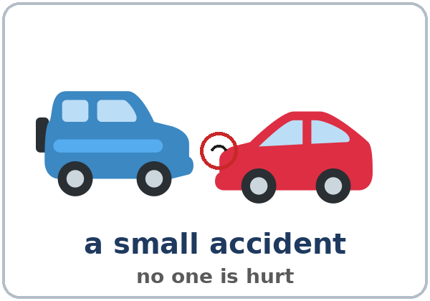
It Happened So Fast
Today you will:
• Say what you were doing
• Tell what happened with when / while
• Answer questions about a small accident
Lesson 4 · Level 3
Notes:
Welcome learners as they arrive.
Point to the title and read it: "It happened so fast." Say: "Tonight we talk about a small car accident. No one is hurt. Only a dent."
Read the three lines under "Today you will". Give one quick example of each: "At 8:00 I was driving to work." • "I was waiting at the light when a car hit my car." • "Was anyone hurt? No, everyone was OK."
Keep it simple and non-graphic: this lesson is about dents, not injuries. Never ask about real accidents, injuries, or experiences with the police. Use the pictures and the invented stories. If a learner starts a personal story, thank them and go back to the picture. Say once, clearly: "In a real emergency, call 911."
Lesson plan: Topic; At a glance: Objectives; Teacher notes: Keep it simple and non-graphic.
Picture: Twemoji graphics by Twitter, Inc. and other contributors (https://github.com/jdecked/twemoji), CC BY 4.0 (https://creativecommons.org/licenses/by/4.0/); resized and combined, with speech bubbles, signs, and labels (images/CREDITS.md).

Slide 2
01
I can say what I was doing.
At 8:00 I was driving to work.
Today's
Goals
02
I can ask Were you…? and Was anyone hurt?
03
I can tell what happened with when and while.
By the end of class, you can do these six things.
A small accident. No one is hurt.
We check at 7:25!
04
I can answer an insurance agent's questions.
05
I can say what people were doing in a picture.
06
I can read a story and fill out a report.
Notes:
Read each goal slowly. Learners repeat.
Goal 1: was / were + -ing (At 8:00 I was driving to work.). Goal 2: Were you…? → Yes, I was. / No, I wasn't. and Was anyone hurt? Goal 3: when and while (I was waiting at the light when a car hit my car.).
Goal 4: answer an insurance agent's questions about a small car accident. Goal 5: describe what people were doing in a picture (a witness). Goal 6: read a short accident story and fill out a simple accident report.
"We check at 7:25" = the Progress Check. It is not a test grade.
Lesson plan: At a glance: Objectives.

Slide 3

OPENING TALK · 6:00
Opening Talk
A asks a card question.
Did you use to walk to school?
B answers with 2–3 sentences.
A asks one follow-up.
Really? How far was it?
Then switch.
Notes:
Step 1 · 6:00–6:10 · Opening Talk + Homework Check · 10 min. Pairs (7 pairs + 1 trio with 15 learners; 3–4 pairs with 7–8).
Before class, write on the board: Did you use to…? What did you use to do?
Model with one learner: "Did you use to walk to school?" → (answer) → "Really? How far was it?" (Click to show the follow-up.)
Opening Talk (6 min): learners open the Opening Talk page. A asks a card question; B answers with 2–3 sentences; A asks one follow-up. Switch after each card. The cards are on the next slide.
If behind: one card only, then the homework check.
Lesson plan: Step 1; Opening Talk page.
Picture: Twemoji graphics by Twitter, Inc. and other contributors (https://github.com/jdecked/twemoji), CC BY 4.0 (https://creativecommons.org/licenses/by/4.0/); resized and combined, with speech bubbles, signs, and labels (images/CREDITS.md).

Slide 4
Opening Talk
Cards
01
Did you use to walk to school? How far was it?
02
What did you use to do on weekends as a child?
Work with a partner. Then switch.
Follow-ups:
Really? Why? Where? Do you miss it? What about now?
03
What did you use to eat for breakfast? What about now?
04
What do you do now that you didn't use to do?
05
Homework check: Lesson 3, item 1.
Notes:
Step 1, continued. The four cards from the Opening Talk page. Each click shows the next card.
A asks a card question. B answers with 2–3 sentences. A asks one follow-up question (follow-ups on the right). Then switch.
Homework Check (4 min, last click): partners read their Lesson 3 Homework item 1 (3 sentences about their childhood or a place they used to live) to each other. The partner asks one question about it. Walk around. Write 2 common errors on the board (often I use to live… or Did you used to…?) and correct them together.
Lesson plan: Step 1; Opening Talk page: cards, follow-ups, homework check.

Slide 5
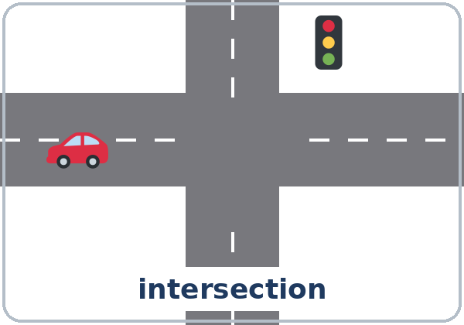
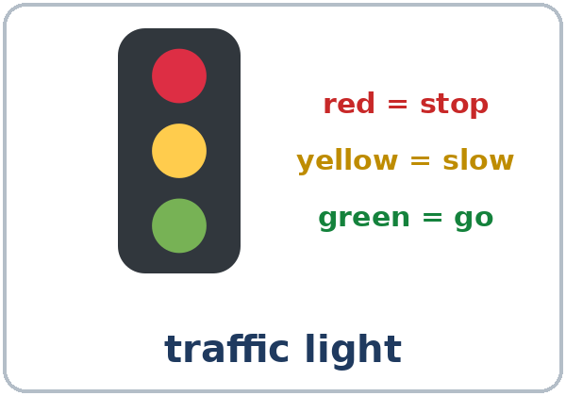
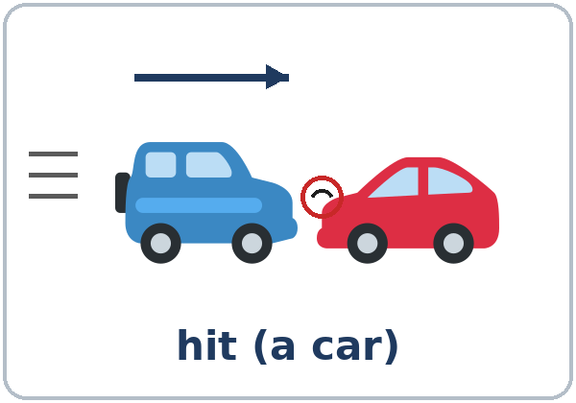
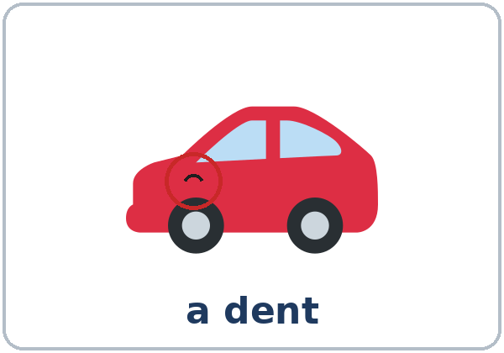
Look. Listen.
Repeat.
New Words
★ accident
★ intersection
★ traffic light
★ stop sign
★ hit (a car)
★ dent
Notes:
Step 2 · 6:10–6:18 · New Words · 8 min (this slide and the next). Whole class, then pairs.
Point to each picture and say the word. Learners repeat once. ★ = the most important words. Each click shows the next word.
Show hit and dent with two toy cars or two books: move one into the other ("hit"), then point to a small spot ("a dent, a small problem").
Keep it light: say "a small accident. No one is hurt. Only a dent." Use only the pictures; don't ask about learners' own accidents.
If behind: teach the ★ words only.
Lesson plan: Step 2; Key vocabulary; New Words page.
Pictures: Twemoji graphics by Twitter, Inc. and other contributors (https://github.com/jdecked/twemoji), CC BY 4.0 (https://creativecommons.org/licenses/by/4.0/); resized and combined, with speech bubbles, signs, and labels (images/CREDITS.md).

Slide 6
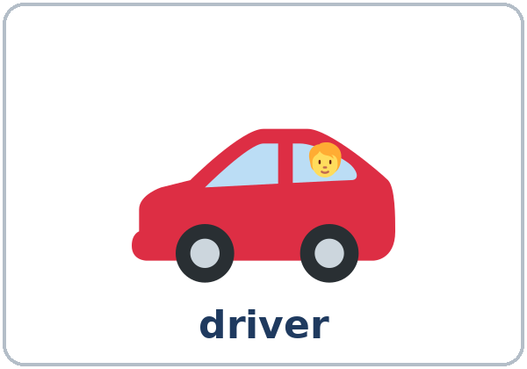
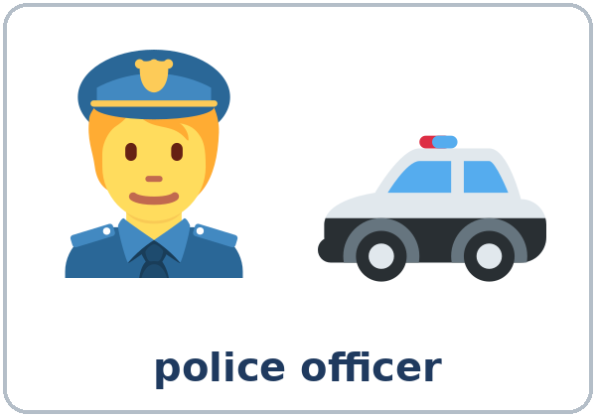
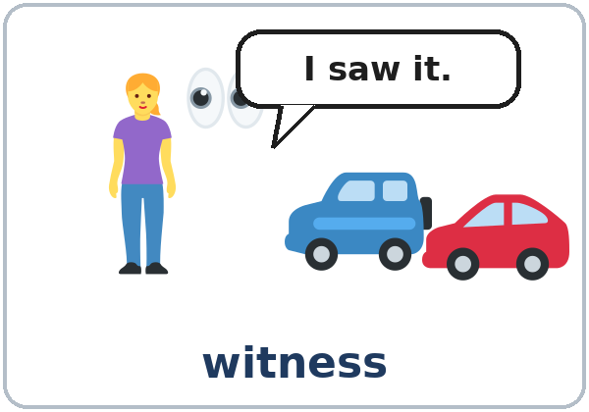
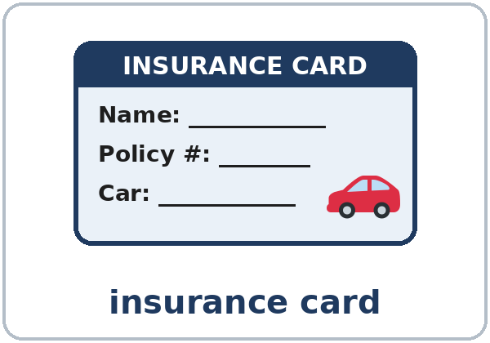
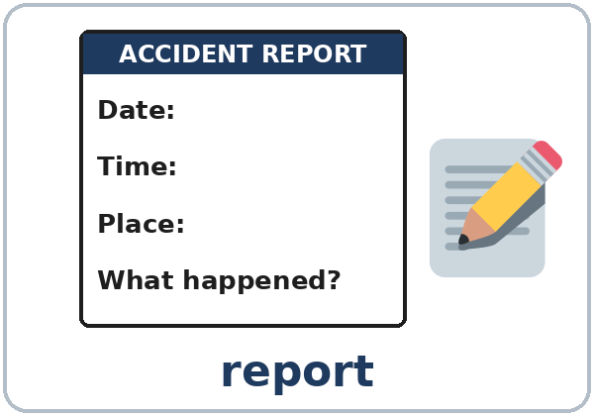
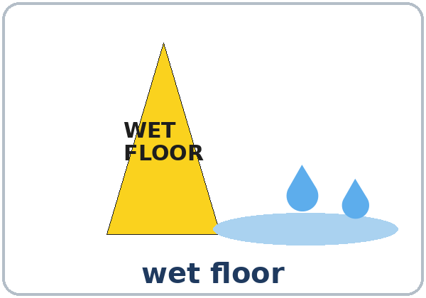
Partner game:
A says. B points.
More New Words
★ driver
★ police officer
★ witness
★ insurance card
★ report
wet floor
Notes:
Step 2, continued. Point to each picture and say the word. Learners repeat once.
wet floor (no ★) is for the workplace option in the teacher notes.
Partner game (2 min): A says a word. B points to the picture and makes a sentence (A: witness. B: The witness saw the accident. / The driver stopped at the stop sign.). Switch.
If behind: teach the ★ words only.
Lesson plan: Step 2; New Words page; Partner game.
Pictures: Twemoji graphics by Twitter, Inc. and other contributors (https://github.com/jdecked/twemoji), CC BY 4.0 (https://creativecommons.org/licenses/by/4.0/); resized and combined, with speech bubbles, signs, and labels (images/CREDITS.md).

Slide 7
Check the Meaning
Look at the picture. Answer the question.
1
2
3
Who saw the accident?
Who writes the report?
Red light: stop or go?
a witness
a police officer
stop
Notes:
Step 2 · Check meaning · 1 min. Whole class.
The answers are hidden. Ask each question and wait for the class to answer. Then click to show the answer. Each click shows one answer, in order: 1, 2, 3.
1. "Who saw the accident?" (a witness) • 2. "Who writes the report?" (a police officer) • 3. "Red light: stop or go?" (stop)
One more question for the class: "Where do two streets meet?" (an intersection)
Lesson plan: Step 2: Check meaning.
Pictures: Twemoji graphics by Twitter, Inc. and other contributors (https://github.com/jdecked/twemoji), CC BY 4.0 (https://creativecommons.org/licenses/by/4.0/); resized and combined, with speech bubbles, signs, and labels (images/CREDITS.md).

Slide 8
Before You
Listen for:
Listen
Where did it happen?
Elena had a small car accident. No one was hurt. Now she's calling Mark at her insurance company.
Was anyone hurt?
01
Audio: about 1:18. It plays once.
Narrator
02
Mark
Play 1: Task A
03
Elena
Notes:
Step 3 · 6:18–6:30 · Listening + "Say it" · 12 min (slides 8 to 12). Individuals, then pairs check.
Before you listen (1 min). Point to the accident picture and say: "This is Elena's car. She had a small accident. No one was hurt. Now she's calling her insurance company. Where did it happen? Listen."
There are three voices: a Narrator, Mark (Safe Road Insurance), and Elena. Each click highlights the next voice.
The audio (L3_L4_listening.mp3, about 1:18) plays the conversation once. Press play again for play 2. A third play is fine if the class needs it.
No speaker? Read the script with a volunteer at a normal, friendly speed.
Audio: synthetic voices, computer-generated (Chatterbox TTS cloned from Kokoro-82M reference clips). No recordings of real people. The names and the story are invented.
Lesson plan: Step 3; Listening script; Listening page.
Picture: Twemoji graphics by Twitter, Inc. and other contributors (https://github.com/jdecked/twemoji), CC BY 4.0 (https://creativecommons.org/licenses/by/4.0/); resized and combined, with speech bubbles, signs, and labels (images/CREDITS.md).

Slide 9
Listen. Circle the answer.
Play 1
Listening A
Where did it happen?
a. in a parking lot
b. at the intersection of Oak Street and Second Avenue
c. on the highway
1
b
Pairs: compare your answers.
Then check together.
2
Was anyone hurt? Yes / No
No
Notes:
Play 1 → Task A (where? was anyone hurt?). Pairs compare. Check together.
Click to show each answer (one click per item): 1 b (at the intersection of Oak Street and Second Avenue) • 2 No (everyone was OK).
Then read Tasks B and C together (1 min) so learners know what to listen for.
Lesson plan: Step 3; Listening Task A; Answer key.

Slide 10
Listen again. Put the events in order.
Write 1–5.
Listening B
A police officer wrote a report.
4
Elena was driving to work.
1
Listen again.
Pairs: compare.
Then check together.
The other car hit her car.
3
Elena stopped at the red light.
2
Elena called her insurance company.
5
Notes:
Play 2 → Tasks B and C. Pairs compare. Then show the answers.
Click to show each number (one click per line, top to bottom): 4, 1, 3, 2, 5.
The order: 1 Elena was driving to work. • 2 She stopped at the red light. • 3 The other car hit her car. • 4 A police officer wrote a report. • 5 Elena called her insurance company.
Lesson plan: Step 3; Listening Task B; Answer key.

Slide 11
Listen again.
Write was, were, or wasn't.
Listening C
1
____ anyone hurt?
Was
2
What ____ you doing when it happened?
were
3
I ____ driving to work.
was
Pairs: compare your answers.
Then check together.
4
He ____ talking on his phone.
was
5
He ____ looking, and he hit my car.
wasn't
6
Two people ____ crossing the street.
were
Notes:
Task C (play 2). Click to show each answer (one click per item, 1 to 6): 1 Was, 2 were, 3 was, 4 was, 5 wasn't, 6 were.
If behind: do Task C together on the board, reading the lines yourself.
Lesson plan: Step 3; Listening Task C; Answer key.

Slide 12
Say it: was and were
Say It
The class repeats each line.
I was driving. (wuz, short)
They were crossing. (wer, short)
In a sentence: short and quiet.
In a short answer: strong.
Say each line two times.
Yes, I WAS. (strong)
Notes:
"Say it" (2 min). Say: "In a sentence, was and were are short and quiet: I was driving (wuz). In a short answer, they're strong: Yes, I WAS."
Read the lines in the "Say it" box. The class repeats each line twice.
Lesson plan: Step 3: "Say it"; Listening page: Say it.

Slide 13
Grammar Box 1
What were you doing?
was / were + -ing = a long action
QUESTION
ANSWER
What were
you doing at 8:00? / last night?
I was driving / walking to work. / home.
What were
they doing at the corner?
They were waiting for the bus. / at the light.
What was
he / she doing in the parking lot?
He was / She was carrying a box. / some bags.
Notes:
Step 4 · 6:30–6:45 · Grammar Q&A · 15 min (slides 13 to 21). Whole class, then pairs. Show the Grammar page. The left side is the question. The right side is the answer.
Draw a timeline on the board: a long wavy line labeled I was driving (8:00–8:30) and a short arrow in the middle labeled a car hit my car (8:15). Say: "The long action is was + -ing. The short action is the simple past."
Box 1 (3 min): ask: "What were you doing at 8:00 this morning?" Learners answer: I was working. I was sleeping. Then read Box 1 across; the class answers from the right side. Each click shows the answer side of one row.
Lesson plan: Step 4; Grammar Box 1; Teacher notes: What the past continuous means.
Picture: Twemoji graphics by Twitter, Inc. and other contributors (https://github.com/jdecked/twemoji), CC BY 4.0 (https://creativecommons.org/licenses/by/4.0/); resized and combined, with speech bubbles, signs, and labels (images/CREDITS.md).

Slide 14
Grammar Box 2 · short answers
Were you…? Was anyone…?
QUESTION
ANSWER
Were you driving? / working?
Yes, I was.
No, I wasn't.
Was he / she talking on the phone?
Yes, he / she was.
No, he / she wasn't.
Was anyone hurt?
No, everyone was OK.
Notes:
Box 2 (2 min): questions and short answers: Were you driving? → Yes, I was. / No, I wasn't. Was anyone hurt? → No, everyone was OK.
In the short answer, was is strong: Yes, I WAS. Each click shows the answer side of one row.
Lesson plan: Step 4; Grammar Box 2.
Picture: Twemoji graphics by Twitter, Inc. and other contributors (https://github.com/jdecked/twemoji), CC BY 4.0 (https://creativecommons.org/licenses/by/4.0/); resized and combined, with speech bubbles, signs, and labels (images/CREDITS.md).

Slide 15
Grammar Box 3
A Long Action + when
when + a short action
LONG ACTION (was / were + -ing)
when + SHORT ACTION (simple past)
I was waiting at the light
when a car hit my car.
We were eating dinner
when the phone rang.
They were crossing the street
when the light changed.
Notes:
Boxes 3 and 4 (4 min): when + the short action; while + the long action. Point to the timeline each time.
A reads the long action; B reads the when part. Each click shows the right side of one row.
when usually goes with the short action (…when a car hit my car). Don't spend a long time on exceptions.
Lesson plan: Step 4; Grammar Box 3; Teacher notes: when or while.
Picture: Twemoji graphics by Twitter, Inc. and other contributors (https://github.com/jdecked/twemoji), CC BY 4.0 (https://creativecommons.org/licenses/by/4.0/); resized and combined, with speech bubbles, signs, and labels (images/CREDITS.md).

Slide 16
Grammar Box 4
while + a Long Action
While + LONG ACTION
WHAT HAPPENED
While I was turning left,
the other driver was talking on the phone.
While she was walking to work,
it started to rain.
While we were waiting for the bus,
we saw an accident.
Notes:
Box 4: while goes with the long action (While I was waiting…). Point to the timeline. Each click shows the right side of one row.
Check questions: "At 7:00 I ___ eating." (was) • "They ___ crossing the street." (were) • "I was cooking when the phone ___." (rang, a short action) • "___ I was walking home, it started to rain." (While)
Lesson plan: Step 4; Grammar Box 4; check questions.
Picture: Twemoji graphics by Twitter, Inc. and other contributors (https://github.com/jdecked/twemoji), CC BY 4.0 (https://creativecommons.org/licenses/by/4.0/); resized and combined, with speech bubbles, signs, and labels (images/CREDITS.md).

Slide 17
Grammar Box 5 · review
What should I do?
QUESTION
ANSWER
What should I do? (after a small accident)
You should call your insurance company. / take a picture. / tell your supervisor.
You shouldn't leave. / get angry.
Notes:
Box 5 is a quick should review (You should take a picture.). A reads the question; B answers from the right side. The click shows the answers.
Error to watch: You should to call. Say: "You should call."
Lesson plan: Step 4; Grammar Box 5.
Picture: Twemoji graphics by Twitter, Inc. and other contributors (https://github.com/jdecked/twemoji), CC BY 4.0 (https://creativecommons.org/licenses/by/4.0/); resized and combined, with speech bubbles, signs, and labels (images/CREDITS.md).

Slide 18
Practice A: write the words.
was / were + -ing
Practice A
1
At 7:00 I ____ (eat) breakfast.
was eating
2
They ____ (wait) for the bus.
were waiting
3
____ you ____ (work) at 9:00 last night?
Were … working
Write was or were + the verb with -ing.
Pairs: check your answers.
4
She ____ (not / look) at the road.
wasn't looking
5
We ____ (watch) TV when the lights went out.
were watching
6
What ____ he ____ (do)?
was … doing
Notes:
Practice A and B (3 min): learners write, then pairs check. Go over the answers.
Click to show each answer (one click per item, 1 to 6): 1 was eating, 2 were waiting, 3 Were … working, 4 wasn't looking, 5 were watching, 6 was … doing.
Lesson plan: Step 4; Grammar Practice A; Answer key.

Slide 19
Circle the right words.
Practice B
1. I was driving when a car ____ my car.
hit
was hitting
2. While I ____, the phone rang.
cooked
was cooking
3. The phone ____ when I was taking a shower.
rang
was ringing
4. I was sleeping ____ the alarm rang.
when
while
5. ____ I was turning left, the other driver was talking on the phone.
When
While
6. You ____ call your insurance company.
should
should to
Notes:
Practice B. Learners circle the right words. Pairs check.
Click to circle each answer (one click per item, 1 to 6): 1 hit, 2 was cooking, 3 rang, 4 when, 5 While, 6 should.
Lesson plan: Step 4; Grammar Practice B; Answer key.

Slide 20
Common Mistakes
Don't say
Say
I was drive to work.
I was driving to work.
They was crossing the street.
They were crossing the street.
I was waiting when a car was hitting my car.
I was waiting when a car hit my car.
Were you work at 9:00?
Were you working at 9:00?
While I cooking, the phone rang.
While I was cooking, the phone rang.
You should to call the police.
You should call the police.
Notes:
Common mistakes (never skip this table). Read a line from Don't say. Ask: "What's the right way?" Learners try first. Then click to show the right form. Each click shows one line, in order 1 to 6.
1 and 4: was / were + verb-ing • 2: they / we / you = were • 3: the short action is the simple past (hit) • 5: don't forget was / were • 6: should + verb (no to).
Say the right form clearly; the learner repeats. Learners can read the Spanish note and the tip on their Grammar page themselves; you don't need to explain them.
Lesson plan: Grammar: Common mistakes; Teacher notes: Typical mistakes.
Picture: Twemoji graphics by Twitter, Inc. and other contributors (https://github.com/jdecked/twemoji), CC BY 4.0 (https://creativecommons.org/licenses/by/4.0/); resized and combined, with speech bubbles, signs, and labels (images/CREDITS.md).

Slide 21
Pair Drill
A says a time.
01
A says a time. B answers with I was…ing. Then switch.
A: Yesterday at 6:00?
B: I was…ing.
Then switch.
02
B says a time.
A answers: I was…ing.
Notes:
Pair drill (last 2 min of Step 4). Pairs.
A says a time (Yesterday at 6:00?); B answers I was…ing (for example I was cooking dinner.). Switch.
If behind: skip the pair drill. Talk Time practices it.
Lesson plan: Step 4: Pair drill.
Picture: Twemoji graphics by Twitter, Inc. and other contributors (https://github.com/jdecked/twemoji), CC BY 4.0 (https://creativecommons.org/licenses/by/4.0/); resized and combined, with speech bubbles, signs, and labels (images/CREDITS.md).

Slide 22
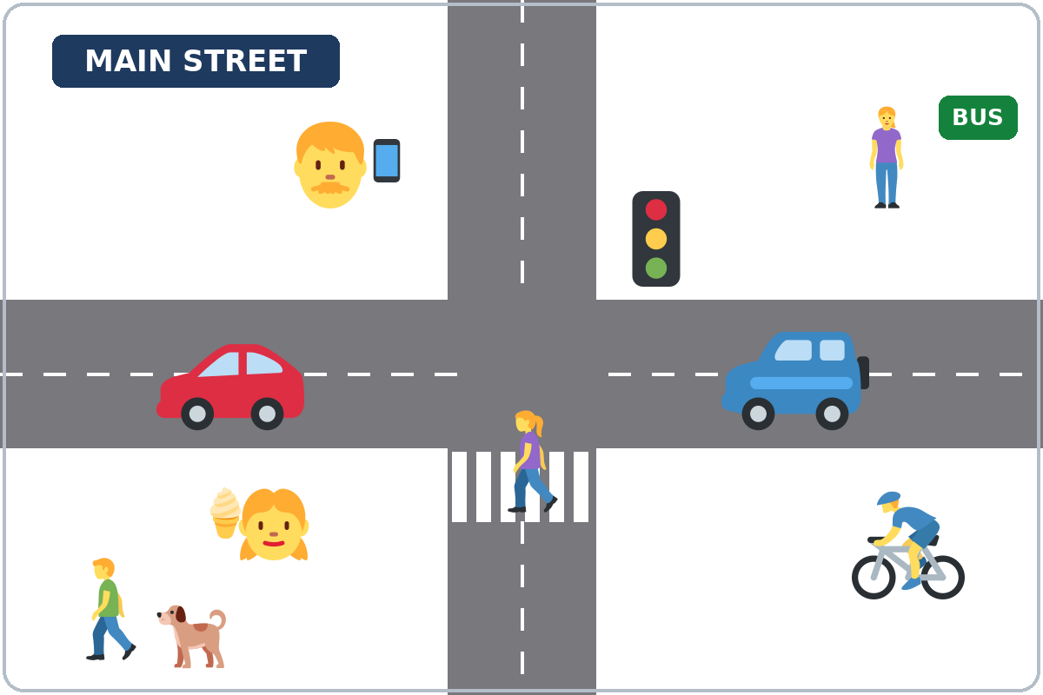
Talk Time
Witness: Round 1
Pairs.
A looks. B asks.
7:00–7:12
1
A looks at Picture 1 for 30 seconds.
B does not look.
2
A turns the page over.
B asks: Was anyone crossing the street?
3
A answers from memory.
Yes. A woman was crossing.
Notes:
Step 5 · 7:00–7:12 · Talk Time: Witness · 12 min. Pairs (one group of 3 with an odd number).
Before Talk Time (at the break), write on the board: What was he / she doing? He / She was…ing. Was anyone…? Yes, … was… / No, no one was…
Model with one learner (1 min): show Picture 1 to one learner for 30 seconds. Then ask: "Was anyone crossing the street?" → "Yes, a woman was crossing." Write it on the board.
Round 1 (5 min): A opens Picture 1 (Main Street). B does not look. Start the timer: A looks for 30 seconds and then turns the page over. B opens the Witness Form and asks the Round 1 questions. A answers from memory (I think… I'm not sure. I didn't see.). B writes short answers. Each click shows the next step.
Round 1 questions: 1 Was anyone crossing the street? 2 What was the man with the dog doing? 3 What was the woman at the bus stop doing? 4 What was the man with the phone doing? 5 What was the girl doing? 6 What was the man on the bike doing?
Answers: 1 Yes. A woman was crossing the street. • 2 He was walking (with his dog). • 3 She was waiting for the bus. • 4 He was talking on the phone. • 5 She was eating ice cream. • 6 He was riding a bike.
Check (1 min): A and B look at the picture together. B checks ✓ the right answers.
Keep it simple and non-graphic: this lesson is about dents, not injuries. Never ask about real accidents, injuries, or experiences with the police. Use the pictures and the invented stories. If a learner starts a personal story, thank them and go back to the picture. Say once, clearly: "In a real emergency, call 911."
Lesson plan: Step 5; Talk Time pages; Answer key.
Picture: Twemoji graphics by Twitter, Inc. and other contributors (https://github.com/jdecked/twemoji), CC BY 4.0 (https://creativecommons.org/licenses/by/4.0/); resized and combined, with speech bubbles, signs, and labels (images/CREDITS.md).

Slide 23
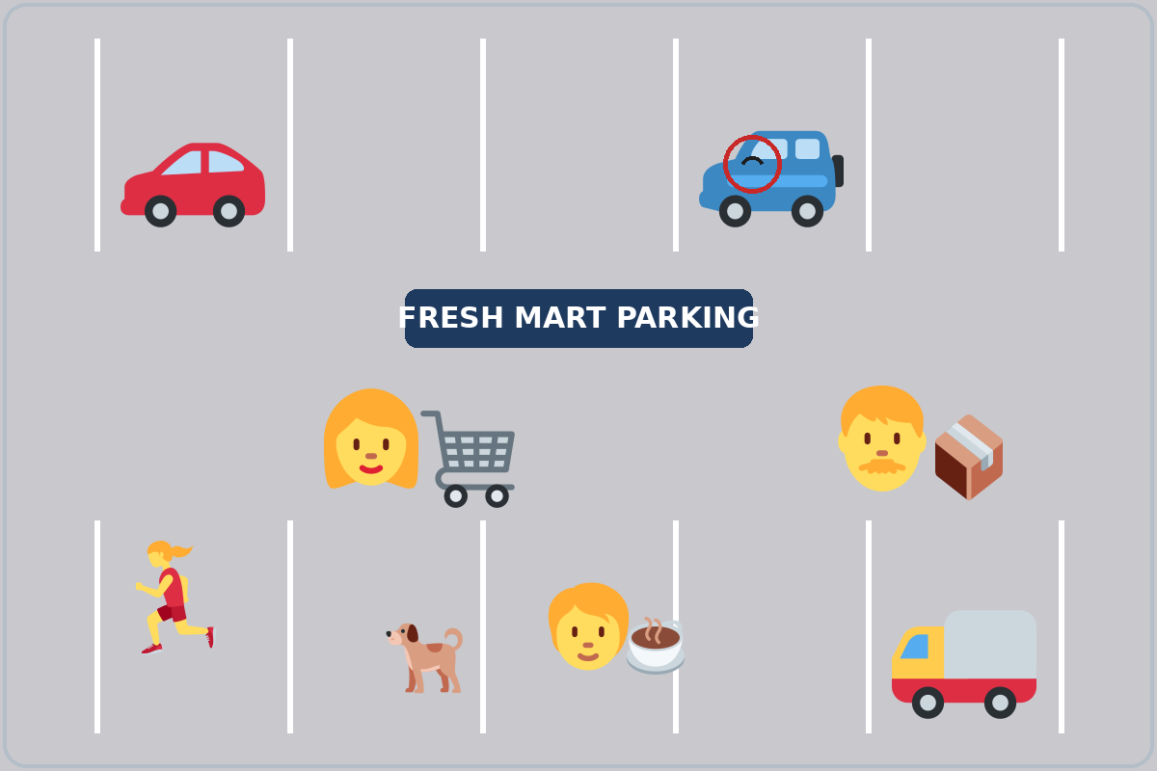
Talk Time
Witness: Round 2
Switch.
B looks. A asks.
7:00–7:12
1
B looks at Picture 2 for 30 seconds.
A does not look.
2
A asks the Round 2 questions.
What was the man carrying?
3
Look at the picture together.
Check ✓ the right answers.
Notes:
Round 2 (5 min): switch. B looks at Picture 2 (the parking lot) for 30 seconds; A asks the Round 2 questions. Each click shows the next step.
Round 2 questions: 1 What was the woman with the cart doing? 2 What was the man carrying? 3 Was anyone running? 4 What was the person with the cup doing? 5 Which car had a dent? 6 My question: (a question of their own).
Answers: 1 She was shopping / pushing a shopping cart. • 2 He was carrying a box. • 3 Yes. A woman was running. • 4 He / She was drinking coffee. • 5 The blue car (at the top). • 6 answers will vary.
Score: Round 1 ___ / 6, Round 2 ___ / 6. Fast pairs: add one question of their own (What was the man wearing?). If behind: one picture only.
Workplace option: use a small workplace incident instead (I was carrying a box when I slipped on the wet floor.) with the wet floor card. The grammar is the same.
Lesson plan: Step 5; Talk Time pages; Answer key; Teacher notes: Workplace option.
Picture: Twemoji graphics by Twitter, Inc. and other contributors (https://github.com/jdecked/twemoji), CC BY 4.0 (https://creativecommons.org/licenses/by/4.0/); resized and combined, with speech bubbles, signs, and labels (images/CREDITS.md).

Slide 24
Before You Go 7:12–7:17
01
Exit ticket
02
Homework
Write two sentences:
1. One with was / were + -ing.
2. One with when or while and because or so:
I was walking home when it started to rain, so I ran.
Give it to me at the door.
About 15 minutes.
1. What were you doing yesterday?
2. Make one sentence with when.
3. Ask: What were you doing at 8:00 last night?
4. Review: 2 sentences with used to.
Bring it next week!
Notes:
Step 6 · 7:12–7:17 · Exit Ticket + Homework · 5 min · NEVER SKIP.
Exit ticket: each learner writes two sentences on a slip: one with was / were + -ing (At 7:00 last night I was cooking dinner.), and one with when or while and because or so (I was walking home when it started to rain, so I ran.). Collect at the door.
Homework: open the Homework page. Do item 1 together (one sentence on the board: Yesterday at 7:00 a.m., I was…). Say: "About 15 minutes. Bring it next week."
Homework items: 1 what were you doing yesterday at these times? (I was…ing) • 2 make one sentence with when (I was walking. It started to rain. → I was walking when it started to rain.) • 3 ask a family member, a neighbor, or a friend: What were you doing at 8:00 last night? • 4 review (Lesson 3): 2 sentences with used to or didn't use to.
Read & Write (7:17–7:25, on the Student Pages): a 4-picture story and Lee's story; questions 1–5; then the Accident Report for Lee. If behind: questions 1–5 only; the report becomes homework.
Lesson plan: Step 6; Homework page; Read & Write step.
Picture: Twemoji graphics by Twitter, Inc. and other contributors (https://github.com/jdecked/twemoji), CC BY 4.0 (https://creativecommons.org/licenses/by/4.0/); resized and combined, with speech bubbles, signs, and labels (images/CREDITS.md).

Slide 25
Progress Check 7:25
D. I can…
😀 🙂 😐
Check one face.
I can say what I was doing at a time in the past.
I can tell what happened with when and while.
I can answer questions about a small car accident.
I can fill out a simple accident report.
A. Listen to the teacher. Circle a or b.
Answer
1. a. driving to work b. waiting at the light
a
2. a. driving to work b. waiting for the bus
b
3. a. Someone was hurt. b. No one was hurt.
b
4. a. talking on the phone b. crossing the street
a
Notes:
Progress Check · 7:25–7:30 · 5 min. Individuals. Open the Progress Check page.
Part A: read each sentence slowly, 2 times. Learners circle a or b. Then click to show the answer (one click per item, 1 to 4).
Say: 1 "At eight o'clock this morning, I was driving to work." (a) • 2 "She was waiting for the bus when it started to rain." (b) • 3 "Was anyone hurt? No, everyone was OK." (b) • 4 "The other driver was talking on the phone." (a)
Parts B and C: learners do them alone. Walk around and help with the instructions only. B answers: 1 was, 2 were, 3 Were, 4 wasn't. C: answers will vary (for example I was cooking dinner when my friend called. / While I was walking to work, I saw an accident.).
Part D: read each "I can…" line aloud and point to the 3 faces: 😀 "I can do it." 🙂 "With a little help." 😐 "Not yet."
Scoring: A /4 + B /4 + C /2 = /10. This is not a test grade. It shows who needs more help hearing the past continuous (A), with was / were (B), and with when / while (C).
Collect the pages (or check them at the start of Week 5). If behind: do the Progress Check in Week 5 at 6:00, while learners arrive.
Lesson plan: Progress Check step; Progress Check page; Answer key.

Slide 26
Goodbye! See You Next Week!
Now you can:
• Say what you were doing
• Tell what happened with when / while
• Answer questions about a small accident
Lesson 4 · Level 3
Notes:
Read the title: "Goodbye! See you next week!" Learners repeat.
Read the three "Now you can" lines. Ask one learner: "What were you doing at 8:00 this morning?" and wait for a short answer.
Remind learners: homework is about 15 minutes. Bring it next week.
Lesson plan: At a glance: Objectives; Step 6.
Picture: Twemoji graphics by Twitter, Inc. and other contributors (https://github.com/jdecked/twemoji), CC BY 4.0 (https://creativecommons.org/licenses/by/4.0/); resized and combined, with speech bubbles, signs, and labels (images/CREDITS.md).

Slide 27
Credits
Pictures
Vocabulary pictures use Twemoji graphics by Twitter, Inc. and other contributors (https://github.com/jdecked/twemoji), licensed under CC BY 4.0 (https://creativecommons.org/licenses/by/4.0/). The graphics were resized and combined, and speech bubbles, signs, and labels were added.
The faces on the Progress Check are standard emoji characters shown with the computer's emoji font.
Names and story
Elena, Mark, and Lee are invented names. The listening story is invented.
Audio and font
Audio: synthetic voices made with Chatterbox TTS (MIT License), cloned from short synthetic reference clips made with Kokoro-82M (Apache License 2.0). No recordings of real people were used. Each file carries an inaudible Perth watermark marking it as AI-generated. Font: Lexend Deca (OFL 1.1).
© 2026 the authors. The authors license this deck under CC BY-NC-SA 4.0.
Notes:
Credits. You don't need to read this slide in class.
Pictures: Twemoji graphics by Twitter, Inc. and other contributors, CC BY 4.0; the file-by-file list is in images/CREDITS.md.
Audio: synthetic voices, computer-generated (Chatterbox TTS cloned from Kokoro-82M reference clips). No recordings of real people. The names and the story are invented.
Course materials: © 2026 the authors, licensed under CC BY-NC-SA 4.0 (https://creativecommons.org/licenses/by-nc-sa/4.0/).
Lesson plan: Picture Credits. Picture list: images/CREDITS.md.

